Slide 1
MVTX Stave Production Readiness
Ming Liu
LANL
10/12/2018
sPHENIX PMG Meeting

Slide 2
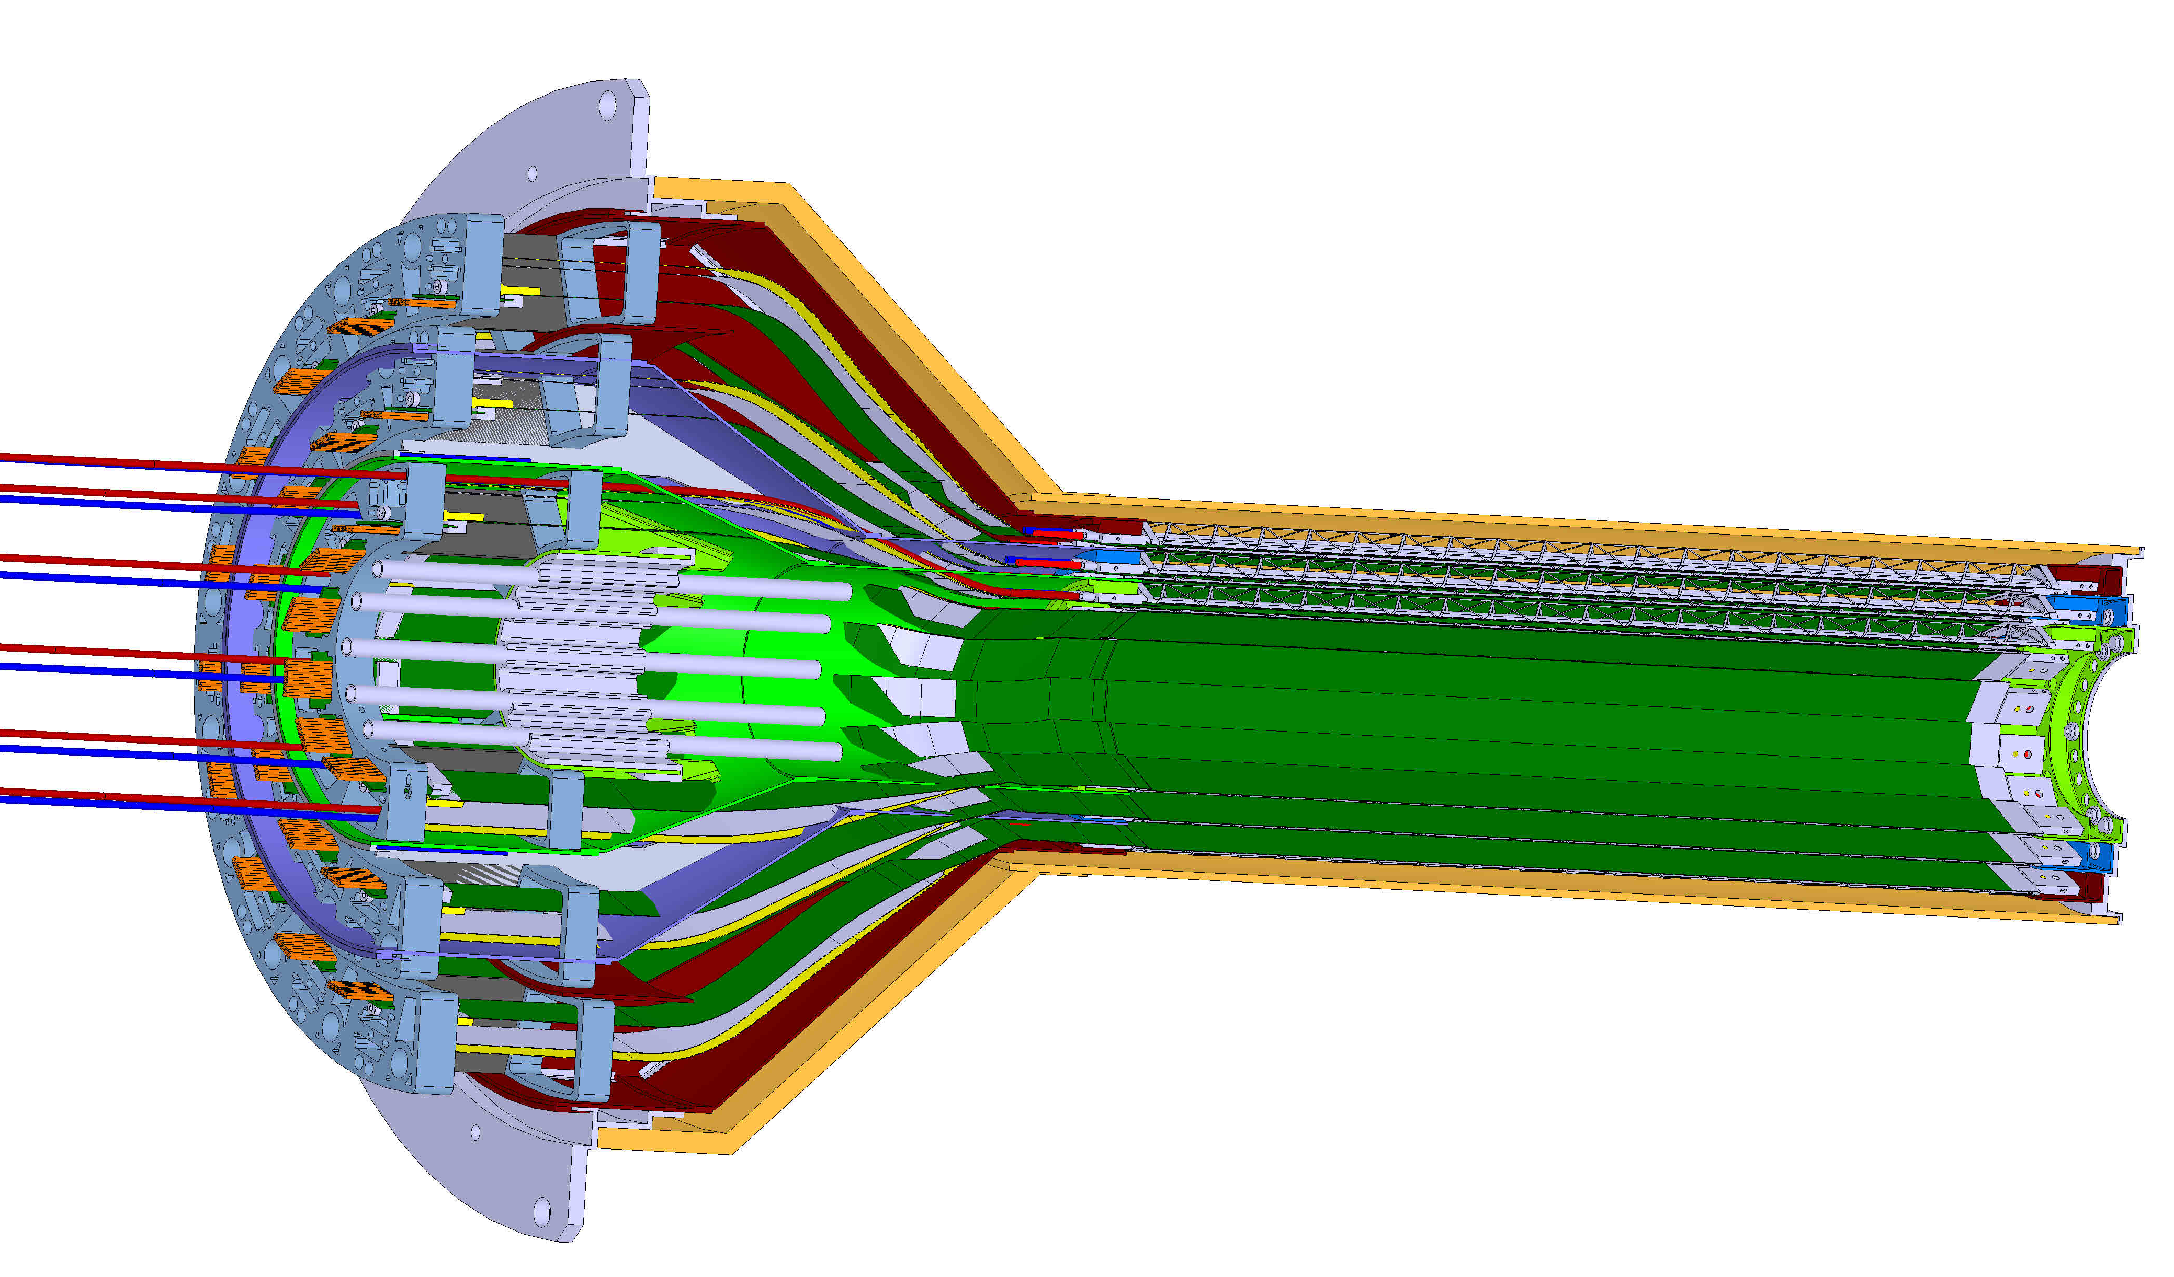

MVTX Detector
Service cone: signal, power, cooling
and mechanical support
CYSS: Cylindrical Shell Structure
End-Wheel
3-layer sensor barrel
- 48 staves, 432 chips
Figure for ALICE ITS/IB design
(slightly modified mechanically for sPHENIX)
MVTX
parameters
MVTX RUs, PUs & other services

Slide 3
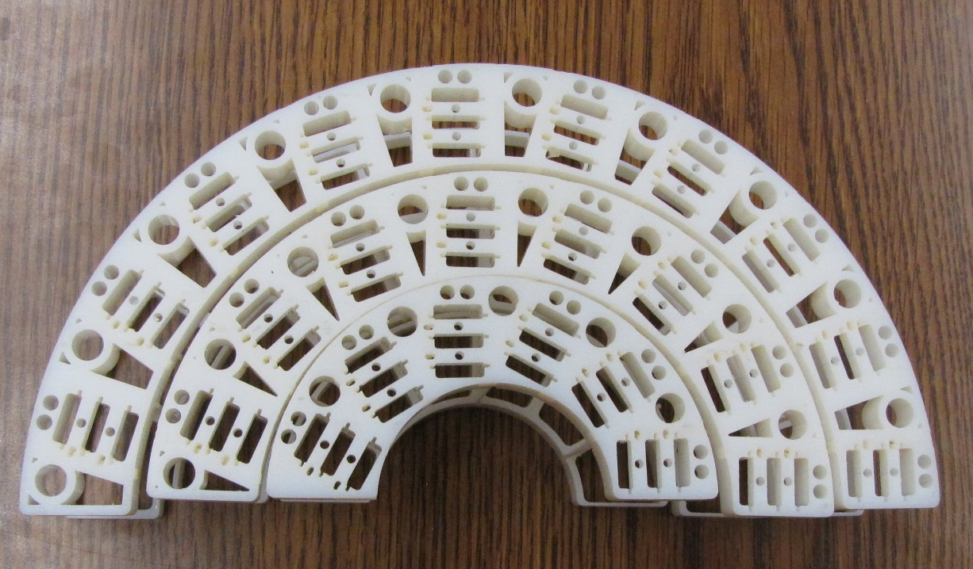
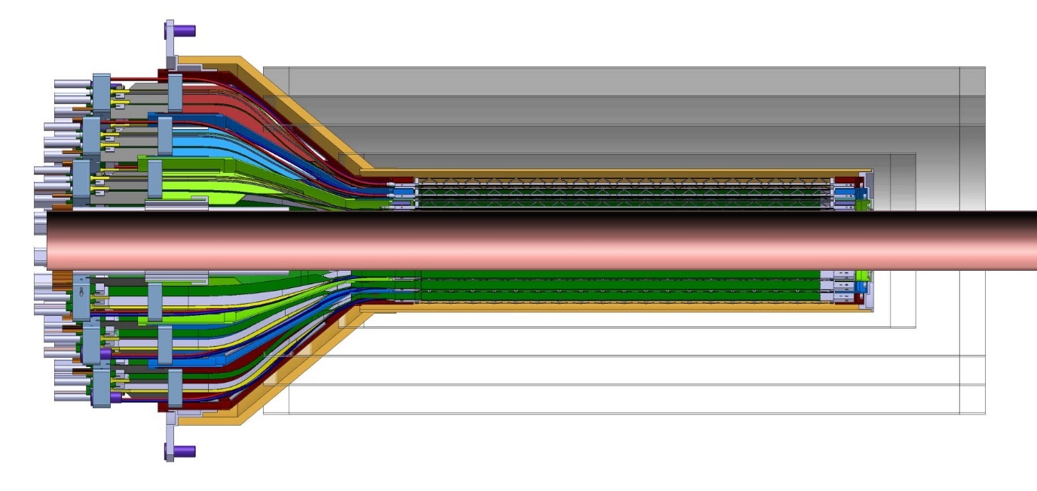
INTT-MVTX Conflict: a Resolution
INTT 4-layers
Layers: 1, 2, 3
ALICE IB Patch-Panel 3-D Model
- All connectors are located
at the same Z position
- One can move some connectors
out in Z to reduce “R”
- Longer power cables!
- HS FPC untouched!
Interconnect patch-panels
Original design for the ALICE ITS inner tracker; three layers of MAPS type detectors
The INTT shown only includes ladders; no extension cables, connectors, cooling barbs, etc.

Slide 4
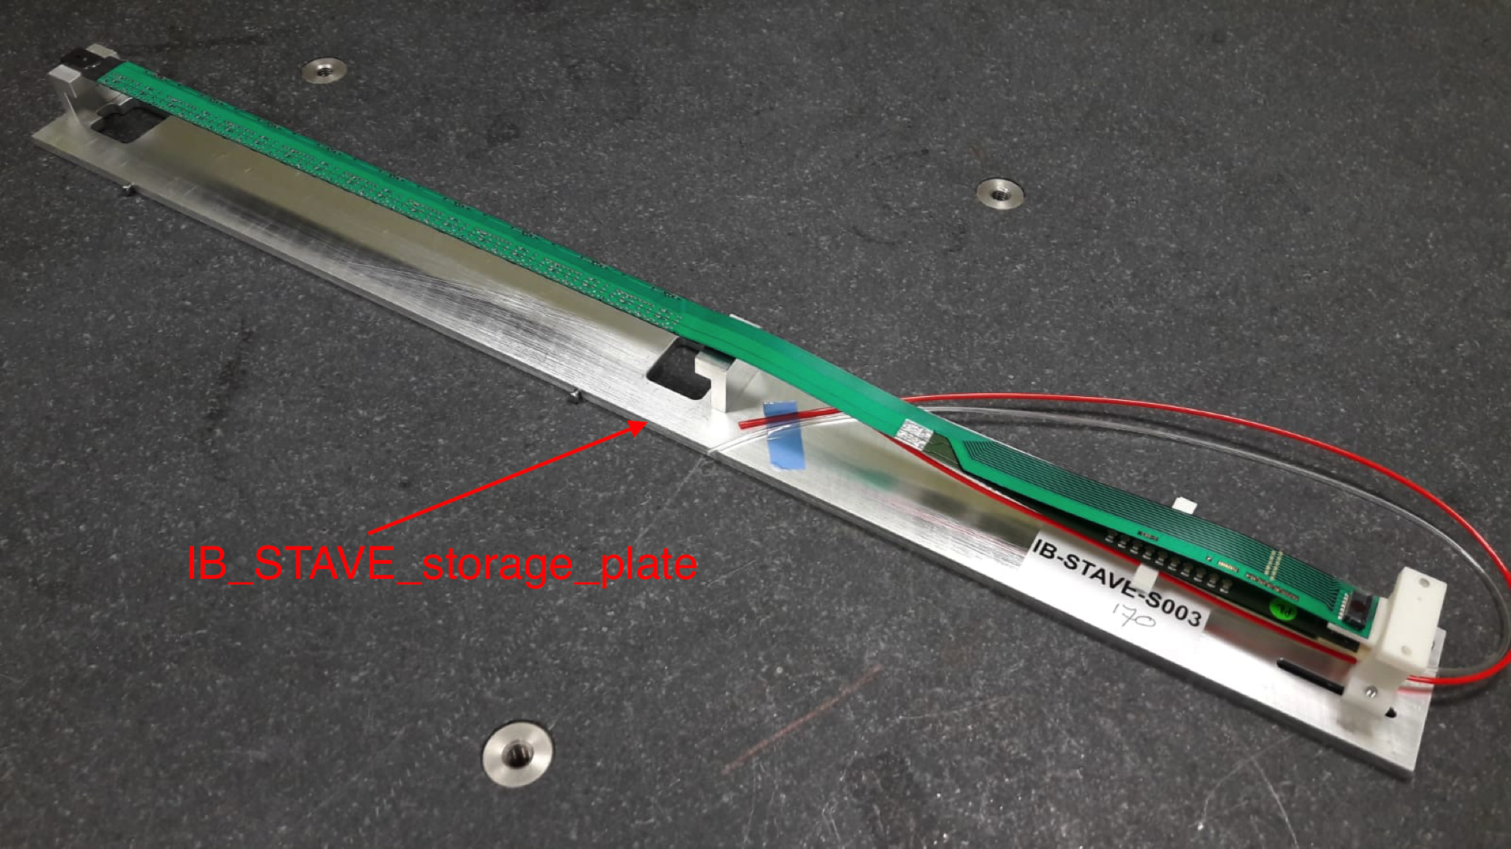
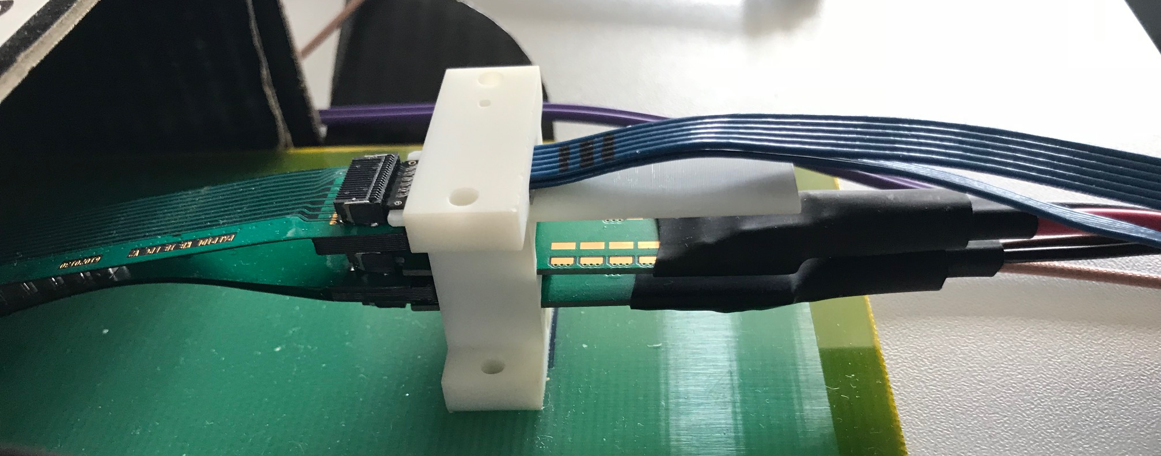
9 sensors
Flexible Printed Circuit (FPC) for
9 HS Signals, CLK, CTRL
Flexible power extension PCB
DVDD, AVDD and Bias V.
Soldered to FPC
- To be modified for sPHENIX
ALICE IB Stave

Slide 5
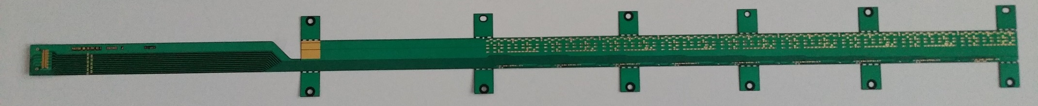
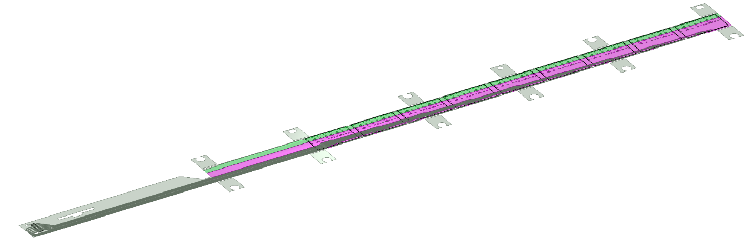
IB FPC Layout
From Antonello Di Mauro
506.2 mm
41.9 mm
16 mm
16.15 mm
4.1 mm
5.5 mm
20 µm COVERLAY
p
AVDD
DVDD
25 µm ALUMINUM
75 µm UPILEX
165 µm
subs
AGND
DGND
25 µm ALUMINUM
4.1 mm
11.15 mm
20 µm COVERLAY
90 µm Glue
50 µm Silicon chip
CHIP 9
300 µm
850 µm
CHIP 8
CHIP 7
CHIP 6
Large planes are used to distribute analogue and digital power and respective ground connections.
CHIP 5
CHIP 4
CHIP 3
CHIP 2
CHIP 1
The 9 silicon chips are read out in parallel: each chip sends its data stream to the end of Stave by a dedicated differential pair, 100 μm wide. Two additional differential pairs distribute the clock and configuration signals.

Slide 6
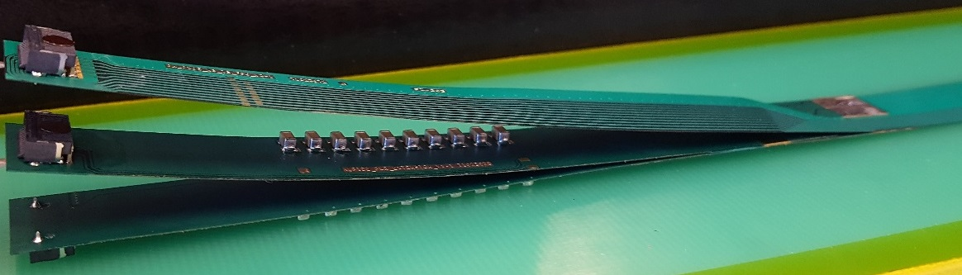
FPC Extension for Connection to Electrical Services
From Antonello Di Mauro
The connection to the service cables is achieved by a double FPC extension which is soldered to the HIC
x-section at interconnection between FPC and extensions
AVDD
AVDD
AVDD
AVDD
DVDD
FPC
AVDD
DVDD
AGND
AGND
Flex power extension
AVDD
DVDD
AGND
FPC
AGND
DGND
DVDD
DVDD
AGND
DGND
DVDD
AGND
DGND
FPC
DGND
DGND
Flex power extension
DGND
signal lines (FPC)
Modified for sPHENIX:
15cm -> 40cm
digital power
analogue power

Slide 7
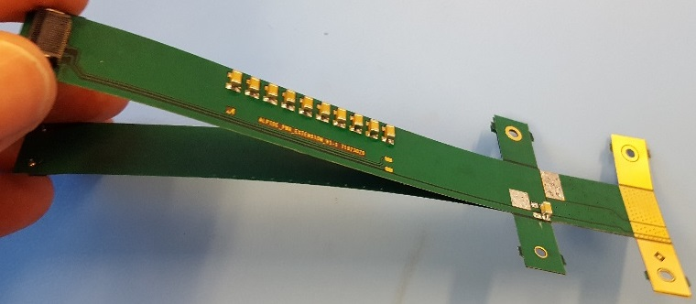
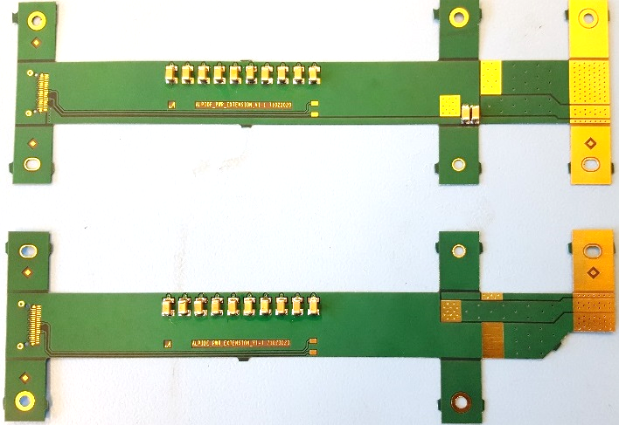
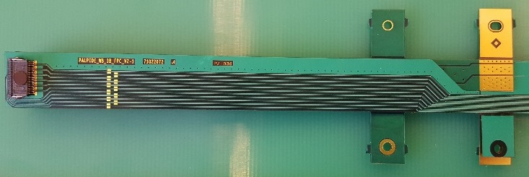
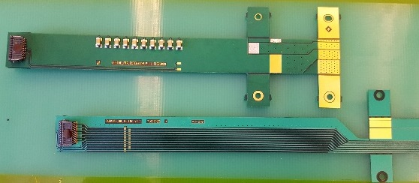
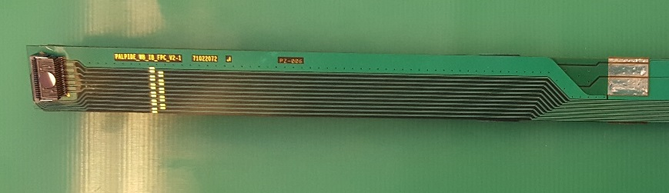
From Antonello Di Mauro
FPC Extension for Connection to Electrical Services
2-layer flex, PI: 50 µm, Cu: 35 µm, solder mask: 20 µm
analogue
analogue
Unchanged
digital
DGND
Longer copper traces ~30cm
for sPHENIX, no other components
AGND
digital
The two flexes are connected together, AVDD is transferred from top to bottom
digital
AVDD
DVDD
The PWR extension is connected to the FPC by iron soldering and wings are cut.

Slide 8
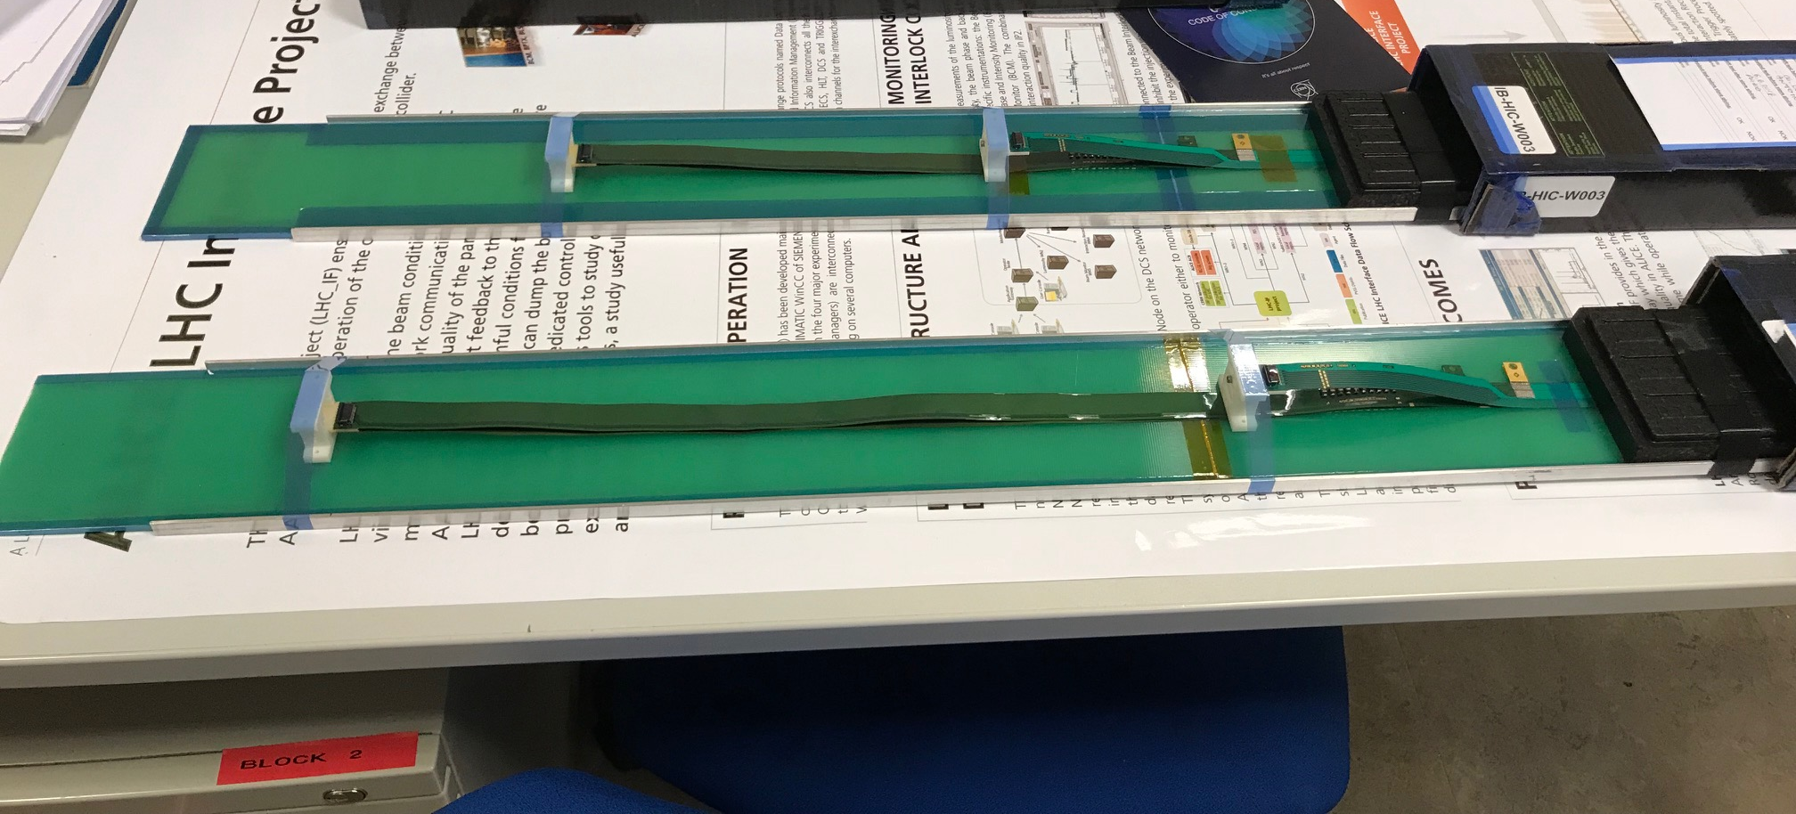
Two HICs Produced and Tested at CERN w/ Extended Power Cables
NO noticeable difference in sensor performance, as expected
MVTX: 40cm flex power PCB
MVTX: 60cm flex power PCB
ALICE IB: 15cm

Slide 9
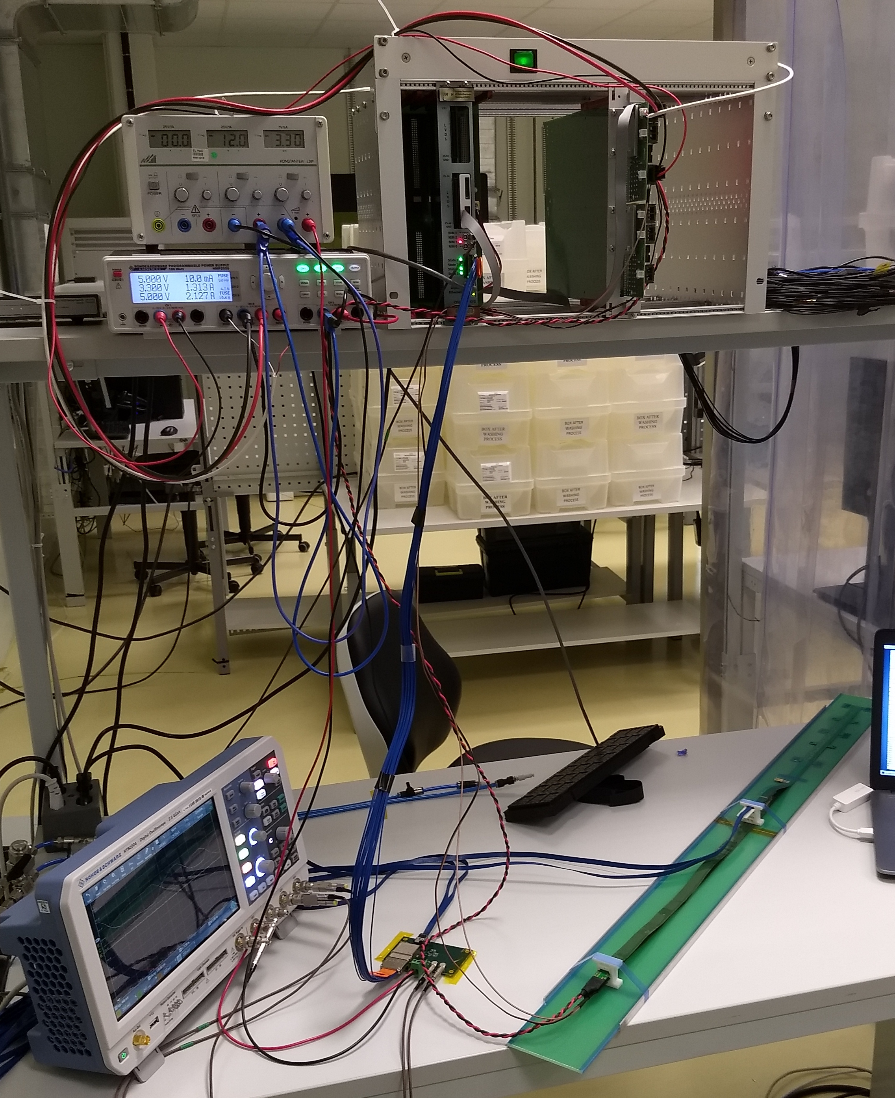
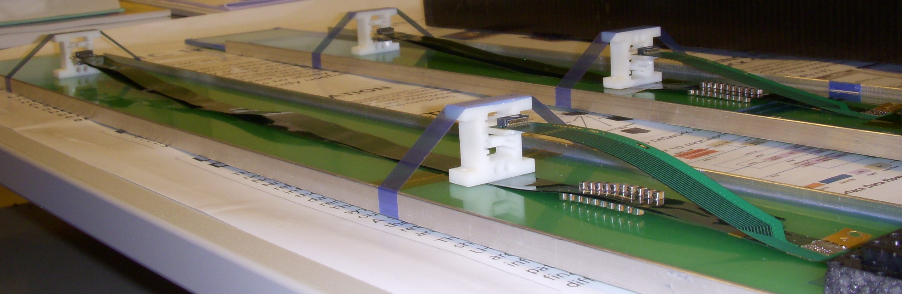
Test Stave/HIC with extended power PCB
Built and tested two HICs at CERN in the week of 9/17
  No change in sensor performance (noise, threshold) observed, as expected;
More details presented by Dr. Sho Uemura at last Friday’s sPHENIX general meeting 9/23/2018
40cm PWR FPC
60cm PWR FPC
ALICE: 15cm PWR FPC
Followed identical
ALICE IB QA test procedure,
with a 8m SamTec cable!

Slide 10
HICs Test Results from CERN
After: same ALICE HICs, replaced power FPCs
Before: 2 ALICE IB HICs
Thr.
HIC1
Noise
Thr.
Noise
HIC2
Noise level: ~4 e’s; Threshold: ~180e’s; MIP: ~1000 e’s
Chip-0
Chip-8

Slide 11
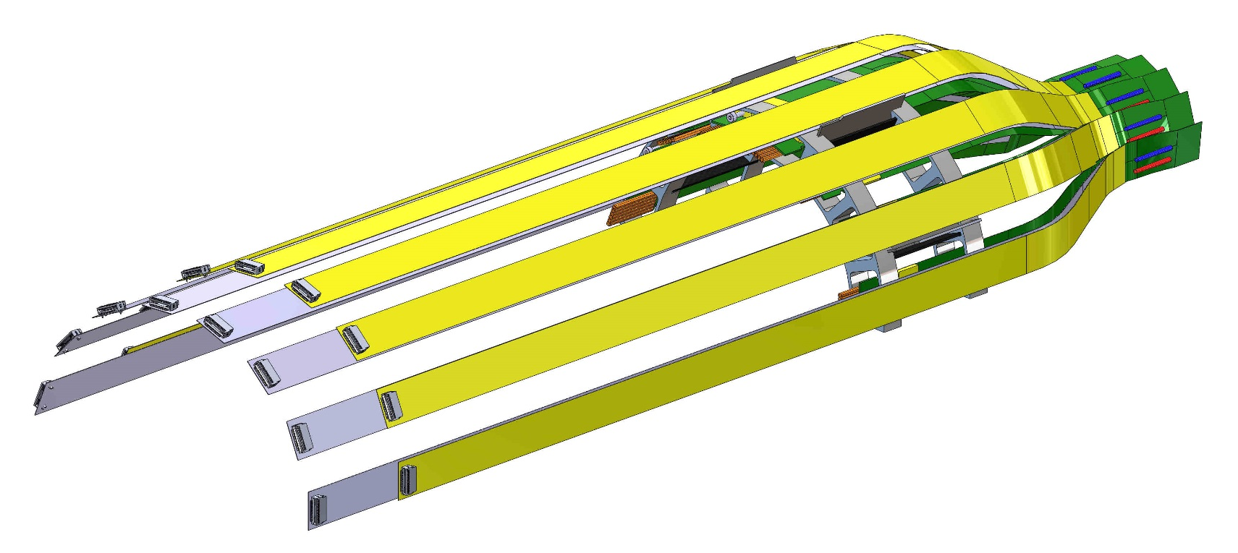
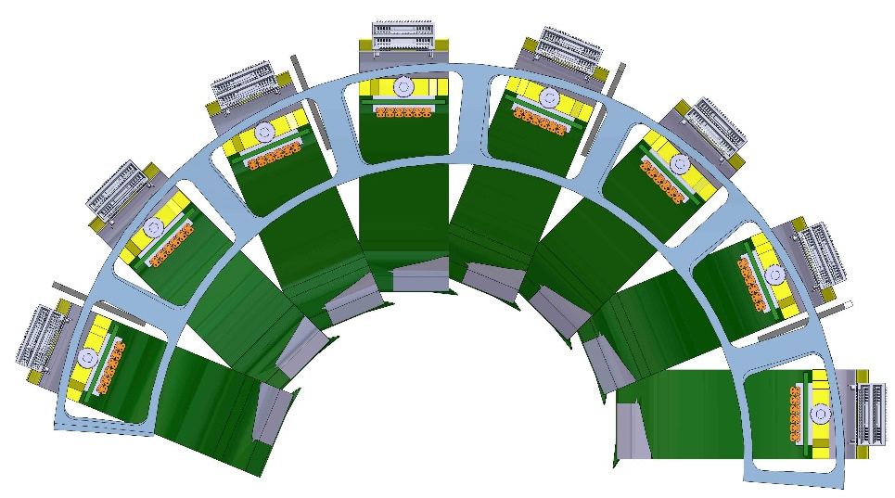
MVTX middle layer – power extension cable assembly including the reduced ID & OD patch-panel
From Walt Sondheim

Slide 12
Power PCB cost: Unit price ~ Cable length
Components: ~$40/pair
Assembly: ~$2K
15cm Flex PCB (ALICE): $61/pair
40cm Flex PCB (MVTX): $123/pair

Slide 13
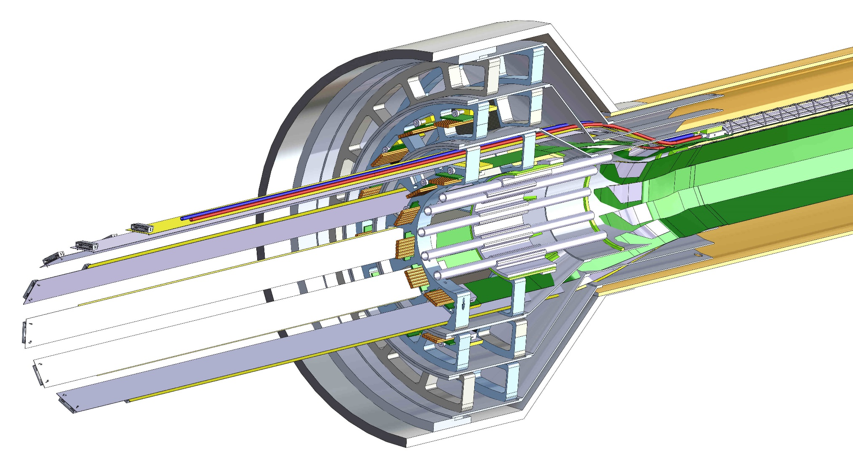
Latest CAD model patch panels;
From Walt Sondheim
Extended 38cm
AVDD Flex PCB
HS signal cable and connector
Extended 40cm
DVDD Flex PCB

Slide 14
Summary:
Modifications of the Power Extension PCB w.r.t. ALICE IB Design
What to be modified:
  Extend the Flex Power PCB length from 15cm(ALICE) to 40cm(sPHENIX)
  Keep all noise filtering capacitors at current locations, just extend the passive copper traces.
Risks and impacts
  40cm Power extension PCB production
    OK, industry standard
    Extra cost on materials ($61/pair vs $123/pair, 84+ pairs, total cost <$20K)
  Stave assembly (need more inputs from ALICE)
    Wire bonding machine operation clearance?
      Solder power PCB after the wire bonding to make a HIC?
    Jigs modified to hold the longer flex power PCB?
    Extra cost?
  Shipping and storage
    Longer support Al-plate required for shipping and handling
    Extra cost, on-going discussion between ALICE and LBNL on modification and fabrication
  Technical risks: minimal
BNL Director’s Review: July 19-20, 2018

Slide 15
Sensor Irradiation Test
BNL Director’s Review: July 19-20, 2018
Recently (in 9/2018) ALICE carried out irradiation test up to 2.7MRad:
Sensor can still function well with high efficiency and low noise

Slide 16
Sensor Radiation Hardness – OK at 2.7MRad
Continuous effort by ALICE (@NPI, Czech)
BNL review recommendation: test sensor up to 1MRad
MVTX Operation Window
https://indico.cern.ch/event/758048/

Slide 17
sPHENIX MVTX Max. Hit and Noise Rates
From MVTX proposal
sPHENIX MVTX targeted noise level: <10⁻⁵
Very conservative estimate

Slide 18
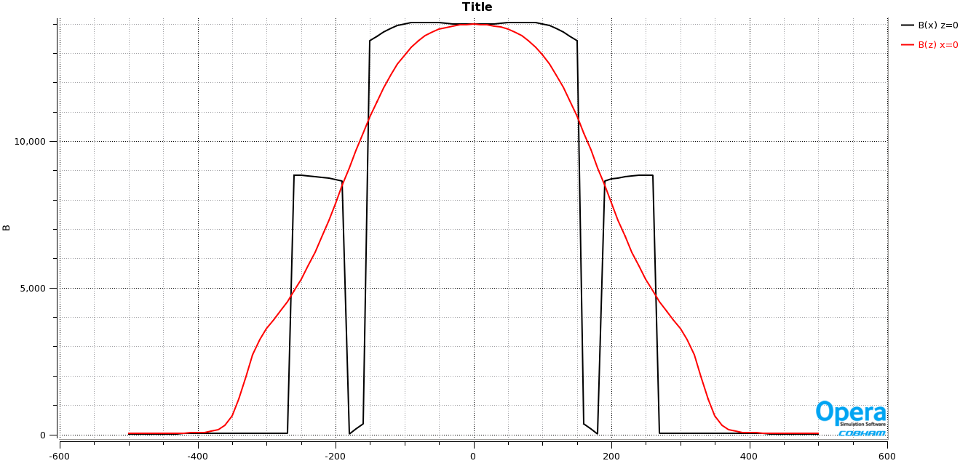
Expected B-field in the Rack Area (RU, PU Electronics)
Low fringe field, < 50Gauss outside of HCal
ALICE RU and PU designed to operate in 0.5T field
Simulation:
Steel 1020
Thanks John H.
for the plot
Rack. B < 50G

Slide 19
SamTec Cables Tested and Finalized for ITS: ~8m!
Two cables per IB stave: 2.65m + 5.30m
HDR-203194 (Type B)
HDR-206142 (Type A)
RUs
PP2
Staves
L: 5300 mm
L: 2650 mm

Slide 20
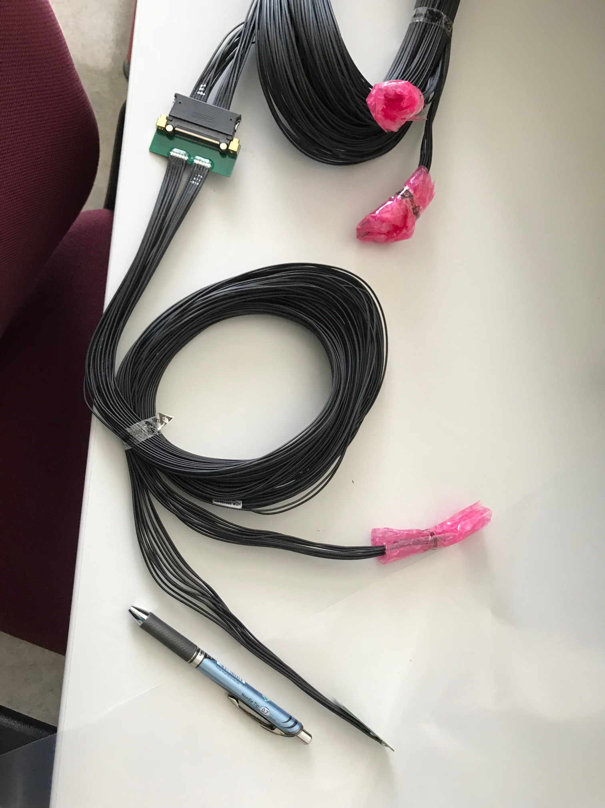
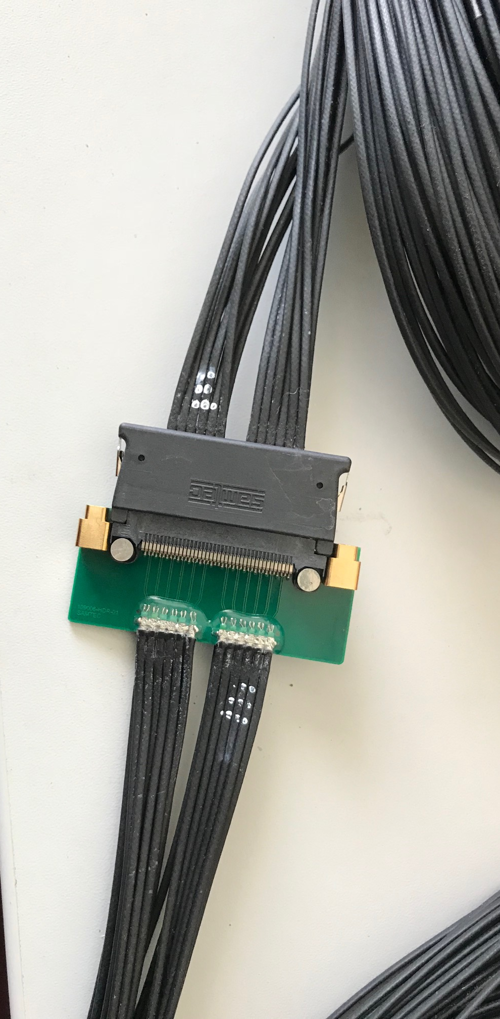
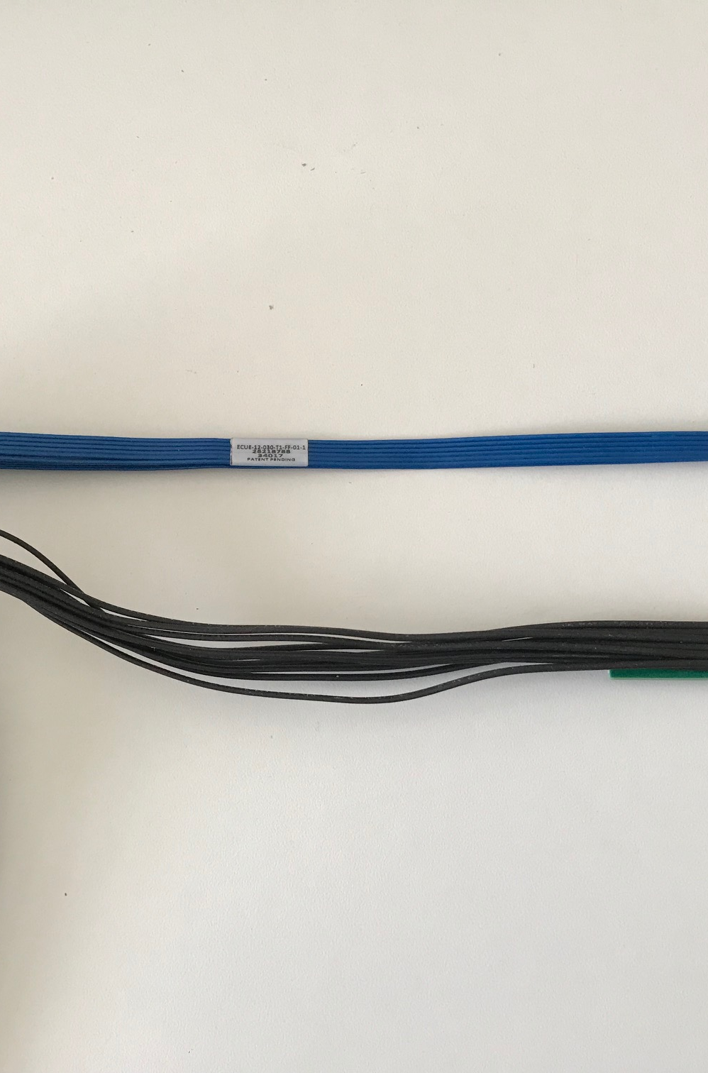
Type-A
Type-B
Type-A

Slide 21
Summary:
Technically sPHENIX/MVTX staves are ready for production
Cost being updated

Slide 22
Backup slides

Slide 23
sPHENIX/MVTX IB Stave Assembly Procedure
(to be confirmed/optimized by ALICE)
Prepare sensors and FPC
Glue 9 sensors to FPC
Wire bonding 9 sensors to FPC
Solder power flex PCB to FPC
  (or do #3 wire bonding after soldering power flex PCB?)
Glue HIC to coldplate/carbon space frame
A stave is ready for QA

Slide 25
From Antonello Di Mauro

Slide 26
From Antonello Di Mauro

Slide 27
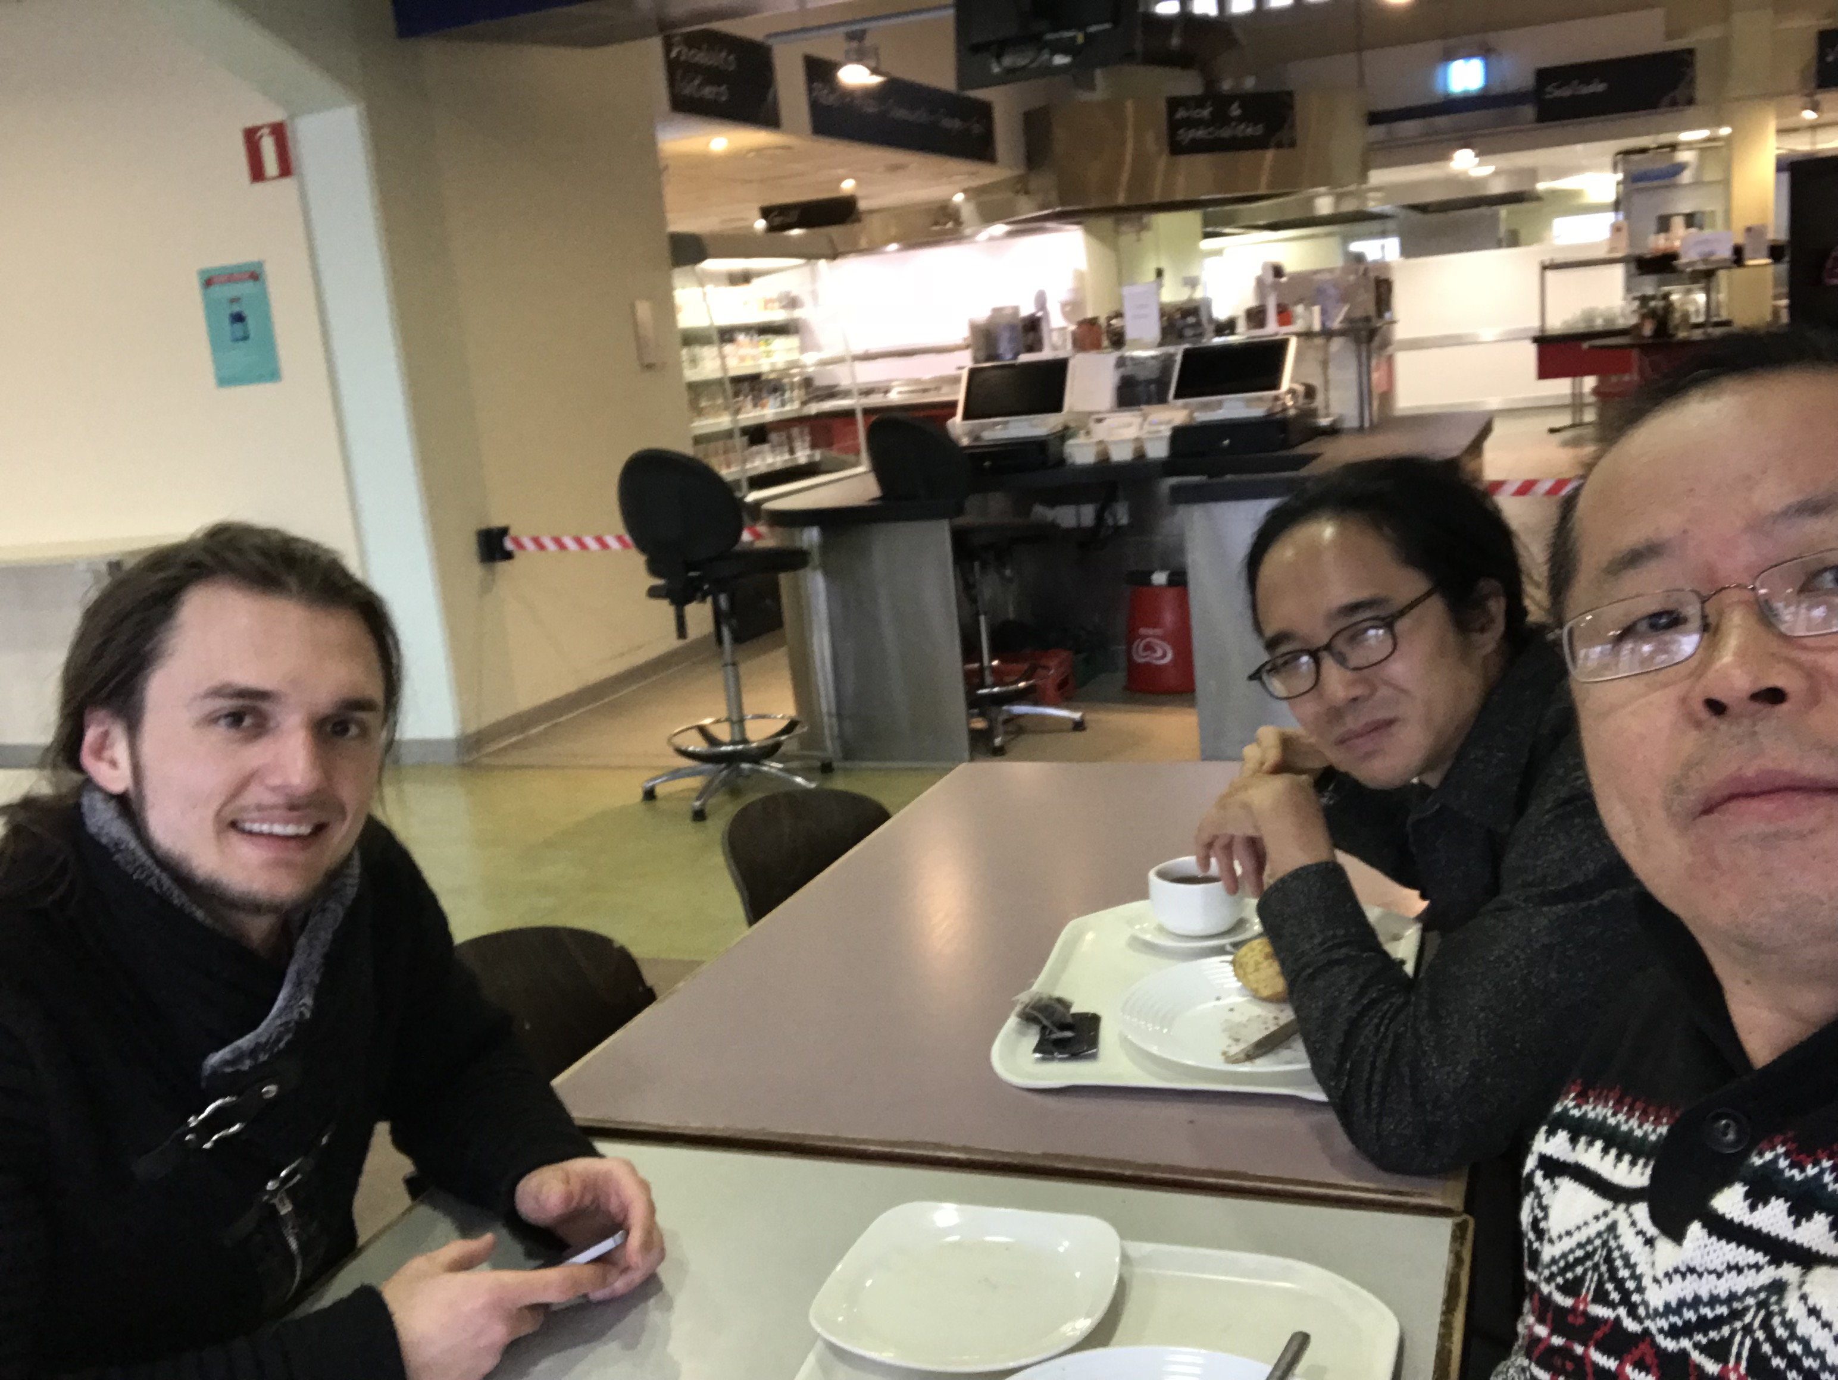
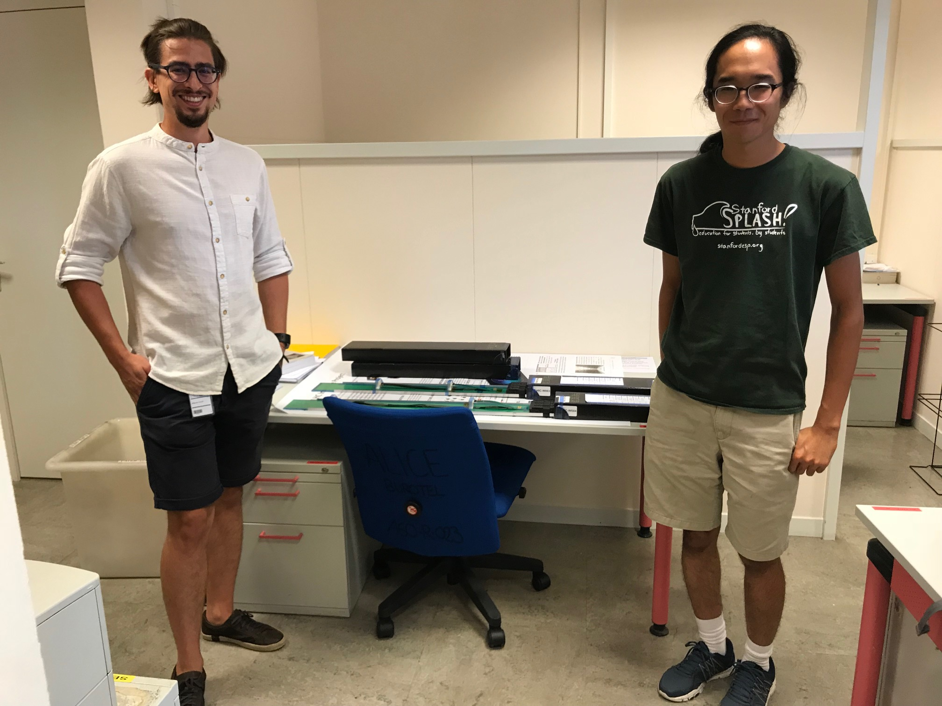
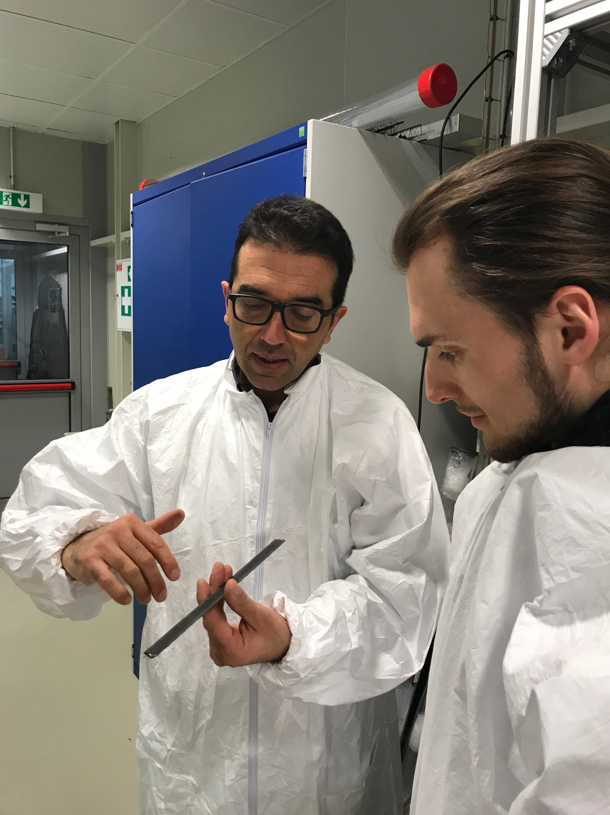
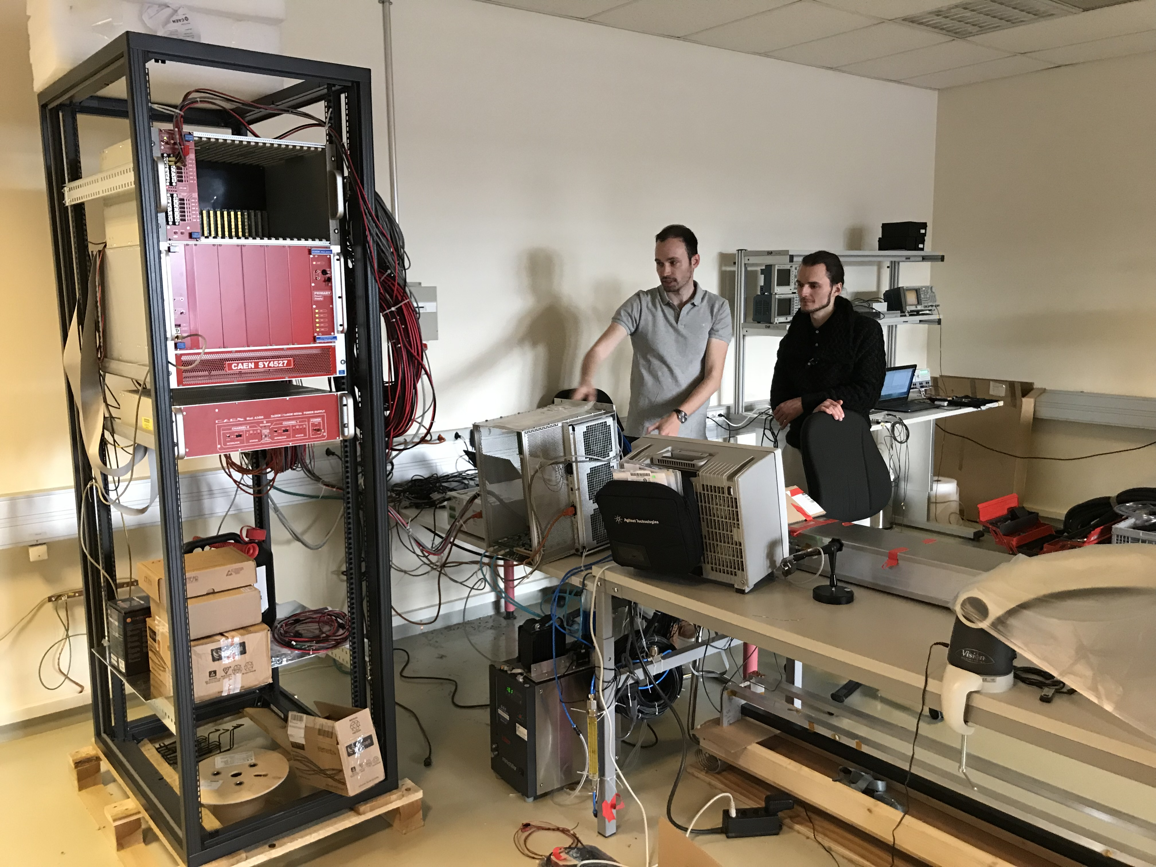
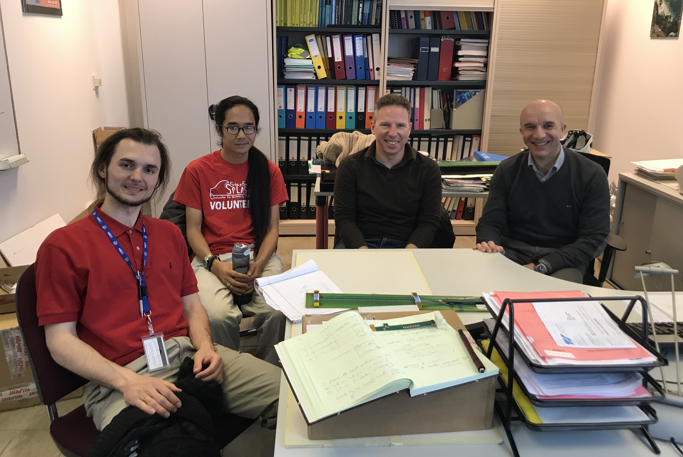
Actions @CERN
Many thanks to CERN colleagues!
Many are not shown here!
Miko
Sho
Corrado
Sho
Alex
Ming
Felix
Antoine
Antonello

