Slide 1
MVTX Status Monthly Report
Ming Liu
LANL
10/3/2018

Slide 2
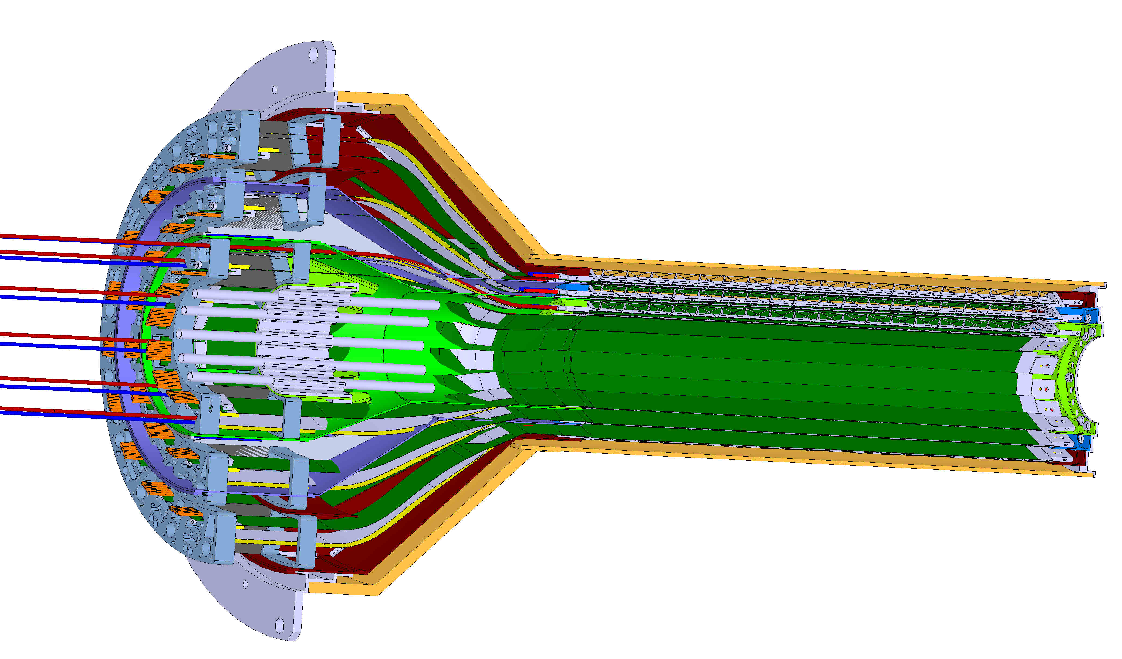
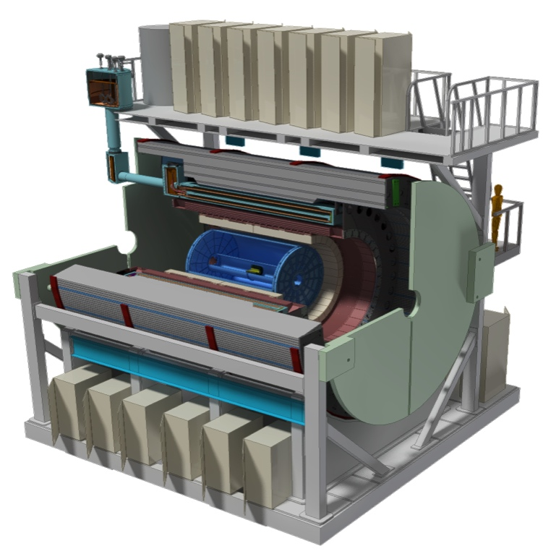
MVTX Detector
Service cone: signal, power, cooling
and mechanical support
CYSS: Cylindrical Shell Structure
End-Wheel
3-layer sensor barrel
- 48 staves, 432 chips
Figure for ALICE ITS/IB design
(slightly modified mechanically for sPHENIX)
MVTX
parameters
MVTX RUs, PUs & other services

Slide 3
MVTX Plan - WBS 3.12 (renumber?)
About $5M to be added to the sPHENIX Management Portfolio
When will the fund be available for procurement?
Have an updated baseline cost and schedule by January 2019
Will NOT be part of CD-2/3 DOE review
Monthly report to sPHENIX and BNL upper management
Early procurements of staves and readout units (RU) through US-Alice, a separate funding from the above $5M budget, ~$1.5M

Slide 4
Scope of the MVTX Project
From BNL Director’s Review
July 19-20, 2018
MAPS Staves & Electronics
Readout Integration R&D (LANL LDRD)
Frontend: ALICE/ITS, RU
Backend: ATLAS FELIX
Reprogram RU & FELIX for sPHENIX
Production:
84 ALICE/ITS-IB staves from CERN
Acceptance test @LBNL
48+spares(36)
58 ALICE/ITS-RU from CERN
Acceptance test @UT-Austin, 48+spares(10)
sPHENIX production, 8 ATLAS/FELIX
Acceptance test @LANL
Final detector assembly in US
LBNL and BNL
Ancillary systems, “adopt” ALICE system
Mechanics & Cooling
Changes to ALICE/ITS inner tracker mechanical structures,
End Wheels
Cylindrical structure shells
Detector half barrels
Detector and Service half barrels
Mechanical Integration,
Conceptual design by LANL LDRD
Prototype by sPHENIX R&D, MIT/LANL
Design integration frames
Composite structures, LBNL
Installation tooling etc.
Adopt ALICE cooling plant design
Modifications to fit sPHENIX
Much smaller heat load than ALICE ITS
- Early R&D by LANL LDRD, $5M, FY17-19, readout, mechanical design and physics
- Established LANL-ALICE MoU in 12/2016 for joint R&D for MVTX

Slide 5
Proposed Schedules and Milestones
From BNL Director’s Review
July 19-20, 2018
sPHENIX: CD1/3a CD2
Installation
1st collisions
CY-2018 | 2019 | 2020 | 2021 | 2022 | 2023
MVTX
ALICE IB stave done;
Facilities available for
sPHENIX production;
A window of opportunity:
Low technical risk
Cost saving
Stave & RU
production
FELIX
production
Detector mechanics design & production, global interface to sPHENIX
End Wheels
Note:
updated 10/3/2018
Stave production:
Starting ~ Jan, 2019
Last for ~12months
CYSS
Service barrel
design & production
Ready for beam;
sPHENIX day-1 run
Barrel Assembly & Testing @LBNL
Install half barrels
@sPHENIX IR
Half barrel #1
Half barrel #2
Half barrels
arrive @BNL
Power system
production
MVTX installation & commissioning @BNL
RU, FELIX, PS, cables etc.

Slide 6
Schedule
MS Project updated during the summer, now moved into P6
Stave and RU production through ALICE, moved out of the scope
The rest of tasks, some still evolving, need to optimize funding profile
An updated baseline cost and schedule by January 2019;
Early procurement of staves and readout units(RU)
Try to complete all paperwork approvals by ~mid November, then will have better understanding of sPHENIX stave and RU production schedules
RU production through ALICE: 60 RUs
Being started at CERN, first batch of full production ~ Dec., 2018
sPHENIX RUs available ~Summer 2019
Acceptance test and QA at UT-Austin: ~summer 2019
Stave production through ALICE: 84 staves
Starts ~ January 2019, following the completion of ALICE ITS IB stave production
3 months (Wafer production) + 1 month (dicing & testing) + 12months (assembly)
Acceptance test and QA at LBNL, ~Summer 2019

Slide 7
ALICE RU Production – Timeline
Presented at ITS Plenary Meeting, 9/24/2018
Both RUs and Data Cables are at the DAI. Goal is having 20 RUs before Christmas Break, as well as enough data cables to connect the whole IB (24 assemblies, equal to 40 data cables).
Jul
Aug
Sep
Oct
Nov
Dec
Jan
Feb
Mar
Apr
May
Data cables
TP
Tendering
DAI
Batch 1a (24 A+B)
Batch 1b
(46 A+B)
Batch 2 (90 A+B)
Batch 3 (90 A+B)
Batch 4 (90 A+B)
IB covered
Acpt.
48 Lnk
92 Lnk
180 Lnk
180 Lnk
180 Lnk
RUs
TP
Tendering
DAI
Ref.
Prototypes (20)
Batch 1 (140)
Batch 2 (150)
Acpt. (extensive)
Acpt. (40 b/w)
(standard)
Acpt. (40 b/w)
(standard)
Microsemi
140 RU
150 RU
Tendering
DAI
Lead time
(26)
Xilinx
→sPHENIX RU
production
Tendering
DAI
Lead time
2018
2019

Slide 8
Procurement Status
Stave and RU, through ALICE production
Near final technical spec and cost estimate document under discussion with ALICE now, plan to complete the document in this week;
All approvals and final green light to CERN/ALICE ~ mid of November 2018
Total ~ $1.5M, will be purchased through US-ALICE, in coming weeks
Near term procurement plan
To be ready for stave acceptance test & QA at LBNL
Clean room, standalone test stand, manpower etc.
To be ready for RU acceptance test & QA at UT-Austin
Test equipment, manpower
Design and produce carbon structures like End-Wheels etc.
LANL, LBNL, BNL…
Funding is needed immediately or the schedule will slip

Slide 9
Recent Progress
Completed sensor/HIC/stave evaluations at CERN
Built and tested two HICs with 40cm and 60cm long power FPC
Confirmed sensor performance comparable with the ALICE default configuration
Sensors irradiated up to 2.7MRad, no problem (updated 9/18/2018).
Confirmed low magnetic field in RU/PU racks, <50Gauss; RU/PU designed for 0.5T
Addressed all recommendations on stave/sensor R&D and RU from recent BNL review
MVTX/INTT mechanical integration
Mechanical design being updated and 3-D mockup in progress
Inner tracking simulation task force, good progress
SamTec cables
ALICE confirmed signal performance with 8m long readout cables
This eases mechanical integration and layout of the services
Final documentation to address July MVTX Director’s Review recommendations
MVTX/INTT mechanical integration, draft available
Inner tracking optimization near final, optimal INTT layers, in ~1-2 weeks

Slide 10
Backup slides

