Slide 1
MVTX Status - WBS 3.2
Ming Liu
L2 Managers Meeting
11/08/2018

Slide 2
Stave and RU Production Preparation
Stave and RU production through UTK
DOE and UTK met last week and discussed details how to proceed
Supplemental grant request to be submitted through PAMS by UTK
Procurement technical document being prepared for UTK
Technical deliverables for staves and RUs
Testing, shipping and QA plan
Paperwork likely ready by the end of this year
Possible impact on Stave and RU production cost and schedule
Under discussion with Luciano

Slide 3
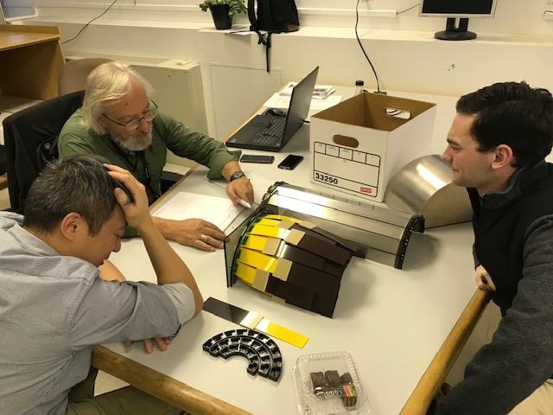
MVTX Project Update
Meetings at BNL with ALD on 11/1, MIT/BNL/LANL/LBNL
MIT & Bates, Boleck, Jim and Ross
sPHENIX is the top priority for midterm plan
More resources will be devoted to sPHENIX MVTX, mostly on mechanical engineering work
Also student/postdoc/Tech helping stave production QA at CERN
Mechanical integration engineering discussions
MVTX, INTT, TPC global integration
Project cost & schedule optimization in progress
Overhead rates for labor and materials
Procurement plan
Tasks and resources being updated
Move some tasks into WBS 2.x infrastructure activity
carbon and non-carbon structure design and fabrication
Service barrel design & mechanical system integration
EE support for commissioning etc.

Slide 4
Technical Update
ALICE ITS IB
Cables
BNL approved to use SamTec blue cables
Electrically better & mechanically compact
Signal and power cable samples ordered for mechanical global system integration mockup
Preliminary design from CERN for stave transportation plates
To get quote soon for production at CERN
BNL PMG recently requested:
“Conduct a technical review with subject matter experts for the installation of the MVTX into sPHENIX (conduct before November 14, 2018). The details of the installation need to be understood and agreed upon before issuing the procurement for the power cables. “
A review being planned on 11/19 (TBD, led by John H.)
MVTX/Tracking workfest @FSU, 12/5, 8,9
Project update
Tracking and simulations
Physics update
Extended design from CERN

Slide 5
backup

Slide 6
Progress and Technical Update
4rd OHCal steel sector order will be received at BNL tomorrow.
TEC (Production) accounts open for the Long Lead Time Procurement Orders
We have ordered all 100k SiPMs from Hamamatsu LLP-1
Scintillating fiber order is the next LLP-2 to be placed
The production scintillating tile LLP-3 and W powder LLP-4 orders waits for additional preproduction work.
We are working on the MVTX stave and Read Out unit order. The price is set. The order will be placed to CERN through Univ Tennessee.
Ming is working on a short “proposal” 3-4 pages that Tom Cormier has requested detailing the order, deliverables, cost, etc.
Order for the SAMPA v5 multi-project run at TSMC has been placed with a lot of help from USP and SBU. Expect prototype ASIC components at USP for testing in January.

Slide 7
Issues to Address
The Chinese institutions, particularly Fudan and U Peking, want to commit to building the forward eta coverage for the EMCal.
They would like to send BNL funds to purchase the scintillating fibers and SiPMs for this part of their portion of the production.
GSI/FAIR/CBM wants to get in on our buy of the FELIX boards. They need to send funds to BNL to participate.
BNL did not succeed in getting a contract placed with IMEC for the SAMPA production. Future SAMPA orders with IMEC will get placed through SBU.
PPMP back from Lloyd and Jim with comments. We need the comments from Jehanne and BNL Management.
We held an sPHENIX-MIT meeting on MIT’s responsibility on the MVTX. Berndt spent a long time there. I think that it went very well and MIT wants to contribute to the project in a significant way: scientists, engineers, tech and students.

Slide 8
3.X “Silicon” WBS
The MVTX WBS 3.2 is updated with current labor rates. Ming has sent updates on precise scope included in WBS 3.2
The dates when stave work starts and ends at CERN will be drivers of the overall schedule
Support system and installation will be moved to WBS 2.3 and 2.5 respectively to be consistent with approach for other subsystems
The INTT WBS has been reviewed briefly. A decision on the layer count is needed to make progress.
Both INTT and MVTX are included in the WBS 2.5 Installation sequence. So far things mesh well

Slide 9
MVTX Level 3 Organization
3.2 MVTX (Ming Liu Level 2 Manager)
3.2.1 MVTX Management – Ming Liu/LANL
3.2.2 MVTX Electronics – Mark Prokop/LANL
3.2.3 MVTX Mechanics and Detector Assembly – Grazyna Odyniec/LBNL
3.2.4 MVTX Integration and Infrastructure - Ross Corliss/MIT

Slide 10
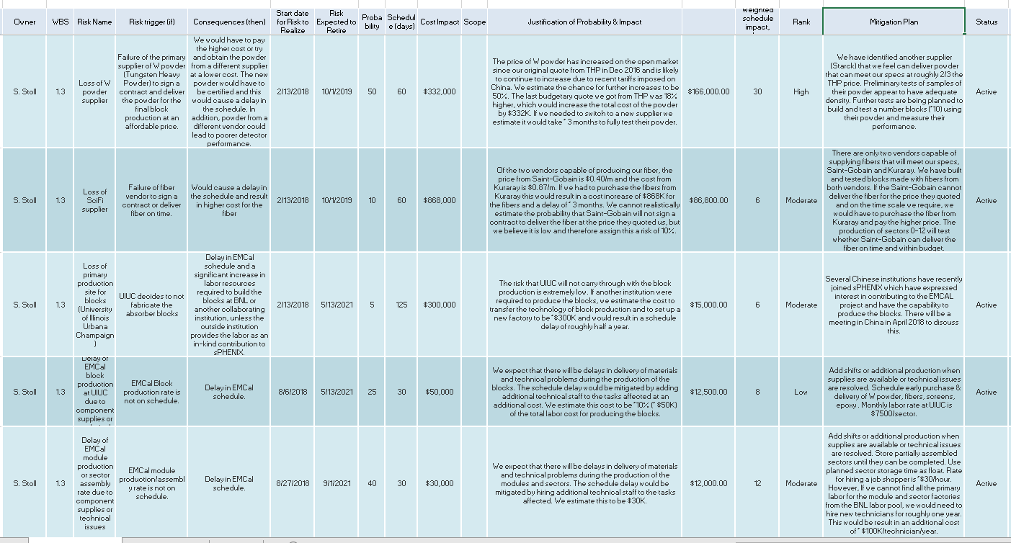
Risk Registry (EMCal)
Alt vendors being evaluated. F&P Univ also have vendor
25% of fiber on hand, PO for remainder to go out soon.
Less probable?
Having F&P U as an alt production site could reduce this risk?

