Slide 1
MVTX Status - WBS 3.2
Ming Liu
sPHENIX L2 Meeting
11/29/2018

Slide 2
Project Status
RU and Stave procurement in progress
Tom is working on the paperwork through OSP at UTK, more news in two weeks
Technical doc and paperwork were prepared and sent to UTK from BNL
MVTX project in P6
Work in progress on funding details
Split engineering/tech T&E among LANL, MIT, LBNL, BNL etc.
Adjustment in WBS scope (some moved to WBS 2.x) to keep the total cost under $5M cap
To be updated at Dec. sPHENIX collaboration meeting
MVTX Interim Design Review, 11/19/2018
Led by John Haggerty, draft recommendations being circulated
no evident showstoppers
https://indico.bnl.gov/event/5351/

Slide 3
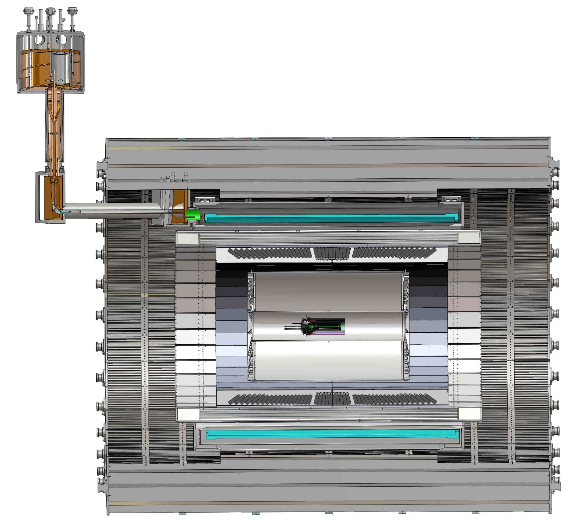
Progress with MVTX Global Mechanical Integration
MVTX service barrel design proposed, with two parts:
Part-1: from MVTX to PP-1b, all power PCB, 40cm
Part-2: length TBD later, from PP-1b to PP-2
Service Barrel
TPC
TPC
INTT
MVTX
PP-1a:
short signal cables
PP-2:
Signal and power cables
R= 209.6cm
PP-1b:
power cables
L = 350.0 cm

Slide 4
Near Term Plan
CERN/ALICE visit planned ~end of January 2019
Walt, Ming, and MIT/Bolek, Jim, Ross et al
Mechanical design and integration
Produce 5 staves for MVTX telescope
Preparation for MVTX stave production at CERN
One LANL PD hired at CERN
MIT student/postdoc/tech help at CERN, under discussion
LBNL will start preparing the MVTX detector lab as soon as funds will transferred
Fermilab beam test with INTT, ~May 2019
Waiting for HDI cables for INTT
MVTX telescope will be ready ~March 2019
A joint test beam proposal being developed
Test global tracking, timing etc.
Possible MVTX beam test at LBNL
MVXT sensor and readout electronics characterization etc.
Details under discussion

Slide 5
MVTX & Tracking Workfest at FUS, 12/5, 8-9
Update project cost & schedule
Discuss and update institution roles
Tasks, resources and schedules
Improve MVTX related tracking and analysis
Decision regarding number of layers of the INTT during the collaboration meeting
Update tracking software
Update physics plots
Draft agenda,
https://docs.google.com/document/d/1oqJOvoqNYKJQM1N8acV2lidam84iOIE4uLY1kfrC20o/edit?usp=sharing

