Slide 1
Power Distribution
Leo Greiner - LBNL
ALICE ITS Upgrade
Stave Production Readiness Review
CERN, 27 April 2017

Slide 2
Requirements
Review of Power System Design
Design and Prototype/Production Status
System Modularity/Granularity, Characteristics
Most of the material in this presentation is available in greater detail in a system description document available at the link below
Comprehensive baseline power system description available at:
https://twiki.cern.ch/twiki/pub/ALICE/Presentations20on20power20system/2017_04_08_ITS_upgrade_power_system_description.docx

Slide 3
Power System Requirements
The requirements for the powering system are closely inter-dependent with the sensor and module FPC requirements in that all of these components need to work together to meet the overall detector requirements for the ALICE ITS upgrade. These are most succinctly expressed as:
Supply power (sensor supply and bias) to the modules/half-staves such that:
Module sensor efficiency ≥ 99%
Module sensor noise rate < 10⁻⁶
Radiation length of the power bus in the fiducial volume is < 0.4%
Survive the radiation environment at the power board location.
Interface to the ALICE ITS RDO board for control of PS functions and readout of parameters.
Fit into the space allocated in the ITS upgrade integration envelopes.
To this end, the design of the powering system is intended to be compatible with meeting these requirements. This design will be tested in the development of individual modules and extended into the fabrication of half and full staves.
The desirable functional attributes for system include:
Overcurrent protection for each power channel
Remote current readout for each power channel
Remote voltage readout for each power channel
Remote voltage setting capability for each channel

Slide 4
Baseline System Design
Magnet face
(10k rad)
Inside TCP field cage (100k rad)
CANbus
RDO
unit
data, config, control
Half-stave
monitor, control
Power bus
Power
Bias bus
bias
Power Supply
and Bias
Control board
Filter
Board
FB-BOB
Breakout board
power, bias
PP1
PP0
CAEN
bias
supply
CAEN
Main
Power
Power, sense
bias, sense
Racks (low rad)
Control Room (no rad)

Slide 5
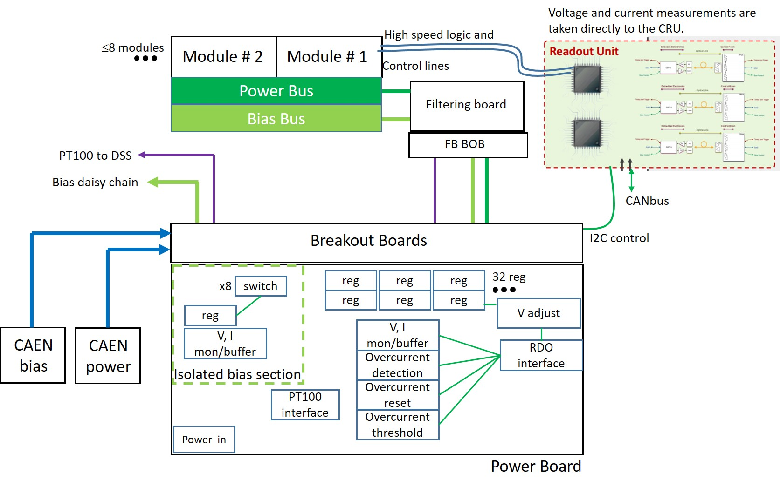
Functional System Design

Slide 6
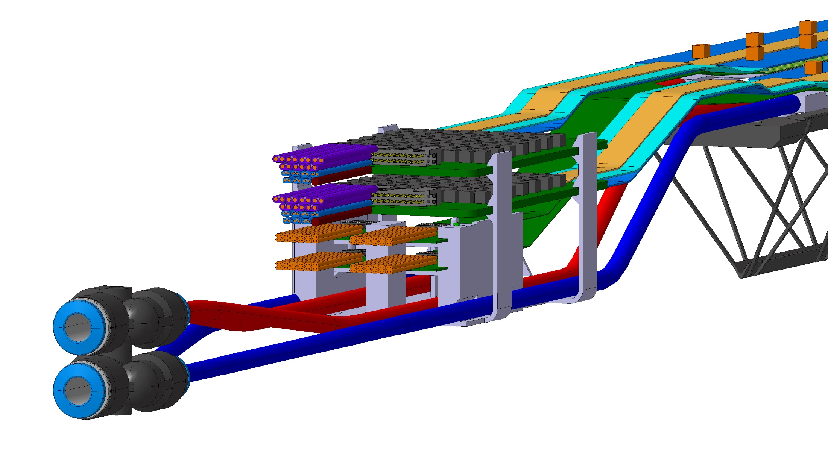
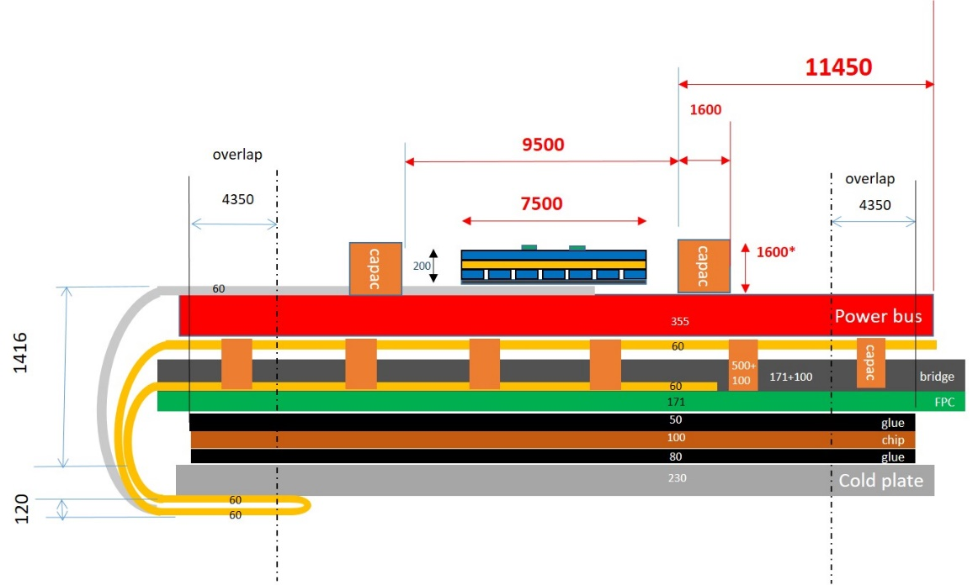
End of Stave Structure for ML / OL
Stack up end view of stave

Slide 7
Power System Components
Power Bus
Filtering board
Bias Bus
Power Bus
Bias Bus
Filter Board
FB-BOB to PB-BOB cable
Power Board
CAEN Supplies
FB BOB
Breakout Boards
x8
reg
reg
reg
32 reg
switch
reg
reg
reg
V adjust
reg
CAEN Supplies
Main power
Bias
V, I mon/buffer
V, I mon/buffer
Overcurrent
detection
RDO
interface
Isolated bias section
PT100 interface
Overcurrent
reset
Overcurrent
threshold
Power in
Power Board

Slide 8
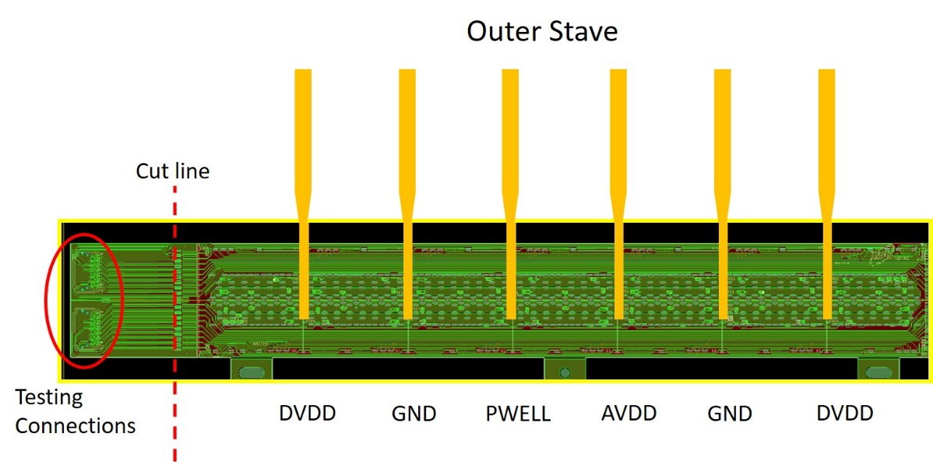
Power Bus Design
Updates from EDR
Aluminum conductor with individual VDDD, VDDA traces to each module. Common GND return.
Equalized resistance trace structure.
Solders directly to Filter Board.
100 um Al thickness on both sides (2 layer)
1 module of power bus
Filter
Board
Three piece power bus structure with power bus extension pieces soldering to the filter board
Module with cross-pieces

Slide 9
Bias Bus Design
OL Bias bus is a 2 piece design like the power bus
BB + extension piece
Extension piece
Bias bus
This allows the solder tabs to me fabricated from 100 um thick aluminum for strength in the solder connection to the bias bus.
Because the bias bus is no longer centered on the PB axis, we need separate BB and BB extensions for each half-stave type (or possibly separate filter board designs, TBD).
The ML power and bias bus is the same basic design as the OL power and bias bus, but modified for the ML 4 module stave.

Slide 10
Power Bus and Bias Bus Status
The full design for the OL and ML power bus, bias bus and cross pieces is completed and the fabrication packages are complete. These may be found at:
https://twiki.cern.ch/twiki/pub/ALICE/Presentations20on20Power20Bus/2017_03_20_ITS_power_bus_spec_files.zip
A full specification for the production fabrication procurement has been written and the price enquiry has been released.
A set of prototypes fabricated at Kharkov is complete containing prototype OL & ML power buses, OL & ML bias buses and cross pieces. These are expected to be delivered shortly.
These will be tested with the stave prototypes and assessed for functionality.
A previous set of prototypes including full length assemblies have been produced and tested, the results of the testing are very promising and links to the descriptions and testing results are below. https://twiki.cern.ch/twiki/pub/ALICE/Presentations20on20Power20Bus/2015_08_26_Report_on_Al_cable_preliminary_tests.docx https://twiki.cern.ch/twiki/pub/ALICE/Presentations20on20Power20Bus/2016_02_09_Kharkov_power_bus_test_results.pdf https://twiki.cern.ch/twiki/pub/ALICE/Presentations20on20Power20Bus/PowerBus-03032016-7-F.pptx

Slide 11
Filter Board Status
The design for the prototype Filter board and filter board breakout board are complete.
The design has been fabricated and prototypes are at Bari, CERN and Torino
The Filter Board fabrication package is available at: https://twiki.cern.ch/twiki/pub/ALICE/Presentations20on20Power20Bus/filter_board.zip
For this round of testing, the OL and ML filter board design is the same.
The prototype Filter Board uses one design for both OL and ML.
The granularity is 1 filter board per half-stave for the ML and OL staves.
Filter Board break out board
Filter Board

Slide 12
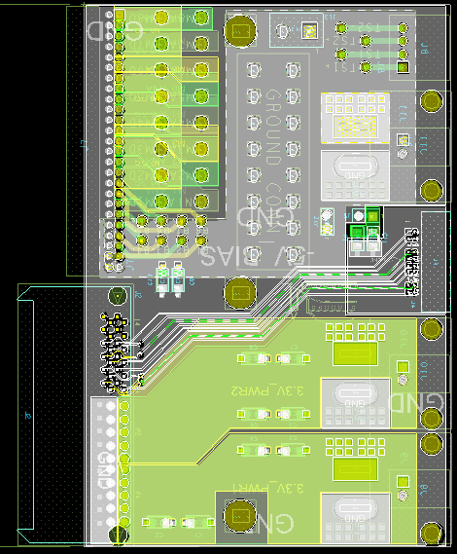
FB-BOB to PB-BOB Cable Status
The FB-BOB has been designed and fabricated (see previous slide).
The PB-BOB has been designed and is currently being fabricated. PCBs are at LBNL and being loaded.
An external company has been contacted to get a quotation for the full production of custom cable harnesses using the two board designs and following the granularity shown earlier.
~5 m
OL contains:
7 x module power VDDD (16 AWG)
7 x module power VDDA (18 AWG)
7 x module GND (16 AWG)
7 x module GND (18 AWG)
7 x bias (22 AWG)
4 x PT100 (22 AWG)
FB-BOB
PB-BOB

Slide 13
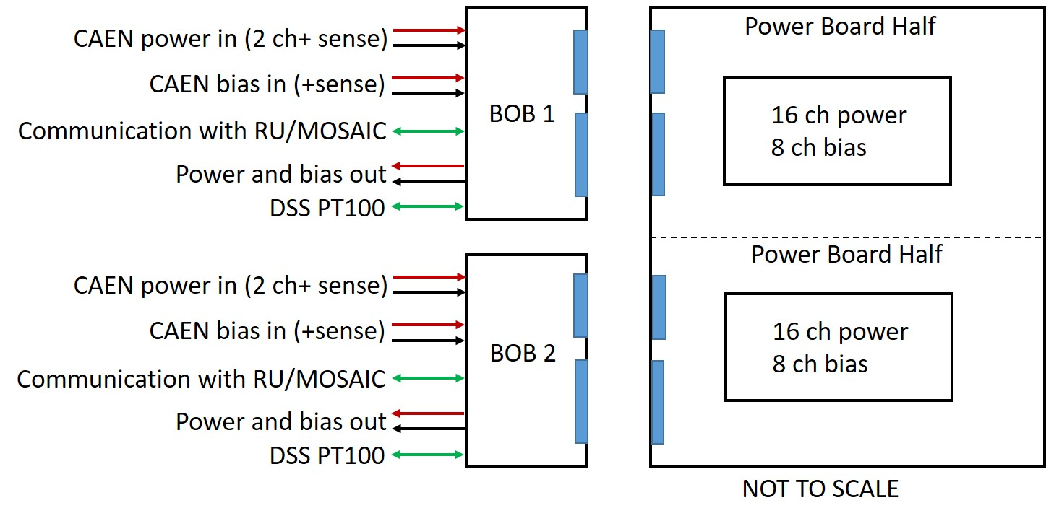
Power Board Status
The power board design has 2 power board halves. Each contains a separately controlled set of 16 channels of regulated power and 8 switched bias outputs

Slide 14
Power Board Status
A Power Board design that meets the requirements shown earlier has been designed.
An internal review of the prototype power board design was held on March 9, 2017. The review results and material may be found at https://twiki.cern.ch/twiki/bin/view/ALICE/Prod_proto_PB_review.
Based on this review, the design for the prototype PB was released for layout and fabrication.
The layout is complete and the purchase requisition for 10 prototype turnkey loaded boards was released.
The fabrication package including design, gerber, BOM and assembly files may be found at https://twiki.cern.ch/twiki/pub/ALICE/Prototype_power_board/2017_04_04_ITS_prototype_power_board_fab_package.zip.
We expect to take delivery of the prototype PBs in the second week of May.
After a week of validation testing, an order for 20-25 prototype PBs will be released to allow delivery of testing PBs to the module and stave assembly sites.

Slide 15
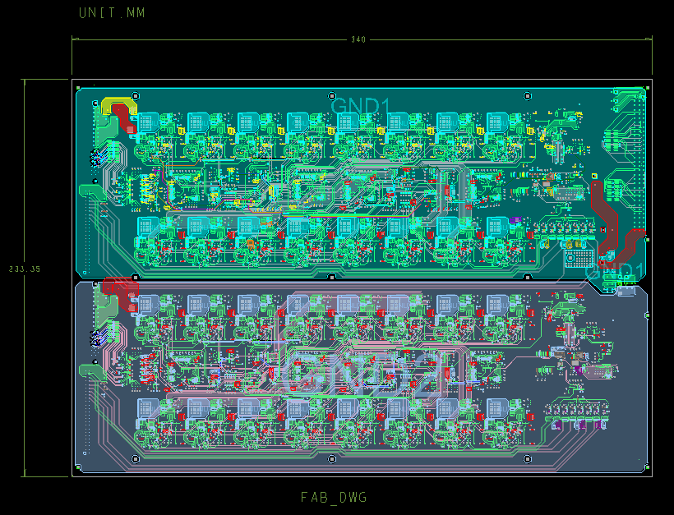
Power Board Status
Layout of prototype power board
6U x 340 mm format
8 layer, 0.062” thick

Slide 16
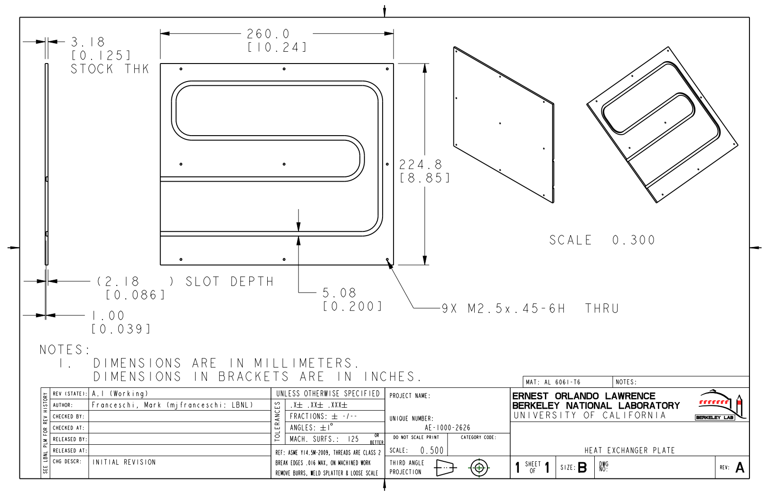
Power Board Status
Prototype heat exchanger
We dissipate up to 22.6 W in the power boards in operation with ML staves.
This requires a rear mounted heat exchanger to keep the boards from overheating.
These must be in place for the power boards to be distributed and used.
A simple prototype heat exchanger has been designed and fabricated for use with the prototype PBs.
These will be mounted to the prototype PBs for testing and distribution.
Note that this requires assembly sites to have a chiller/recirculator.

Slide 17
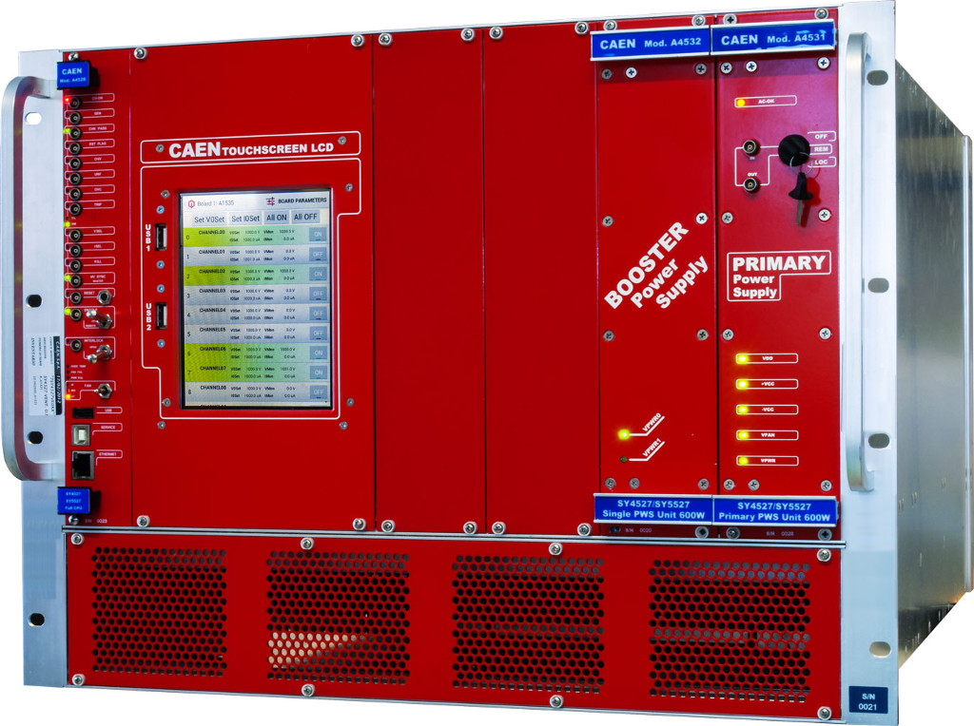
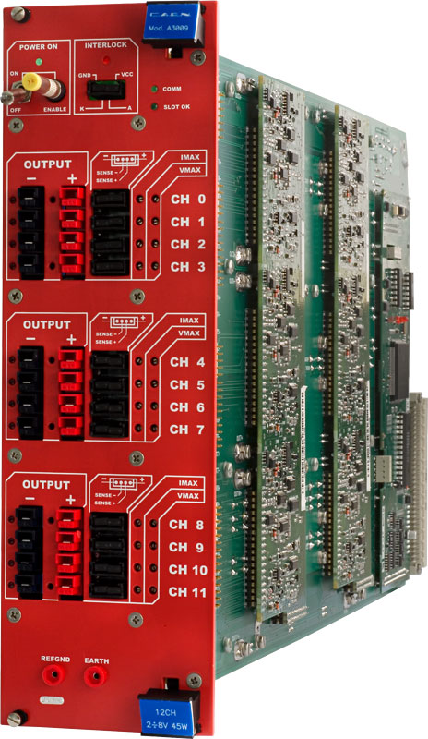
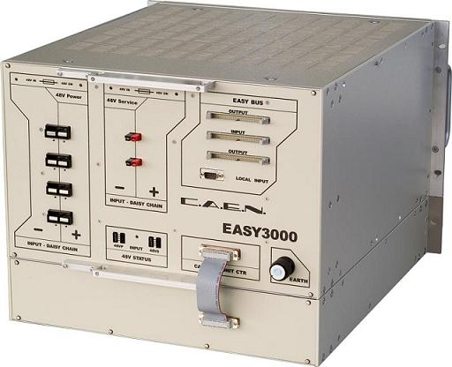
Baseline Main PS Design Status
This is a commercial system and will be a procurement
We will have a meeting with CAEN in the next months to specify the system and understand the options
We have existing CAEN systems on hand for testing with the power board prototypes
x1 SY4527B Mainframe
x2 A1676A - Easy3000 Branch Controller
CR4
x8 Easy3000 Remote Crates
x4 A3486 - AC/DC bulk power supply 2x 2kW
x43 A3009 - 12Ch/8V/9A/45W
RB24 - SideA

Slide 18
Modularity of Power System
The baseline modularity is four CAEN supply channel per stave. Each half-power board is controlled by 1 RU.
Power Board
IL stave
CAEN PS 1
1.67 A
8 power ch.
0 A
PB
CAEN PS 2
8 power ch.
Inner Layers Modularity
CAEN BIAS
8 bias ch.
2 staves per PB
(4/32 ch utilization)
IL stave
CAEN PS 3
1.67 A
8 power ch.
0 A
PB
CAEN PS 4
8 power ch.
CAEN BIAS
8 bias ch.

Slide 19
Modularity of Power System
The baseline modularity is four CAEN supply channel per stave. Each half-power board is controlled by 1 RU.
Power Board
ML half-stave
CAEN PS 1
4.474 A
8 power ch.
3.724 A
PB
ML half-stave
CAEN PS 2
8 power ch.
Middle Layers Modularity
CAEN BIAS
8 bias ch.
2 staves per PB
(full PB utilization)
4.474 A
ML half-stave
CAEN PS 3
8 power ch.
3.724 A
PB
ML half-stave
CAEN PS 4
8 power ch.
CAEN BIAS
8 bias ch.
931 mA / module combined digital and analog @ 1.8V nominal

Slide 20
Modularity of Power System
The baseline modularity is four CAEN supply channel per stave. Each half-power board is controlled by 1 RU.
Power Board
OL half-stave
CAEN PS 1
3.543 A
8 power ch.
3.724 A
PB
CAEN PS 2
8 power ch.
Outer Layers Modularity
CAEN BIAS
8 bias ch.
1 staves per PB
(28/32 ch utilization)
OL half-stave
CAEN PS 3
3.543 A
8 power ch.
3.724 A
PB
CAEN PS 4
8 power ch.
CAEN BIAS
8 bias ch.
931 mA / module combined digital and analog @ 1.8V nominal

Slide 21
Modularity of Power System
 | QTY | CAEN power channels per stave | CAEN bias channels per power board | Power Boards per stave | Total CAEN power channels | Total CAEN bias channels | Total Power boards
Inner layer staves | 48 | 1 | 0.2* | 0.5 | 48 | 5 | 24
Middle Layer staves | 54 | 2 | 0.2* | 0.5 | 108 | 6 | 27
Outer Layer staves | 90 | 4 | 0.2* | 1 | 360 | 18 | 90
Total |  |  |  |  | 516 | 29 | 141
* Assuming bias power daisy chains to 5 PB per CAEN channel

Slide 22
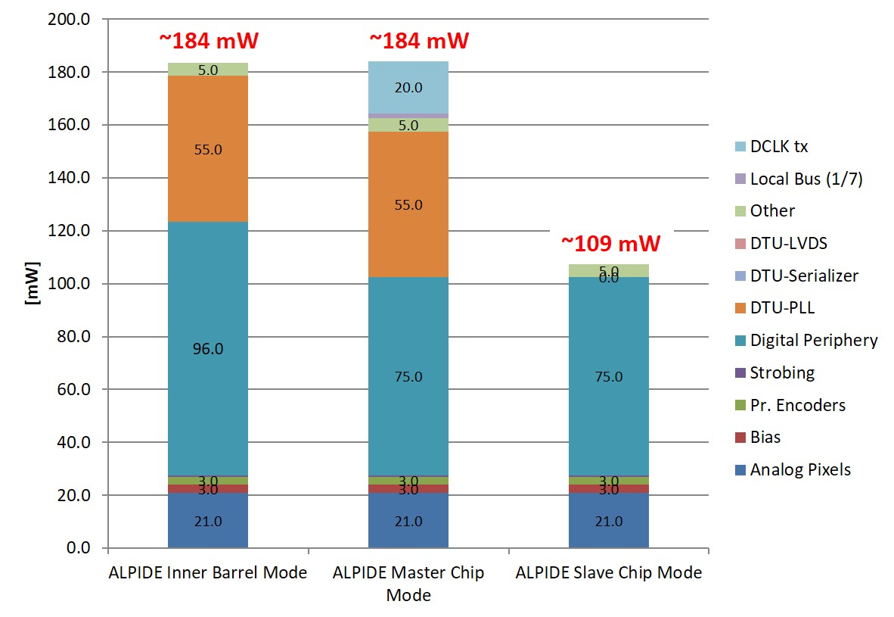
Power Dissipation
ALPIDE Power Consumption
Nominal ALPIDE Outer/Middle Layer Modules consist of:
2 x Master @ 184 mW
12 x Slave @ 109 mW
1676 mW/module @ 1.8 V nominal operating voltage
(VDDA = 163 mA and VDDD = 768 mA)
Power Board dissipation
in regulators (nominal):
Middle Layer PB => 22.6W
Outer Layer PB => 20.1W
Inner Layer PB => 6.3W
In board logic:
2.5W/power board half
Data: combination of available measurements and simulations
Estimated uncertainty ± 10%
Values scaled for readout at 100 kHz rates and max occupancies
Clock gating enabled

Slide 23
Stave Power Dissipation
 | Number of staves | Dissipation per stave | Dissipation per layer
Layer 0 (IL) | 12 | 1.656 W | 19.9 W
Layer 1 (IL) | 16 | 1.656 W | 26.5 W
Layer 2 (IL) | 20 | 1.656 W | 33.1 W
Layer 3 (ML) | 24 | 13.408 W | 321.8 W
Layer 4 (ML) | 30 | 13.408 W | 402.2 W
Layer 5 (OL) | 42 | 23.464 W | 985.5 W
Layer 6 (OL) | 48 | 23.464 W | 1126.3 W
Total dissipation |  |  | 2915.3 W
There is also a small amount of power (single digit watts) dissipated in the power bus and in the connecting cabling

Slide 24
Voltage drops in system
Power bus resistances and voltage drops as a function of module position
target | resistance to power via x-location (ohm) | voltage drop (V) - nominal current | voltage drop (V) - no clock | voltage drop (V) - High current
module 1 VDD via 1 | 0.01253 | 0.00962 | 0.00351 | 0.01629
module 2 VDD via 1 | 0.04508 | 0.03462 | 0.01262 | 0.05861
module 3 VDD via 1 | 0.05609 | 0.04308 | 0.01570 | 0.07291
module 4 VDD via 1 | 0.06137 | 0.04713 | 0.01718 | 0.07978
module 5 VDD via 1 | 0.06413 | 0.04925 | 0.01796 | 0.08337
module 6 VDD via 1 | 0.06628 | 0.05091 | 0.01856 | 0.08617
module 7 VDD via 1 | 0.06773 | 0.05201 | 0.01896 | 0.08804
module 1 VDA via 1 | 0.13070 | 0.02130 | 0.01072 | 0.01072
module 2 VDA via 1 | 0.32212 | 0.05251 | 0.02641 | 0.02641
module 3 VDA via 1 | 0.34257 | 0.05584 | 0.02809 | 0.02809
module 4 VDA via 1 | 0.30032 | 0.04895 | 0.02463 | 0.02463
module 5 VDA via 1 | 0.35719 | 0.05822 | 0.02929 | 0.02929
module 6 VDA via 1 | 0.36172 | 0.05896 | 0.02966 | 0.02966
module 7 VDA via 1 | 0.36167 | 0.05895 | 0.02966 | 0.02966
Nominal
VDDD = 768 mA
VDDA = 163 mA
High Current
VDDD = 1.3 A
VDDA = 163 mA

Slide 25
Voltage drops in system
All power returns are common
Power bus return broken into module length segments.
Each conductor is 210.9 mm long, 30.4 mm wide and 0.1 mm thick
(note that first segment has connection close to the beginning of the power bus and lower resistance)
0.6 mΩ
2.0 mΩ
2.0 mΩ
2.0 mΩ
2.0 mΩ
2.0 mΩ
2.0mΩ
Module position | 1 | 2 | 3 | 4 | 5 | 6 | 7
Summed current | 6.517 A | 5.586 A | 4.655 A | 3.724 A | 2.793 A | 1.862 A | 0.931 A
Voltage drop | 3.9 mV | 11.2 mV | 9.3 mV | 7.4 mV | 5.6 mV | 3.7 mV | 1.9 mV
Sum to get voltage drop at particular location

Slide 26
Voltage drops in system
OL Fixed voltage drops for digital power (VDDD) at nominal operating condition
(VDDD=0.768A, VDDA=0.163A, calculated from geometry and material)
8.4 mV
PB
Out
50.7 mV
13.1 mV
Voltage drops come from spreadsheet
FB
11 mΩ
PB extension
17 mΩ
Power Bus supply
Wire 66 mΩ
0.768A
Cross piece
5 mΩ
Cross piece
5 mΩ
2.0 mV
0.65 mV per
operating module
Module
? mΩ
5.35 mV per
operating module
1.43 mV per
operating module
Cross piece
5mΩ
Cross piece
5 mΩ
2.0 mV
FB
0.7 mΩ
PB extension
1.54 mΩ
Power Bus return
Wire 5.75 mΩ
Voltage drops come from table

Slide 27
Voltage drops in system
Example: VDDD voltage drop for OL module 7
8.4 mV
PB
Out
50.7 mV
13.1 mV
FB
11 mΩ
PB extension
17 mΩ
52.0 mV
Wire 66 mΩ
0.768A
Cross piece
5 mΩ
Cross piece
5 mΩ
2.0 mV
Total voltage drop is 223.21 mV
Module
? mΩ
Cross piece
5 mΩ
Cross piece
5 mΩ
2.0 mV
4.55 mV
10.01 mV
37.45 mV
FB
0.7 mΩ
PB extension
1.54 mΩ
43.0 mV
Wire 5.75 mΩ

Slide 28
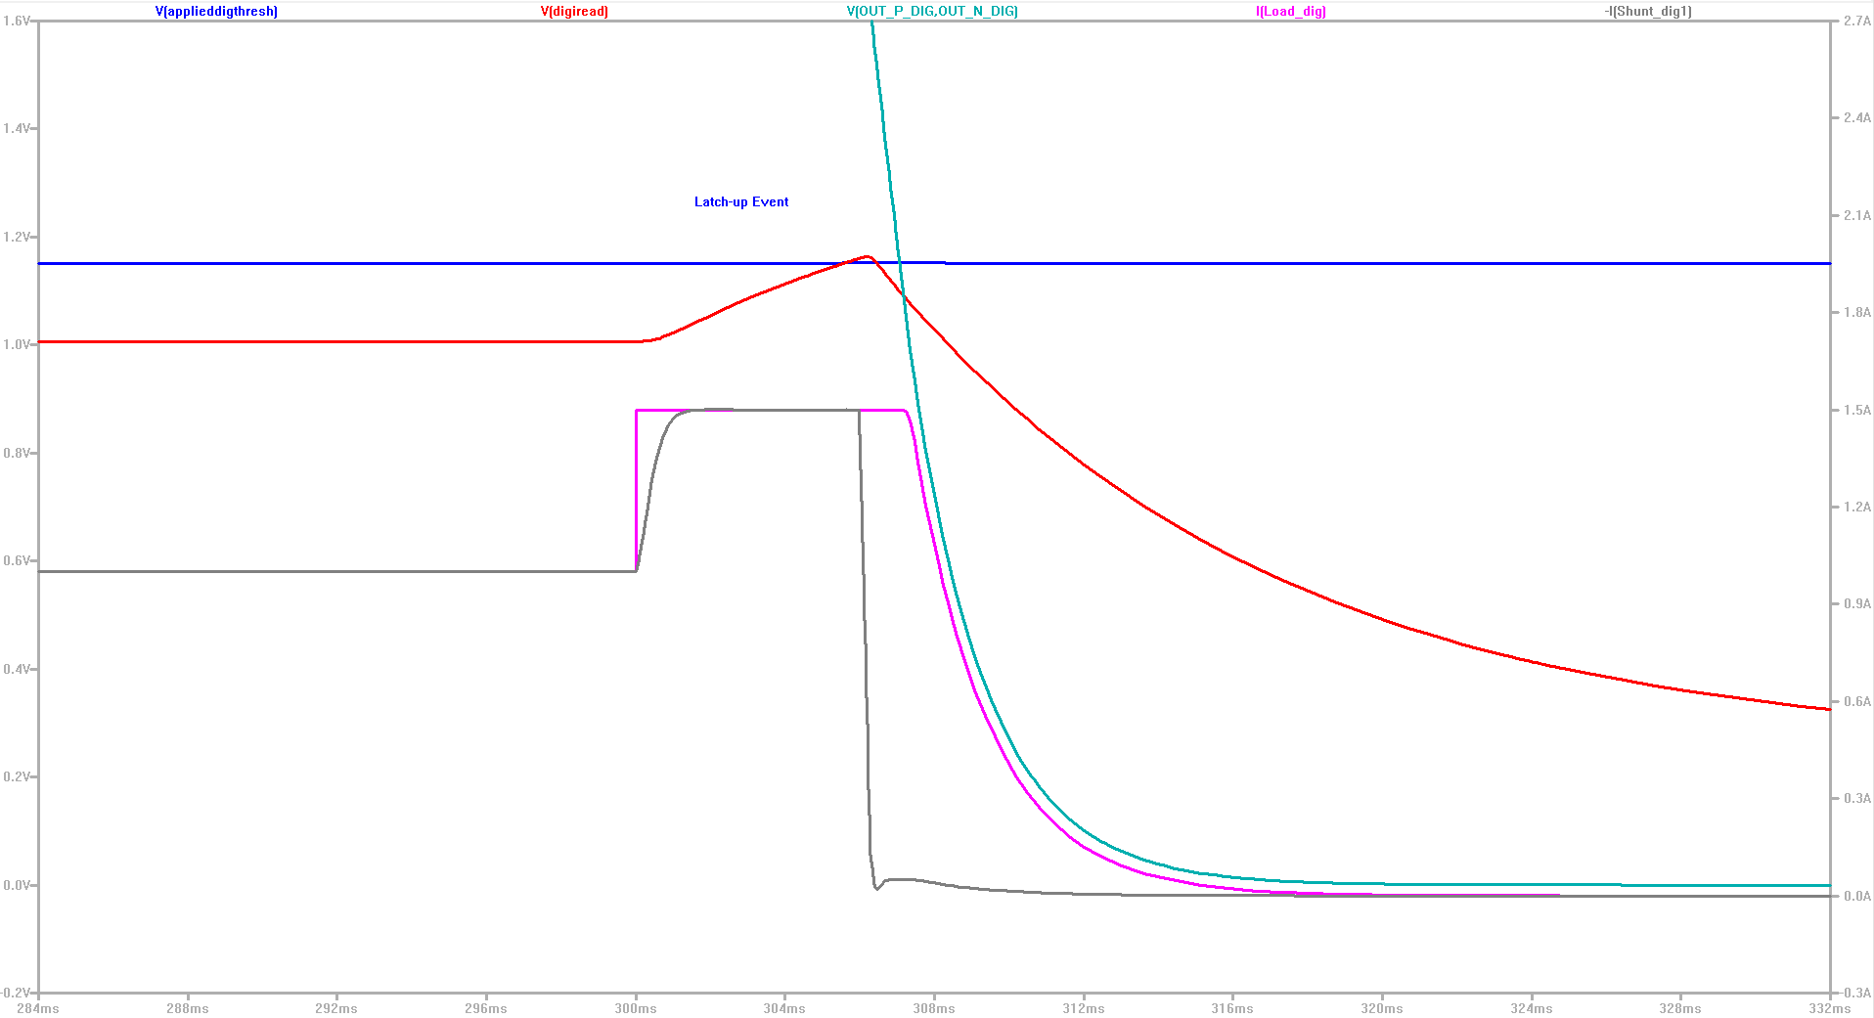
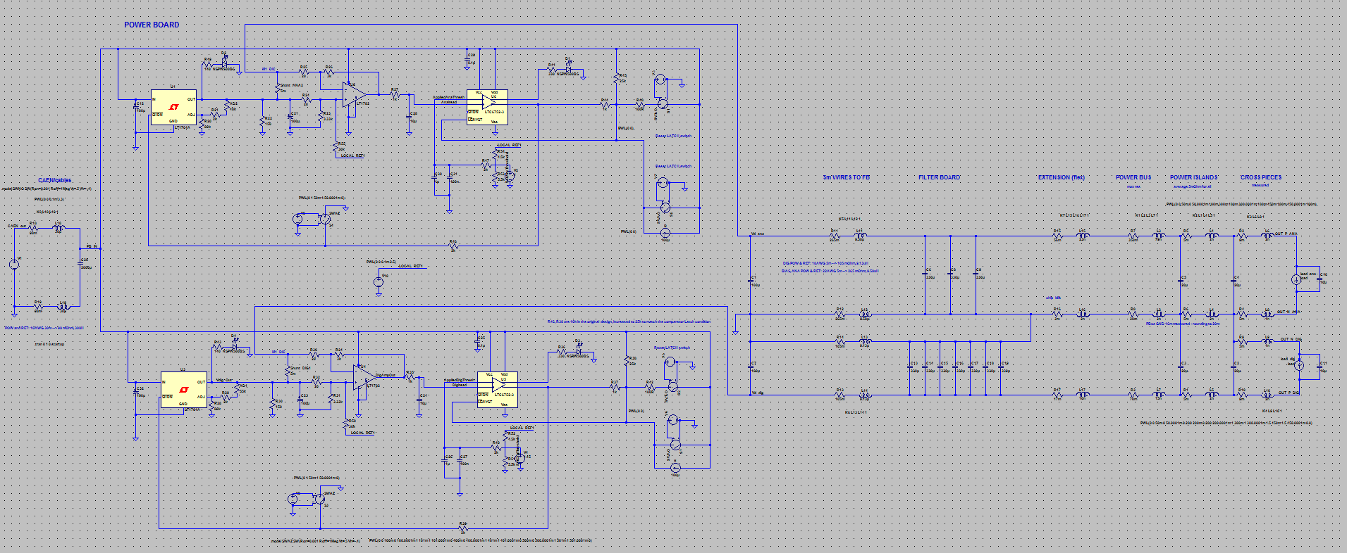
Baseline System Simulation
System simulated in SPICE including power board components.
Response looks as expected and reasonable.
Spice model for VDDA, VDDD for one module
SPICE model response to latch-up overcurrent. Note that the response time of the current measured in the shunt lags the current applied in the module by 1.5 ms. The power (cyan) is removed after 10 ms (to 0.5V).
https://twiki.cern.ch/twiki/pub/ALICE/Presentations20on20power20system/2017_04_09_Power_system_SPICE_simulation_report.docx

Slide 29
Summary
There have been a significant set of design changes since the last review (EDR).
The new design is well advanced and meets the needs of the ITS upgrade well.
The prototype power system is prototyping progressing and will soon have a full set of prototypes for all of the components required to perform a full set of tests with the prototype staves.
Any questions?

Slide 30
BACKUP

Slide 31
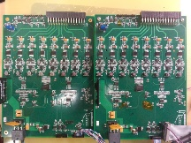
Simplified Power Boards Development Path
Develop 2 module
Testing power board
Extend design to 7 module
Testing power board
Produce and distribute
7 module testing
power boards
Produce and distribute 2
module testing power boards
New direction decided 12/2016. Prototype 8-ch testing PBs delivered to CERN and Bari
Test functionality
Testing power boards
Production power boards
Preliminary production
power board design
Select components
for rad testing
Radiation test
components
PASS
Complete design,
layout and produce production prototypes
Complete
In progress
FAIL
Prototype production PBs will be used for testing.
Select new components/
update design

Slide 32
OL Fixed voltage drops for analog power (VDDA) at nominal operating condition
(VDDD=0.768A, VDDA=0.163A, calculated from geometry and material)
5.4 mV
PB
Out
17.1 mV
9.1 mV
Voltage drops come from spreadsheet
FB
33 mΩ
PB extension
56 mΩ
Power Bus supply
Wire 105 mΩ
0.163A
Cross piece
5 mΩ
1 mV
0.65 mV per
operating module
Module
? mΩ
5.35 mV per
operating module
1.43 mV per
operating module
Cross piece
5 mΩ
1 mV
FB
0.7 mΩ
PB extension
1.54 mΩ
Power Bus return
Wire 5.75 mΩ
Voltage drops come from table

Slide 33
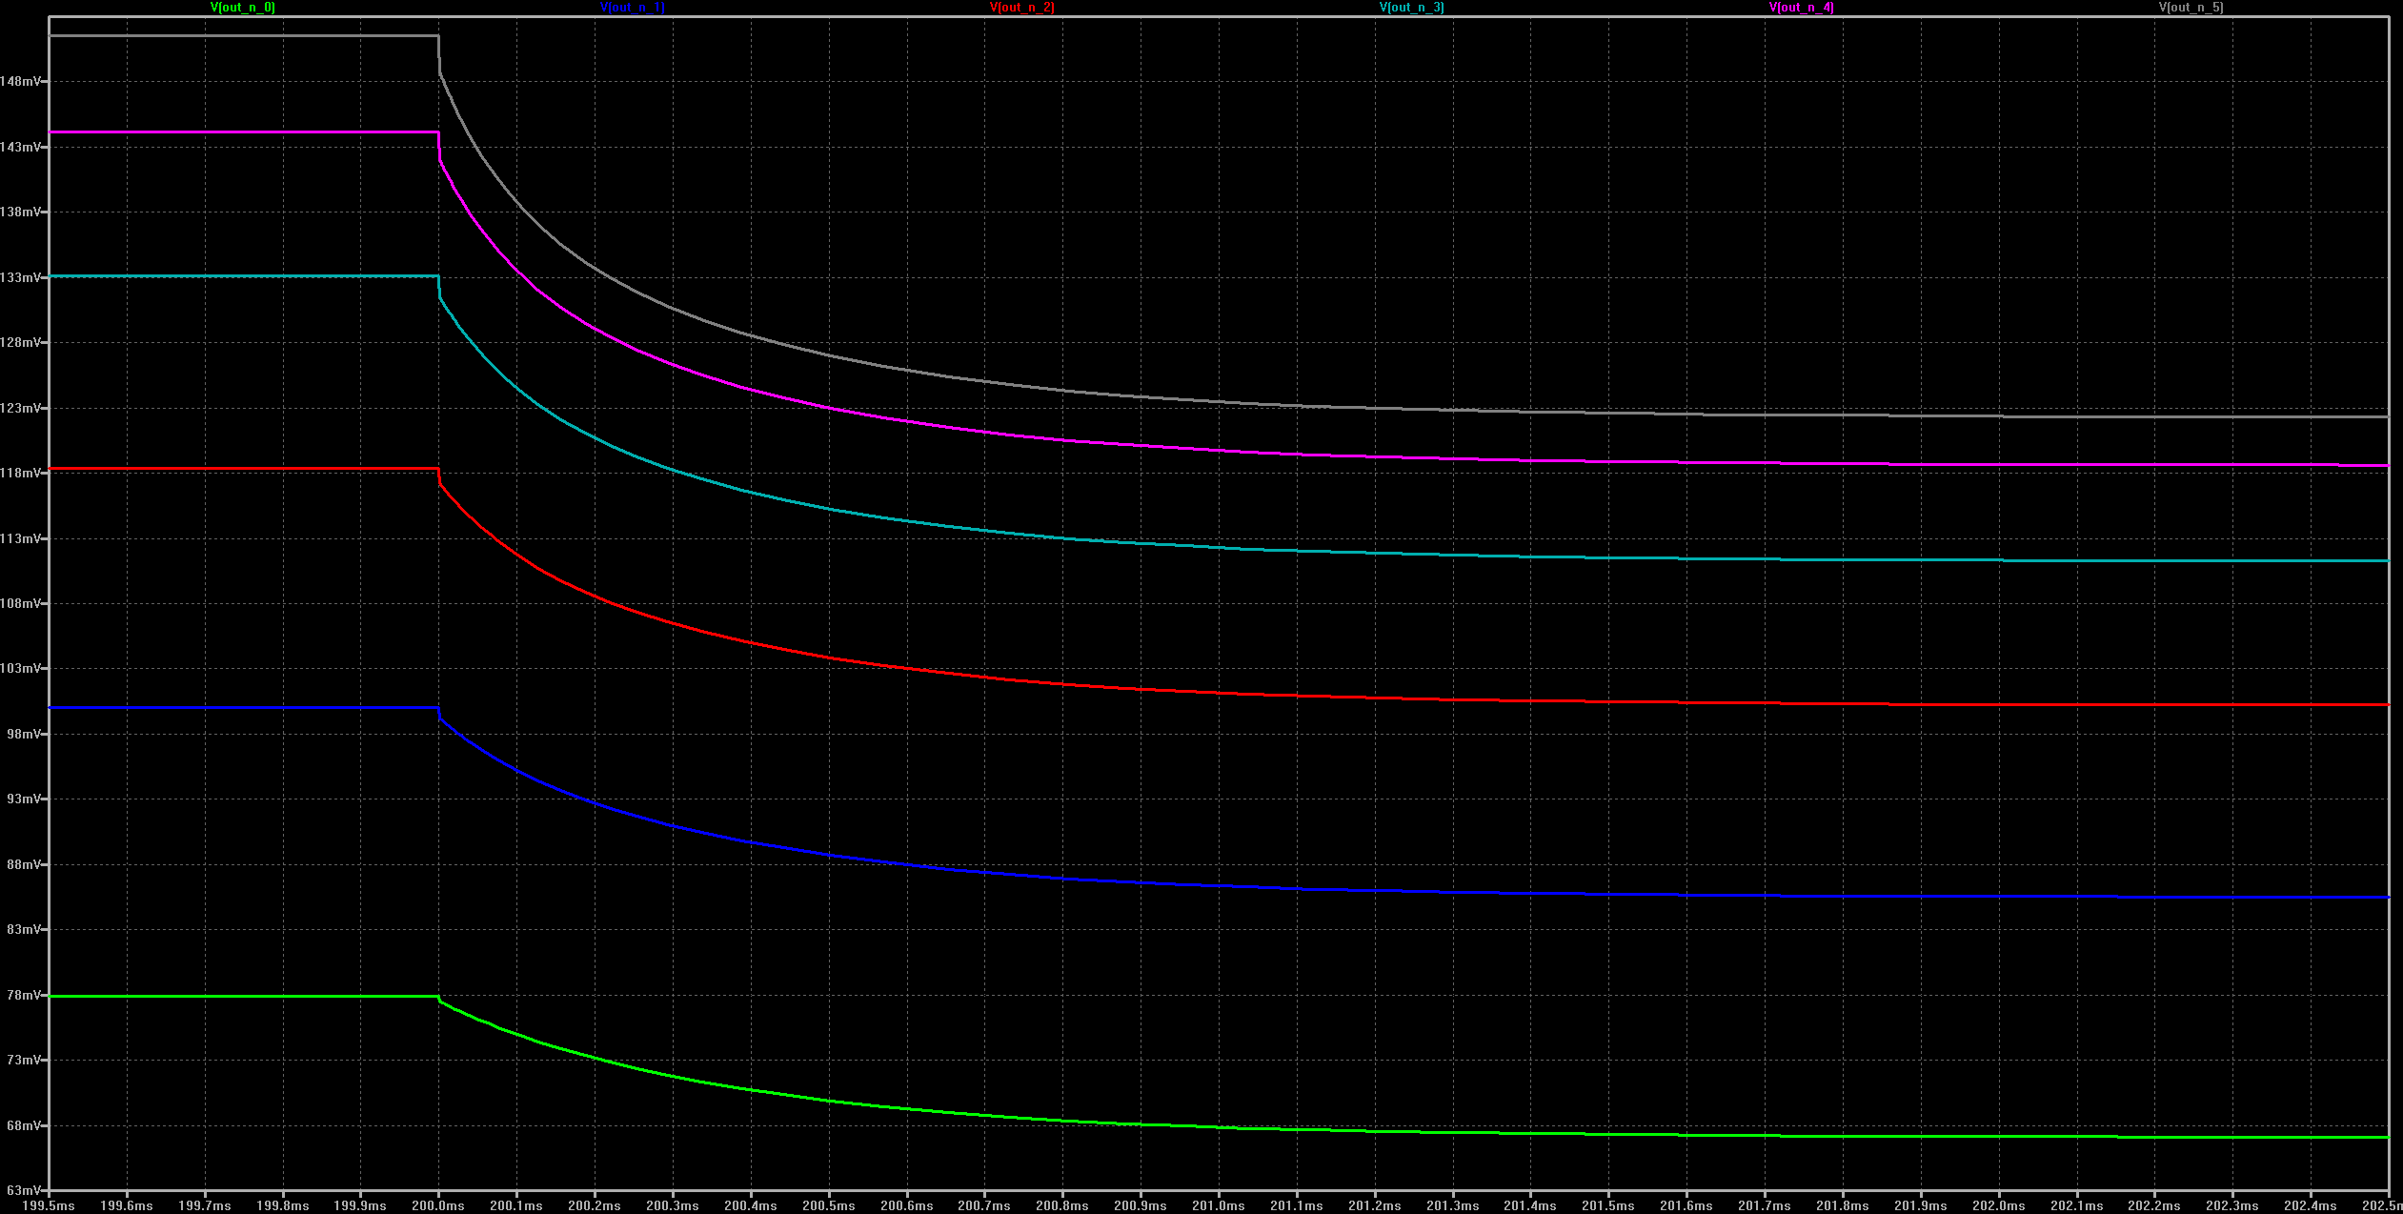
Time response in power bus return path
for module 7 loss of power in nominal operating conditions
(VDDD = 0.8A, VDDA = 0.18A in all modules)
Voltage at module
5 mV / division
Time
100 us / division

Slide 34
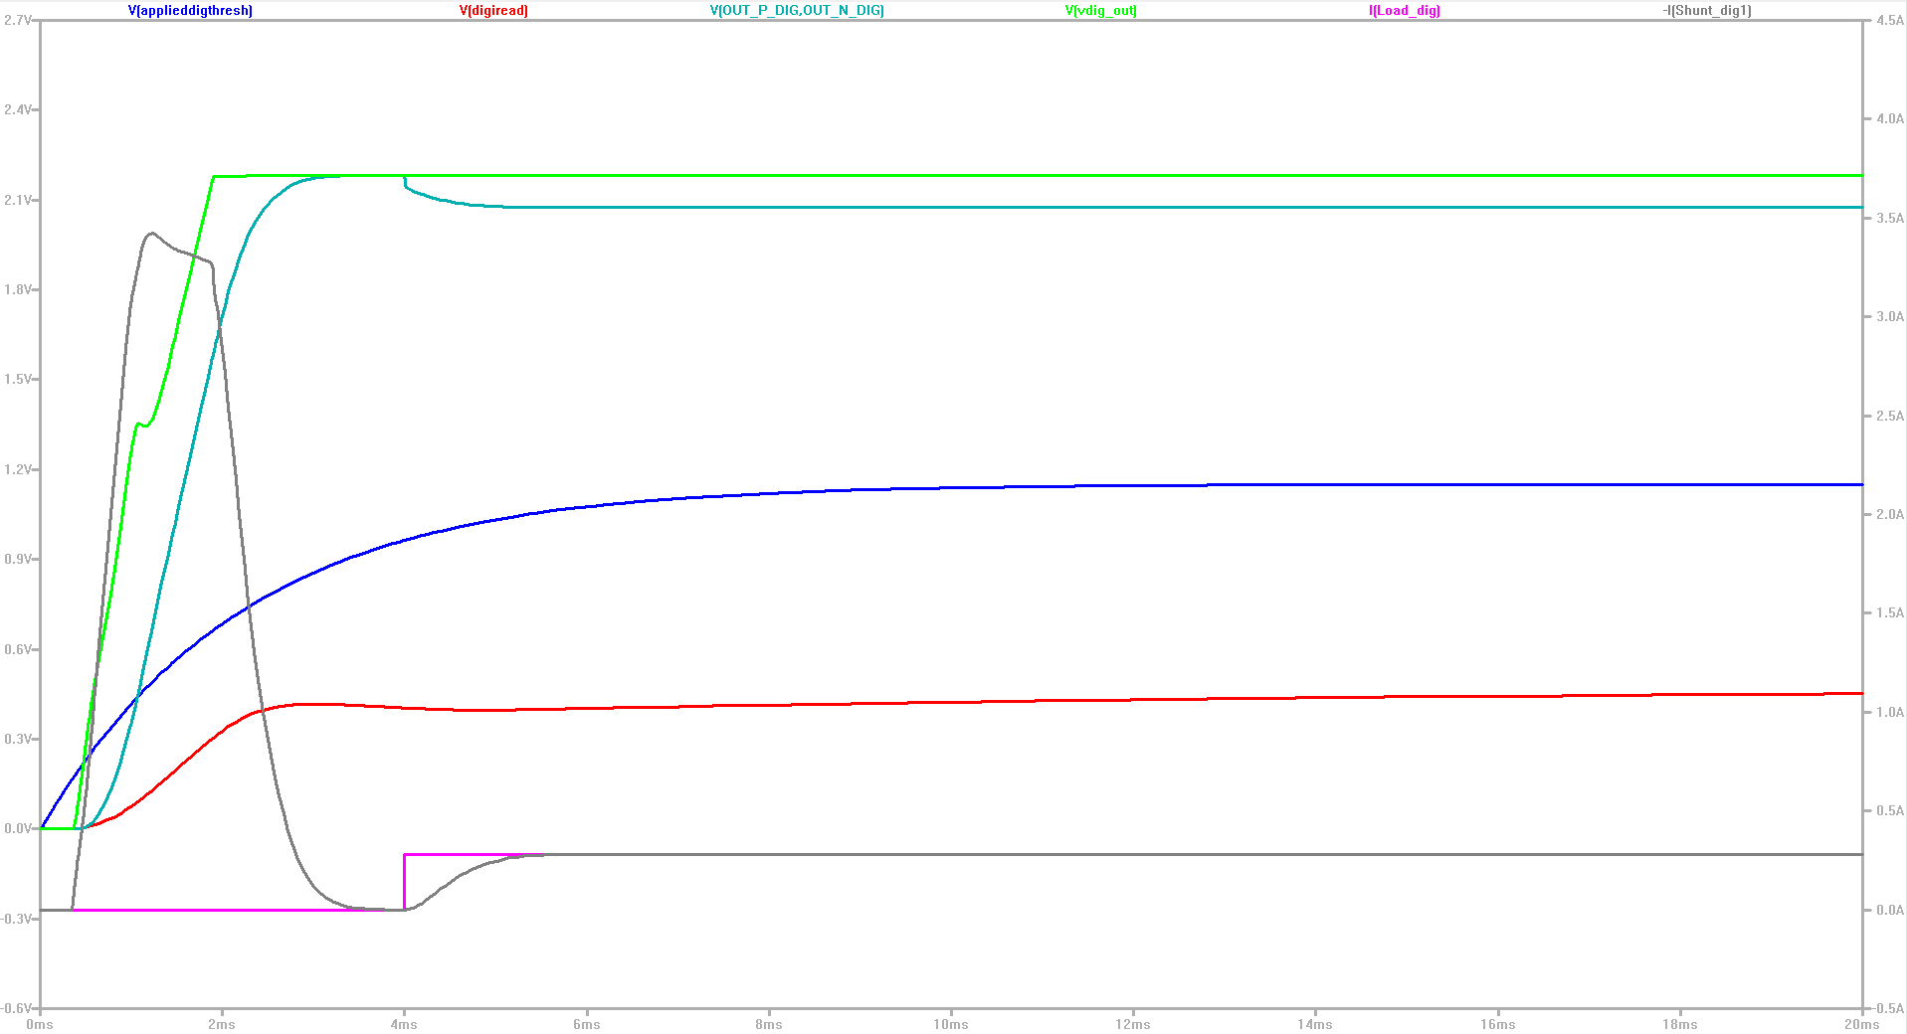
Current peak at the power enable

Slide 35
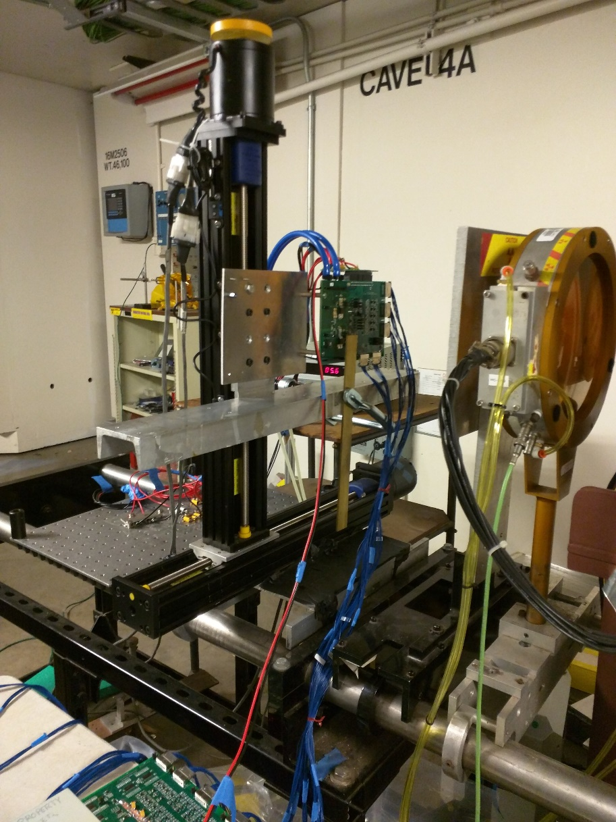
Full Power System Design (Component Testing)
DUT board
Resistor loads for regulators
ADC/RDO boards
Total dose testing at the BASE facility at LBNL 88” cyclotron for power system and RDO Unit components

Slide 36
Modularity of Power System
Middle Layers
½ stave
½ stave
½ PB
2 staves per PB
(full PB utilization)
½ stave
½ stave
½ PB
Outer Layers
½ stave
½ PB
1 staves per PB
(28/32 ch utilization)
½ stave
½ PB
Inner Layers
1 stave
½ PB
2 staves per PB
(4/32 ch utilization)
1 stave
½ PB

