Slide 1
OB Stave construction organization and workflow
Stefania Beolè and Silvia Coli - INFN & University Torino
ALICE ITS Upgrade
Stave Production Readiness Review
CERN, 27 April 2017

Slide 2
OUTLINE
Construction Organization and workflow
Preparation of the construction sites
Packaging and Shipping

Slide 3
Stave Production organization: components procurement
Pixel Chip Series Test
Yonsei, Pusan/Inha
FPC completion and test
INFN - Trieste
HIC Assembly and Test
(Apr ‘17 - Jun ‘18)
IB: CERN; OB: Bari, Liverpool, Pusan-Inha, Strasbourg, Wuhan
Stave Mechanics
CERN
Stave Assembly and Test
(Jun ‘17 - Sep ‘18)
IB: CERN; OB: Daresbury, Frascati, LBNL, NIKHEF, Turin
Power Bus
Kharkov
IB and OB Assembly and Commissioning
CERN

Slide 4
Assembly procedure – Workflow
The OB stave assembly procedure can be split into 2 separate main steps:
HS assembly and test
Stave assembly and test
The assembly workflow can be summarized as follows:
HS assembly:
HIC acceptance test, TAB and Wings cut,
validation test
HIC alignment and gluing on the CP
HIC to HIC interconnections
HS functional test
The next slides show how the production flow is scheduled, within the assumption of receiving a batch of 14 HICs + spares every 2 weeks.
The schedule foresees 5 days devoted to HS assembly and test followed by 5 days devoted to Stave assembly and test. If required by the schedule, it could be compressed such to start the construction of a new Stave on day 7.
Stave assembly:
HS_R alignment and gluing under SF
HS_L alignment and gluing under SF
Stave metrological survey
Power Bus Soldering
Stave functional test
Stave packaging and shipping

Slide 5
Assembly procedure – Timing
 |  | 8:00 | 9:00 | 10:00 | 11:00 | 12:00 | 13:00 | 14:00 | 15:00 | 16:00 | 17:00
DAY 1 | CMM |  |  |  |  |  |  |  | HS1 - HIC1 - HIC 7 ALIGNMENT AND POWERING TEST
 | HS TEST STATION
 | MOD TEST STATION |  |  | ACCEPTANCE TEST/TAB CUTTING
 | STAVE TEST STATION
DAY 2 | CMM |  | HS1 |  |  |  |  |  | HS2 - HIC1 - HIC 7 ALIGNMENT AND POWERING TEST
 | HS TEST STATION |  |  |  | HS 1 |  |  |  |  |  | HS1
 | MOD TEST STATION |  |  | ACCEPTANCE TEST/TAB CUTTING
 | STAVE TEST STATION
DAY 3 | CMM |  | HS2
 | HS TEST STATION | HS1
 | MOD TEST STATION
 | STAVE TEST STATION
DAY 4 | CMM |  |  |  |  |  |  |  |  | HS1 ALIGNMENT UNDER SPACE FRAME
 | HS TEST STATION |  |  |  | HS 2 |  |  |  |  |  | HS2
 | MOD TEST STATION
 | STAVE TEST STATION
DAY 5 | CMM |  |  |  |  | HS1
 | HS TEST STATION | HS2
 | MOD TEST STATION
 | STAVE TEST STATION
TAB CUT
GLUING
CURING
TEST
MOD. INTECONNECTION
MET. SURVEY
PB SOLDERING

Slide 6
Assembly procedure – Timing
 |  | 8:00 | 9:00 | 10:00 | 11:00 | 12:00 | 13:00 | 14:00 | 15:00 | 16:00 | 17:00
DAY 6 | CMM |  | HS1 | HS2 ALIGNMENT UNDER SPACE FRAME
 | HS TEST STATION
 | MOD TEST STATION
 | STAVE TEST STATION
DAY 7 | CMM | HS2 |  | STAVE METROLOGIC SURVAY
 | HS TEST STATION
 | MOD TEST STATION
 | STAVE TEST STATION |  |  |  |  |  | POWER BUS SOLDERING |  |  | STAVE TEST
DAY 8 | CMM
 | HS TEST STATION
 | MOD TEST STATION
 | STAVE TEST STATION | STAVE TEST
DAY 9 | CMM
 | HS TEST STATION
 | MOD TEST STATION
 | STAVE TEST STATION | STAVE TEST
DAY 10 | CMM
 | HS TEST STATION
 | MOD TEST STATION
 | STAVE TEST STATION |  |  |  |  |  |  |  |  |  | STAVE PACKAGING AND SHIPPING
TAB CUT
GLUING
CURING
TEST
MOD. INTECONNECTION
MET. SURVEY
PB SOLDERING

Slide 7
OB stave assembly – Construction site preparation
The OB stave assembly will take place in 5 sites:
Torino (IT): responsible for Stave assembly procedure and tooling development
Daresbury (UK): OL
LNF (IT): OL
NIKHEF (NL): OL
LBNL (USA): ML
Tooling for OL was designed by INFN Torino and produced by SEL srl (IT)
Tooling for ML was designed and produced at LPSC Grenoble (FR)
The full set of tools was sent to the OL sites and the laboratories are being prepared for the training phases and for the start of production
Tools for ML sites will be sent to LBNL within middle May. Planarity issues of HS bases were found, these tools are being machined by SEL srl to assure the necessary planarity

Slide 8
OB stave assembly – Laboratory readiness and team training
Verification of the laboratory readiness and extensive training of the teams involved in the construction is foreseen
Laboratory readiness: each site will organize a workshop which includes an “hands on session” as soon as the CMM and tools are installed and ready for production.
First workshop will be in LNF May 24-25th, Daresbury, Nikhef and LBNL will follow. Schedule will be defined in the next weeks
Team training: 2 kind of training are foreseen
- assembly tools and procedures: divided in 3 phases
- test procedures: based on single chip and HIC test set-up

Slide 9
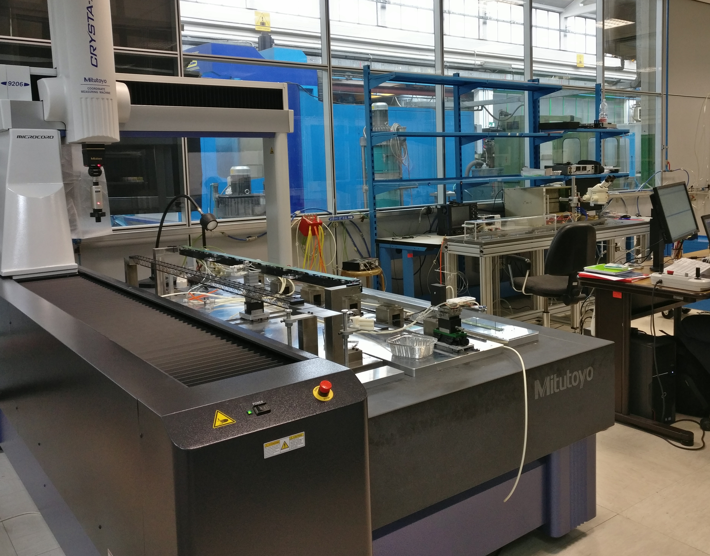
OB stave assembly – Torino (IT)
The Torino site was equipped with prototype tools and contributed to the development of tools and procedures and to the production of Dummy Staves for mechanical tests and the Stave 0
Status of the laboratory: READY FOR PRODUCTION
Training on assembly procedures: DONE
Training on test procedures: DONE
Clean Room space optimized
Plants:
Vacuum
Compressed air
Mitutoyo Crysta Apex S 9206: operational
All jigs installed and ready

Slide 10
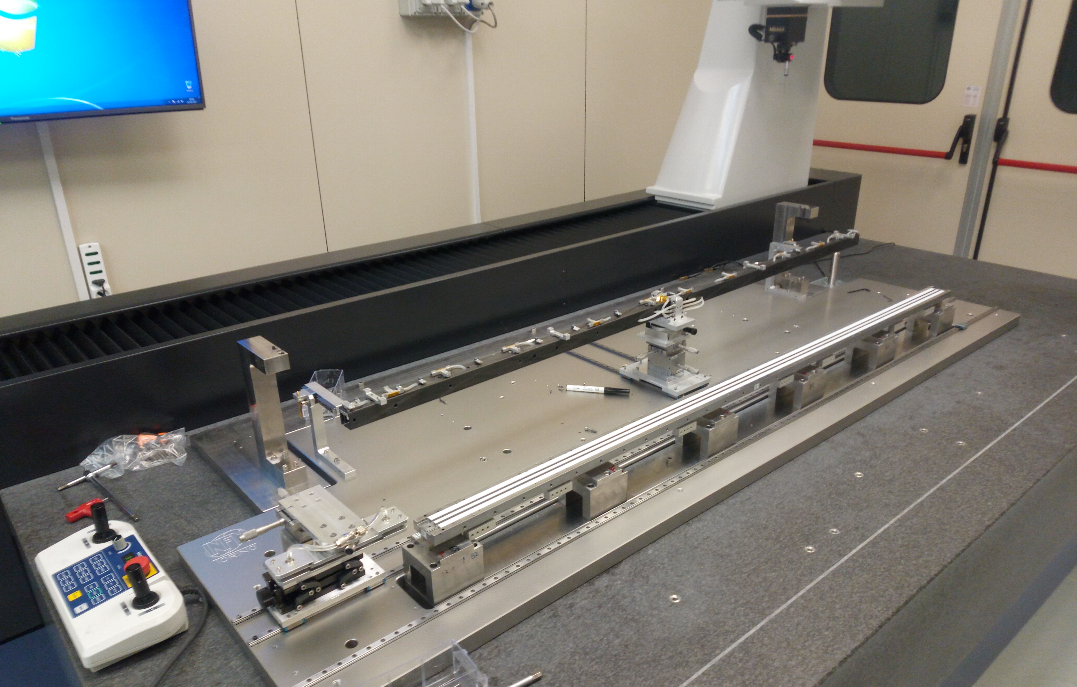
OB stave assembly – LNF (IT)
The LNF site was equipped with prototype tools and contributed to the validation of tools and procedures and to the production of Dummy Staves for mechanical tests
Status of the laboratory: READY FOR PRODUCTION
Training on assembly procedures: DONE
Training on test procedures: ONGOING
Clean Room space optimized
Plants:
Vacuum
Compressed air
Mitutoyo Crysta Apex S 9206: operational on Atlas GA5FF
Final jig installed and ready
Custom HS soldering table under construction
Grey area (used ALPIDE single chip tests) is being prepared for Stave operations (PB soldering and tests)

Slide 11
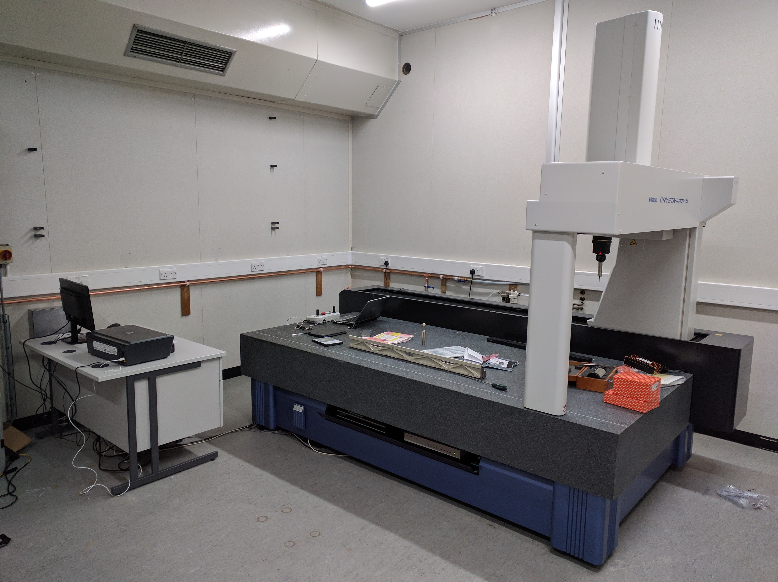
OB stave assembly – Daresbury (UK)
Status of the laboratory: ALMOST READY
Training on assembly procedures: TO BE DONE
Training on test procedures: TO BE DONE
New Clean Room available
Plants:
Vacuum
Compressed air
Mitutoyo Crysta Apex S 9206: delivered and being commissioned
Tools will be installed in the next 2 weeks

Slide 12
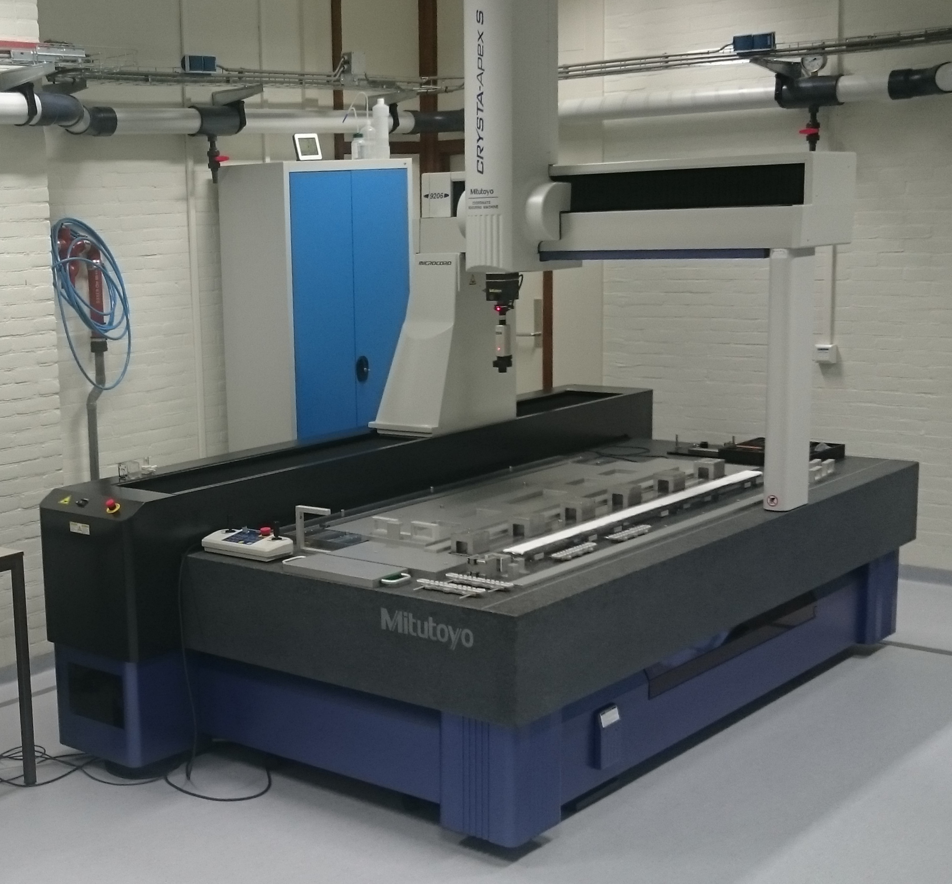
OB stave assembly – NIKHEF (NL)
Status of the laboratory: READY FOR PRODUCTION
Training on assembly procedures: ONGOING
Training on test procedures: to be done
Clean room ready
Mitutoyo Crysta Apex S 9206 operational
Plants:
Vacuum
N2
Compressed air
Glue dispenser
Tables for additional stations: To be done
Soldering station
Gluing station
Test station
Stave assembly tools received
Ready for training session

Slide 13
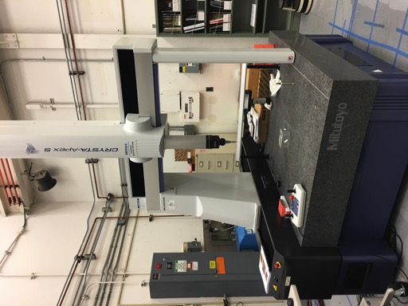
OB stave assembly – LBNL (USA)
Status of the laboratory: ALMOST READY
Training on assembly procedures: TO BE DONE
Training on test procedures: TO BE DONE
Clean room being prepared
Mitutoyo Crysta Apex operational
Stave assembly tools being revised at SEL
ready for training on site early summer

Slide 14
OB stave assembly – Assembly training program
Teams training is divided into 3 phases
Phase 1: WHERE: Torino, DURATION: 5 days, CREW: Torino+ construction site
tooling description
gluing procedure
CMM programs description and test
Phase 2: WHERE: each site, DURATION: 3-4 days, CREW: Torino+ construction site
CMM program migration annd validation
module alignment test
HS to SF alignment test (with bare CP)
Phase 3: WHERE: each site, DURATION: 4 weeks, CREW: construction site
gluing test
FPC-FPC interconnection tests using test structures
dummy module alignment and gluing to dummy CP
realistic dummy modules alignment and gluing to real CP + metrology
FPC-FPC interconnection
HS alignment and gluing to SF
stave final metrology

Slide 15
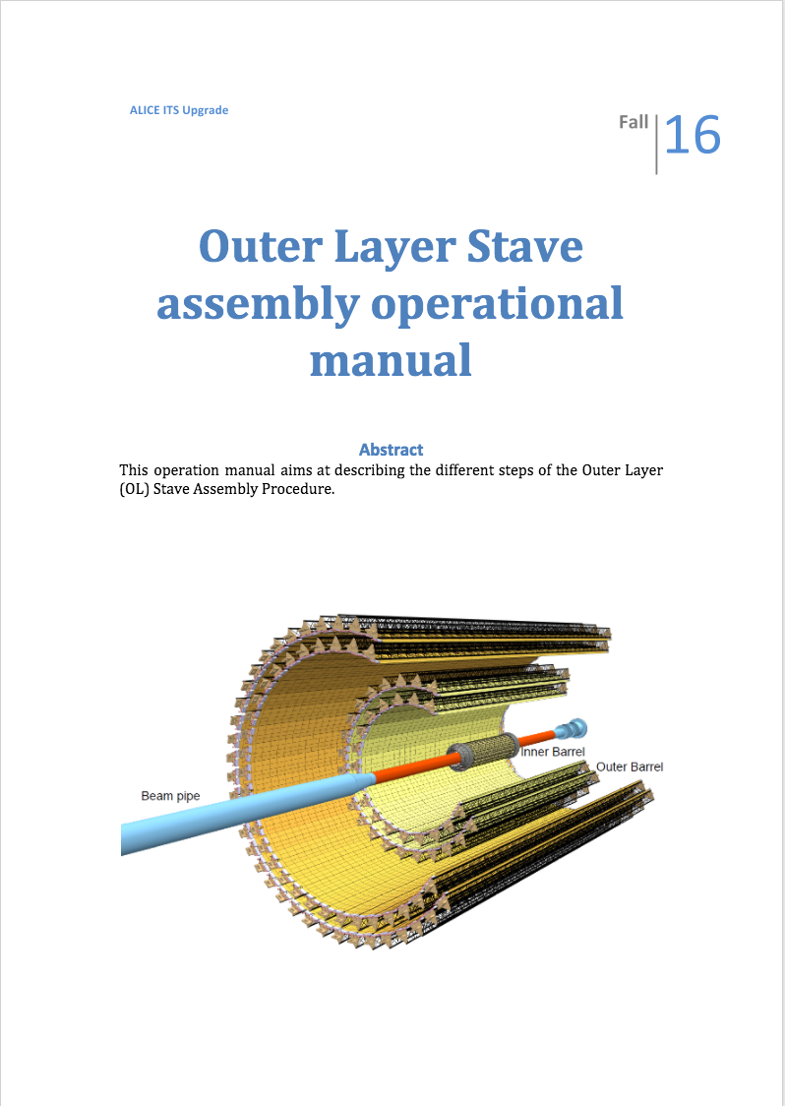
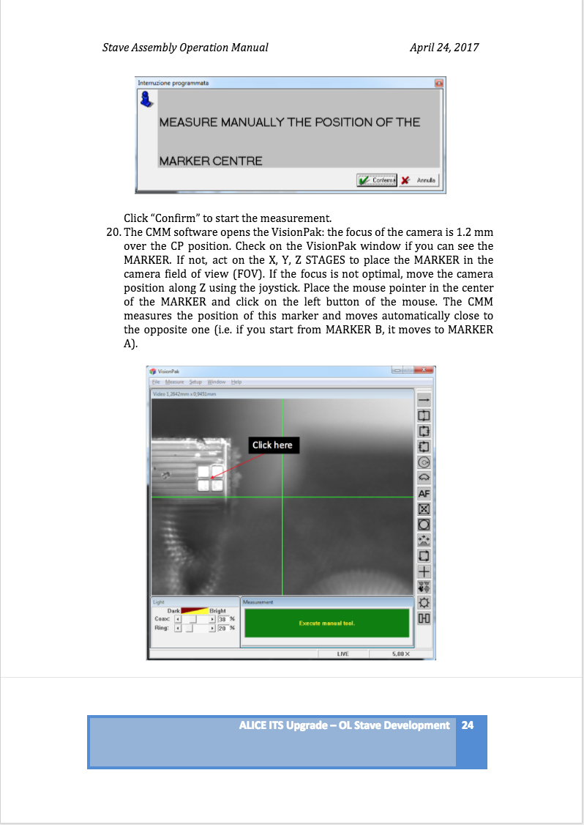
OB stave assembly – Assembly operation manual

Slide 16
OB stave assembly – Assembly training timetable
Draft schedule of training plan
LABORATORY | training | site | DATE
NIKHEF | phase 1 | TURIN | Done
 | phase 2 | Amsterdam | May 27
 | phase 3 |  | June
LBNL | phase 1 | TURIN+LNF | May 15-26
 | phase 2 | Berkeley | June 26
 | phase 3 |  | July
DARESBURY | phase 1 | TURIN+LNF | June 5
 | phase 2 | Daresbury | June 12
 | phase 3 |  | June-July

Slide 17
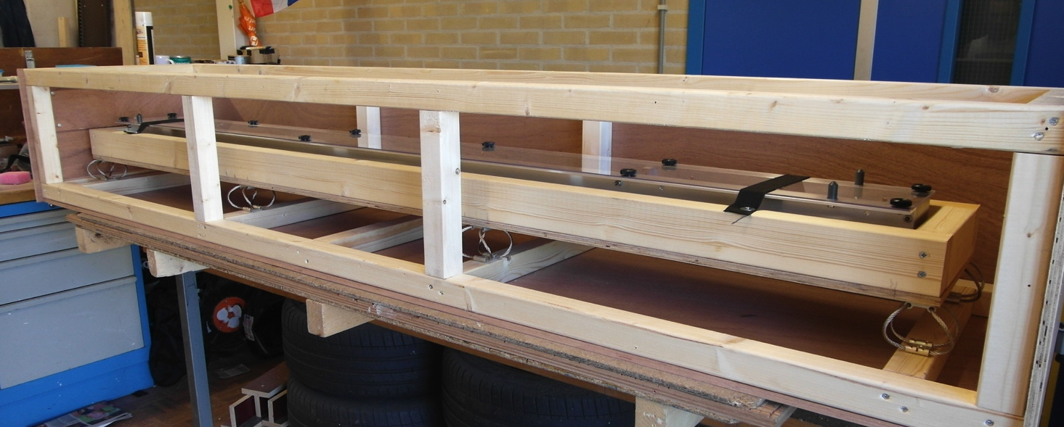
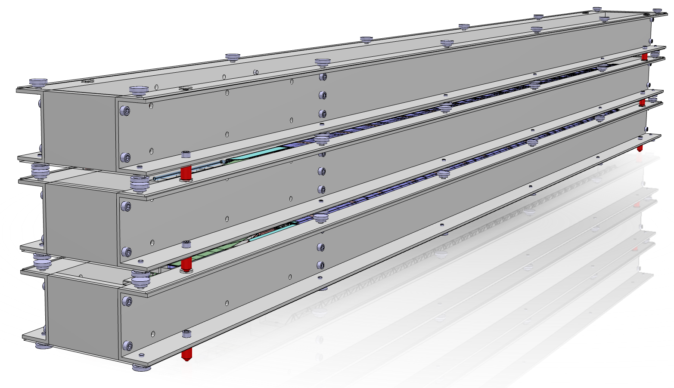
OB stave assembly – Stave transport and shipping
Prototype of Stave Transport Box was designed and produced:
Shock absorption: Wire ropes
Recommended cut off frequency ~10 Hz
Storage/transport box enclosed in plastic bag
with Nitrogen
Shipping:
CONTINENTAL EUROPE: staves will be transported from construction sites to CERN using laboratories cars/trucks
UK: staves will be transported from Daresbury to CERN either using laboratory owned cars/trucks or by commercial carriers
USA: staves will be transported from LBNL to CERN by commercial carriers
The Stave Development working group is evaluating different companies for the shipment.

Slide 18
Summary
The OB Stave Assembly workflow was outlined: 10 working days are needed to complete the construction and validation of a Stave
5 Laboratories are being prepared for production
Training of teams on different activities is ongoing. Training plan will be completed by end of July
Stave transport box was designed and prototypes are available. Different shipment methods are being evaluated. A first test is foreseen after Stave 0 validation

