Slide 1

ALICE
OB FPC
PRR – 27 April 2017

Slide 2
OUTLINE
Layout: changes wrt EDR
  Tab extension
  Vias for wire bonds
  New connection for BB
Prototype production
  Metrology
  Data transmission
  Soldering
Tendering and production
  Tender procedure
  Components mounting
  Cross cables
  Quality assurance
Shipment to assembly sites

Slide 3
layout details

Slide 4
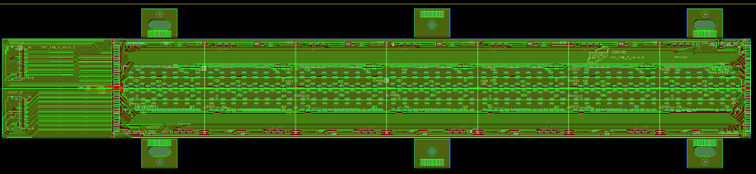
OB FPC : OVERALL VIEW
Wings for alignment
width: 33 mm
TAB: 37 mm
length: 210.9 mm
Length: 210.9 mm width: 33 mm
WINGS with precise holes for alignment during HIC assembly:
TAB for test purpose (cut after tests)
TOP LAYER:DIGITAL AND ANALOG power planes
BOTTOM LAYER: GND PLANES
Back Bias voltage supply line
2 rows of 7 chips
  each row: 1 master + 6 slaves
MASTER-SLAVE COMMUNICATION
  internal single ended data bus for
    data: 4 lines
    ctrl: 1 line
    busy: 1 line
  internal differential CLK line
CTRL and CLK lines from end of stave to MASTER chip
14 DIFFERENTIAL DATA lines

Slide 5
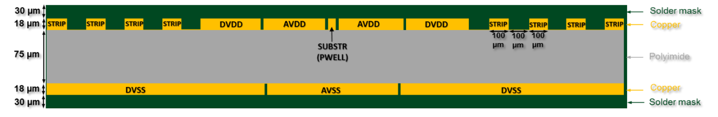
STACK-UP of the OB-FPC
18 μm
18 μm
75 μm
18 μm
18 μm
Copper (top, bottom) thickness: 18 μm
Substrate (dielectric) thickness: 75 μm
Soldermask (top, bottom) thickness: 18 μm
MATERIALS:
Substrate (dielectric) type: Pyralux AP8535R by Dupont (double-sided, copper-clad laminate, Cu thickness 18 um, polyimide core 75 um)
Finishing: ENIG (Ni layer: 3-5 um Au layer: of 60-100 nm)

Slide 6
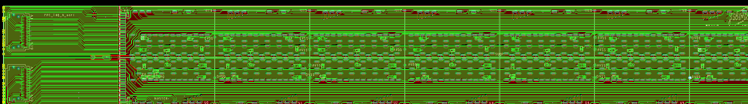
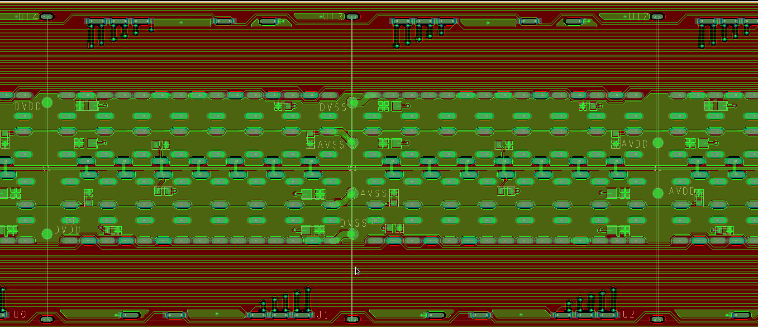
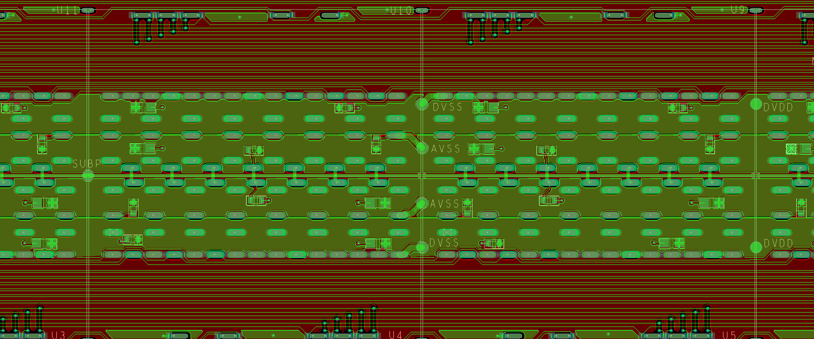
Cross cables for connection to PB
y
0;0
DVDD
GND
AVDD
x
BB
GND
DVDD
CC type A:
DVDD-GND- AVDD
5 per module
CC type B:
Back-bias
1 per module

Slide 7
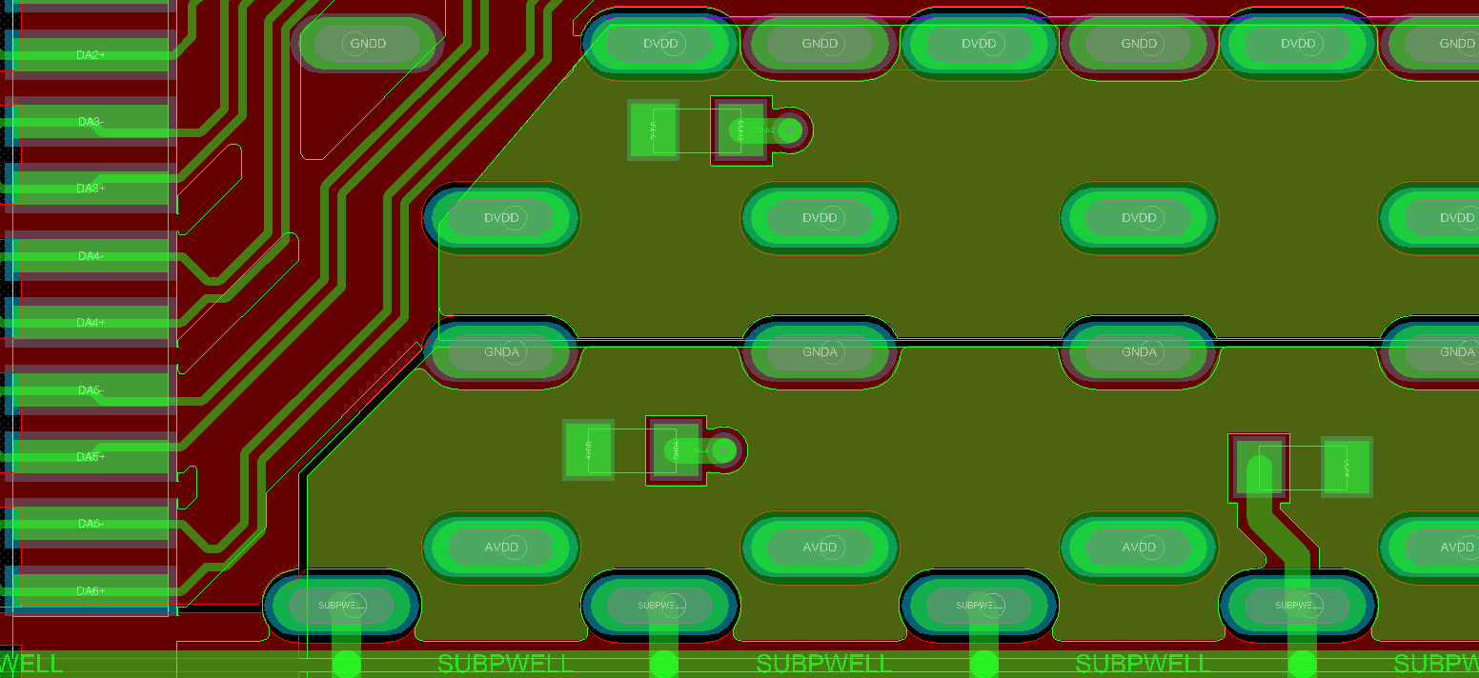
decoupling capacitors
on DVDD
0402 dec. capacitor
on AVDD
on SUBPWELL
SMD 0402 on all the chips (up to 22 μF each)
  AVDD and DVDD: 2 SMD 0402
  SUB/PWELL: 1 SMD vs AVDD and 1 SMD VS AVSS

Slide 8
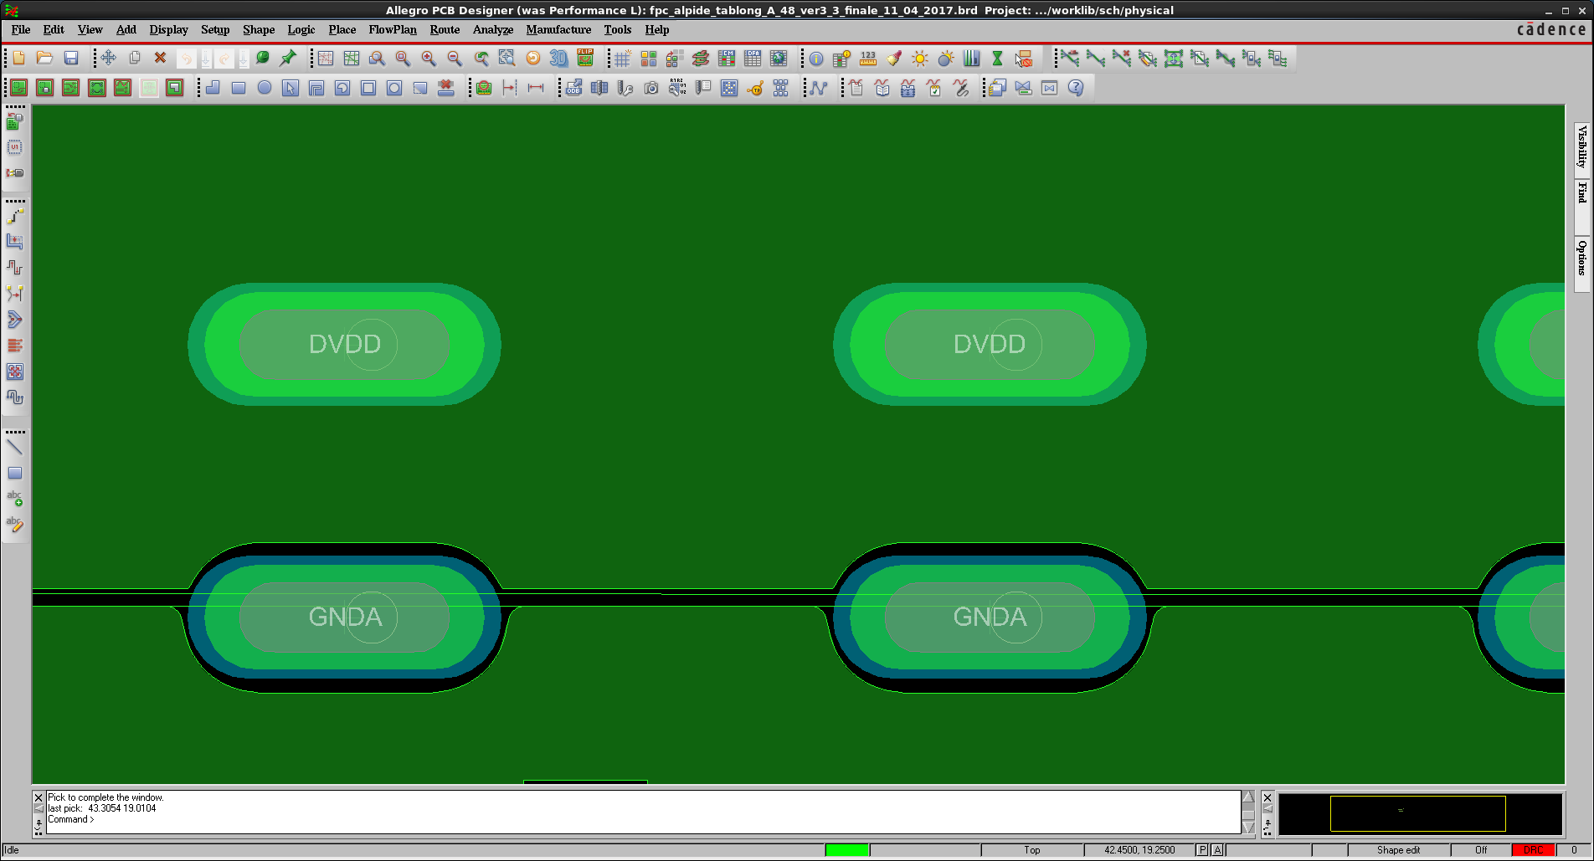
vias optimized for WIRE bonding
1600 µm
1600 µm
700 µm
400 µm
600 µm
700 µm
400 µm
600 µm
100 µm
100 µm
200
µm
200
µm
100 µm
200
µm
200
µm
100 µm
1200 µm
1200 µm
Example of via for power
Example of via for ground
oblong symmetric shapes
  hole 400x1200 μm²
  metallized crown 600x1600 μm²
  Soldermask opening: 700x1800 μm²
  bonding area: 200 μm

Slide 9
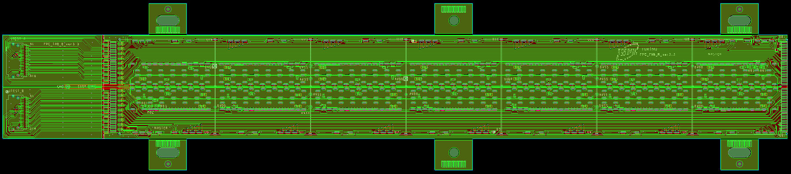
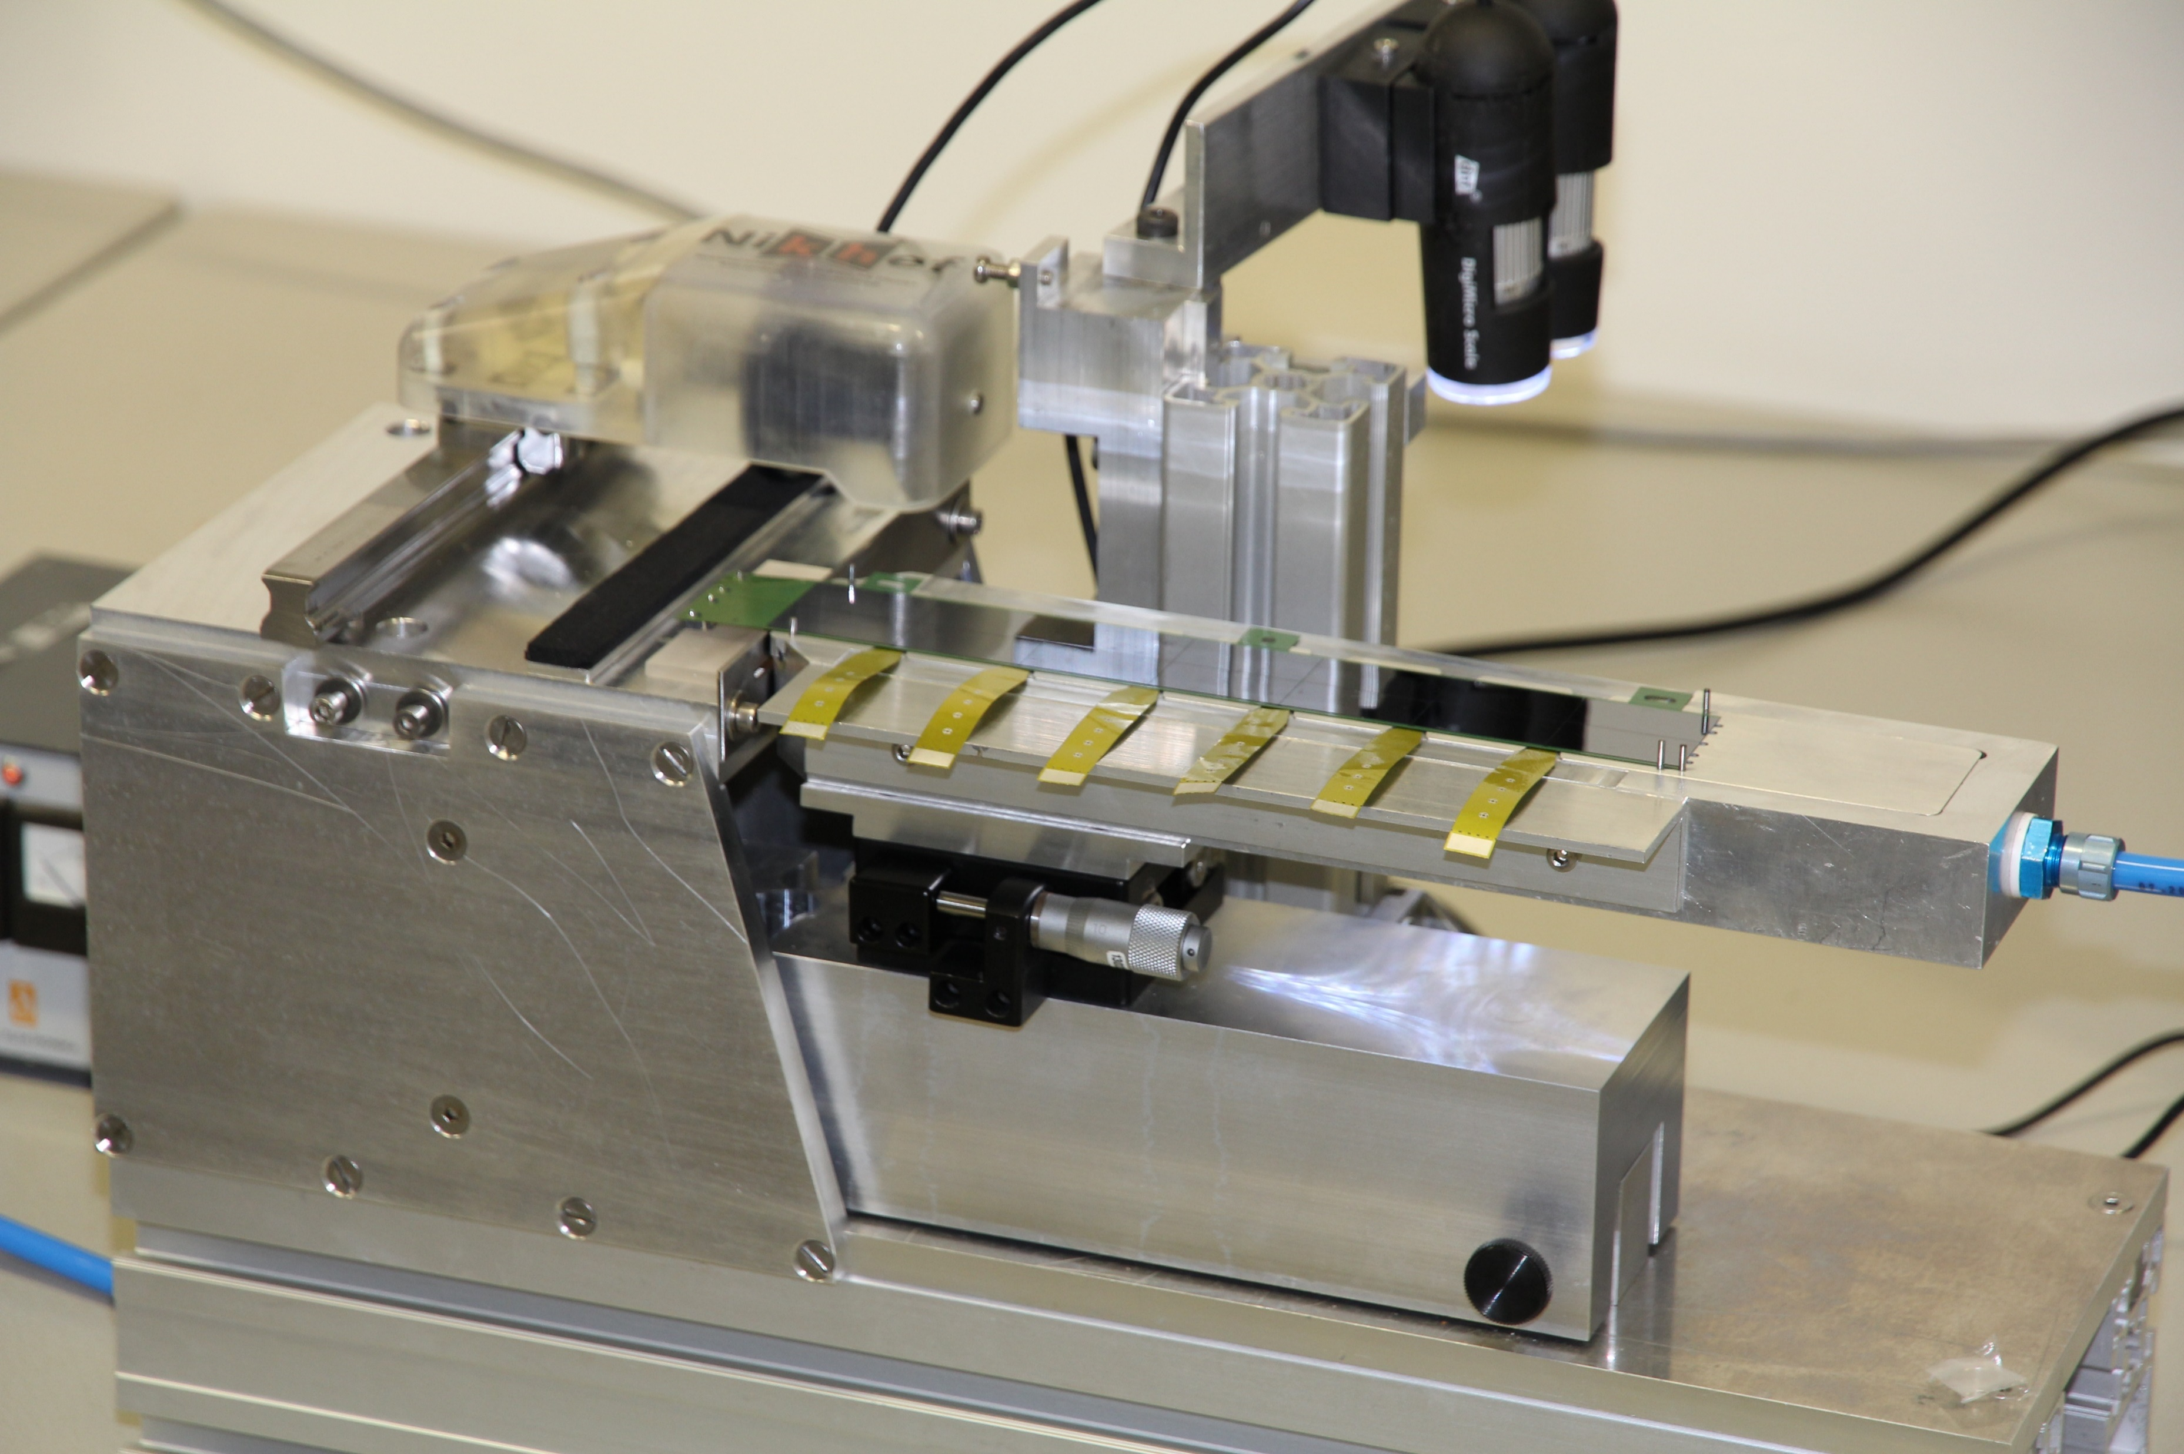
FPC TYPE A – TYPE B
TAB cut line
Wings for alignment
TYPE A
width: 33 mm
TAB: 37 mm
length: 210.9 mm
TAB cut line
Wings for alignment
TYPE B
width: 33 mm
TAB: 31.9 mm
length: 216 mm
Version with TAB has been designed and produced
TYPE B is for the first module of the Half-Stave (HS)
TAB needs to be removed after test before module assembly on HS
TAB cutting procedure developed: more details in “OB HIC test” presentation

Slide 10
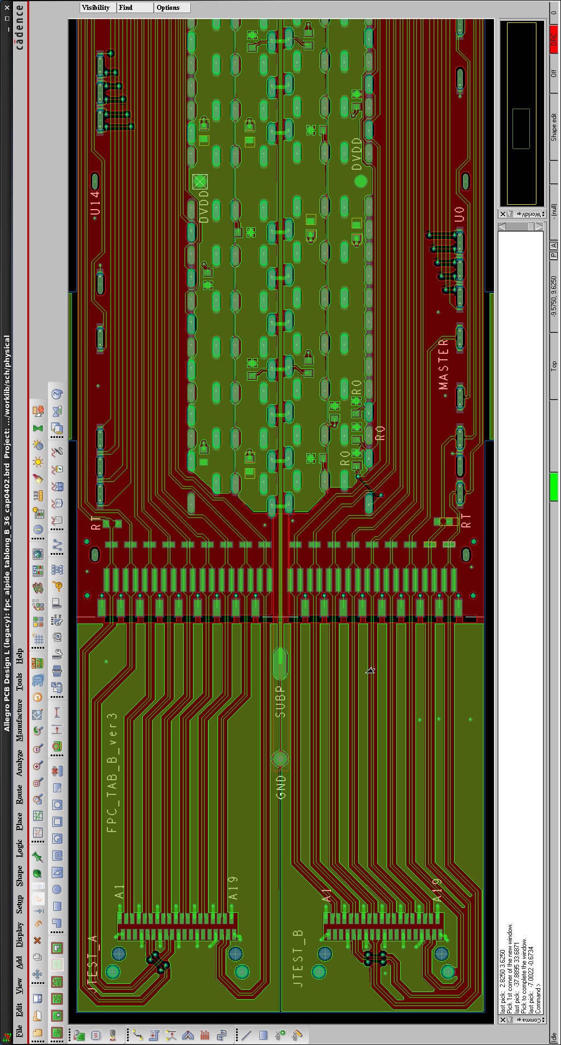
FPC TYPE B
A dedicated version of the FPC was necessary for the first module of the Half-Stave to allow reliable and safe connection to the external electronics.
→ The FPC for the first module of the Half-Stave was extended by a few mm.

Slide 11
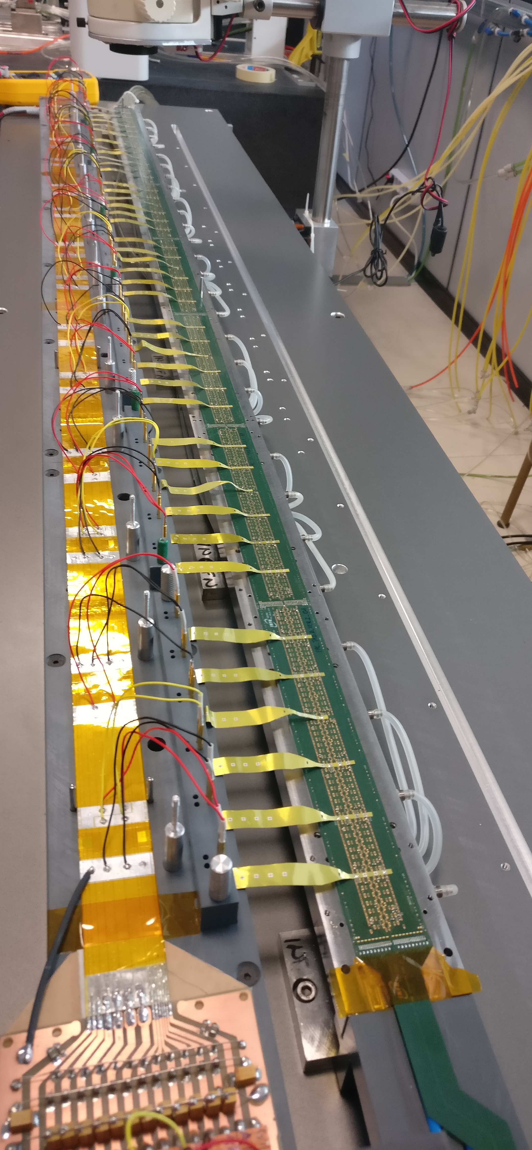
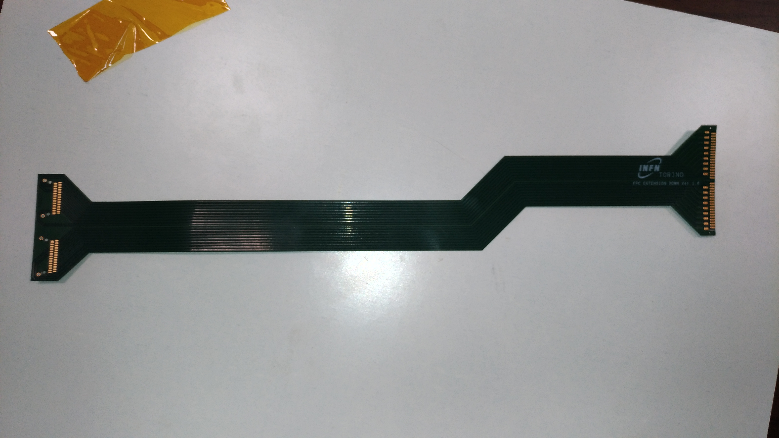
FPC extension
Pads for connection with TAB B FPC
Pads for the connector
Second column for data, clk, ctrl transmission
Second column for ground transmission
The extension is needed to transmit data, clock and control to/from the external electronics
One extension for each HS
At the end, 2 Firefly connectors are soldered
288 extensions + spares needed
Estimated cost:30KEu; no tendering needed
Prototypes designed and produced (SwissPCB)
External electronics

Slide 12
FPC PROCUREMENT

Slide 13
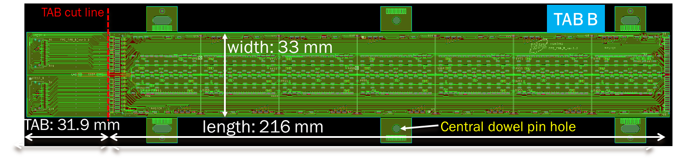

TECHNICAL SPECIFICATIONS
Distance between the centre of the central dowel pin hole and | Required tolerances (mm)
Right edge | ±25
upper and lower edges | ±25
Holes center | ±50
Pads center (all pads types) | ±50
List of main dimensional requirements
Central dowel pin hole diameter: | -0,+20
Oblong holes/vias (major and minor axis) | ±50
Strips width, distance | ±10
Cu thickness Surface (solder mask) flatness | ±2 ±5
Central dowel pin hole

Slide 14
FPC prototypes characterization
Companies pre-selection result of a long R&D with several companies.
Main industrial challenges faced:
Dimensional tolerances of structures and circuit
Tolerance on position of FPC edges and structures wrt reference dowel pin hole ~0.2‰
Surface (soldermask) flatness: ±5μm (crucial for proper and safe HIC gripping)
Copper thickness tolerance: (18±2) μm
Improvements with all companies; SwissPCB only company to fulfil all requirements (special procedure for guaranteeing uniform soldermask thickness)

Slide 15
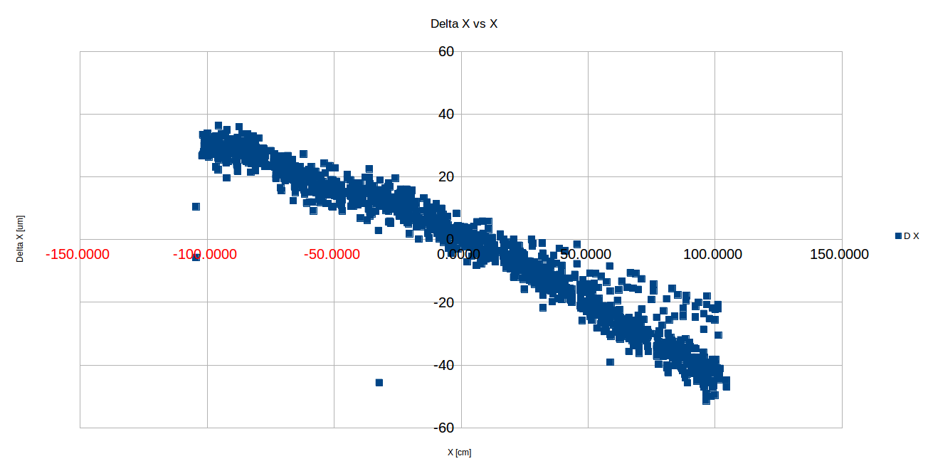
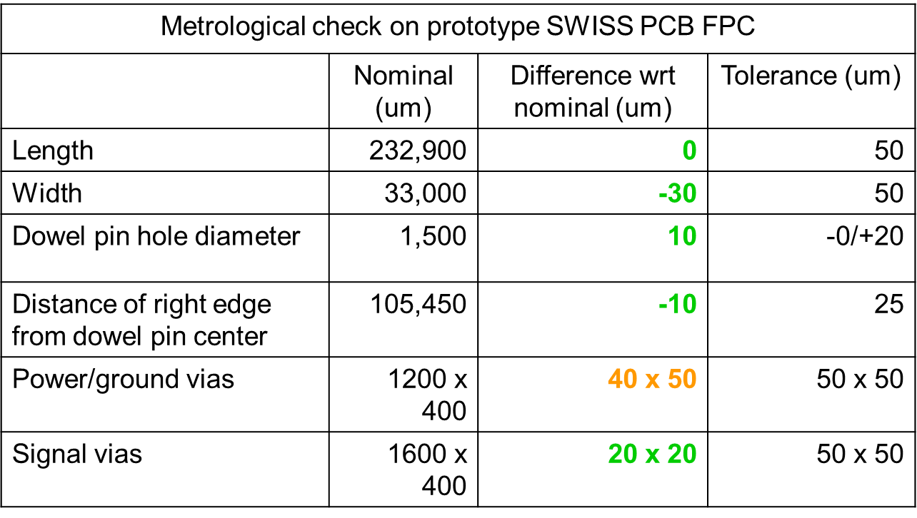
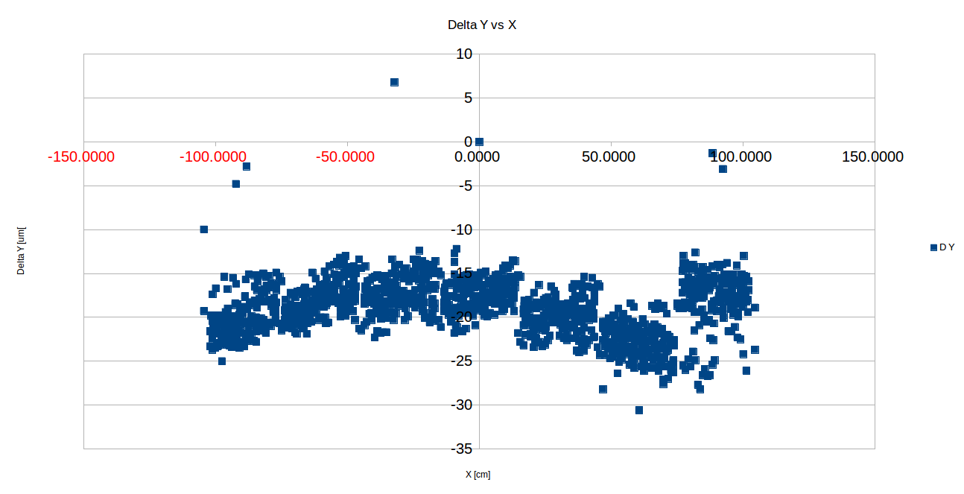

FPC prototypes characterization-SOME EXAMPLES
Metrological tests (by Modus97 company) of all structures of a (SwissPCB) prototype FPC
X
Measurement of some critical dimensions of a (S.PCB) prototype FPC
Holes Position relative to alignment hole
→X maximum deviation from nominal position = (-40,+50) μm [tol.:± 50μm]
→ Y maximum deviation from nominal position = (-10,+25) μm [tol.:± 50μm]
Y

Slide 16
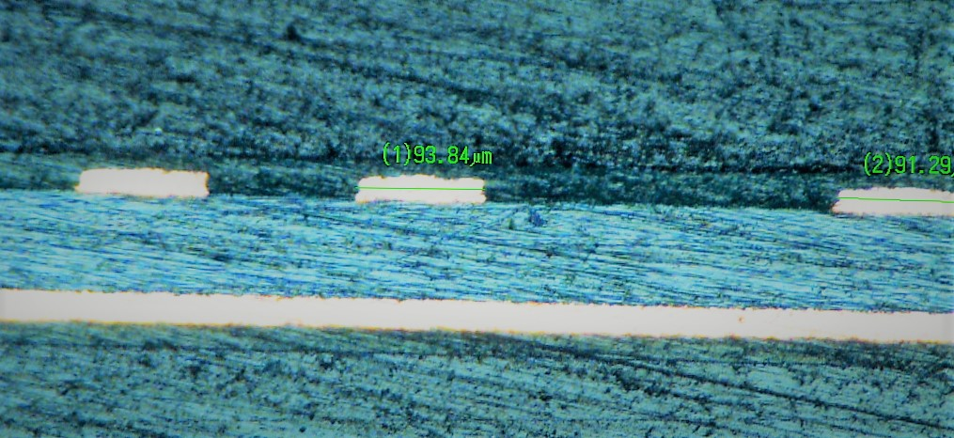
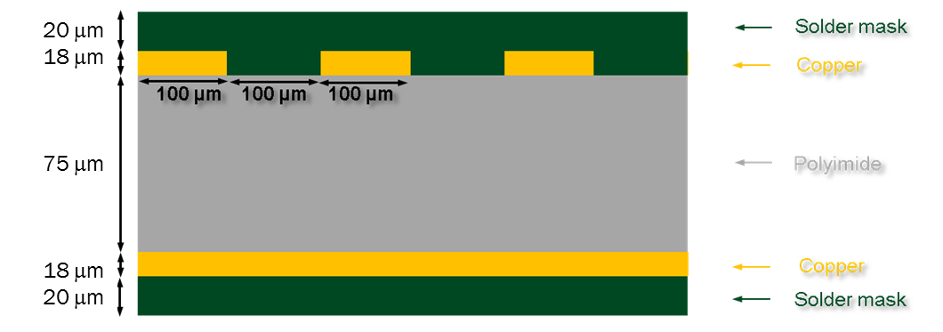
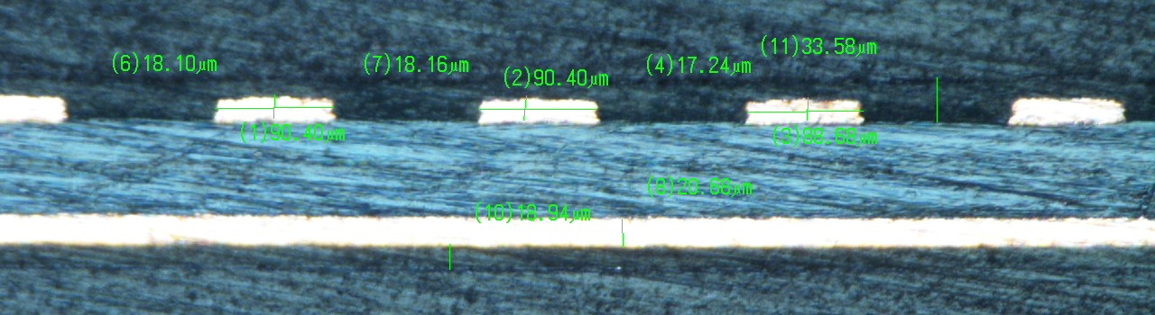
FPC prototypes characterization
Encapsulating epoxy
Solder mask thickness guarantees good planarity also in regions around strips
Soldermask →
Cu
Cu
←Soldermask →
polyamide →
Polyamide
Cu →
Cu
Soldermask →
←Soldermask →
Encapsulating epoxy
18 μm
18 μm
75 μm
18 μm
18 μm
Micro-sections of a prototype fpc (by Swiss-pcb) and reference stack up for the prototype

Slide 17
FPC prototypes characterization
Encapsulating epoxy
Solder mask thickness guarantees good planarity also in regions around strips
Soldermask →
Cu
Cu
←Soldermask →
polyamide →
Polyamide
Cu →
Cu
Soldermask →
←Soldermask →
Encapsulating epoxy
18 μm
18 μm
75 μm
18 μm
18 μm
Micro-sections of a prototype fpc (by Swiss-pcb) and reference stack up for the prototype

Slide 18
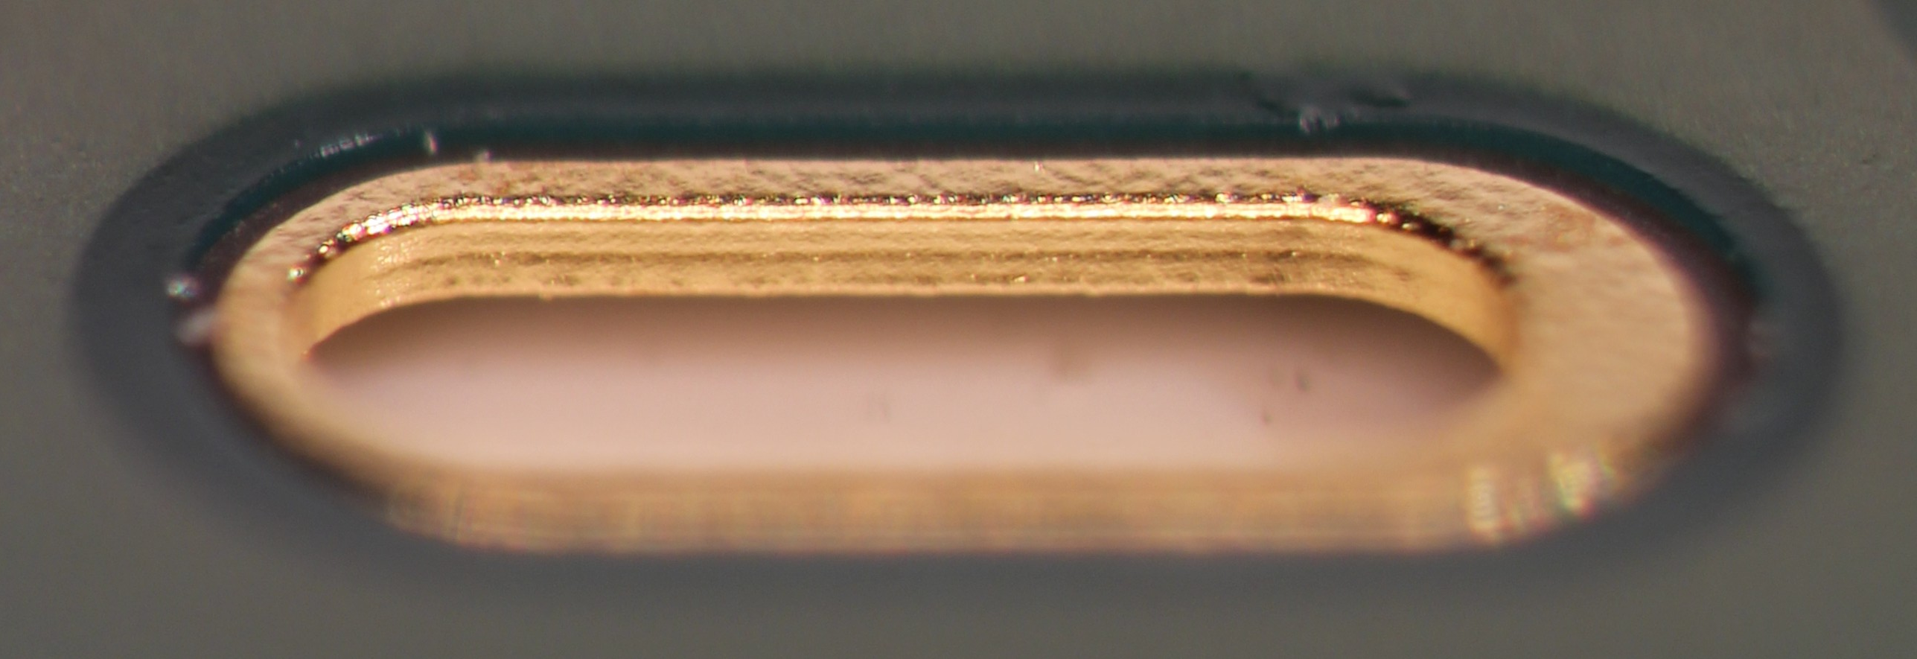
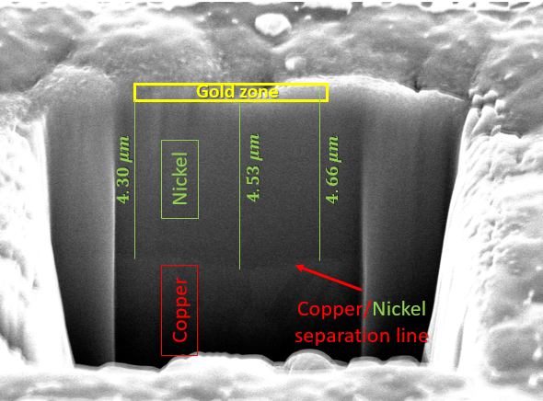

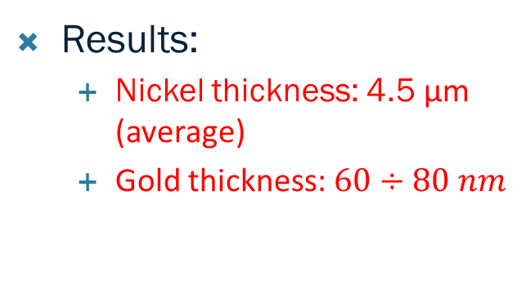
FPC Metallization quality (2)
Pad plating: Electroless Nickel Immersion Gold (ENIG)
Focused Ion Beam (FIB) (30 keV gallium ions) measurement to
  Measure the thicknesses of the pad/via finishing
Finishing layer thicknesses expected (above copper):
    6 μm of Nickel
    100 nm of Gold
Via metallization
Gold on vias
ZOOM
73nm
Results:
  Nickel thickness: 4.5 μm (average)
  Gold thickness: $60÷80 nm$

Slide 19
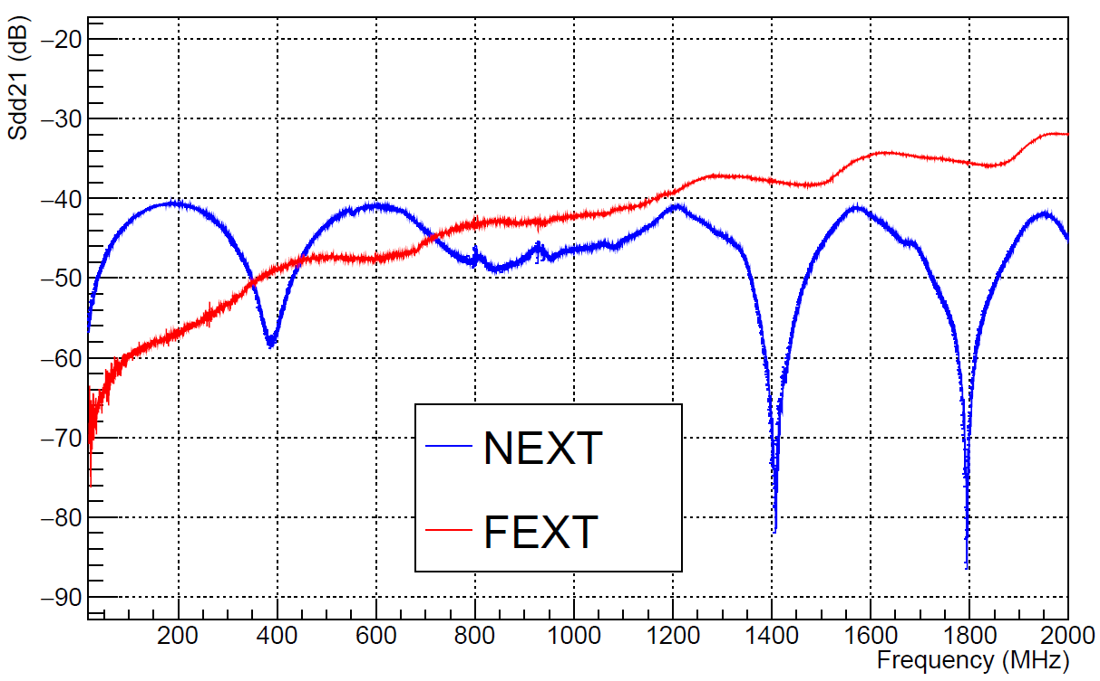
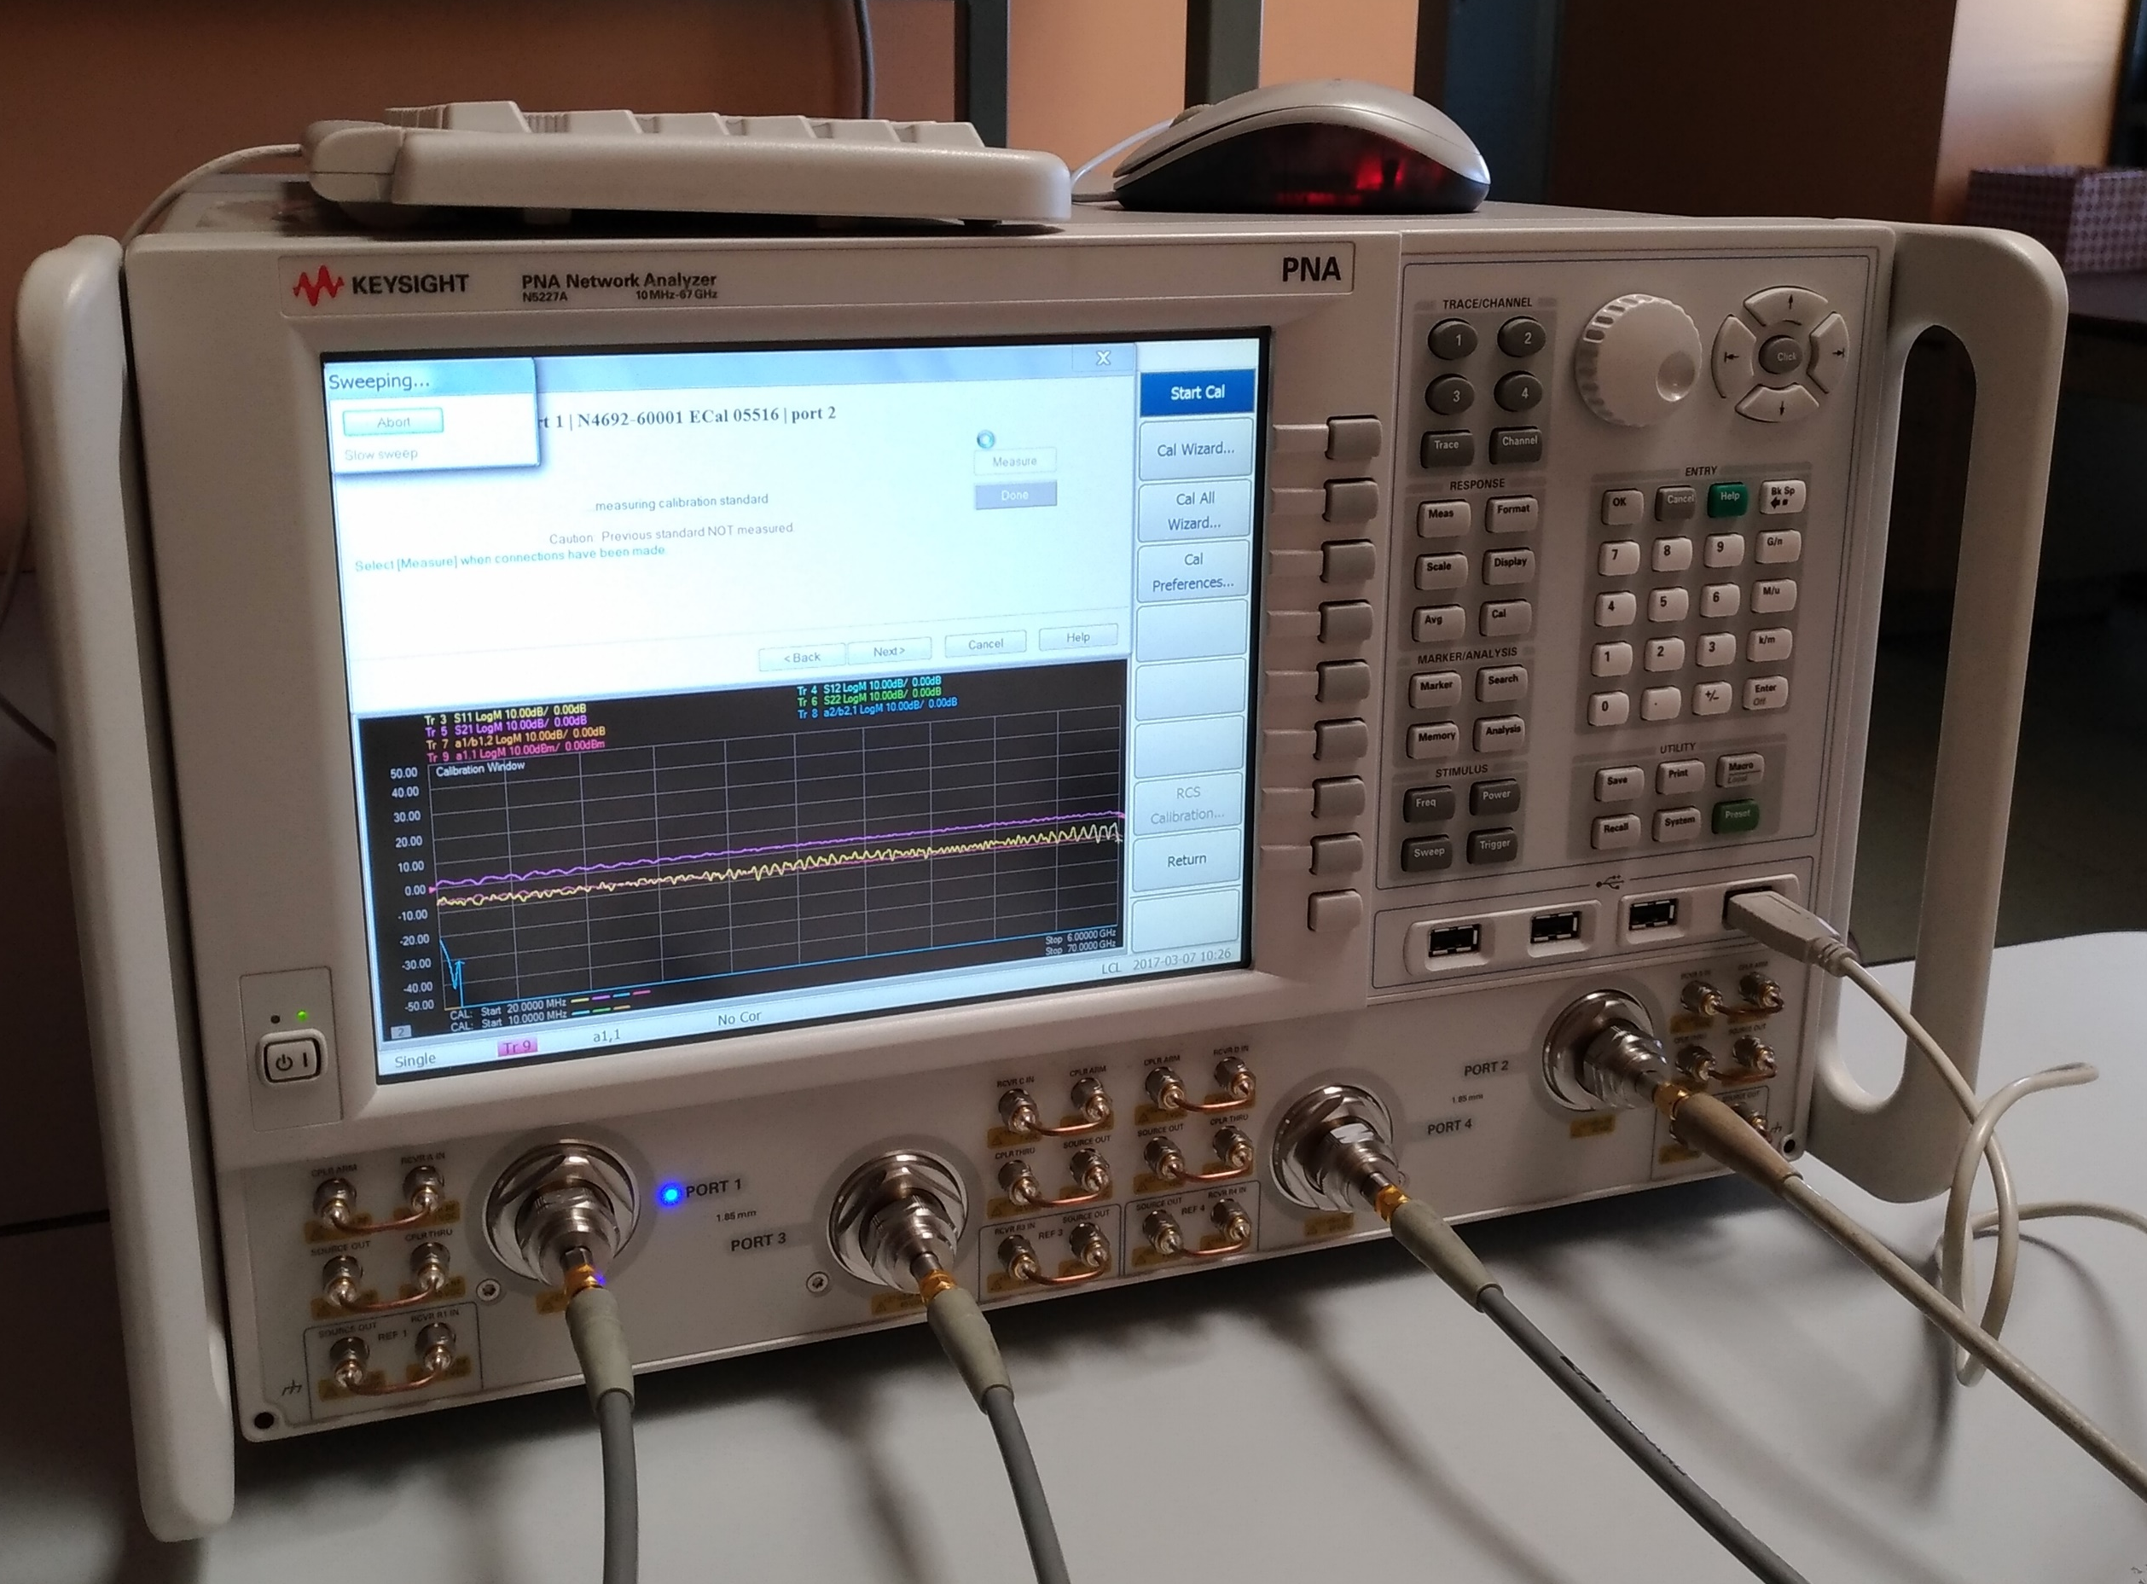
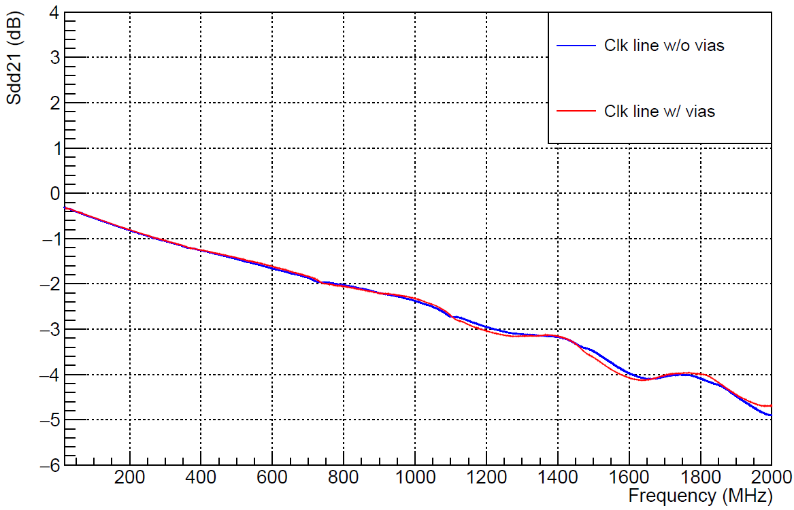
electrical tests on prototypes (2)
Swiss PCB ver 2 production
Test on CLK and DATA lines:
  Measured the s-parameters to quantify
    the attenuation of differential lines
    the cross-talk between differential lines (Near-End and Far-End Xtalk).
Results:
  Attenuatation: up to -3.6 dB on a single FPC.
  Cross-talk between data lines: cross-talked signal attenuated of - 40 dB wrt the signal of the aggressor.
Cross-talk
Max frequency to consider
Attenuation
Max frequency to consider
Setup with a Vector Network Analyzer

Slide 20
FPC planarity TESTS
Measurement of FPC planarity using touch probe (SMART SCOPE).Corrected for jigplanarity (top fig.)
FPC under test testç dummy (no finishing) by SwissPCB
Measurement along 3 different lines, (each is average of 3 measurements)
Note: red line higher than other lines, no vacuum holes underneath
FPC planarity
Jig planarity

Slide 21
FPC Procurement-TENDER
1692 FPCs to be mounted on staves
+20 % spares →2030
+25% (assumed 80% production yield) →2537 FPCs needed
Firm selected with a tendering procedure.
Tender based on technical + economical evaluation
5 companies invited to tender
Only one company capable of fulfilling all technical requirements.
Successful bidder: GS Swiss PCB AG
Automated Components mounting by Hybrid SA
Automated Assembly procedure not validated yet but test assembly by Hybrid of a first batch of fpcs presently under way.
Manual mounting still a viable option in case of need (all prototypes mounted manually up to now)

Slide 22
Quality assurance by company
Quality of delivered items verified by company QA tests.
SWISS pcb will guarantee compliance to Technical Specs by means of exhaustive tests.
Defects search, geometrical compliance of structures (e.g. strip width) by Automated Optical Inspection
Dimensional requirements of Techical Specs checked with measuring machine
Cu (soldermask) thickness: sample micro sections
Isolation of all lines (AOI and electrical)
Continuity of lines (electrical)
Flatness of FPC
General visual inspection
Plating quality: visual inspection
SMD mounting quality: visual inspection

Slide 23
Production schedule
Two production phases :
pre-production for process validation
production
Pre-production: 100 (+200) assembled FPCs (within 45 days from contract signature)
Validation (<45 days)
  Electrical
  Metrological
  Finishing/Bonding verification
  Assembly
Production: 320 assembled fpcs/45 days
(10 fpcs/week/assembly site)

Slide 24
FPC quality assurance

Slide 25
ELECTRICAL acceptance TESTS
ELECTRICAL TESTS ON ALL FPCS
Test of DATA,CTRL and CLK lines
  Open
  Shorts
  Resistance (→ Cu strips thickness and width)
SAMPLE TESTS ON SELECTED FPCS
  data transmission parameters: s-parameters, attenuation, eye diagram
  bondability test

Slide 26
metrological acceptance inspection
General visual inspection
  Plating quality, presence of defects on strips, …
Verify overall dimensions (measuring machine)
  Distance of right fpc edge w.r.t. reference hole
    Relevant for HIC assembly and HS assembly;
    Tolerance: ± 25μm
  Position and shape of a subset of holes w.r.t. reference hole to be within tolerances
Flatness
SAMPLE TESTS ON SELECTED FPCS
  Full metrology @ metrological company
    Check overall dimensions
    Check positions of ALL bonding holes and pads vs. central reference hole
  Thickness of substrate/Cu lines/cover layer: micro-section, tomography

Slide 27
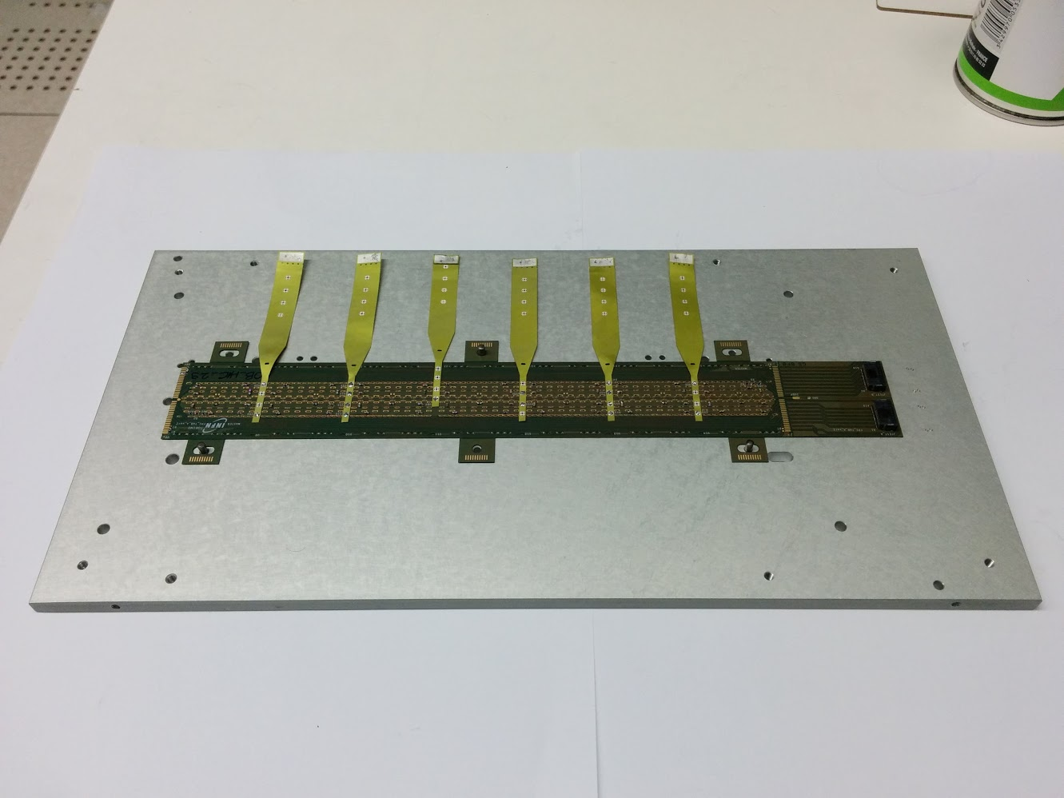
Final operations
  Once electrical and metrological tests are passed
  Cleaning
  Cross cables soldering
    Will be done in house
    Manual soldering (with soldering iron)
    Note: soldering performed before silicon sensors mounting
  Delivery to assembly centers using same carrier plates as for HICs.

Slide 28
summary
Layout finalized
  A few changes w.r.t. EDR:
  Tab extension finalized, lines and pads optimization, vias for wire bonding optimized, new connection for substrate bias
prototype production
  Several small productions with different companies (new company SwissPCB)
  Metrology, data transmission, soldering and bonding tests on prototypes for proper characterization and evaluation of different productions
Procurement
  Tender finished and job assigned to
  SWISS PCB AG for FPC construction (HYBRID SA will perform smd assembly)
FPC acceptance and preparation for assemby
  Quality assurance
  Cross cables soldering
  Distribution to HIC assembly sites

Slide 29
Spare slides

Slide 30
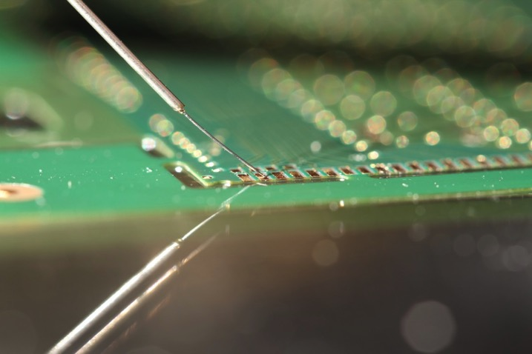
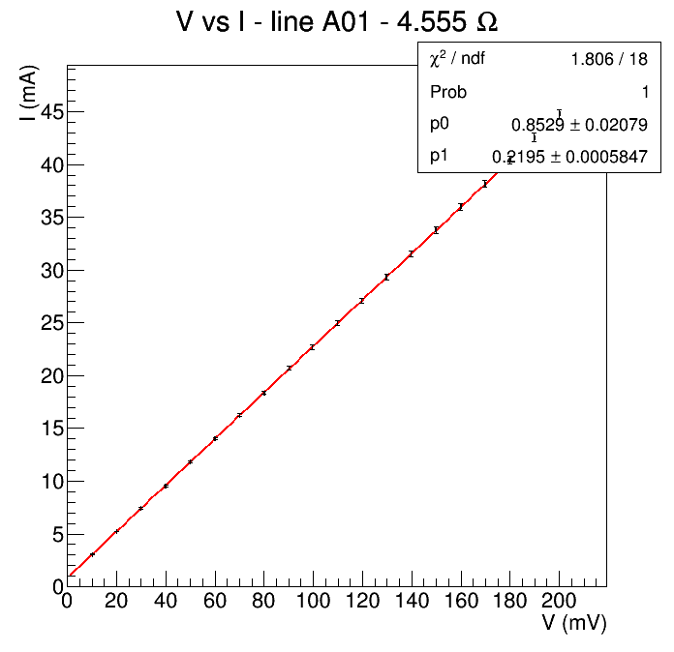
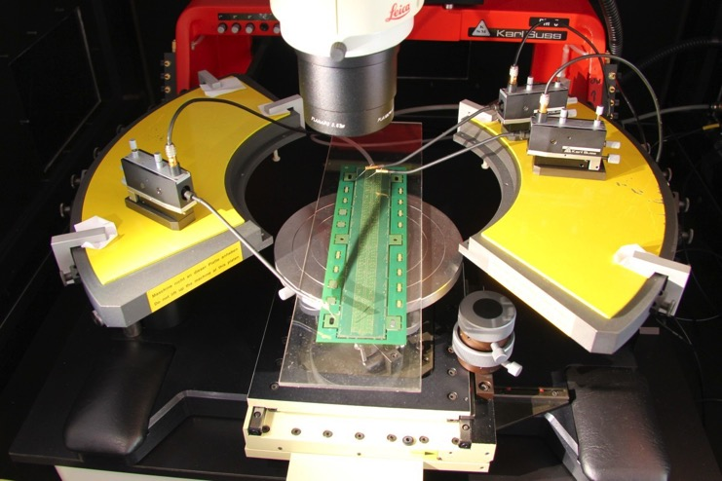
electrical tests on prototypes (1)
Test on CLK, CTRL and DATA line:
  Measured I-V curves to calculate resistance of lines
  V: <200 mV, I: max. 50 mA
Results:
  No shorts, no opens encountered
  Contact+cables introduce 0.8 Ω
  resistance for data lines<4Ω
  resistance on power planes: 10-20mΩ
    test ongoing on new version
CTRL line
~3.7 Ω

Slide 31
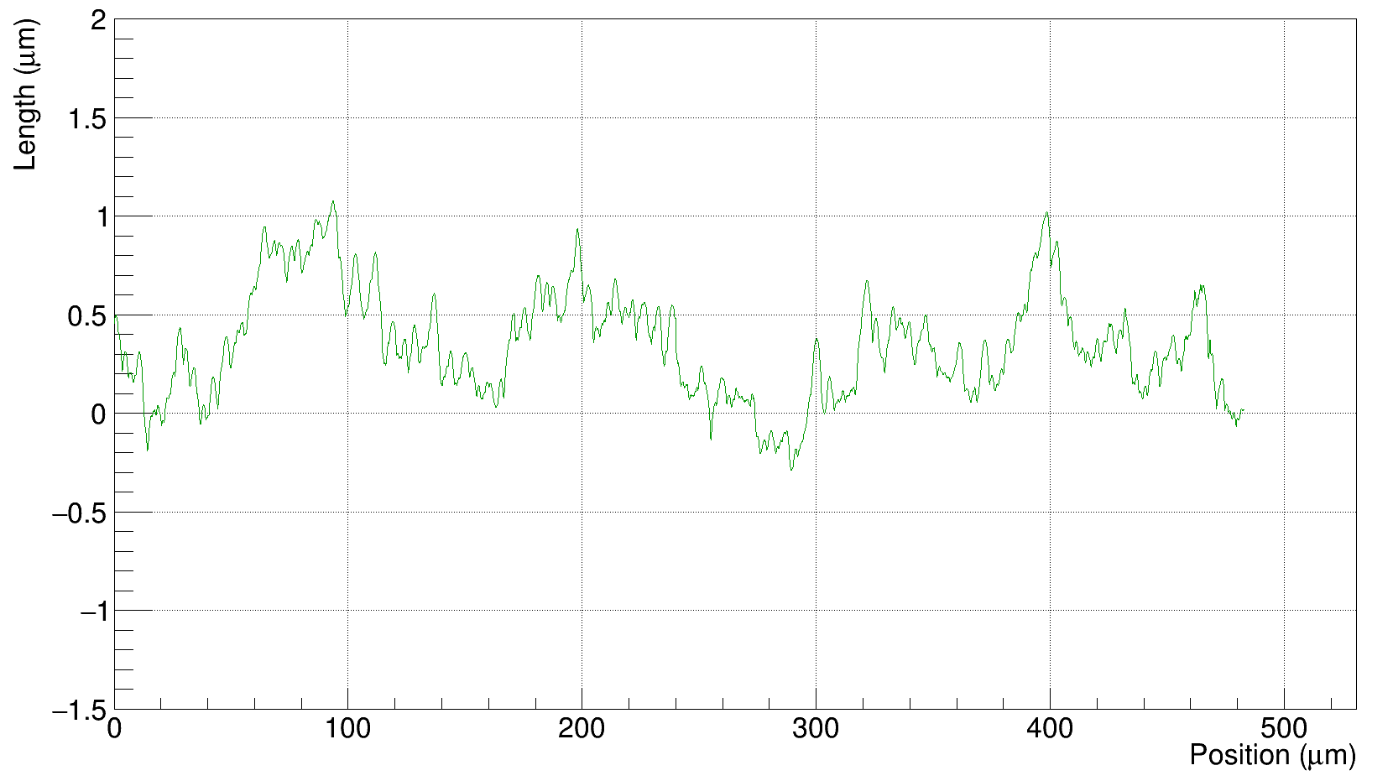
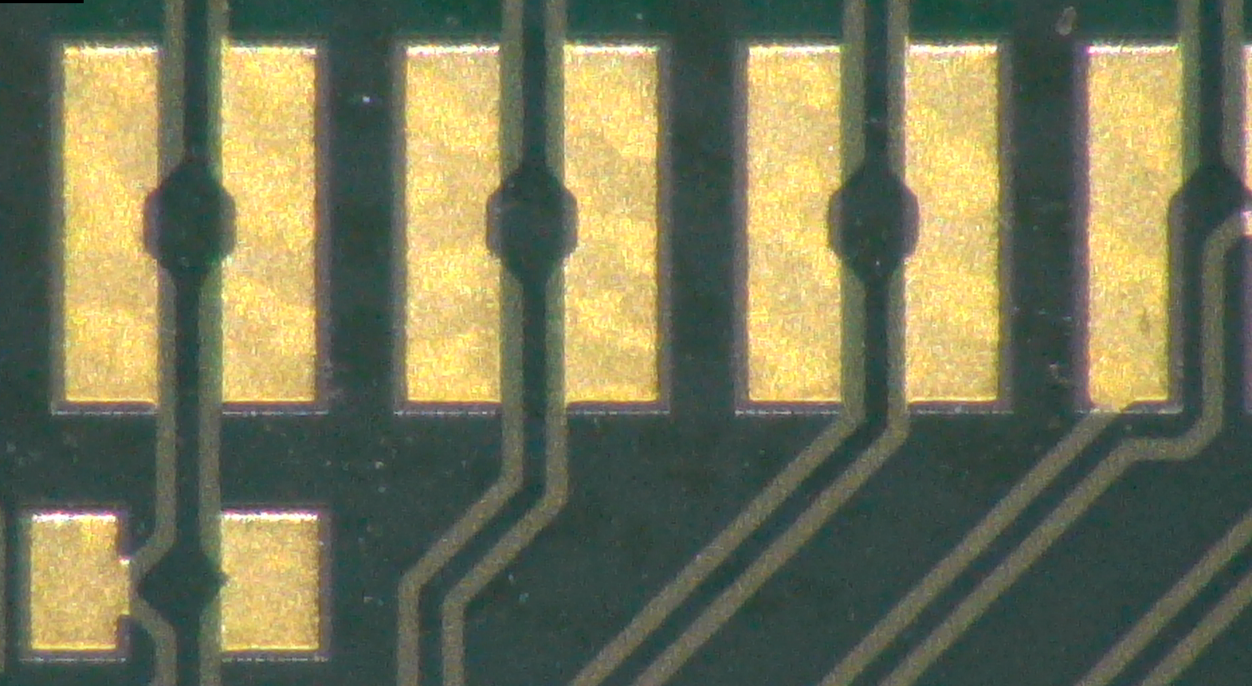
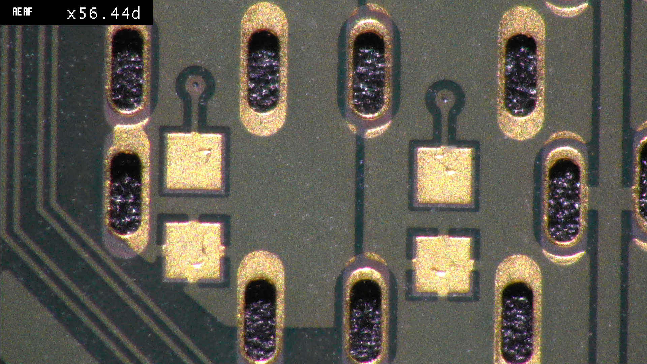
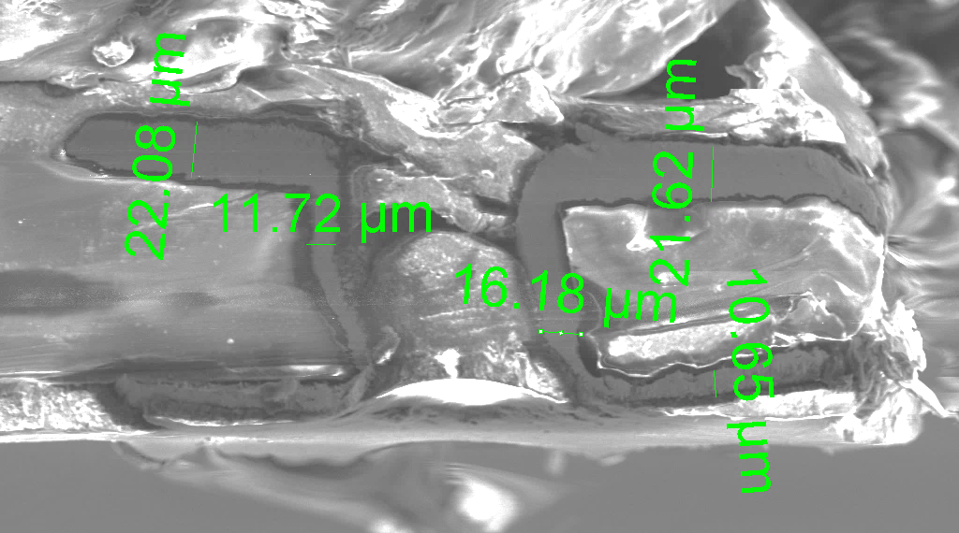
FPC Metallization quality (1)
Measurement at SEM and surface profile machine to
  Measure the planarity of the pads
  Verify the quality of the industrial process
Via metallization
Pad surface profile
Max roughness of 1.4 μm
Pad metallization
Via
Via high cross-section quality

