Slide 1
OB Flexible Printed Circuit
Paolo Camerini – INFN Trieste
ALICE ITS Upgrade
Stave Production Readiness Review
CERN, 27 April 2017

Slide 2
Outline
Layout: changes wrt EDR
Tab extension
Vias for wire bonds
New connection for BB
Prototype production
Metrological tests
Data transmission tests
Test Stages and Setups
Tender Procedure
Components mounting
Production Schedule
Acceptance and Preparation for Assembly
Quality assurance
Cross cables mounting
Transport to assembly sites

Slide 3
LAYOUT DETAILS

Slide 4
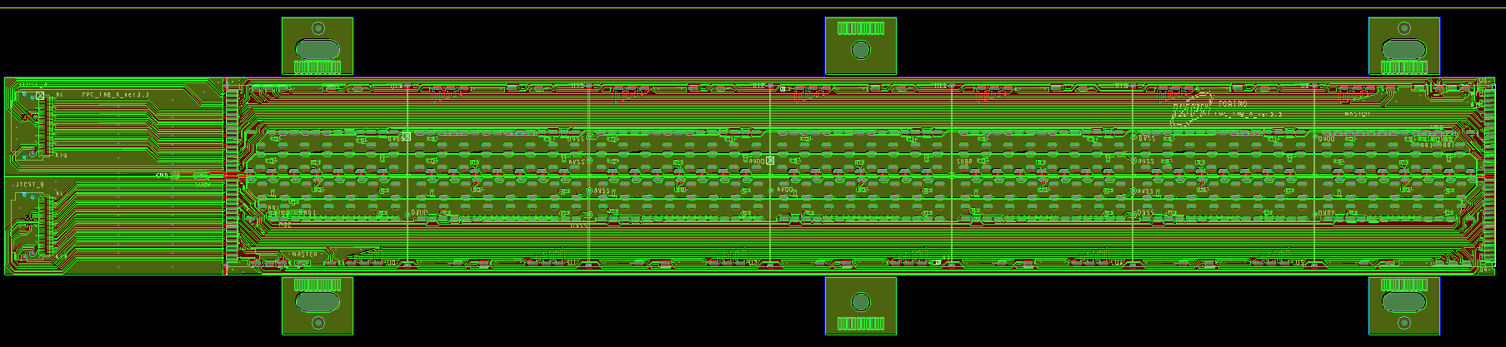
OB FPC: Overall View
Wings for alignment
width: 33 mm
TAB: 37 mm
length: 210.9 mm
Length: 210.9 mm width: 33 mm
WINGS with precise holes for alignment during HIC assembly:
TAB for test purpose (cut after tests)
TOP LAYER:DIGITAL AND ANALOG power planes
BOTTOM LAYER: GND PLANES
Back Bias voltage supply line
2 rows of 7 chips: each row with 1 master + 6 slaves
MASTER-SLAVE Communication
internal single ended data bus for: data (4 lines), ctrl (1 line), busy (1 line)
internal differential CLK line
CTRL and CLK lines from end of stave to MASTER chip
14 DIFFERENTIAL DATA lines

Slide 5
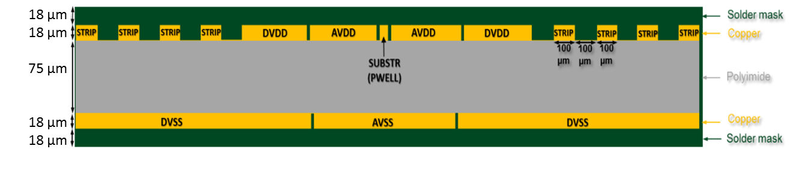
OB FPC Layer Stack-up
Copper (top, bottom) thickness: 18 μm
Substrate (dielectric) thickness: 75 μm
Soldermask (top, bottom) thickness: 18 μm
MATERIALS
Substrate (dielectric) type: Pyralux AP8535R by Dupont (double-sided, copper-clad laminate, Cu thickness 18 um, polyimide core 75 um)
Finishing: ENIG (Ni layer: 3-5 um Au layer: of 60-100 nm)

Slide 6
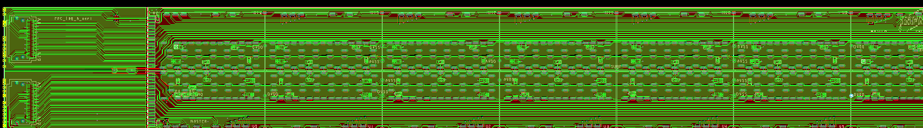
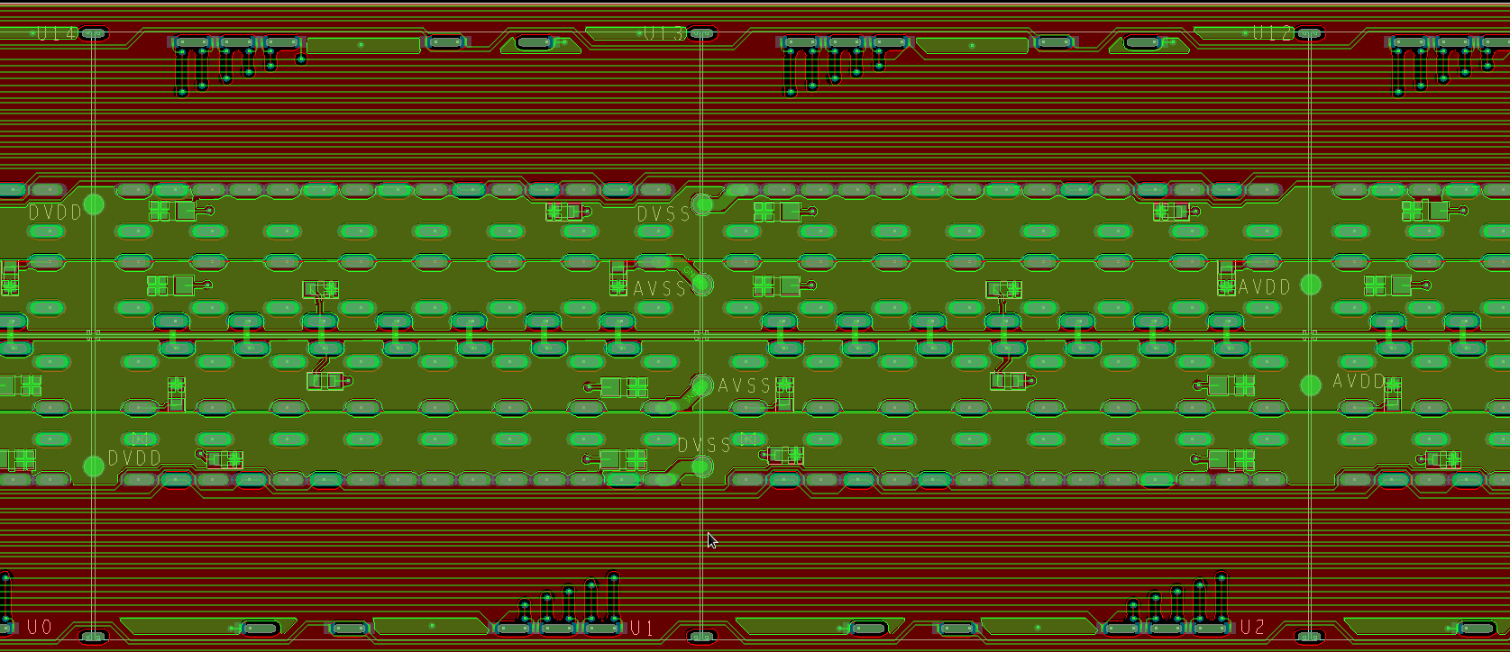
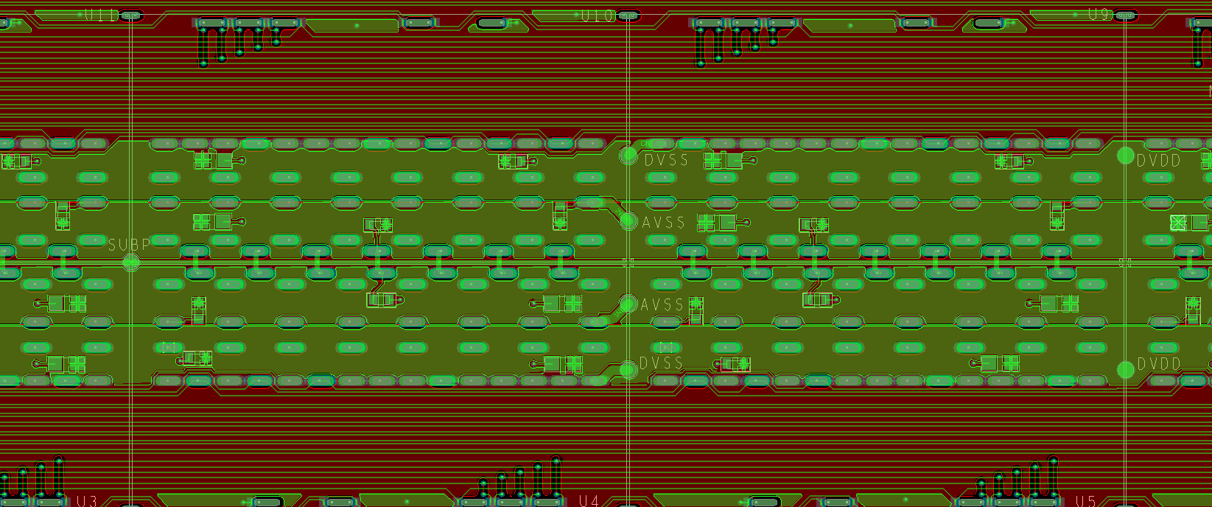
Cross Cables for Connections to PB
y
0;0
DVDD
GND
AVDD
x
BB
GND
DVDD
CC type A:
DVDD-GND- AVDD
5 per module
CC type B:
Back-bias
1 per module

Slide 7
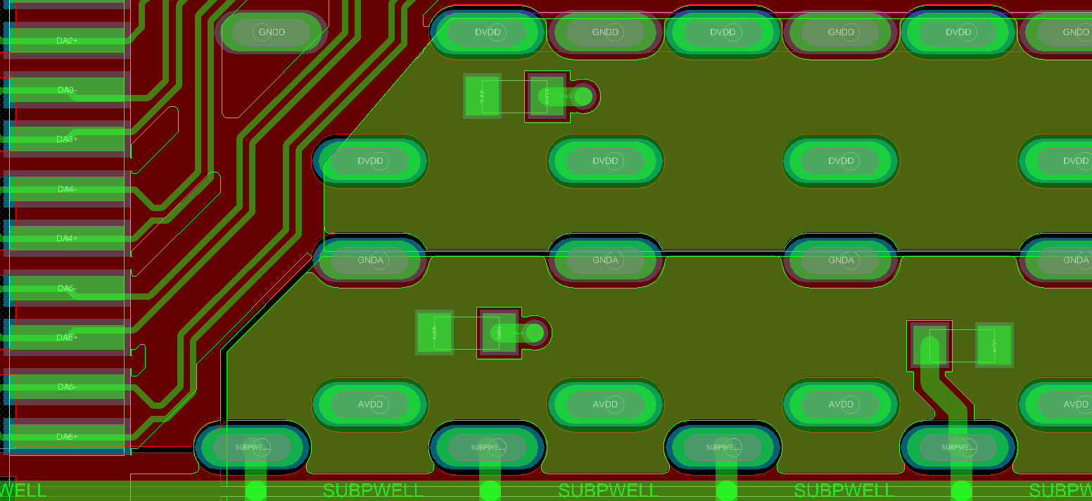
Decoupling Capacitors
on DVDD
0402 dec. capacitor
on AVDD
on SUBPWELL
SMD 0402 on all chips (up to 22 μF each)
AVDD and DVDD: 2 SMD 0402
SUB/PWELL: 1 SMD to AVDD and 1 SMD to AVSS

Slide 8
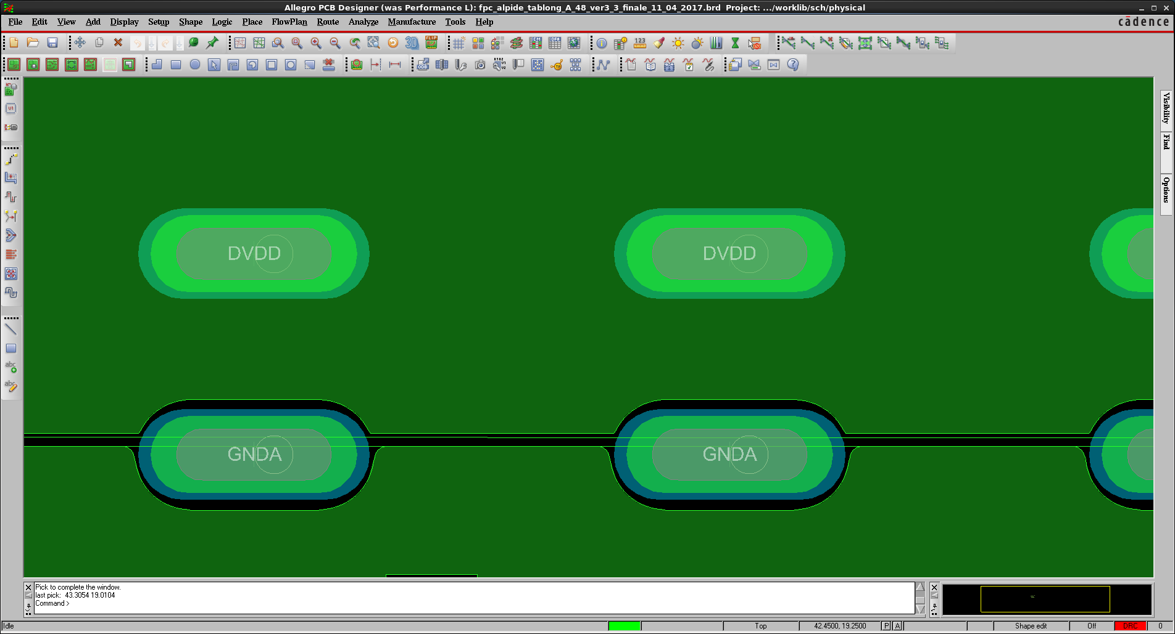
VIAs Optimized for Wire Bonding
1600 µm
1600 µm
700 µm
400 µm
600 µm
700 µm
400 µm
600 µm
100 µm
100 µm
200
µm
200
µm
100 µm
200
µm
200
µm
100 µm
1200 µm
1200 µm
Example of via for power
Example of via for ground
Oblong symmetric shapes
hole 400 x 1200 μm²
metallized crown 600 x 1600 μm²
soldermask opening: 700 x 1800 μm²
bonding area: 200 μm

Slide 9
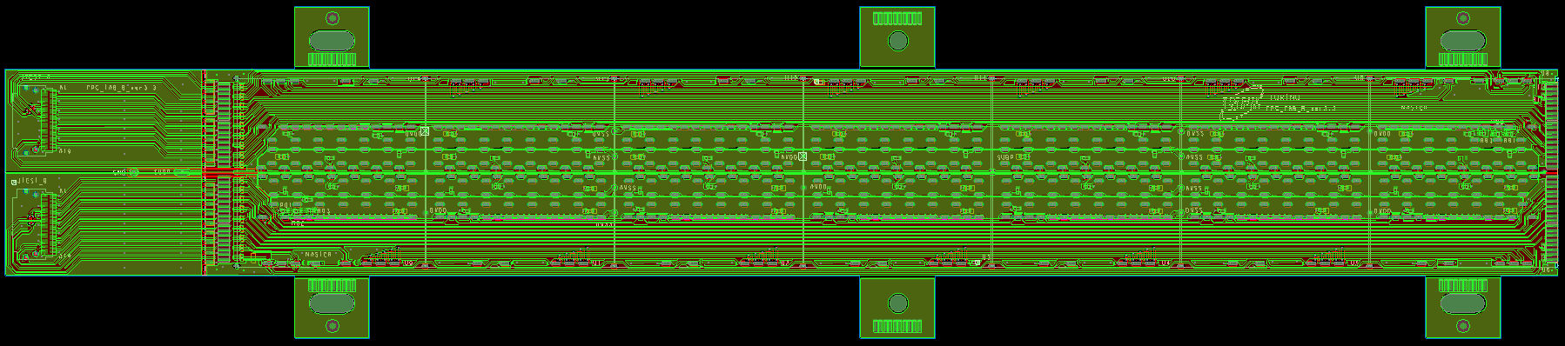
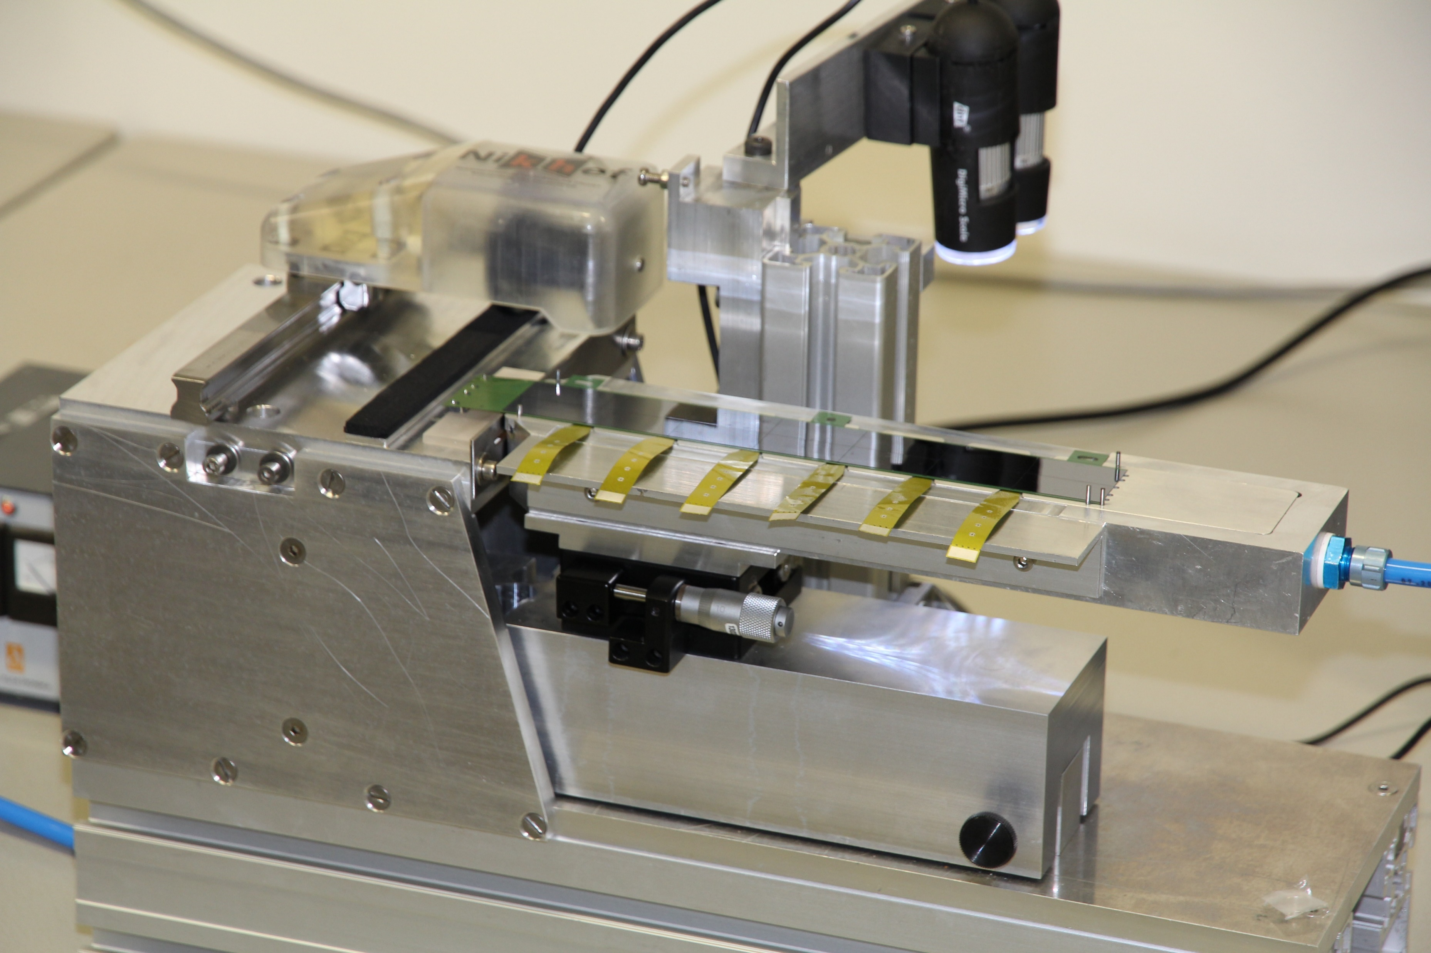
FPC Type A – Type B
TAB cut line
Wings for alignment
TYPE A
width: 33 mm
TAB: 37 mm
length: 210.9 mm
TAB cut line
Wings for alignment
TYPE B
width: 33 mm
TAB: 31.9 mm
length: 216 mm
Version with TAB has been designed and produced
TYPE B is for the first module of the Half-Stave (HS)
TAB needs to be removed after test before module assembly on HS
TAB cutting procedure developed: more details in “OB HIC test” presentation
9

Slide 10
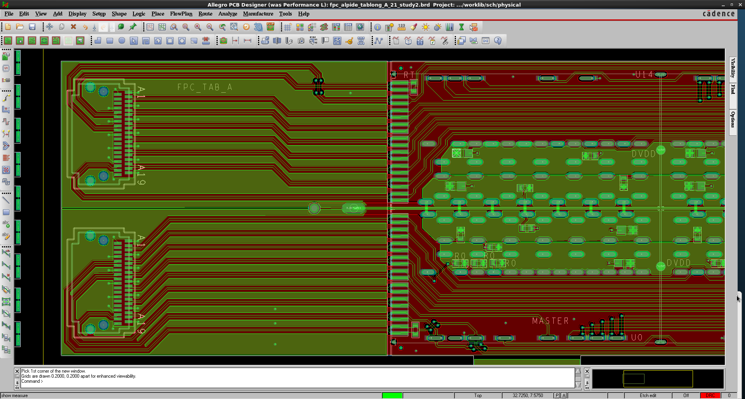
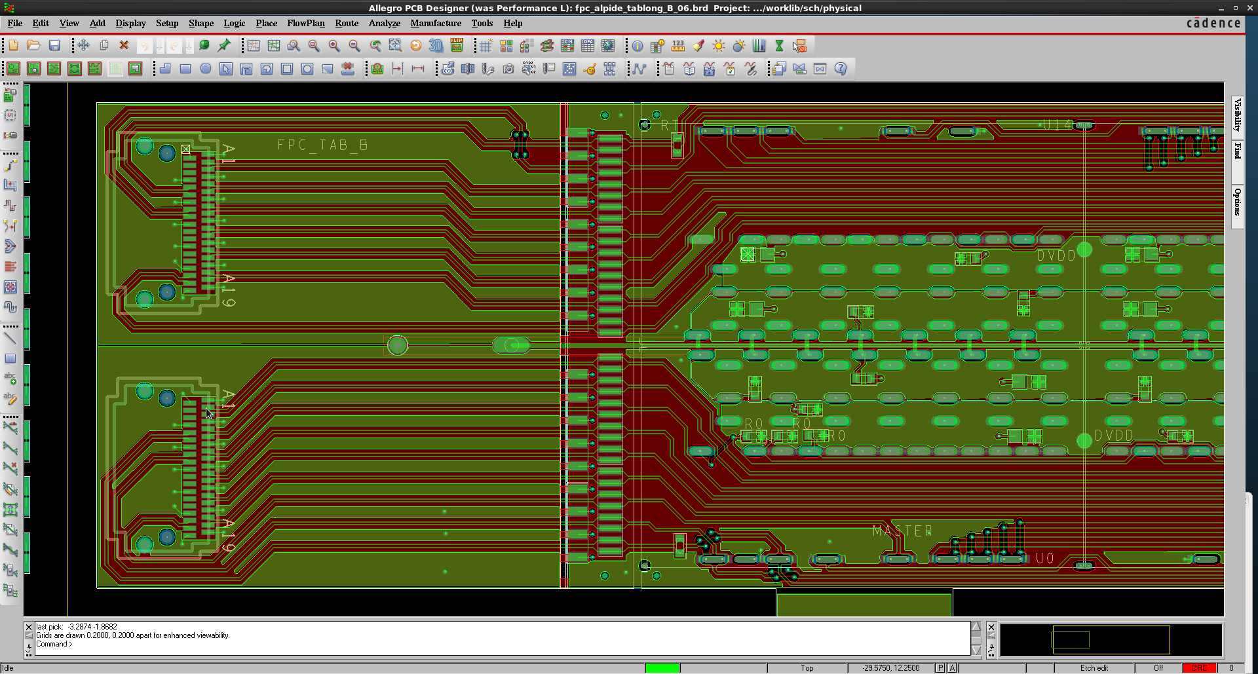

FPC Type B
TYPE A
A dedicated version of the FPC is necessary for the first module of the Half-Stave to allow a reliable and safe connection to the “external electronics” ➔ see next slide
➔ The FPC for the first module of the Half-Stave is extended by a few mm.

Slide 11
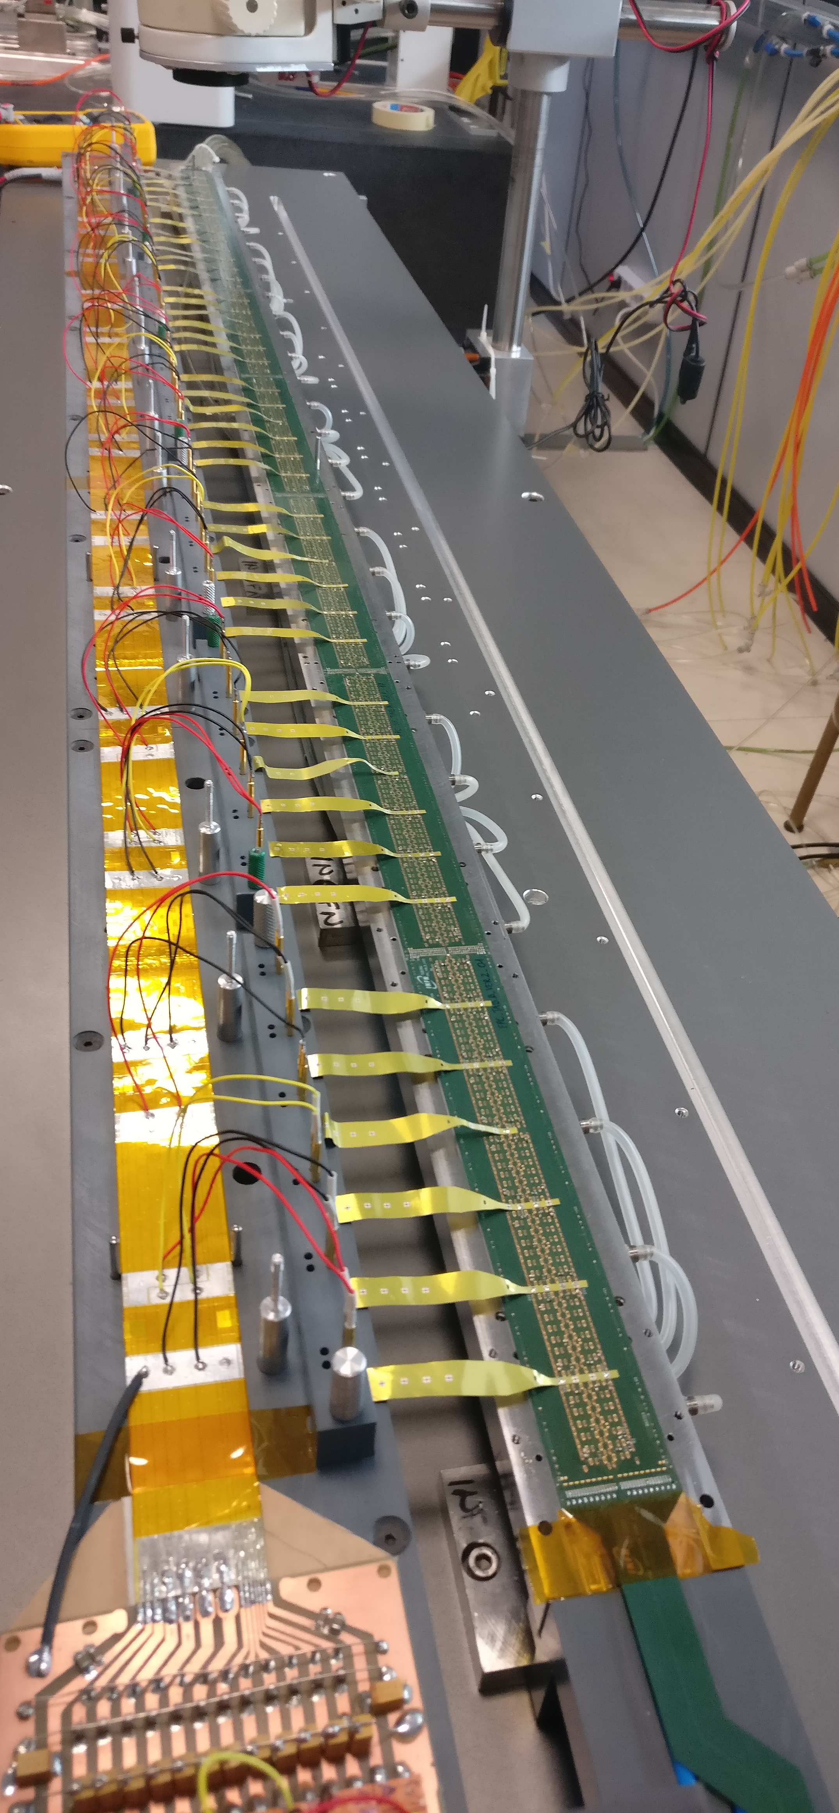
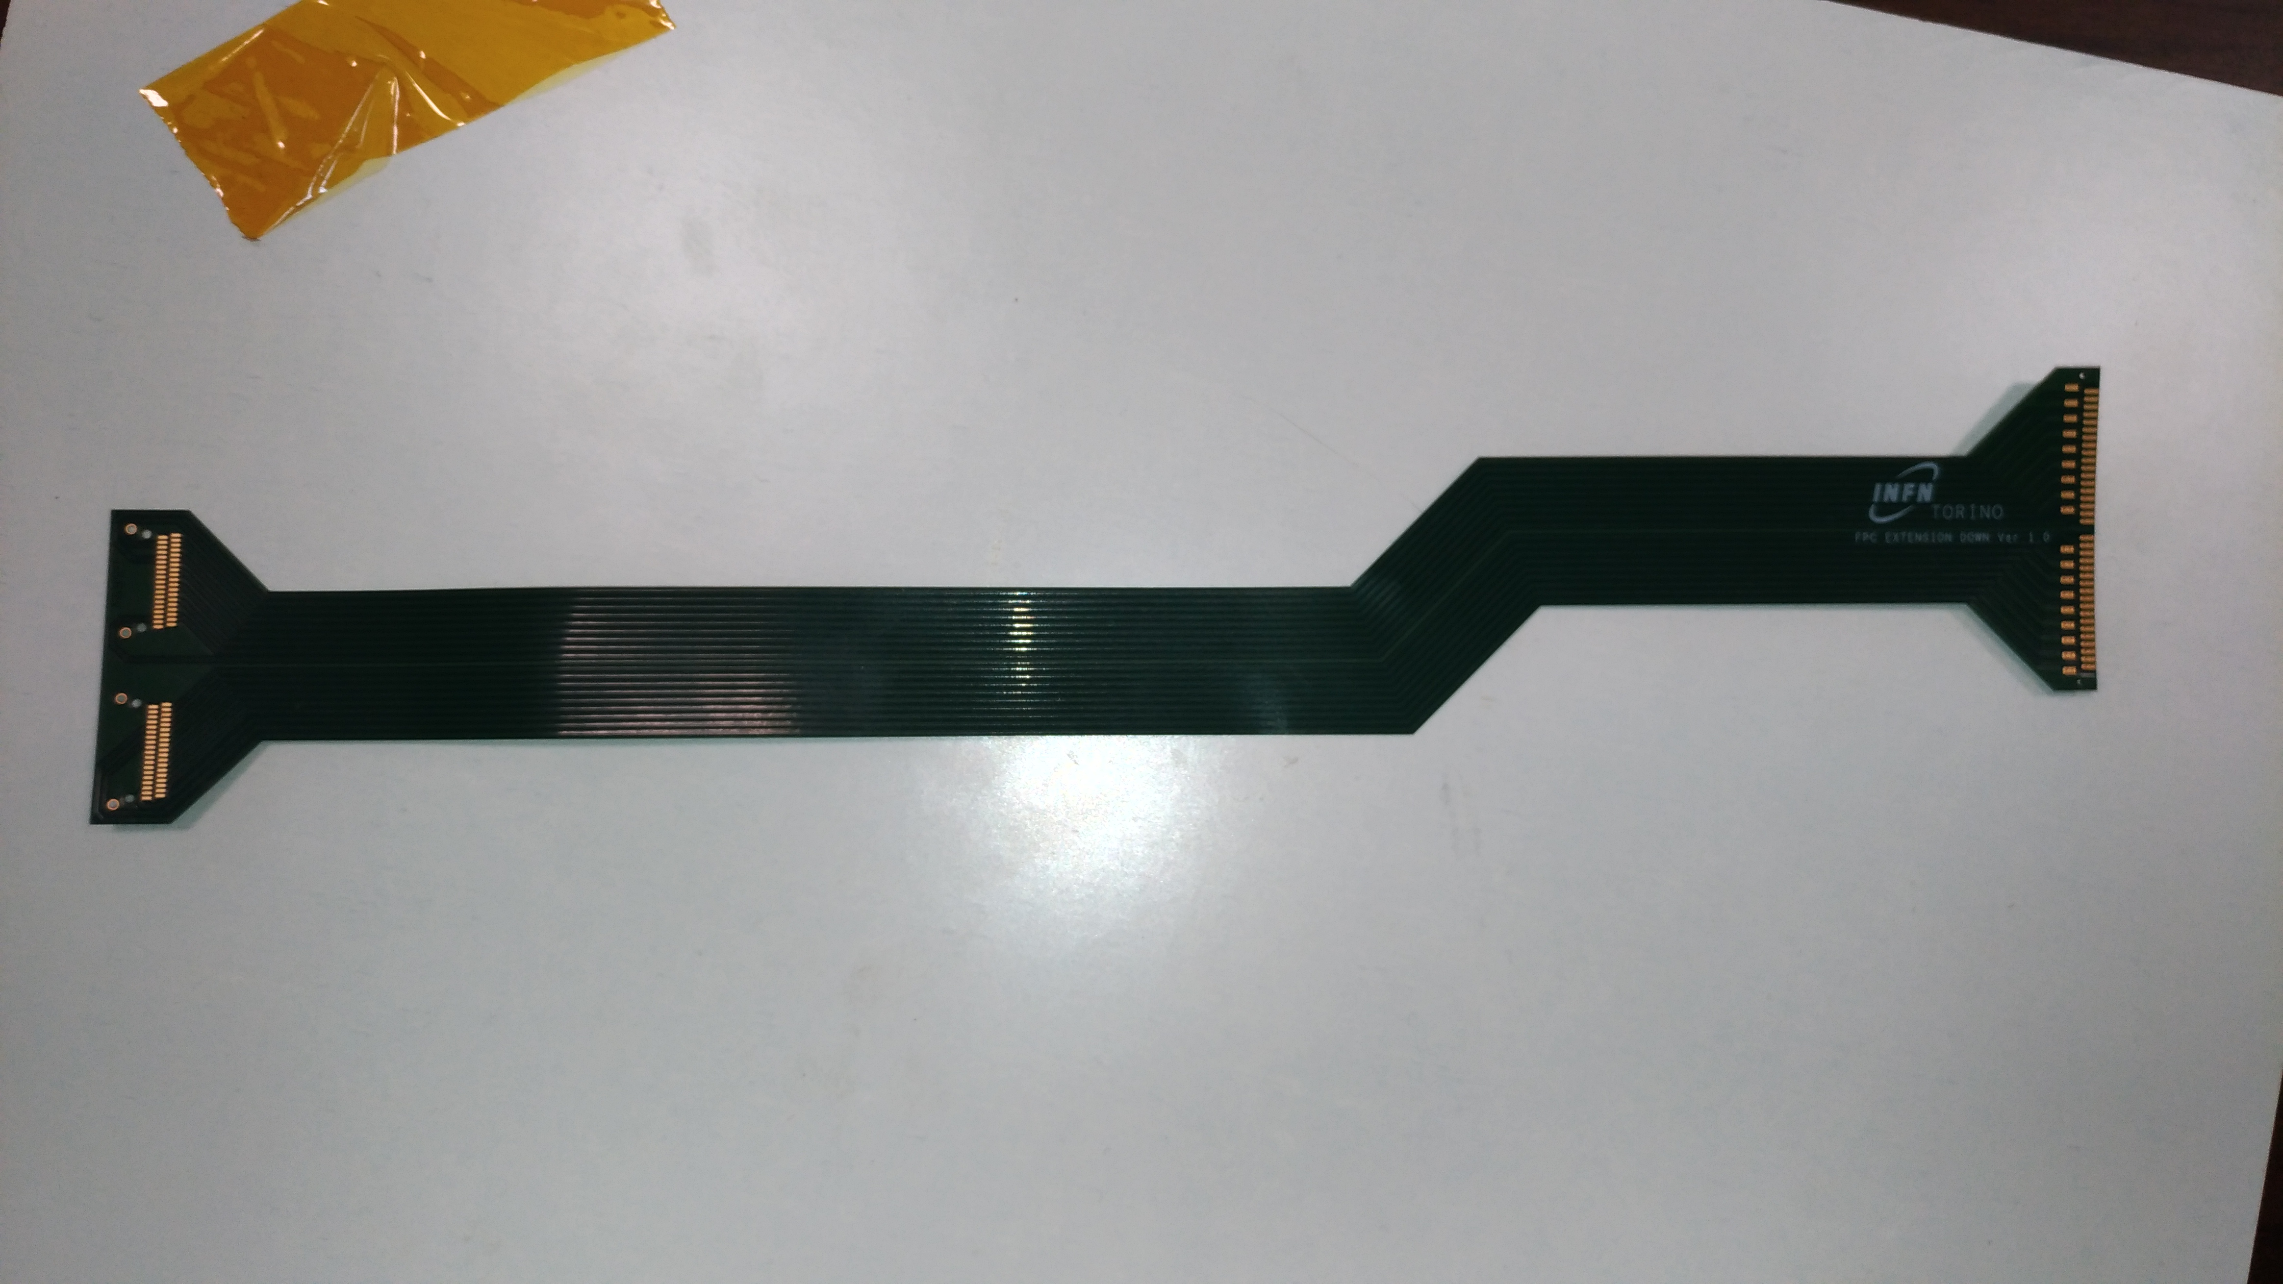
FPC Extension
Pads for connection with TAB B FPC
Pads for the connector
Second column for data, clk, ctrl transmission
Second column for connection to ground
The extension is needed to transmit data, clock and control to/from the external electronics
One extension for each HS
At the end, 2 Firefly connectors are soldered
288 extensions + spares needed
Estimated cost: 30KEu ➔ no tendering needed
Prototypes designed and produced (SwissPCB)
External electronics

Slide 12
FPC Procurement

Slide 13
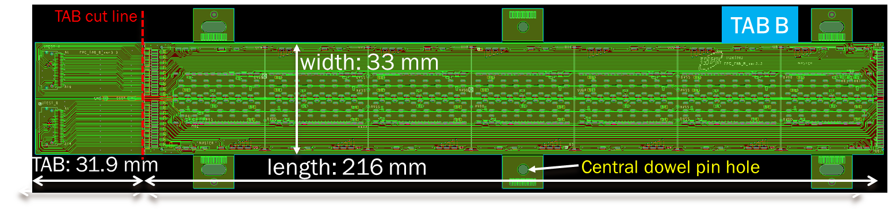
Technical Specifications
Distance between the centre of the central dowel pin hole and | Required tolerances (mm)
Right edge | ±25
upper and lower edges | ±25
Holes center | ±50
Pads center (all pads types) | ±50
List of main dimensional requirements
Central dowel pin hole diameter: | -0,+20
Oblong holes/vias (major and minor axis) | ±50
Strips width, distance | ±10
Cu thickness Surface (solder mask) flatness | ±2 ±5

Slide 14
FPC Prototype Characterization
Vendor selection is the result of a long and intensive R&D with several companies.
Main fabrication challenges
Dimensional tolerances of structures and circuit
Tolerance on position of FPC edges and structures wrt reference dowel pin hole ~0.2‰
Surface (soldermask) flatness: ±5μm (crucial for proper and safe HIC gripping)
Copper thickness tolerance: (18±2) μm
Improvements with all companies;
SwissPCB only company to fulfil all requirements (special procedure for guaranteeing uniform soldermask thickness)

Slide 15
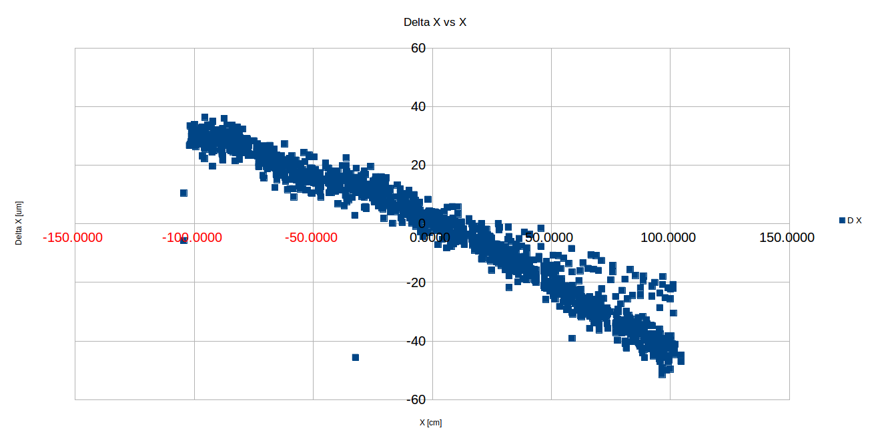
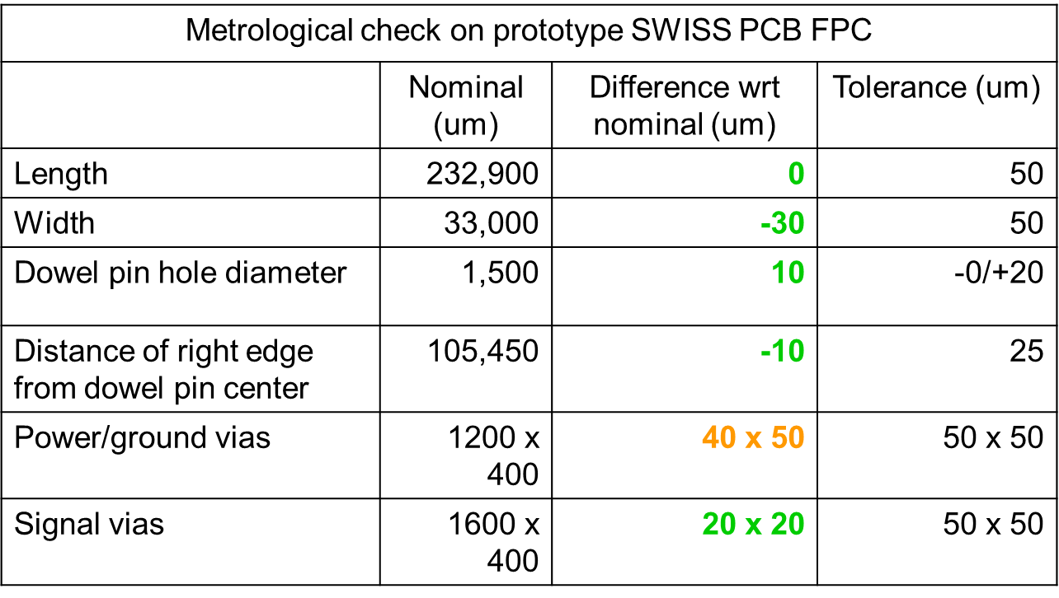
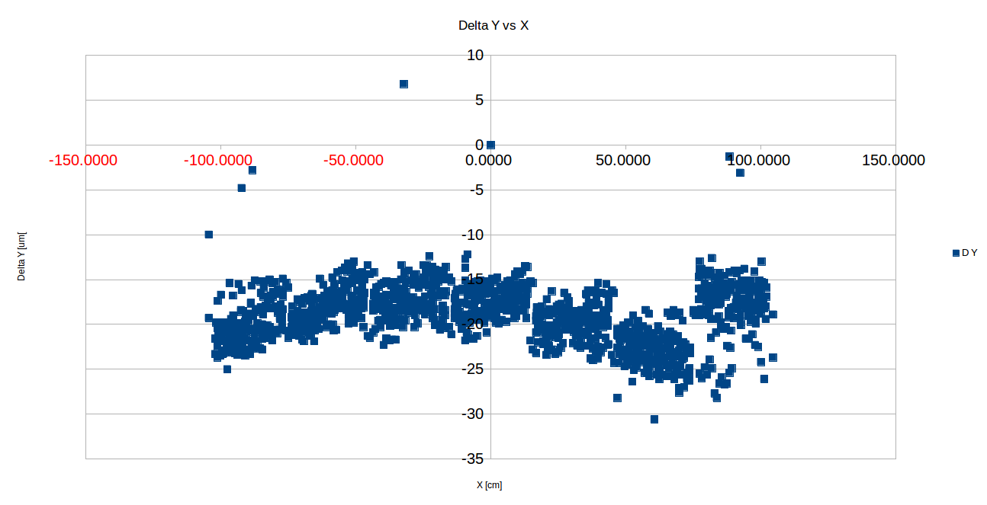

FPC Prototype Characterization – Some Examples
Metrological tests (by Modus97 company) of all structures of a (SwissPCB) prototype FPC
X
Measurement of some critical dimensions parameters of a (S.PCB) prototype FPC
Holes Position relative to alignment hole
→ X maximum deviation from nominal position = (-40,+50) μm [tol.:± 50μm]
→ Y maximum deviation from nominal position = (-10,+25) μm [tol.:± 50μm]
Y

Slide 16
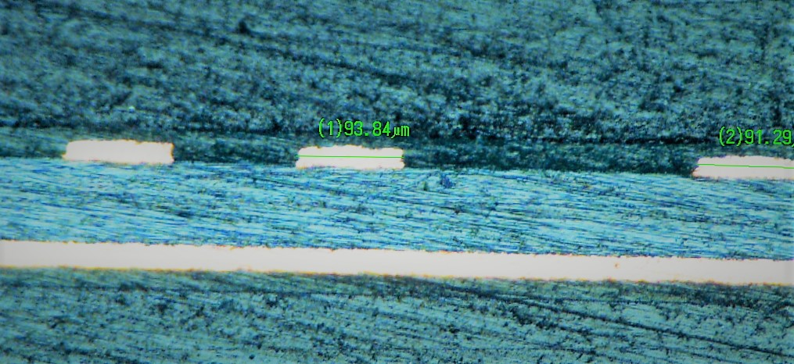
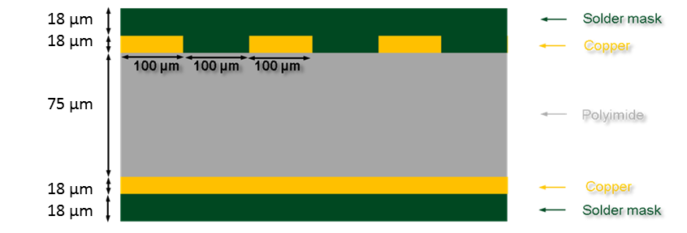
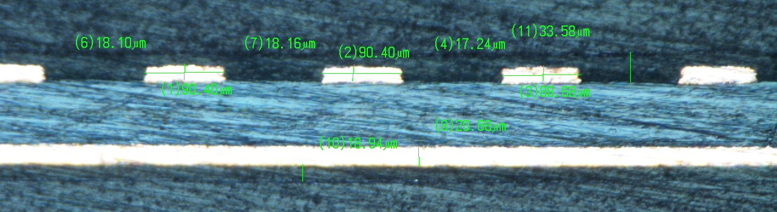
FPC Prototype Characterization – Some Examples
Encapsulating epoxy
Solder mask thickness guarantees good planarity also in regions around strips
Soldermask →
Cu
Cu
←Soldermask →
polyamide →
Polyamide
Cu →
Cu
Soldermask →
←Soldermask →
Encapsulating epoxy
Micro-sections of a prototype fpc (by Swiss-PCB) and reference stack up for the prototype

Slide 17
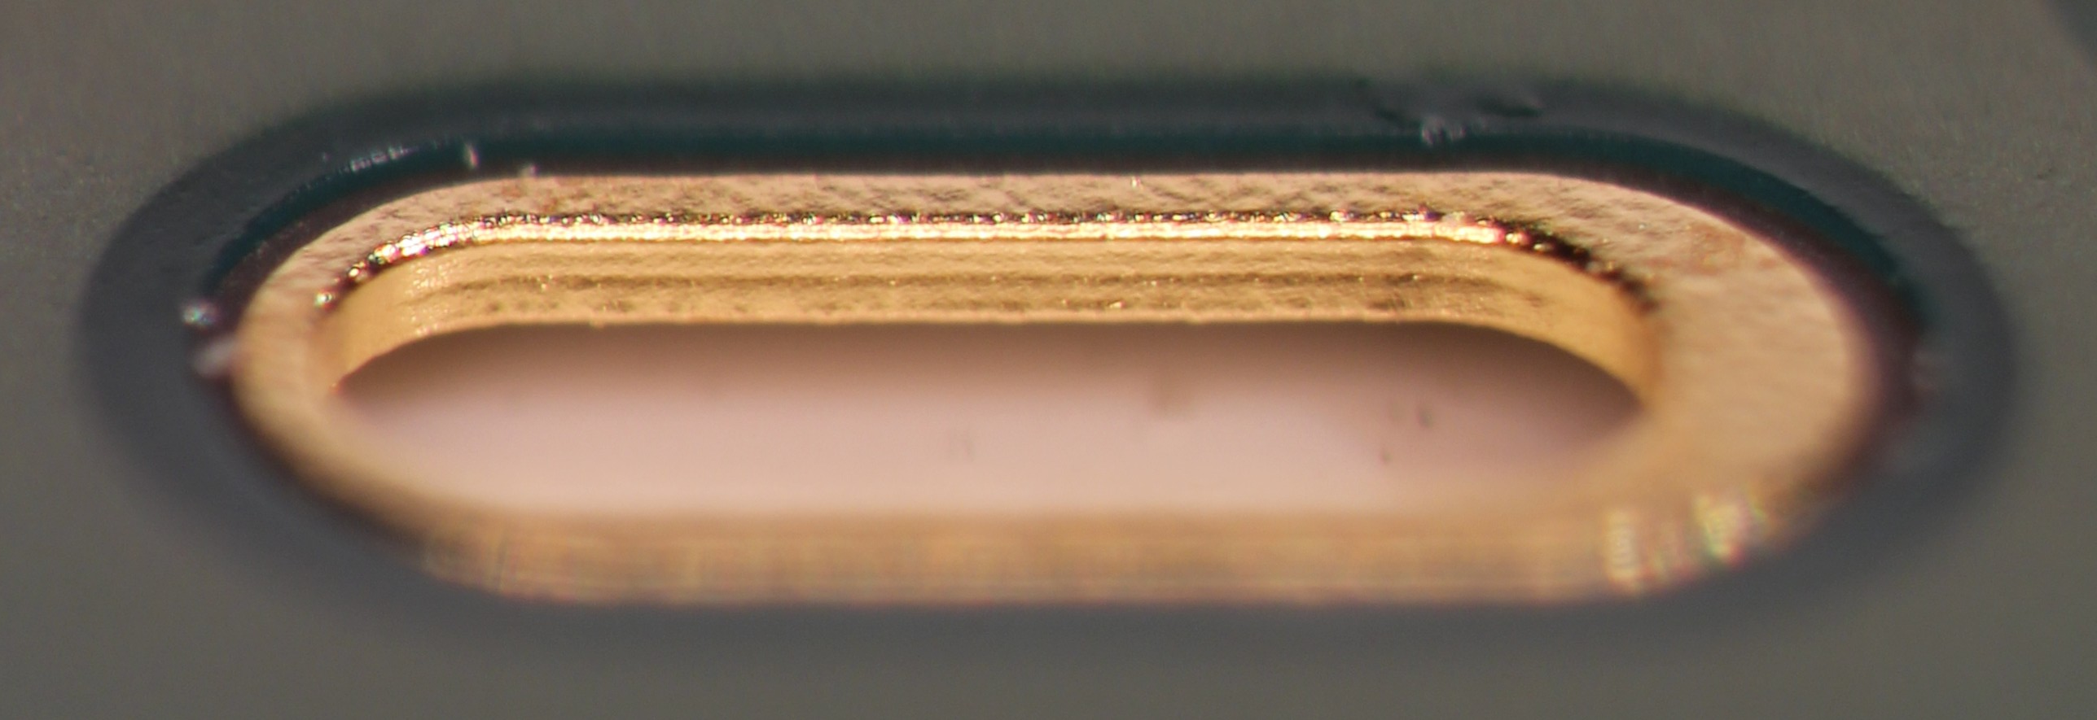
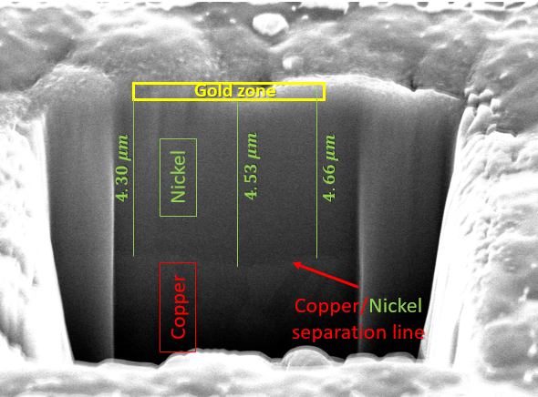

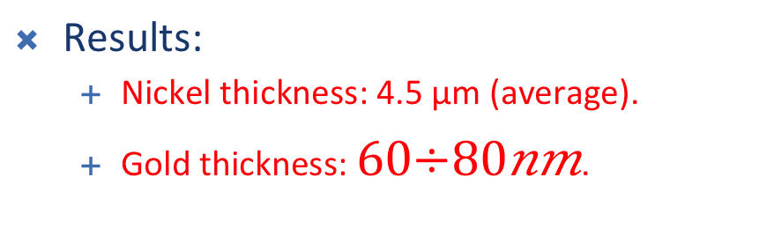
FPC Metallization Quality
Pad plating: Electroless Nickel Immersion Gold (ENIG)
Focused Ion Beam (FIB) (30 keV gallium ions) measurement to
Measure the thicknesses of the pad/via finishing
Finishing layer thicknesses expected (above copper):
3-5 μm of Nickel
60-100 nm of Gold
Via metallization
Gold on vias
ZOOM
73nm
Results:
Nickel thickness: 4.5 μm (average).
Gold thickness: $60÷80nm$.

Slide 18
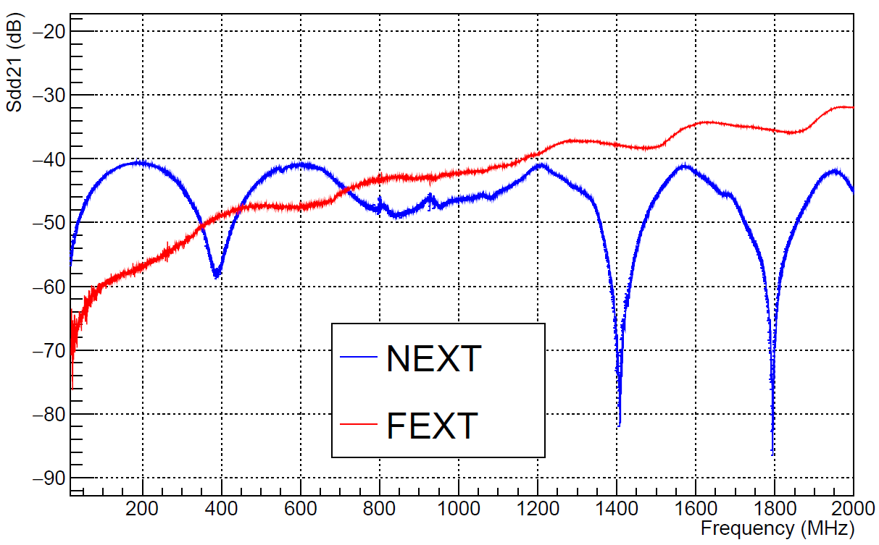
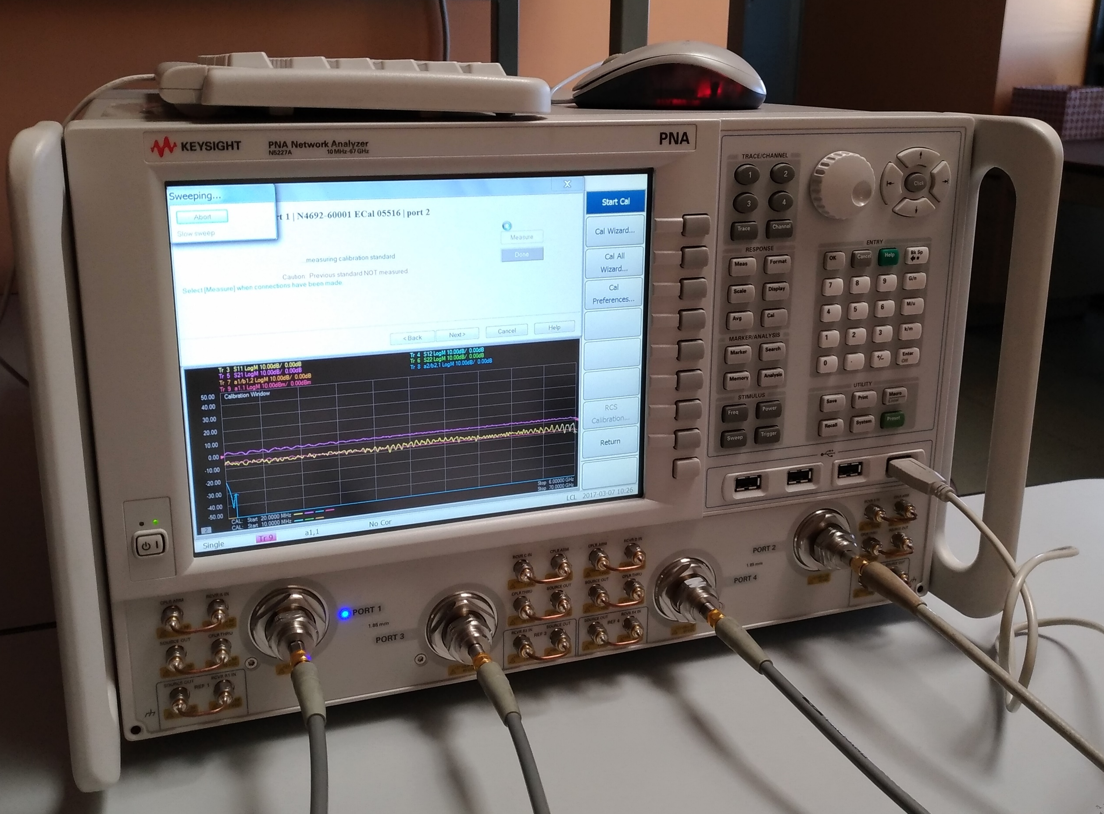
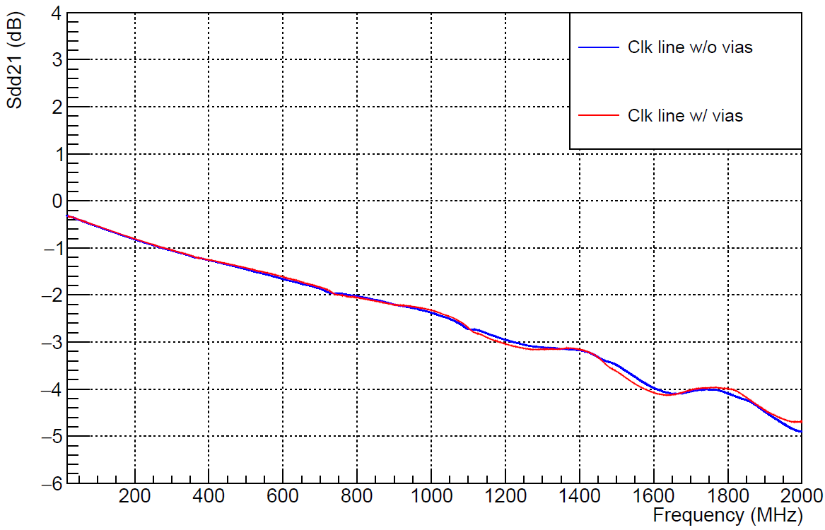
Electrical Tests on Prototypes
Swiss PCB ver 2 production
Test on CLK and DATA lines:
Measured the s-parameters to quantify
the attenuation of differential lines
the cross-talk between differential lines (Near-End and Far-End Xtalk).
Results:
Attenuation: up to -3.6 dB on a single FPC.
Cross-talk between data lines: cross-talked signal attenuated of - 40 dB wrt aggressor's signal
Cross-talk
Max frequency to consider
Attenuation
Max frequency to consider
Setup with a Vector Network Analyzer

Slide 19
FPC Planarity Test
Measurement of FPC planarity using touch probe (SMART SCOPE). Corrected for jig planarity (top figure)
Measurement along 3 different lines, (each is average of 3 measurements)
Note: red line higher than other lines; no vacuum holes underneath
FPC under test: dummy (no finishing) by SwissPCB

Slide 20
FPC Procurement - Tender
1692 FPCs to be mounted on staves
+20 % spares →2030
+25% (assuming 80% production yield) →2537 FPCs needed
Firm selected with a tendering procedure.
Tender based on technical + economical evaluation
5 companies invited to tender
Only one company capable of fulfilling all technical requirements.
Successful bidder: GS Swiss PCB AG
Automated Components mounting by Hybrid SA
Automated Assembly procedure not validated yet but test assembly by Hybrid of a first batch of FPCs presently under way.
Manual mounting still a viable option in case of need (all prototypes mounted manually up to now)

Slide 21
Production Quality Assurance (Vendor)
Quality of delivered items verified by company QA tests
SwissPCB will guarantee compliance to Technical Specs by means of exhaustive tests
Defects search, geometrical compliance of structures (e.g. strip width) by Automated Optical Inspection
Dimensional requirements of Techical Specs checked with measuring machine
Cu (soldermask) thickness: sample micro sections
Isolation of all lines (AOI and electrical)
Continuity of lines (electrical)
Flatness of FPC
General visual inspection
Plating quality: visual inspection
SMD mounting quality: visual inspection

Slide 22
Production Schedule
Two production phases
pre-production for process validation
production
Pre-production: 100 (+200) assembled FPCs (within 45 days from contract signature)
Validation (<45 days)
Electrical
Metrological
Finishing/Bonding verification
Assembly
Production: 320 assembled fpcs/45 days (10 fpcs/week/assembly site)

Slide 23
FPC Quality Assurance

Slide 24
Electrical Acceptance test
Electrical Tests Carried-out on All FPCs
Test of DATA,CTRL and CLK lines
Open
Shorts
Resistance (→ Cu strips thickness and width)
Tests Carried out on a Sample of FPC of each Batch
Data transmission parameters: s-parameters, attenuation, eye diagram
Bondability test

Slide 25
Metrological Inspection
General visual inspection
Plating quality, presence of defects on strips, …
Verify overall dimensions (measuring machine)
Distance of right fpc edge w.r.t. reference hole
Relevant for HIC assembly and HS assembly;
Tolerance: ± 25μm
Position and shape of a subset of holes w.r.t. reference hole to be within tolerances
Flatness
SAMPLE TESTS ON SELECTED FPCS
Full metrology @ metrological company
Check overall dimensions
Check positions of ALL bonding holes and pads vs. central reference hole
Thickness of substrate/Cu lines/cover layer: micro-section, tomography
Planarity

Slide 26
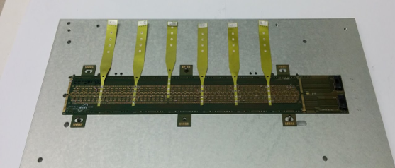
Final Operations
Once electrical and metrological tests are passed
Cleaning
Cross cables soldering
Will be done in house
Manual soldering (with soldering iron)
Note: soldering performed before silicon sensors mounting
Delivery to assembly centers using same carrier plates as for HICs

Slide 27
Summary
Layout finalized
A few changes w.r.t. EDR:
Tab extension finalized, lines and pads optimization, vias for wire bonding optimized, new connection for substrate bias
Prototypes production
Several small productions with different companies (new company SwissPCB)
Metrology, data transmission, soldering and bonding tests on prototypes for proper characterization and evaluation of different productions
Procurement
Tender finished and job assigned to
SWISS PCB AG for FPC construction (HYBRID SA will perform smd assembly)
FPC acceptance and preparation for assemby
Quality assurance
Cross cables soldering
Distribution to HIC assembly sites

Slide 28
Additional Material

Slide 29
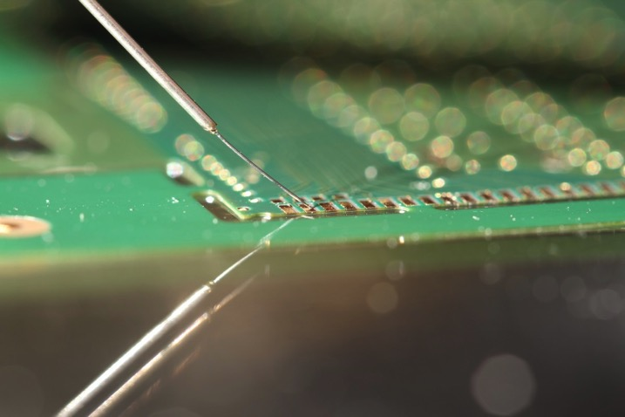
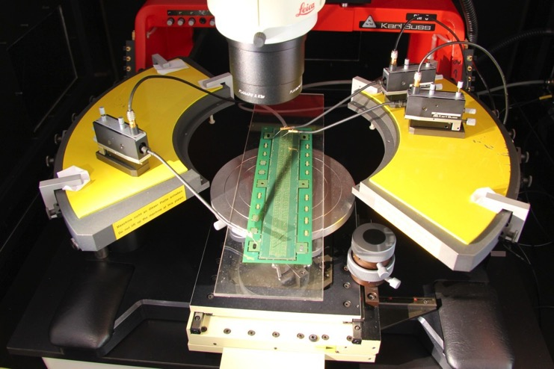
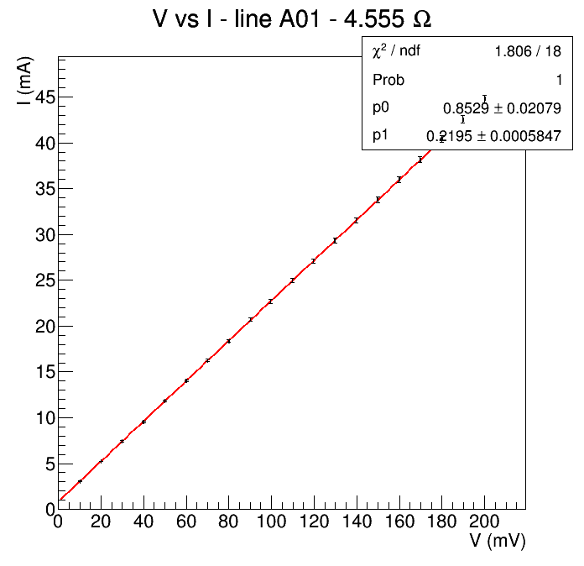
Electrical Tests on Prototypes
Test on CLK, CTRL and DATA line
Measured I-V curves to calculate resistance of lines
V: <200 mV, I: max. 50 mA
Results
No shorts, no opens encountered
Contact+cables introduce 0.8 Ω
resistance for data lines<4Ω
resistance on power planes: 10-20mΩ
CTRL line
~3.7 Ω

Slide 30
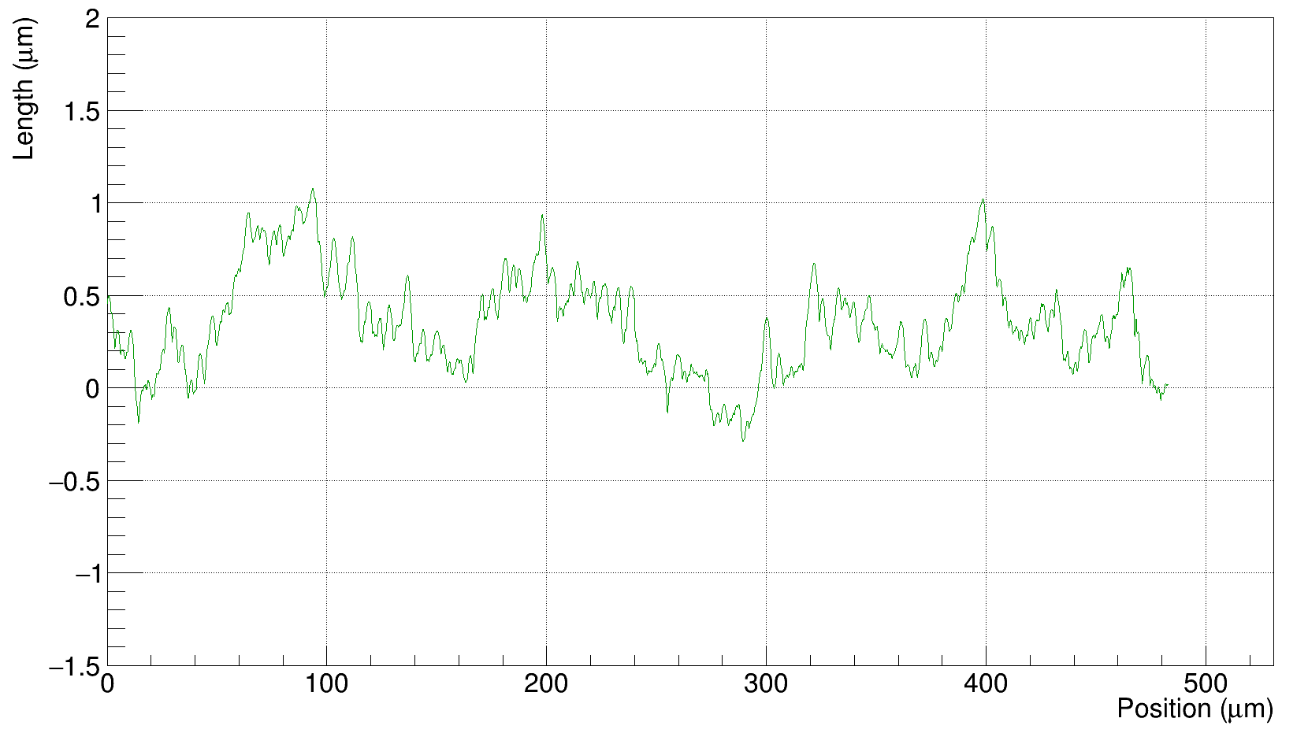
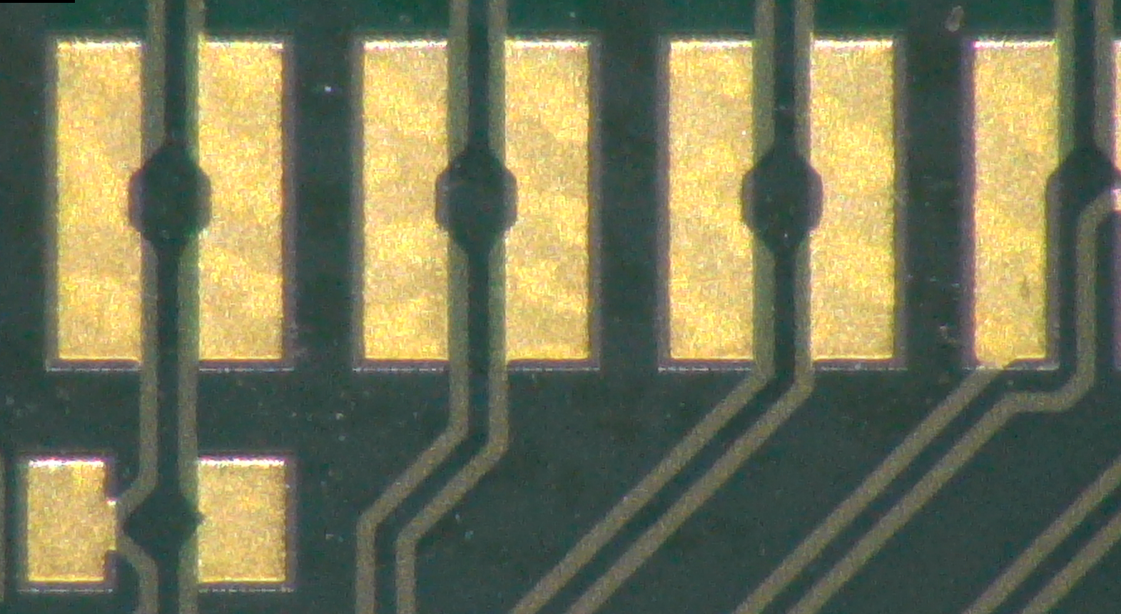
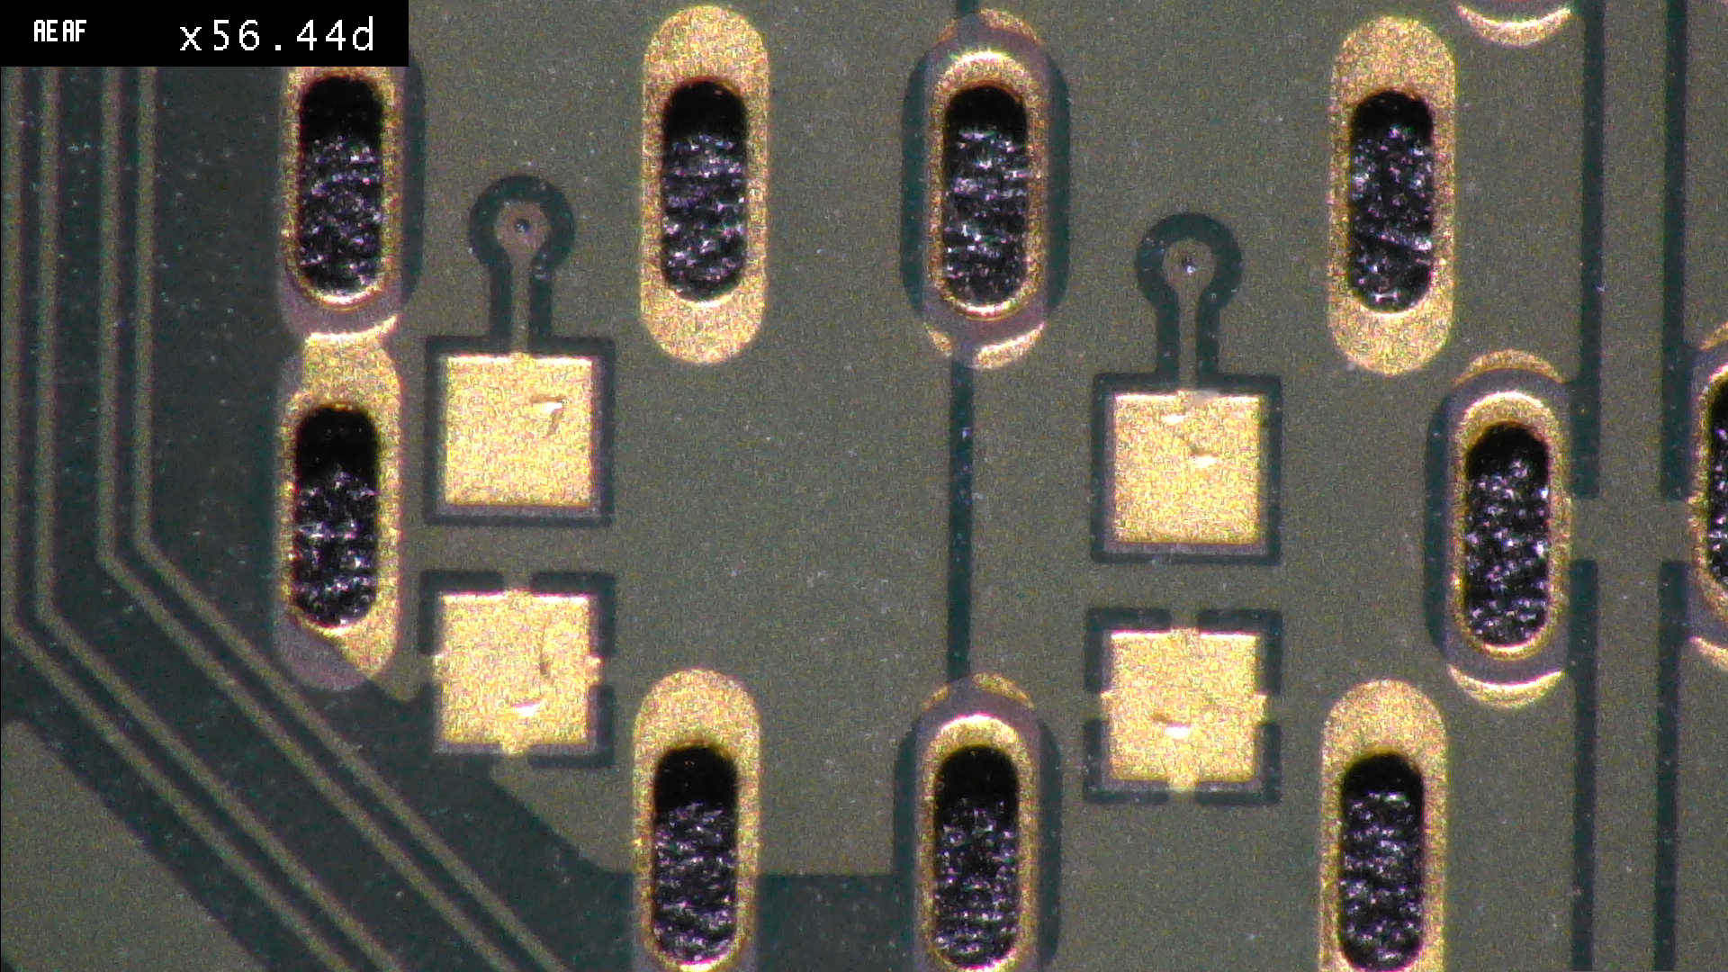
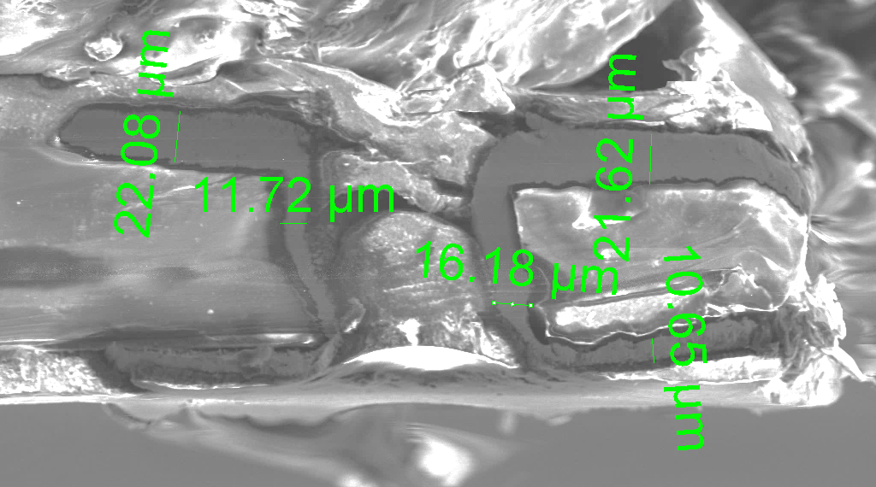
FPC Metallization Quality
Via metallization
Measurement at SEM and surface profile machine to
Measure the planarity of the pads
Verify the quality of the industrial process
Pad surface profile
Max roughness of 1.4 μm
Pad metallization
Via
Via high cross-section quality

