Slide 1
HIC and Stave Test Systems and Procedures
Markus Keil - CERN
ALICE ITS Upgrade
Stave Production Readiness Review
CERN, 27 April 2017

Slide 2
Executive Summary
The test strategy for the ITS HICs and envisages several testing steps, in order to guarantee the best possible quality of the produced staves.
Baseline procedures for all testing steps have been devised, based on the experience with prototype and pre-production HICs; the necessary setups have been designed and prototypes for all crucial components have been produced.
After a final testing phase the production of the test setups will be started in the coming weeks.
A GUI has been designed to allow comfortable testing for the operator. The GUI is based on the currently used characterisation software. Additional components for communication with the power boards and the production database have been developed. The final integration of the GUI is ongoing.

Slide 3
OUTLINE
Test Procedure
Test Setups – Basic Components
Test Stages and Setups
Software Architecture

Slide 4
Test Procedure – Overview
HIC Assembly
Reception Test
Tab Cutting
HIC Qualification Test
Powering Test
HIC Production Site
Stave Assembly Site
Mounting on Stave
Endurance Test
Test Before Curing
Shipping to Stave Assembly Site
Completion of HS
Half-Stave Test

Slide 5
OUTLINE
Test Procedure
Test Setups – Basic Components
Test Stages and Setups
Software Architecture

Slide 6
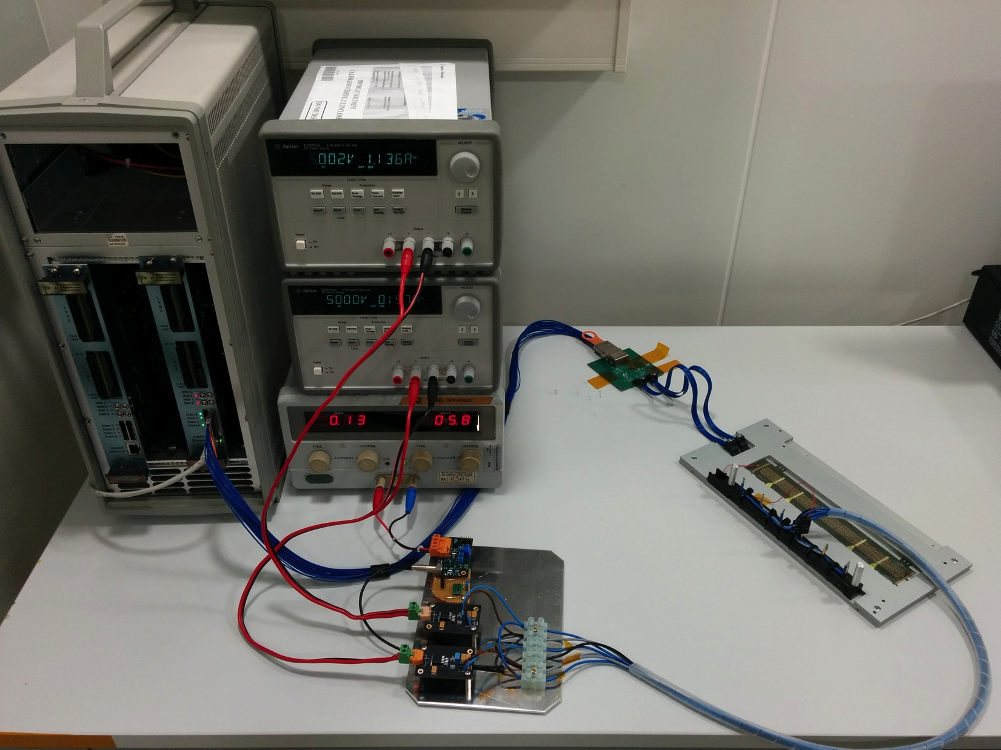
Test Setup
All production test setups are based on the setup that is already in use for prototype and pre-production testing (photo):
Control and readout of the HICs / staves is done with the MOSAIC board.
Connection to the HICs through SAMTEC Eyespeed and Firefly cables
Powering:
During pre-production done with standalone regulator boards, in production with ITS power boards
Power board cooling: for single modules ventilation is sufficient, for stave and endurance test power boards are cooled with chiller

Slide 7
Test Setup
HICs will be on a support plate from assembly up to mounting on the half-stave
For (reversible) power connection a power adapter with spring loaded probes is mounted above the test pads of the cross cables
A PCB with local decoupling routes the power lines to a connector at the end of the carrier plate
Prototypes of all components successfully used for pre-production series

Slide 8
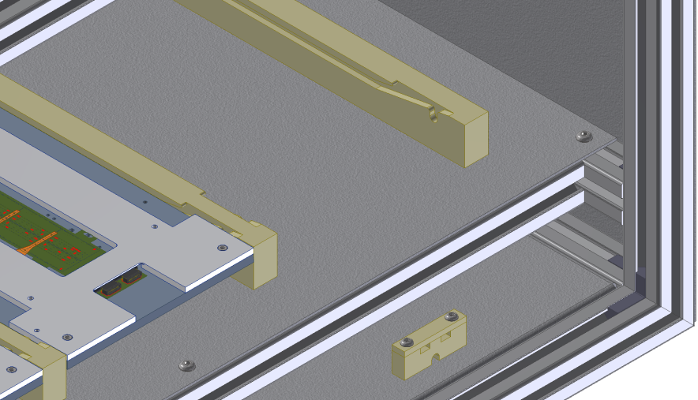
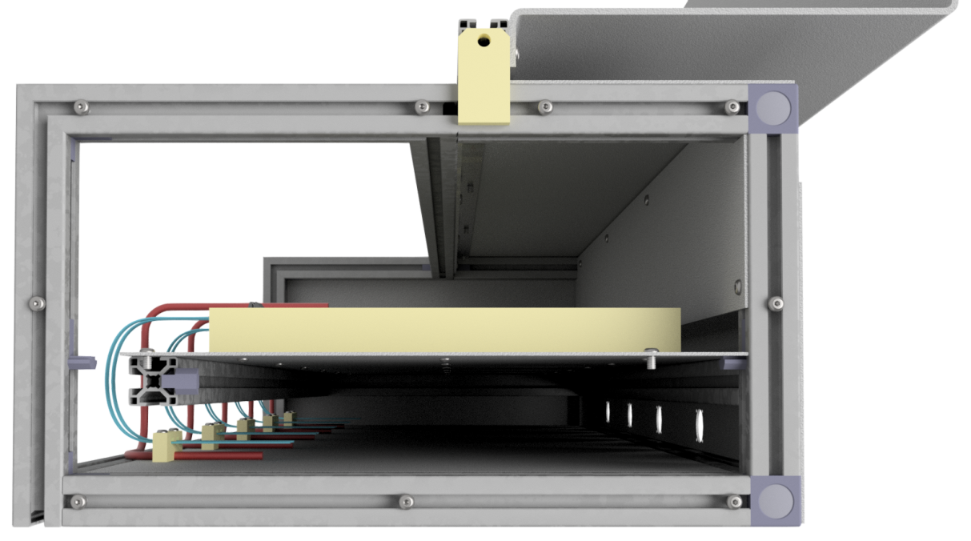
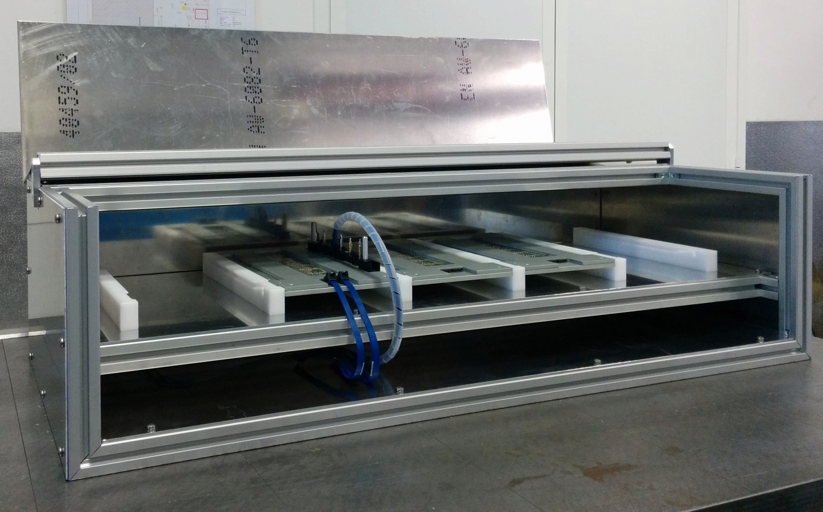
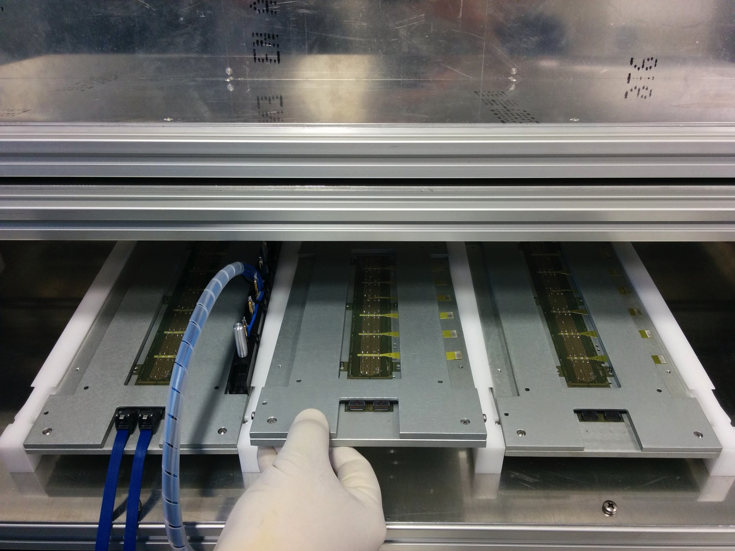
Mechanical Setup
For testing the HIC will be placed in a light-tight setup with ventilation
HIC slides with carrier plate and power adaptor into guide rails
Identical concept for single module and for endurance test setup (shown here: endurance test setup for 5 HICs)

Slide 9
OUTLINE
Test Procedure
Test Setups – Basic Components
Test Stages and Setups
Software Architecture

Slide 10
HIC Qualification Test
Purpose: This is the first test of the HIC after assembly. The purpose is an assessment of the HIC quality as well as a determination of the operating point
Time: 4 hrs / HIC available, planned program needs < 2 hrs
Procedure:
Powering test: measure supply currents and I-V-curve on substrate bias
Test of control communication
Test of readout with digital injections
Vary DTU parameters to determine optimal settings
Repeat for upper and lower corners of digital supply
Threshold tuning; equalise chip thresholds
Threshold scan over full HIC
Measure noise occupancy and determine noise mask
With and without reverse substrate bias

Slide 11
HIC Qualification Test – Setup
Setup basically identical to currently used prototype setup with two modifications:
HIC placed in light-tight, ventilated box
Powering is done with power board, which allows automatic setting of voltages and reading of currents (prototypes tested, final version expected end of May)

Slide 12
Endurance Test
Purpose: Exercise the HICs for an extended period of time and exclude infant mortality
Procedure:
Operate 10 HICs at a time for 7 days, including power cycling, configuration, triggering (10 modules correspond to one week of production / site)
Monitor supply currents during test
At the end of test: perform digital and threshold scan and compare results with HIC qualification test

Slide 13
Endurance Test – Setup
Changes with respect to HIC qualification setup:
Setup holds five modules in parallel (2 setups per site)
Adapter needs to accommodate 10 control interfaces with duplicate module / chip IDs
Adapter and setup designed, produced and currently under test

Slide 14
Reception Test
Purpose: Exclude transport damage after shipping from HIC to stave assembly site
Procedure:
Powering test: measure supply currents and current on substrate bias
Test of control communication with register readback test (FIFO test)
Test of data readout with digital injections
Setup: identical to module qualification test

Slide 15
Powering Test
Purpose: Exclude mechanical damage to the HIC during tab cutting and mounting on the stave. The latter is to be done before glue curing, such that in case of damage the HIC can still be removed.
Procedure:
At this point (after the tab cutting) control and data lines are not accessible; the procedure therefore consists in a mere powering test:
Powering test: measure supply currents and I-V-curve on substrate bias
Setup: power adapter contacting the cross cables

Slide 16
Half-Stave Test
Purpose: Verify functionality of modules after half-stave assembly
Characterise modules in close-to-final environment
Procedure:
Powering test on all modules: measure supply and substrate bias current
Test of control communication with FIFO test
Test of data readout with digital injections
Threshold scan with and without reverse substrate bias
Noise occupancy measurement with and without reverse substrate bias
Repeat for upper and lower corner of digital supply voltage

Slide 17
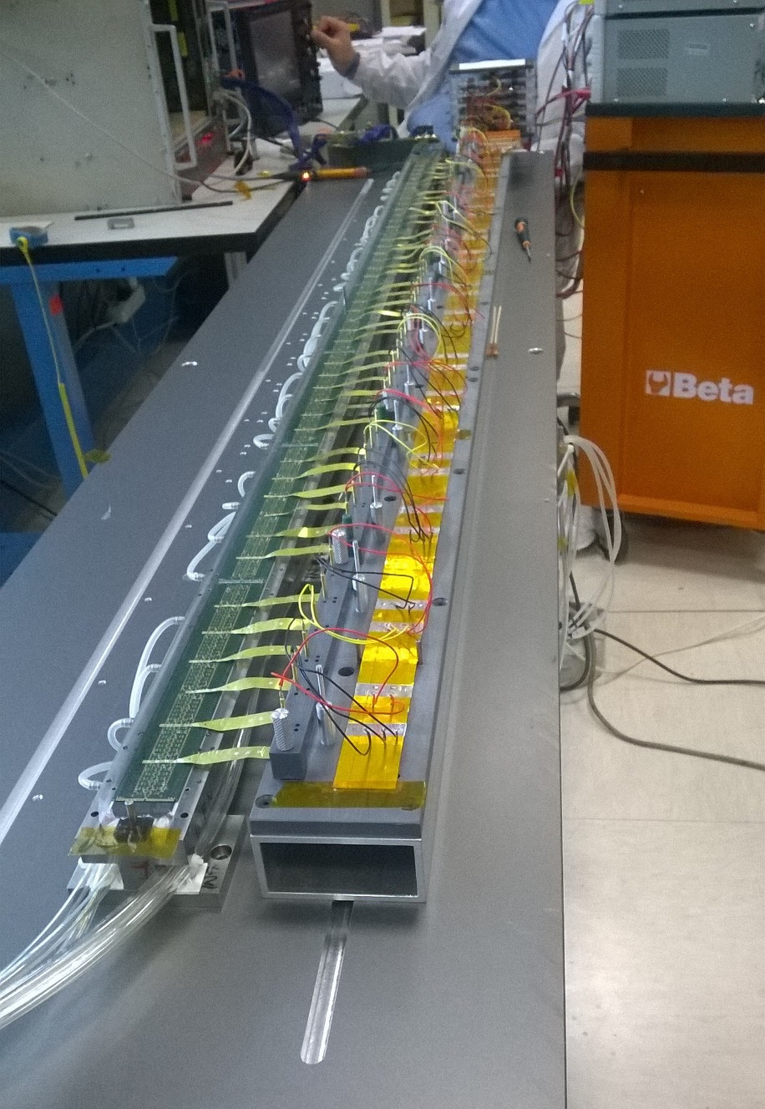
Half-Stave Test – Setup
Changes with respect to HIC qualification setup:
Each module is powered through a power adaptor. The connection between the power adaptors and the power board is done through the “real” powering chain of power bus and filter board (photo)
To read the 7 modules of a HS two MOSAICs and a special adapter are needed. (photo below).
The HS is cooled during the test

Slide 18
OUTLINE
Test Procedure
Test Setups – Basic Components
Test Stages and Setups
Software Architecture

Slide 19
Software Architecture
Only user interface is a single GUI, which loads the necessary libraries to connect to the hardware and the database
The scan routines are the same as currently used for characterisation; power board driver and database interface have been developed and tested standalone, integration into GUI is ongoing
GUI
Alpide
Driver
MOSAIC
Driver
Power Board
Driver
Database
Interface
Currently used characterisation software

Slide 20
Data Handling
Data analysis and database interface are integrated into the GUI. Different levels of data storage are foreseen:
Stored as value in database: single, numeric parameters e.g.: currents, number of dead pixels, avg. threshold and noise per chip …
Stored as attachment in database: text files e.g.: config files, list of dead pixels
Stored on eos with link in data base: processed, voluminous data Example: maps of thresholds
Not stored: raw data Example: histograms of hits vs charge in threshold scan

Slide 21
Component Status
Support plate and power adaptor: Designed, prototypes produced and in use; production to be started as soon as first experience completed
Adaptors for readout path:
Adaptor for endurance test developed, prototype under test; adaptors for all other setups produced and already in use
Mechanical setup:
Designed, prototype under test
Software:
Core software is the one already in use for characterisation; standalone version of power board driver and database interface existing.
First version of GUI existing and tested with integrated threshold scan, remaining integration ongoing

Slide 22
Component Status
MOSAIC readout cards: Available
Power boards:
Tests done with prototypes, final version expected to be available end of May
“Off-the-shelf” components:
Mostly identified, to be ordered in the coming weeks

Slide 23
Executive Summary
The test strategy for the ITS HICs and envisages several testing steps, in order to guarantee the best possible quality of the produced staves.
Baseline procedures for all testing steps have been devised, based on the experience with prototype and pre-production HICs; the necessary setups have been designed and prototypes for all crucial components have been produced.
After a final testing phase the production of the test setups will be started in the coming weeks.
A GUI has been designed to allow comfortable testing for the operator. The GUI is based on the currently used characterisation software. Additional components for communication with the power boards and the production database have been developed. The final integration of the GUI is ongoing.

