Slide 1

ALICE
Characterisation of IB HICs
Staves production readiness review – 27 April 2017

Slide 2
Introduction

Slide 3
Test Procedure – Overview
To be more comparable to the experiment, the test setup used for the results shown in this presentation has been modified w.r.t. the production test setup:
Powering: powering is done with a prototype powerboard and 5 m long cables
Data readout: the readout is done through a 5 m long Firefly cable
Data transmission: for tests of the data transmission a prototype of the ITS readout unit is used instead of the MOSAIC test board

Slide 4
Electrical Characterisation

Slide 5
Static Voltage Drop
Measurement of the supply voltages at the decoupling capacitors along the HIC
Drop in DVDD 48 mV between chip 0 and 8, comparable to simulation (52 mV)
Drop in AVDD 14 mV, much better than simulation (60 mV), due to lower current
Drop on extension comparable to drop along HIC
Currents during measurement: digital 885 mA, analog 110 mA
(simulation 900 / 450)
New

Slide 6
Dynamic Voltage Drop
New
Digital voltage at last chip on HIC, injection of 512 pixels, 100 kHz Trigger rate
Setup: Power board + 5 m power cable
Train of 1000 triggers, voltage saturates at ΔV = – 30 mV

Slide 7
Dynamic Voltage Drop
New
Digital voltage at power extension, injection of 512 pixels, 100 kHz Trigger rate
Setup: Power board + 5 m power cable
Train of 1000 triggers, voltage saturates at ΔV = – 22 mV

Slide 8
Signal Attenuation
Measurement of the high speed signals, comparison of chip 0 vs. chip 8, comparison with simulation

Slide 9
Data Transmission

Slide 10
Data Quality
Bathtub diagrams with max. occupancy, 100 kHz injections + triggers, full detector slice (data taken, diagrams to be prepared)

Slide 11
Operating Range
Digital Scan working between 1.3 V and 2.2 V

Slide 12
Functional Characterisation

Slide 13
Threshold Scan
Threshold (top) and noise (bottom) measured on a HIC

Slide 14
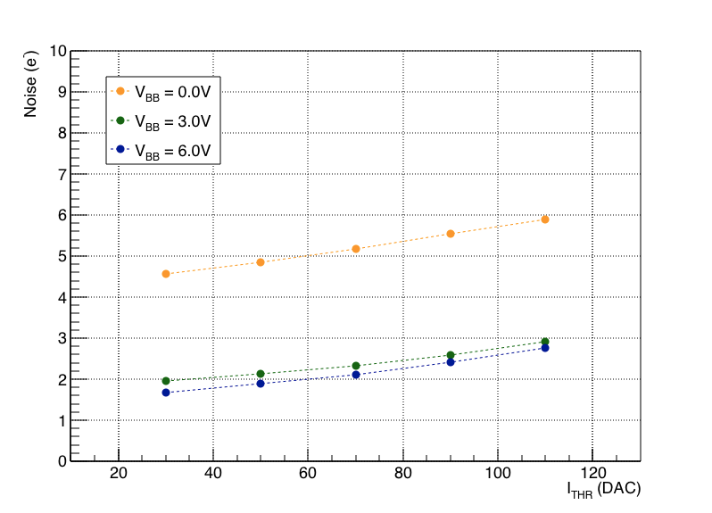
Noise Performance
Avg. noise of chips on HIC as a function of chip position
From ALPIDE PRR (for comparison):
Noise of single ALPIDE chips as a function of ITHR
Noise extracted from threshold scan (s-curve fit):
Measured noise values ~ 5 e without back bias, ~ 3 e with 3 V back bias
Noise independent of position of chip on HIC
Noise values in good agreement with noise measured on single chip

Slide 15
Noise over all chips
New, to be fixed

Slide 16
Comparison with chip tests
Threshold chip test vs threshold HIC test
New, to be fixed

Slide 17
New, to be fixed

Slide 18
Noise Occupancy
Noise Occupancy measured with random triggers, for all chips of a HIC
Left plot: noise occupancy vs. number of masked pixels; in most cases noise concentrated in <10 noisy pixels
Right plot: noise occupancy per chip as a function of threshold
(5 pixels per chip masked, i.e. 1 / 100000)

Slide 19
Ageing Tests

Slide 20
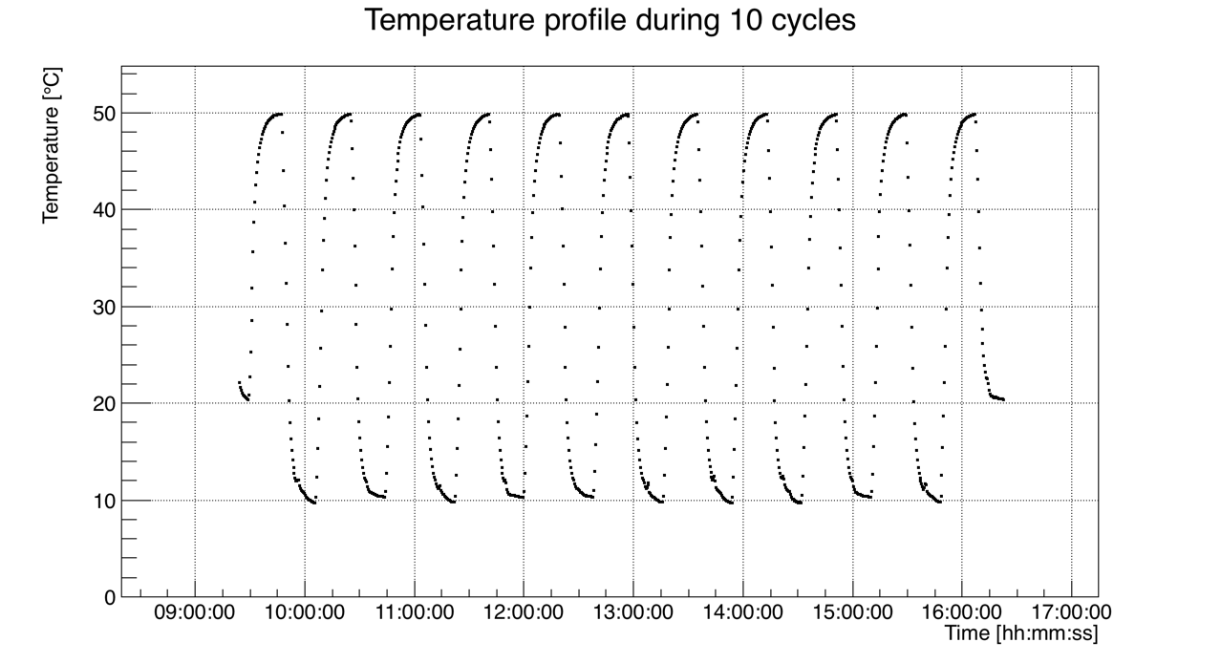
Thermal Cycling
Description of cycles
List of tested devices

Slide 21
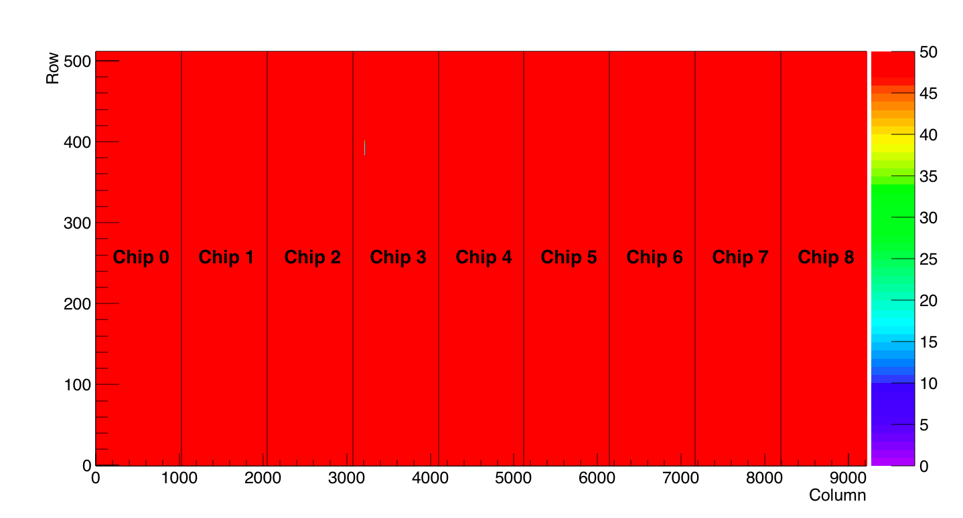
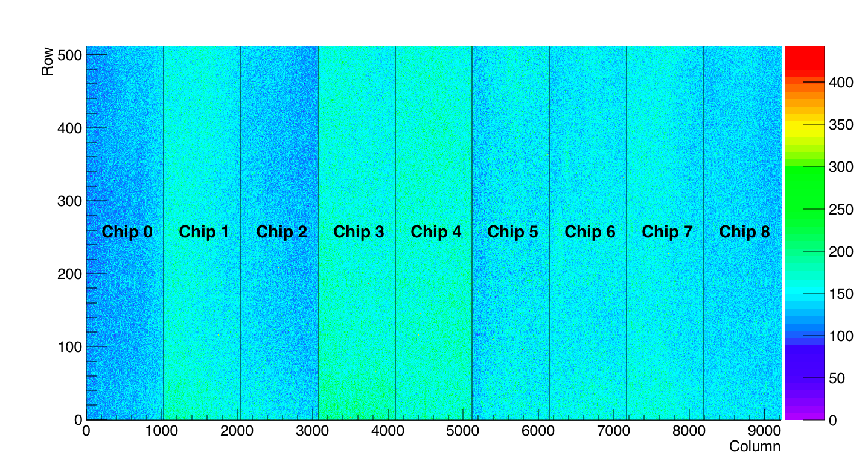
Thermal Cycling Results
All HICs still working after thermal cycling, here: HIC 14 after 300 cycles (digital + threshold)

Slide 22
Thermal Cycling Results
Comparison of performance before and after cycling (HIC 14)
Chip | Dead Pixels
 | Before | After
0 | 0 | 0
1 | 1 | 1
2 | 0 | 0
3 | 678 | 678
4 | 1701 | 1701
5 | 1022 | 1022
6 | 0 | 0
7 | 1022 | 1022
8 | 0 | 0

Slide 23
Magnet Tests
Description of Setup and Procedure
  Chip in 0.5 T magnetic field
  Digital injections into 1024 pixels (3 – 4 times maximum occupancy in L0)
  Scan of trigger frequency between 40 kHz and 400 kHz
Results / Observations
  Chip still working after test
  Monitoring of digital supply wire bonds with USB microscope did not reveal any movement

Slide 24
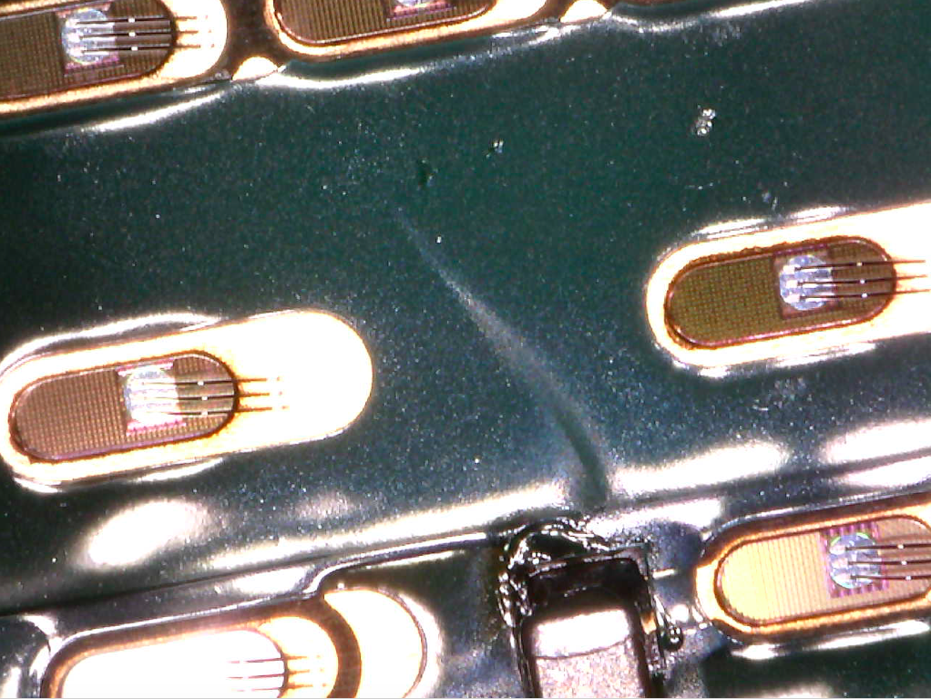
Magnet Tests
Microscope picture of DVDD wire bonds during magnet test
DGND
DVDD
DVDD

Slide 25
Stave Tests

Slide 26
Stave Tests
Functional Tests:
  Comparison HIC / Stave?
Metrology:
  Expansion during digital scan (12 um, no cooling!)
Ageing:
  Same as for HICs

