Slide 1
Characterisation of IB HIC and Stave Prototypes
Markus Keil - CERN
ALICE ITS Upgrade
Stave Production Readiness Review
CERN, 27 April 2017

Slide 2
Executive Summary
An extensive characterisation program has been executed with inner barrel HICs and staves.
The electrical characterisation shows characteristics well in agreement with simulations of the FPC whereas the functional characterisation demonstrates a performance comparable to single ALPIDE chips. On the level of individual chips the results of the HIC tests clearly reflect the results of prior probe station tests.
No significant difference in performance was found between bare HICs and HICs mounted on staves.
Ageing studies showed no evidence of damage, neither due to thermal cycles nor due to wire bond vibrations in a magnetic field.

Slide 3
OUTLINE
Introduction
Electrical Characterisation
Data Transmission
Threshold and Noise
Ageing
Stave Tests

Slide 4
Test Setup
In order to guarantee conditions as close as possible to the final detector, the test setup used for the measurements shown in this presentation has been modified with respect to the production test setup:
Powering: powering is done with a prototype power board, which is connected to the HIC through 5 m long cables
Data readout: Data readout is done through a 5 m long FireFly cable
Data transmission: for tests of the data transmission a prototype of the ITS readout unit is used instead of the MOSAIC test board

Slide 5
OUTLINE
Introduction
Electrical Characterisation
Data Transmission
Threshold and Noise
Ageing
Stave Tests

Slide 6
Static Voltage Drop
Measurement of the supply voltages at the decoupling capacitors along the HIC
Drop between first and last chip in DVDD 48 mV, in AVDD 14 mV
Both comparable to values from the simulation (52 mV / 15 mV)
Drop in extension comparable to drop along HIC
Currents during measurement: digital 885 mA, analogue 110 mA

Slide 7
Dynamic Voltage Drop
Digital Voltage at last chip on HIC during digital injections with 100 kHz into 512 pixels
Powering scheme: power board with full length (5 m) power cables
Train of 1000 triggers, voltage saturates at ΔV = - 30 mV
Time scale: 20 us / div
Time scale: 2 ms / div

Slide 8
Dynamic Voltage Drop
Same conditions but measured on the power extension
High-frequency component completely filtered by capacitors, voltage drop -22 mV
Time scale: 20 us / div
Time scale: 2 ms / div

Slide 9
Signal Attenuation
Comparison of HS data lines of first and last chip, measured on the FPC (connector end)
Measured attenuation ~13% , corresponding to -1.2 dB (note: distance between first and last chip is only half of total FPC length)

Slide 10
OUTLINE
Introduction
Electrical Characterisation
Data Transmission
Threshold and Noise
Ageing
Stave Tests

Slide 11
Data Quality
24 h PRBS bathtub tests with full detector slice
Measurement conditions: 100 kHz injections (max. L0 occupancy) and trigger, readout with 600 Mbps (left) and 1.2 Gbps (right)
BER (with 99% CL): < 9.87 x 10⁻¹⁵ for 600 Mbps and < 4.94 x 10⁻¹⁵ for 1.2 Gbps (limited by measurement time)

Slide 12
Readout Stability / Operating Range
Control Communication working for DVDD >= 1.1 V Data readout working for DVDD >= 1.3 V
Left figure: digital scan @ 1.5 V (lowest set voltage of power board, voltage on HIC: 1.39 V)
Right figure: scan of voltage over broader range with lab power supply
no data corruption over full range, slight change in number of bad pixels (sub-per-mill)

Slide 13
OUTLINE
Introduction
Electrical Characterisation
Data Transmission
Threshold and Noise
Ageing
Stave Tests

Slide 14
Threshold Scan
Threshold (top) and noise (bottom) measured on HIC 14 (after thermal cycling)

Slide 15
Threshold Variation
Threshold vs. chip position for 5 different HICs (normalised to average of resp. HIC)
No systematic trend visible, threshold variation dominated by random chip-to-chip variation
(In either case variation can be adjusted for)

Slide 16
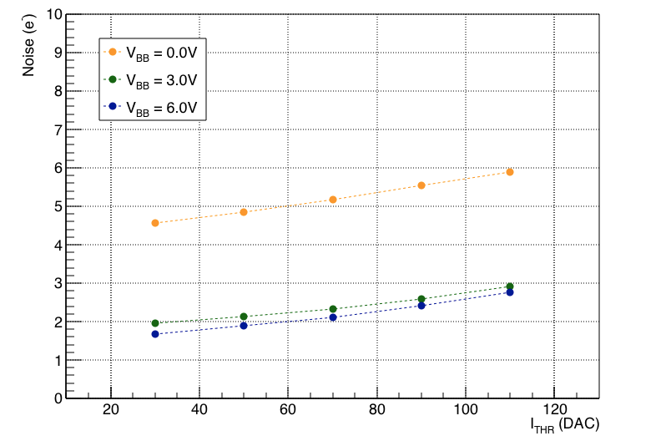
Noise Performance
Noise extracted from threshold scan (s-curve fit):
Measured noise values ~5e without back bias, ~3e with 3 V back bias
Noise independent on position of chip on HIC
Noise values in good agreement with values measured on single chip
Avg. noise of chips on HIC as a function of chip position
From ALPIDE PRR (for comparison): Noise of single ALPIDE chips as a function of ITHR

Slide 17
Noise
Noise homogeneous over all tested HICs (here: average noise values for the chips of 6 HICs)

Slide 18
Comparison with Chip Tests
Comparison of thresholds (chip average) between probe test and measurement on HIC
Absolute value depends on measurement condition, but values clearly correlated

Slide 19
Comparison with Chip Tests
Comparison of number of broken pixels between HIC and Probe tests for all chips of 6 HICs:
Green: number of broken pixels for same chip lower on HIC, Red: lower in probe test
In large majority of cases number is lower on HIC
In particular, very few instances where number of broken pixels was 0 in probe test, > 0 on HIC

Slide 20
Noise Occupancy
Noise occupancy measured from data taking with random triggers:
Left plot: noise occupancy as function of masked pixels -> in most cases noise concentrated in < 10 noisy pixels
Right plot: noise occupancy with 5 pixels (i.e. 1/100000) masked as a function of threshold

Slide 21
OUTLINE
Introduction
Electrical Characterisation
Data Transmission
Threshold and Noise
Ageing
Stave Tests

Slide 22
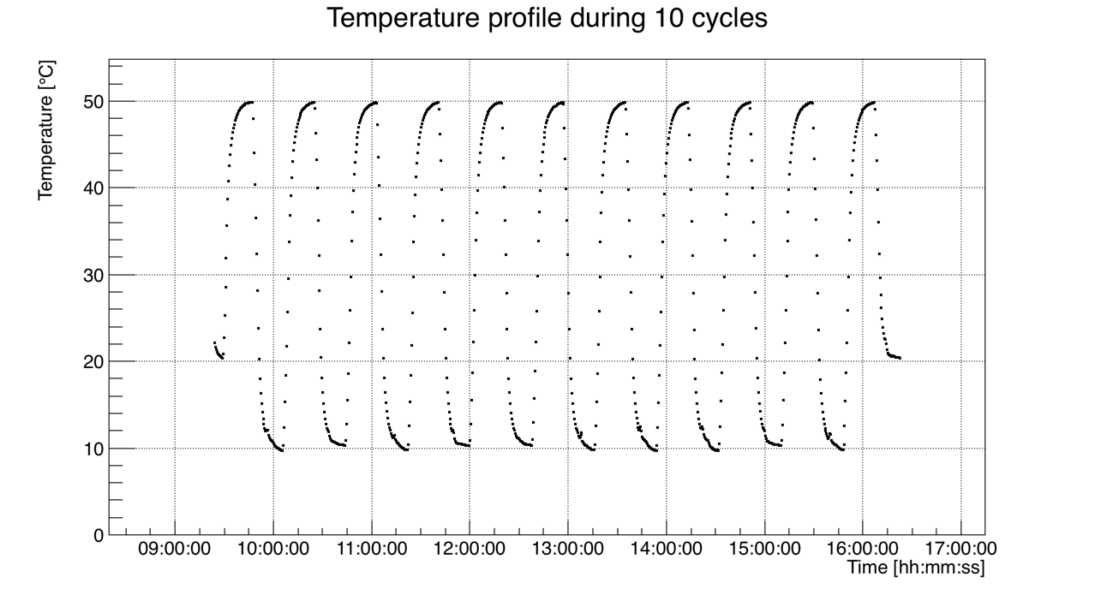
Thermal Cycling
Performed thermal cycling on several devices:
300 cycles 10 – 50 deg C (corresponding to 10 years of operation) plus “non-operative” cycles (10-60 deg C)
Tested devices: 7 HICs (5 complete) and 1 stave (expected to finish Mon, April 24)

Slide 23
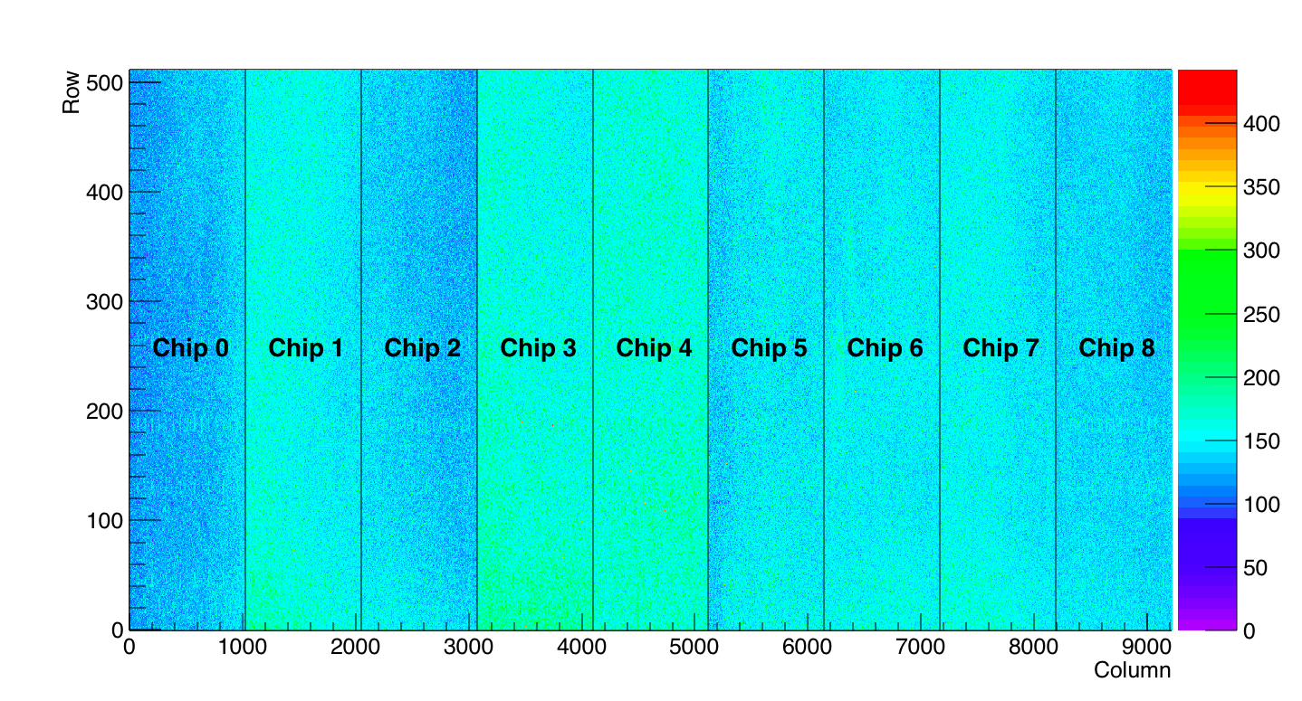
Thermal Cycling Results
All devices still working after full number of cycles:
Visual inspection shows no broken wire bonds
Functional tests show no or only very minor differences (below: threshold map of HIC after cycling)

Slide 24
Thermal Cycling: Comparison Before – After
Comparison of performance before an after thermal cycling (HIC 14)
Chip | Dead Pixels
 | Before | After
0 | 0 | 0
1 | 1 | 1
2 | 0 | 0
3 | 678 | 678
4 | 1701 | 1701
5 | 1022 | 1022
6 | 0 | 0
7 | 1022 | 1022
8 | 0 | 0

Slide 25
Tests in Magnetic Field
Setup and Procedure:
Chip placed in 0.5 T magnetic field with bond wires parallel to B-field
Digital injections into 1024 pixels (3 – 4 times max. occupancy expected in L0)
Scan of trigger frequency between 40 kHz and 400 kHz
Observations:
Chip kept working throughout (and after) test
Monitoring of bond wires with USB microscope did not reveal any movement of the bond wires (next slide)

Slide 26
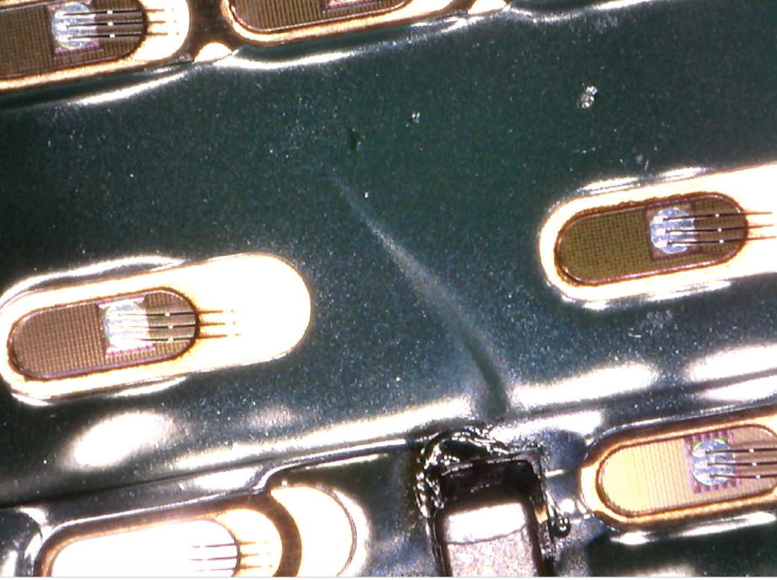
Tests in Magnetic Field
Microscope picture of bond wires (digital supply) during magnetic field test
DGND
DVDD
DVDD

Slide 27
OUTLINE
Introduction
Electrical Characterisation
Data Transmission
Threshold and Noise
Ageing
Stave Tests

Slide 28
Stave Tests
The same functional characterisation has been performed for HICs and staves; no difference in performance has been observed. Below: comparison for a HIC before and after mounting on a stave
Left: Comparison of noise per chip
Right: Correlation of thresholds

Slide 29
Executive Summary
An extensive characterisation program has been executed with inner barrel HICs and staves.
The electrical characterisation shows characteristics well in agreement with simulations of the FPC whereas the functional characterisation demonstrates a performance comparable to single ALPIDE chips.
No significant difference in performance was found between bare HICs and HICs mounted on staves.
Ageing studies showed no evidence of damage, neither due to thermal cycles nor due to wire bond vibrations in a magnetic field.

