Slide 1
IB Stave construction and prototypes
ALICE ITS Upgrade
Stave Production Readiness Review
CERN, 27 April 2017

Slide 2
Introduction
The stave assembly procedure has been established with the aim to ensure
  chip integrity (IB silicon chips are thinned to 50 μm)
  precise alignment to better than 10 μm of full stave
  reliable and reproducible results
The main steps are
  Chips alignment
  Chips gluing on FPC (HIC) and wire bonding
  HIC gluing on carbon fiber spaceframe (STAVE)
After the EDR, we focused mainly on 2) since 1) is ensured by the MAM and 3) was already well advanced

Slide 3
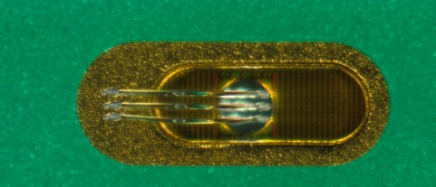
Interconnection Layout
Hybrid Integrated Circuit (HIC) schematic cross section
coverlay 20 um
Al 25 um
p.i. 75 um
Al 25 um
coverlay 20 um
Main constraints for FPC to silicon gluing:
Optimize/minimize amount of glue
Ensure good adherence under FPC pads, no vibrations during wire bonding
Prevent glue contamination of pads to be bonded
Optimisation of gluing mask
Characterisation of glue layer
Upilex-75S
FPC
Ablestik 45W 90 um
ALPIDE 50 um
glue
silicon
(power supply connection)

Slide 4
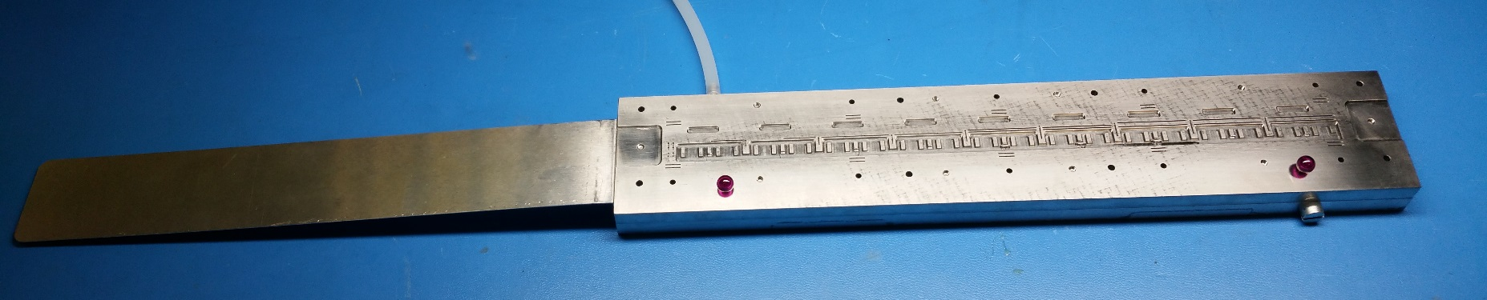
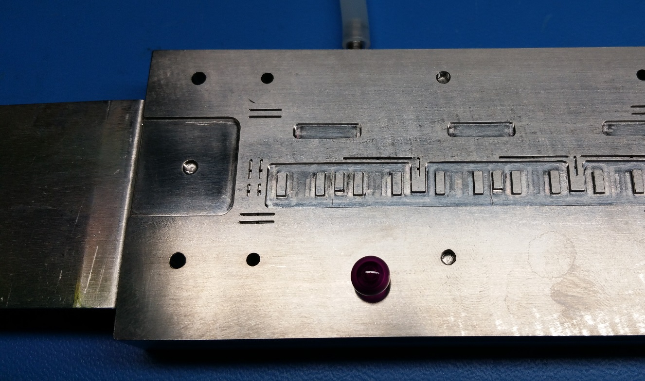
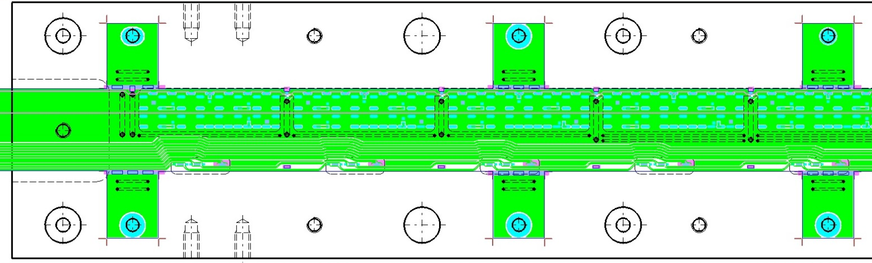
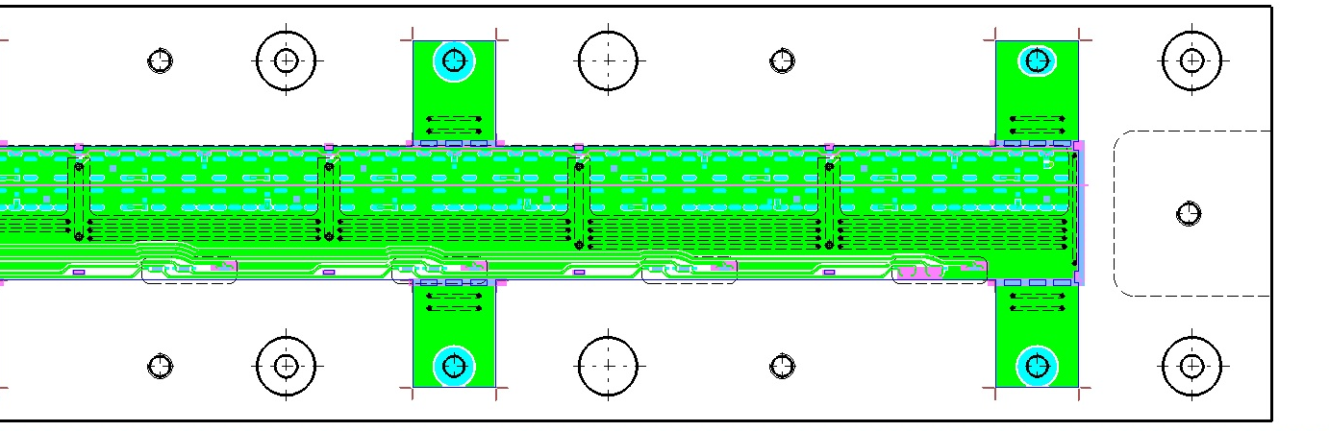
Jigs for HIC Assembly
FPC gripper
FPC extension support
(temporary)
Recess to accommodate SMD and wire bonds
Grooves for vacuum clamping
Planarity: 15 um

Slide 5
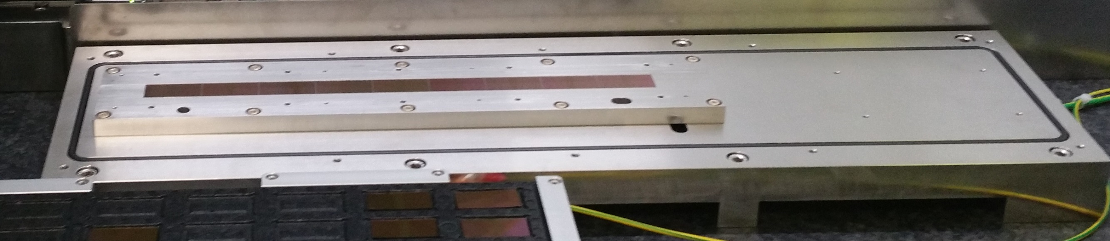
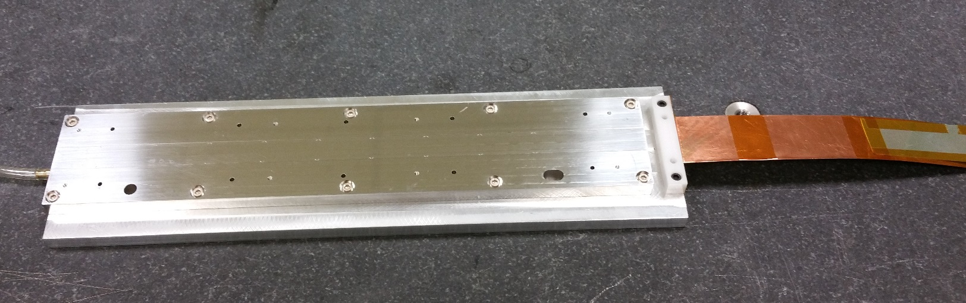
Jigs for HIC Assembly
Chips vacuum chuck
(HIC assembly table)
Planarity: 13 um
Wire bonding table

Slide 6
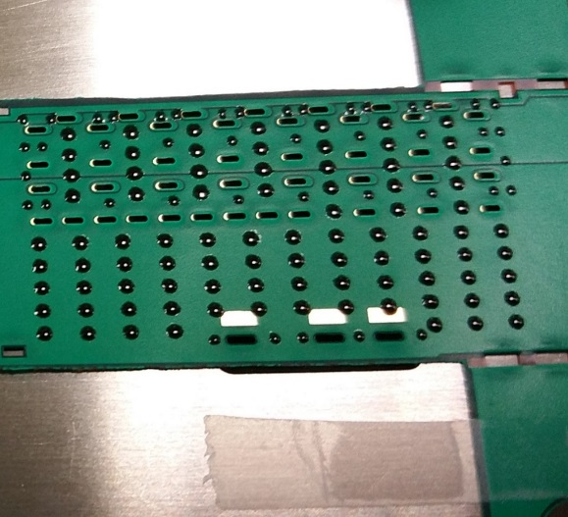
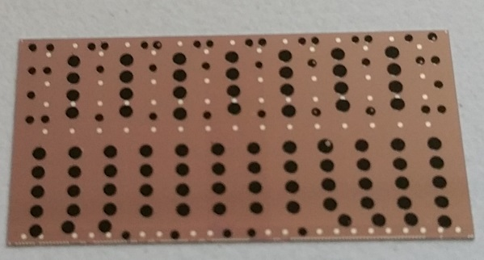
Gluing Mask Optimisation
Initially the procedure to glue FPC and chips was based on adhesive mask Oracal 638, 90 μm thick associated to shimming producing a final glue layer of 50 μm. This turned out to be incompatible with the sum of the assembly tolerances involved ➔ glue layer was increased to 90 μm
Other critical items optimized since EDR
  Glue spots not close enough to vias edges
  Weak adherence
Assembly stack-up
FPC gripper
FPC
glue
silicon
Chip vacuum chuck
Component | Tolerance
Chip vacuum chuck planarity | 13 um
Chip thickness | 5 um
FPC thickness (5 sigma) | 20 um
FPC vacuum chuck | 15 um
Shimming (5 sigma) | 5 μm
TOTAL (linear) | 58 um
Glass plate glued on chip using mask with 50 um shimming

Slide 7
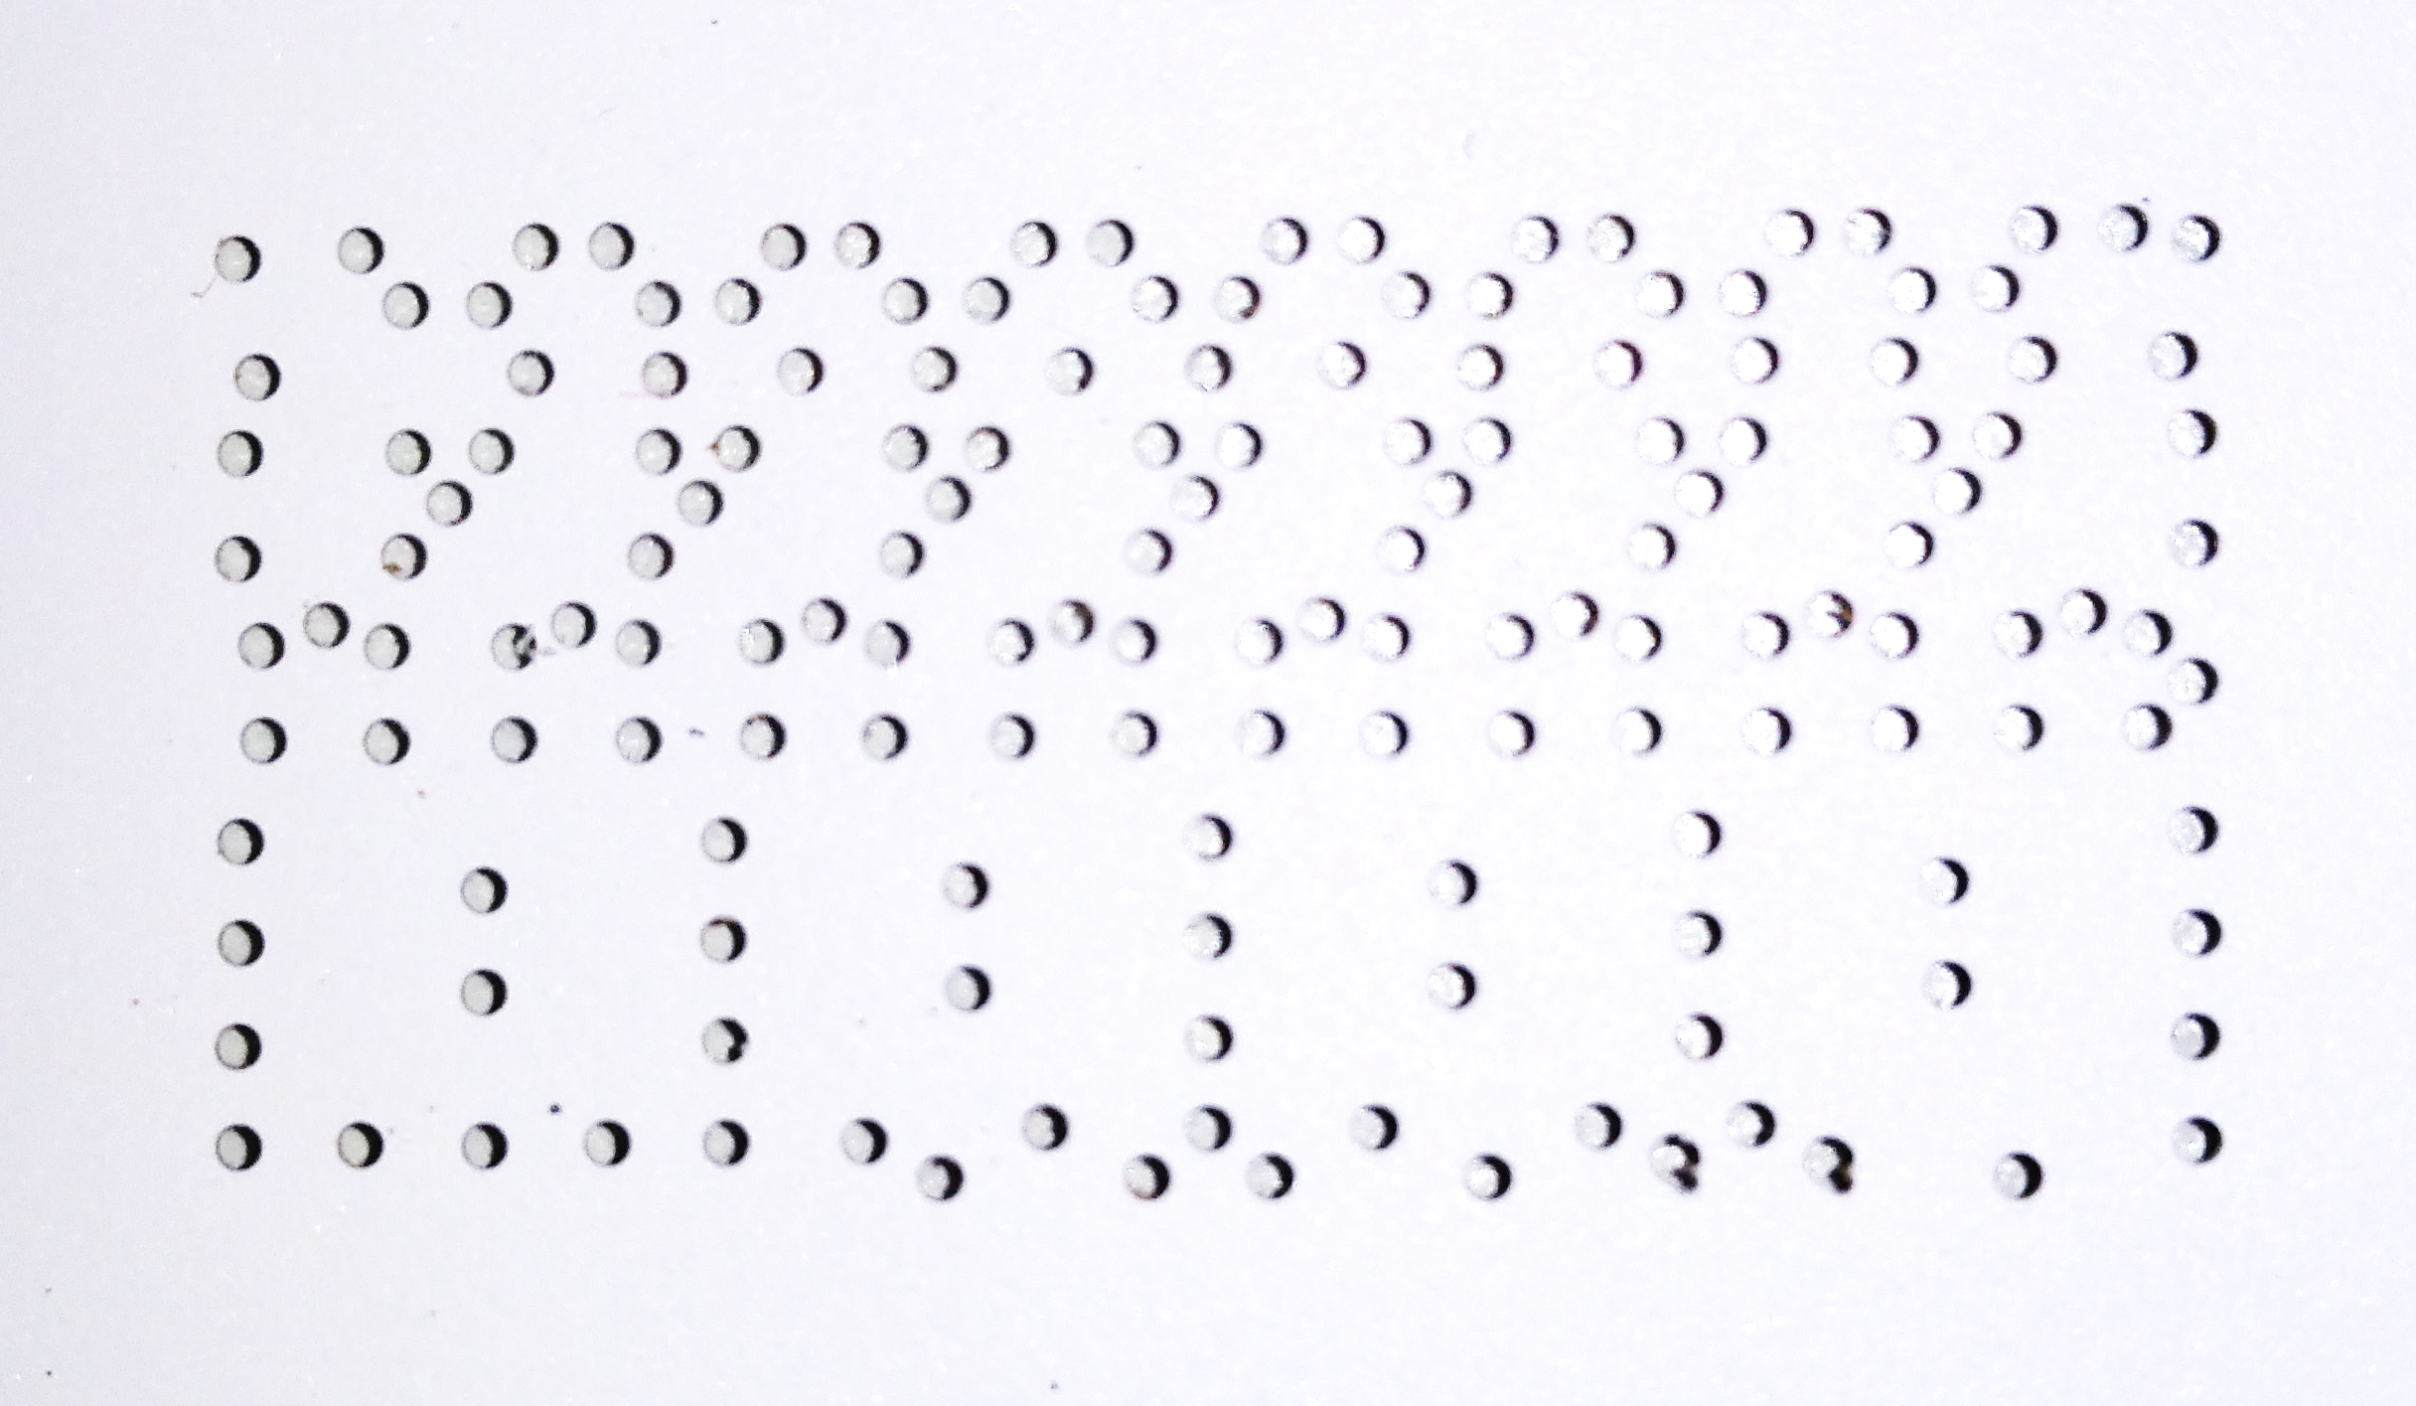
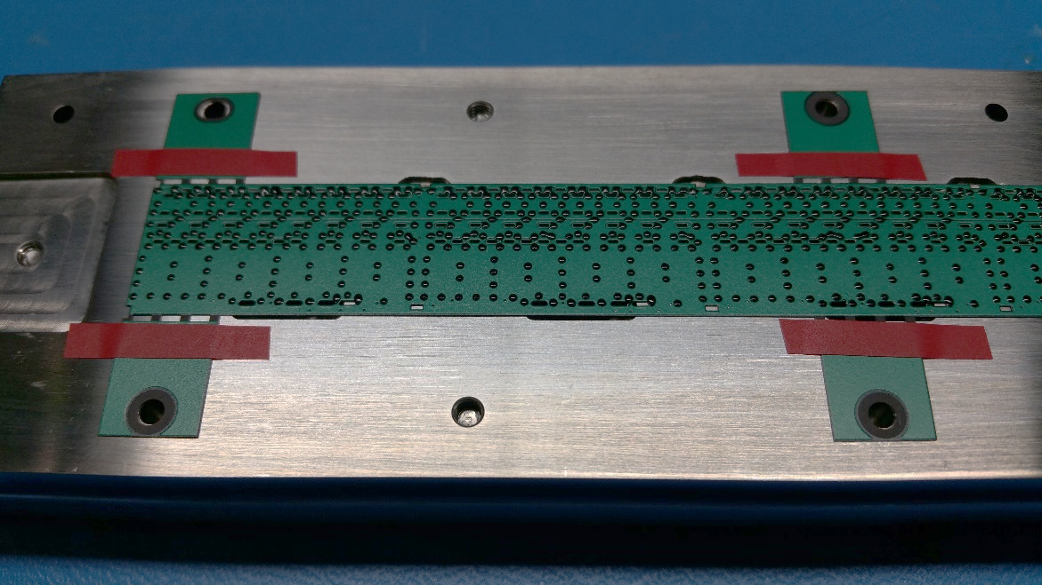
Gluing mask optimisation
Upgraded gluing procedure
  Optimised holes amount and geometry (remove holes where not necessary, use everywhere Ø 0.7 mm)
  SDAG adhesive film RS-150-137 (150 um thick) with 90 um shimming (Oracal 638 tape)
  Hand mixing of 3g of glue for 30”, instead of plastic mixer nozzle

Slide 8
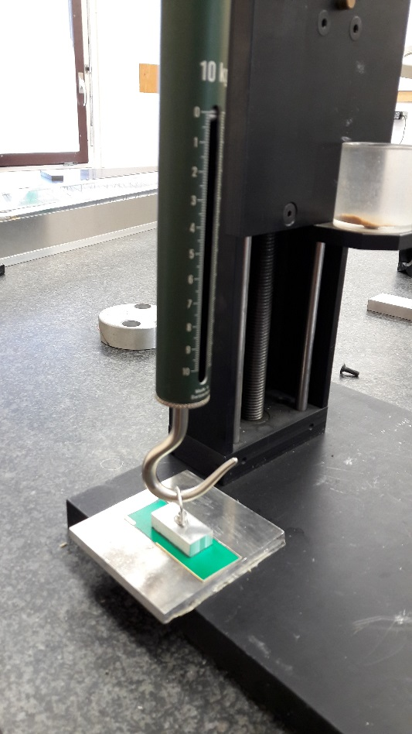
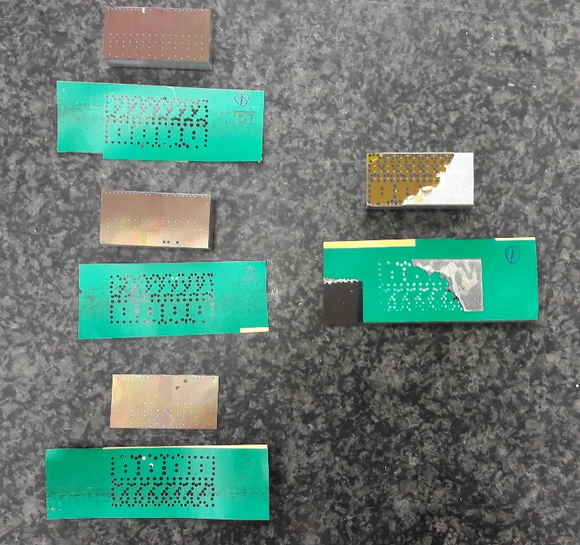
Glue Characterisation
Chemical analysis for ionic impurities (MIL STD 883H): dangerous ions concentration is below threshold
Pull tests
Single chips glued to 3 FPC samples using same HIC procedure
In all cases the glue stays on the FPC
Max load for standard 50 um chip : 3.9 kg
Max load for PIQ coated 100 um chip: 6.9 kg
Veritas laboratories (F)

Slide 9
HIC Assembly Procedure Overview
Chip automated inspection in ALICIA
Chip alignment on ALICIA assembly table
FPC clamping by vacuum on dedicated jig, alignment using dowel pins
Adhesive mask application on FPC and glue distribution
Mask removal, check of glue spots, application of shims (adhesive tape) on FPC wings
Flip FPC and overlap on chips using ruby balls for alignment
Curing on assembly table at room T for 12 h
Transfer on wire bonding jig
Visual inspection
Chips interconnection by wire-bonding
Transfer on HIC storage plate and electrical test

Slide 10
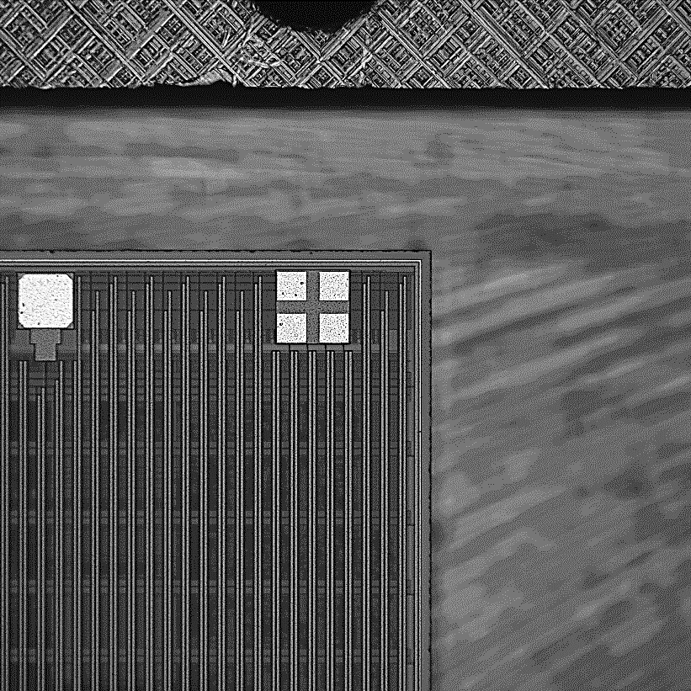
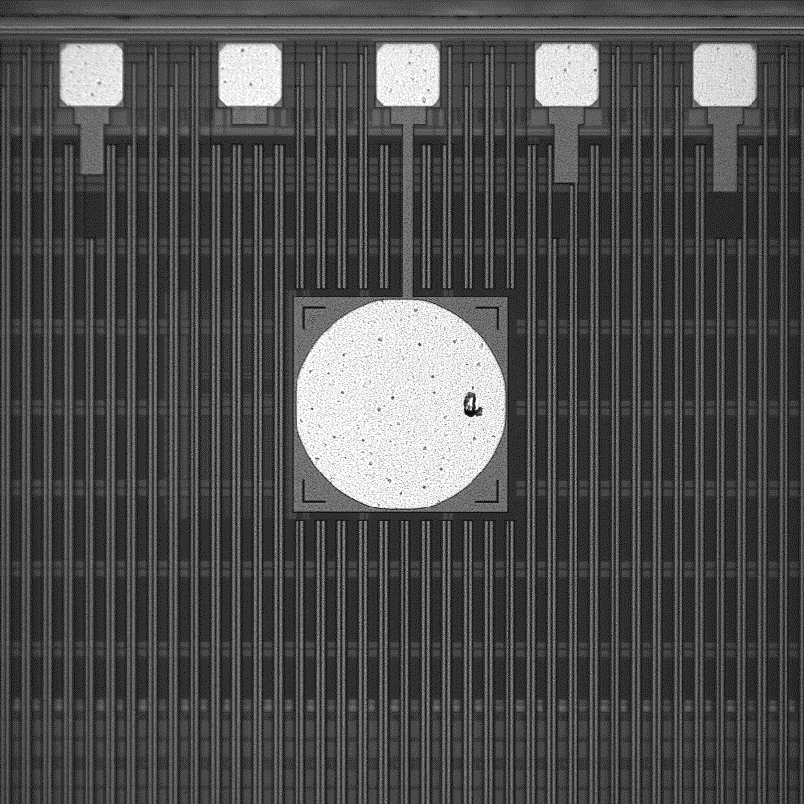
1. Chips Inspection
Chips are identified by the serial no. of the storage tray and by the position inside it. Each position in a tray is uniquely associated to a position in the original wafer
Prior to assembly, chips are inspected to verify dimensions (the size shall not differ from nominal one by more than ±5 μm), edge integrity (no cracks shall be present at a distance shorter than 10 μm from the seal ring) and pad cleanliness (the total area occupied by one or more particles shall not exceed 10% of the pad surface).

Slide 11
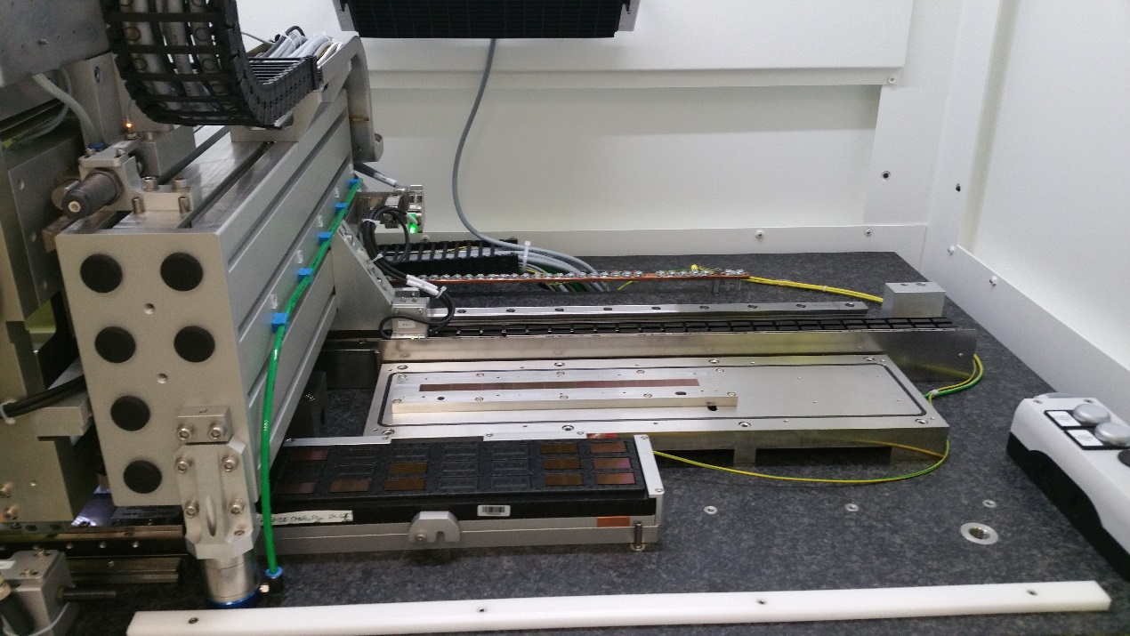
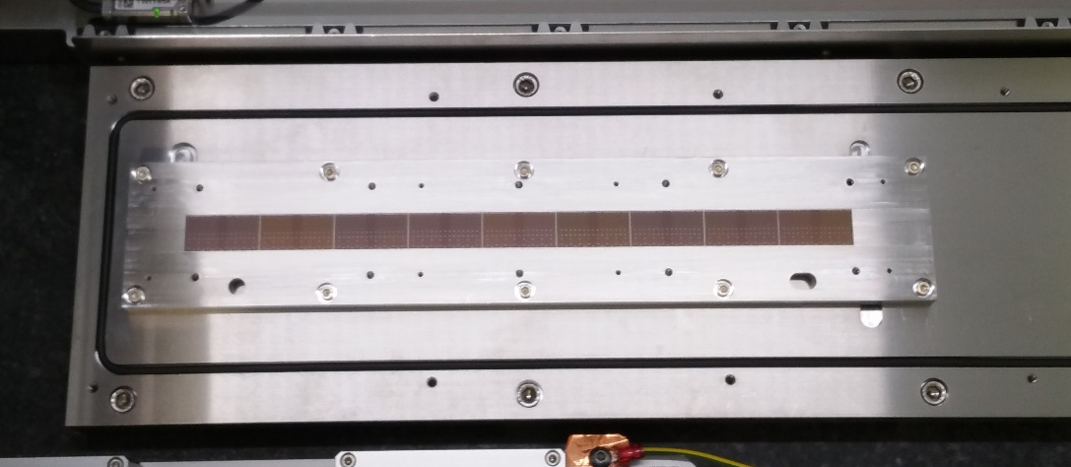
2. Chip Alignment on Assembly table Vacuum Chuck
Chips which pass the quality inspection are aligned on the vacuum chuck of the assembly table
An accuracy of ± 5 μm is required on the position; the gap between the chips is 150 μm (seal-ring to seal-ring)

Slide 12
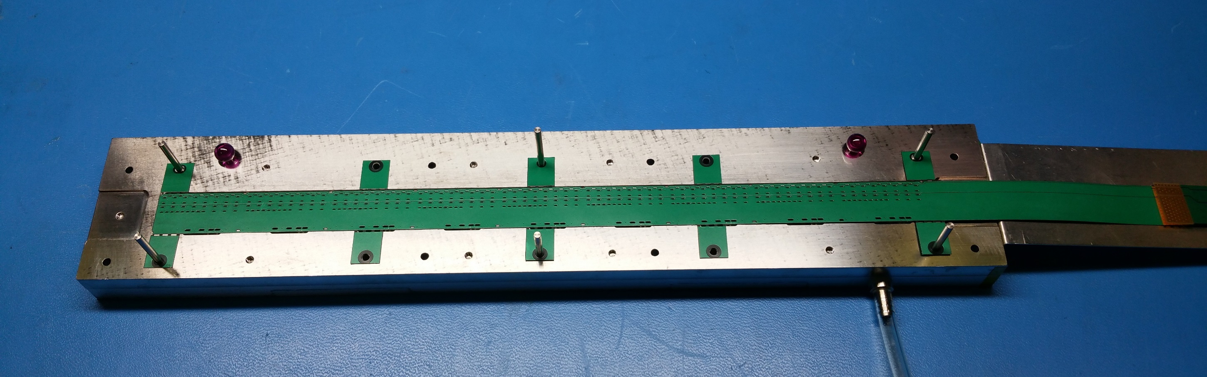
3. FPC Mounting on Gripper
The FPC is aligned on the gripper using dowel pins and vacuum is started

Slide 13
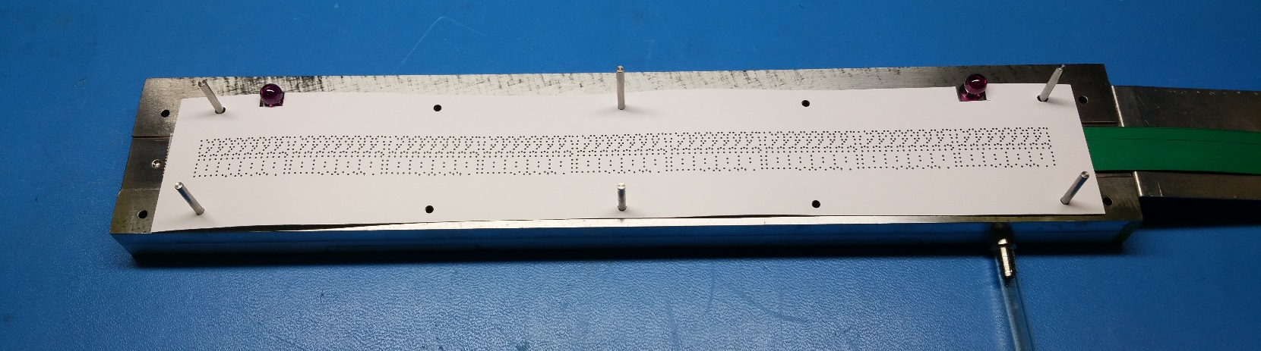
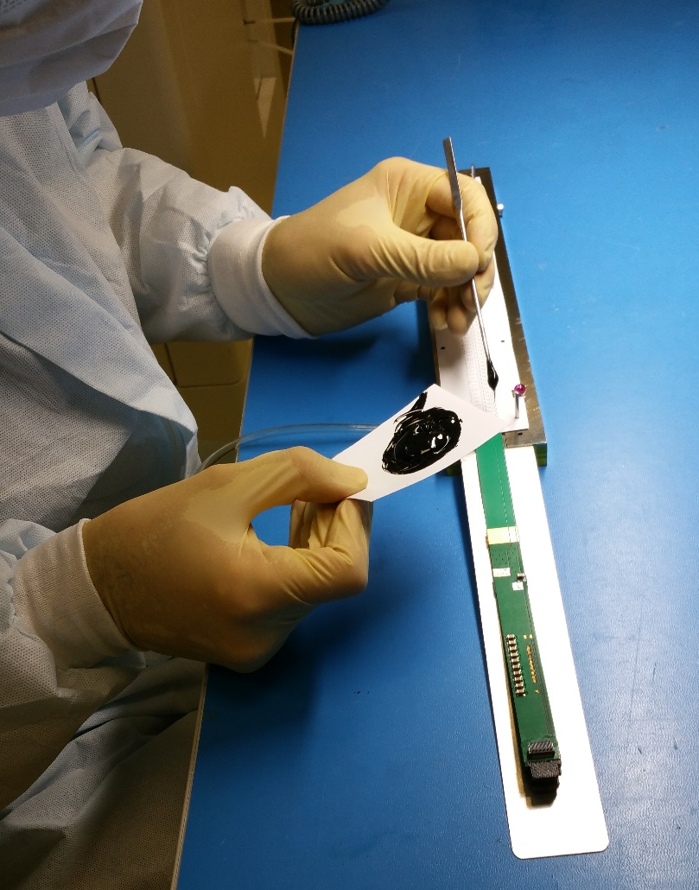
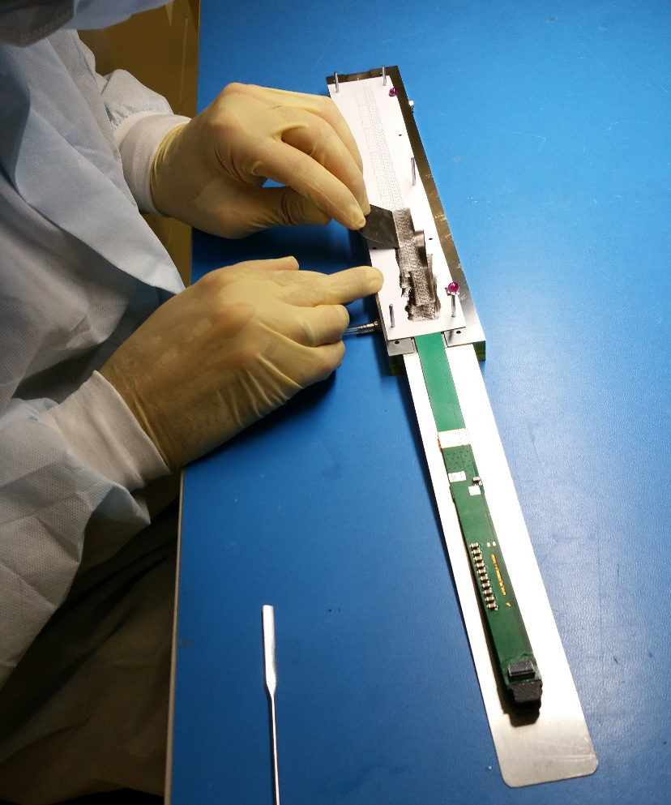
4. Adhesive Mask Application on FPC and Glue Distribution
1
The gluing mask is aligned on top of the FPC using the same dowel pins
2
3
Glue distribution using a metallic spatula
Glue preparation

Slide 14
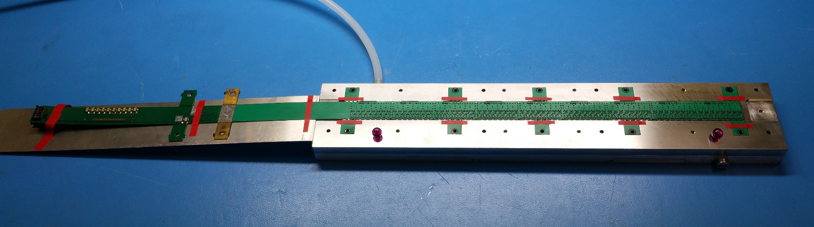
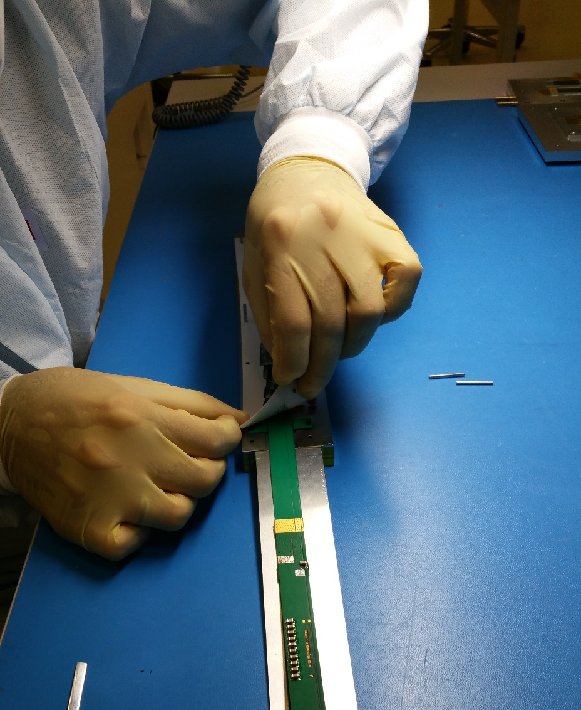
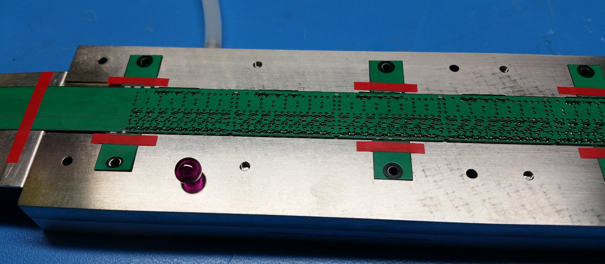
5. Mask Removal and Application of Shims (90 um tape)
1
2
3

Slide 15
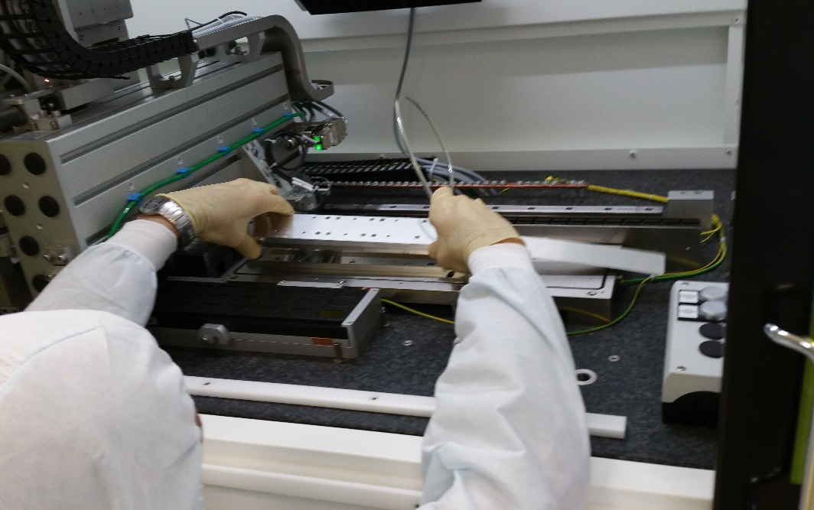
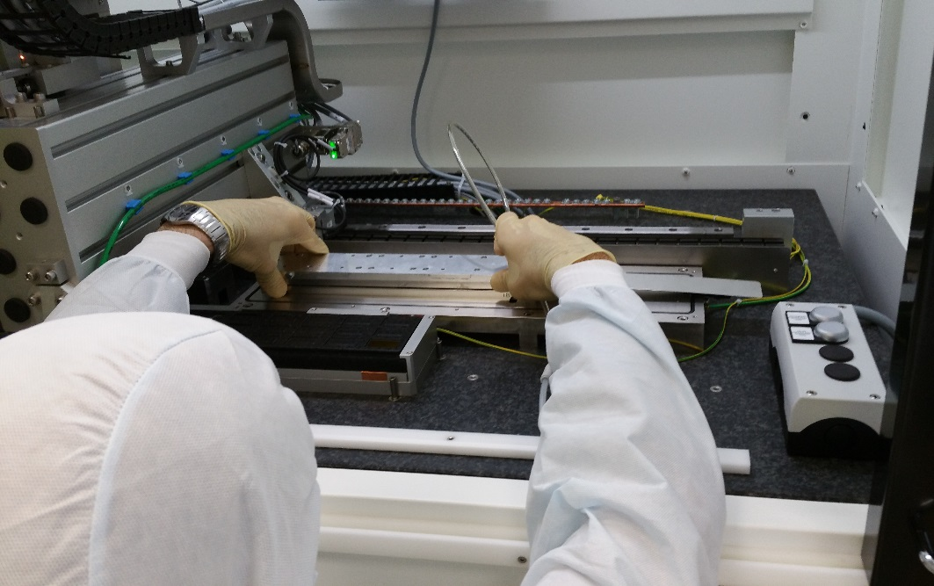
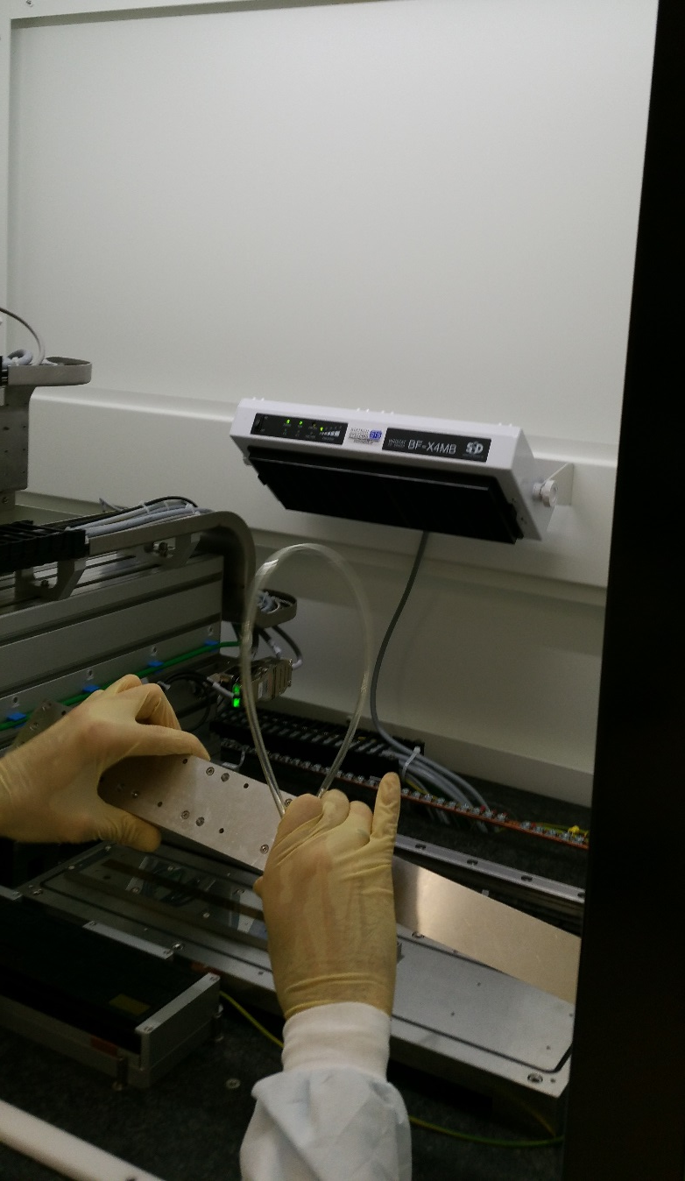
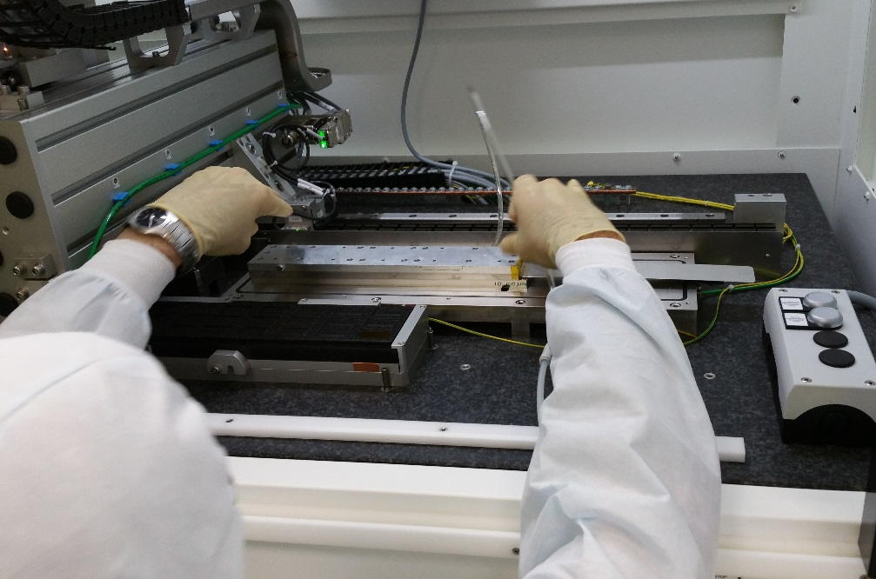
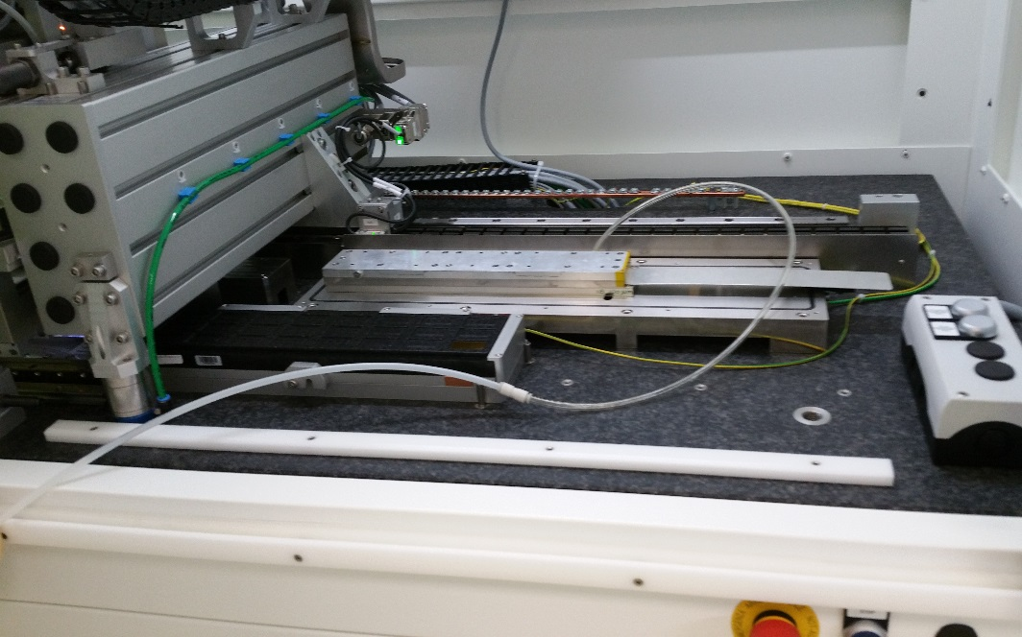
6. Flip FPC and Overlap on Aligned Chips Using Ruby Balls
1
2
3
4
5

Slide 16
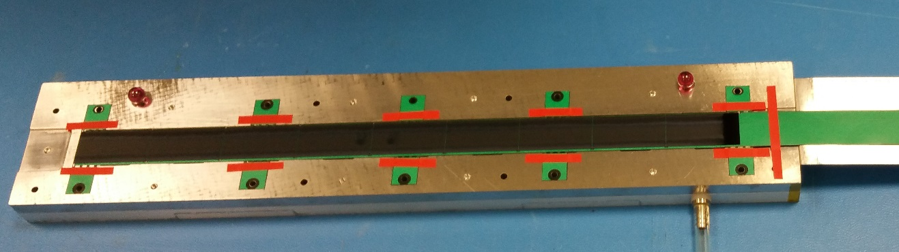
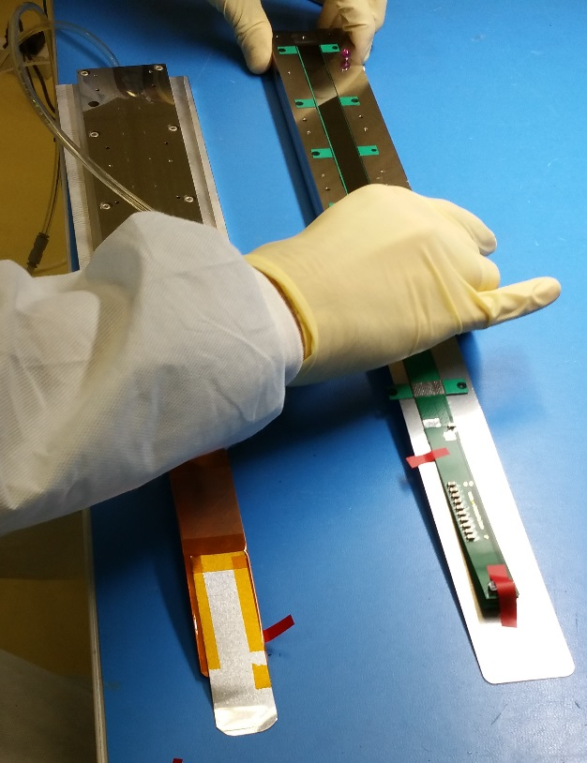
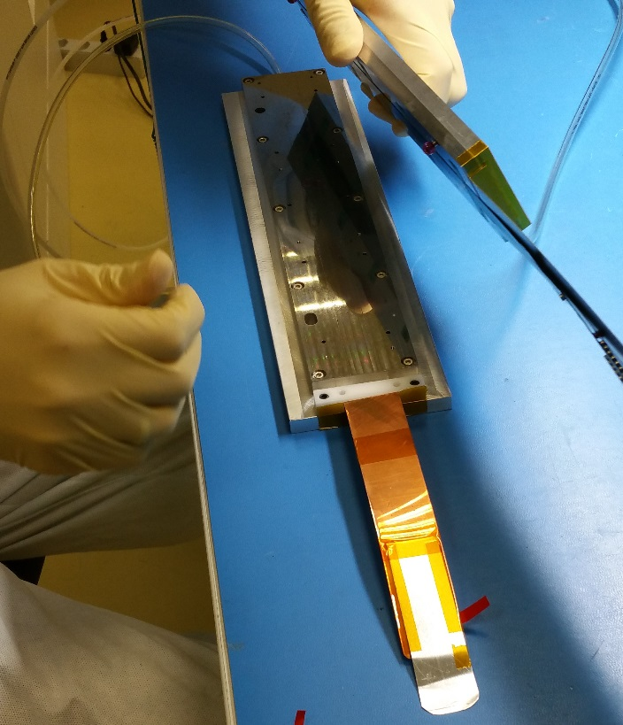
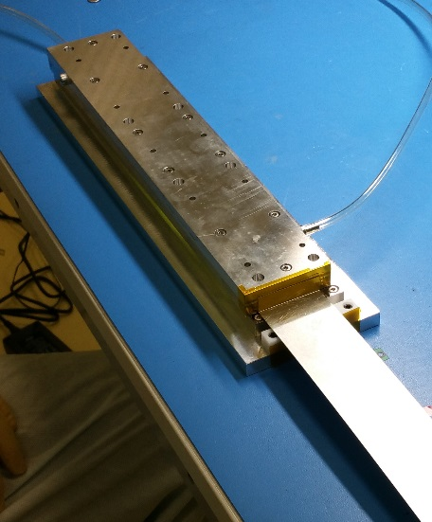
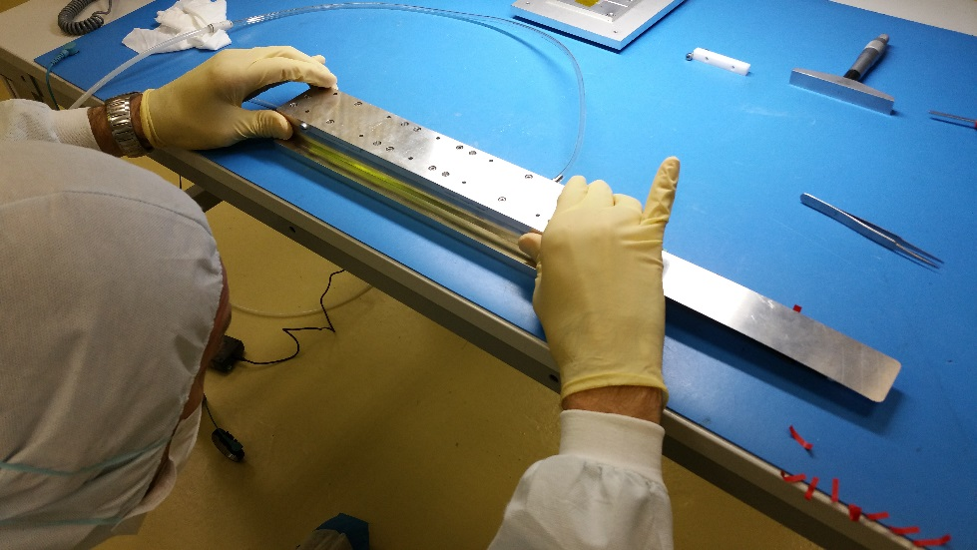
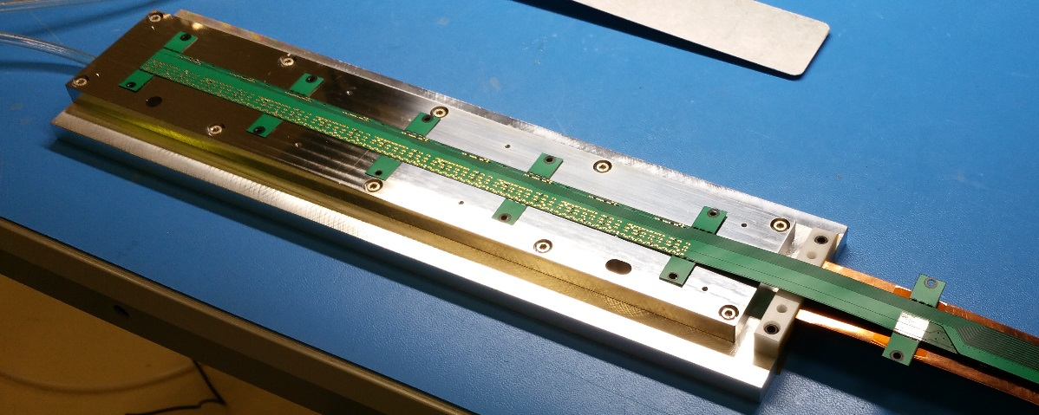
Last Steps
1
7. Curing at room T for 12 h
8. Removal from machine and transfer on wire bonding jig (copy of chips vacuum chuck)
1
2
2
3
3
4
4
5
6
9. Visual inspection under microscope (alignment, presence of glue)
10. Chips interconnection by wire-bonding

Slide 17
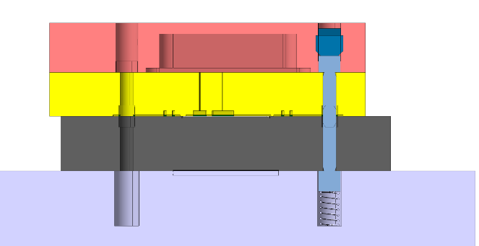
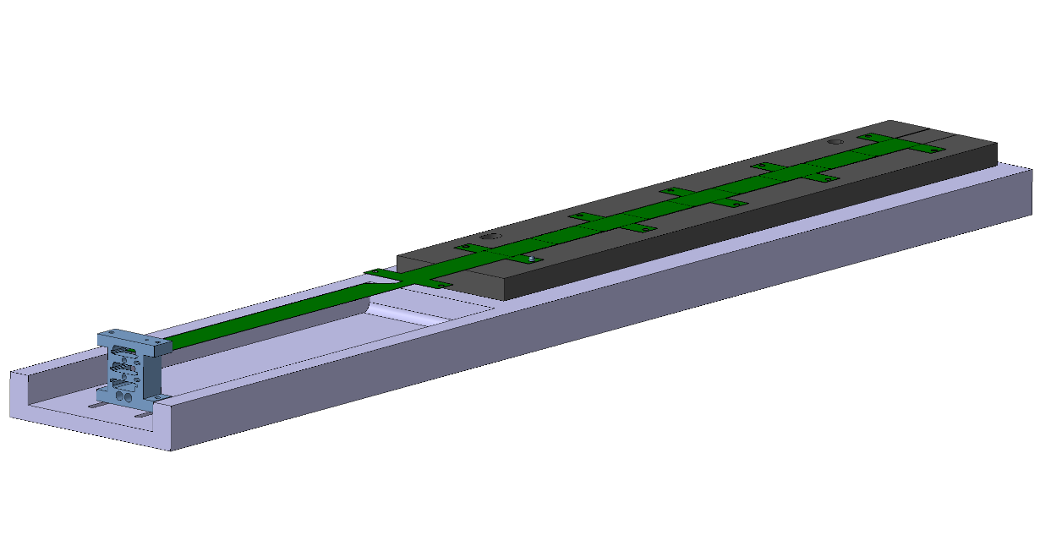
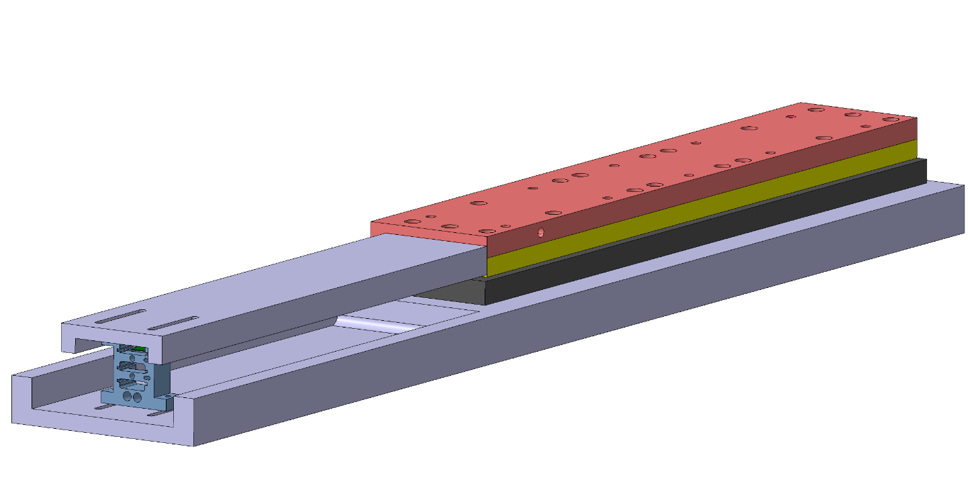
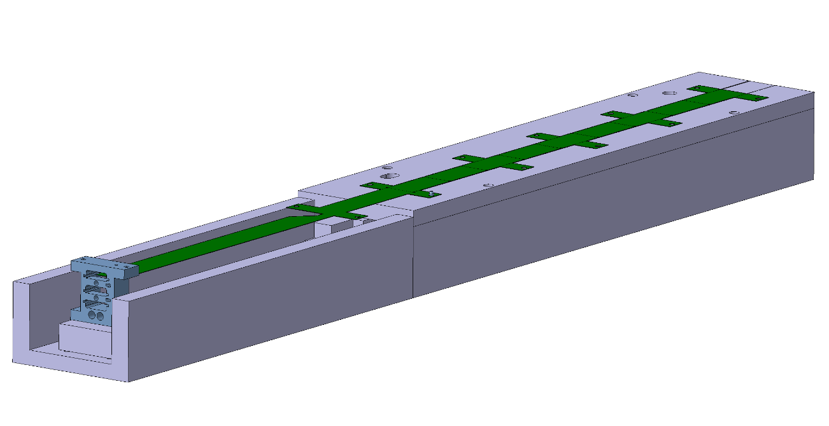
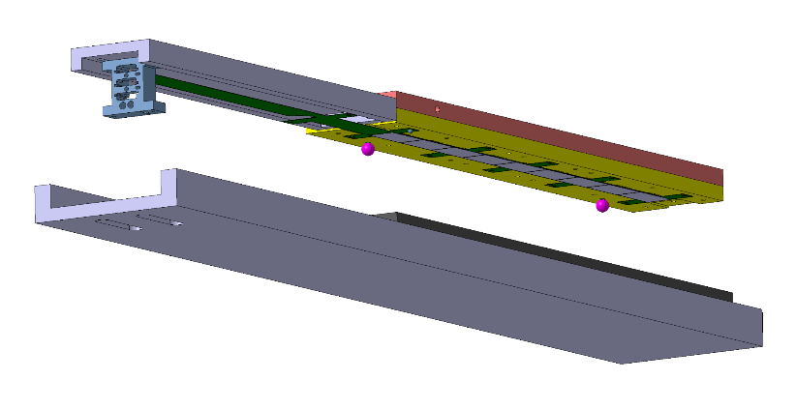
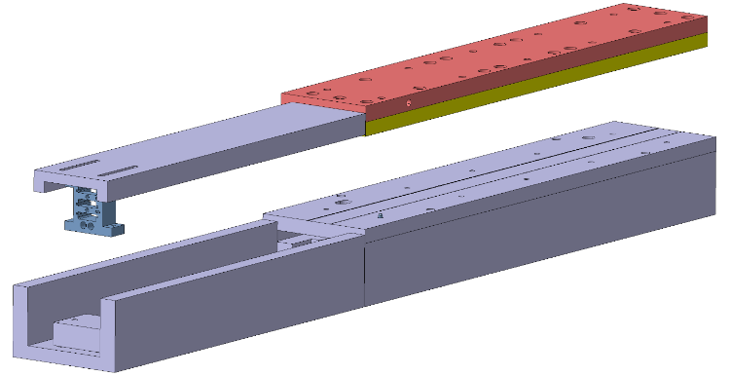
11. Transfer on HIC Storage Plate and Electrical Test
New (improved) tools under procurement
Spring loaded pin to align/release FPC/HIC
New base plate of bonding jig with FPC extension support
2
1
New FPC extension support on FPC gripper
3
4
HIC storage plate

Slide 18
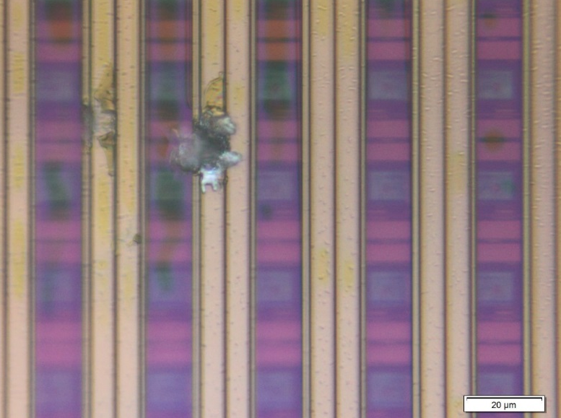
Flip-chip gluing optimization
After the assembly of the first functional HICs, the nominal 50 μm thickness of the glue layer turned out to be not sufficient to compensate the mechanical tolerances on the planarity of assembly table, FPC gripper, FPC, silicon chip and shim.
Local defects of the surfaces and/or the presence of dust particles trapped between the FPC and the silicon chip may cause ohmic contacts between strips of the power mesh that lead to an excessive power consumption.
These “shorts” are systematically cured when the corresponding supply
voltage is progressively increased to the nominal value
To mitigate this issue the following actions have been taken:
  Increase the thickness of the glue layer from 50 to 90 μm
  Deposit a polyimide protection layer on the chip surface as
  an additional step of the wafer processing
Outcome of the HICs assembled with these options
  IB HIC → 90 μm of glue prevents the appearance of shorts regardless the presence of the polyimide layer
        The polyimide layer prevents the appearance of shorts even if the glue layer is reduced to 50 μm
  OB HIC → 90 μm of glue is not sufficient to prevent the appearance of the shorts if the chip surface is not
  protected with the polyimide layer

Slide 19
Summary of IB HIC Pre-Series
List of prototypes produced since 08/2016
90 um thick glue layer
HIC ID | Chip | status | Comments
IB-HIC-WB14 | 100 um | working | OK
IB-HIC-WB15
IB-HIC-WB16
IB-HIC-WB17 | 50 um | 8 out of 9 chips working | chip damaged during removal from temporary storage plate
IB-HIC-WB18 | 50 um | working | OK
IB-HIC-WB19 |  | working
IB-HIC-WB20 |  | working
IB-HIC-WB21
IB-HIC-WB22 | 100 um PIQ
IB-HIC-WB24 | 50 um
IB-HIC-WB25
IB-HIC-WB28 |  | Ready for testing
50 um thick glue layer
HIC ID | Chip | status | Comments
IB-HIC-WB05 | 100 um | working | OK
IB-HIC-WB08 |  | working | Initial high currents at low supply voltages. Current reach their nominal value when supply voltage is increased progressively to the nominal value. Afterwards supply currents show nominal values at all supply voltages
IB-HIC-WB09 |  | working
IB-HIC-WB10 |  | partially working
IB-HIC-WB11 |  | working
IB-HIC-WB12 |  | partially working
IB-HIC-WB13 |  | working
IB-HIC-WB23 | 100 um PIQ | working
IB-HIC-WB26 | 100 um PIQ | working | OK
IB-HIC-WB27
19

Slide 20
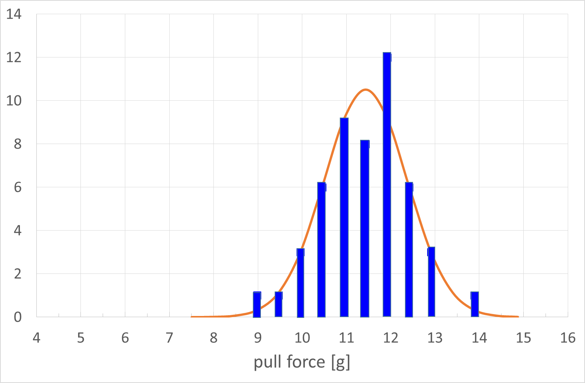
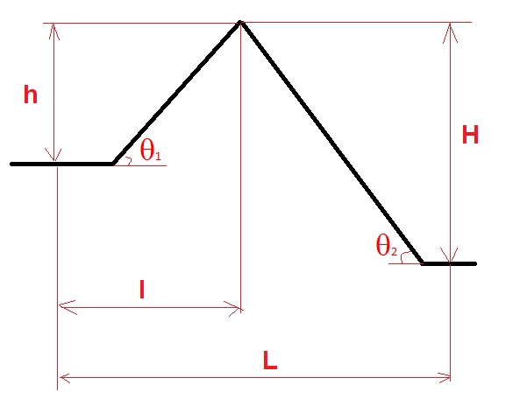
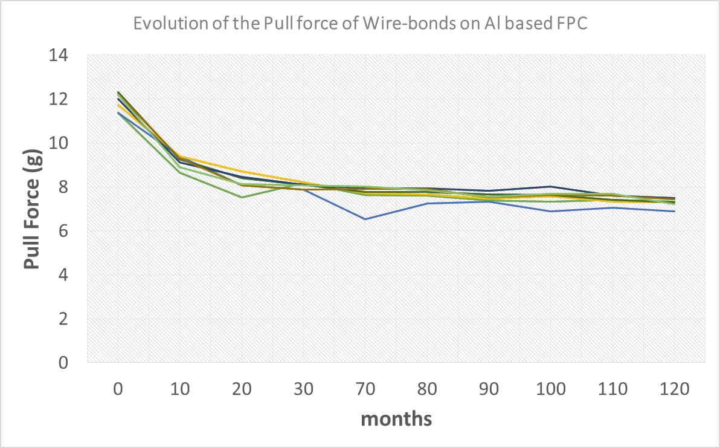
Wire Bonding Characterisation (@ CERN Bond-Lab)
Results of pull test on 50 bonds
Avg- 3stdev = 8.4 g (> 7 g min. ref. load)
Failure modes:
  1st bond heel break , 46 wires
  2nd bond lift, 4 wires
Bond loop params:
  h = 220; H = 420
  L = 700; l = 335
mean = 11.2 g
stdev = 0.93 g
Min = 8.96 g
Max= 13.78 g
Ageing test: check the evolution of the Al based FPC metallisation over time (10 years at 30 ºC is 12 days at 130 ºC), 7 samples, 30 bonds on each test
After 10 y a pull force of 7.5 g has been obtained , which is considered a standard value

Slide 21
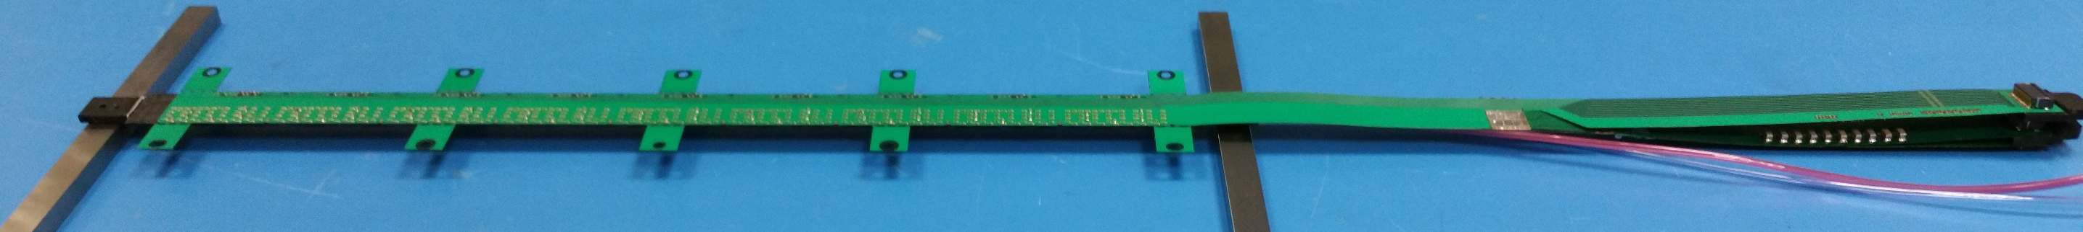
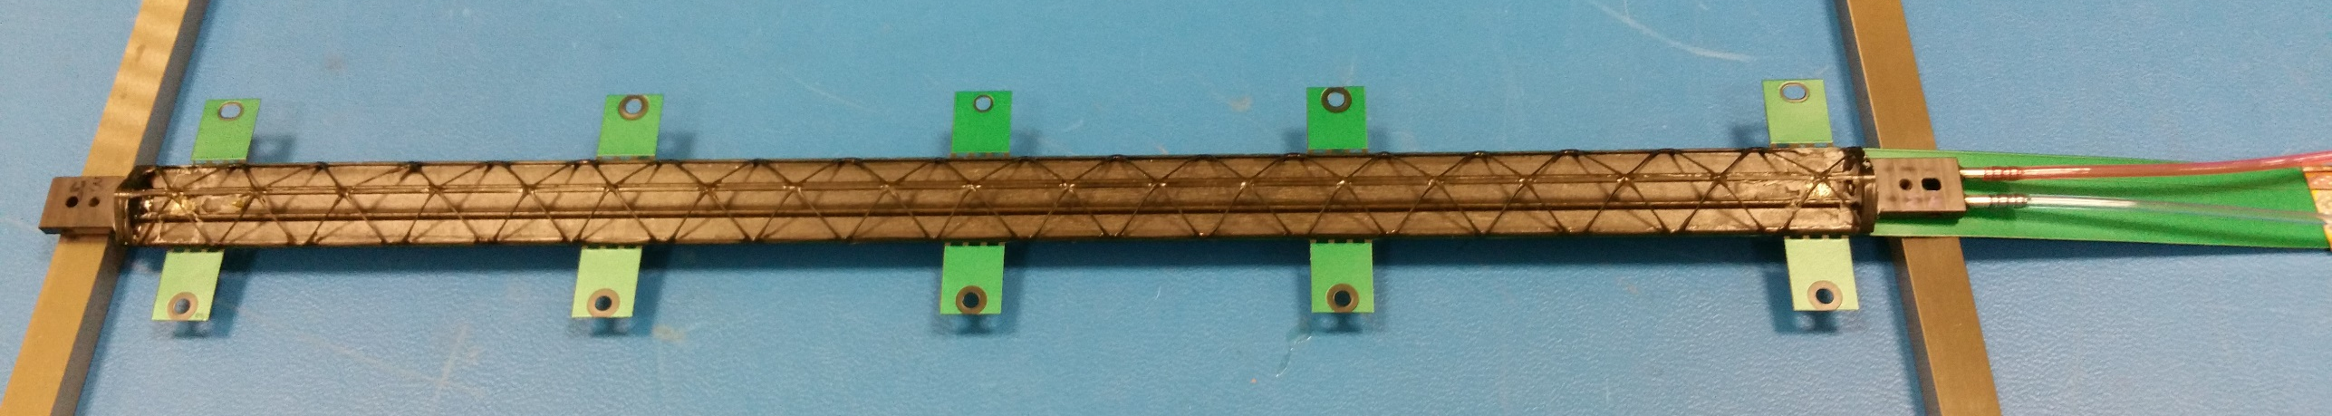
IB STAVE Assembly Procedure
Objective
glue the HIC to the IB spaceframe & coldplate, such to provide HIC support, alignment, and thermal contact to the coldplate
Only minor changes wrt to EDR

Slide 22
IB Stave Layout
15,4 mm
5 mm
Cold plate
Glue (90µm)
Pixel Chip (50µm)
0.85 mm
15 mm
0.3 mm
16.15 mm
FPC (175µm)

Slide 23
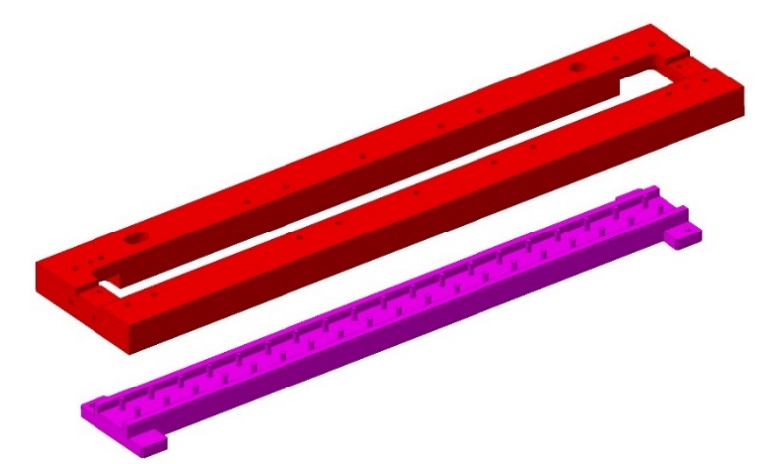
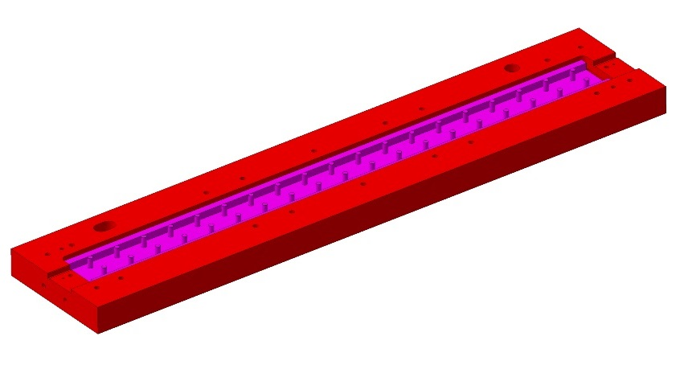
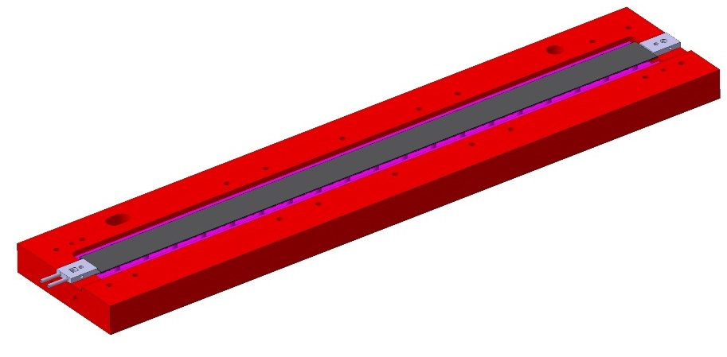


Assembly Components and Jigs
jig used for HIC gluing to IB spaceframe
Spaceframe jig
IB Spaceframe& Coldplate
glue
FPC/HIC_ jig (vacuum)
FPC

Slide 24


Tooling and Mechanical Tolerances
Requirements: geometrical tolerance 10 micron (planarity)
Spaceframe jig
~12µm
FPC/HIC jig (optimized vacuum holes)
~15 µm
Measured: geometrical tolerance 15 micron (planarity)

Slide 25


IB SF + HIC Gluing Steps
1. Install the IB speceframe&coldplate in the SF_ jig
2. Position gluing mask (90 µm thick), using locating pins

Slide 26




IB SF + HIC Gluing Steps
3. Distribute glue Ablestik 45 using a spatula
4. Remove the mask
1
2
3
4

Slide 27



IB SF + HIC Gluing Steps
5. Position SF jig on top of HIC jig using ruby balls for alignment;
a nominal 50 µm glue layer after the matching of the 2 jigs is obtained by design of the SF jig
1
2
3

Slide 28


IB SF + HIC Gluing Steps
6. Rotate the assembly and cure 12h at RT.
7. Brake the vacuum on the HIC jig and remove the SF jig

Slide 29



IB SF + HIC Gluing Steps
New (improved) tools under procurement
FPC extension support on FPC/HIC jig
FPC extension support on SF jig
Gluing of the stave

Slide 30




IB SF + HIC Gluing Steps
New (improved) tools under procurement
8. Stave storage and cutting of wings
Stave holder
Stave storage/testing plate
Wings are cut using special pliers
(procedure under test)

Slide 31
Pre-series
A small pre-series of 6 staves all based on final components was built
ID | HIC used | Main HIC characteristics | Status
STAVE-00 | IB-HIC-WB09 | 100 um chip, 50 um glue | Working - tested in NA61 with Pb beam)
STAVE-01 | IB-HIC-WB18 | 50 um chip, 90 um glue | Working - used for cooling and full electrical characterisation
STAVE-02 | IB-HIC-WB21 | 50 um chip, 90 um glue | Working - used for ageing test
STAVE-03 | IB-HIC-WB24 | 50 um chip, 90 um glue | Partially working (1 chip physically damaged - handling) - used for mechanical and thermoelastic tests
STAVE-04 | IB-HIC-WB25 | 50 um chip, 90 um glue | Working - used for metrology program validation
STAVE-05 | IB-HIC-WB27 | 100 um PIQ chip, 50 um glue | Working
STAVE-06 | IB-HIC-WB28 | 50 um chip, 90 um glue | In preparation

Slide 32

Metrology Check for QA
All staves will be checked at the CERN metrology
  To verify the correct alignment
  Map chips position inside the stave
STAVE-4
0.5

Slide 33



Lab Space at the CERN Department Silicon Facility
HIC and Stave assembly area
Components cleaning and inspection area
Microscope inspection tables
Preparation of zones for electrical test and storage in progress

Slide 34
Production Workflow and Planning
Tentative production weekly plan
a) HIC assembly: 14h (chips alignment in machine and gluing preparation: ~ 2 h; curing : 12h; visual inspection: ~ 1 h)
b) HIC wire bonding: 2 h
c) HIC electrical test: 2 h
d) STAVE assembly and test : 1 day
 | Mo | Tue | Wed | Thu | Fri
morning | d+a | b+c | d+ a | b+c | d+a
afternoon | a | d | a | d | a
Starting in June 2017, with a rate of 10 HICs and STAVES / month and a yield of 90%, expect to complete the IB-1 by January 2018 and IB-2 + spares by July 2018.

