Slide 1
IB stave construction and prototypes
ALICE ITS Upgrade
Stave Production Readiness Review
CERN, 27 April 2017

Slide 2
Introduction
The stave assembly procedure has been established with the aim to ensure:
  chip integrity (IB silicon chips are thinned to 50 μm)
  precise alignment to better than 10 μm
  reliable and reproducible results
The main steps are:
  Chips alignment
  Chips gluing on FPC (HIC) and wire bonding
  HIC gluing on carbon fiber spaceframe (STAVE)
After the EDR, we focused mainly on 2) since 1) is ensured by the MAM and 3) was already well advanced

Slide 3
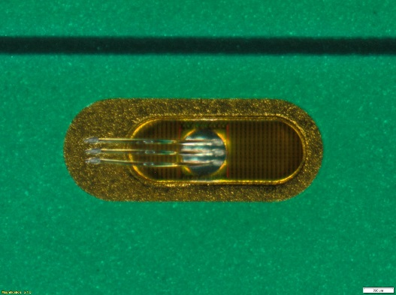
Interconnection layout
Hybrid Integrated Circuit (HIC) schematic cross section
coverlay 20 um
Al 25 um
p.i. 75 um
Al 25 um
coverlay 20 um
Main constraints for FPC to silicon gluing:
Optimize/minimize amount of glue
Ensure good adherence under FPC pads, no vibrations during wire bonding
Prevent glue contamination of pads to be bonded
Optimisation of gluing mask
Characterisation of glue layer
Upilex-75S
FPC
glue
Ablestik 45W 90 um
ALPIDE 50 um
silicon
(power supply connection)

Slide 4
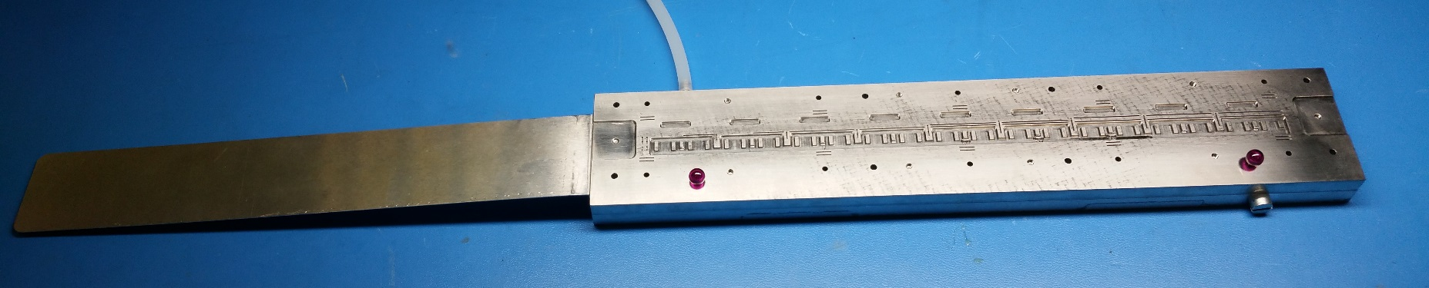
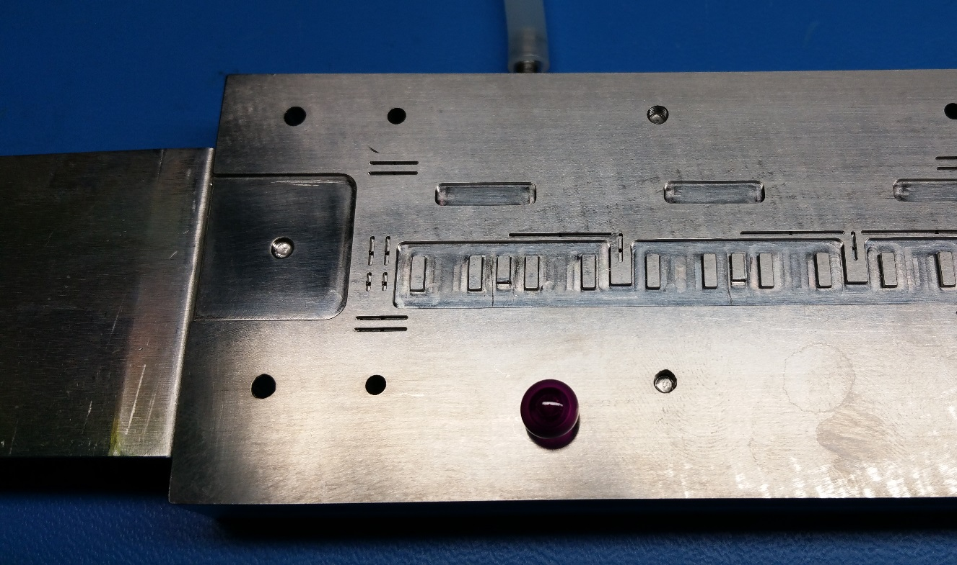
Jigs for HIC assembly
FPC extension support
(temporary)
FPC gripper
Planarity: 15 um
Recess to accommodate SMD and wire bonds

Slide 5
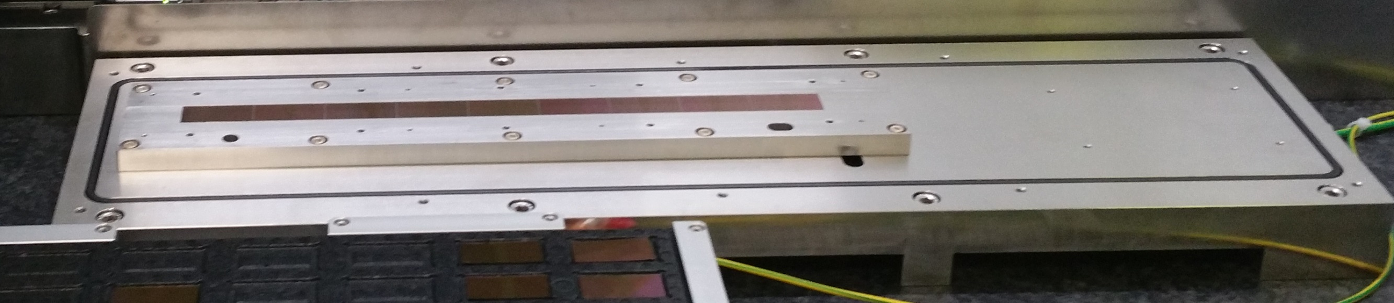
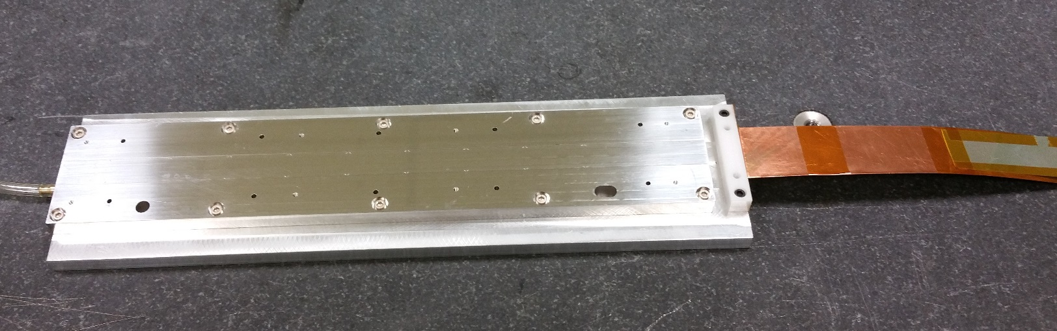
Jigs for HIC assembly
Chips vacuum chuck
(HIC assembly table)
Planarity: 13 um
Wire bonding table

Slide 6
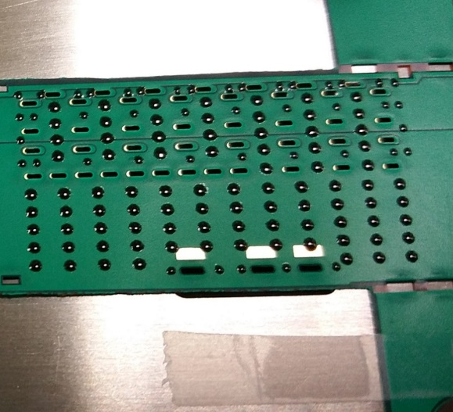
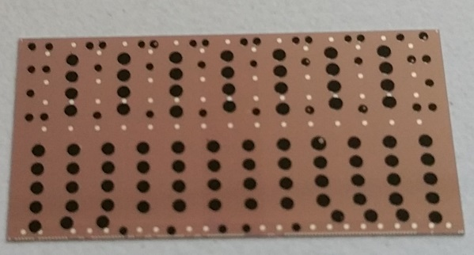
Gluing mask optimisation
Assembly stack-up
Initially (at the EDR) the procedure to glue FPC and chips was based on adhesive mask Oracal 638, 90 um thick associated to shimming producing a final glue layer of 50 um, compatible with the sum of tolerances involved
Observed issues:
  Glue spots not close enough to vias edges
  Weak adherence
FPC gripper
Coverlay
Aluminiium
Polyimide (Upilex 75S)
Aluminium
Coverlay
Ablestik 45
Silicon chip
Chip vacuum chuck
Component | Tolerance
Chip vacuum chuck planarity | ± 7 um
Chip thickness | ± 5 um
FPC thickness | ± 10 um
FPC vacuum chuck | ± 8 um
TOTAL (linear) | ± 30 um
TOTAL (quadratic sum) | ± 15.5 um
Glass plate glued on chip using mask with 50 um shimming

Slide 7
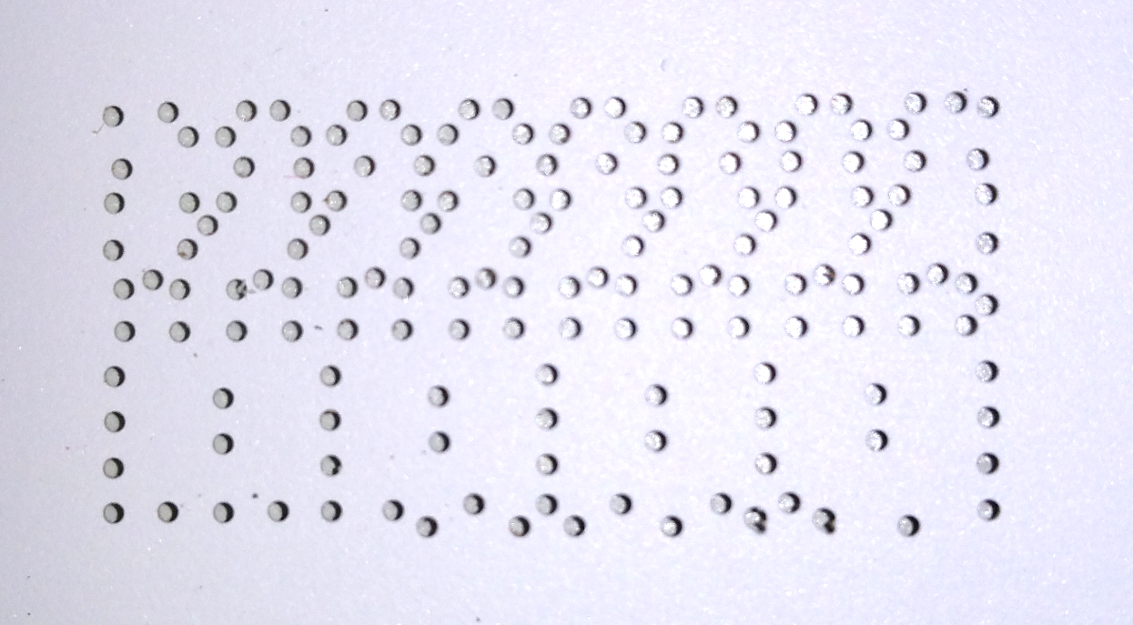
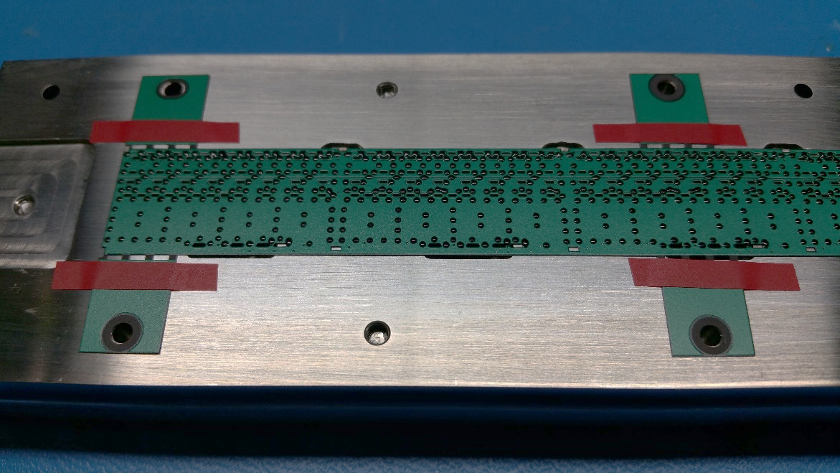
Gluing mask optimisation
Upgraded gluing procedure:
  Optimised holes amount and geometry (remove holes where not necessary, use everywhere Ø 0.7 mm)
  SDAG adhesive film RS-150-137 (150 um thick) with 90 shimming (Oracal 638 tape)
  Hand mixing (3g for 30”) instead of mixer dispenser nozzle

Slide 8
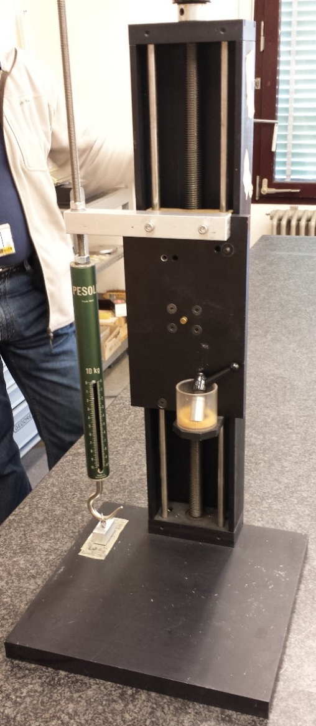
Glue characterisation
Chemical analysis for ionic impurities (MIL STD 883H): dangerous ions concentration is below threshold
Pull tests
Glue prepared by hand mixing for 30”
5 samples of FPC + single chip using last procedure (mask/shimming)
Average load measured on 3 samples : 3.9 kg
2 samples under ageing test
ADD RESULTS LATER
+ TEST ON PIQ CHIPS
Veritas laboratories (F)
ADD PHOTO OF SAMPLE

Slide 9
HIC assembly procedure overview
Chip automated inspection in ALICIA
Chip alignment on ALICIA assembly table
FPC clamping by vacuum on dedicated jig, alignment using dowel pins
Adhesive mask application on FPC and glue distribution
Mask removal, check of glue spots, application of shims (adhesive tape) on FPC wings
Flip FPC and overlap on chips using ruby balls for alignment
Curing on assembly table at room T for 12 h
Transfer on wire bonding jig
Visual inspection
Chips interconnection by wire-bonding
Transfer on HIC storage plate and electrical test

Slide 10
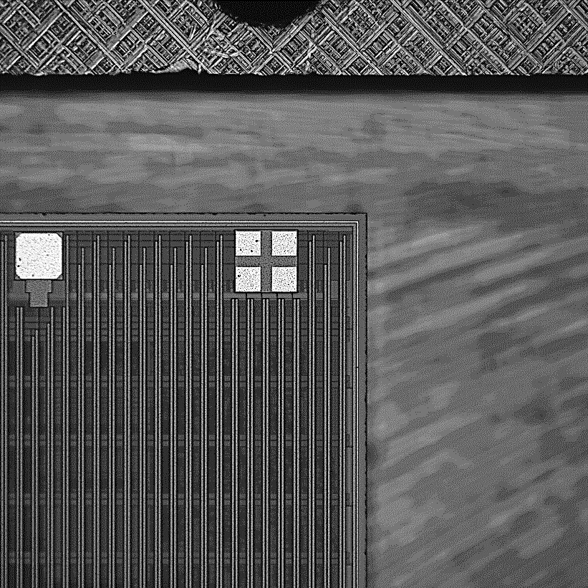
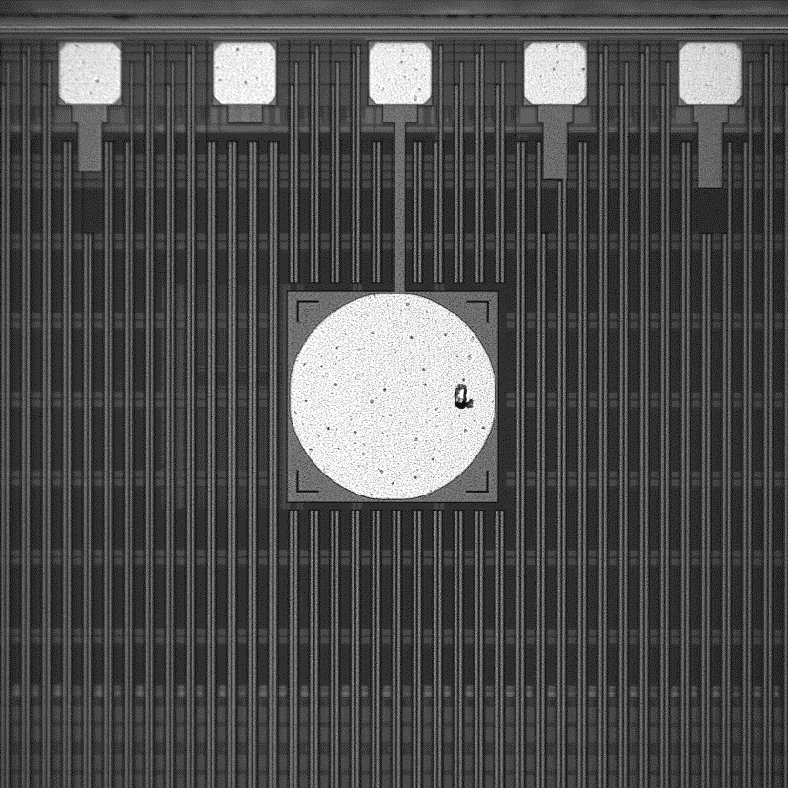
1. Chips inspection
Chips are identified by the serial no. of the storage tray and by the position inside it. Each position in a tray is uniquely associated to a position in the original wafer
Prior to assembly, chips are inspected to verify dimensions (the size shall not differ from nominal one by more than 5 μm), edge integrity (no cracks shall be present at a distance shorter than 10 μm from the seal ring) and pad cleanliness (the total area occupied by one or more particles shall not exceed 10% of the pad surface).

Slide 11
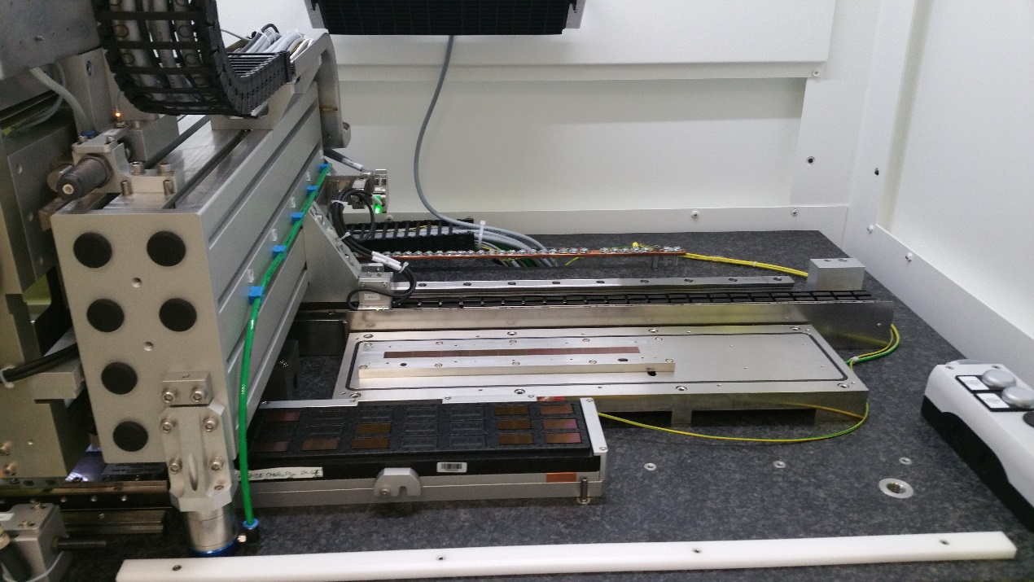
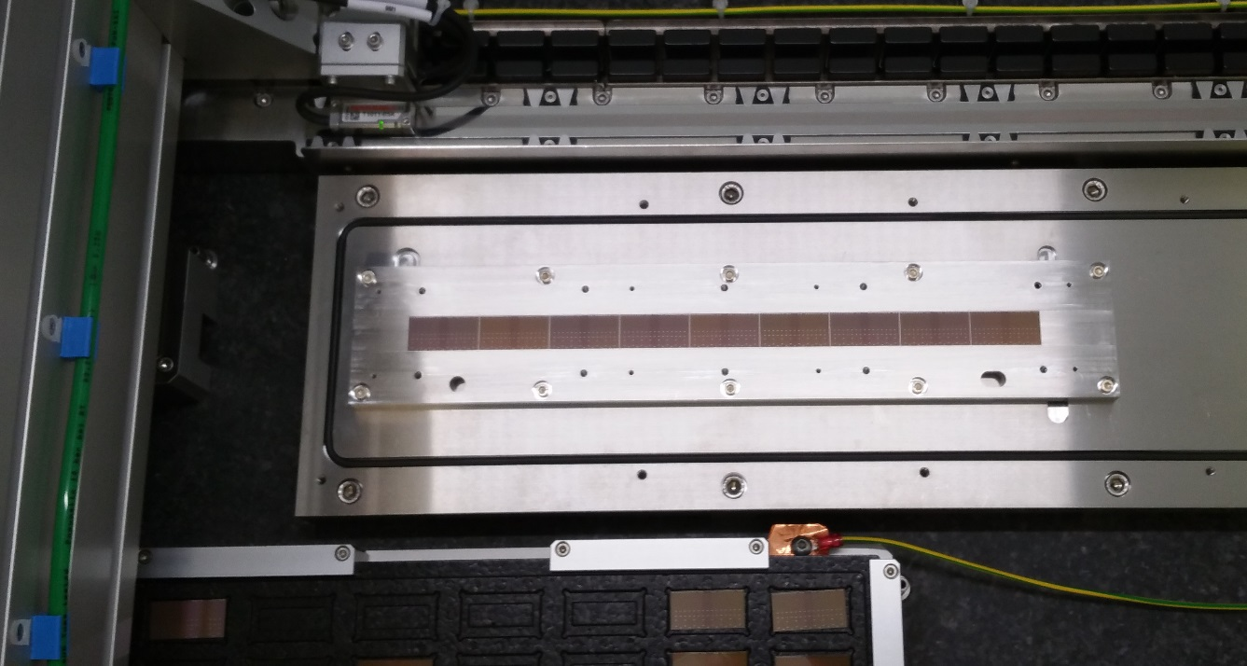
2. Chip alignment on assembly table vacuum chuck
Chips which passes the quality inspection are aligned on the vacuum chuck of the assembly table
An accuracy of ± 5 μm is required on the position; the gap between the chips is 150 μm (seal-ring to seal-ring)
After alignment a further visual inspection is performed to spot presence of bumps produced by particle under the chips (→ chips and table cleaning)

Slide 12
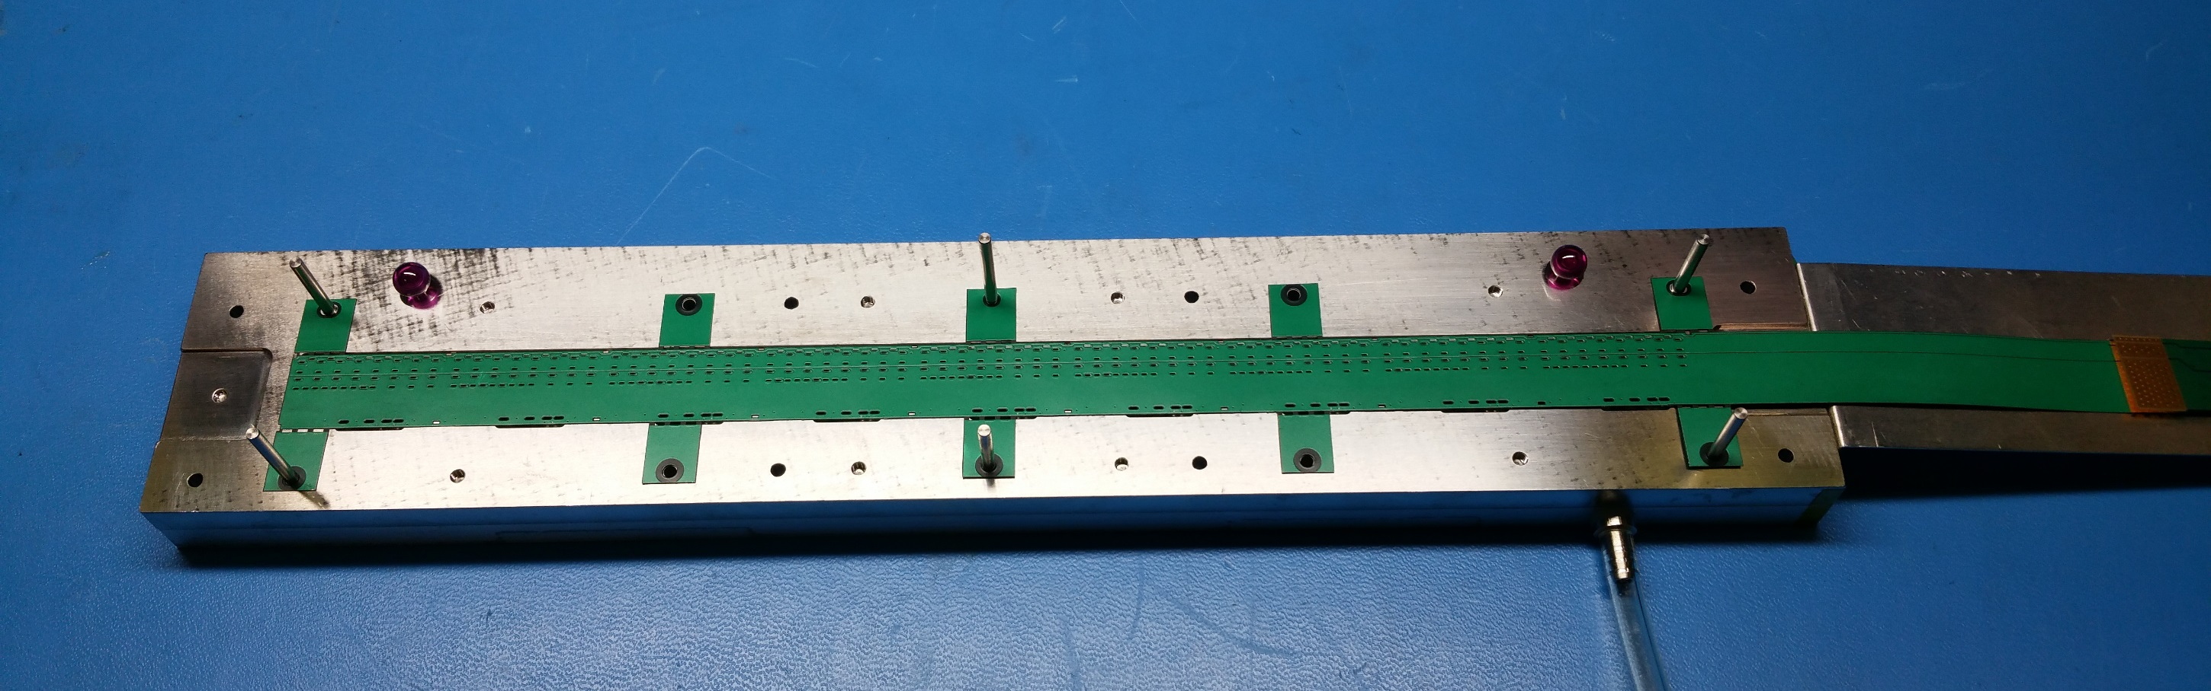
3. FPC mounting on gripper
The FPC is aligned on the gripper using dowel pins and vacuum is started

Slide 13
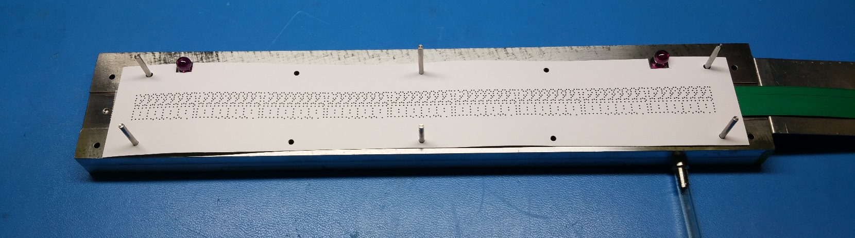
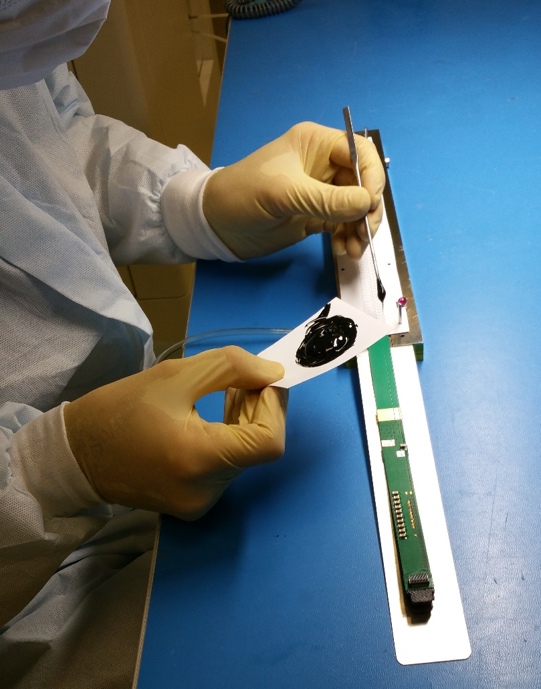
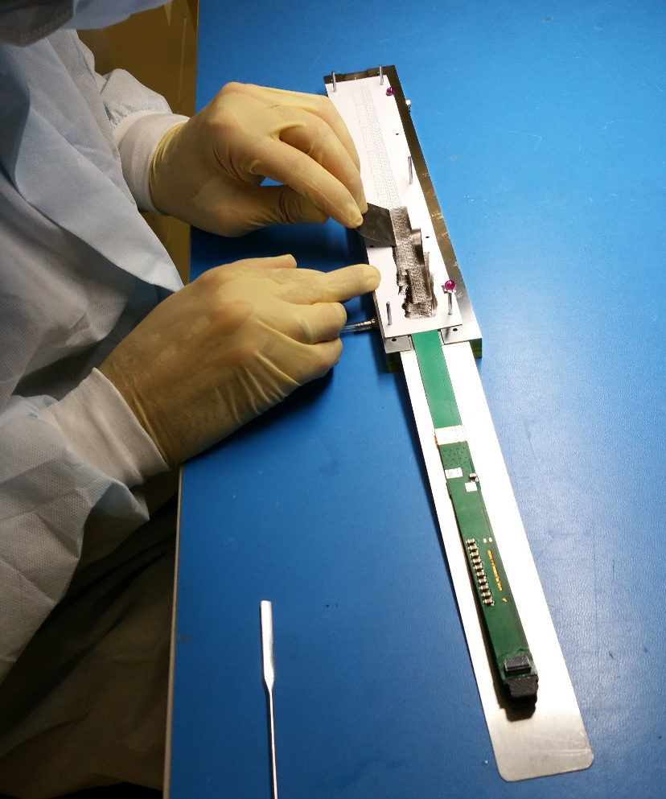
4. Adhesive mask application on FPC and glue distribution
1
The gluing mask is aligned on top of the FPC using the same dowel pins
2
3
Glue distribution using a metallic spatula
Glue preparation

Slide 14
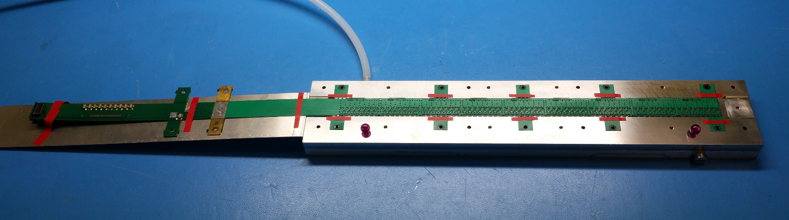
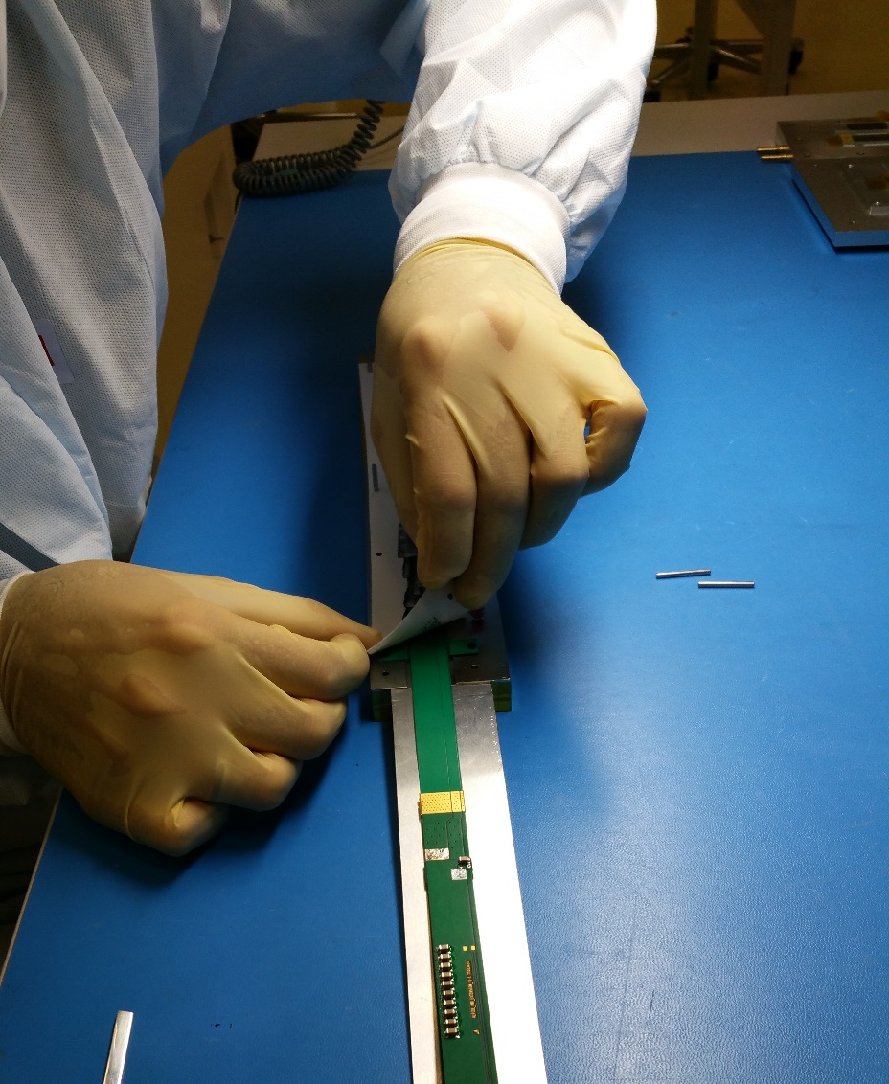
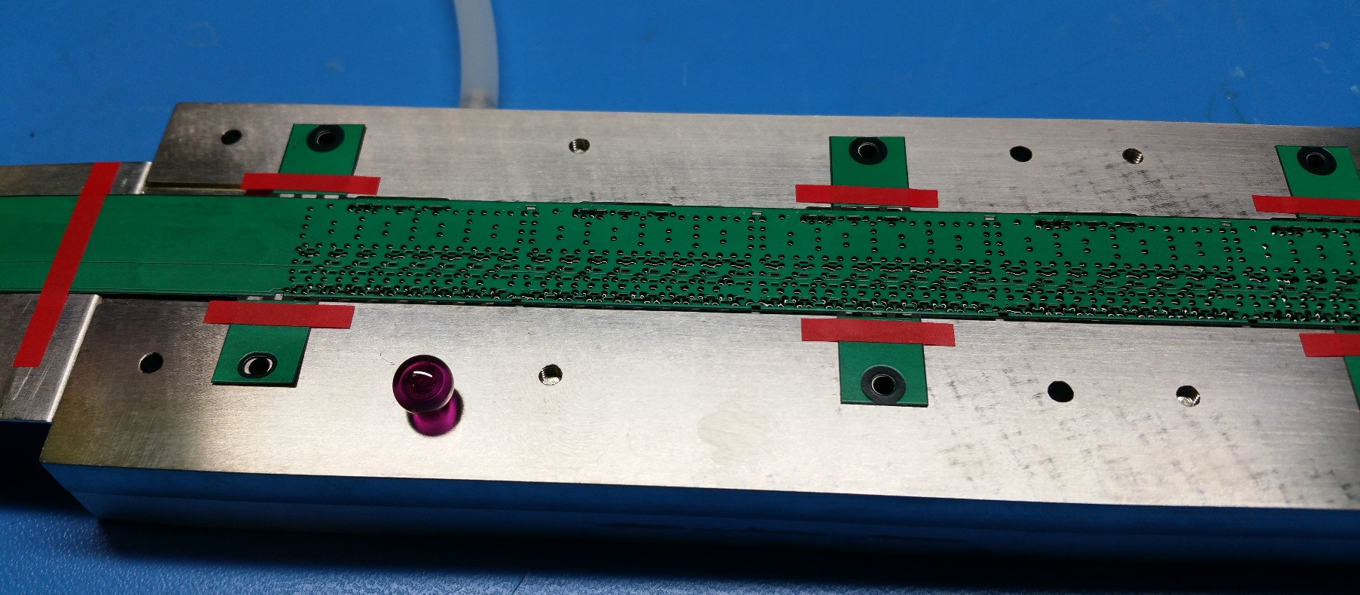
5. Mask removal and application of shims (90 um tape)
1
2
3

Slide 15
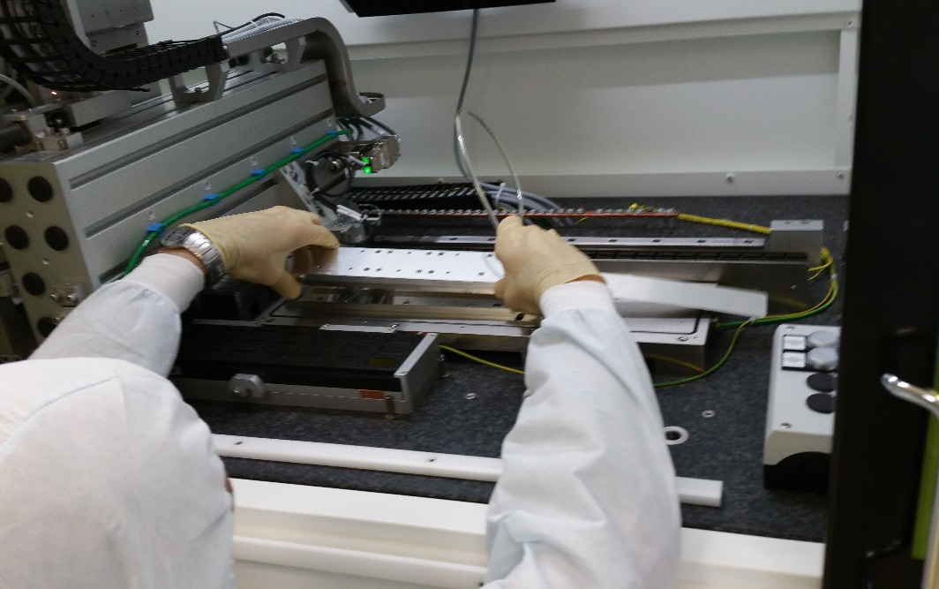
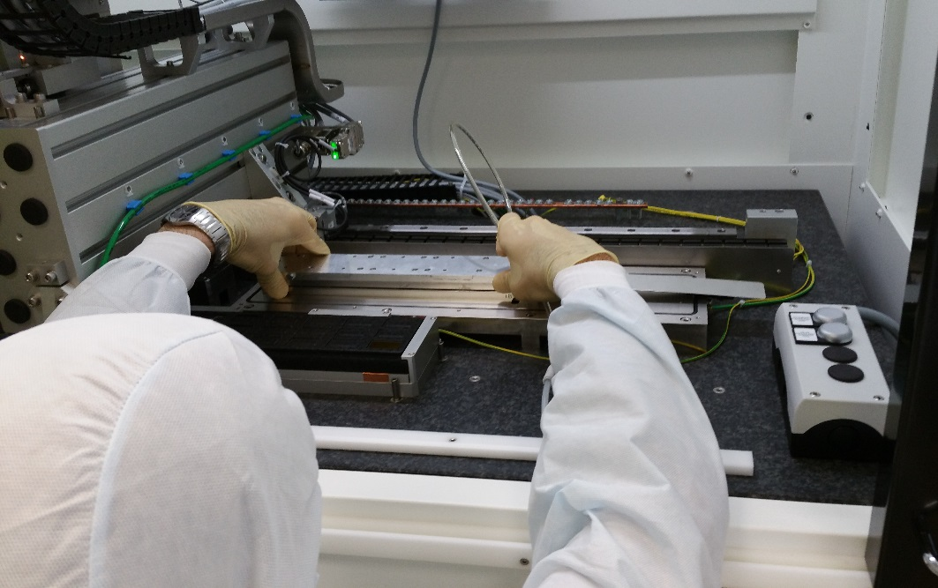
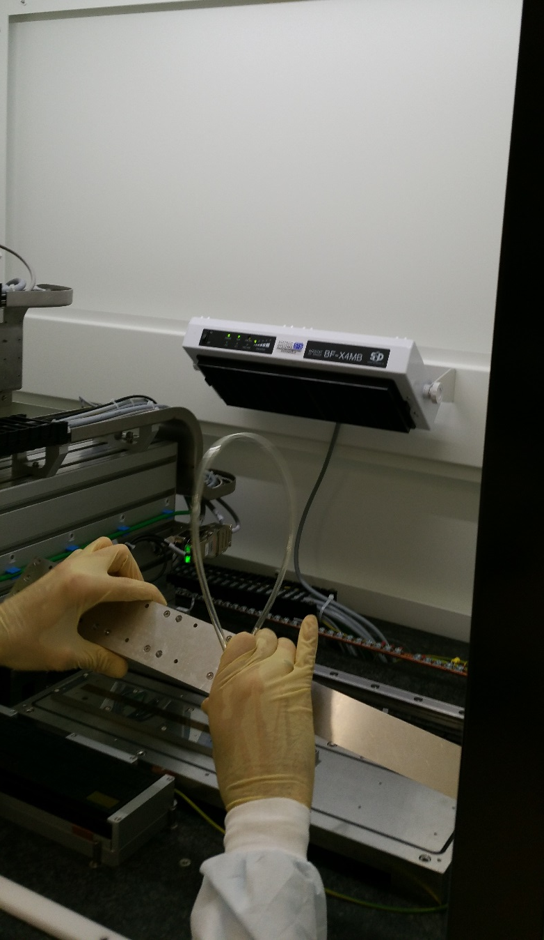
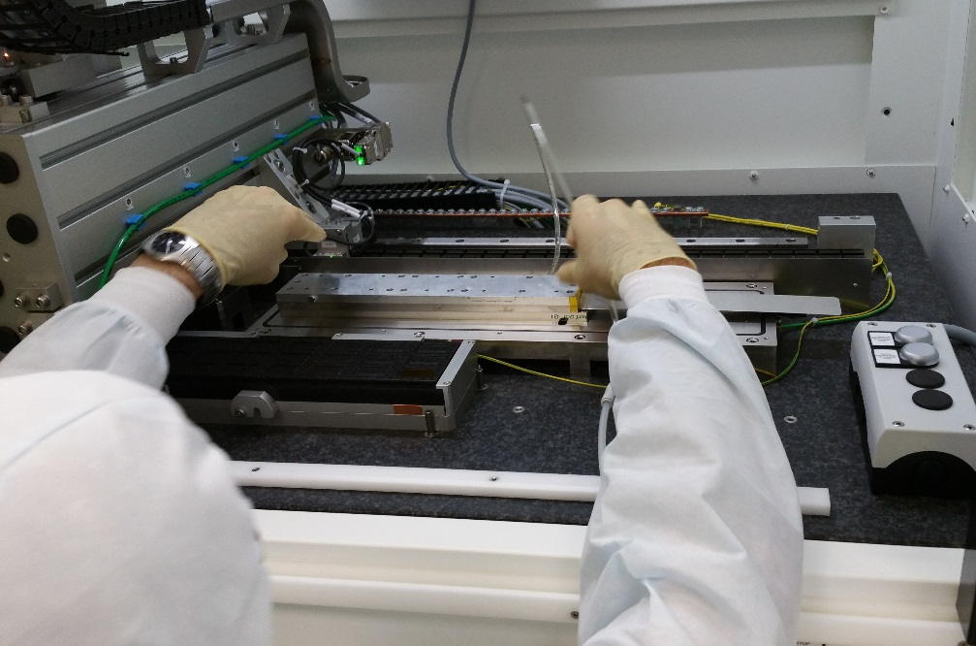
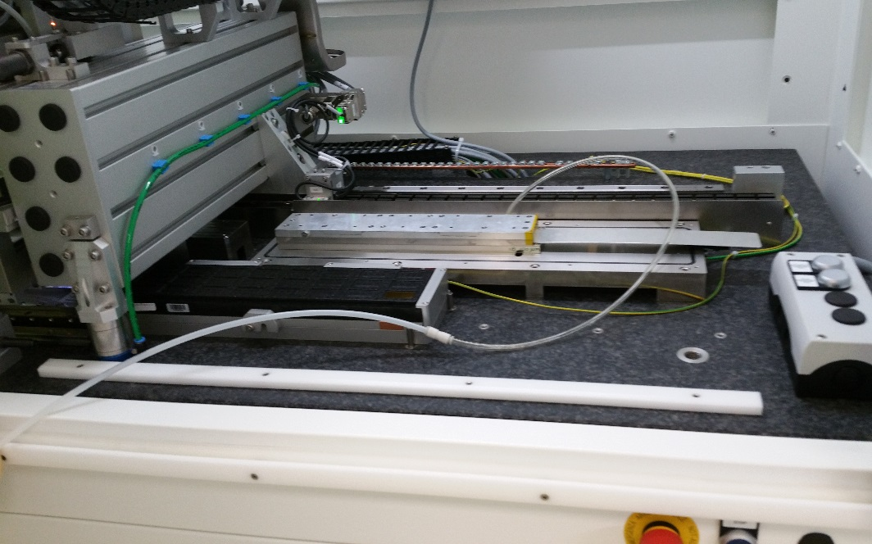
6. Flip FPC and overlap on aligned chips using ruby balls
1
2
3
4
5

Slide 16
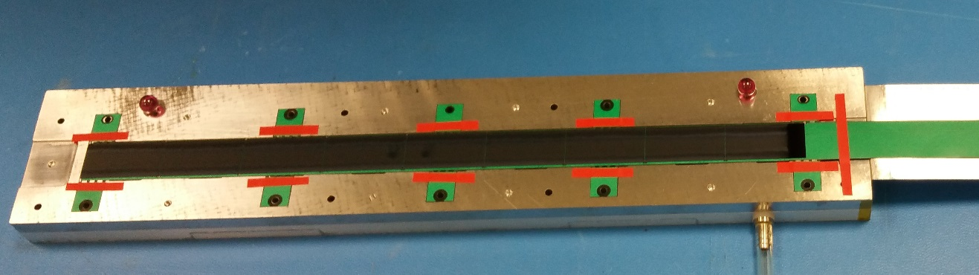
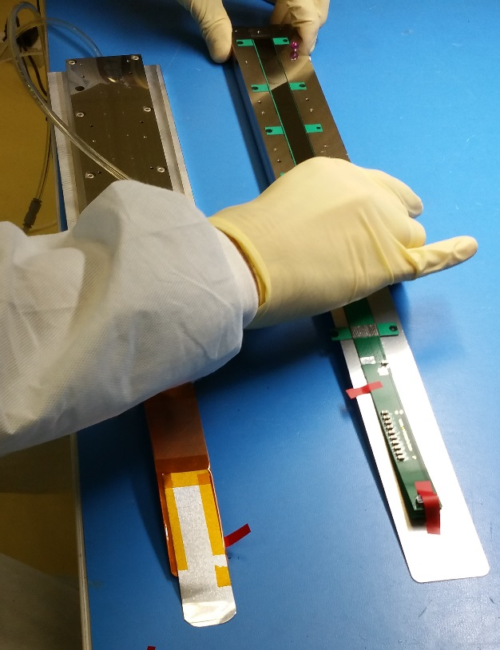
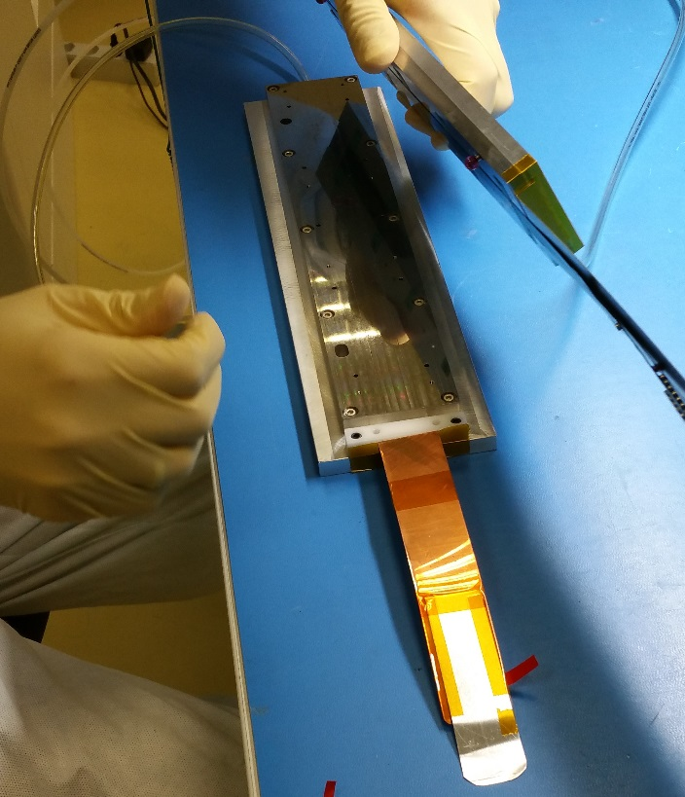
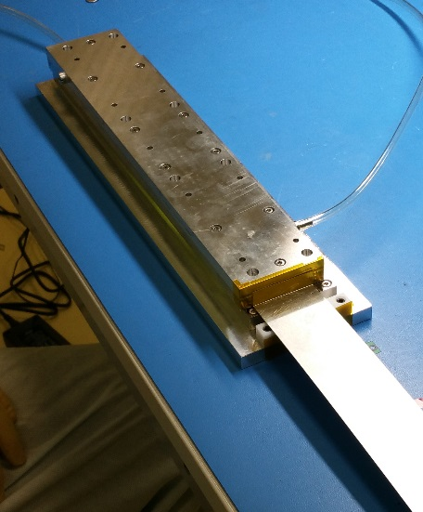
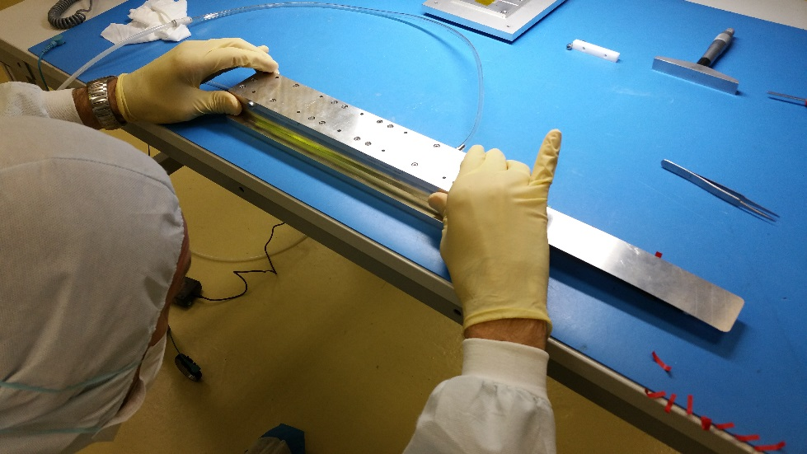
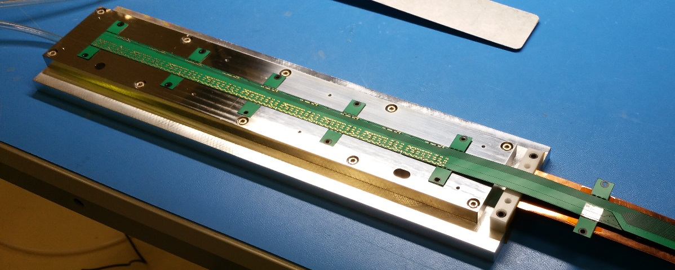
Last steps
1
7. Curing at room T for 12 h
8. Removal from machine and transfer on wire bonding jig (copy of chips vacuum chuck)
1
2
2
3
3
4
4
5
6
9. Visual inspection (alignment, presence of glue)
10. Chips interconnection by wire-bonding

Slide 17
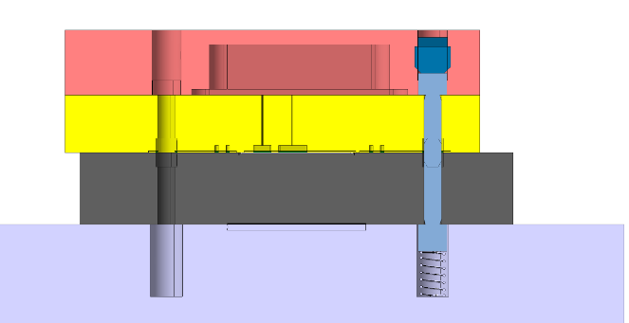
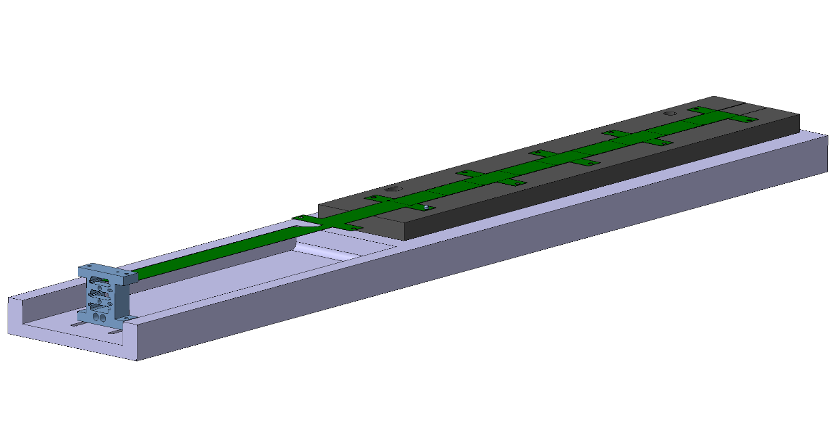
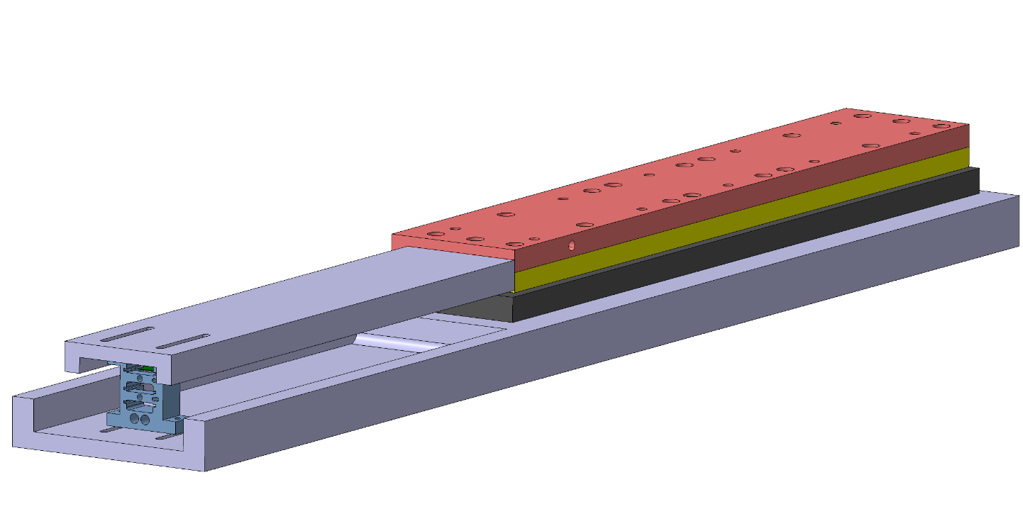
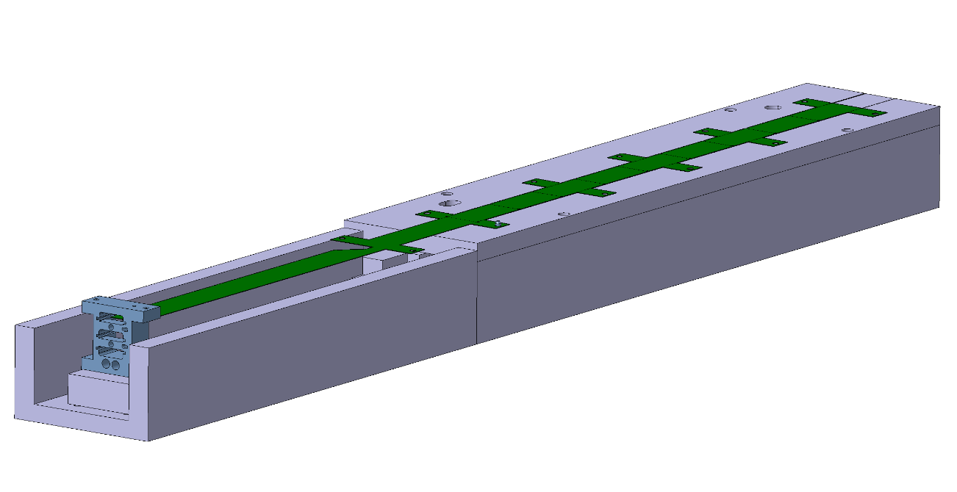
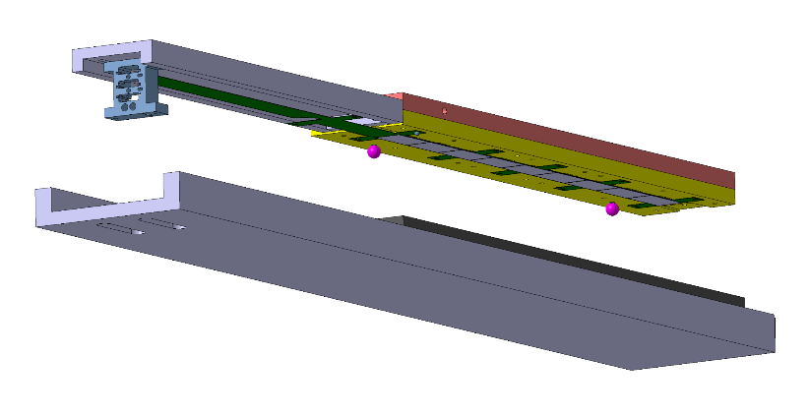
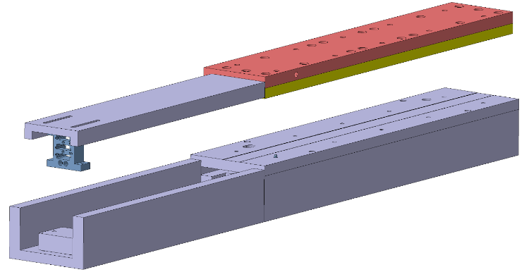
11. Transfer on HIC storage plate and electrical test
New tools under procurement
Spring loaded pin to align/release FPC/HIC
New base plate of bonding jig with FPC extension support
2
1
New FPC extension support on FPC gripper
3
4
HIC storage plate

Slide 18
Summary of IB HIC prototypes
List of prototypes produced from 08/2016
HIC ID | Gluing procedure | Chip | status | Comments
IB-HIC-proto-WB05 | 50 um shims, mask V4 | 100 um | working | 3 bonding wires, no shorts
IB-HIC-proto-WB08 | = | = | working | 3 b. w., initial shorts
IB-HIC-proto-WB09 | = | = | working -> STAVE-0 (NA61) | 1 b. w., initial shorts
IB-HIC-proto-WB10 | + hand mixing | = | partially working | 1 b. w., initial shorts
IB-HIC-proto-WB11 | = | = | working | 1 b. w., initial shorts
IB-HIC-proto-WB12 | = | = | partially working | 1 b. w., initial shorts
IB-HIC-proto-WB13 | + mask V5 | = | working | 1 b. w., initial shorts
IB-HIC-proto-WB14 | 90 um shims + mask V6 | = | working, ageing test done | 1 b. w., no shorts
IB-HIC-proto-WB15 | + mask V7 | = | working, ageing test done | 1 b. w., no shorts
IB-HIC-proto-WB16 | = | = | working, ageing test done | 3 b. w., no shorts
IB-HIC-proto-WB17 | = | 50 um | working, ageing test partial | 3 b. w., “small” shorts
IB-HIC-proto-WB18 | = | = | working -> STAVE-1 | 3 b. w., no shorts
IB-HIC-proto-WB19 | = | = | working, ageing test in progress | 3 b. w., no shorts
IB-HIC-proto-WB20 | = | = | 8 chips working | 3 b. w., no shorts, chip 9 broke after transfer on test plate

Slide 19
Summary of IB HIC prototypes
List of prototypes produced from 08/2016
HIC ID | Gluing procedure | Chip | status | Comments
IB-HIC-proto-WB21 | 90 um shims + mask V7 | 50 um | working -> STAVE-2, ageing test in progress | 3 b. w., no shorts
IB-HIC-proto-WB22 | = | 100 um PIQ | working, ageing test in progress | 3 b. w., no shorts
IB-HIC-proto-WB23 | 50 um shims + mask v7 | 100 um PIQ | working | 3 b. w., initial short in one chip
IB-HIC-proto-WB24 | 90 um shims + mask V7 | 50 um | working | 3 b. w., initial shorts
IB-HIC-proto-WB25 | = | 50 um | working | 3 b. w., initial shorts
IB-HIC-proto-WB26 | 50 um shims + mask v7 | 100 um PIQ | under test
IB-HIC-proto-WB27 | = | 100 um PIQ | under test

Slide 20
Wire bonding characterisation
Results of pull test on 80 bonds
  Min load= 8.278 g, Max load= 13.476 g, avg = 11.005 g, stdev = 1.08 g
  Avg- 3stdev = 7.764 g (> 7 g min. ref. load)
  Grade details:
    1st bond heel break , 79 events, avg. 10.993 g
    2nd bond lift, 1 event, 11.926 g
RESULTS FROM AGEING TEST TO BE ADDED

Slide 21
STAVE assembly procedure

Slide 22
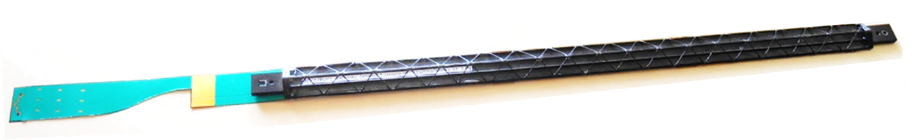
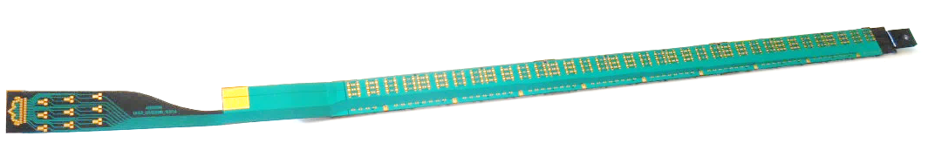
IB STAVE ASSEMBLY
ASSEMBLY PROCEDURE
TOOLING AND MECHANICAL TOLERANCES
To be updated

Slide 23

Layout
15,4 mm
INNER BARREL
5 mm
To be updated
Cold plate
Glue (50µm)
Pixel Chip (50µm)
0.85 mm
15 mm
0.3 mm
16.15 mm
FPC (175µm)

Slide 24
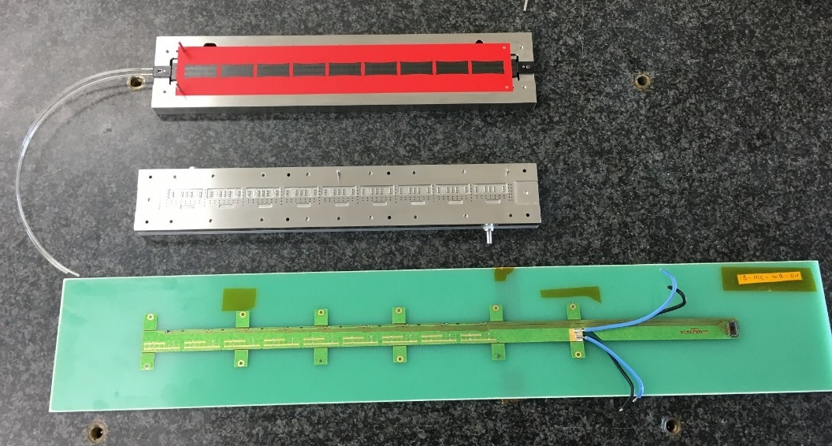
IB SF&CP + HIC Gluing
Objective:
glue the HIC to the IB spaceframe & coldplate, such to provide HIC support, alignment, and thermal contact to the coldplate
To be updated
temporary test wires

Slide 25
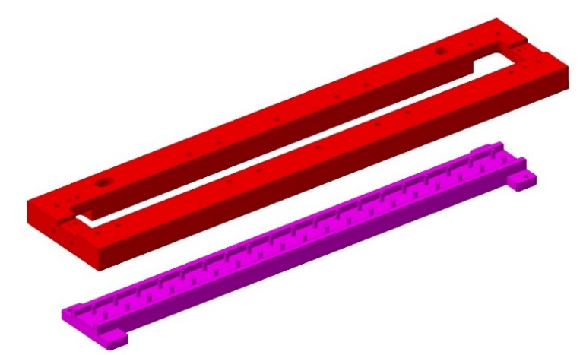
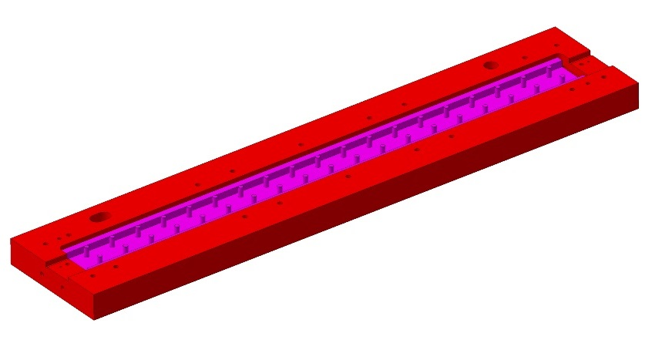
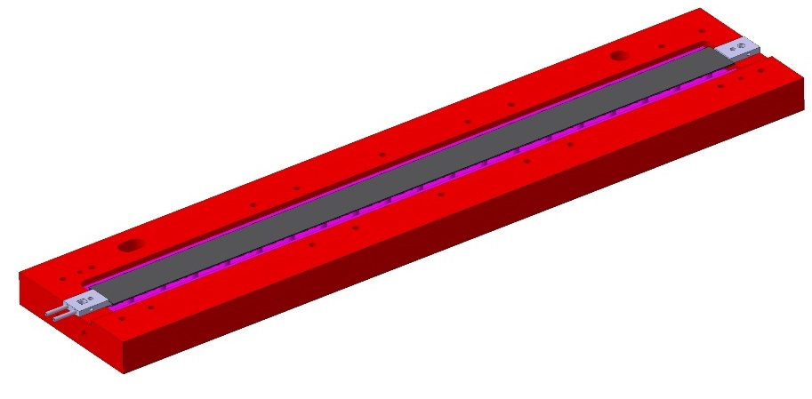
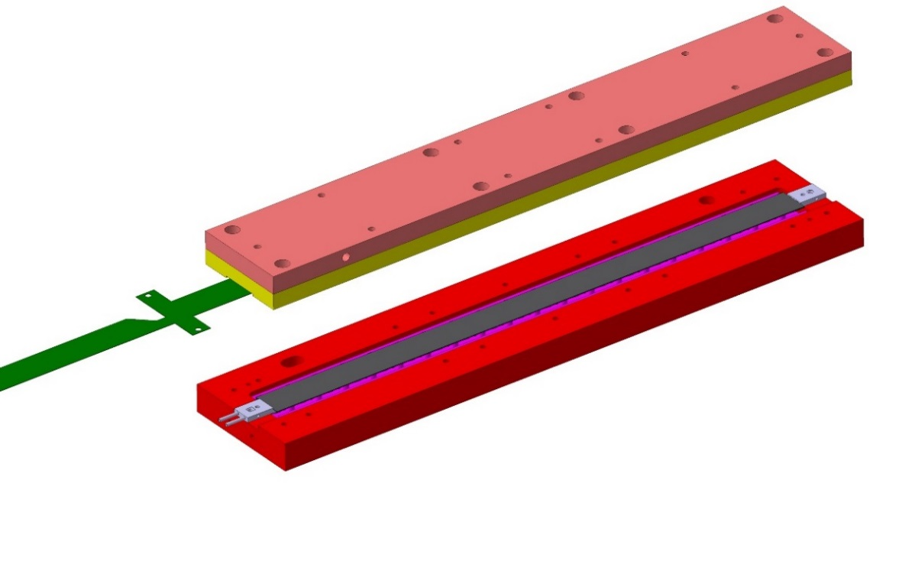
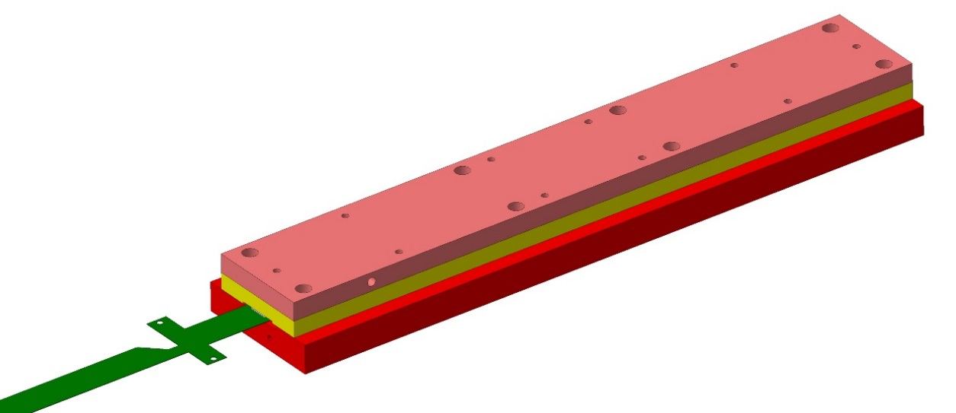
Assembly components and jigs
jig used for HIC gluing to IB spaceframe
SF_ jig
To be updated
IB Spaceframe& Coldplate
glue
HIC_ jig (vacuum)
FPC

Slide 26
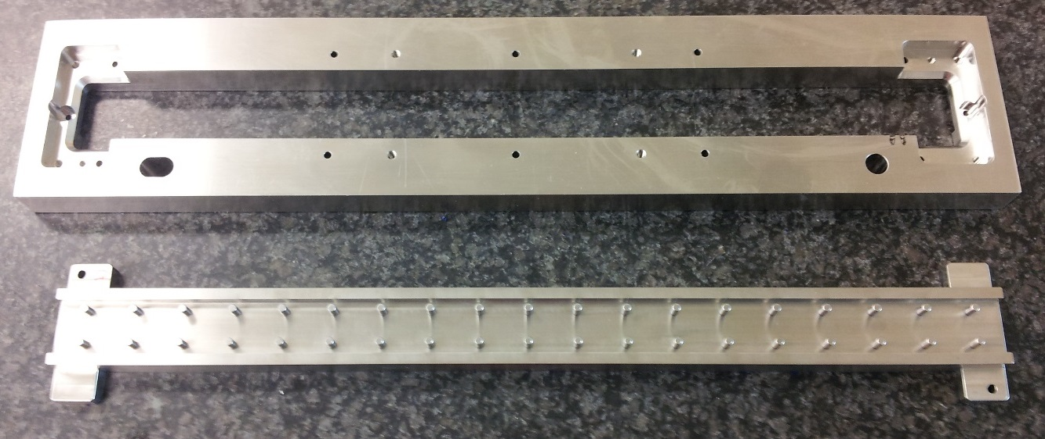
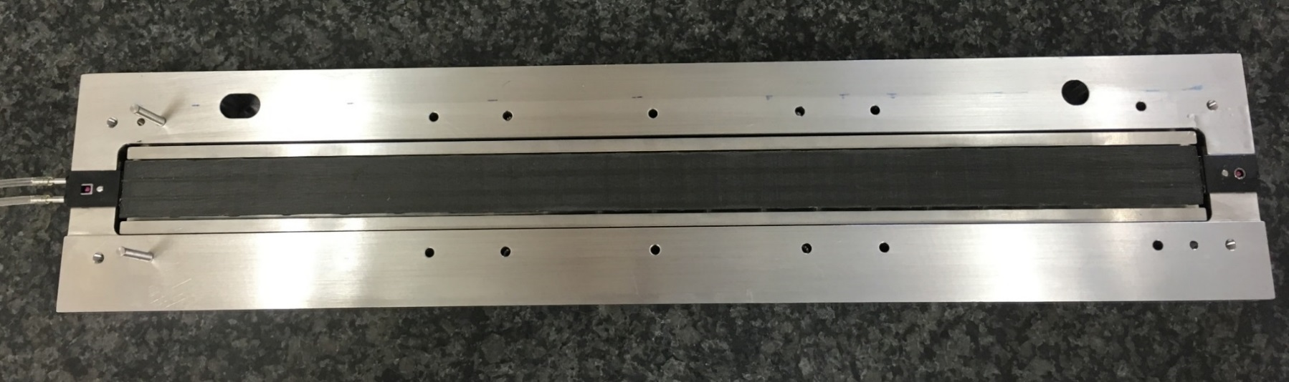
IB SF&CP + HIC Gluing steps
To be updated
1. Install the IB speceframe&coldplate in the SF_ jig

Slide 27
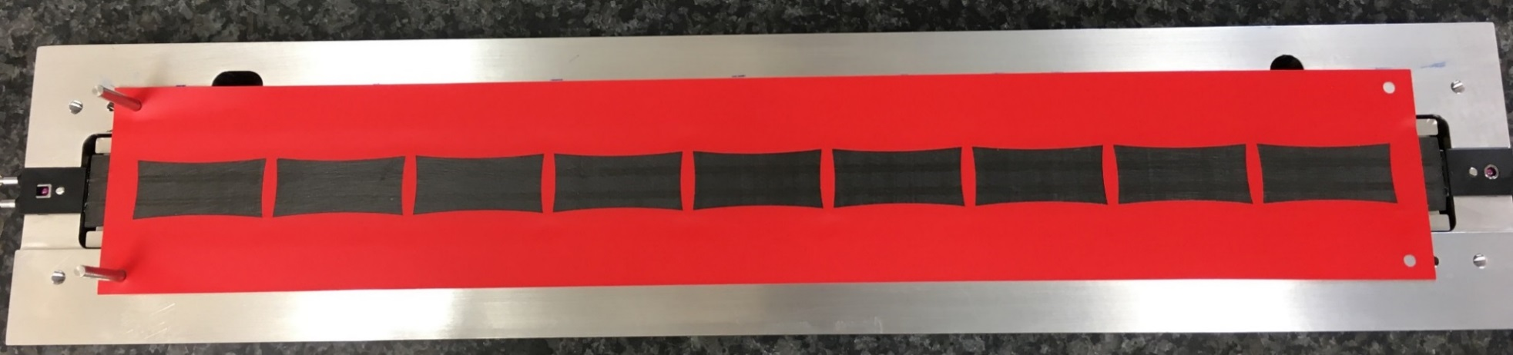
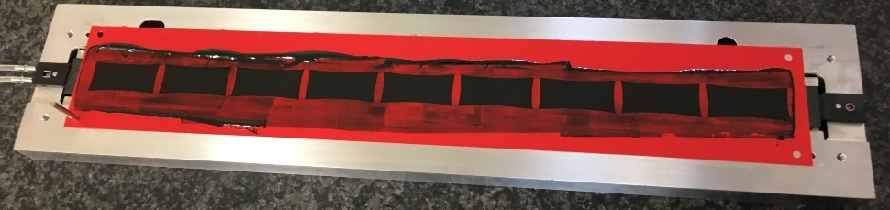

IB SF&CP + HIC Gluing steps
2. Position gluing mask (100 µm thick), use locating pins
To be updated
3. Apply glue ECCOBOND 45 and level with spatula
4. Remove gluing mask

Slide 28




IB SF&CP + HIC Gluing steps
5. Position the HIC on the HIC-Jig, use locating pins and vacuum
To be updated
HIC_jig has to provide room to allocate the FPC capacitors and bonded wires
10 µm
500 µm
25 µm
75 µm
25 µm
10 µm
100 µm
HIC_jig (vacuum chuck)

Slide 29

IB SF&CP + HIC Gluing steps
To be updated
6. Position shims to accommodate for a nominal 50 µm glue thickness after the matching of the 2 jigs

Slide 30


IB SF&CP + HIC Gluing steps
To be updated
7. Position the SF_ jig on top HIC_jig, use locating pin and fasteners.
8. Rotate the assembly and cure 24h at RT.

Slide 31

IB SF&CP + HIC Gluing steps
9. Remove SF_jig
To be updated
10. Remove Stave from SF jig and HIC_jig

Slide 32


IB SF&CP + HIC Gluing steps
To be updated
11. Remove wings – cuts wing bridges, procedure under test

Slide 33

IB SF&CP + HIC Gluing steps
Test setup for first prototype
To be updated
12. Acceptance Tests

Slide 34
IB STAVE ASSEMBLY
ASSEMBLY PROCEDURE
TOOLING AND MECHANICAL TOLERANCES
To be updated

Slide 35


Tooling and mechanical tolerances
Requirements:
Geometrical tolerance 10 micron (planarity)
~12µm
To be updated
~14 µm
Measured:
Geometrical tolerance 14 micron (planarity)

Slide 36






Tooling and mechanical tolerances:
engineering jig (old)
Spaceframe+
Connectors
HIC
To be updated
32 µm
~21µm
Old jigs, out of tolerance

Slide 37







Tooling and mechanical tolerances:
tol achieved with engineering jig (old)
Before HIC gluing
+0.039 mm
- 0.039 mm
free
free
Spaceframe 1_21 ( w/o connectors) free
After HIC gluing
To be updated
ruby
screw
+0.034 mm
- 0.034 mm
clamped
clamped
With HIC, stave 1_21 clamped
+0.033 mm
- 0.033 mm
free
free
With HIC, stave 1_21 free

Slide 38
Production workflow

Slide 39
Production planning

