Slide 1
IB Flexible Printed Circuit
ALICE ITS Upgrade
Stave Production Readiness Review
CERN, 27 April 2017

Slide 2
Design Requirements
Low material budget
The choice of the material to be used for the metal layers of the FPC is dictated by the need to minimise the material budget, thus Al has been preferred to the standard Cu (the respective radiation lengths being 8.9 cm and 1.44 cm).
Small losses and minimum impedance for homogenous power supply along the detector modules (9 pixel sensors row) and high quality of control and readout signals
The thickness of each Al layer is 25 μm, a value which allows keeping at the required value the voltage drop along the power supply lines; in addition, with a thickness of 75 μm for the polyimide substrate (Upilex-75S), a differential impedance of 100 Ω in the signal lines is obtained.
Dimensional specifications
The geometry of vias and interconnection pads has been optimized wrt the preliminary layout presented at the EDR, in order to allow reliable wire bonding using 3 wires per connection.
Position tolerance of ± 40 μm is required to align vias on sensor interconnection pads by overlapping the FPC on the pixel chips using nominal positions provided by alignment pin-holes.

Slide 3
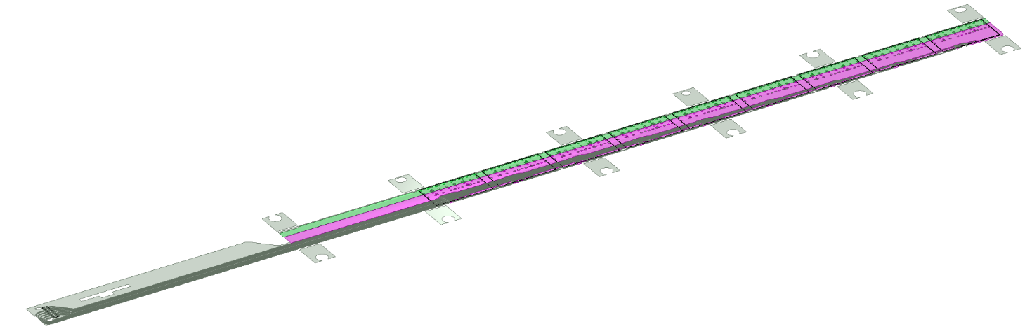
IB FPC Layout
506.2 mm
A
16 mm
16.15 mm
41.9 mm
A
4.1 mm
5.5 mm
20 µm COVERLAY
p
AVDD
DVDD
25 µm ALUMINUM
75 µm UPILEX
subs
AGND
DGND
25 µm ALUMINUM
4.1 mm
11.15 mm
20 µm COVERLAY
90 µm Glue
50 µm Silicon chip
CHIP 9
300 µm
850 µm
CHIP 8
CHIP 7
Fig 2: IB FPC Layer stackup
CHIP 6
CHIP 5
Large planes are used to distribute analogue and digital power and respective ground connections.
CHIP 4
CHIP 3
CHIP 2
CHIP 1
The 9 silicon chips are read out in parallel: each chip sends its data stream to the end of Stave by a dedicated differential pair, 100 μm wide. Two additional differential pairs distribute the clock and configuration signals.

Slide 4
IB FPC Layout
Alignment and handling wings
2
1
2
3
2
1
2
2
2
2
2
2
1
1
Oblong hole : 3 mm x 2.5 mm
10 mm
12.75 mm
2
Round hole : Ø 2.7 mm
3
Round hole : Ø 2.5 mm (for precise alignment)
16 mm
16.15 mm
Wings are partially cut for easier final removal at the end of Stave assembly
13 mm
2

Slide 5
IB FPC Layout
PWELL
SUBS
AVDD
AVDD PAD
AGND PAD
Supply and GND
DVDD
DVDD PAD
DGND PAD
High speed data lines
CTRL and CLK lines

Slide 6
IB FPC Layout
GND and power supply vias
GND via
350 µm
1200 µm
100 µm
4 x decoupling ceramic capacitor per chip
22 uF (0402)
400 µm
100 µm
100 µm
1200 µm
400 µm
Power via
DCTRL termination resistor
100 Ω (0402)
DCLK termination resistor
100 Ω (0402)

Slide 7
IB FPC Layout
Control and data vias
975 µm
200 µm
600 µm
1600 µm
600 µm
400 µm
400 µm
50 µm
50 µm

Slide 8
Inspection Slits
0.7 mm
1 mm
2 mm
2 mm
0.5 mm
1 mm
Inspection slits are implemented to verify and measure underlying chips position using reference marks
2 mm
2 mm
2 mm
0.5 mm
1.2 mm

Slide 9
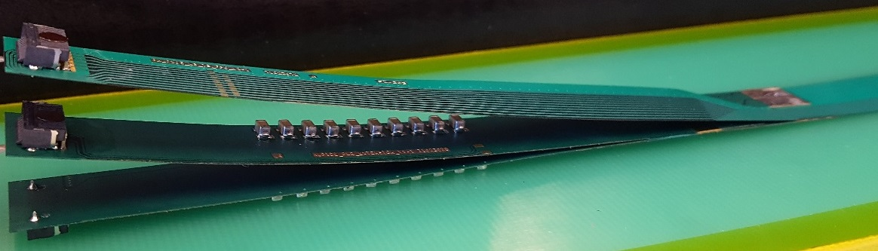
FPC Extension for Connection to Electrical Services
The connection to the service cables is achieved by a double FPC extension which is soldered to the HIC
x-section at interconnection between FPC and extensions
AVDD
AVDD
AVDD
AVDD
DVDD
FPC
AVDD
DVDD
AGND
AGND
Flex power extension
AVDD
DVDD
AGND
FPC
AGND
DGND
DVDD
DVDD
AGND
DGND
DVDD
AGND
DGND
FPC
DGND
DGND
Flex power extension
DGND
signal lines (FPC)
digital power
analogue power

Slide 10
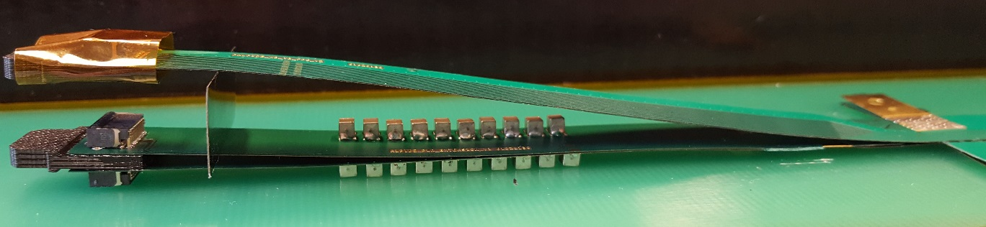
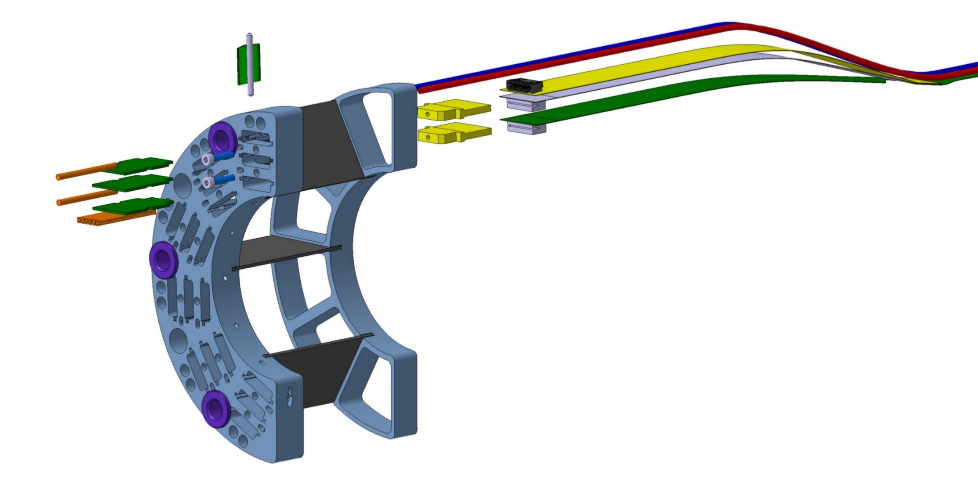
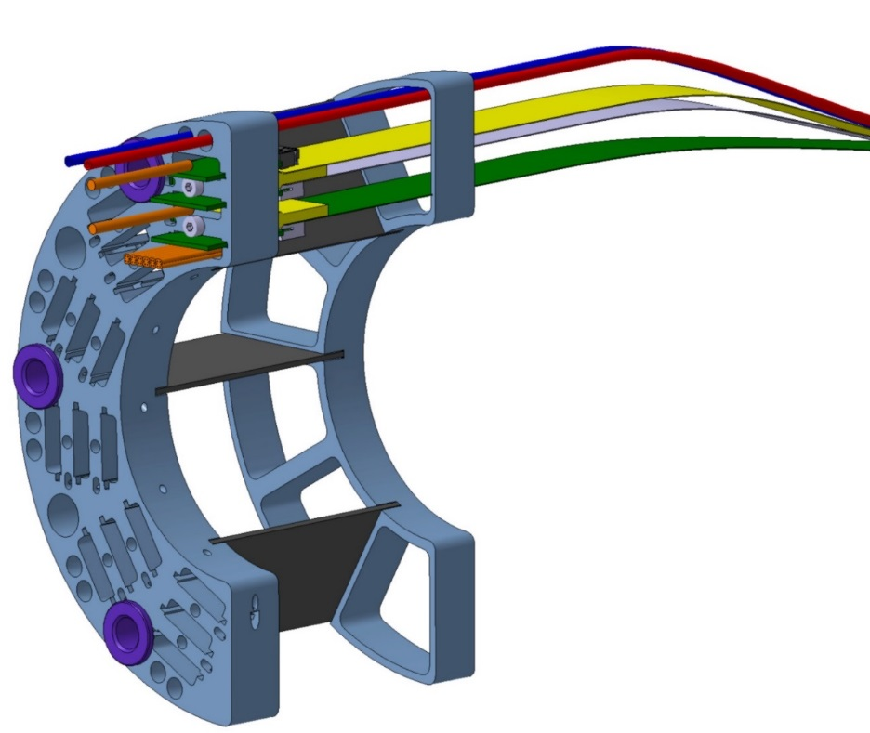
FPC Extension for Connection to Electrical Services
Such extensions are equipped with passive components (10x 220 μF capacitors) to stabilize the analogue and digital power supplies, respectively
IB FPC
Power extension Flex
to the Detector
to the Service
This solution allows to implement a “flexible” connection to external service cables with minimized space occupancy

Slide 11
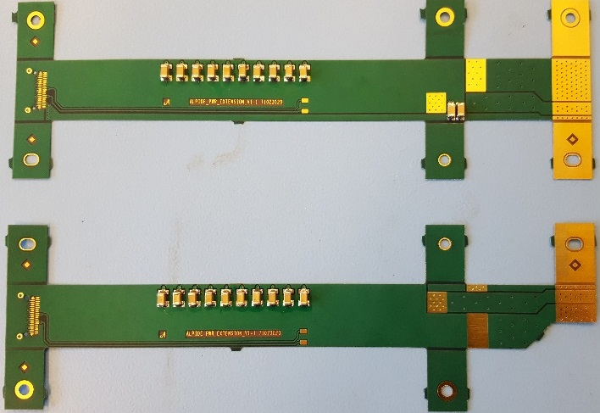
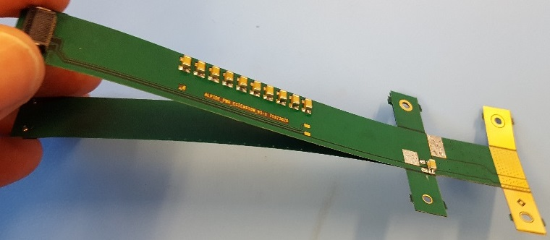
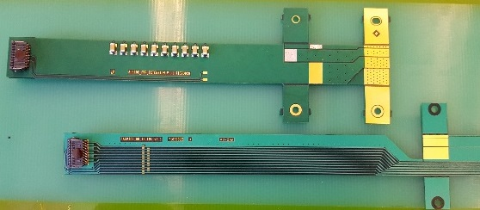
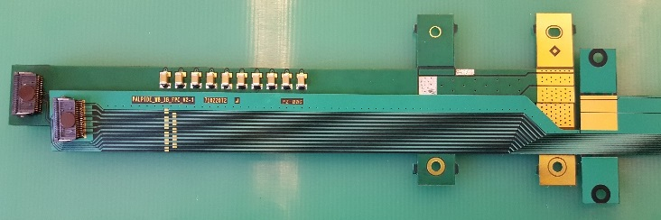
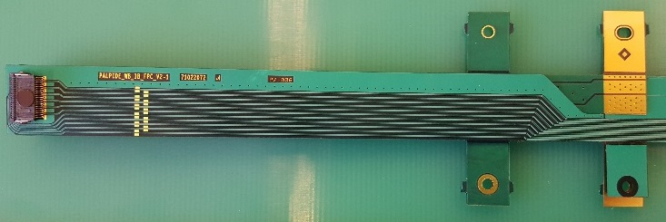
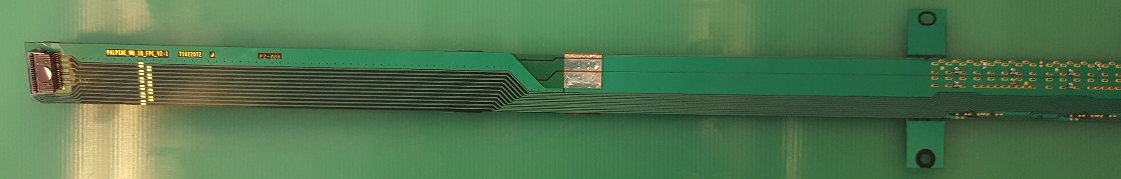
FPC Extension for Connection to Electrical Services
The 2 flexes are glued together, in the middle to have a 4 layers flex.
2 Cu layer flex, PI : 50 µm, Cu : 35 µm, Solder mask : 20 µm
The PWR_extension is connected to the FPC by iron soldering.

Slide 12
IB FPC Performance: Supply Voltage Drop
ANSYS simulation parameters
Nominal Supply Voltage (analog and digital) => 1.8V
Chip area : 3cm x 1.5 cm => 4.5 cm²
Chip power : 4.5 cm² x 45 mW/cm² => 202 mW
2/3 for digital : 180 mW / Chip
1/3 for analogue : 22 mW / Chip

Slide 13
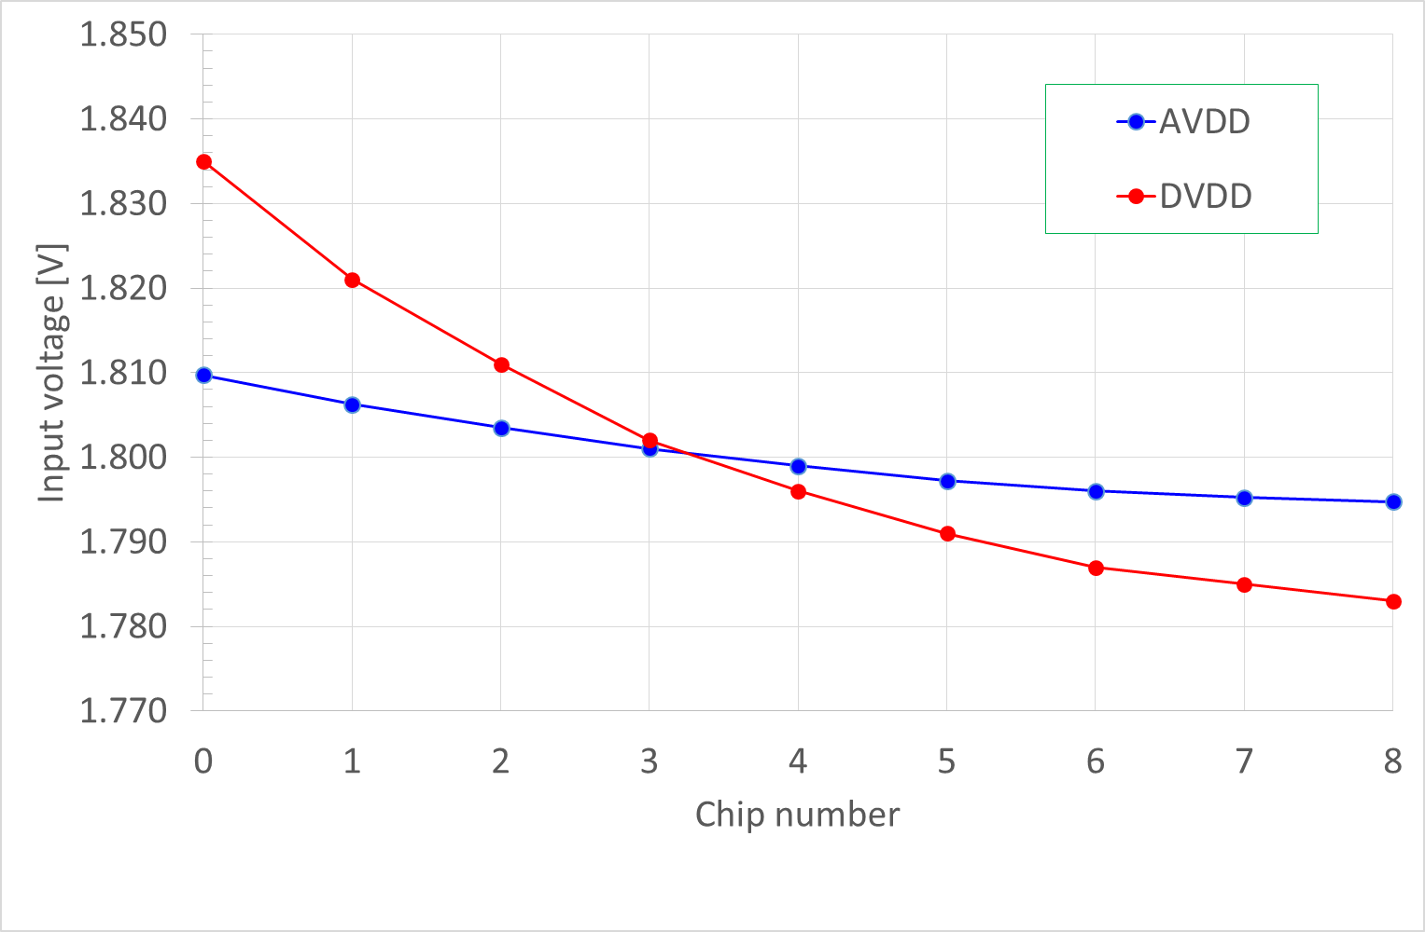
IB FPC performance: power supply drop
Power plane, AVDD & DVDD DC Voltage drop
Ground plane, AGND & DGND DC Voltage drop
ANALOGUE | Mean | Voltage drop
Chip0 | 1.810V | + 9.75 mV
Chip1 | 1.806V | + 6.25 mV
Chip2 | 1.804V | + 3.5 mV
Chip3 | 1.801V | + 1 mV
Chip4 | 1.799V | - 1 mV
Chip5 | 1.797V | - 2.75 mV
Chip6 | 1.796V | - 4 mV
Chip7 | 1.795V | - 4.75 mV
Chip8 | 1.795V | - 5.25 mV
Chip0
Chip1
Chip2
Chip3
DIGITAL | Mean | Voltage drop
Chip0 | 1.835V | + 35 mV
Chip1 | 1.821V | + 21 mV
Chip2 | 1.811V | + 11 mV
Chip3 | 1.802V | + 2 mV
Chip4 | 1.796V | - 4 mV
Chip5 | 1.791V | - 9 mV
Chip6 | 1.787V | - 13 mV
Chip7 | 1.785V | - 15 mV
Chip8 | 1.783V | - 17 mV
Chip4
Chip5
Chip6
Chip7
Chip8

Slide 14
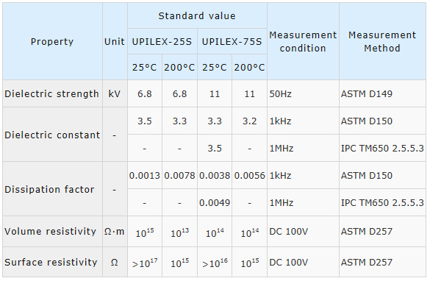
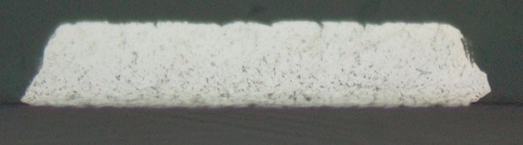
IB FPC Performance: High Speed Signal
S-PARAMETERS
120 µm
80 µm
120 µm
100 µm
100 µm
Solder-mask 20 µm
Al 25 µm
UPILEX-75S 75 µm
Al 25 µm
Solder-mask 20 µm
104.39 µm
24 µm
120.95 µm
IB FPC aluminium conductivity : 2.40E+07 s/m
IB FPC high speed differential lines length

Slide 15
IB FPC Performance: High Speed Signal
- 3 dB 500 Mhz
- 8 dB Limit to no equalisation

Slide 16
IB FPC Manufacturing Procedure
step | conditions | place | validation
1 . Thermal stabilisation of Upilex-75S sheets | 2 h at 400 ºC and 1E-08 mbar | CERN or Bodycote (F) | Visual inspection
2. Holes drilling by laser | 23 +/- 1 ºC (Upilex-75S CTE 20 ppm) | KIRANA (IT) | Metrology (dimensional)
3. Preparation for Al coating: cleaning, light polishing in sand blasting machine | 3 passages at 1.5 bar, 0.2 m/s, pumice powder coarse FF 10-177 um | CERN | Metrology (witness samples surface roughness)
4. Al PVD coating | 12 h of vacuum P < 10E-08 before starting | HEF (F) | Peel test, R² measurement, Al thickness on witness samples
5. LDI, etching, Ni/Au, solder mask coverlay |  | CERN | Visual inspection, electrical continuity, resistivity measurements, metrology, metal layers thickness, “bondability” test
6. SMD components mounting by hand (baseline); evaluation of vapour phase reflow oven @ 160 ºC in progress | Sn-Pb solder paste, | CERN | Visual inspection
7. Cleaning | isopropyl alcohol ultrasonic bath 3’ | CERN | Visual inspection, electrical continuity, resistivity measurements
8. Storage in N2 |  | CERN

Slide 17
“Fiche de Suivi”

Slide 18
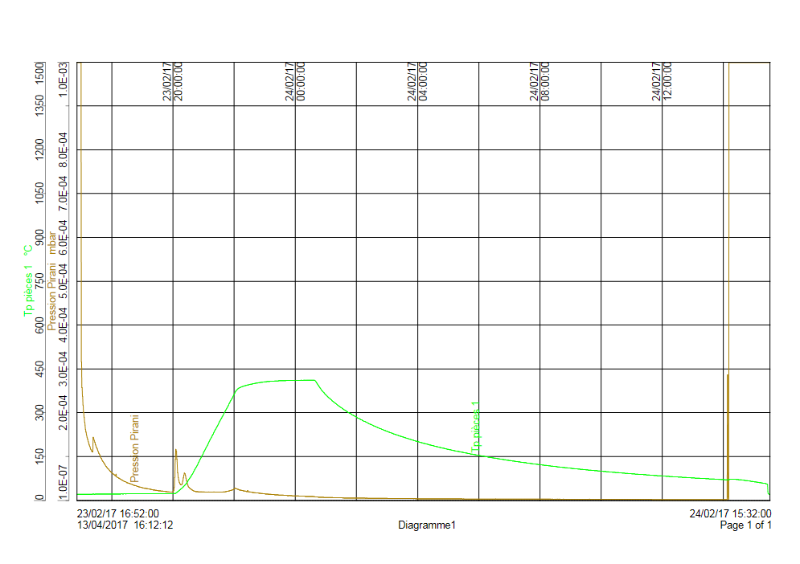
Upilex Thermal Stabilisation Treatment
2 h at 400 ºC and P ~ 1E-07 mbar
Upilex-75S has the lowest heat shrinkage, however this treatment turned out to be necessary to minimize and control dimensional variations during the processing
Brand/ name | Heat shrinkage [%]
Dupont/ Kapton 300 HPP-ST | 0.03 (30’ @ 150 ºC)
UBE/ Upilex-75S | 0.01 (2 h @ 200 ºC)
Kaneka/ Apical 300 NP | 0.04 (30’ @ 150 ºC) 0.08 (2 h @ 200 ºC)
Saint Gobain/ Norton TH-075 | 0.05 (2 h @ 200 ºC)

Slide 19
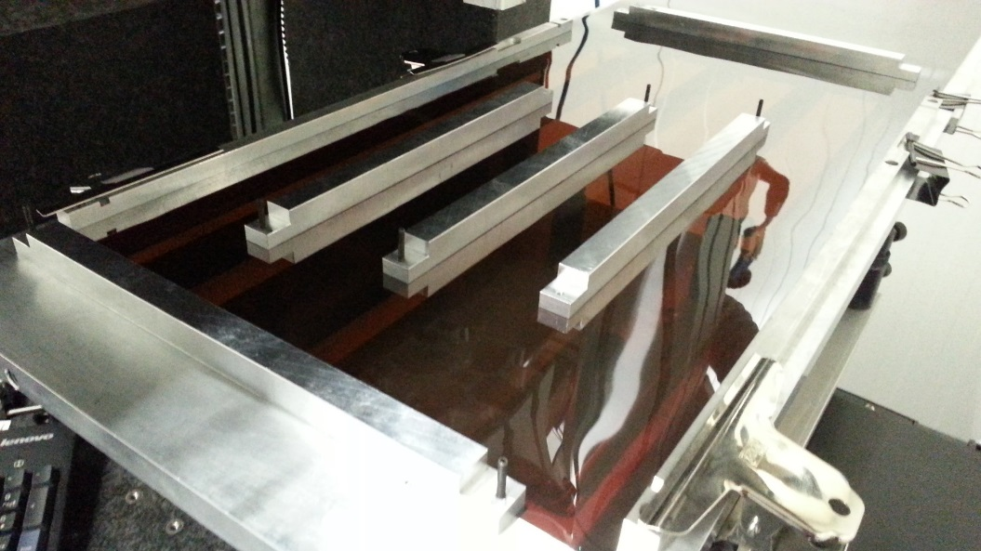
Laser Drilling
Upilex sheet
Max four sheets of 95x28 cm² can be mounted in the PVD system performing the Al coating; the layout has been optimized in order to maximize the number of FPC/sheet (+ production shared with MFT)
Hole pattern layout
1
2
3
IB
MFT
4
5
6

Slide 20
FPC Metrology Results
The holes pattern has been designed to compensate the residual shrinking observed after Al coating (~ 0.14 %) induced by cooling down of deposited Al layers
Reference values:
  Distance (D12) between first and last via of central row in each FPC
  Position (XT0, YT0) of reference hole used for alignment wrt to first via
D12 266.99
XT0 133.645
YT0 17.66
QUOTE | nominal value [mm] | Compensated value [mm]
D12 | 266.990 | 267.364
XT0 | 133.645 | 133.830
YT0 | 17.660 | 17.684

Slide 21
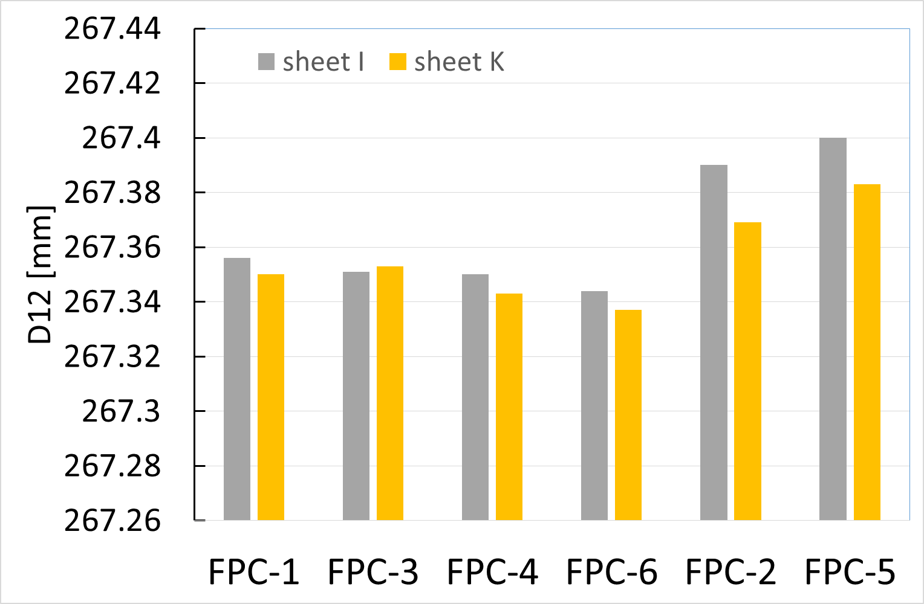
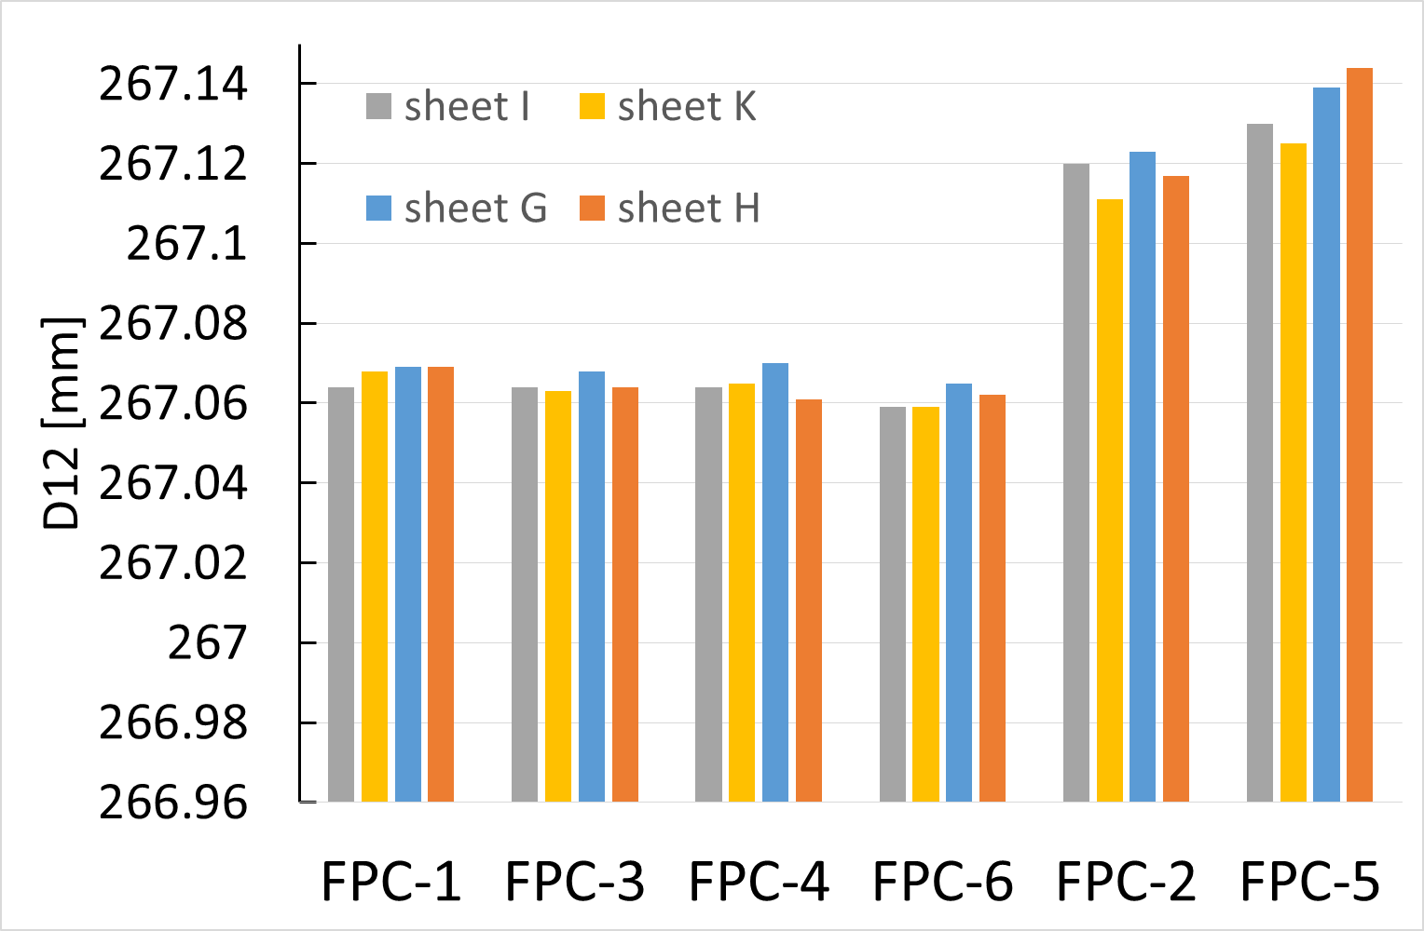
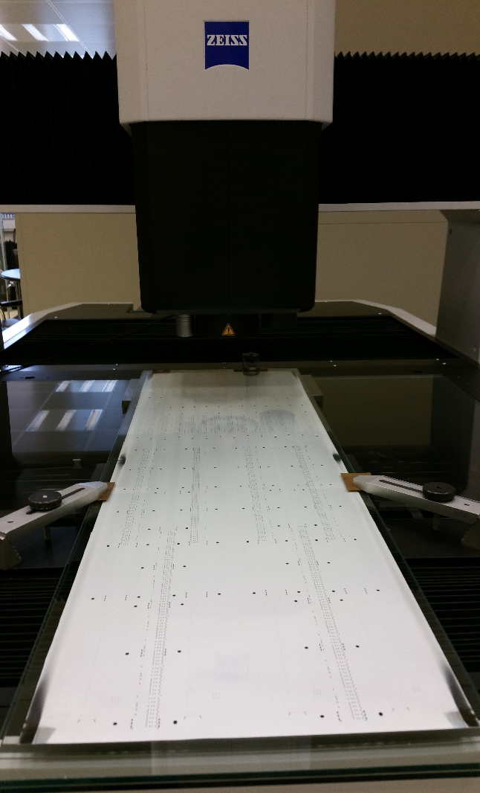
FPC Metrology Results
D12
after laser drilling
after Al PVD coating
Avg/stdev | I+K (1,3,4,6) | I+K (2,5) | G+H (1,3,4,6) | G+H (2,5) | PZ+PX (1,3,4,6) | PZ+PX (2,5)
After laser drilling | 267.35/0.006 | 267.39/0.01 |  |  | 267.35/0.01 | 267.40/0.01
After Al coating | 267.06/0.003 | 267.12/0.007 | 267.07/0.003 | 267.13/0.012 | 267.02/0.003 | 267.087/0.01
Finished FPC |  |  |  |  | 267.08/0.015 | 267.16/0.013
FPC thickness
Typical st. dev in one FPC ~ 4 um
On a sample of 12 pieces:
avg: 167.7 um, st. dev. 2.8 um
FPC (2, 5) longer than FPC (1, 3, 4, 6) by ~ 60-80 um
Finished FPCs (1, 3, 4, 6) are longer than nominal by ~60 um
St. dev. ~ 15 um
Fine tune shrink factor for the two groups

Slide 22
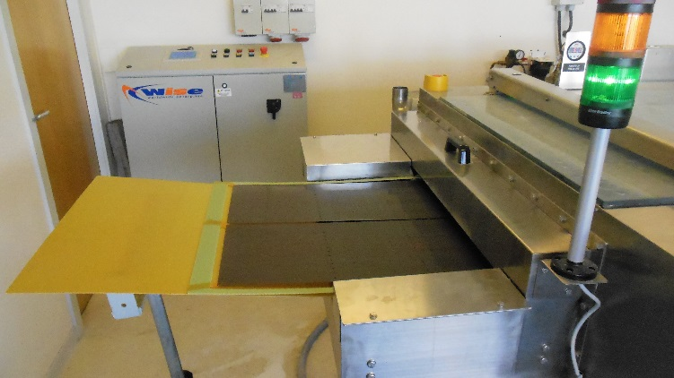
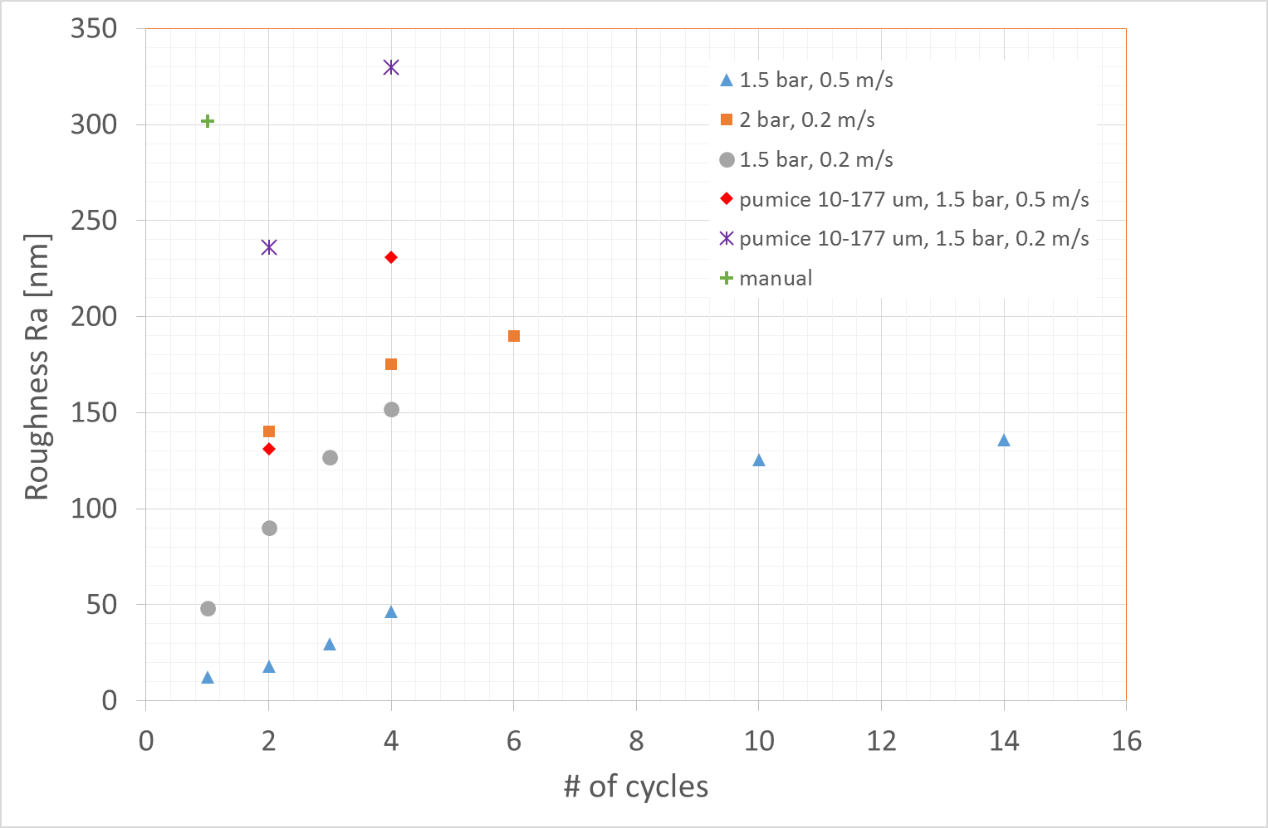
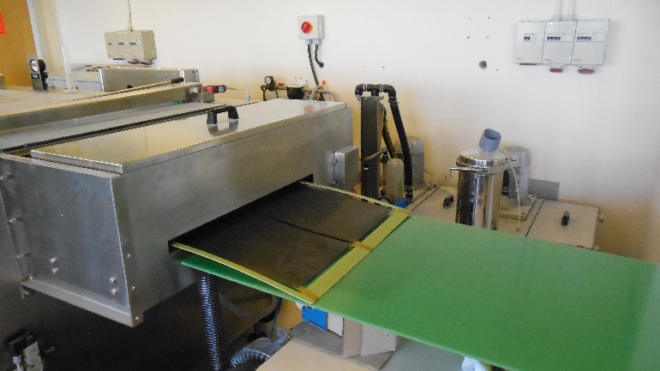
Sand Blasting
Usage of automated sand blasting required various tests to fine tune process parameters (pumice powder size, speed, pressure) in order to achieve same Ra (~ 300 nm) as with the lengthy manual treatment.
manual
sand blasting

Slide 23
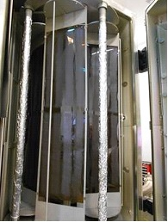
Al PVD Coating
Monitoring of main process parameters (some not available to customers)
Observed values during pre-series production
acceptance criteria | Visual inspection | P lim [mbar] | Adherence (NF 2409) | Al thickness > 25 µm TOP/BOTTOM samples | R2 [mΩ ] TOP/BOTTOM samples
Average | Aspect uniformity | 8,4 .10-7 | Classe ≤ 1 | 25,9/26,3 | 11,13/11,13
MIN |  | 7,2 .10-7 |  | 25,3/25,2 | 10,8 /10,8
MAX |  | 1,1.10-6 |  | 26,9/27,1 | 11,3/11,3

Slide 24
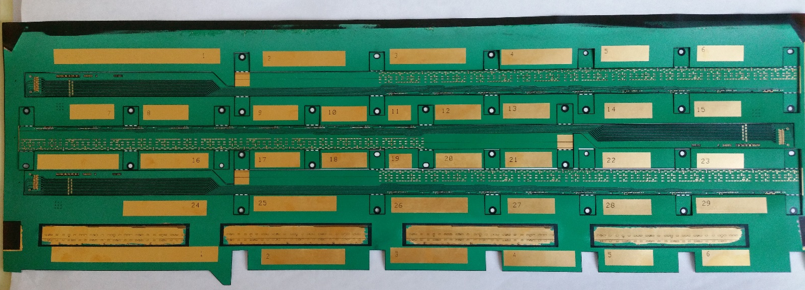
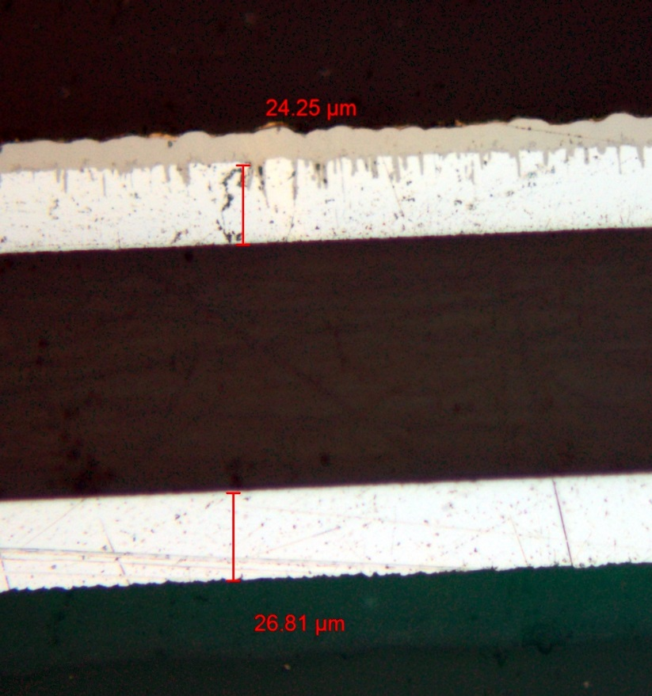
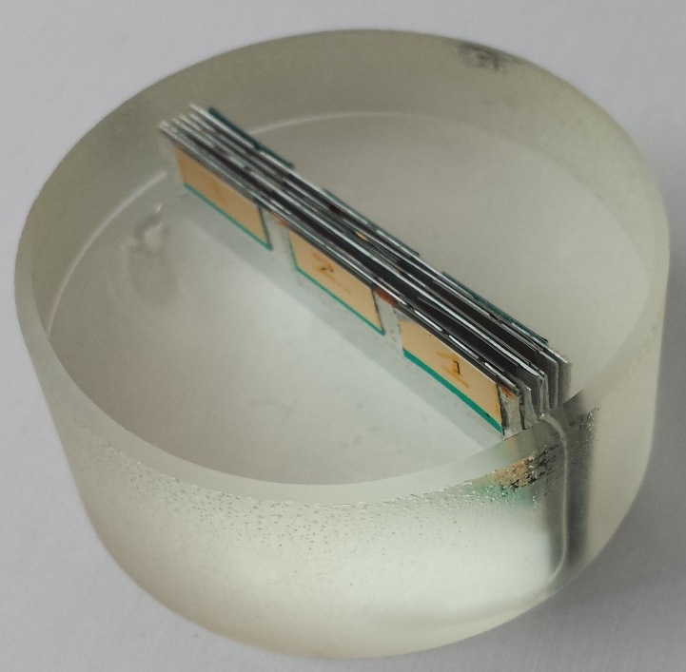
Metal Layers Thickness
FPC samples cut from not used area (the numbered rectangles) are embedded in resin and micro-section photos are used to measure the thickness
 | 1 | 2 | 3 | 4 | 5 | 6 | 7 | 8 | 9 | 10 | 11 | 12 | 13 | 14
1 | 25 | 25 | 25 | 25 | 25 | 25 | 25 | 25 | 25 | 24 | 24 | 21 | 20.5 | 2
2 | 25 | 25 | 25 | 25 | 25 | 25 | 25 | 25 | 27 | 24.3 | 22 | 23 | 24 | 18
3 | 24 | 23.66 | 23.6 | 23.6 | 23 | 22.5 | 24.275 | 25.6 | 25.2 | 24.2 | 23 | 22 | 21 | 18
4 | 24 | 24 | 24 | 24 | 24 | 24 | 24 | 23.5 | 24 | 24 | 23 | 22 | 20 | 16.5
5 | 23.5 | 23.5 | 23.5 | 23.5 | 23.5 | 23.4 | 23.5 | 23.4 | 23.8 | 23 | 23 | 22.5 | 22 | 21

Slide 25
Resistance and Impedance Measurements
Measured resistance HS lines on FPC PX-001 to PX-006
PX-003 HSDATA_P9 and HSDATA_N9 impedance
 | PX-001 (Ω) | PX-002 (Ω) | PX-003 (Ω) | PX-004 (Ω) | PX-005 (Ω) | PX-006 (Ω) | Length (cm)
DCLK_N | 6.624 | 6.826 | 6.331 | 6.757 | 6.707 | 6.634 | 51.27247
DCLK_P | 6.6 | 6.783 | 6.255 | 6.69 | 6.661 | 6.589 | 51.23493
DCTRL_N | 6.762 | 6.917 | 6.423 | 6.818 | 6.78 | 6.71 | 51.4434
DCTRL_P | 6.91 | 7.084 | 6.61 | 7.034 | 6.981 | 8.313 | 51.19231
HSDATA_N1 | 3.496 | 3.274 | 3.065 | 3.493 | 200 | 3.343 | 26.41708
HSDATA_N2 | 3.827 | 3.633 | 3.418 | 3.853 | 3.607 | 3.684 | 29.21161
HSDATA_N3 | 4.16 | 3.997 | 3.849 | 4.206 | 3.989 | 4.043 | 32.03476
HSDATA_N4 | 4.315 | 4.248 | 4.185 | 4.384 | 4.21 | 4.254 | 33.92726
HSDATA_N5 | 4.66 | 4.657 | 4.6 | 4.767 | 4.596 | 4.632 | 36.95352
HSDATA_N6 | 5 | 5.059 | 4.952 | 5.137 | 4.98 | 5.006 | 40.00215
HSDATA_N7 | 5.353 | 5.481 | 5.368 | 5.501 | 5.373 | 5.379 | 43.06259
HSDATA_N8 | 5.717 | 5.922 | 5.72 | 5.89 | 5.767 | 5.754 | 46.13386
HSDATA_N9 | 6.073 | 6.425 | 6.144 | 6.276 | 6.197 | 6.106 | 49.20237
HSDATA_P1 | 3.505 | 3.268 | 3.066 | 3.51 | 3.268 | 3.352 | 26.44469
HSDATA_P2 | 3.841 | 3.626 | 3.431 | 3.862 | 200 | 3.692 | 29.23948
HSDATA_P3 | 4.155 | 3.99 | 3.855 | 4.194 | 3.607 | 4.036 | 32.06206
HSDATA_P4 | 4.323 | 4.237 | 4.187 | 4.389 | 4.216 | 4.261 | 33.8915
HSDATA_P5 | 4.663 | 4.648 | 4.6 | 4.77 | 4.601 | 4.631 | 36.91777
HSDATA_P6 | 5.01 | 5.06 | 4.942 | 5.142 | 4.983 | 5.008 | 39.9664
HSDATA_P7 | 5.36 | 5.486 | 5.37 | 5.516 | 5.369 | 5.388 | 43.02763
HSDATA_P8 | 5.717 | 5.923 | 5.715 | 5.897 | 5.775 | 5.761 | 46.09889
HSDATA_P9 | 6.065 | 6.416 | 6.139 | 6.275 | 6.192 | 6.099 | 49.16661
The curve slope is dues to the resistive loss
Probe and FPC interconnection

Slide 26
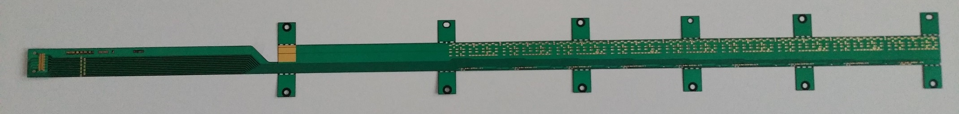
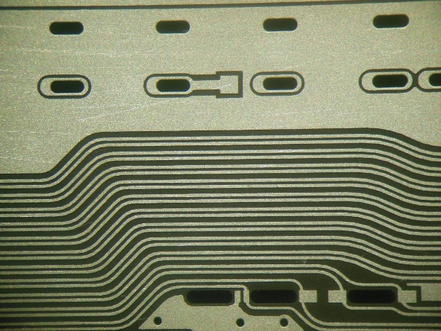
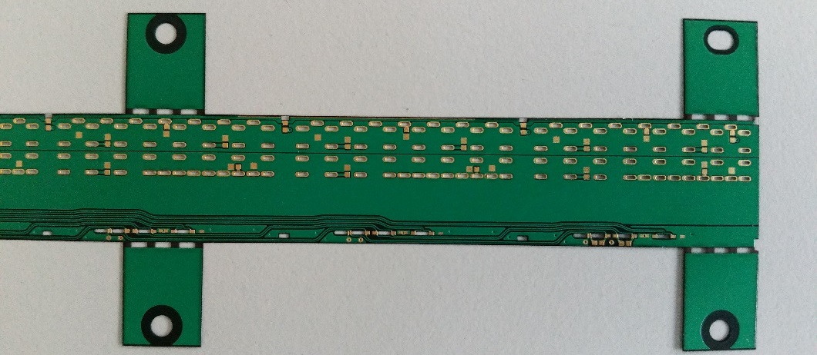
Prototypes Production
Layout and processing have been optimized during all 2016 ( more than 40 prototypes produced)
In 2017 we procured 24 prototypes, yield ~ 80 %
Al top layer after etching

Slide 27
Production Schedule
Amount to be produced: two full IB (96) + 20% → 116 FPC
Including a yield of 80% for FPC production and of 90% for HIC modules production a total number of 160 FPC is required
Each sheet contains 6 FPC (possibility to include a 7th under investigation), a total of 24 sheets need to be processed
The estimated time for full production (started in March) is 9 months, completion of 48 FPC (for IB-1) expected for mid August

Slide 28
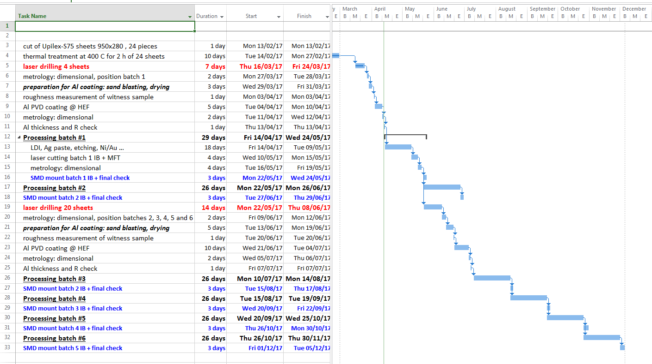
Production Schedule

