Slide 1
IB Flexible Printed Circuit
ALICE ITS Upgrade
Stave Production Readiness Review
CERN, 27 April 2017

Slide 2
Design requirements
Low material budget
The choice of the material to be used for the metal layers of the FPC is dictated by the need to minimise the material budget, thus Al has been preferred to the standard Cu (the respective radiation lengths being 8.9 cm and 1.44 cm).
Small losses and minimum impedance for homogenous power supply along the detector modules (9 pixel sensors row) and high quality of control and readout signals
The thickness of each Al layer is 25 μm, a value which allows keeping at the required value the voltage drop along the power supply lines; in addition, with a thickness of 75 μm for the polyimide substrate (Upilex-75S), a differential impedance of 100 Ω in the signal lines is obtained.
Dimensional specifications
The geometry of vias and interconnection pads has been optimized wrt the preliminary layout presented at the EDR, in order to allow reliable wire bonding using 3 wires per connection.
Position tolerance of ± 40 μm is required to align vias on sensor interconnection pads by overlapping the FPC on the pixel chips using nominal positions provided by alignment pin-holes and reference marks.

Slide 3
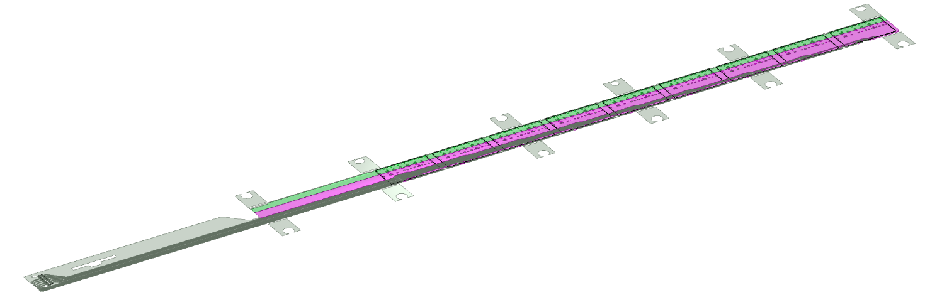
IB FPC layout
506.2 mm
A
16 mm
16.15 mm
41.9 mm
A
4.1 mm
5.5 mm
20 µm COVERLAY
p
AVDD
DVDD
25 µm ALUMINUM
75 µm UPILEX
subs
AGND
DGND
25 µm ALUMINUM
4.1 mm
11.15 mm
20 µm COVERLAY
90 µm Glue
50 µm Silicon chip
CHIP 9
300 µm
850 µm
CHIP 8
CHIP 7
Fig 2: IB FPC Layer stackup
CHIP 6
CHIP 5
Large planes are used to distribute analogue and digital power and respective ground connections.
CHIP 4
CHIP 3
CHIP 2
CHIP 1
The 9 silicon chips are read out in parallel: each chip sends its data stream to the end of Stave by a dedicated differential pair, 100 μm wide. Two additional differential pairs distribute the clock and configuration signals.

Slide 4
IB FPC layout
Alignment and handling wings
2
1
2
3
2
1
2
2
2
2
2
2
1
1
Oblong hole : 3 mm x 2.5 mm
10 mm
12.75 mm
2
Round hole : Ø 2.7 mm
3
Round hole : Ø 2.5 mm
16 mm
16.15 mm
Wings are partially cut for easier final removal at the end of Stave assembly
13 mm
2

Slide 5
IB FPC layout
PWELL
SUBS
AVDD
AVDD PAD
AGND PAD
Supply and GND
DVDD
DVDD PAD
DGND PAD
High speed data lines
CTRL and CLK lines

Slide 6
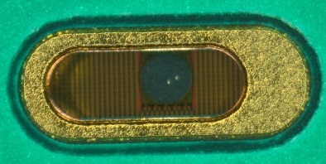
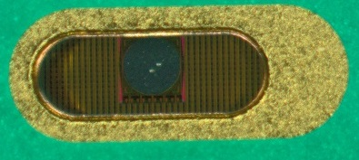
IB FPC layout
GND and power supply vias
350 µm
1200 µm
100 µm
400 µm
4 x Decoupling ceramic capacitor per chip
10 uF (0402)
100 µm
100 µm
1200 µm
400 µm
GND via
DCTRL termination resistor
100 Ω (0402)
DCLK termination resistor
100 Ω (0402)
Power via

Slide 7
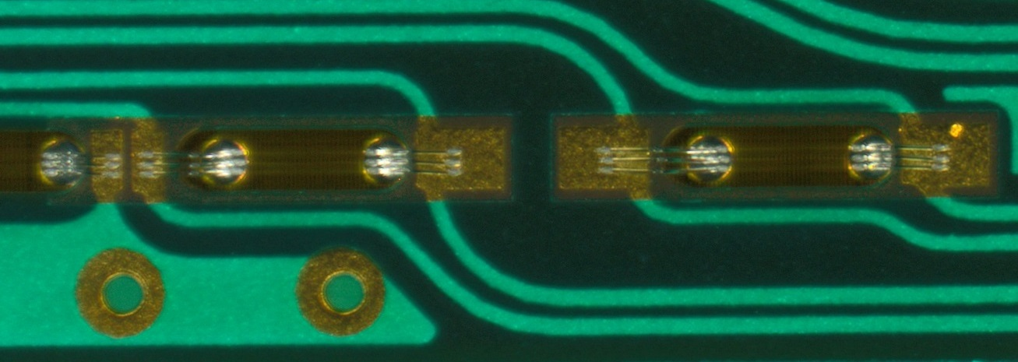
IB FPC layout
Control and data vias
975 µm
200 µm
600 µm
1600 µm
600 µm
400 µm
400 µm
Teardrops
50 µm
50 µm

Slide 8
Inspection slits
0.7 mm
1 mm
2 mm
2 mm
0.5 mm
1 mm
Inspection slits are implemented to verify and measure underlying chips position using reference marks
2 mm
2 mm
2 mm
0.5 mm
1.2 mm

Slide 9
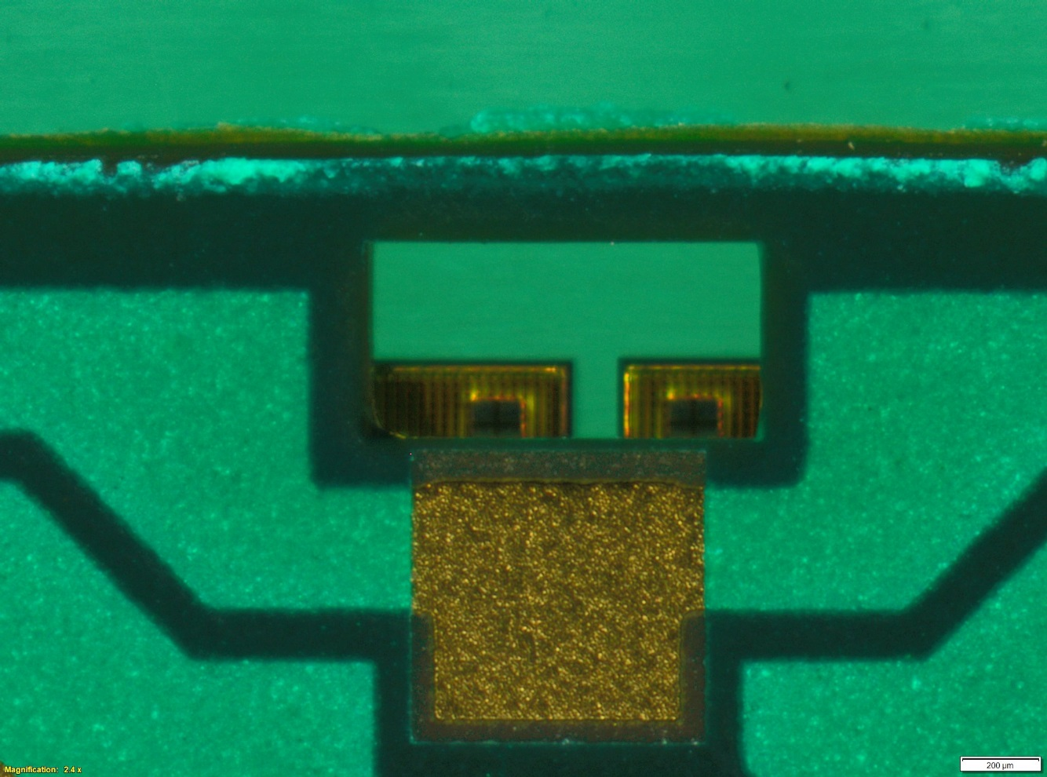
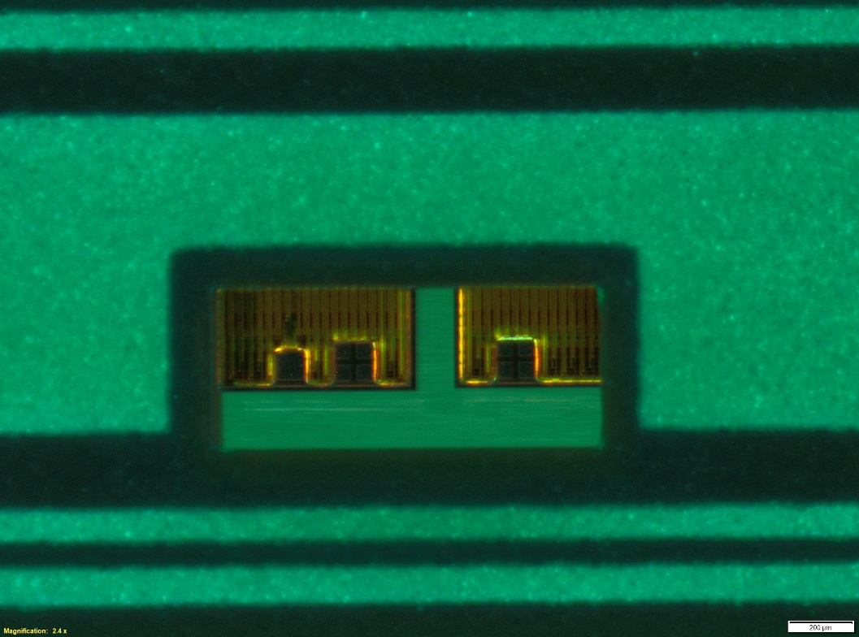
Inspection slits

Slide 10
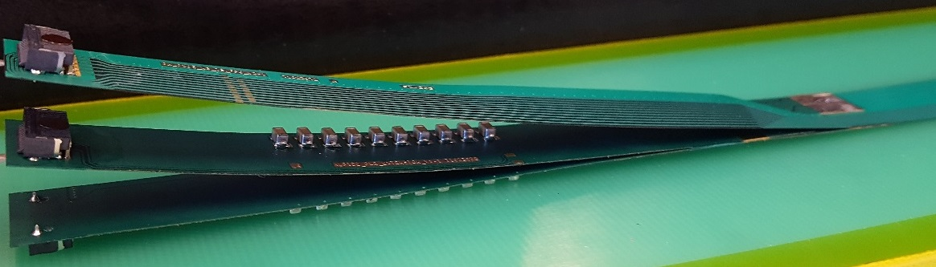
FPC extension for connection to electrical services
The connection to the service cables is achieved by a double FPC extension which is soldered to the HIC.
x-section at interconnection between FPC and extensions
AVDD
AVDD
AVDD
DVDD
AVDD
AVDD
DVDD
FPC
AGND
AVDD
DVDD
AGND
Flex power extension
FPC
AGND
AGND
DGND
DVDD
AGND
DGND
DVDD
AGND
DGND
DVDD
FPC
DGND
DGND
Flex power extension
signal lines (FPC)
DGND
digital power
analogue power

Slide 11
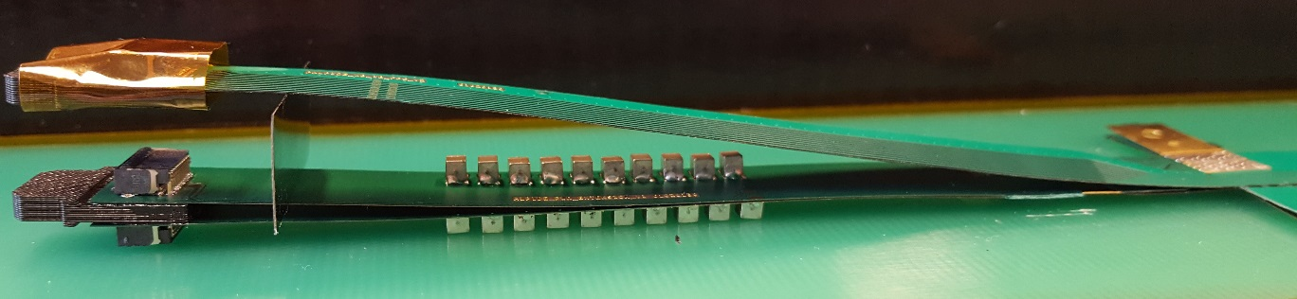
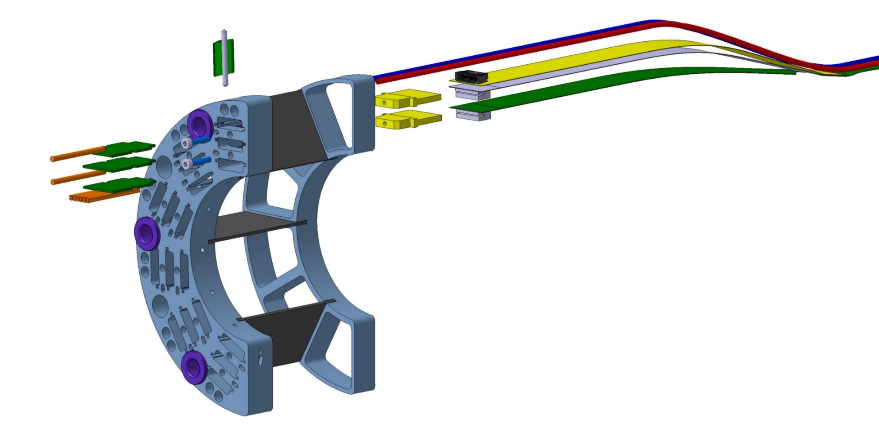
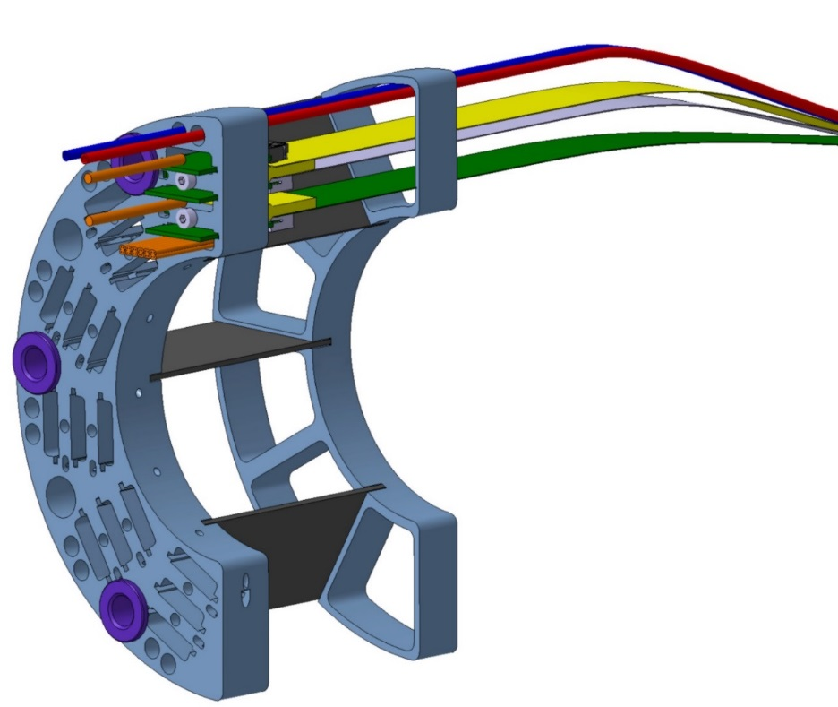
FPC extension for connection to electrical services
Such extensions are equipped with passive components (10x 220 μF capacitors) to stabilize the analogue and digital power supplies, respectively.
IB FPC
Power extension Flex
to the Detector
to the Service
This solution allows to implement a “flexible” connection to external service cables with minimized space occupancy

Slide 12
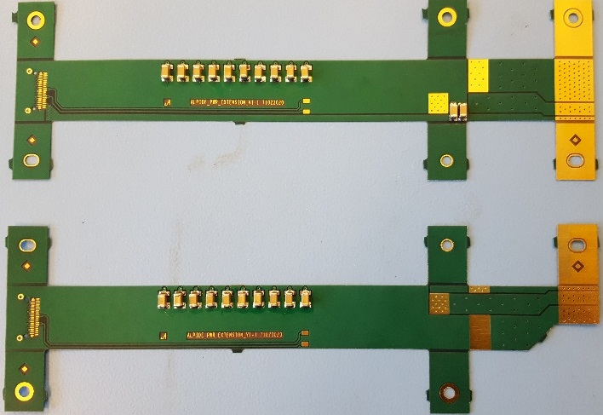
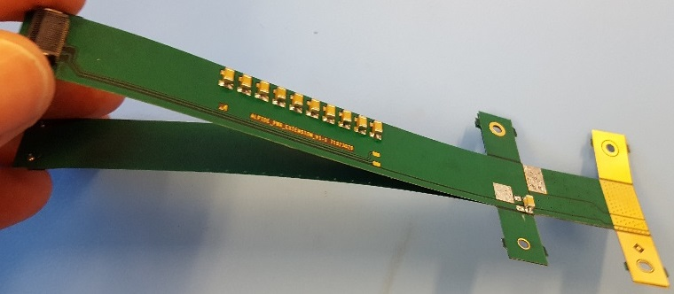
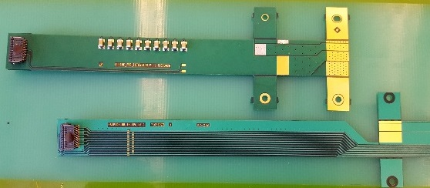
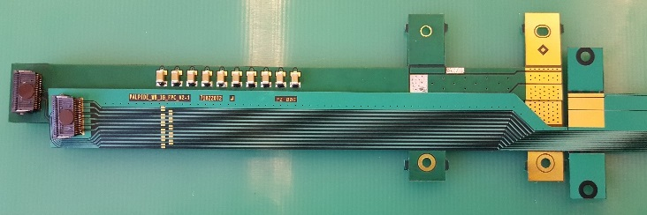
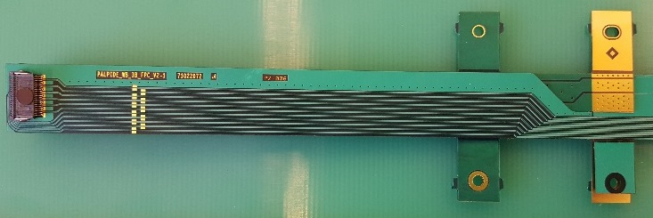
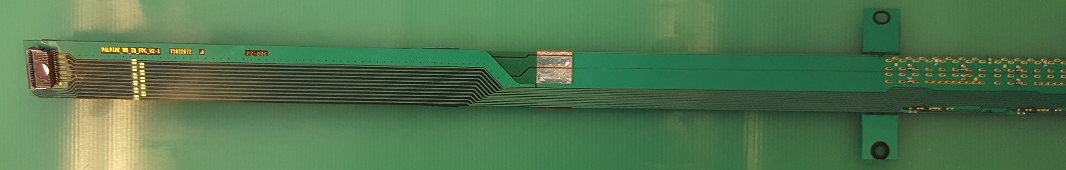
FPC extension for connection to electrical services
The 2 flexes are glued together, in the middle to have a 4 layers flex.
2 Cu layer flex, PI : 50 µm, Cu : 35 µm, Solder mask : 20 µm
The PWR_extension is connected to the FPC by iron soldering.

Slide 13
IB FPC performance:
power supply drop
ANSYS simulation parameters
Power supply : Analog and Digital => 1.8V
Chip area : 3cm x 1.5 cm => 4.5 cm²
Chip power : 4.5 cm² x 60 mW => 0.27 W / chip
2/3 for digital : 180 mW / Chip
1/3 for analog : 90 mW / Chip

Slide 14
IB FPC performance:
power supply drop
1.9 V on connector
Power plane, AVDD & DVDD DC Voltage drop
Ground plane, AGND & DGND DC Voltage drop
ANALOG | Mean | Voltage drop
Chip0 | 1.839V | + 39 mV
Chip1 | 1.825V | + 25 mV
Chip2 | 1.814V | + 14 mV
Chip3 | 1.804V | + 4 mV
Chip4 | 1.796V | -4 mV
Chip5 | 1.789V | - 11 mV
Chip6 | 1.784V | -016 mV
Chip7 | 1.781V | -19 mV
Chip8 | 1.779V | -21 mV
Chip0
Chip1
Chip2
Chip3
DIGITAL | Mean | Voltage drop
Chip0 | 1.835V | + 35 mV
Chip1 | 1.821V | + 21 mV
Chip2 | 1.811V | + 11 mV
Chip3 | 1.802V | + 2 mV
Chip4 | 1.796V | - 4 mV
Chip5 | 1.791V | - 9 mV
Chip6 | 1.787V | - 13 mV
Chip7 | 1.785V | - 15 mV
Chip8 | 1.783V | - 17 mV
Chip4
Chip5
Chip6
Chip7
Chip8

Slide 15
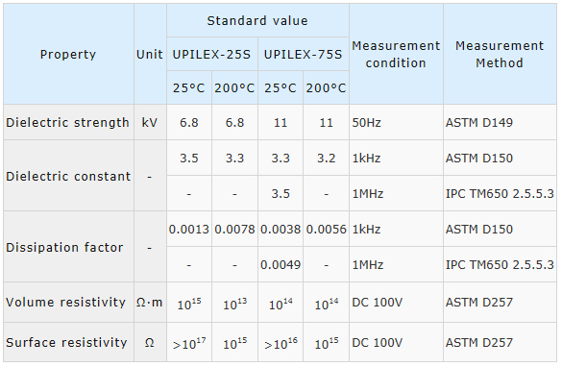
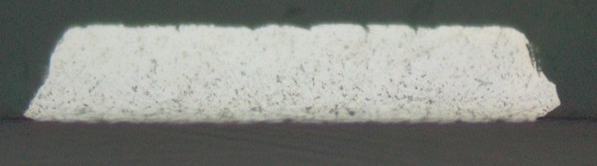
IB FPC performance:
high speed signal propagation
S-PARAMETERS (Setting)
IB FPC aluminium conductivity : 2.40E+07 s/m
120 µm
80 µm
120 µm
100 µm
100 µm
Solder-mask 20 µm
Al 25 µm
UPILEX-75S 75 µm
Al 25 µm
Solder-mask 20 µm
104.39 µm
IB FPC high speed differential lines length
24 µm
120.95 µm

Slide 16
IB FPC performance:
high speed signal propagation
- 3 dB 500 Mhz
- 8 dB Limit to no equalisation

Slide 17
IB FPC final manufacturing procedure
step | conditions | place | validation
1 . Thermal stabilisation of Upilex-75S sheets | 2 h at 400 ºC and 1E-08 mbar | CERN or Bodycote (F) | Visual inspection
2. Holes drilling by laser | 23 +/- 1 ºC (Upilex-75S CTE 20 ppm) | KIRANA (IT) | Metrology (dimensional)
3. Preparation for Al coating: cleaning, light polishing in sand blasting machine | 3 passages at 1.5 bar, 0.2 m/s, pumice powder coarse FF 10-177 um | CERN | Metrology (witness samples surface roughness)
4. Al PVD coating | 12 h of vacuum P < 10E-08 before starting | HEF (F) | Peel test, R² measurement, Al thickness on witness samples
5. LDI, etching, Ni/Au, solder mask coverlay |  | CERN | Visual inspection, electrical continuity, resistivity measurements, metrology, metal layers thickness, “bondability” test
6. SMD components mounting by hand (baseline); under investigation vapour phase reflow oven @ 160 ºC | Sn-Pb solder paste, | CERN | Visual inspection
7. Cleaning | isopropyl alcohol ultrasonic bath 3’ | CERN | Visual inspection, electrical continuity, resistivity measurements
8. Storage in N2 |  | CERN

Slide 18
Fiche de suivi

Slide 19
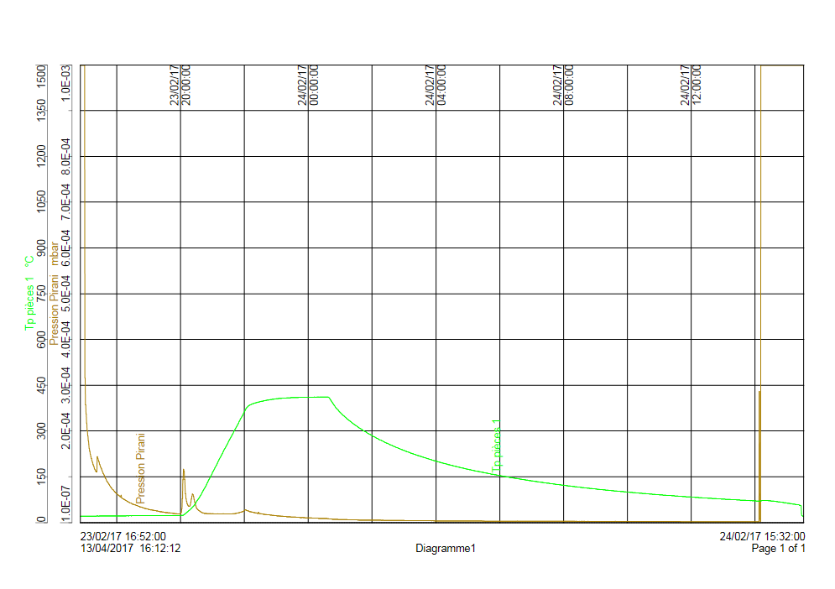
Upilex thermal treatment

Slide 20
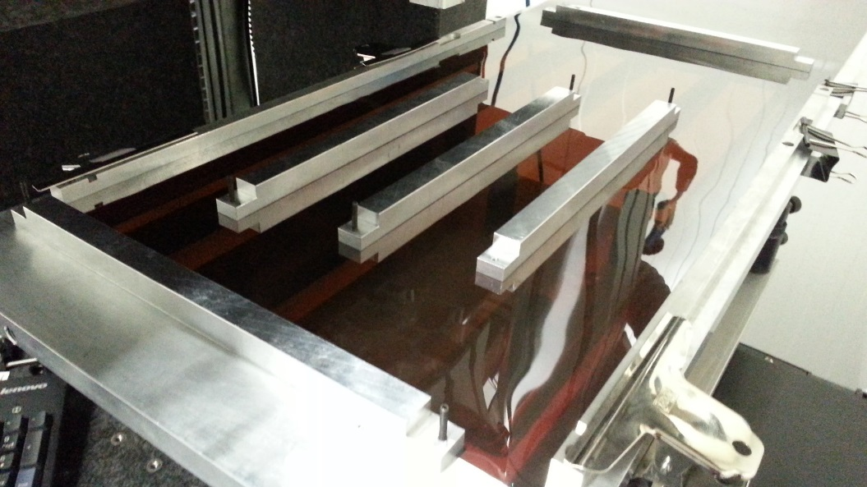
Laser drilling
Upilex sheet
Max four sheets of 95x28 cm² can be mounted in the PVD system performing the Al coating; the layout has been optimized in order to maximize the number of FPC/sheet (+ production shared with MFT)
Hole pattern layout
IB
MFT

Slide 22
FPC metrology results
Hole pattern is designed to compensate the shrinking observed after Al coating (~ 0.14 %)
Reference values:
  Distance (D12) between first and last via of central row in each FPC
  Position (XT0, YT0) of reference hole used for alignment wrt to first via
D12 266.99
XT0 133.645
YT0 17.66
QUOTE | nominal value | Compensated (1.0014)
D12 | 266.99 | 267.36
XT0 | 133.645 | 133.83
YT0 | 17.66 | 17.68

Slide 23
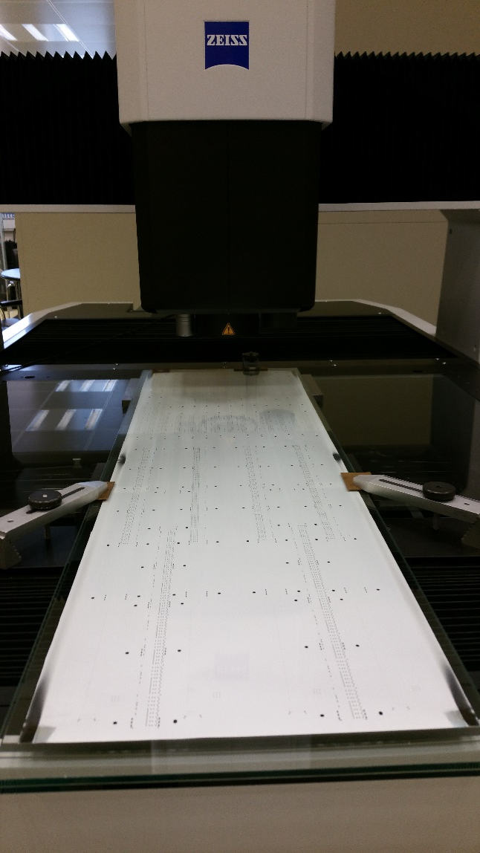
FPC metrology results
Add results

Slide 24
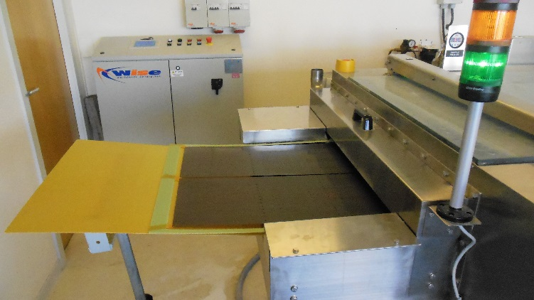
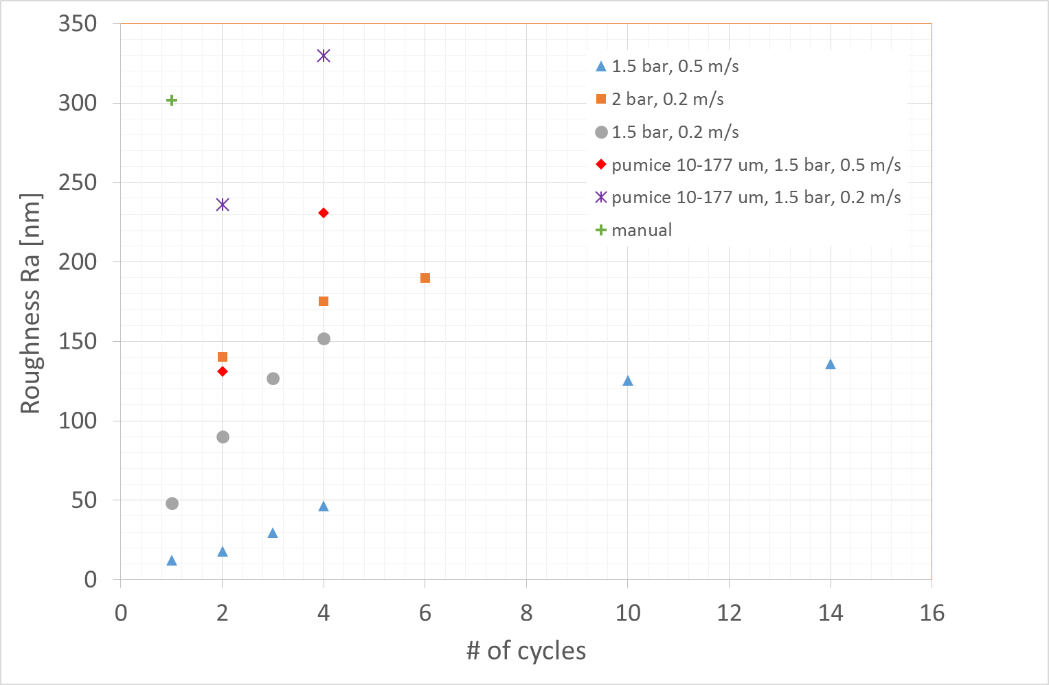
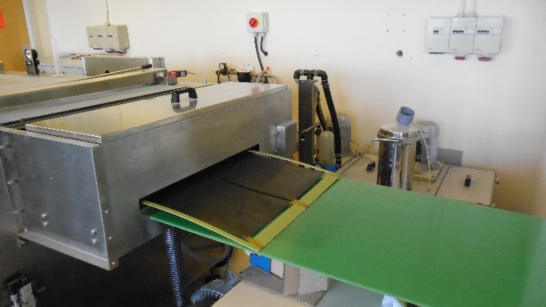
Sand blasting
Usage of automated sand blasting required various tests to fine tune process parameters (pumice powder size, speed, pressure) in order to achieve same Ra (~ 300 nm) as with the lengthy manual treatment.
manual
sand blasting

Slide 25
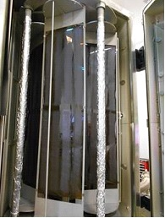
Al PVD coating
acceptance criteria | Visual inspection | P lim mbar | Adherence | Al thickness > 25 µm TOP/BOTTOM samples | R2 TOP/BOTTOM samples
Average | Aspect uniformity | 8,4 .10-7 | No detachment | 25,9/26,3 | 11,13/11,13
MIN |  | 7,2 .10-7 |  | 25,3/25,2 | 10,8 /10,8
MAX |  | 1,1.10-6 |  | 26,9/27,1 | 11,3/11,3

Slide 26
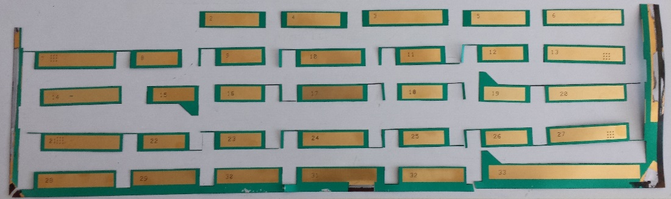
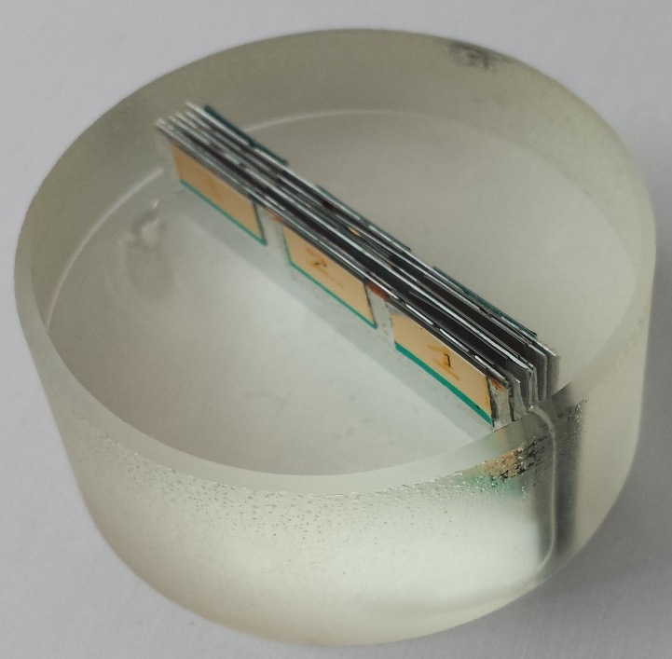
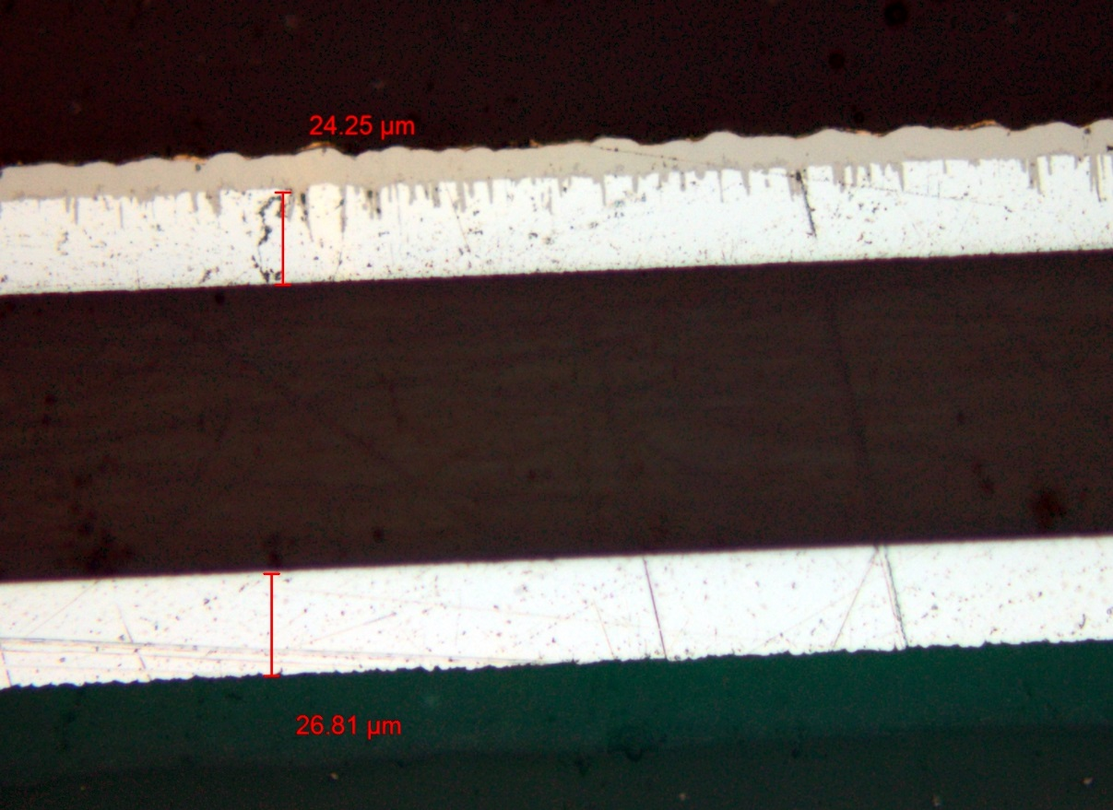
Metal layers thickness
Samples are embedded in resin and cross section photos are taken at microscope

Slide 27
 | 1 | 2 | 3 | 4 | 5 | 6 | 7 | 8 | 9 | 10 | 11 | 12 | 13 | 14
1 | 25 | 25 | 25 | 25 | 25 | 25 | 25 | 25 | 25 | 24 | 24 | 21 | 20.5 | 2
2 | 25 | 25 | 25 | 25 | 25 | 25 | 25 | 25 | 27 | 24.3 | 22 | 23 | 24 | 18
3 | 24 | 23.66 | 23.6 | 23.6 | 23 | 22.5 | 24.275 | 25.6 | 25.2 | 24.2 | 23 | 22 | 21 | 18
4 | 24 | 24 | 24 | 24 | 24 | 24 | 24 | 23.5 | 24 | 24 | 23 | 22 | 20 | 16.5
5 | 23.5 | 23.5 | 23.5 | 23.5 | 23.5 | 23.4 | 23.5 | 23.4 | 23.8 | 23 | 23 | 22.5 | 22 | 21
Black : Mesured values
Red : Estimated values
 | 1 | 2 | 3 | 4 | 5 | 6 | 7 | 8 | 9 | 10 | 11 | 12 | 13 | 14
1 | 7.5 | 15 | 15 | 15 | 15 | 15 | 15 | 15 | 15 | 15 | 15 | 13.4 | 12 | 0
2 | 26.8 | 26 | 26 | 25 | 26 | 25 | 24 | 25 | 24 | 24.3 | 24 | 23 | 24 | 22
3 | 26.8 | 25.8 | 24 | 24 | 24 | 24 | 24.275 | 25.2 | 25 | 24 | 23 | 23 | 23 | 22
4 | 26 | 26 | 26 | 26 | 26 | 26 | 24 | 24 | 24 | 24.5 | 23 | 22.6 | 22 | 21.3
5 | 26 | 26 | 26 | 26 | 26 | 26 | 24 | 23.8 | 23.5 | 23.2 | 23 | 22.5 | 22 | 17.5

Slide 28
Resistivity measurements
 | PX-001 (Ω) | PX-002 (Ω) | PX-003 (Ω) | PX-004 (Ω) | PX-005 (Ω) | PX-006 (Ω) | Length (cm)
DCLK_N | 6.624 | 6.826 | 6.331 | 6.757 | 6.707 | 6.634 | 51.27247
DCLK_P | 6.6 | 6.783 | 6.255 | 6.69 | 6.661 | 6.589 | 51.23493
DCTRL_N | 6.762 | 6.917 | 6.423 | 6.818 | 6.78 | 6.71 | 51.4434
DCTRL_P | 6.91 | 7.084 | 6.61 | 7.034 | 6.981 | 8.313 | 51.19231
HSDATA_N1 | 3.496 | 3.274 | 3.065 | 3.493 | 200 | 3.343 | 26.41708
HSDATA_N2 | 3.827 | 3.633 | 3.418 | 3.853 | 3.607 | 3.684 | 29.21161
HSDATA_N3 | 4.16 | 3.997 | 3.849 | 4.206 | 3.989 | 4.043 | 32.03476
HSDATA_N4 | 4.315 | 4.248 | 4.185 | 4.384 | 4.21 | 4.254 | 33.92726
HSDATA_N5 | 4.66 | 4.657 | 4.6 | 4.767 | 4.596 | 4.632 | 36.95352
HSDATA_N6 | 5 | 5.059 | 4.952 | 5.137 | 4.98 | 5.006 | 40.00215
HSDATA_N7 | 5.353 | 5.481 | 5.368 | 5.501 | 5.373 | 5.379 | 43.06259
HSDATA_N8 | 5.717 | 5.922 | 5.72 | 5.89 | 5.767 | 5.754 | 46.13386
HSDATA_N9 | 6.073 | 6.425 | 6.144 | 6.276 | 6.197 | 6.106 | 49.20237
HSDATA_P1 | 3.505 | 3.268 | 3.066 | 3.51 | 3.268 | 3.352 | 26.44469
HSDATA_P2 | 3.841 | 3.626 | 3.431 | 3.862 | 200 | 3.692 | 29.23948
HSDATA_P3 | 4.155 | 3.99 | 3.855 | 4.194 | 3.607 | 4.036 | 32.06206
HSDATA_P4 | 4.323 | 4.237 | 4.187 | 4.389 | 4.216 | 4.261 | 33.8915
HSDATA_P5 | 4.663 | 4.648 | 4.6 | 4.77 | 4.601 | 4.631 | 36.91777
HSDATA_P6 | 5.01 | 5.06 | 4.942 | 5.142 | 4.983 | 5.008 | 39.9664
HSDATA_P7 | 5.36 | 5.486 | 5.37 | 5.516 | 5.369 | 5.388 | 43.02763
HSDATA_P8 | 5.717 | 5.923 | 5.715 | 5.897 | 5.775 | 5.761 | 46.09889
HSDATA_P9 | 6.065 | 6.416 | 6.139 | 6.275 | 6.192 | 6.099 | 49.16661
 | Average (Ω) | Sigma (Ω)
DCLK_N | 7.4324 | 0.6618
DCLK_P | 7.2967 | 0.5282
DCTRL_N | 7.4372 | 0.5531
DCTRL_P | 7.6450 | 0.5094
HSDATA_N1 | 3.7591 | 0.3344
HSDATA_P1 | 3.7351 | 0.3392
HSDATA_N2 | 4.1198 | 0.3692
HSDATA_P2 | 4.1478 | 0.3570
HSDATA_N3 | 4.5333 | 0.3896
HSDATA_P3 | 4.4985 | 0.4219
HSDATA_N4 | 4.7643 | 0.3950
HSDATA_P4 | 4.7547 | 0.3895
HSDATA_N5 | 5.1867 | 0.4223
HSDATA_P5 | 5.1780 | 0.4169
HSDATA_N6 | 5.6042 | 0.4520
HSDATA_P6 | 5.5971 | 0.4475
HSDATA_N7 | 5.8900 | 0.4774
HSDATA_P7 | 6.0237 | 0.4740
HSDATA_N8 | 6.4557 | 0.5045
HSDATA_P8 | 6.4498 | 0.5018
HSDATA_N9 | 7.0496 | 0.5412
HSDATA_P9 | 6.8871 | 0.5282
E.G measured resistance sheet PX
Average and sigma calculated with 21 FPC from sheet F1, F2, PX and PZ

Slide 29
Impedance measurement
The curve slope is dues to the resistive loss
Probe and FPC interconnection
PX-003 HSDATA_P9 and HSDATA_N9 impedance

Slide 30
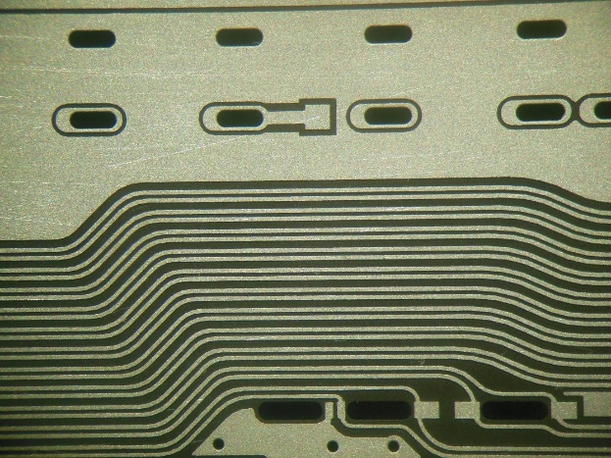
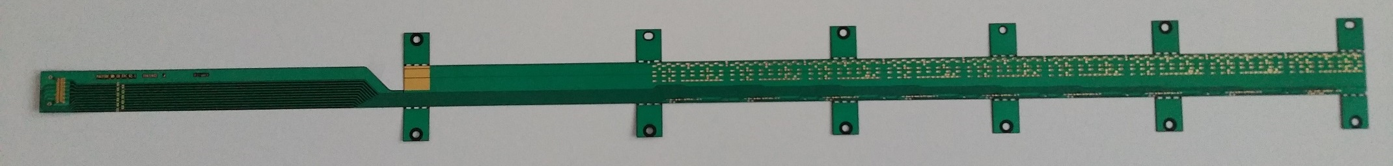
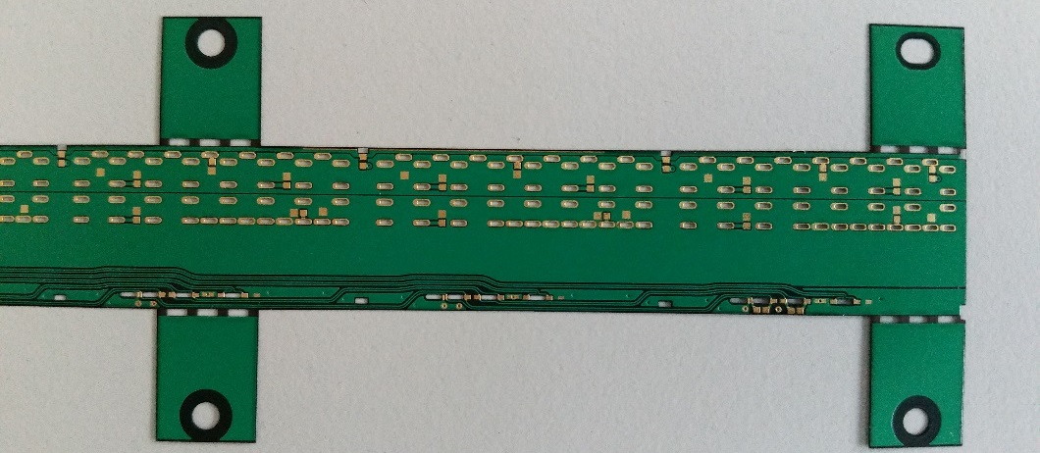
Prototypes production
Layout and processing have been optimized during all 2016 ( more than 40 prototypes produced)
In 2017 we procured 24 prototypes, yield ~ 80 %
Al top layer after etching

Slide 31
Production schedule
Amount to be produced: two full IB (96) + 20% → 116 FPC
Including a yield of 80% for FPC production and of 90% for HIC modules production a total number of 160 FPC is required
Each sheet contains 6 FPC (possibility to include a 7th under investigation), a total of 24 sheets need to be processed
The estimated time for full production (started in March) is 9 months, completion of 48 FPC (for IB-1) expected for mid August

Slide 32
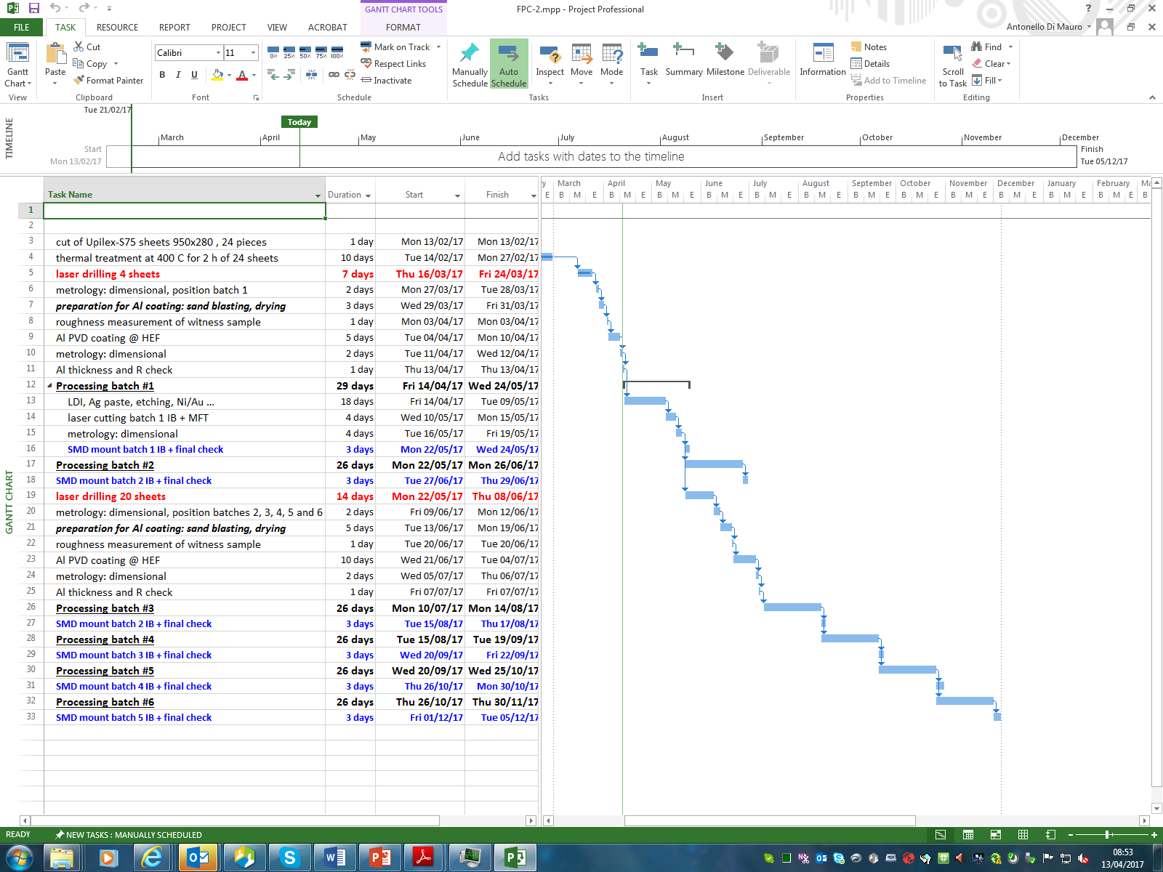
Production schedule

Slide 33
Backup slides

Slide 34
Polyimide selection
Brand/ name | Heat shrinkage [%] | Dielectric strength [kV/mm] | Dielectric constant | Dissipation factor | Volume resistance [Ω cm] | Surface resistance [Ω]
Dupont/ Kapton 300 HPP-ST | 0.03 (30’ @ 150 ºC) | 5.2 | 3.5 | 0.002 | 1.4 x 10¹⁷
UBE/ Upilex-75S | 0.01 (2 h @ 200 ºC) | 6.8 | 3.3 | 0.0038 | 10¹⁴ | > 10¹⁶
Kaneka/ Apical 300 NP | 0.04 (30’ @ 150 ºC) 0.08 (2 h @ 200 ºC) | 8 | 3.3 | 0.001 | > 10¹⁶
Saint Gobain/ Norton TH-075 | 0.05 (2 h @ 200 ºC) | 5.8 | 3.3 | 0.005 | > 10¹⁶ | > 10¹⁶
Upilex-75S has been adopted as polyimide due to its lowest shrinkage coefficient and suitability as substrate for Al coating using PVD

