Slide 1
Control Interfaces

Slide 2
Detector Control System (DCS) Paths
Readout Unit
FLASH
FPGA
PROASIC3
FLASH
PROM
SUPPLY SENSE
TEMP SENSE
CANBUS
SRAM
FPGA
XILINX
ULTRASCALE
POWER
UNIT
I2C
I2C
SCA
POWER
UNIT
I2C
I2C
DETECTOR
SENSORS
DCTRL
GBTx0
VTRX
CRU /
O2 FLP
GBTx1
VTTX
USB3
FX3
GBTx2
VTRX
LTU/
CTP

Slide 3
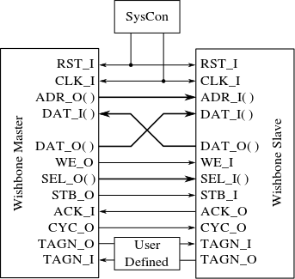
Control Interface
FPGA
Control
Interface
Wishbone Slave 1
16 bit Data
15 bit Address
1 bit R/W
FiFo
Wishbone Master
32 bit
Wishbone Slave 2
Wishbone Bus
FiFo
.
.
Wishbone Bus Structure
32 bit
Wishbone Slave n
Optional

Slide 4
Controls Protocol
Based originally on 32bit USB words sent over FX3
DCS -> FPGA
  Write Request:
  Read Request:
FPGA -> DCS
  Write Response:
    None (no acknowledgement, but errors are kept in a wishbone slave register – associated with the wishbone master - for possible later interrogation)
  Read Response:
  Errors are kept in a wishbone slave register – associated with the wishbone master - for possible later interrogation
31 24 16 0
W/R=1 | Module Addr[6:0] | Reg Addr[7:0] | Data[15:0]
31 24 16 0
W/R=0 | Module Addr[6:0] | Reg Addr[7:0] | Don’t Care[15:0]
31 24 16 0
Error | Module Addr[6:0] | Reg Addr[7:0] | Data Response[15:0]

Slide 5
GBT Controls Transactions
GBT – SWT: Single Word Transaction
79
75
0
DV
SWT
Transaction Parameters
0
No problem on downstream path:
Only kind of communication
Upstream path: SWT interspersed between data packets

Slide 6
GBT Control Protocol
Use CRU protocol “Single Word Transactions” (SWT) as a means for both downlink and uplink of control information
Every USB transaction described in previous slides maps exactly to one SWT GBT word
For radiation testing purposes, we implemented SWT words containing duplicated USB packets
Downstream and Upstream GBT words have the same format:
  Downstream GBT words contain request packets to the wishbone bus
  Upstream GBT words contain response packets from the wishbone bus
A Python module for interacting with the CRU “SWT handler” using the above protocol was developed based on the O² Python module “libReadoutCard”
The User Interface of this “SWT” module are the following functions:
  clrFifos(): Clear the SWT FIFOs in the firmware
  write(mod, addr, data): Write “data” to module “mod” at register address “addr”
  read(mod, addr): Read register “addr” in module “mod”
DV 76 64 32 0
0 | SWT (0x3) | Don’t Care (12b) | Duplicated USB Word (32 bit) | USB Control Word (32 bit)
80 bit GBT word + Data Valid (DV)

Slide 7
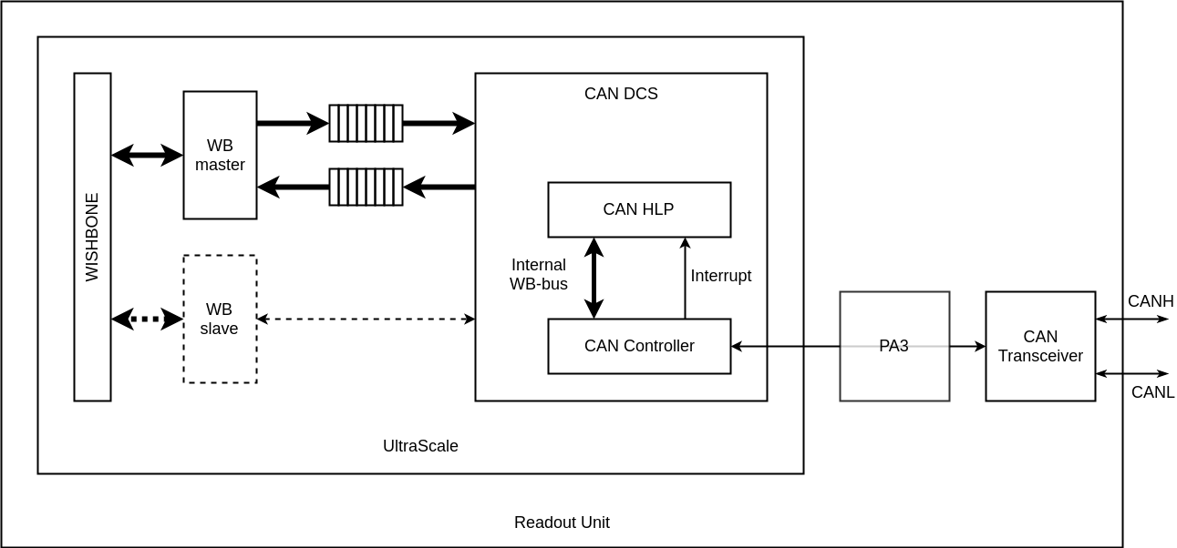
CANbus Controls Transactions
CANbus Opencores controller for raw packets
High-Level-Protocol on top of controller to define a node based communication interface and to define simple READ and WRITE transactions & responses with appropriate payload
Interface to wishbone bus same as GBT:
  Input & Output FIFOs
  Wishbone Master for transactions on bus
WB slave interface in controller to configure protocol parameters like baud-rate and filters
Electrical pass-through
Emulate a “network topology”: Divide 11-bit CAN ID field into a “Node ID” and a “Command” field:
MsgID[10:4] = N[6:0] = NodeID
MsgID[3:0] = C[3:0] = Command
ID[10] | ID[9] | ID[8] | ID[7] | ID[6] | ID[5] | ID[4] | ID[3] | ID[2] | ID[1] | ID[0]
N[6] | N[5] | N[4] | N[3] | N[2] | N[1] | N[0] | C[3] | C[2] | C[1] | C[0]
Allows for up to 128 nodes per CAN network

Slide 8
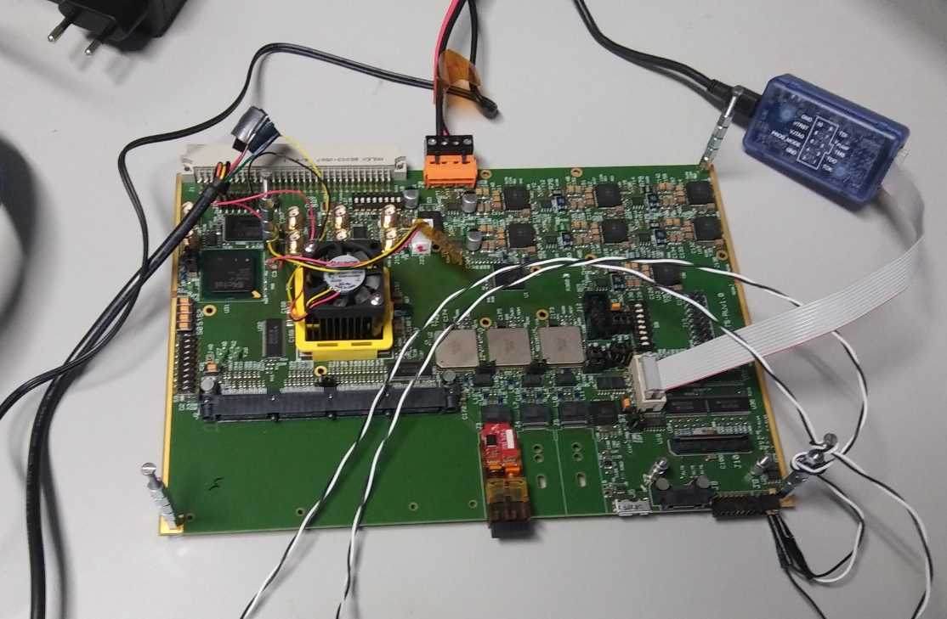
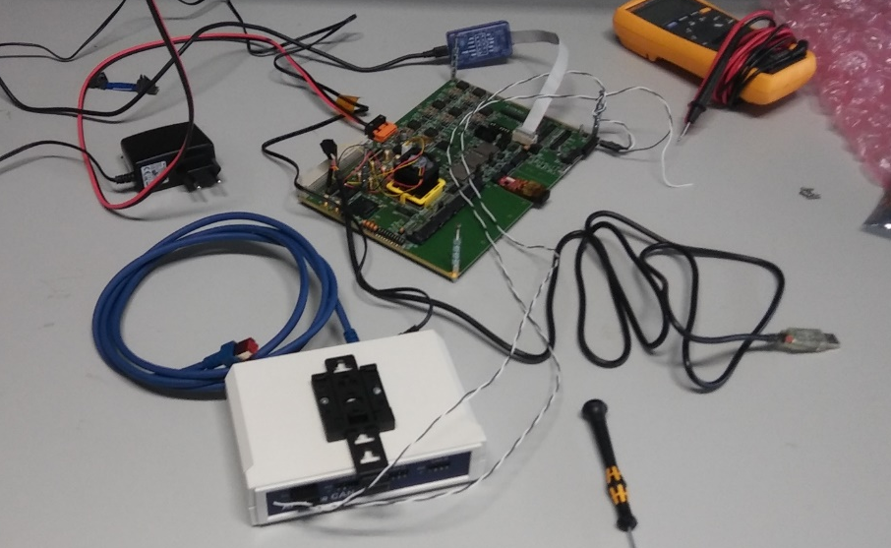
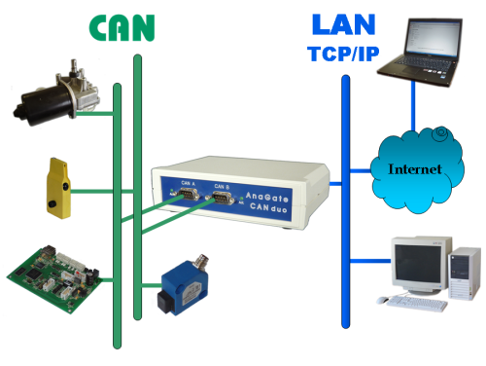
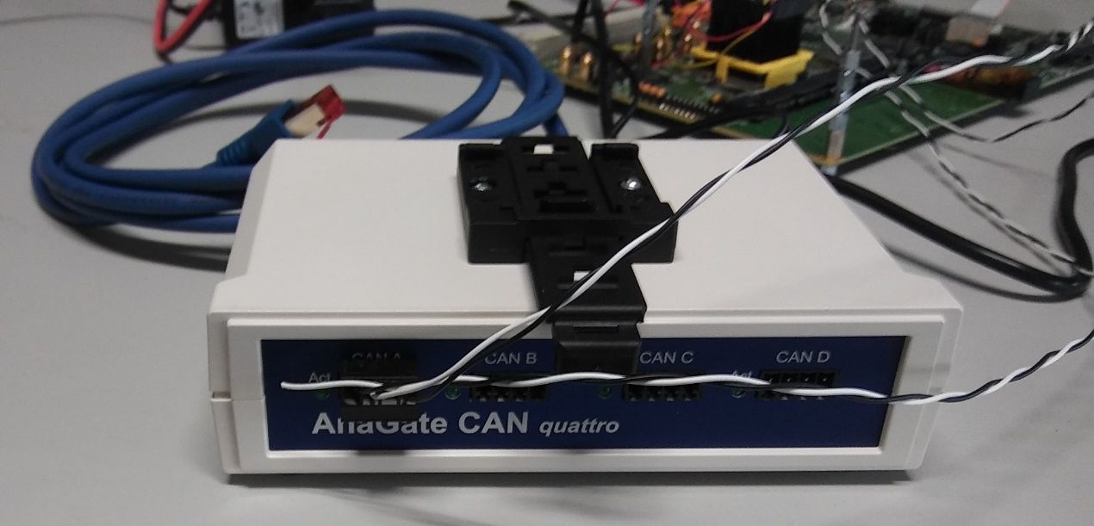
CANbus Test Setup
Anagate “CAN Quattro” CAN controller
Opencores “Project CAN” protocol controller
Wishbone interface to PA3 firmware for configuration
Configured for 1Mbps baud rate
“CAN Monitor” from Anagate to generate and receive standard and extended ID CAN packets with up to 8 bytes payload

Slide 9
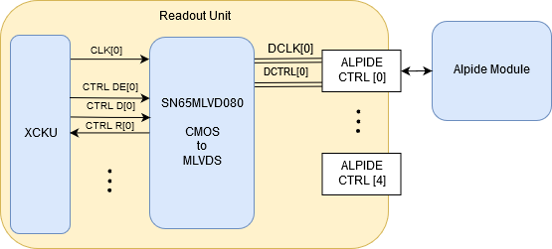
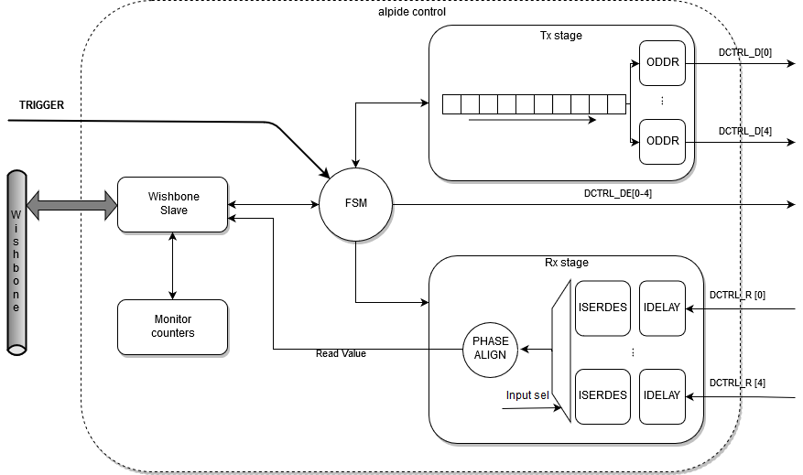
Alpide Control Implementation
Physical Implementation
Firmware Logic

Slide 10
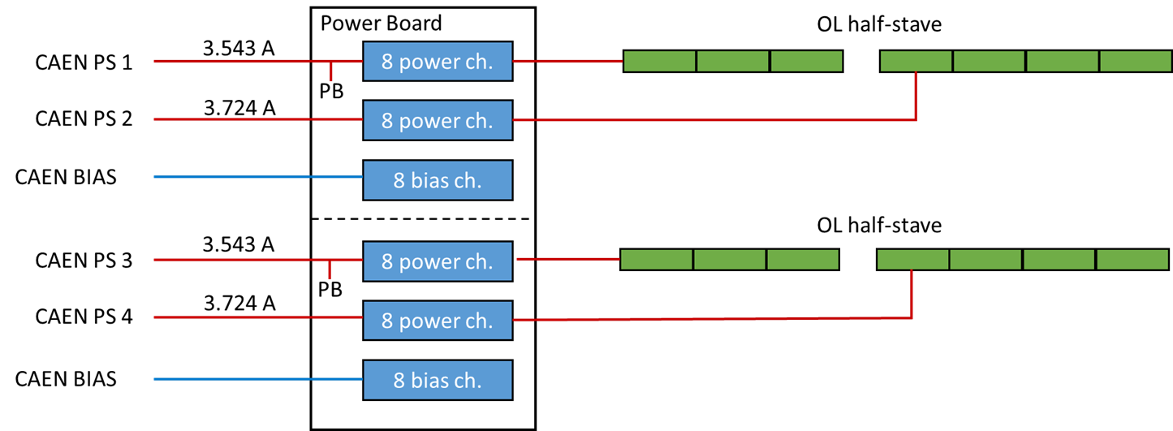
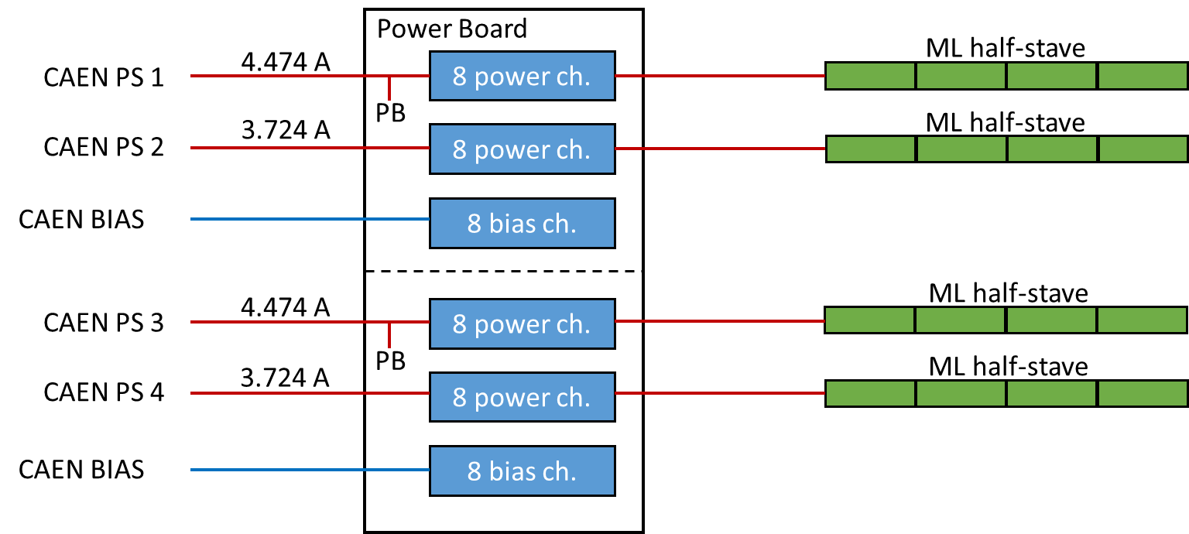
Power Board – Interface to Readout Unit
Two 8-channel Power Units are combined into one board stack called a “Power Board”.
Each Power Unit provides power for up to 8 modules (16 per Power Board)
In layers 5 & 6 each Power Board provides power for one full stave (one power unit per half-stave)
In all other layers, each Power Unit provides power for one stave, so there are 2 staves per Power Board
Each Power Unit is interfaced to a Readout Unit via 2 (differential) I2C buses, with multiple devices per bus
Each Power Board consisting of 2 Power Units therefore has a total of four I2C buses
In layers 5 & 6, each Power Board interfaces to one Readout Unit (a total of four I2C buses per Readout Unit)
In all other layers, each Power Unit interfaces to one Readout Unit (a total of two I2C buses per Readout Unit)
Control via two I2C wishbone slaves (one per Power Unit) allows setting and monitoring voltages, currents, temperature thresholds and power status
Outer Layer Configuration
Middle Layer Configuration

Slide 11
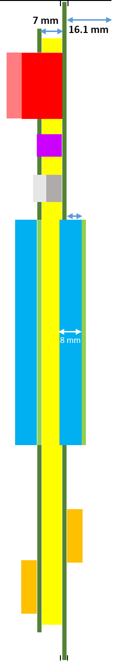
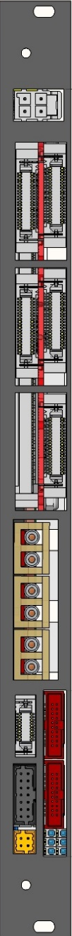
Power Board – Readout Unit Pairing
Outer Layers
Middle Layers
Inner Layers
I2C
I2C
I2C
I2C
I2C
I2C
I2C
I2C
I2C
I2C
I2C
I2C

Slide 12
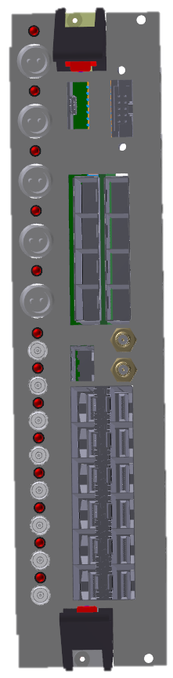
Trigger Interface – Optical Splitting
The CTP directly drives a set of Local Trigger Units (LTUs), each responsible for delivering the trigger to a specific detector.
ITS will have its own LTU
ITS LTU will drive 12 (or 6) Single Mode, 1030nm SFP+ Modules.
Mini-frame
Low radiation area
Readout Unit
Sensor
ITS
optical
copper
Passive optical splitting 1:16 (1:32 also possible)
optical
16×
Up to 28×
Each optical line is split into 16/32 lines by a passive optical splitter, which can withstand the foreseen TID level (10 kRad) and does not suffer from SEU.
As each LTU has 12 optical drivers, a 1:16 splitting ratio (at least) will be ok
12×

Slide 13
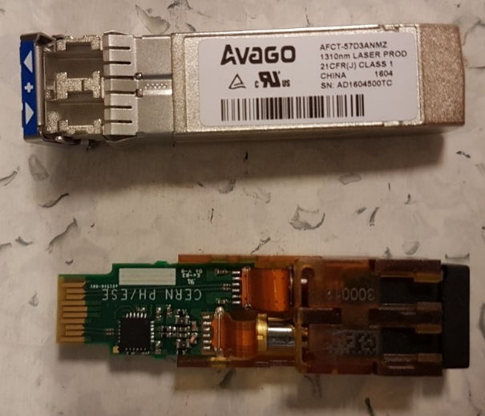
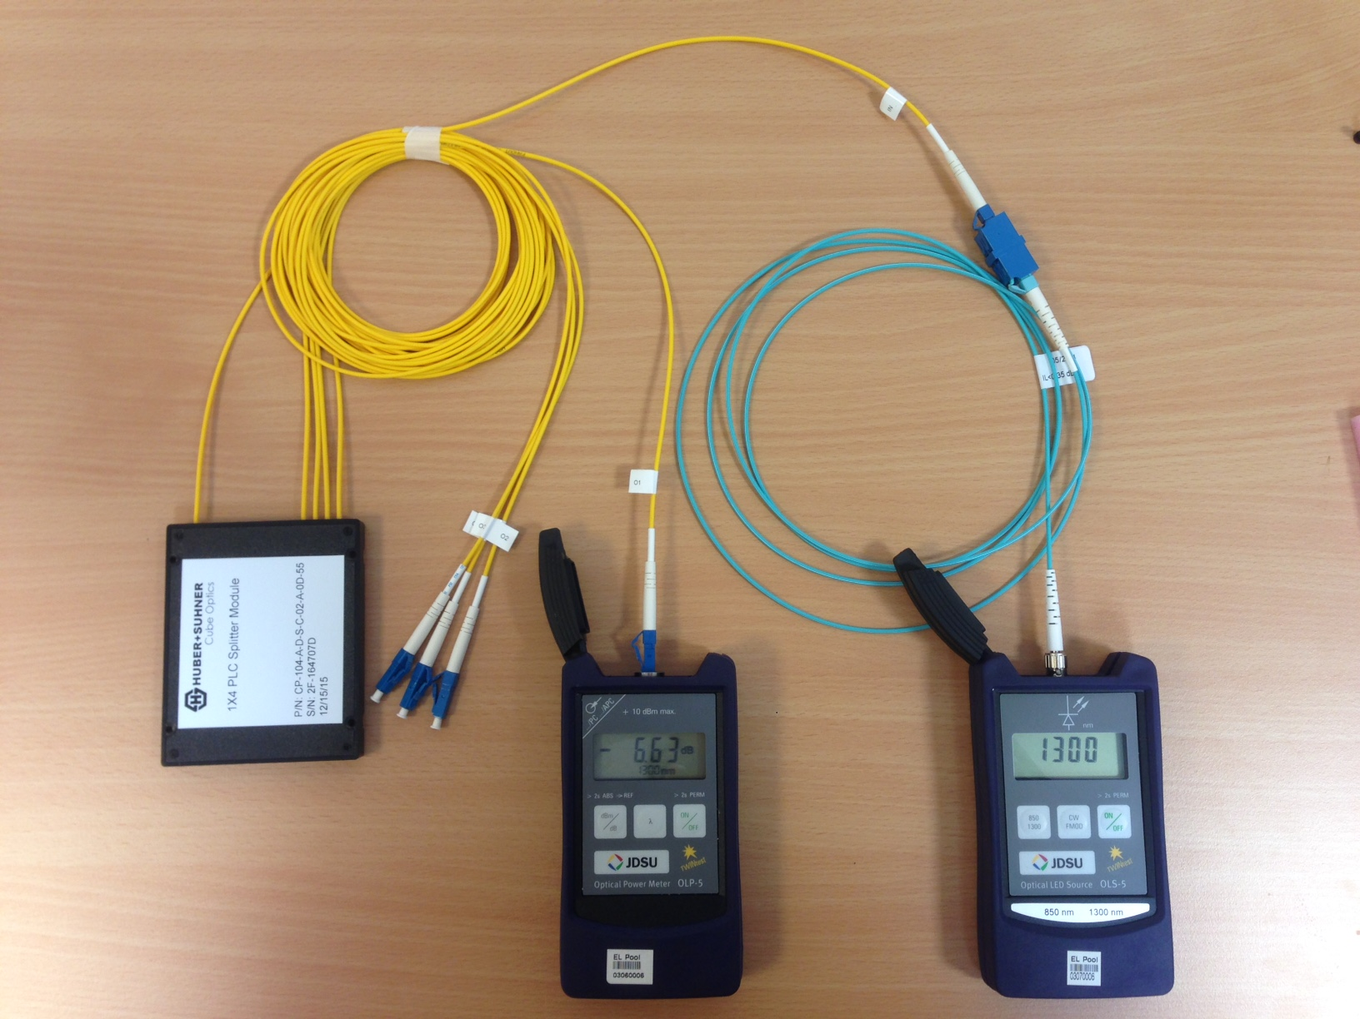
Optical Fiber Power Loss Tests
Splitter | Power loss Ideal splitter [dB]¹ | Power loss Measured [dB] | Margin [dB]²
1:2 splitter | 3 | 3.686 | 16.689
1:4 splitter | 6 | 6.838 | 13.539
1:8 splitter | 9 | 10.535 | 9.841
1:16 splitter | 12 | 14.333 | 6.044
1:32 splitter | 15 | 16.359 | 4.983
¹ The numbers for ideal power loss is taken from
http://www.thefoa.org/tech/ref/testing/test/couplers.html
² Margin is given based on:
- the Avago AFCT-57D3ANMZ transmitter (optical power output +5 dBm)
- the VTRx sensitivity (-15.376 dBm)
³ Fiber optics association: http://www.thefoa.org/tech/lossbudg.htm
As a general rule, the link loss margin should be greater than approximately 3 dB to allow for link degradation over time³.
The dynamic range for the chosen Transmitter & Receiver is about 20 dB
  The LTU has been verified to support the powerful Avago AFCT-57D3ANMZ transmitter.
The power tests shows that all topologies have a margin > 3 dB
  This is in line with the specifications given by the manufacturer of the splitter

