Slide 1
Firmware Overview
J. Schambach

Slide 2
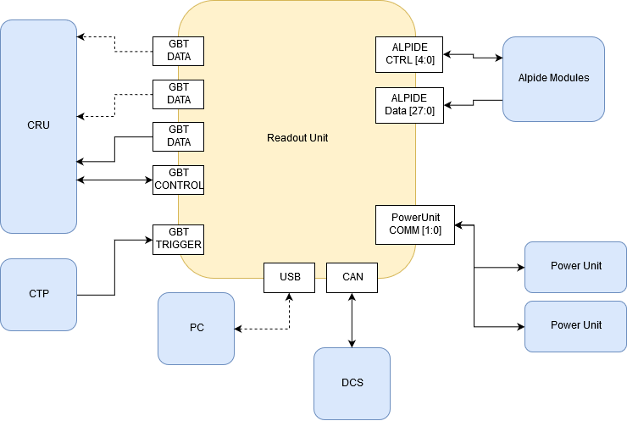
Readout Unit Connectivity

Slide 3
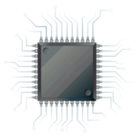
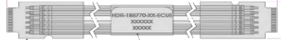
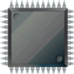

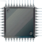
Readout Unit Firmware Purpose
From/To ITS
Readout Unit
SCA
From/To CRU
Copper Links
GBT Links
Programmable Logic
3.2 Gb/s
GBTx
Control
FLASH
Memory
3.2 Gb/s
Optical transceiver
VTRx
Data @ 3.2 Gb/s
FLASH
Memory
Data: 9 x 960 Mb/s
or 16/28 x 320 Mb/s
FLASH
FPGA
3.2 Gb/s
GBTx
Optical transceiver
VTTx
Data @ 3.2 Gb/s
Control (80 Mb/s)
Data @ 3.2 Gb/s
SRAM
FPGA
Clock (40MHz)
3.2 Gb/s
3.2 Gb/s
GBTx
Optical transceiver
VTRx
Trigger
Main Tasks of the Readout Unit:
Receive triggers (heartbeat & physics) from CTP & decode
Receive “control” information from CRU
Deliver triggers to stave sensors
Control, configure and monitor stave sensors
Receive data from stave; decode & compress
Deliver monitoring information to CRU (forwarded to DCS)
Deliver CRU framed data packets to CRU
Determine and handle busy information
Monitor and control Power Board
Handle radiation upsets in programmable logic (& sensors)
Power Board
Power Unit (PU)

Slide 4
Flash FPGA

Slide 5
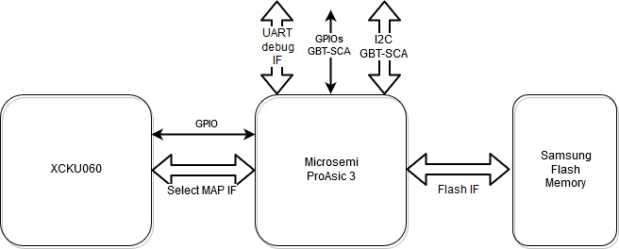
Flash FPGA: Configuration and Scrubbing
Details in
“System scrubbing & re-programming” talk

Slide 6
ProAsic3 Firmware
Components w/ TMR

Slide 7
SRAM FPGA

Slide 8
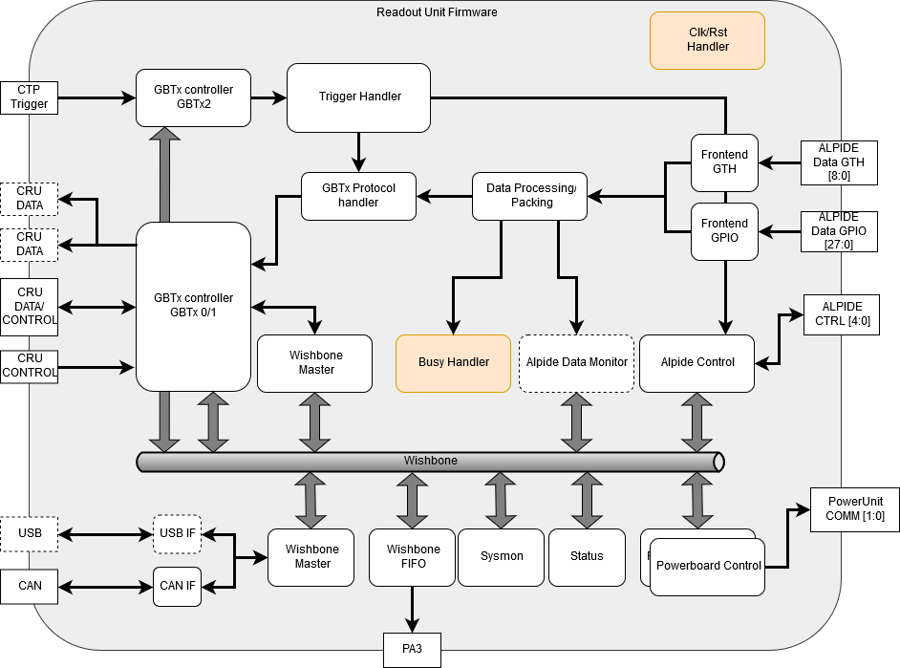
Readout Firmware Overview

Slide 9
Firmware modules - Status
Control Interface (Wishbone bus)
  Implemented and tested (lab, test beams)
  Sending and receiving control words over USB and GBT
Power Board Interface
  Implemented and tested for all 4 I2C busses
  Controls sensor power, read status, currents, and voltages
Alpide Control
  Implemented and tested for all 5 FireFly connectors
  Handles configuration and triggers to sensors
Data Readout and Packaging
  2 Flavors: Inner Barrel (MGT transceivers), Outer Barrel (GPIO fabric logic)
  Implemented and tested for MGT (lab, test beams)
  Outer Barrel path under development (only receiving logic different)
  Receives data from sensors, deserialization, idle removal
  Add CRU protocol and Trigger info
  Send data packets over GBT
  Some features still missing (OB sensor data packaging, sparsification)
GBTx Communication
  Implemented and tested (lab, test beams)
  Use only single GBT link for now for trigger, control, and data
  Full access to Wishbone via CRU protocol
Trigger Handler
  Proof of principle implemented and tested
  Needs additional work (pipelining, additional triggers, …)
Radiation Monitor
  Implemented and tested
  SEU observation
System Monitor
  Implemented and tested
  Read voltages, temperatures
USB interface to wishbone
  Implemented and tested
  Used for tabletop tests, lab setups
FIFO interface to PA3
  Implemented and tested
  Used for fast firmware update of flash
  Can be used from GBT (via CRU control protocol)
Datapath Monitor
  Implemented to monitor protocol, gbtx
Error/Busy Handling
  Still missing

Slide 10
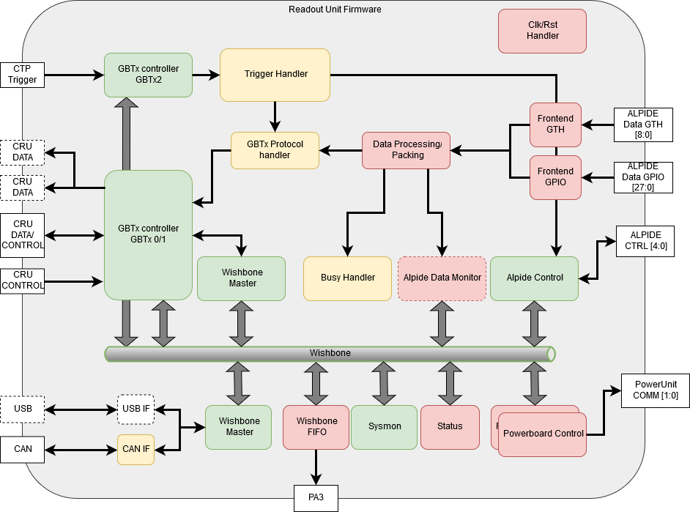
Radiation Protection: Triple Modular Redundancy
TMR Status
TMR completed
To be TMR’ed
No TMR planned

Slide 11
Alpide Data Path Details

Slide 12
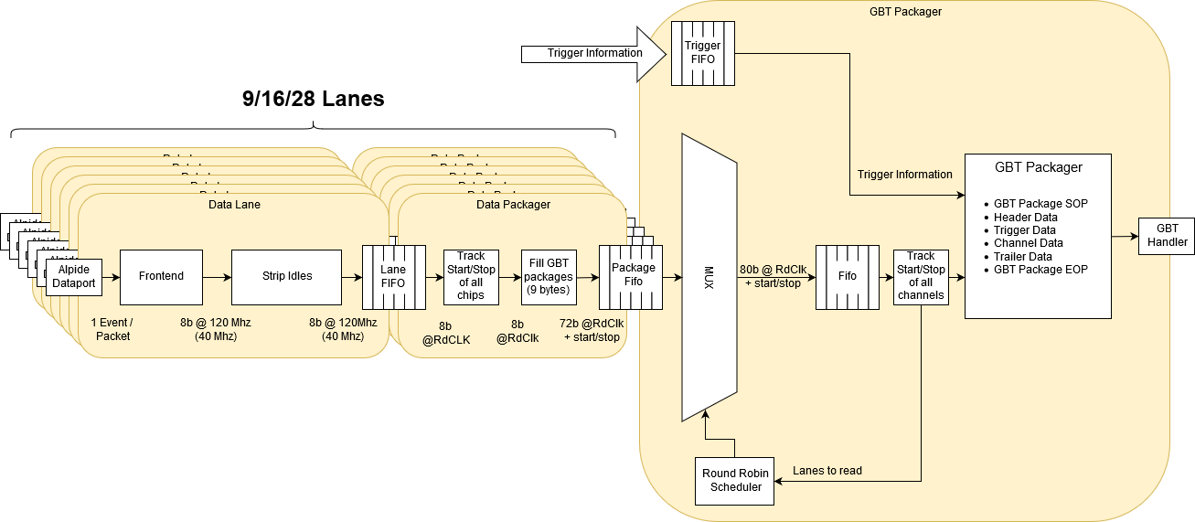
Data Flow

Slide 13
Inner Barrel Data Format
Legend:
C<n>W<m>: Cable <n>, Word <m>
Cx_Id: FIFO identifier (1-9, 5bit)
SOP: CRU Start-of-Packet
EOP: CRU End-of-Packet
BC: Bunch Crossing ID (12bit)
Data out of the Alpide Readout firmware module in the inner barrel mode arrives with a rate of 8 bits every 120MHz clock period. Nine 8-bit data words from one cable are combined with an ID for the FIFO they originate from into an 80 bit GBT word as shown here. A round-robin MUX collects data from each of the nine cables. Finally, the data is framed with the appropriate CRU protocol words, and trigger and status information is added to complete a CRU data packet.
Header

Slide 14
Outer Barrel Data Format
Legend:
C<n>W<m>: Cable <n>, Word <m>
Cx_Id: FIFO identifier (1-28, 5bit)
SOP: CRU Start-of-Packet
EOP: CRU End-of-Packet
BC: Bunch Crossing ID (12bit)
Header
For the outer barrel mode, the same principle on the previous slide applies, but with modified rates and number of fragments combined into a GBT word.

Slide 15
Continuous Readout
HB = Heart Beat Trigger
HBF = Heart Beat Frame
Strobe<x> = Trigger strobe to sensor with trigger time = BC+Orbit at time<x>
BCID<x> = BC ID (part of SDH) (with BC+Orbit) at time<x> after HB
Data = Sensor Pixel addresses
SOP = “Start Of Packet” (CRU protocol)
EOP = “End Of Packet” (CRU protocol)
“Continuous” readout in ITS is accomplished by using “long” (10’s of µ-seconds) strobe lengths (firmware triggered) with short (10’s of nano-seconds) inter-strobe periods to initiate readout. ITS RU firmware therefore divides a “Heartbeat Frame” into several “Strobe” frames with fixed strobe lengths, synchronized to the received heartbeat triggers.
Heart Beat Triggers come every 89.4 µs, so trigger strobes (“frames”) in this example would be approximately 89.4 / 4 = 22.3 µs long and each Heart Beat Frame (HBF) would thus contain 4 packets from the RU. This parameter is programmable and could be adjusted, e.g. to 89.4/8 to have 8 “sub-frames” in each HBF
Data will appear from the sensor some tens of ns after the end of the strobe signal, and some 40MHz clock cycles later on the GBT links. Data contained in each packet corresponds to all physical signals (“events”) between times tx and tx+1. The packets might also contain the busy status for individual sensors of an RU, which could then be used to determine the need for throttling at the CTP.
Although data packets are shown here contiguous, it is possible that “DATA” GBT words are interspersed with “IDLE” or “SWT” (for DCS data) during data transmission to the CRU. Since there is the possibility of SEUs in the RUs’ FPGAs, there will be a “timeout provision” in the CRU protocol to determine if a packet is corrupted/incomplete/missing.

Slide 16
CRU Data
RU 1
RU 2
8 Readout Units
(up to 3 fibers each)
RU 8
HB1
Time
FID
0
FID
0
…
…
FID
0
FID
1
FID
1
FID
1
Need to be combined into 1 Heart Beat Frame (HBF) in FLP
FID
2
FID
2
FID
2
FID
3
FID
3
FID
3
HB2
FID
0
FID
0
FID
0
DMA to FLP memory

Slide 17
Data Hierarchy
IB
MB
OB
9
16
28
…
…
…
Cable 1
Cable 9
Cable 1
Cable 16
Cable 1
Cable 28
8
192
RU
RU
RU
....
RU
......
8
8
....
....
24 (12 FLP?)
CRU/FLP
.......
CRU/FLP
EPN

Slide 18
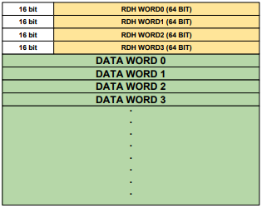
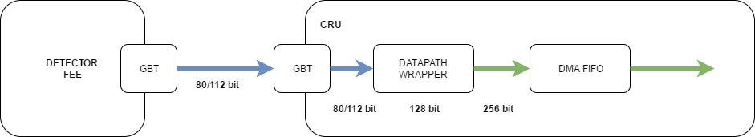
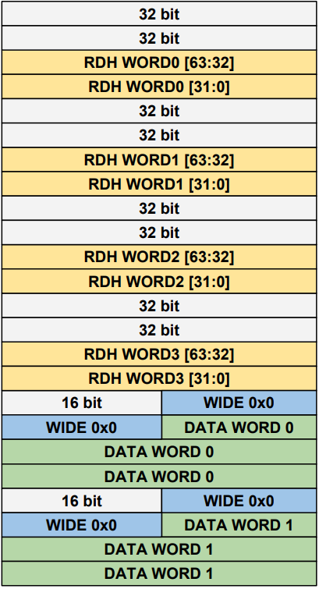
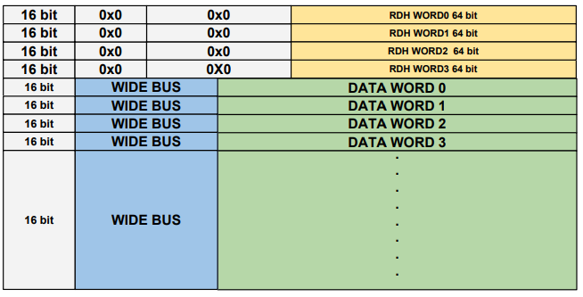
Data Format: GBT to CRU to FLP
GBT RDH
FLP memory
79…………………….……………….……….…………0
0x00
0x04
0x08
0x0C
0x10
CRU memory
127……………………………………………………………………...…63………..……………………………………………………………...…0

Slide 19
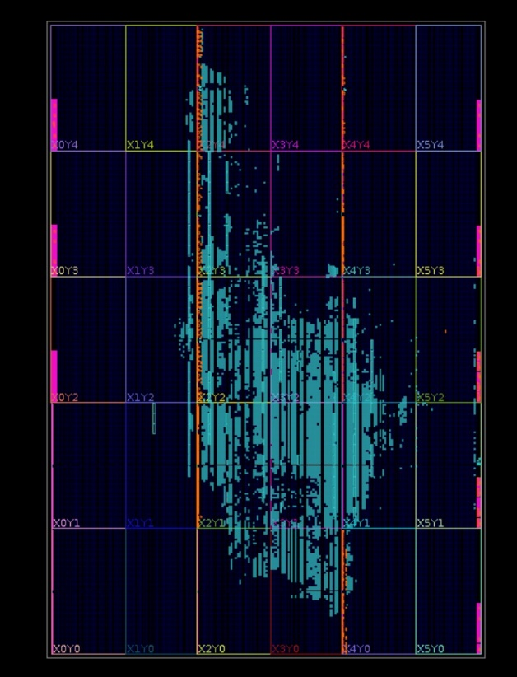
Utilization Report
CLB Logic
Site Type | Used | Available | Util %
CLB | 6038 | 41460 | 14.56
CLBL | 3062
CLBM | 2976
LUT as Logic | 23100 | 331680 | 6.96
using O5 output only | 466
using O6 output only | 19961
using O5 and O6 | 2673
LUT as Memory | 0 | 146880 | 0.00
LUT Flip Flop Pairs | 6970 | 331680 | 2.10
fully used LUT-FF pairs | 855
LUT-FF pairs with one unused LUT output | 5736
LUT-FF pairs with one unissued Flip Flop | 5160
Unique Control Sets | 931
CLB Registers | 26374 | 663360 | 3.98
CARRY8 | 757 | 41460 | 1.83
F7 Muxes | 702 | 165840 | 0.42
F8 Muxes | 287 | 82920 | 0.35
F9 Muxes | 0 | 41460 | 0.00
BLOCKRAM
Site Type | Used | Available | Util %
Block RAM Tile | 146 | 1080 | 13.52
RAM36/FIFO | 134 | 1080 | 12.41
RAMB36E2 only | 134
RAM18 | 24 | 2160 | 1.11
RAMB18E2 only | 24

