Slide 1
Data Streaming

Slide 2
Schematic Setup for Data Streaming Tests
Remote Control
Power Supply
RUv1
UART/USB-2
Power
DC/DCs
ADC
SCA
GPIO or I2C
PA3
PC
Kintex
Ultrascale
Select
Map
CRU
GBTx
CLK
GBT
10
10
Flash
PROM
Power
9 DATA
Power
Board
DCTRL
I2C
DCLK
Inner Barrel Module
Power

Slide 3
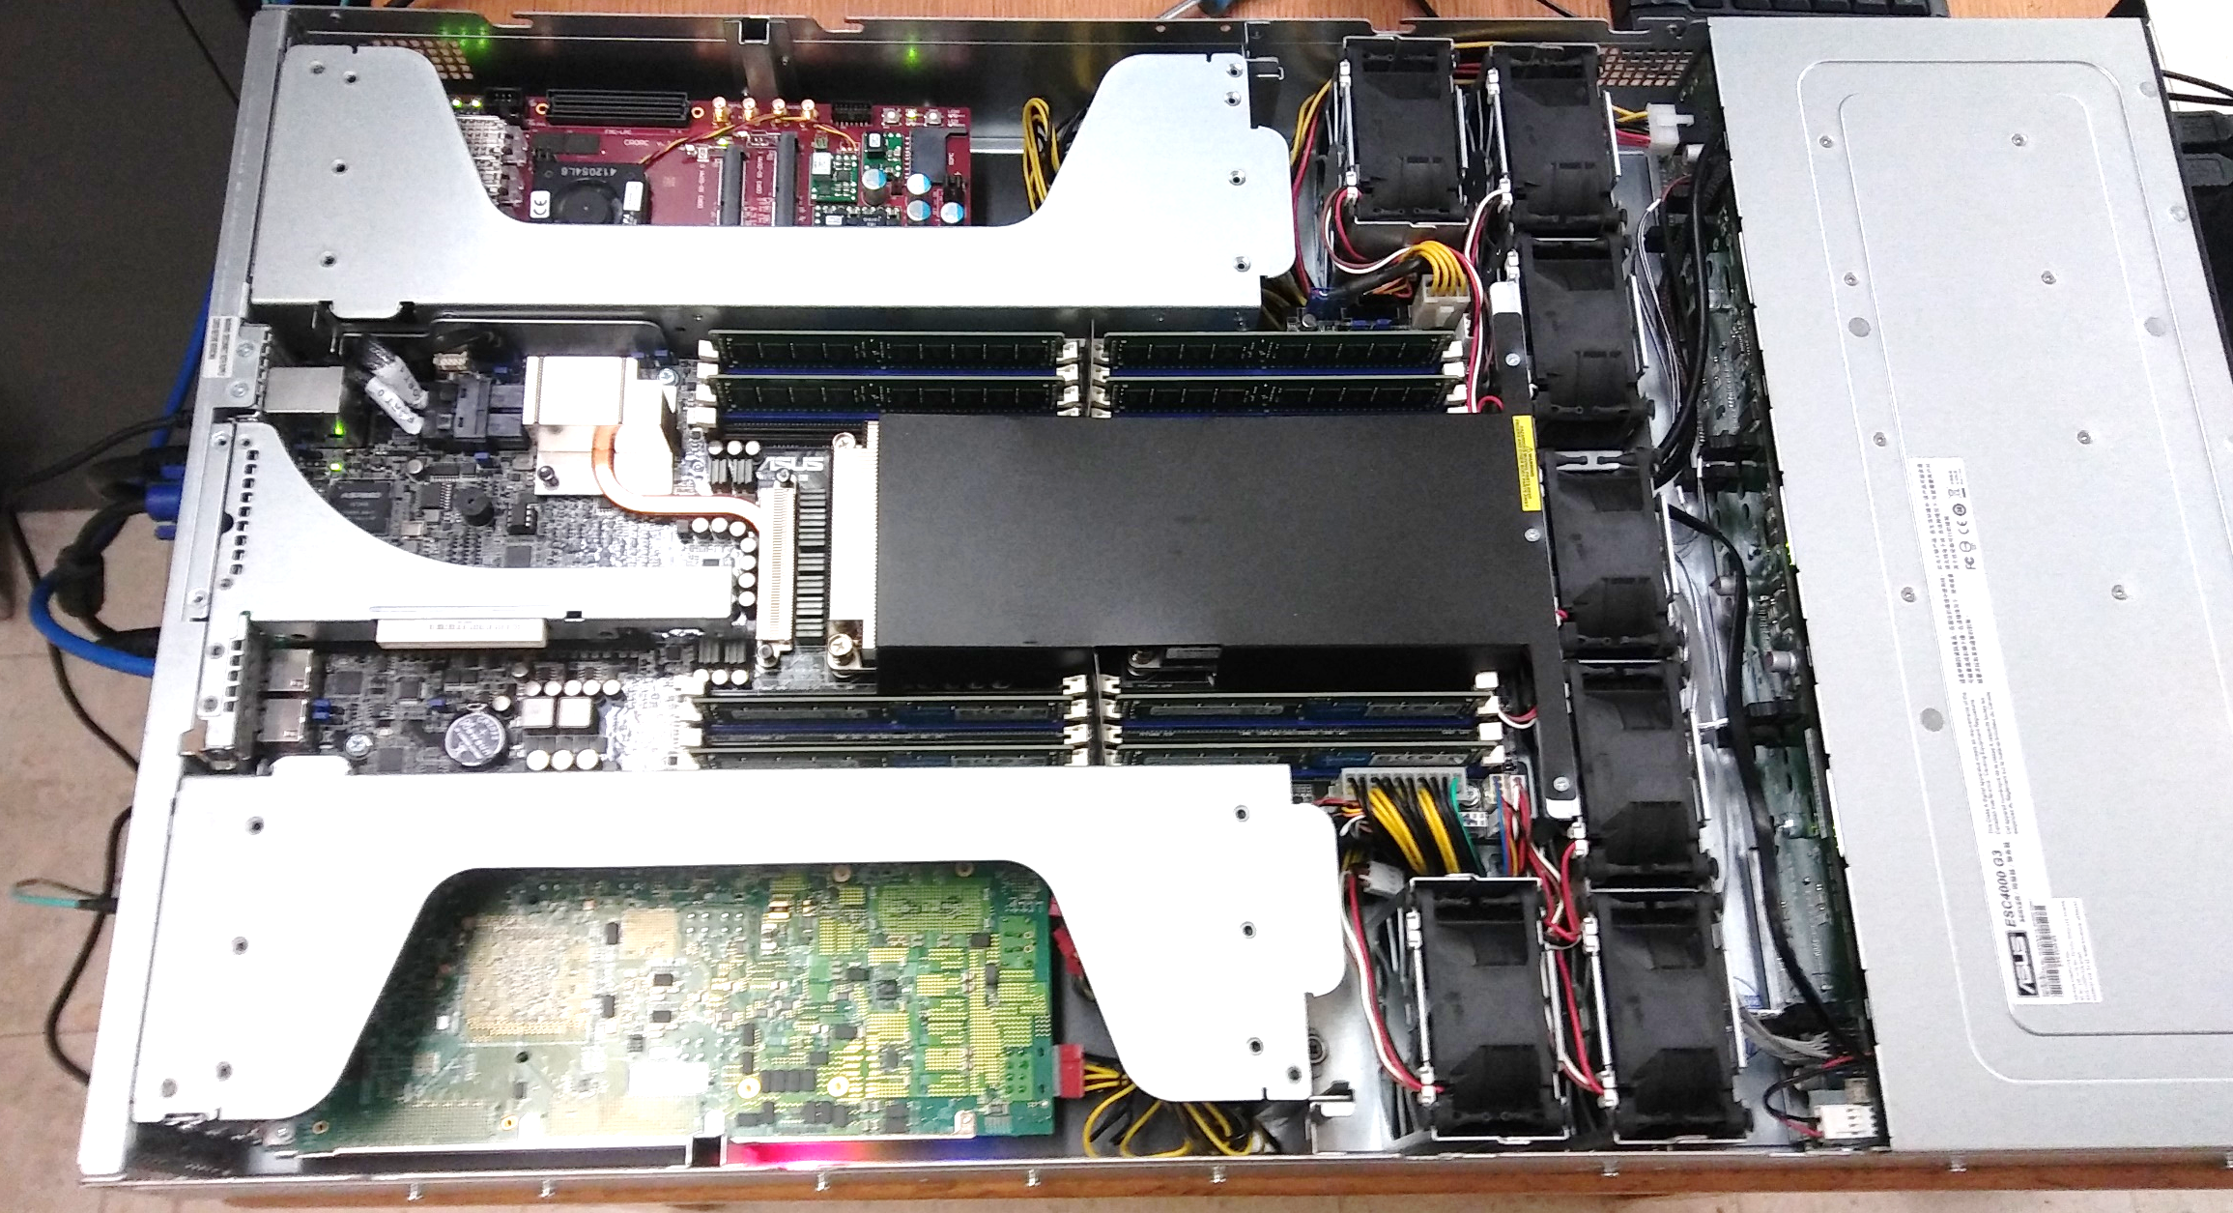
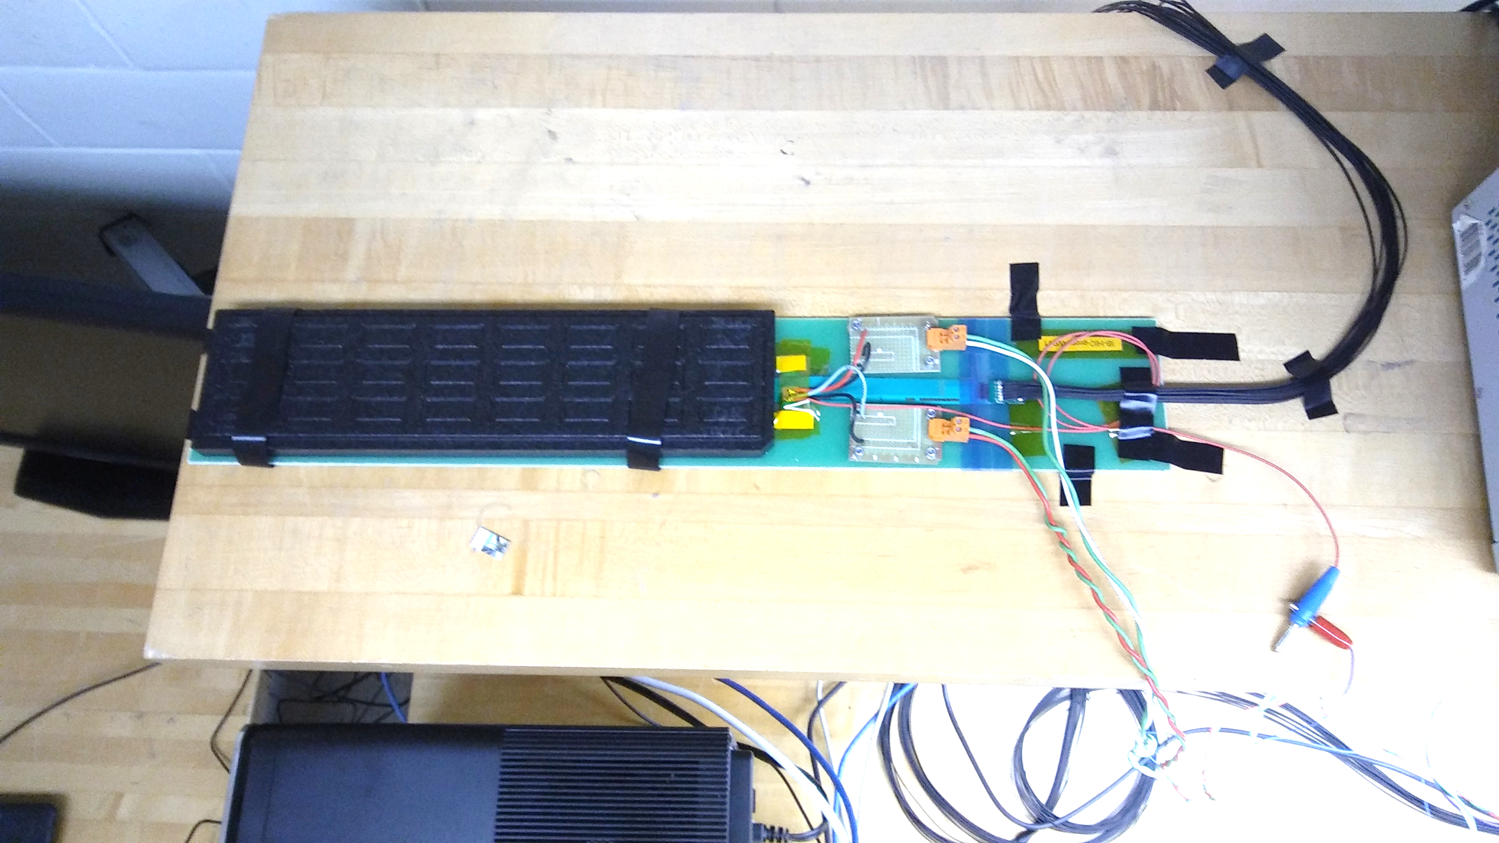
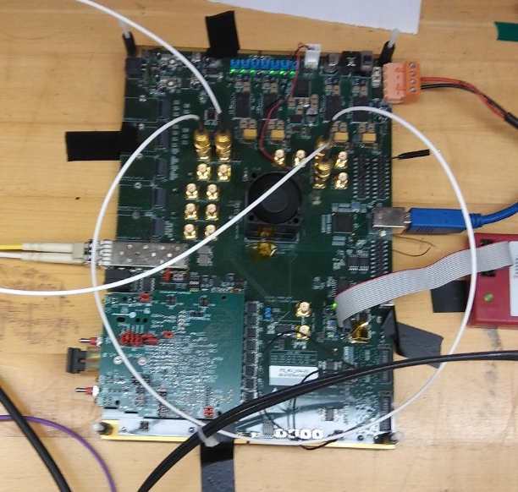
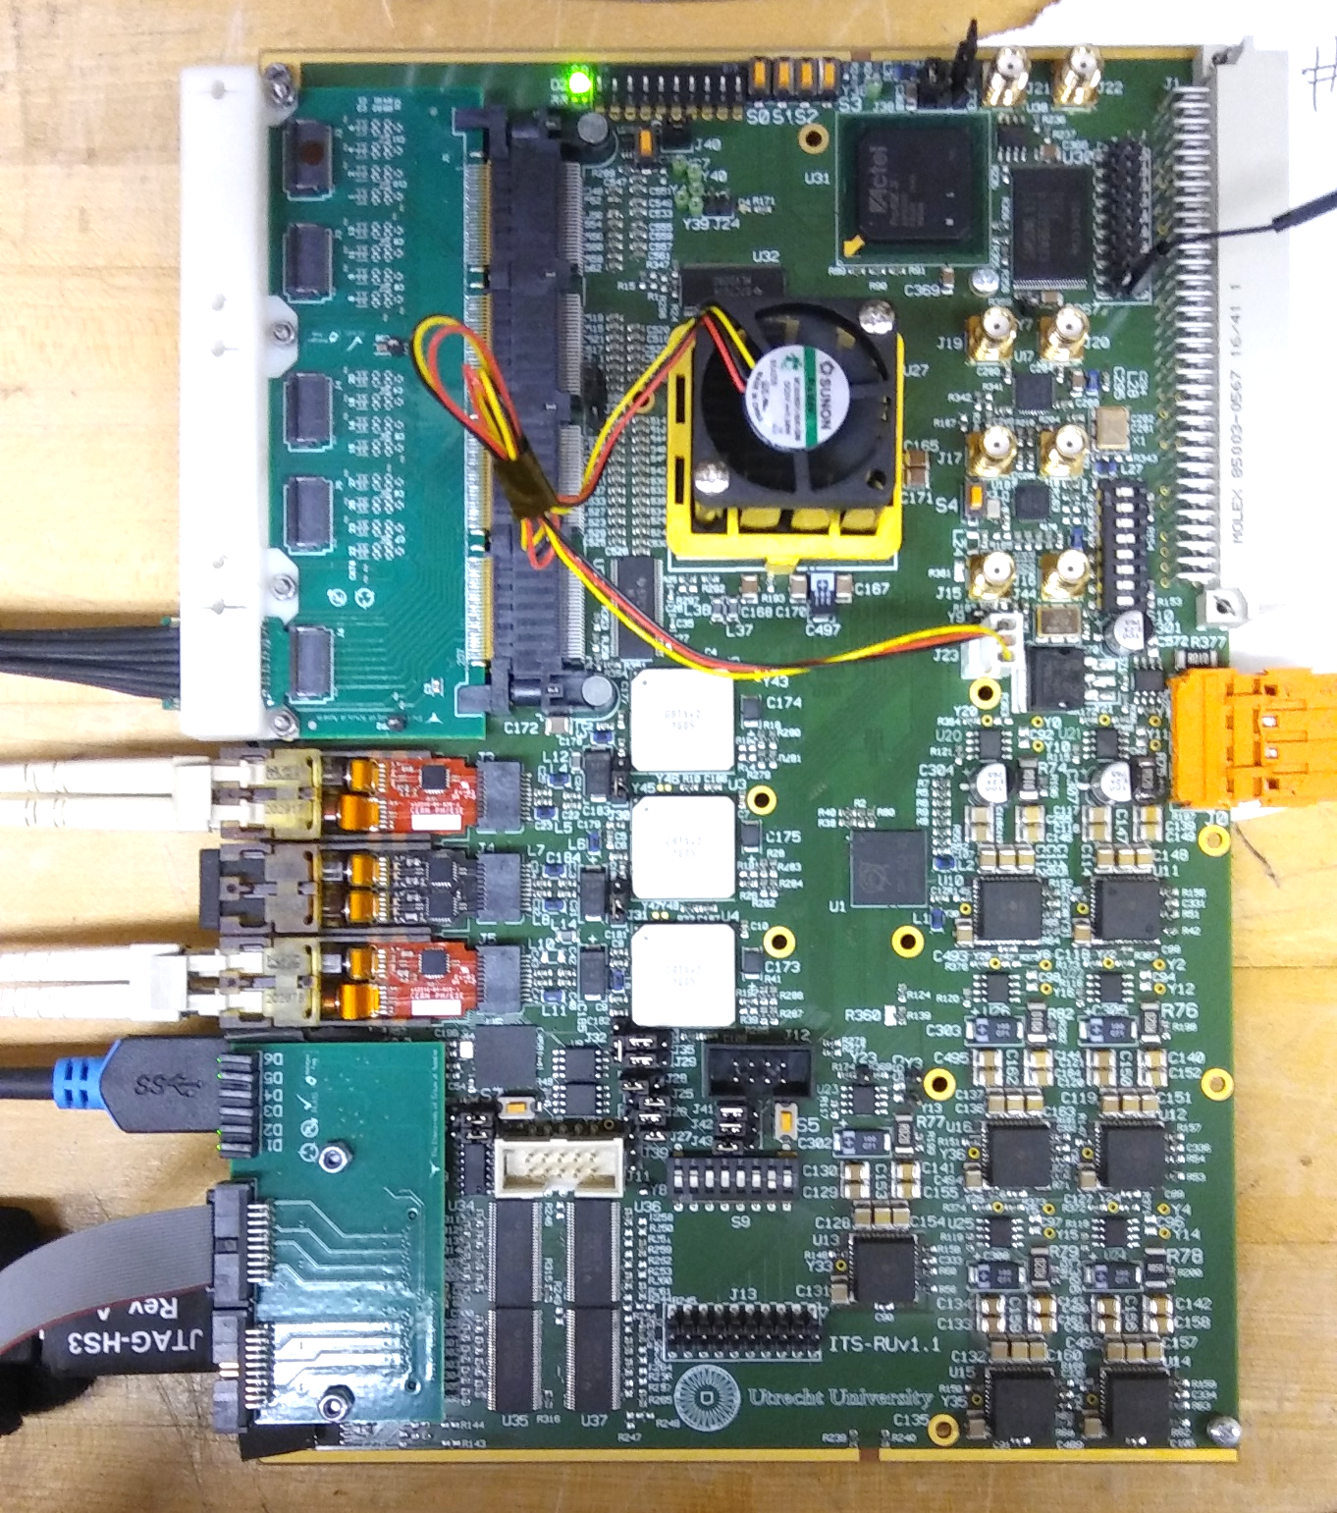
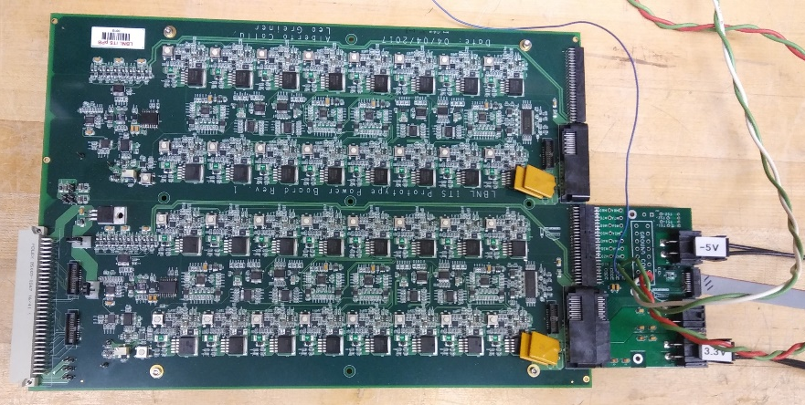
Data Streaming Test Setup
CRU
FLP
Altera Arria-X DevKit
Inner Barrel Module
“CRU” Emulator
Power Board Prototype
RUv1

Slide 4
CRU Interface Tests
Three different Interfaces from CRU to Readout Unit tested: SCA, SWT, Data
SCA interface provided by both C++ and Python library via register write/read.
Tested with Python interface library to read voltages, currents and temperatures from RU SCA
SWT interface provided by both C++ and Python library via registers that access SWT FIFOs in CRU firmware
Tested with Python interface library to read and write registers from various wishbone slaves
Data Path Configuration interface via C++ library to interface with configuration registers
Setup Data Streaming into one of 3 modes:
  Packet Mode
  Raw Link streaming (continuous mode)
  Packet Emulator (for testing)
Trigger Interface Path with configurable source:
  CTP Emulator (firmware from CTP group)
  TTC PON (from LTU)
Data output via DMA over PCIe to memory of FLP in 8kByte packets
Option to record memory pages to a disk file for later analysis

Slide 5
CRU simplified logical data flow
Trigger Emulation inside CRU Firmware

Slide 6
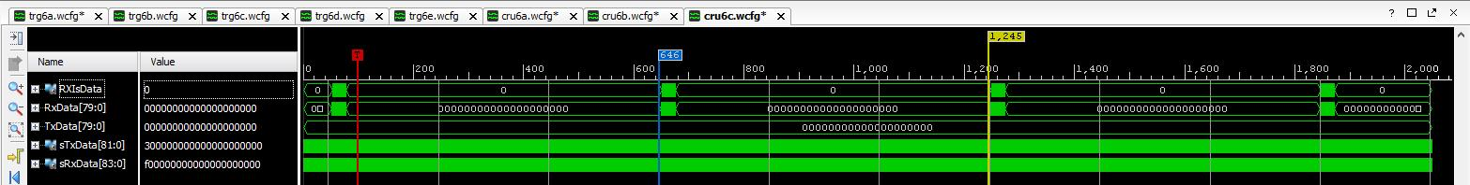
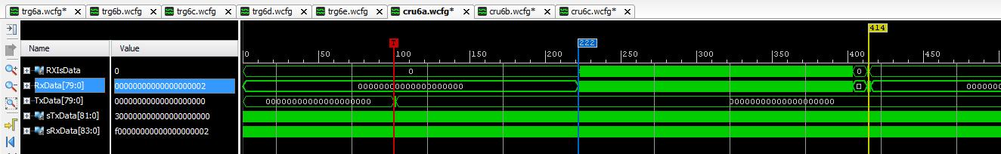
Data Arrival in CRU - Continuous and Triggered
Continuous Readout
Triggered Readout

Slide 7
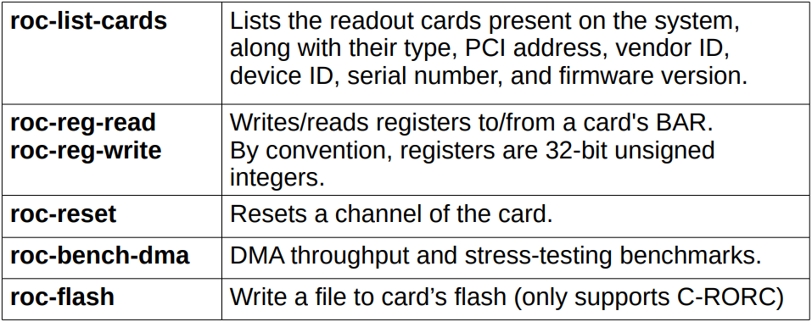
CRU: “Readout Card” (ROC) Interface library

Slide 8
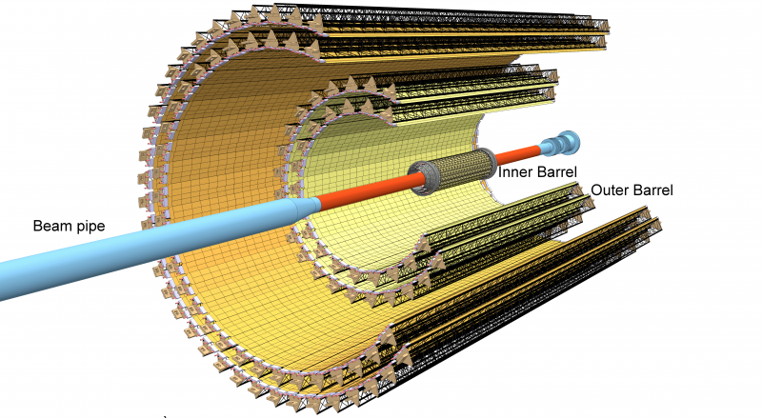
ITS Readout – Data Rate Specifications
ALICE baseline requirements:
50 kHz Pb-Pb
200 kHz p-p
ITS design specification:
100 kHz Pb-Pb
400 kHz p-p

Slide 9
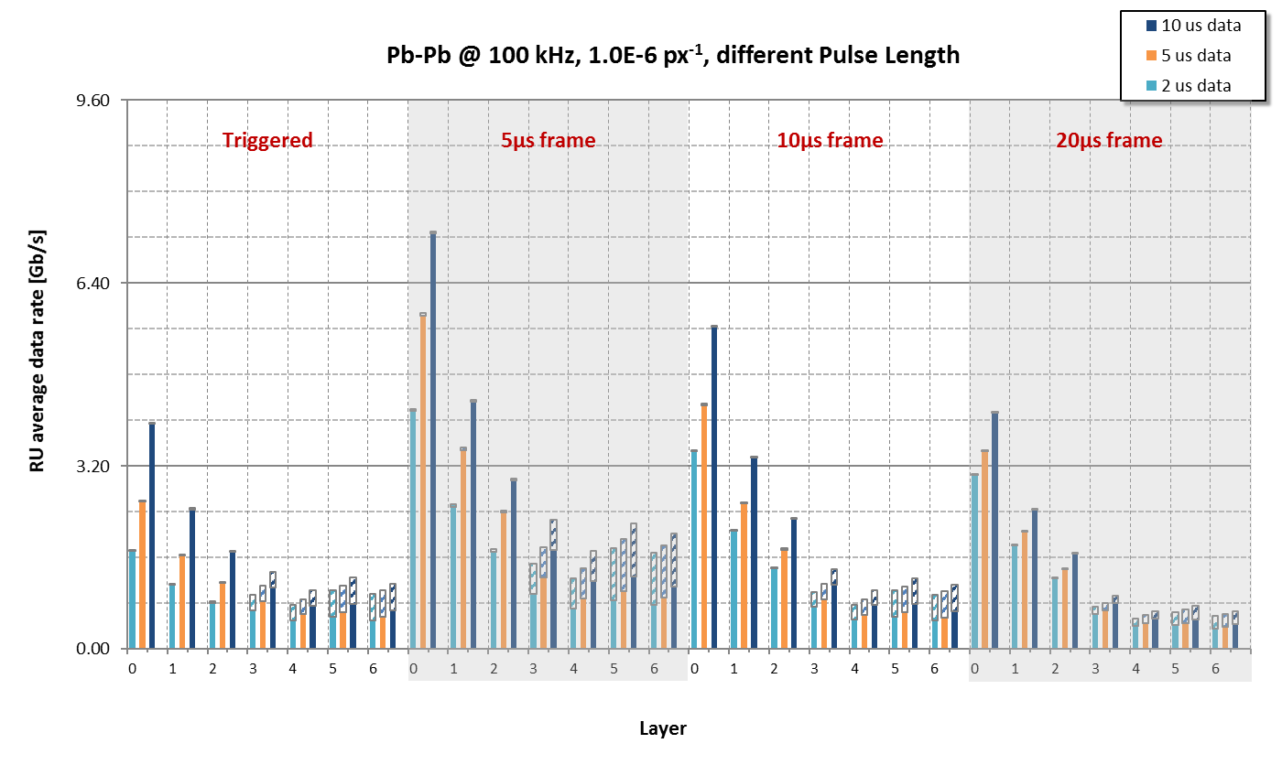
Data rate – PbPb @ 100kHz per Readout Unit

Slide 10
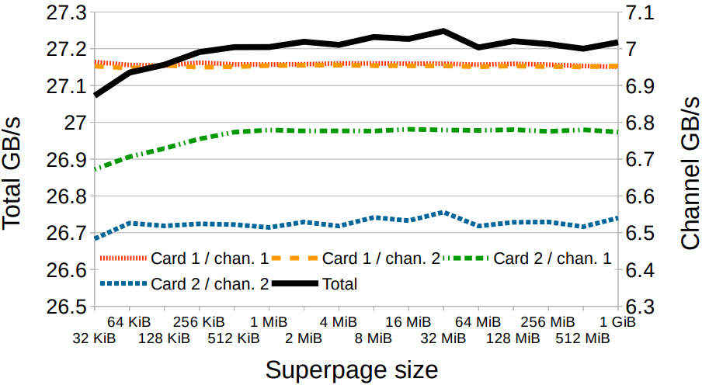
ROC bench tool performance
FLP 2 CRUs 4 PCIe endpoints
Total throughput

Slide 11
Backup Slides - Firmware

Slide 12
Firmware Development Environment
E-group: All communication between firmware developers is organized through membership in a CERN e-group (alice-its-wp10-firmware@cern.ch). The e-group is also used for access control to the version control system (gitlab) and the issue tracking system (JIRA)
Online Documentation: Documentation of hardware, Firmware, and software is posted at the WP10 Twiki page in the “ALICE Web” Twiki: https://twiki.cern.ch/twiki/bin/view/ALICE/ITS-WP10
Hardware Programming languages: We decided to allow 3 different firmware languages: VHDL, Verilog and System Verilog. Currently, the prototype development is on the Xilinx 7-series, and the Vivado toolset supports all 3 languages.
Tool Sets: The current design of the Readout Unit (RU) foresees the main programmable logic to be a Xilinx SRAM based Kintex UltraScale(+). Prototyping was started with a Xilinx Kintex-7. These devices are supported by the Xilinx Vivado Toolset. We are currently using Vivado version 2017.4. The RU design also includes a flash-based device to support scrubbing. This device is foreseen to be the ProAsic-3 from Microsemi which is supported by the Microsemi Libero SoC Design Suite. To develop detector specific logic on the CRU requires the use of the Altera Quartus toolset. We are considering evaluating this toolset in the future. For FX3 (USB) firmware design, we are using the Cypress EZ-USB Suite & GPIF-II Designer.
Simulations: Currently two toolsets are used for firmware test benches: Mentor Modelsim and Cadence Incisive (NCSim). The Cadence tools is only used by CERN collaborators at the moment.
Coding Style: For firmware coding in VHDL, a coding style document was developed: https://twiki.cern.ch/twiki/bin/view/ALICE/FwDevFlowMethods
Scripting: Most firmware toolsets support scripting in Tcl. Tcl is the scripting languate integrated in the Vivado tool environment. The firmware projects developed in WP10 are required to include a Tcl script to create the project and compile it to ensure common project configuration amongst developers. An optional “Makefile” can be used to call targeted Tcl scripts for various tasks (project creation, compilation, simulation, etc…)

Slide 13
Software
Hardware Platform: The main supported platform is currently a PC running the CERN CentOS 7 (CC7) operating system with Vivado 2016.4 and Modelsim SE 10.4a installed. Similar features can be achieved by using the Windows mingw platform with the Msys shell, but full compatibility with the Linux development is not guarantied by WP10
Software Environment: To ensure compatibility for software co-development it is recommended to install the Linux Developer Toolset in CC7 (https://linux.web.cern.ch/linux/devtoolset/), which provides more up-to-date compilers and libraries. Python is used for scripting to interact with the WP10 prototype hardware (currently via USB). We use the Continuum Analytics Anaconda platform (Python 3.6 version) to provide the python tools (https://www.continuum.io/anaconda-overview). This platform is also available for Windows.
Version Control: CERN gitlab is used for version control of the firmware and software development within WP10. The gitlab group for WP10 is located at: https://gitlab.cern.ch/alice-its-wp10-firmware/. Membership in this gitlab group is via the e-group. Various projects are hosted in this gitlab group, the main prototype development is currently in the project “itswp10”.
Issue Tracking: CERN JIRA is used for issue tracking. The WP10 issues are tracked underneath the ALICE project JIRA at: https://alice.its.cern.ch/jira/projects/IT.
File exchange: Files that are too big or not version controlled are exchanged via a shared CERNbox. Currently, this is by invitation only, since the CERNbox account used is a private account.

Slide 14
Backup Slides – Control Interfaces

Slide 15
Opencores CAN Protocol Controller
https://opencores.org/project,can
Written in Verilog
Supports basic CAN and extended CAN
  11-bit ID and 29-bit ID
  ID mask and filtering
Up to 1Mbps operation
Transmit/receive/error interrupts
Wishbone interface (8-bit address and data)
Register map compatible with Philips SJA1000 CAN Controller IC
  https://www.nxp.com/docs/en/data-sheet/SJA1000.pdf
Size: 12k gates (930 flip-flops)

Slide 16
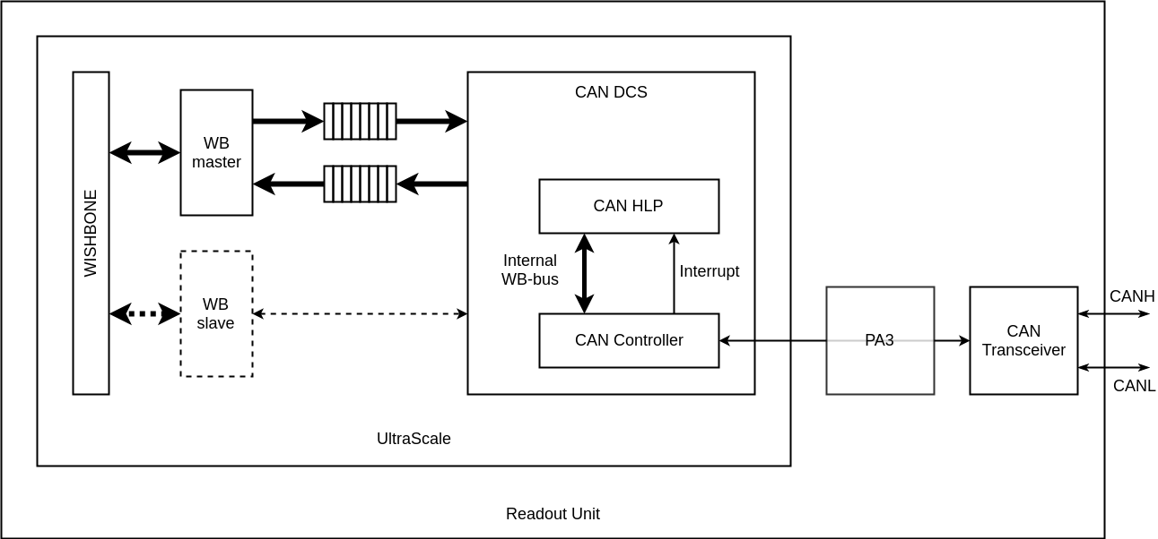
CANbus protocol proposal
Emulate a “network topology”: Divide 11 bit CAN ID field into a “Node ID” and a “Command” field:
MsgID[10:4] = N[6:0] = NodeID
MsgID[3:0] = C[3:0] = Command
ID[10] | ID[9] | ID[8] | ID[7] | ID[6] | ID[5] | ID[4] | ID[3] | ID[2] | ID[1] | ID[0]
N[6] | N[5] | N[4] | N[3] | N[2] | N[1] | N[0] | C[3] | C[2] | C[1] | C[0]
Allows for up to 128 nodes per CAN network
Command Codes
Command Code | Meaning
1 | DATA
2 | “WRITE” command
3 | Write Response (optional)
4 | “READ” command
5 | Read Response
7 | ”STATUS” or “ALERT”
Write Request:
Read Request:
Write (2) | Write Command
Bytes 0 - 1: | “Address” of this “WRITE”.
Bytes 2 – 3: | “Data”
Read (4) | Length= 2
Bytes 0-1: | “Address” of this “READ”.
Write Response:
Read Response:
Write Response (3) | Length = 3
Bytes 0-1: | “Address” (copied from the received message).
Byte 2: | Status resulting from this write or sub-command. A value=0 indicates successful completion. Non-zero values indicate (various) errors (to be determined)
Read Response (5) | Length 2 to 4 bytes
Byte 0-1: | “Address” of this “READ” (copied from the received message).
Bytes 2-3: | 2 additional bytes representing data value resulting from “reading” the requested address. Lack of these bytes (i.e. a short message) indicates an invalid read address/request.

Slide 17
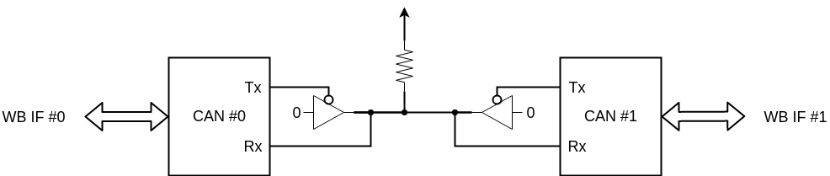
OpenCores CAN Protocol Controller Simulations
Tested using a simple Bitvis UVVM style testbench
Two instances of the CAN controller connected
Two separate WB interfaces to write to each controller
40 MHz clock

Slide 18
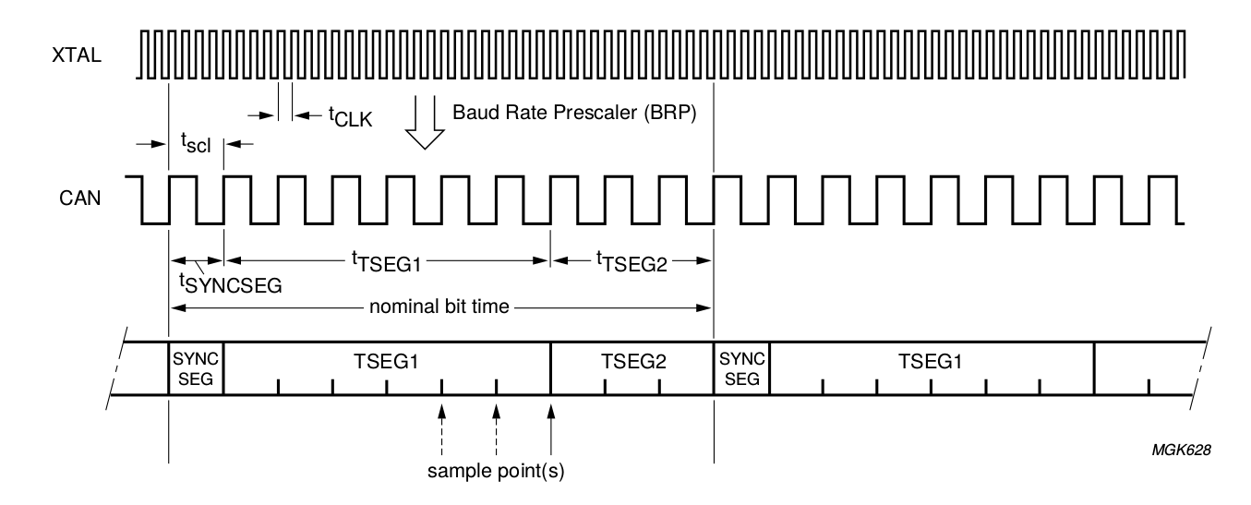
OpenCores CAN Protocol Controller Simulations
Bit Timing Register (BTR0) configured for 4x baud clock prescale
t_{SEG1} set to 7 baud clocks, t_{SEG2} set to 3 baud clocks, in BTR1
t_{SYNCSEG} is always 1 baud clock
Gives us a bit rate of 40 MHz / (4 * (1+7+3)) = 1Mbps

Slide 19
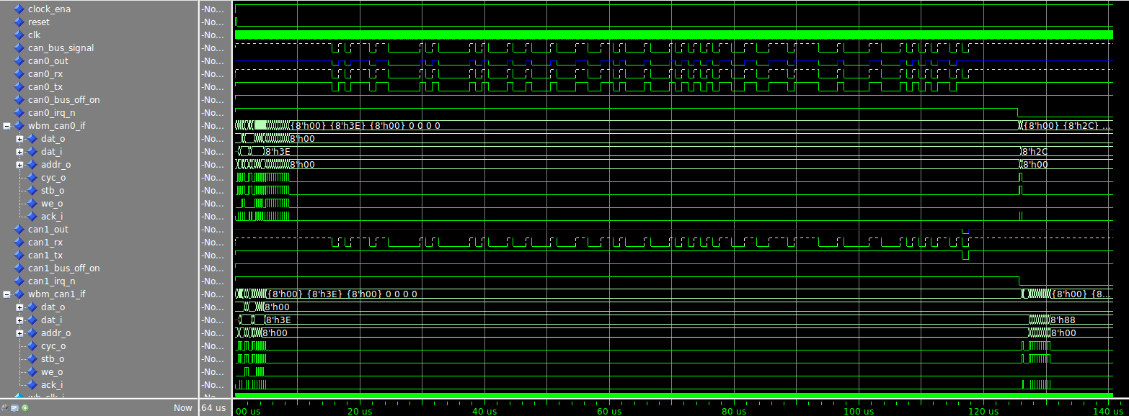
OpenCores CAN Protocol Controller Simulations
Simulation waveforms, showing initial WB transactions on both controllers, CAN transmission, and CAN IRQ lines going low after message

Slide 20
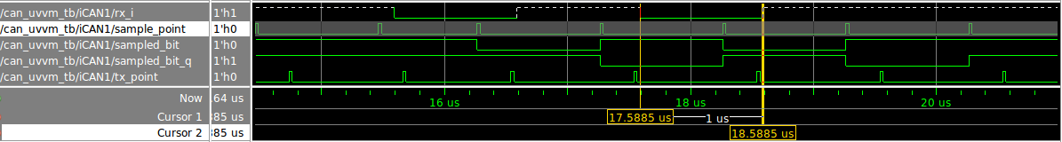
OpenCores CAN Protocol Controller Simulations
sample_point marks the point where bits on rx_i are being sampled
The simulated bit period is 1 us, as it was configured for
The sampling point is located at 7/10ths of a microsecond into each bit, corresponding to what t_{SEG1} and t_{SEG2} were configured for

Slide 21
OpenCores CAN Protocol Controller Simulations
Testbench log
Set up TX buffer on CAN0 with message for CAN1 (ID 0xBB)
# UVVM: ID_LOG_HDR 4940.0 ns TB seq. Start a transaction from CAN0 to CAN1
# UVVM: -------------------------------------------------------------------------------------------------------------------------------------------------------------------------
# UVVM: ID_BFM 5115.0 ns TB seq. wb_write(A:x"0A", x"BB") completed. Set TXID1 to xBB
# UVVM: ID_BFM 5465.0 ns TB seq. wb_write(A:x"0B", x"08") completed. Set TXID2 to x08, 8 bytes data
# UVVM: ID_BFM 5815.0 ns TB seq. wb_write(A:x"0C", x"11") completed. Set data1 to x11
# UVVM: ID_BFM 6165.0 ns TB seq. wb_write(A:x"0D", x"22") completed. Set data2 to x22
# UVVM: ID_BFM 6515.0 ns TB seq. wb_write(A:x"0E", x"33") completed. Set data3 to x33
# UVVM: ID_BFM 6865.0 ns TB seq. wb_write(A:x"0F", x"44") completed. Set data4 to x44
# UVVM: ID_BFM 7215.0 ns TB seq. wb_write(A:x"10", x"55") completed. Set data5 to x55
# UVVM: ID_BFM 7565.0 ns TB seq. wb_write(A:x"11", x"66") completed. Set data6 to x66
# UVVM: ID_BFM 7915.0 ns TB seq. wb_write(A:x"12", x"77") completed. Set data7 to x77
# UVVM: ID_BFM 8265.0 ns TB seq. wb_write(A:x"13", x"88") completed. Set data8 to x88
# UVVM: ID_BFM 8615.0 ns TB seq. wb_write(A:x"01", x"01") completed. Request transmission on CAN0
# UVVM:
# UVVM:
# UVVM: ID_LOG_HDR 8615.0 ns TB seq. Wait for CAN1 to receive message
# UVVM: -------------------------------------------------------------------------------------------------------------------------------------------------------------------------
# UVVM:
# UVVM:
# UVVM: ID_LOG_HDR 125613.5 ns TB seq. Got interrupt from CAN1.
# UVVM: -------------------------------------------------------------------------------------------------------------------------------------------------------------------------
# UVVM: ID_BFM 125790.0 ns TB seq. wb_check(A:x"00", x"XX")=> OK, received data = x"3E". Check that CAN0 transmit interrupt was set
# UVVM: ID_BFM 126140.0 ns TB seq. wb_check(A:x"02", x"XX")=> OK, received data = x"2C". Check that CAN0 transmit complete status bit is set
# UVVM: ID_BFM 126315.0 ns TB seq. wb_check(A:x"00", x"XX")=> OK, received data = x"3E". Check that CAN1 receive interrupt was set
# UVVM:
# UVVM:
# UVVM: ID_LOG_HDR 127315.0 ns TB seq. Verify message received by CAN1
# UVVM: -------------------------------------------------------------------------------------------------------------------------------------------------------------------------
# UVVM: ID_BFM 127490.0 ns TB seq. wb_check(A:x"14", x"BB")=> OK, received data = x"BB". Verify received RXID1
# UVVM: ID_BFM 127840.0 ns TB seq. wb_check(A:x"15", x"08")=> OK, received data = x"8". Verify received RXID2, 8 bytes data
# UVVM: ID_BFM 128190.0 ns TB seq. wb_check(A:x"16", x"11")=> OK, received data = x"11". Verify received data byte 1
# UVVM: ID_BFM 128540.0 ns TB seq. wb_check(A:x"17", x"22")=> OK, received data = x"22". Verify received data byte 2
# UVVM: ID_BFM 128890.0 ns TB seq. wb_check(A:x"18", x"33")=> OK, received data = x"33". Verify received data byte 3
# UVVM: ID_BFM 129240.0 ns TB seq. wb_check(A:x"19", x"44")=> OK, received data = x"44". Verify received data byte 4
# UVVM: ID_BFM 129590.0 ns TB seq. wb_check(A:x"1A", x"55")=> OK, received data = x"55". Verify received data byte 5
# UVVM: ID_BFM 129940.0 ns TB seq. wb_check(A:x"1B", x"66")=> OK, received data = x"66". Verify received data byte 6
# UVVM: ID_BFM 130290.0 ns TB seq. wb_check(A:x"1C", x"77")=> OK, received data = x"77". Verify received data byte 7
# UVVM: ID_BFM 130640.0 ns TB seq. wb_check(A:x"1D", x"88")=> OK, received data = x"88". Verify received data byte 8
Wait for CAN1 to receive message
Verify message contents

Slide 22
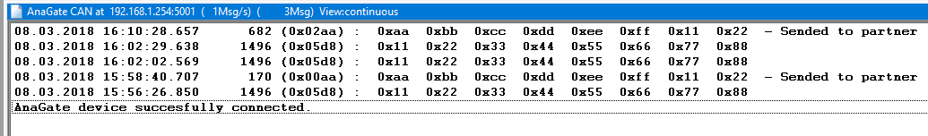
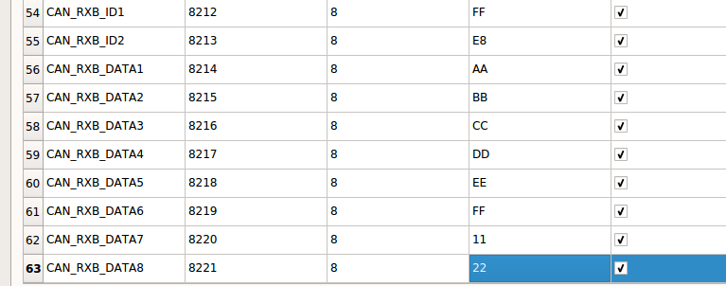
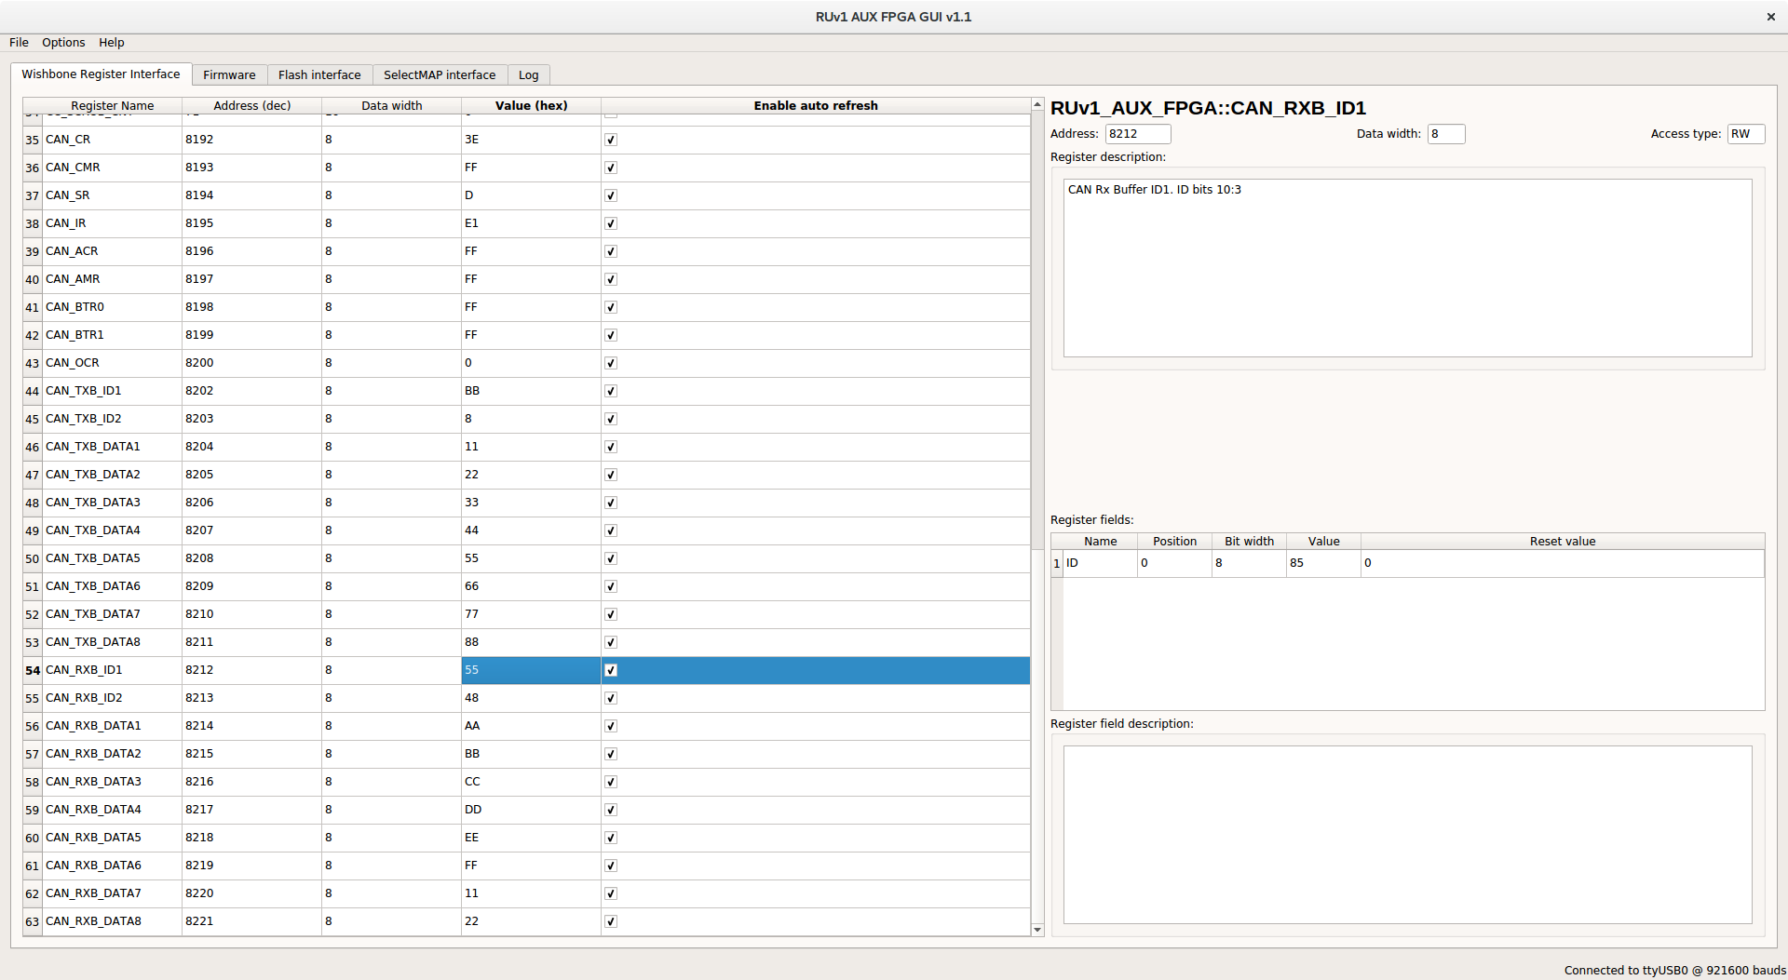
CAN bus testing on RUv1
AnaGate CAN adapter used for testing (same as DCS group is using).
Successfully sent/received CAN messages to/from CAN controller in PA3
AnaGate CAN Monitor program
Readout Unit PA3 GUI software (RX buffer registers)
Readout Unit PA3 GUI software (TX buffer registers)

Slide 23
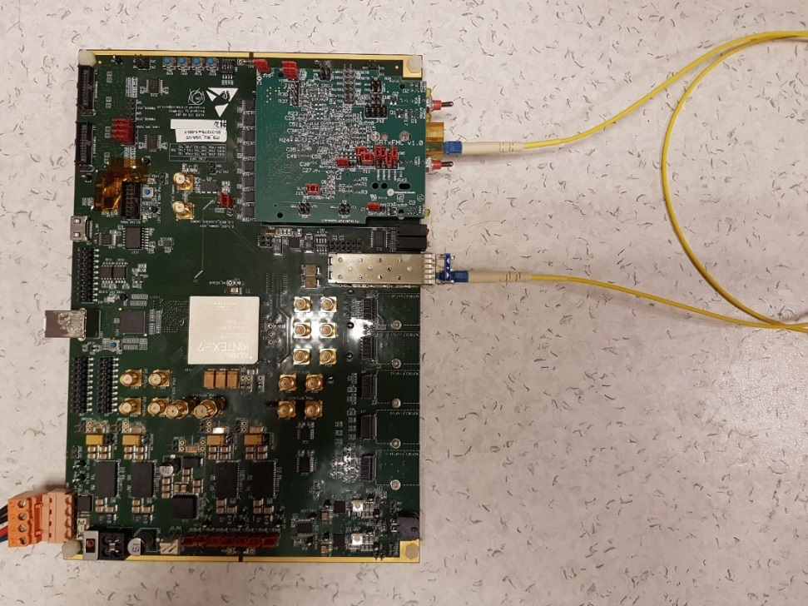
Trigger Interface – Splitter Loopback Test
Loopback test including:
  Actual SFP transmitter & receiver
  1:32 splitter
  Result: 24 hrs w/o errors¹
¹ Test conducted by Jo Schambach

Slide 24
Backup Slides – Data Streaming

Slide 25
PCIe40_v1

Slide 26
CRU v2: PCIe40_v2 from LHCb

Slide 27
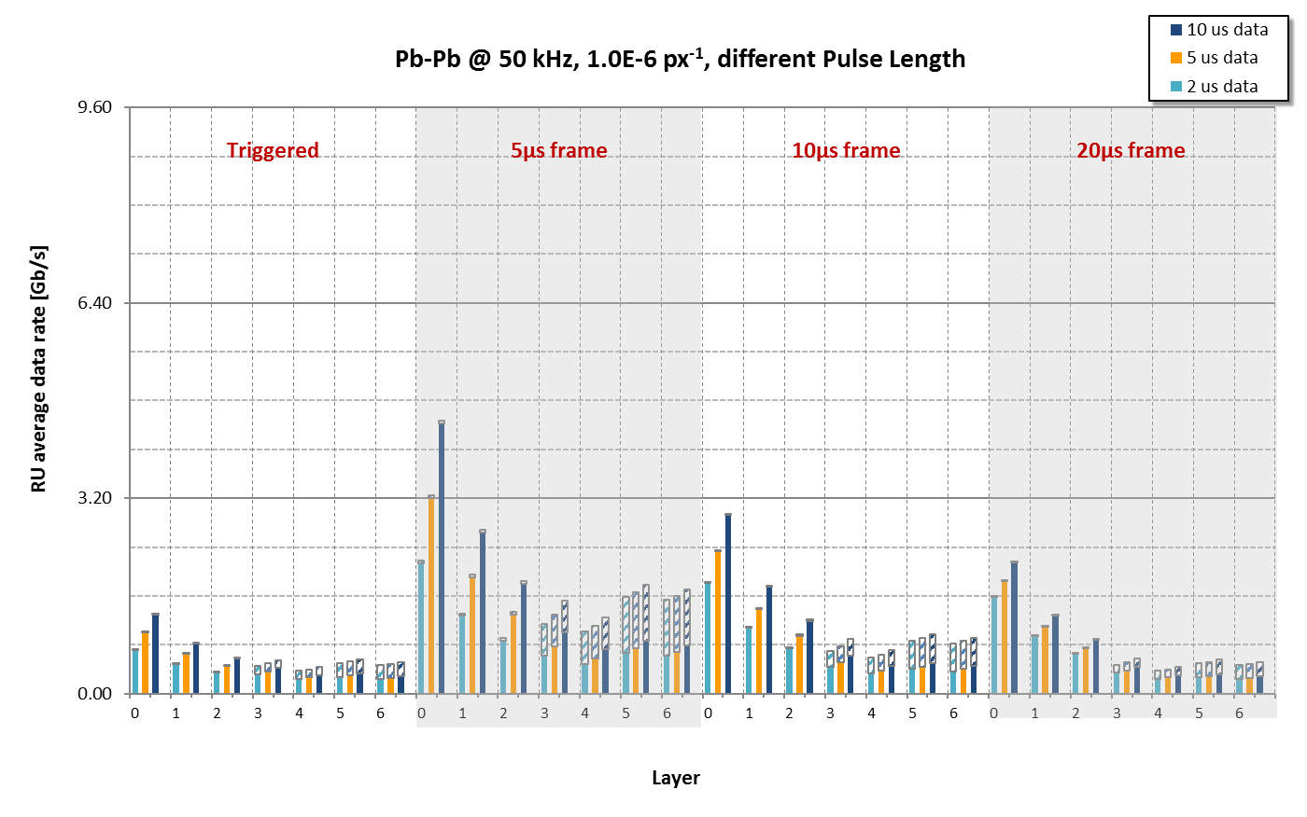
Data rate – PbPb @ 50kHz per Readout Unit

