Slide 1
Expected data rates

Slide 2
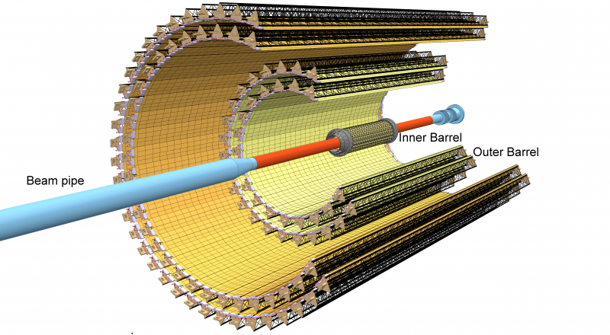
ITS readout – a quick remark on specifications
ALICE baseline requirements:
50 kHz Pb-Pb
200 kHz p-p
ITS design specification:
100 kHz Pb-Pb
400 kHz p-p

Slide 3
Data rate – expected physics rates
The actual data throughput generated by the ITS has been estimated by simulating the full behaviour of the detector with a system-c model (sensors and readout electronics) fed with actual data from the complete ALICE physics simulations (footnotes a, b, c).
 |  | Pb-Pb |  |  | p-p
Layer | Radius | Prim. & sec. particles avgª | Prim. & sec. particles maxª | QED electrons^{b} | Prim. & sec. particles avg^{c} | Prim. & sec. particles max^{c}
 | [mm] | [cm⁻²] | [cm⁻²] | [10⁵ cm⁻² s⁻¹] | [cm⁻²] | [cm⁻²]
0 | 22 | 8.77 | 12.45 | 6.56 | 0.08 | 0.11
1 | 31 | 6.17 | 8.61 | 3.39 | 0.05 | 0.07
2 | 39 | 4.61 | 6.19 | 1.84 | 0.04 | 0.05
3 | 196 | 0.34 | 0.45 | 0.01 | 0.00 | 0.00
4 | 245 | 0.24 | 0.31 | 0.00 | 0.00 | 0.00
5 | 344 | 0.13 | 0.17 | 0.00 | 0.00 | 0.00
6 | 393 | 0.11 | 0.13 | 0.00 | 0.00 | 0.00
^{a)} hit densities in a single Pb-Pb collision (minimum bias event, including secondaries due to material) max is for chip at η=0°. ^{b)} for an integration time of 10 µs, a Pb-Pb interaction rate of 50 kHz, a magnetic field of 0.2 T (worst case scenario) and p_{T} > 0.3 MeV/c. ^{c)} hit densities in central p-p collision (including secondaries produced in material).

Slide 4
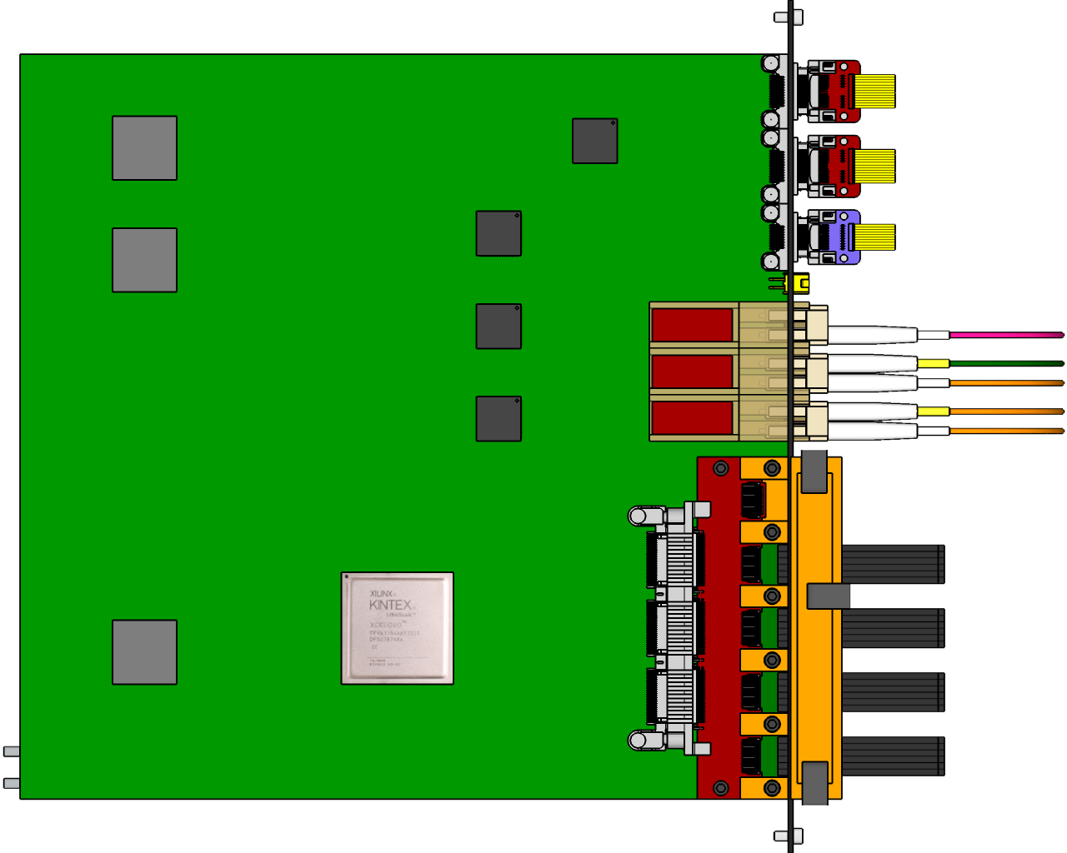
Data rate – layers and event type data load differences highlight
Pb-Pb
p-p
7 chip share one link through the master
320 Mb/s per master
Outer
Layers
Chip 1
Chip 2
Chip 3
Chip 4
Chip 5
Chip 6
Chip 7
16 or 28 master into a single Readout Unit
Copper pairs (5m)
Inner
Layers
Chip 1
Chip 2
Chip 3
Chip 4
Chip 5
Chip 6
Chip 7
Chip 8
Chip 9
960 Mb/s per master
9 master into a single Readout Unit
Copper pairs (5m)
In chip per event data load
Event rate – Pb-Pb generate much more data due to the real events respect to p-p.
Background – QED interactions, depends linearly to the beam intensity and is constant over time. It significantly affects the inner layers only.
Noise – electronic pixel noise (thermal, RTS, etc.), modeled as a single pixel noise. Not a concern given the results of the sensor characterization (see sensor PRR).
Protocol – preliminary data sparsification and chips status communications.
Encoding (8/10) – Error correction encoding, adds 20% to the bandwidth.

Slide 5
Data rate – ALPIDE protocol recall
The simulations implement the complete ALPIDE to calculate the actual data bandwidth, for both the Inner layers and the Middle and Outer Layers.
Time
INNER BARREL (1200 Mbps)
Hit Data
Chip Header
TIME
Data Short
Data Long
Chip Trailer
HEADER 0
HEADER 1
IDLE
REGION
HEADER
IDLE
IDLE
DS0
DS1
IDLE
DL0
DL1
DL2
DS0
DS1
IDLE
TRAILER
IDLE
IDLE
MIDDLE and OUTER BARREL (400 Mbps)
Chip n Header
TIME
Data Short
Data Long
Chip n Trailer
Chip n+1 Header
Chip n+1 Trailer
TIME
HEADER 0
HEADER 1
REGION
HEADER
DS0
DS1
DL0
DL1
DL2
DS0
DS1
TRAILER
IDLE
HEADER 0
HEADER 1
TRAILER
IDLE
Data Bytes
Refer to User Guide section in ALPIDE Operations Manual

Slide 6
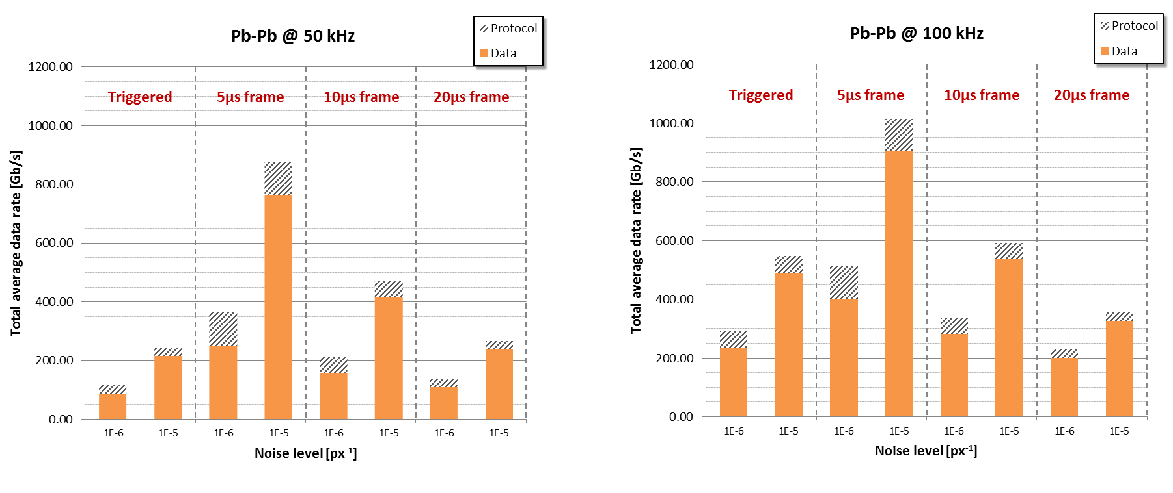
Data rate – expected maximum performances and actual data rates
The system has been designed to sustain a data rate of 100 kHz Pb-Pb collisions with a worst-case scenario noise of 10⁻⁵ px⁻¹. Absolute maximum continuous rates are higher.
 | 10⁻⁵ px⁻¹ (worst case) |  |  |  | 10⁻⁶ px⁻¹ (baseline)
 | Triggered | 5 µs frame | 10 µs frame | 20 µs frame | Triggered | 5 µs frame | 10 µs frame | 20 µs frame
Pb-Pb | 200 kHz | 150 kHz | 200 kHz | 200 kHz | 200 kHz | > 200 kHz | > 200 kHz | > 200 kHz
p-p | 300 kHz | 1 MHz | 1 MHz | 1 MHz | 400 kHz | > 1 MHz | > 1 MHz | > 1 MHz
Event rates at which data loss is less than 1%
Expected real data rate evaluated through system simulation for both safe (10⁻⁶ px⁻¹) and worst-case (10⁻⁵ px⁻¹) noise levels. Ensures adequate safety factor (> 4 ×)
Actual measured noise levels in the sensor < 10⁻⁸ px⁻¹.

Slide 7
Data rate – Pb-Pb 100 kHz, 10⁻⁶ px⁻¹ noise sensor output, triggered
Data rates from master chips. Rates are layer averages (max for η = 0°). Simulation (entire ITS) in system-c and verification (single chip) with cycle-accurate System Verilog chip model.
 |  | Layer
 |  | 0 | 1 | 2 | 3 | 4 | 5 | 6
Average fired pixels per event per sensor | Total (η = 0°) | 253.7 (326) | 152.7 (192.6) | 102.9 (127.2) | 4.8 (5.8) | 3.3 (4.1) | 1.9 (2.3) | 1.6 (1.8)
 | Physics (η = 0°) | 152.6 (224.1) | 101.1 (141.0) | 71.0 (95.3) | 3.0 (4.0) | 2.7 (3.5) | 1.4 (1.8) | 1.1 (1.3)
 | QED | 100.6 | 51.0 | 31.4 | 0.3 | 0.1 | 0.0 | 0.0
 | Noise | 0.53 | 0.52 | 0.5 | 0.5 | 0.5 | 0.5 | 0.5
Average data rate per master [Mbit/s] | Avg | 299.4 | 191.3 | 135.6 | 71.8 | 56.8 | 41.7 | 38.6
 | (η = 0°) | 362.5 | 223.3 | 154.2 | 79.7 | 60.7 | 45.8 | 41.2
Data rate breakdown | H & F | 1% | 1% | 2% | 24% | 31% | 42% | 45%
 | Region H | 7% | 9% | 11% | 17% | 17% | 15% | 15%
 | Short / long | 40% | 43% | 45% | 57% | 62% | 69% | 72%
Cluster size/shape changes accordingly to the layer and the sensor position in the stave, ranging from 2.2 avg pixel (layer 6) to 3.7 avg pixels (layer 0).
The data throughput from Middle and Outer layer chips is that one of the data link connecting the master, i.e. represents the data flow of a group (1 master + 6 slaves). Available link capacity is 320 Mb/s.
Data throughput from a single master sensor. Available link capacity is 960 Mb/s.

Slide 8
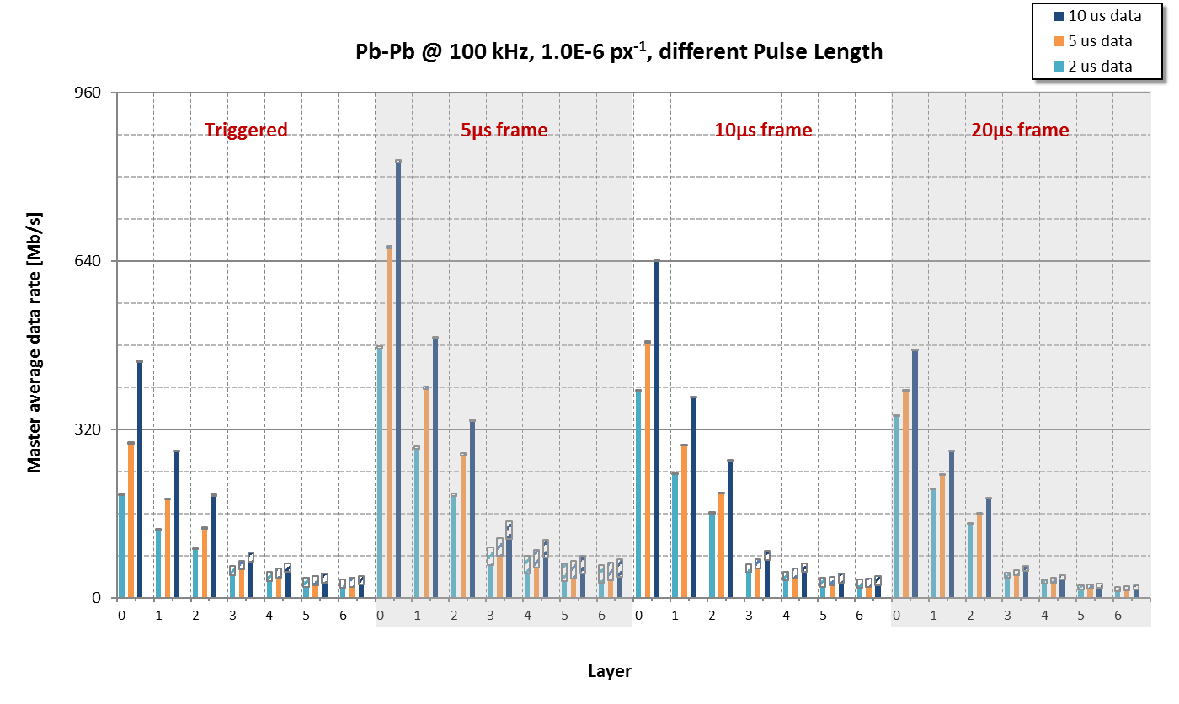
Data rate – Pb-Pb @ 100 kHz data rate per MASTER
Average data throughput for MASTER sensor for Pb-Pb interaction at 100 kHz average rate, for triggered and continuous mode and for different analogue shaping times. Worst case scenario of noise considered, influent only for the outer layers.
Outer layers limit

Slide 9
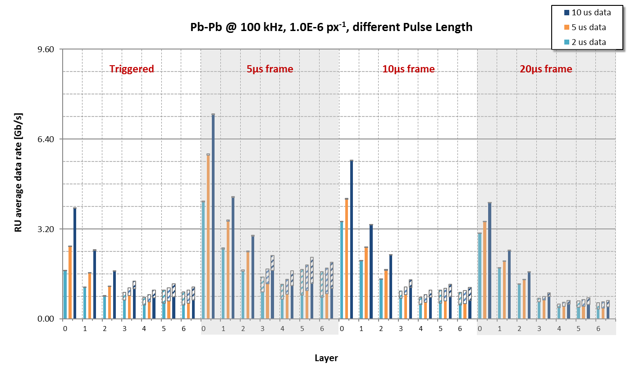
Data rate – Pb-Pb @ 100 kHz data rate per Readout Unit
Same data of previous slide, only reported for Readout Unit to highlight the total bandwidth necessary toward the counting room for each stave (192 staves, and therefore RUs in total).
2 GBT max
payload
1 GBT max
payload

Slide 10
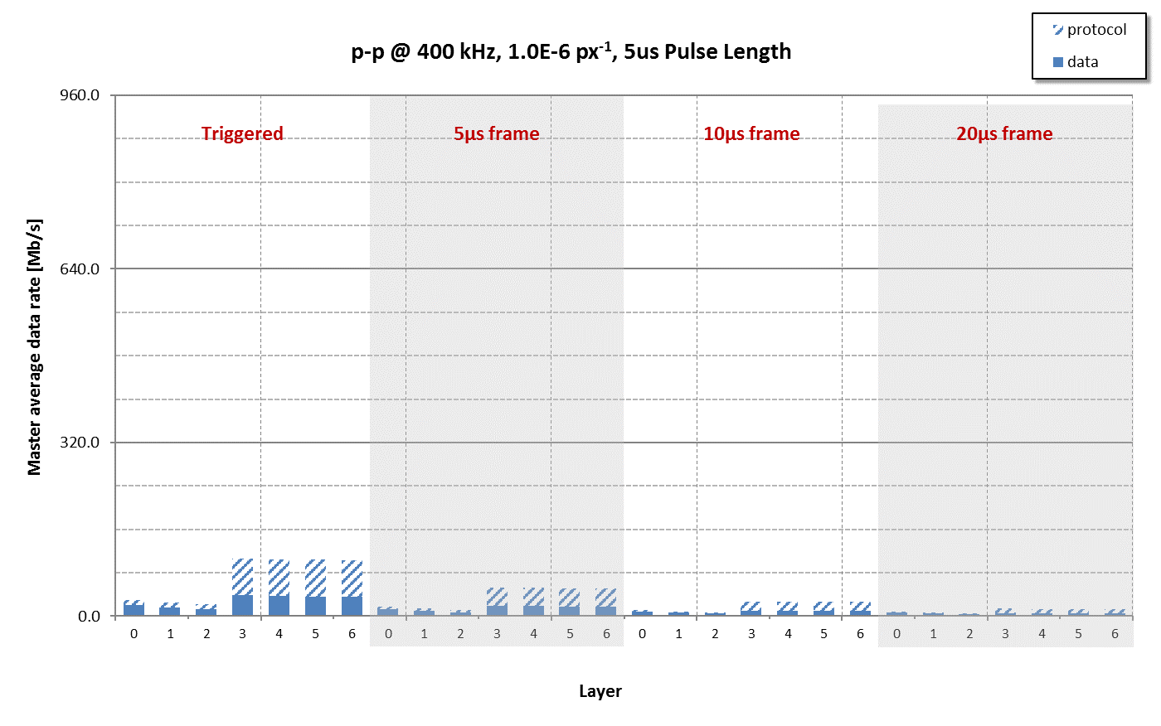
Data rate – p-p @ 400 kHz data rate per MASTER
Data rates from master chips. Rates are layer averages (max for η = 0°). Note how actual data are minimal, while protocol is almost dominant. In production sensors (noise <10⁻⁸ px⁻¹) data rate due to the intrinsic sensor noise will be negligibe.
Outer layers limit

Slide 11
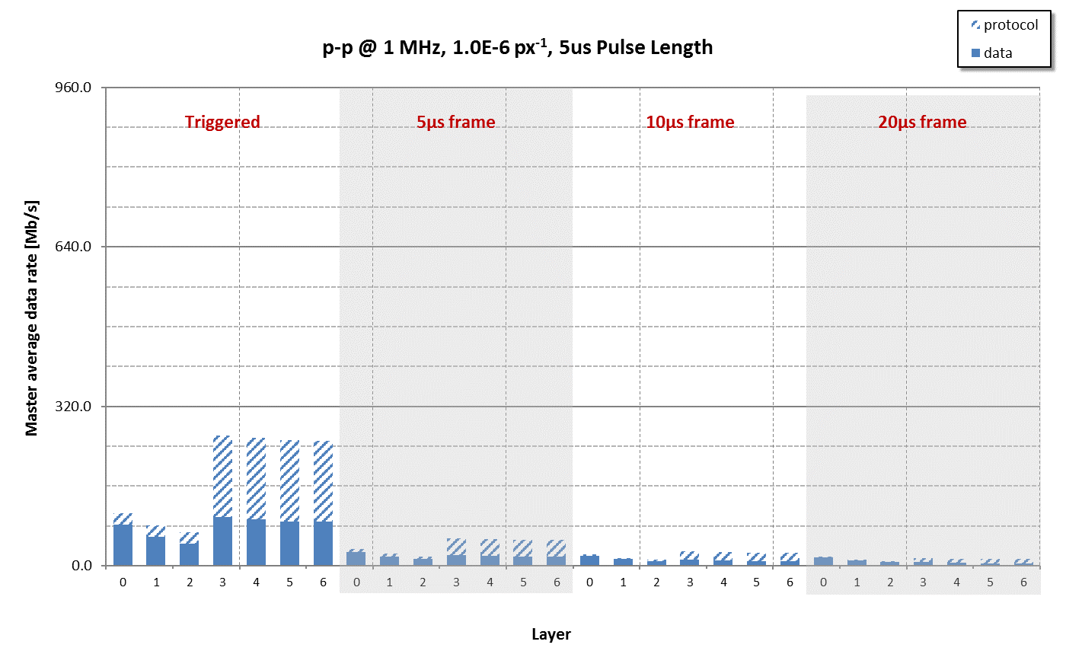
Data rate – p-p @ 1 MHz data rate per MASTER
Data rates from master chips. Protocol is still almost dominant even at 1 MHz interaction rate. In production sensors (noise <10⁻⁸ px⁻¹) data rate due to the intrinsic sensor noise will be negligibe.
Outer layers limit

Slide 12
Further Details

Slide 13
Data rate – Pb-Pb 50 kHz, 10⁻⁶ px⁻¹ noise sensor output, triggered
Data rates from master chips. Rates are layer averages (max for η = 0°). Simulation (entire ITS) in system-c and verification (single chip) with cycle-accurate System Verilog chip model.
 |  | Layer
 |  | 0 | 1 | 2 | 3 | 4 | 5 | 6
Average fired pixels per event per sensor | Total (η = 0°) | 253.7 (326) | 152.7 (192.6) | 102.9 (127.2) | 4.8 (5.8) | 3.3 (4.1) | 1.9 (2.3) | 1.6 (1.8)
 | Physics (η = 0°) | 152.6 (224.1) | 101.1 (141.0) | 71.0 (95.3) | 3.0 (4.0) | 2.7 (3.5) | 1.4 (1.8) | 1.1 (1.3)
 | QED | 100.6 | 51.0 | 31.4 | 0.3 | 0.1 | 0.0 | 0.0
 | Noise | 0.53 | 0.52 | 0.5 | 0.5 | 0.5 | 0.5 | 0.5
Average data rate per master [Mbit/s] | Avg | 114.6 | 74.7 | 53.6 | 31.7 | 25.5 | 19.2 | 17.9
 | (η = 0°) | 140.0 | 88.2 | 61.6 | 35.9 | 27.6 | 21.3 | 19.6
Data rate breakdown | H & F | 1% | 1% | 2% | 24% | 31% | 42% | 45%
 | Region H | 7% | 9% | 11% | 17% | 17% | 15% | 15%
 | short/long | 40% | 43% | 45% | 57% | 62% | 69% | 72%
Cluster size/shape changes accordingly to the layer and the sensor position in the stave, ranging from 2.2 avg pixel (layer 6) to 3.7 avg pixels (layer 0).
The data throughput from Middle and Outer layer chips is that one of the data link connecting the master, i.e. represents the data flow of a group (1 master + 6 slaves). Available link capacity is 320 Mb/s.
Data throughput from a single master sensor. Available link capacity is 960 Mb/s.

Slide 14
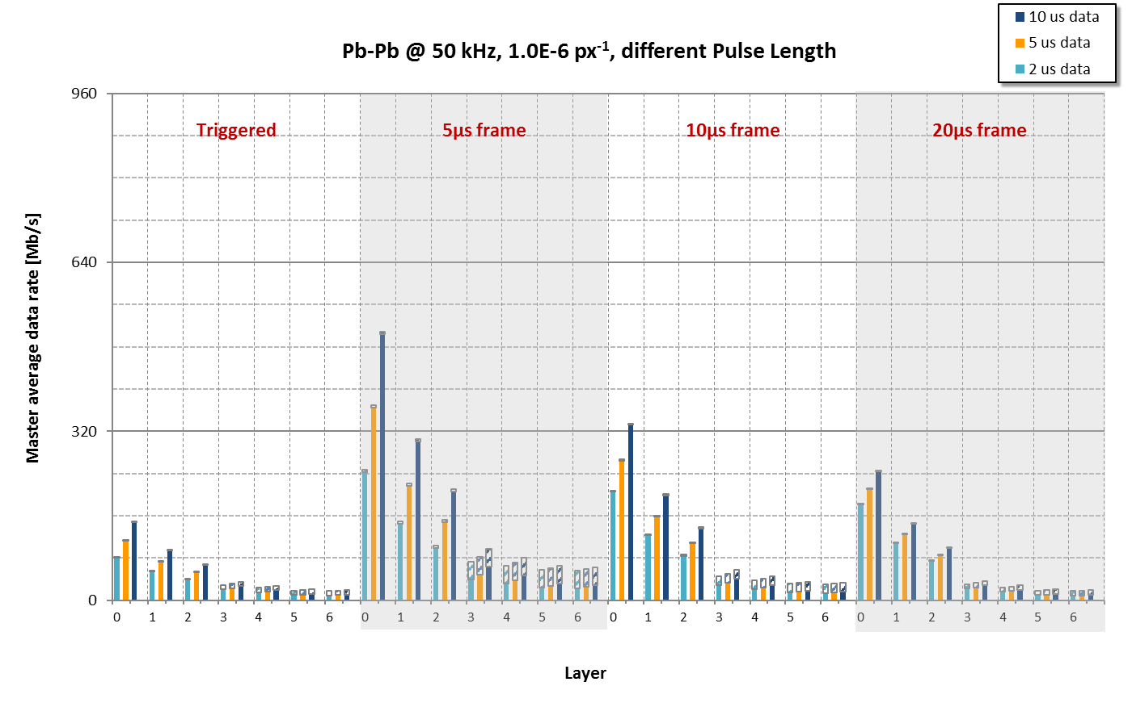
Data rate – Pb-Pb @ 50 kHz (baseline) data rate per MASTER
Average data throughput for Readout Unit for Pb-Pb interaction at 50 kHz average rate, for triggered and continuous mode and for different analogue shaping times. Worst case scenario of noise considered, influent only for the outer layers.
Outer layers limit

Slide 15
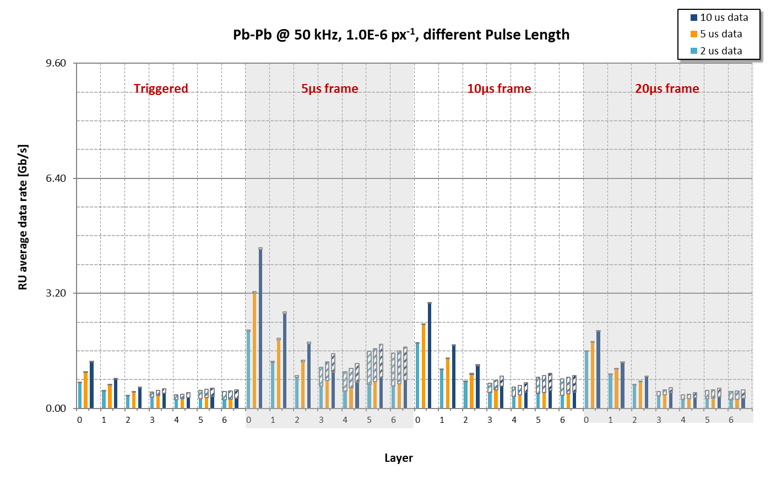
Data rate – Pb-Pb @ 50 kHz (baseline) data rate per Readout Unit
Same data of previous slide, only reported for Readout Unit to highlight the total bandwidth necessary toward the counting room for each stave (192 staves, and therefore RUs in total).
2 GBT max
payload
1 GBT max
payload

