Slide 1
ITS Readout Firmware Overview

Slide 2
Overview

Slide 3
Readout Unit Overview
From/To ITS
Readout Unit
SCA
From/To CRU
Copper Links
GBT Links
Programmable Logic
3.2 Gb/s
GBTx
Control
FLASH
Memory
3.2 Gb/s
Optical transceiver
VTRx
Data @ 3.2 Gb/s
FLASH
Memory
Data: 9 x 960 Mb/s
or 16/28 x 320 Mb/s
FLASH
FPGA
3.2 Gb/s
GBTx
Optical transceiver
VTTx
Data @ 3.2 Gb/s
Control (80 Mb/s)
Data @ 3.2 Gb/s
SRAM
FPGA
Clock (40MHz)
3.2 Gb/s
3.2 Gb/s
GBTx
Optical transceiver
VTRx
Trigger
Main Tasks of the Readout Unit:
Receive triggers (heartbeat & physics) from CTP & decode
Receive “control” information from CRU
Deliver triggers to stave sensors
Control, configure and monitor stave sensors
Receive data from stave; decode & compress
Deliver monitoring information to CRU (forwarded to DCS)
Deliver CRU framed data packets to CRU
Determine and handle busy information
Monitor and control Power Board
Handle radiation upsets in programmable logic & sensors
Power Board
Power Unit (PU)

Slide 4
Firmware Development Rules
E-group: All communication between firmware developers is organized through membership in a CERN e-group (alice-its-wp10-firmware@cern.ch). The e-group is also used for access control to the version control system (gitlab) and the issue tracking system (JIRA)
Online Documentation: Documentation of hardware, Firmware, and software is posted at the WP10 Twiki page in the “ALICE Web” Twiki: https://twiki.cern.ch/twiki/bin/view/ALICE/ITS-WP10
Hardware Programming languages: We decided to allow 3 different firmware languages: VHDL, Verilog and System Verilog. Currently, the prototype development is on the Xilinx 7-series, and the Vivado toolset supports all 3 languages.
Tool Sets: The current design of the Readout Unit (RU) foresees the main programmable logic to be a Xilinx SRAM based Kintex UltraScale(+). Prototyping was started with a Xilinx Kintex-7. These devices are supported by the Xilinx Vivado Toolset. We are currently using Vivado version 2016.4. The RU design also includes a flash-based device to support scrubbing. This device is foreseen to be the ProAsic-3 from Microsemi which is supported by the Microsemi Libero SoC Design Suite. To develop detector specific logic on the CRU requires the use of the Altera Quartus toolset. CERN has licenses for Synthesis tool Synopsis Synplify Premier, which supports Triple-modular-redundancy (TMR). We are considering evaluating this toolset in the future. For FX3 (USB) firmware design, we are using the Cypress EZ-USB Suite & GPIF-II Designer.
Simulations: Currently two toolsets are used for firmware testbenches: Mentor Modelsim and Cadence Incisive (NCSim). The Cadence tools is only used by CERN collaborators at the moment.
Coding Style: For firmware coding in VHDL, a coding style document was developed: https://twiki.cern.ch/twiki/bin/view/ALICE/FwDevFlowMethods
Scripting: Most firmware toolsets support scripting in Tcl. Tcl is the scripting languate integrated in the Vivado tool environment. The firmware projects developed in WP10 are required to include a Tcl script to create the project and compile it to ensure common project configuration amongst developers. An optional “Makefile” can be used to call targeted Tcl scripts for various tasks (project creation, compilation, simulation, etc…)

Slide 5
WP10 Software environment
Hardware Platform: The main supported platform is currently a PC running the CERN CentOS 7 (CC7) operating system with Vivado 2016.4 and Modelsim SE 10.4a installed. Similar features can be achieved by using the Windows mingw platform with the Msys shell, but full compatibility with the Linux development is not guarantied by WP10
Software Environment: To ensure compatibility for software co-development it is recommended to install the Linux Developer Toolset in CC7 (https://linux.web.cern.ch/linux/devtoolset/), which provides more up-to-date compilers and libraries. Python is used for scripting to interact with the WP10 prototype hardware (currently via USB). We use the Continuum Analytics Anaconda platform (Python 3.5 version) to provide the python tools (https://www.continuum.io/anaconda-overview). This platform is also available for Windows.
Version Control: CERN gitlab is used for version control of the firmware and software development within WP10. The gitlab group for WP10 is located at: https://gitlab.cern.ch/alice-its-wp10-firmware/. Membership in this gitlab group is via the e-group. Various projects are hosted in this gitlab group, the main prototype development is currently in the project “itswp10”.
Issue Tracking: CERN JIRA is used for issue tracking. The WP10 issues are tracked underneath the ALICE project JIRA at: https://alice.its.cern.ch/jira/projects/IT.
File exchange: Files that are too big or not version controlled are exchanged via a shared CERNbox. Currently, this is by invitation only, since the CERNbox account used is a private account.

Slide 6
Gitlab Repository Structure
The ITS WP10 repository structure is derived from the opencores directory structure recommendation.
Firmware submodules are currently located in the same folder structure as the containing project itself, but in the future will use the Git “super-project/submodule” paradigm, where a Git “super project” can import modules located in other repositories as “submodules” (https://git-scm.com/book/en/v2/Git-Tools-Submodules).
Repository root
user
firmware
software
RUv0
e.g. prj2
source
vivado
sw
sim
doc
constraints
ip
rtl
bench
<prj_name>
scripts
sub-mod
Synth.
Impl.
hw

Slide 7
Gitlab Based Development Flow
The development of firmware within WP10 is following the gitlab suggested development flow:
The master branch is a protected branch that should contain only stable code.
Only the repository owner(s) are allowed to modify the master branch.
To develop a new feature or fix an issue in an existing feature, a new issue is created in JIRA.
The developer clones the repository to his/her development workstation.
A developer then creates a “feature” or “development” branch derived from the master branch on his/her workstation referencing the issue in JIRA.
When the development is close to being done, this new branch will be pushed to the repository in gitlab.
The developer then “pulls” the latest commits from the gitlab repository at CERN.
The developer merges the “master” branch into his/her development branch to identify any conflicts that might arise from commits since the branching and resolves these conflicts.
The updated branch will be pushed to gitlab again.
A new “merge request” will be opened in gitlab and an online discussion of the merge request starts.
Other developers in WP10 test the code in this branch with their own code to verify that no conflicts are created by this branch.
Once the merge-request discussion is concluded, the repository owner “accepts” the merge request in the online gitlab interface, which performs the actual merge of the branch into the master branch, resolving any conflicts that were identified.
The JIRA issue associated with this development is “closed” (gitlab/Jira integration).
The repository owner then notifies all developers to “pull” the latest repository changes and to merge them into their development branches.
Special features in the code base not needed in the main development flow can be kept in separate repositories, or in special long-lived feature-branches (e.g. code for special hardware tests)

Slide 8
Firmware Structure

Slide 9
Firmware Module Structure
The firmware module structure starts with a top level module called <project_name>_top (e.g. “RU_Top” in the diagram below). This module only instantiates child modules.
All physical ports are declared in this top level module.
Physical interfaces of the ports are converted into single-ended logic ports in an I/O Interface module instantiated by <project>_top.
All user clocks to be used in the fabric logic are derived in a separate “Clock Generator” module instantiated by <project>_top
All fabric logic is instantiated by a “Fabric Logic” top module (“fabric_top”) which only instantiates various child modules for various tasks (such as wishbone bus, Alpide Readout, …..), i.e. no user logic.
The fabric_top module instantiates all other user logic child modules.
RU_Top
completed
in progress
I/O Interfaces
Fabric Logic
Clock Generators
Wishbone Bus
USB Interface
Alpide Control
Alpide Readout
GBT Interface
Trigger Handling
Power Unit Interface
Alpide Power & Monitoring
…

Slide 10
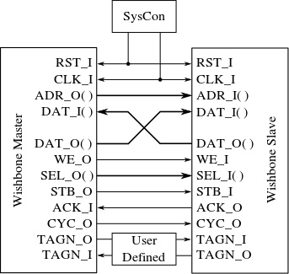
Firmware module configuration: Wishbone Bus Interconnect
All User Logic Module high-speed data exchange is accomplished via FIFOs that also allow proper clock-domain crossing between modules.
Communication between user logic modules and the outside world (both for configuration and monitoring) is accomplished via the open-source “Wishbone Bus Interconnect” used by many opencores projects: http://cdn.opencores.org/downloads/wbspec_b3.pdf.
The specific implementation chosen (different interconnect structures are defined in the standard) is a Shared-Bus interconnect with a multiplexer implemented in an “InterCon” module.
Wishbone
Slave
IP Core
Wishbone
Slave
IP Core
Wishbone
Slave
IP Core
Wishbone
Master
IP Core
Wishbone
Master
IP Core
Shared Bus
Prototype Firmware implements a wishbone bus with currently only one master (no arbiter needed)
The Wishbone Data Bus width is 16-bit
Partial Address Decoding: 8-bit addresses are used internal to each Wishbone-slave, additional address bits used to identify a specific Wishbone Slave. Currently we use 4-bits for up-to 16 slaves, but this can be extended as needed
Only Wishbone required signals are implemented; also no byte-select (SEL) signals are used.
Optional

Slide 11
Acquisition & Sensor Control Firmware Implementation - Overview
From/To ITS sensors
From/To CRU, CTP and DCS
Clock
LHC clock
Control
Controls driver
Controls/Trigger & Configuration I/F
Commands interpreter
GBT Rx
Slow ctrl
Pwr ctrl
Fast latch-up / power controller
Trigger extraction
GBT Rx
Trigger
Readout state control
Heartbeat extraction
Error / busy extraction
Busy?
Data
High speed data receiver
Buffering
CRU packet builder
Data
GBT Tx
Busy
Slow controls
feedback
The main firmware tasks of the RU are outlined in this diagram.
Additionally, Firmware needs to be developed to handle Radiation Induced failures.
Firmware in the flash-based FPGA for scrubbing and configuration of the S-RAM based FPGA is not shown in the above diagram
Also not shown are firmware for USB I/F and Flash-FPGA communication
When GBT is not available, a CAN IP (not shown here) provides power unit control & monitoring

Slide 12
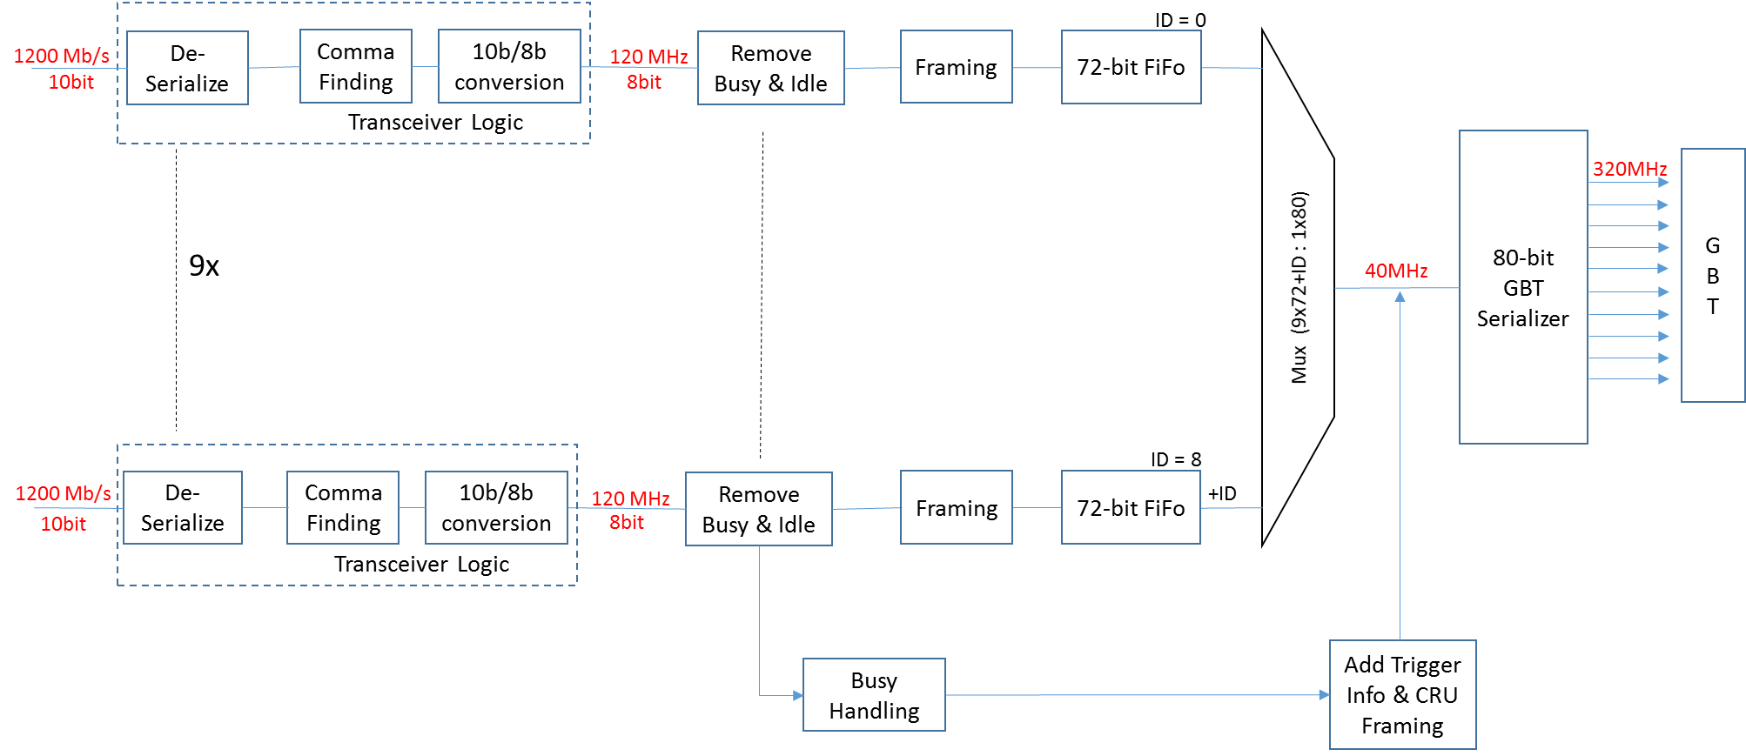
Alpide Data Path – Inner Barrel
Implemented with high-speed GTX transceiver IPs
Includes encoding
Not yet defined; e.g. create busy map

Slide 13
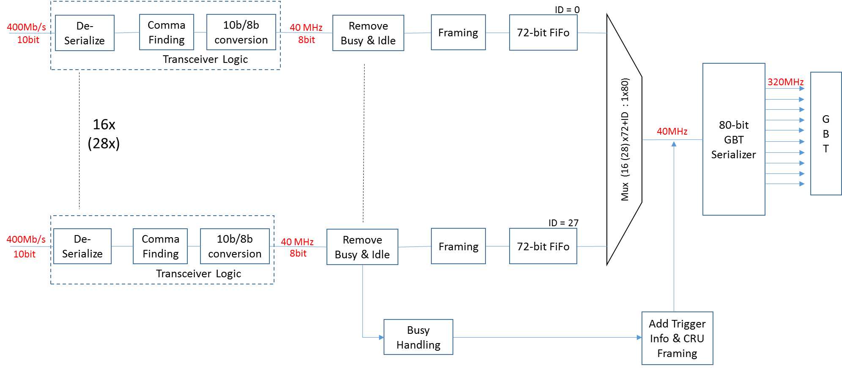
Alpide Data Path – Outer Barrel
Implemented with GPIO DDR SerDes IPs and user decoding
Includes encoding

Slide 14
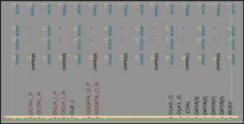
Trigger Handling
The sensor receives a trigger and responds with a complete, partial or empty data frame and/or a busy state depending on the status of its internal resources. Triggers need to be separated by TW > 1 µs. The CTP trigger time (BC & Orbit) are stored for every CTP trigger, and later associated to outgoing data by the Readout Electronics.
CTP Physics trigger
Heart Beat Trigger / BCX counter
Trigger
Send a trigger to the sensor.
Yes
Time since last trigger > TW ?
Generate and store SENSOR trigger event
No
Reset last trigger timer
Store CTP trigger and/or HBF reference
Store Busy condition for current trigger event
Yes
Busy detected?
Associate every SENSOR frame with all stored CTP triggers associated with it.
Data
No
Data
Sensor

Slide 15
Prototype Firmware Development

Slide 16
Prototype Development Hardware
A Readout Unit prototype was designed and fabricated in WP10 to allow firmware development and interface and radiation testing. The prototype hardware was divided into two boards:
RUv0: a Xilinx Kintex-7 based board; contains interfaces to sensors, power unit and an FMC connector
GBTxFMC: an FMC card containing GBTx, SCA, and VTRx.
RUv0 also provides an SFP+ fiber module, which allows the board to be used as a substitute for the CRU and/or CTP, where the FPGA firmware includes the GBT_FPGA IP core provided by the CERN GBT group.
In lieu of a complete GBT setup to control the prototype boards, RUv0 also includes a USB interface provided by a Cypress FX-3 chip, which allows the prototype hardware to be controlled and monitored by a PC via USB.
RUv0 also includes controllable power regulators to provide power to the attached Alpide sensors/modules.
Most Firmware development to date has been done on this hardware platform.
For Radiation Susceptibility testing, small firmware reference test structures have been to check relevant logic cross-sections
The same prototype hardware was also used for evaluation of error mitigation techniques: TMR, safe FSMs, ECC for memory, ….
Configuration of the FPGA is possible over JTAG from both a JTAG header or the GBT-SCA on the GBTxFMC
Different scrubbing methods were investigated over JTAG

Slide 17
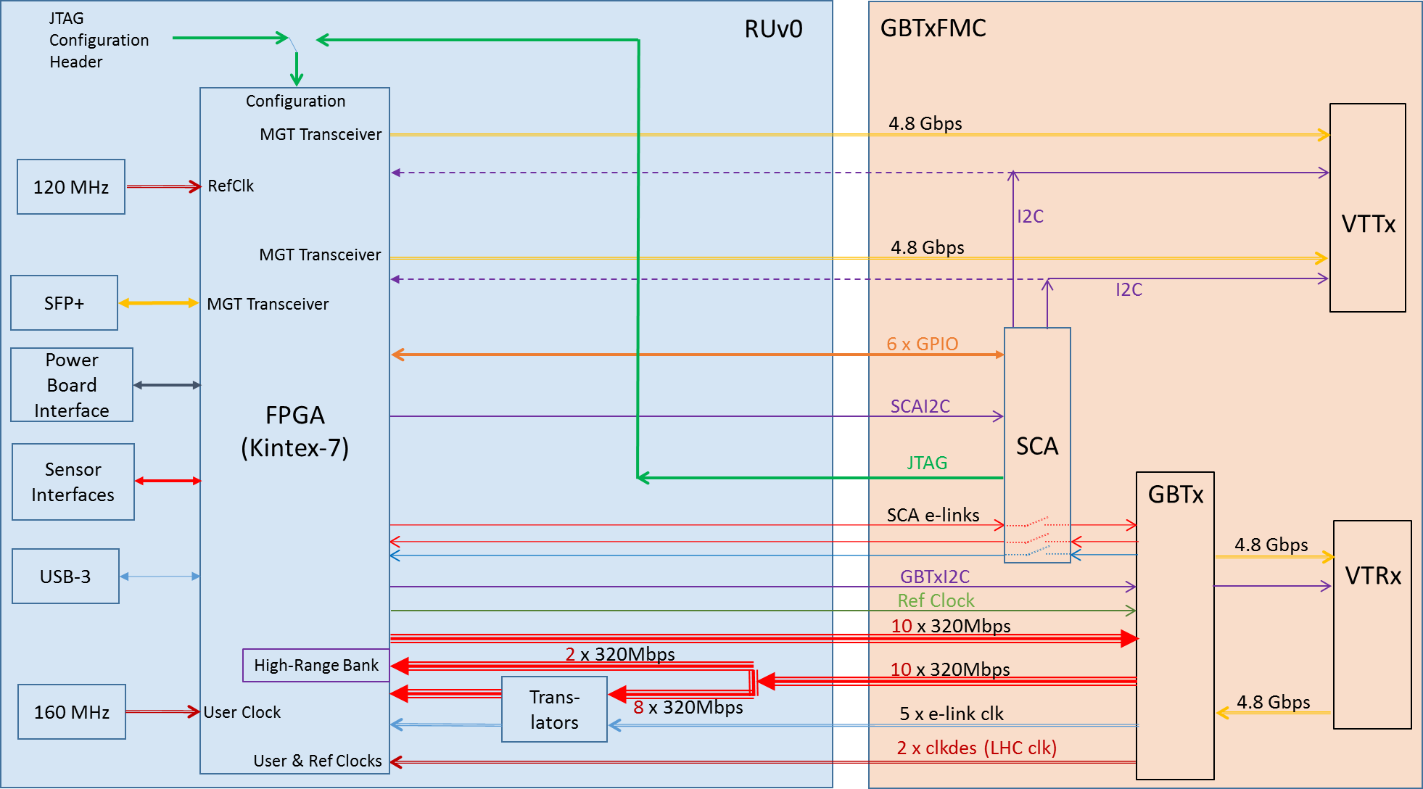
Prototype Hardware: RUv0 and GBTxFMC
10 high-speed e-links and associated clocks, as well as various SCA interfaces are connected between RUv0 and GBTxFMC as shown here:

Slide 18
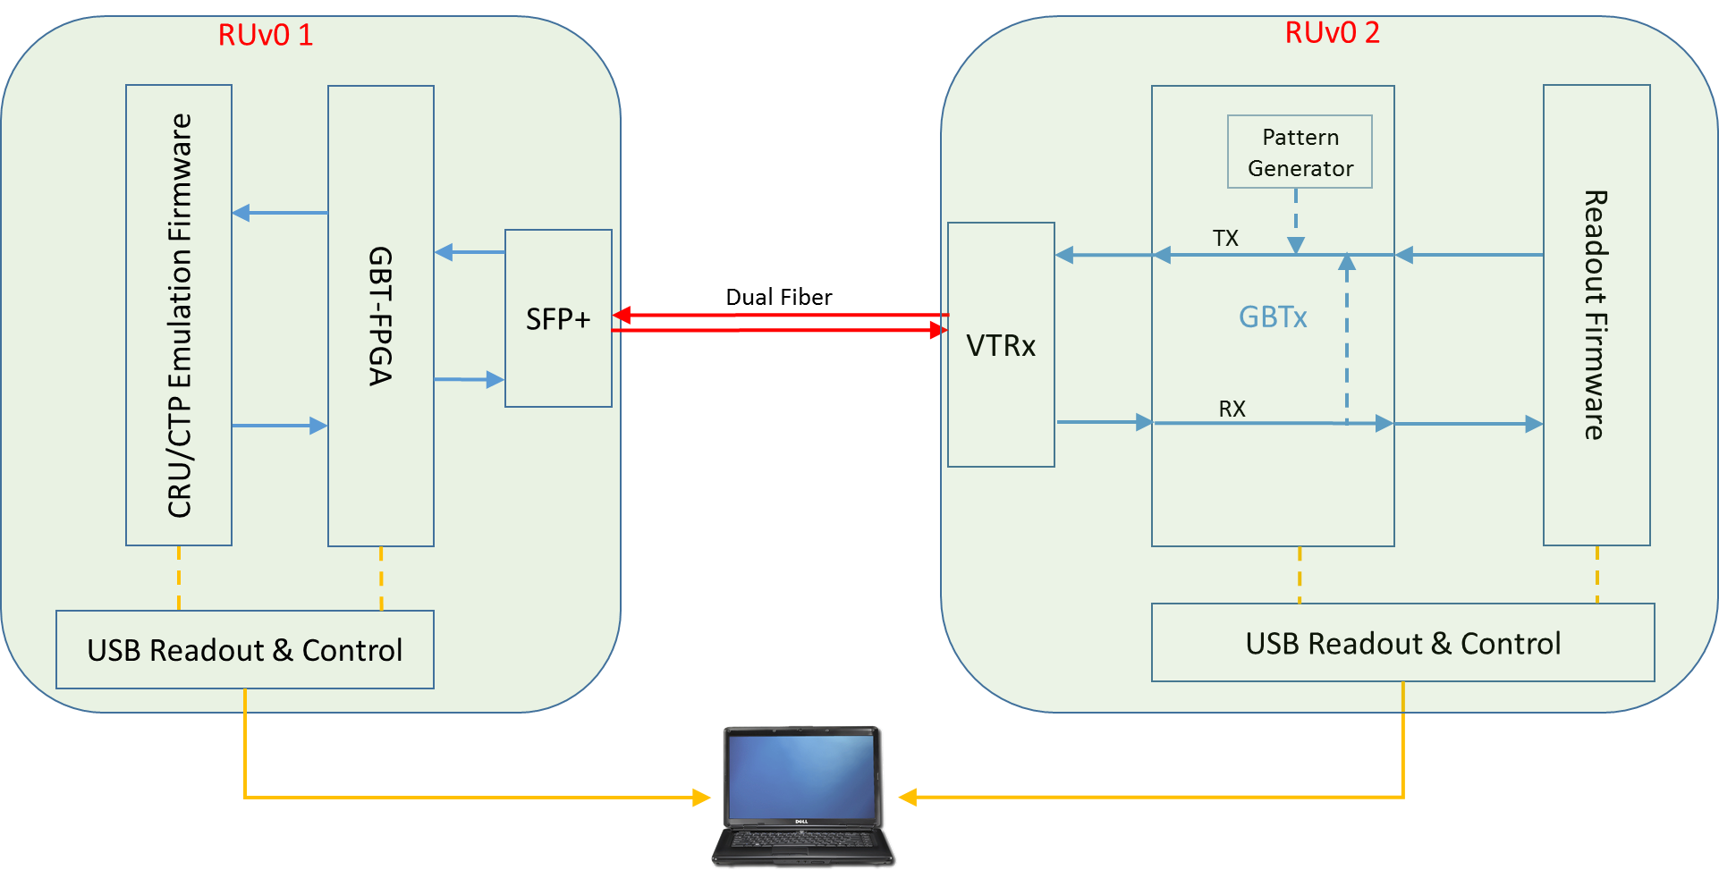
Prototype Development Setup with 2 RUv0
CRU
and/or
CTP

Slide 19
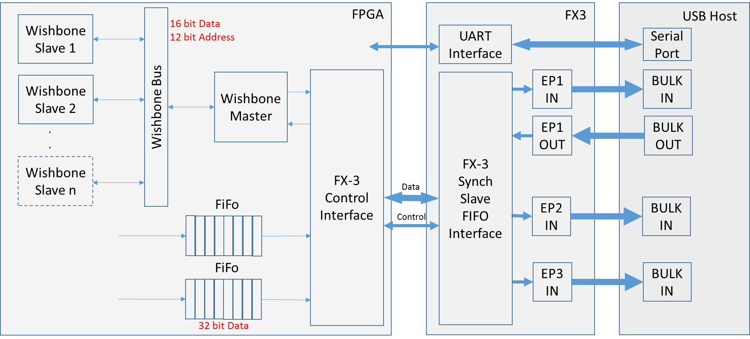
RUv0 USB Interface
FX3 firmware implements 3 endpoints: 1 IN/OUT, and 2 IN
FX3 interface to FPGA is via a synchronous slave FIFO
FPGA FX3 control interface module provides interface to FX3 firmware
FPGA FX3 control interface provides 4 FIFOs to the rest of the firmware: 1 input and 3 outputs
Wishbone master uses 1 in and 1 out FIFO to interpret USB data as wishbone transactions
The other 2 out FIFOs are used for (fast) bulk data transmission from FPGA to PC

Slide 20
GTX Data Readout Path for Inner Barrel
GTX Input
GTX
Transceiver
Comma Alignment
10B-8B
Decoder
1 bit
1200 MHz
20 bit
60 MHz
10 bit
120 MHz
10 bit
120 MHz
CDC
FIFO
PRBS
Checker
8 bit
120 MHz
Protocol
Checker
72 bit
120 MHz
8 bit
120 MHz
8 bit
120 MHz
CRU
Framer
Data Format
Idle Suppress
FIFO
16 kBytes
32 bit
120 MHz
| ……….. | ………. | ………. | ………. |
| Status | Byte2 | Byte1 | Byte0 |
USB

Slide 21
GPIO Data Readout Path for Outer Barrel
GPIO Transceiver 400 Mbps
GPIO input
Delay
delayed input
ISERDES
data enable
Comma Alignment
10B-8B
Decoder
1 bit
200 MHz
DDR
10 bit
40 MHz
10 bit
120 MHz
10 bit
120 MHz
CDC
FIFO
PRBS
Checker
32 steps
78ps resolution
8 bit
120 MHz
Replaces GTX Transceiver
Protocol
Checker
72 bit
120 MHz
8 bit
120 MHz
8 bit
120 MHz
CRU
Framer
Data Format
Idle Suppress
FIFO
16 kBytes
32 bit
120 MHz
| ……….. | ………. | ………. | ………. |
| Status | Byte2 | Byte1 | Byte0 |
USB

Slide 22
Data Path Resource Estimates
RUv0: Kintex-7
(from M. Bonora’s test firmware)
Target Device:
Current Full Implementation on RUv0:
Use all Alpide inputs available on RUv0 (< total 28 needed in final version):
12 GTX Data Receiver Paths
13 GPIO Data Receiver Paths
16k FIFO per Receiver Path
32bit 64k FIFO per USB High-Speed Bulk data port
Logic also contains other firmware modules (e.g. USB, FX3 I/F, I2C, …)
Kintex Ultrascale (XCKU060)
Maximum Resource Usage: Layers 5 & 6
28 GPIO Data Receivers
Resource | Used | Available | Util. %
LUT | 20650 | 331680 | 6%
FF | 40404 | 663360 | 6%
BRAM | 356 | 1080 | 33%
Resource | Used | Available | Util. %
LUT | 22354 | 203800 | 11%
FF | 42492 | 407600 | 10%
BRAM | 287 | 445 | 64%
To estimate the effect of e.g. TMR, simply implement 3 times the actual data paths:
84 GPIO Data Receivers
Resource Usage GPIO vs GTX Data Path
Resource | Used | Available | Util. %
LUT | 58177 | 331680 | 18%
FF | 115106 | 663360 | 17%
BRAM | 832 | 1080 | 77%
 | LUT | FF | BRAM
GPIO Readout | 620 | 1350 | 6.5
GTX Readout | 800 | 1680 | 6.5

