Slide 1
Testing Plans
P. Giubilato, M. Rossewij, J. Schambach

Slide 2
Overview of Testing Procedures
A total of 222 boards will be manufactured for ITS (+ 88 for MFT)
Testing will be done in a 3-stage approach:
  Testing at the manufacturer
  Board bring-up and initial hardware verification at Nikhef/Utrecht
  Functional Testing at 3-4 collaborator sites
We will investigate the possibility & cost of shifting some tests from Nikhef to the board manufacturer

Slide 3
Testing at Manufacturer
PCB Testing:
  Visual inspection (metallographic cuts, thickness of board, …
  Electrical Connectivity Test (flying probes test)
  Controlled Impedance Testing
Assembly Testing:
  Correct placement of parts
  Soldering Quality
  X-ray of BGAs
  Automated Optical Inspection (AOI)
Initial Powering and Testing for shorts
All inspections will be in accordance with IPC-A-610 Class-2 specifications

Slide 4
Testing at Nikhef/Utrecht
Power on test: Voltages & Current verification
Verify I2C bus for GBTx configuration; fuse all GBTx chips
Read out Voltages, Currents, and temperature values via SCA
JTAG configuration of Ultrascale & Microsemi FPGAs
Check FX3/USB3 interface:
  Use Cypress USB “Control Center” application to verify connection over USB
  Use Control Center to program FX3 boot PROM

Slide 5
Functional Testing at Collaborator Sites
Test the various I/Os and internal connections of the board
Uses a custom board to interface to the various I/Os
Testing will be scripted to provide a “yes/no” type result
Failing boards will be returned to Nikhef/Utrecht for further trouble shooting

Slide 6
Readout Unit Overview

Slide 7
I/O lines to be tested in functional test
Purpose | Number | Electrical Standard | Direction | Receiving/sending Chip | Termination | Nominal Speed | Notes
I2C | 8 | MLVDS | Input | SN65MLVD080DGG | 100 Ohm | 200kbps | on Power Mezz
I2C | 8 | MLVDS | Output | SN65MLVD080DGG | 100 Ohm | 200kbps | on Power Mezz
HS Data | 28 | LVDS | Input | Ultrascale GPIO | AC-Coupled -100 | 600Mbps | on transition board to GPIO
HS Data | 9 (28?) | LVDS | Input | Ultrascale GTH | AC-Coupled -100 | 1.2Gbps | on transition board to MGT
DCLK | 5 | MVLDS | Output | SN65MLVD080DGG |  | 40MHz | on transition board
DCTRL | 5 | MVLDS | Input/Output | SN65MLVD080DGG |  | 80MHz | on transition board
FiberOptic | 3 | Optical | Output | GBT VTRx/VTTx |  | 4.8Gbps | Multimode GBT protocol
FiberOptic | 1 | Optical | Input | GBT VTRx |  | 4.8Gbps | Multimode GBT protocol
FiberOptic | 1 | Optical | Input | GBT VTRx |  | 4.8Gbps | SingleMode GBT protocol
Busy | 1 | LVDS | Input | Ultrascale GTH |  | 1.2Gbps | Aux connector
Busy | 1 | LVDS | Output | Ultrascale GTH |  | 1.2Gbps | Aux connector
AUX | 4 | LVDS | Input/Output | Ultrascale GPIO |  | ? | Aux connector
USB | 1 | USB-3 |  |  |  |  | To be tested with Host computer
CANbus | 1 | CAN 2 wire | Input/Output | TPS3306-15D | 120 Ohm |  | To be tested with Host computer
JTAG |  |  |  |  |  |  | Test programming of 2 FPGAs
FX3 EEPROM |  |  |  |  |  |  | Test programming through FX3
I2C |  |  |  |  |  |  | Test programming of GBTx chips

Slide 8
Suggested Tests for Functional Testing
JTAG: Program testing firmware to 2 FPGAs via JTAG; verify running firmware (e.g. blinking LEDs)
USB: verify communication between host computer & FPGA via FX3
I2C: generate PRBS pattern @200kbps on 8 outputs (SCL_w, SDA_w), receive on 8 inputs (SCL_r, SDA_r)
GBT: GBT_FPGA on test board, generate PRBS on TX, receive PRBS on RX
Alpide Data lines: Transceiver IP with 28 RX; generate 1.2Gbps test pattern with OSERDES @ 600MHZ DDR; receive PRBS on Transceiver RX
DCTRL, DCLK: Generate 80Mbps PRBS on DCLK; receive PRBS on DCTRL
BUSY: Loopback PRBS patterns from OUT to IN, using transceivers?
PA3-Flash I/F: Read Flash ID; read & catalogue “bad blocks” (page 0)
“Serial Number”: Read and catalogue UltraScale FPGA DNA value as unique identifier for Readout Unit
CANbus: Connect USB CAN dongle to host computer, send and receive simple CAN packets @ 1Mbp
Ultrascale-PA3 I/F: Send & receive test patterns
SelectMap I/F: PA3 reads US SelectMap ID

Slide 9
Simple Test System Concept
Possibly integrate into 1 board?
RUv2
28 MGT
1.2Gbps
FPGA running custom testing firmware to generate & check PRBS patterns for loopback boards
Loopback Board
28 LVDS
Transition Bd
80Mbps
5 MVLDS
e.g. KCU105 running GBT_FPGA
+ CRU emulator firmware
To be developed
5 MVLDS
FPGA Devkit
Fiber
Mezzanine
Fiber OUT
4.8Gbps
Fiber OUT
FPGA running GBT firmware with PRBS test pattern RX and TX
Fiber OUT
Fiber IN
Fiber IN SM
8 MVLDS
USB / Ethernet
FPGA running custom testing firmware to generate PRBS patterns for loopback boards
Loopback Board
200kbps
Power Mezz
Host Computer
8 MVLDS
USB-3
CAN Dongle
CAN
JTAG Programmer
JTAG

Slide 10
Possible Dev-Kits

Slide 11
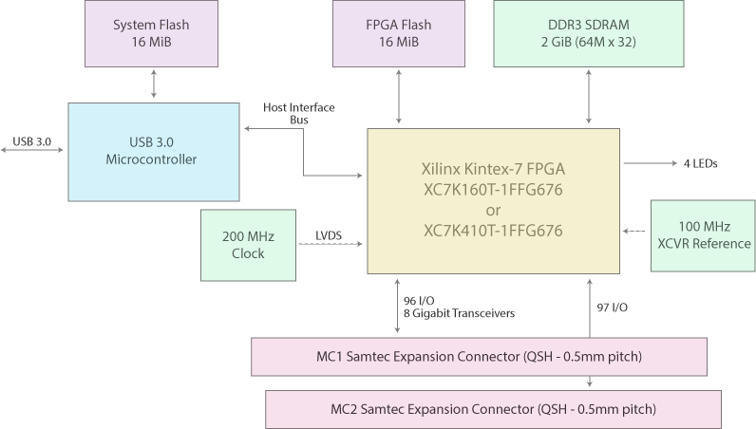
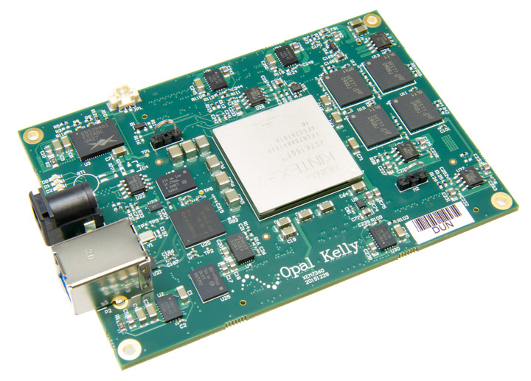
Opal Kelly XEM7360
https://www.opalkelly.com/products/xem7360/
$1,699.95 (+ $129.95 for breakout board)

Slide 12
Backup Slides

Slide 13
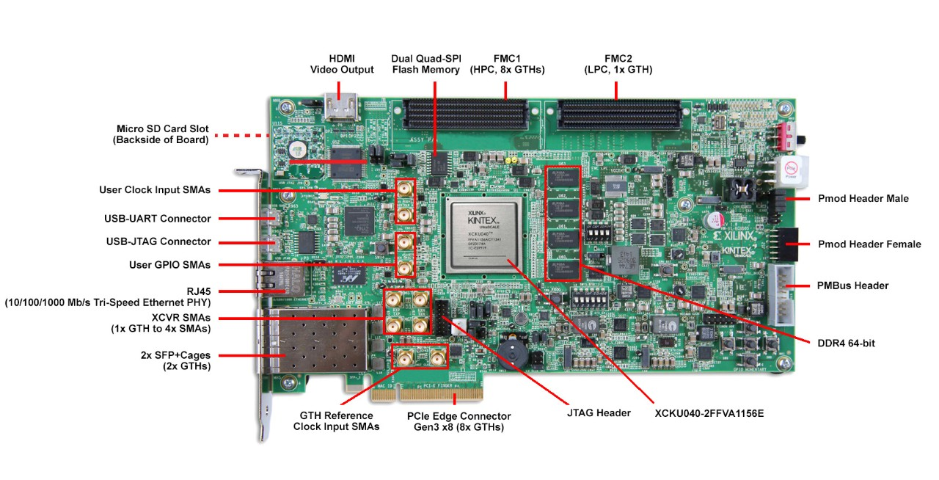
Xilinx KCU105 Evaluation Kit
https://www.xilinx.com/products/boards-and-kits/kcu105.html
$2,995

Slide 14
Expansion Connectors
FMC-HPC (Partial Population) connector (8 GTX Transceiver, 114 single-ended or 57 differential (34 LA & 24 HA) user defined signals)
FMC-LPC connector (1 GTX Transceiver, 68 single-ended or 34 differential user defined signals)
Communication & Networking
Gigabit Ethernet GMII, RGMII and SGMII
2x SFP / SFP+ cage
GTX port (TX, RX) with four SMA connectors
UART To USB Bridge
PCI Express x8 edge connector

Slide 15
Avnet AES-KU040-DB-G
https://www.avnet.com/shop/us/products/avnet-engineering-services/aes-ku040-db-g-3074457345630043740/
$995

Slide 16
Interfaces
Two SFP+ Sockets (up to 12.5Gbps)
Two GTH SMA Interfaces (up to 11.25Gbps)
Two 10/100/1000 Ethernet Interfaces (RGMII)
HDMI Interface
LVDS Touch Panel Interface
FMC HPC Slot (VADJ of 1.8V, 2.5V, 3.3V) with 8 GTH lanes (up to 12.5Gbps)
Four Single Ended Pmod™-Compatible Sockets
USB-UART Interface
8 User LEDs
5 User Push Button Switches
8 User Slide Dip Switches
Analog SYSMON Interface

Slide 17
Some Example Tests already being performed

Slide 18
US <-> PA3 LVDS and GPIO communication
Ultrascale-ProAsic3 Interface consists of 10 diff pairs (5xLVDS out and 5x LVDS in) and 12 SE IOs.
US
PA3
LED
DDR
Lvds
In
5 LVDS pairs
160, 80, 40,
20, 10 MHz
Lvds
out
5 bits
compare
Counter
4bit
DDR
Lvds
out
LvdsIn
XTAL
160 MHz
5 LVDS pairs
160, 80, 40,
20, 10 MHz

Slide 19
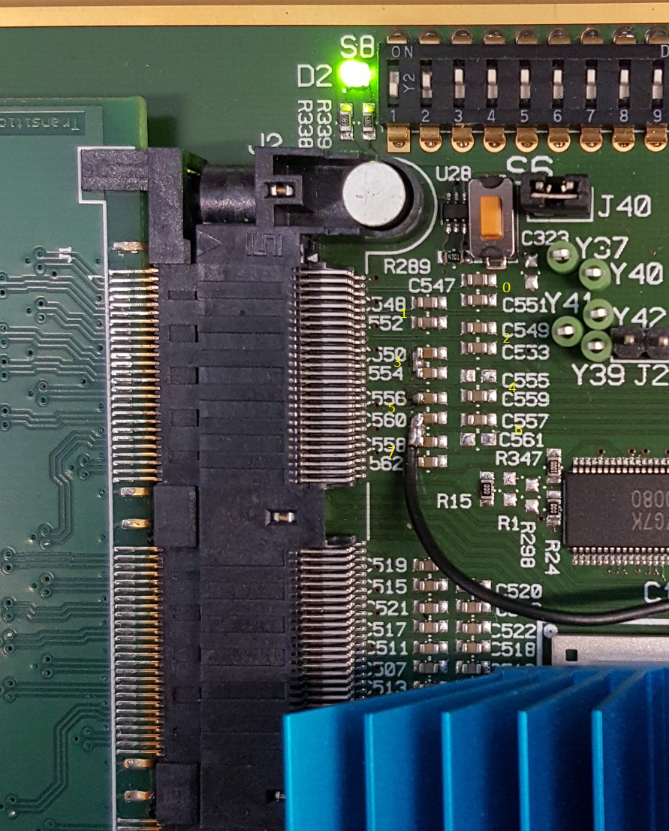
Transitionboard (QMS/QFS) loopback test
For testing the connectivity (short/opens) of the RU transition-board connector, The University of Texas developed a loopback transition-board. It connects the 28 MGT inputs with 28 GPIO_LVDS outputs.
Utrecht developed firmware for testing the connectivity. It generates 1.2Gbps PRBS7 signal on the LVDS outputs and utilizes the MGT PRBS checker to detect the errors. Tests showed the reduced driver swing and limited MGT input equalization is needed to detect all defects (open, shorts...)
Image shows all hardware faults intentionally introduced
The next slide shows under which conditions these faults were able to be detected.
The BUSY out/in was tested in a similar fashion

Slide 20
Transistionboard loopback test
Lowering driver voltage to SUB-LVDS and changing the receiver equalization and termination makes the error conditions visible:
GPIO Diver |  | LVDS | SUB-LVDS
MGT Receiver | Equalize | DFE |  | LPM
 | Termination | 800mV |  |  | 100mV | 1100 | GND | AVTT | Float | Float
 | Coupling | AC |  |  |  |  |  |  |  | DC
0...2 | OK | 700 | 270
 |  |  |  |  |  |  |  |  |  | OK
3 | Short | 0 | 0
 |  |  |  |  |  |  |  |  |  | OK
4 | Neg open | 240 | 90
 |  |  |  |  |  |  |  |  |  | OK
5 | Pos=>GND | 360 | 135
 |  |  |  |  |  |  |  |  |  | OK
6 | Pos open | 270 | 110
 |  |  |  |  |  |  |  |  |  | OK
7 | Neg=>GND | 300 | 130
 |  |  |  |  |  |  |  |  |  | Ok
8 | Stub
 |  |  |  |  |  |  |  |  |  | Ok

Slide 21
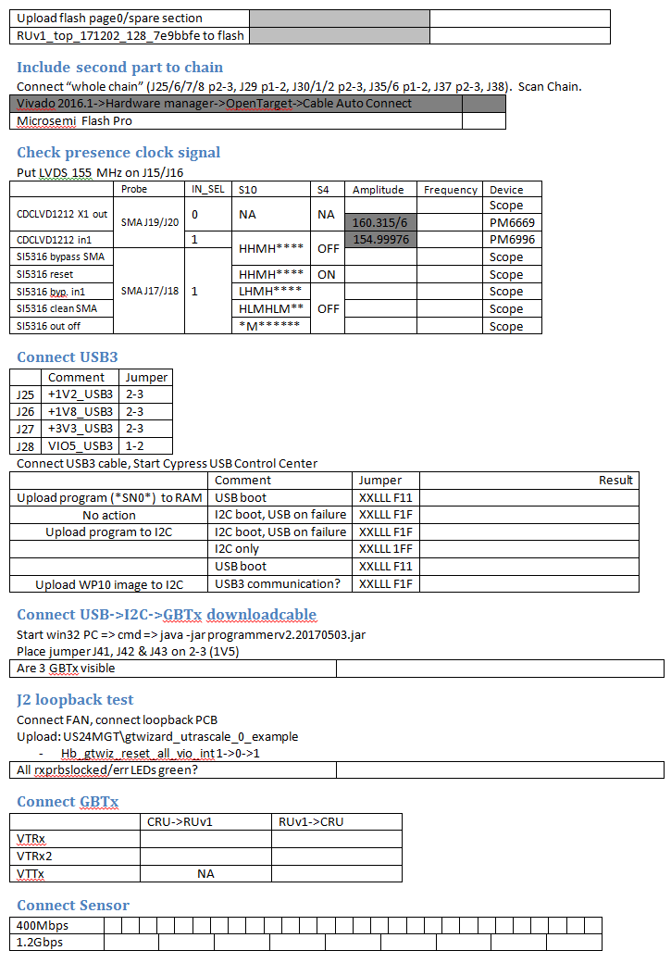
Example of Test Sheet used at Utrecht for RUv1

