Slide 1
RUv1 characterization
Marcel Rossewij
Overview & results all test activities
Jitter introduced by scrubbing
Power supply (LMZ31710 DCDC regulator)
Currents during Power-on and after configuration
Magnetic field tests
Spare slides
DC-Accuracy and voltage drop
Noise (time & frequency domain)
Sense Amplifier offset error
Clock generation/cleaner/distribution performance

Slide 2
RUv1 tested functionalities (1)
RU power section
7 DCDC regulators (accuracy, noise, ripple, Inrush, sequencing)
I_{SENSE} offset problem solved by replacing amp AD626=>AD8418
Communication with sensors/Alpide using transition board & firefly
CLOCK, CONRTOL, DATA @ 1.2Gbps and 400 Mbps
Communication via 4.8 Gbps GBT links (GBTx/1/2, VTRx/VTTx)
Acces & program GBTx using Cern USBI2C dongle (connector bug)
Communication with the SCA-chip
monitor voltage/current, temperature, VTRx optical power
I2C, JTAG, GPIO interface
Clock distriburtion: jitter/levels on crystal oscillators, jitter cleaner and clock buffer
USB3 (using FX3 chip) communication & boot from I2C PROM
JTAG chain (primary US & PA3 program, secondary FX3 & GBTX/1/2)
Program Xilinx US with PA3 via select map interface

Slide 3
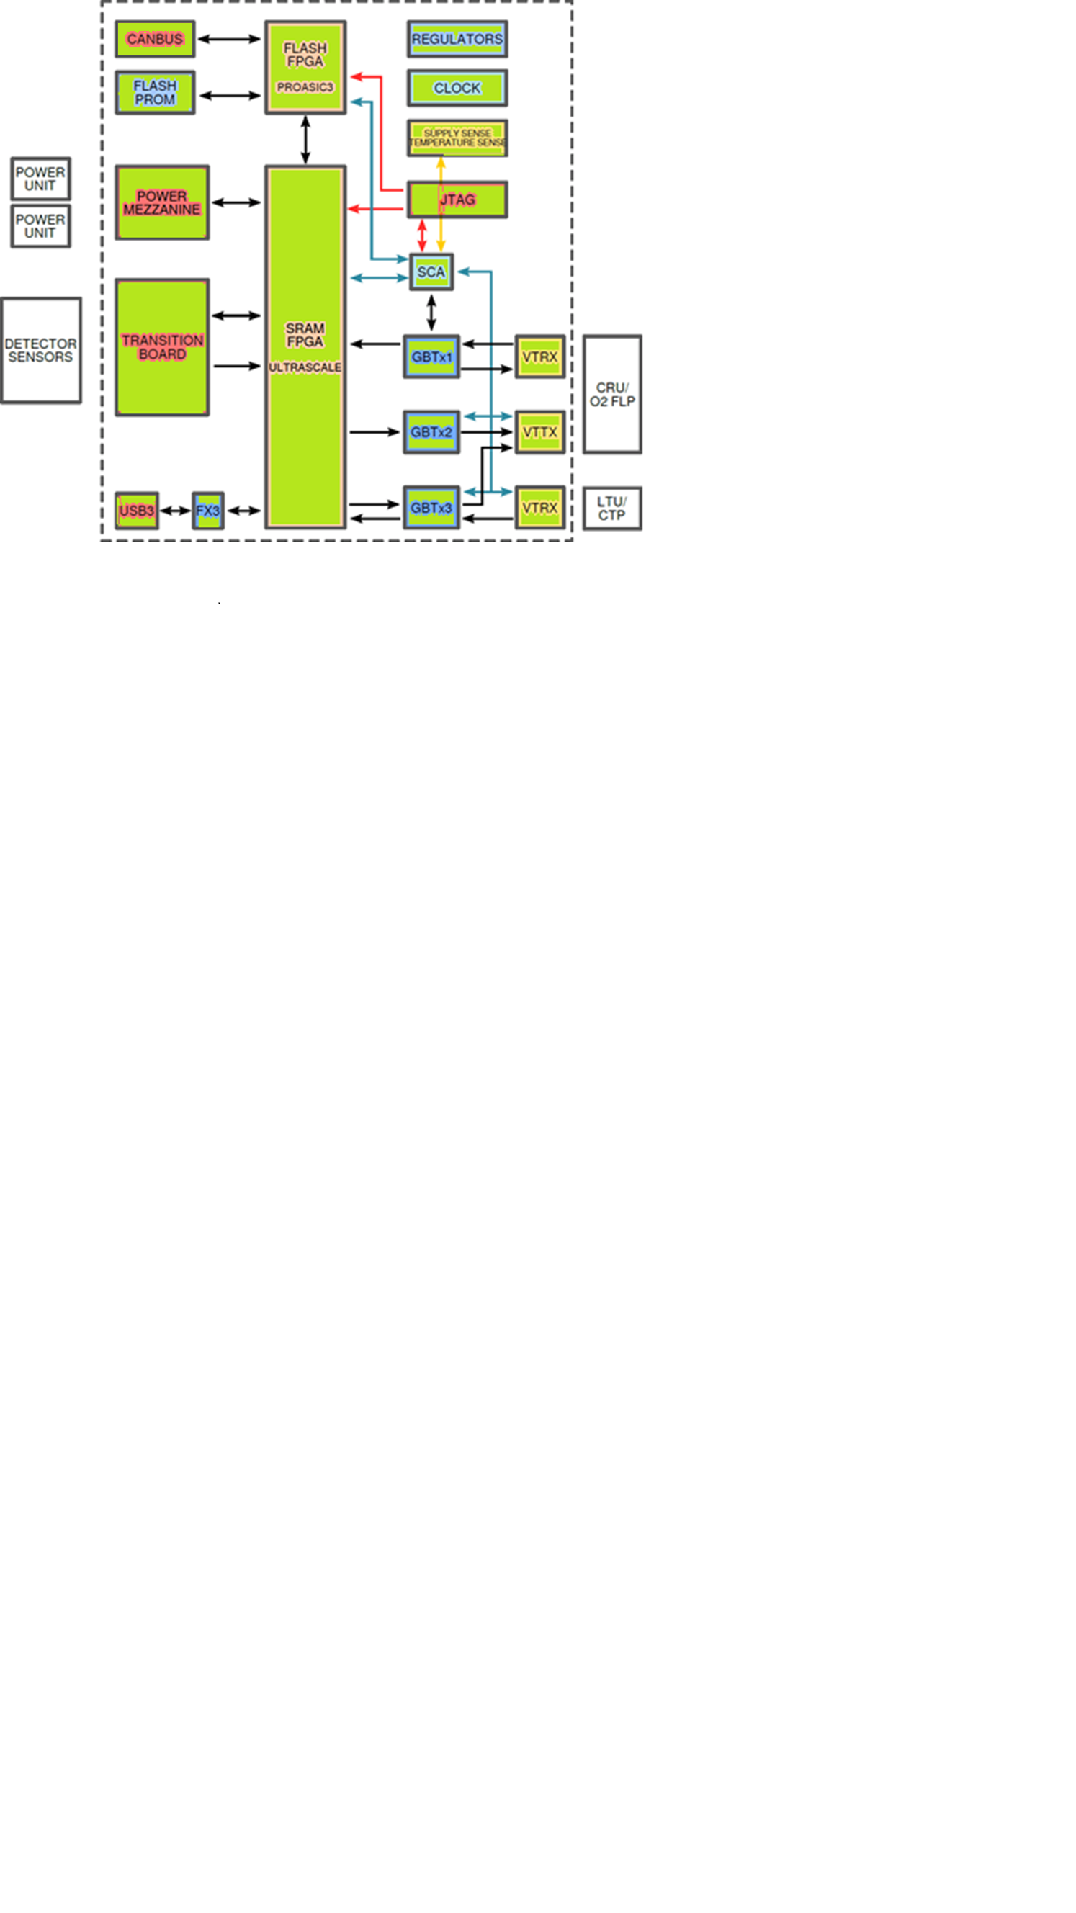
RUv1 tested functionalities (2)
Communication with the PU using front pannel I2C
FLASH PROM (access, read-ID, read & write)
CAN transceiver

Slide 4
RUv1 testes functionalities detailed (1)
Green=Successfully tested, Yellow= not tested, low prio, Grey=Still to be tested
 |  |  | Assigned to | Status | Priority
Polyswitch fuse | F1…F3 | Check hold/trip limits |  |  | Low
Polarity protection | D3 | Check operation |  |  | Low
DC-DC Regulator Input: 5V or 12V | U10…U16 | Functional/Operation | MR | Done | High
 |  | Accuracy | MR | Done | High
 |  | Noise/ripple (RMS) | MR | Done | Medium
 |  | Noise (frequency) | MR | Done | Medium
 |  | Line/load regulation |  |  | Medium
 |  | Efficiency |  |  | Medium
 |  | Switching frequency | MR | Done | Medium
 |  | Current/Temp protection |  |  | Low
 |  | Startup-Sequencing (PWRGD/Inhibit) |  |  | High
GBTx/SCA Reset | S5 | Reset by PWRGD 1V5 |  |  | High
Current sense circuit | U20…U26 | Functional/Operation | MR | Done | High
 |  | Gain & Accuracy | MR | Done | Medium
 |  | Offset | MR | Done | High => change Amp
 |  | Noise |  |  | Low
 |  | Bandwidth |  |  | Low
 |  | CMRR (frequency) |  |  | Low
Inductor/plane Voltage drop | L15…18 L34…39 | Check within FPGA spec |  |  | High
LVDS 1:8 buffer | U17 | Functional/Operation | MR | Done | High
 |  | Output levels |  |  | Medium
 |  | Bandwidth |  |  | Low

Slide 5
RUv1 testes functionalities detailed (2)
 |  |  | Assigned to | Status | Priority
Jitter cleaner Power 3,3 or 2,5V PLL bandwidth | U18 | Functional/Operation (gets locked) | MR |  | High
 |  | Bypass-mode | MR |  | Medium
 |  | Output levels | MR |  | Medium
 |  | Jitter Attenuation (ps)/Loop bandwidth | MR |  | Medium
 |  | Phase noise plot |  |  | Low
XTAL | X1, X2 | Functional/Operation | MR | Done | High
 |  | Accuracy | MR |  | High
 |  | Enable | MR |  | Medium
 |  | Phase noise |  |  | Low
BUSY/AUX connector | J7 | Functional/Operation (Loopback) |  |  | High
 |  | Vary levels & data rates (e.g. BUSY) |  |  | High
 |  | Check attenuation (frequency) |  |  | Low
Alpide Interface | J2 | Check ITS connectivity |  |  | High
 |  | Check attenuation (frequency) |  |  | Low
 |  | Check data-rates/BER |  |  | Medium
 |  | MGT levels, emphasis & equalization |  |  | Medium
 |  | GPIO levels, emphasis & equalization |  |  | Medium
 |  | Fit FireFly holder |  |  | NA
US reset switch | S6 | Reset Xilinx US FPGA | MR | Done | Medium

Slide 6
Xilinx US FPGA | J10 | Functional operation (JTAG config) | MR | Done | High
 |  | Access select map register | At | Done | High
 |  | Configure FPGA via select map | Bergen |  | High
 |  | Scrubbing | Bergen |  | High
 |  | MGT (L&R) refclk (clkdes or local) | MR/Jo | Only local | High
 |  | fabric clk (clkdes or local) switch | Jo | Only local | High
 |  | SCA GPIO interface |  |  | High
 |  | GBTx I2C master interface | Jo | Done | High
 |  | SCA I2C slave interface |  |  | Low
 |  | SCA SPI slave interface |  |  | Low
 |  | PA3 SE interface functional |  |  | High
 |  | PA3 SE interface rates |  |  | High
 |  | PA3 diff interface functional |  |  | High
 |  | PA3 diff interface rates |  |  | High
 |  | Place Fan, enough clearance? Works? |  |  | High => move C169
SMA clk out | J21/J22 | Functional operation | MR | Done | Medium
Alpide DCLK/CTRL | U32, U33 | Functional operation | ML | Done all5 | High
 |  | Jitter effects due to triplicated output |  |  | Low
I2C Power board | U34,U35 | Functional operation | Jo | Done | High
 |  | CM/speed/level Margins MLVDS |  |  | Low, 1 kbit 1 meter
J1 Power board | U36,U37 | Functional operation |  |  | Low
FX3 reset | S7 | FX3 reset | MR | Done | Medium
FX3 | U5 | FX3 data interface functional | ML | Done | High
 |  | FX3 data interface endurance/BER |  |  | Medium
 |  | FX3 UART interface |  |  | High
 |  | FX3 I2C PROM boot | MR | Done | High
FX3 control switch | S9 | Boot mode | MR | Done | High

Slide 7
PA3 | U31 | Functional operation (JTAG config) | MR | Done | Priority
 |  | fabric clk (clkdes or local) | At | Only local | Low
 |  | SCA GPIO interface |  |  | High
 |  | SCA I2C slave interface |  |  | Medium
 |  | Jitter cleaner/buffer control | At/MR |  | Medium
 |  | PA3 resistor reset | Bergen | Fails | Medium =>failed
PA3 reset | U38 | PA3 reset circuit | Bergen | Done | High (fail with high dose)
Flash PROM | U30 | Access Flash Prom ID | At | Done | High
 |  | Perform write/read BER tests | At/JDS |  | High
CAN transceiver | U29 | Functional/Operation |  |  | High
 |  | Loopback-mode |  |  | Low
GBTx | U2 | I2C configuration (US/dongle) | Jo/MR/ML | Done | High
 |  | Data transmission | Jo/MR/ML | Done | High
 |  | Endurance/BER test |  |  | High (5 minutes)
 |  | GBTx Clkdes7 to GBTx1 refclk in | MR | Partly | High
VTRx1 | J3 | Functional operation (transmission) | Jo/MR/ML | Done | High
 |  | LD power via I2C (EC channel) |  |  | Low
 |  | RSSI1 (Photo power to SCA-ADC) |  |  | Low
GBTx/1/2 | U3/4 | I2C configuration (US/dongle) | Jo/MR/ML | Done | High
 |  | Data transmission | Jo/MR/ML | Partly | High
 |  | Endurance/BER test |  |  | High
VTTx | J4 | Functional operation (transmit) | Jo/MR/ML | Partly | High
 |  | LD power via I2C (SCA/US) |  |  | Low
VTRx2 | J5 | Functional operation (receive) | Jo/MR/ML | Partly | High
 |  | RSSI2 (Photo power to SCA-ADC) |  |  | Low
JTAG |  | Chain with US and/or PA3 | MR | Done | High
 |  | Include FX3 and GBTx/1/2 | MR |  | High

Slide 8
RUv1 testes functionalities detailed (5)
 |  |  |  |  | High
Header | J12 | Check GBTx fusing. Are needed: R277/R278 to disconnect SCA? R279, R282 & R285 fusepower R280, R283 & R286 prog. pulse |  | Remove R277/R278 Mirror header | High Header mirrored Fusing GBTx0 only
SCA | U1 | Access SCA via GBTx | Jo | ? | High
 |  | Analog (DCDC-V&I, RSSI, PT1000) |  |  | High
 |  | GPIO (PA3/US and US config signals) |  |  | High
 |  | I2C | Bergen |  | High
 |  | SPI | Jo |  | Low
 |  | SCA JTAG |  |  | High
JTAG |  | Chain with US and/or PA3 | MR | Done | High
 |  | Include FX3 and GBTx/1/2 | MR |  | High
PA3-Pinheader | J14 | Functional operation from PA3 | MR | Done | High
US-Pinheader | J13 | Functional operation from US | MR | Done | High
LEDs | J10 | Functional operation from US/PA3 | MR/At | Done | High
Switch/push button | S0…3,S8 | Functional operation to US/PA3 | MR/At | Done | High

Slide 9
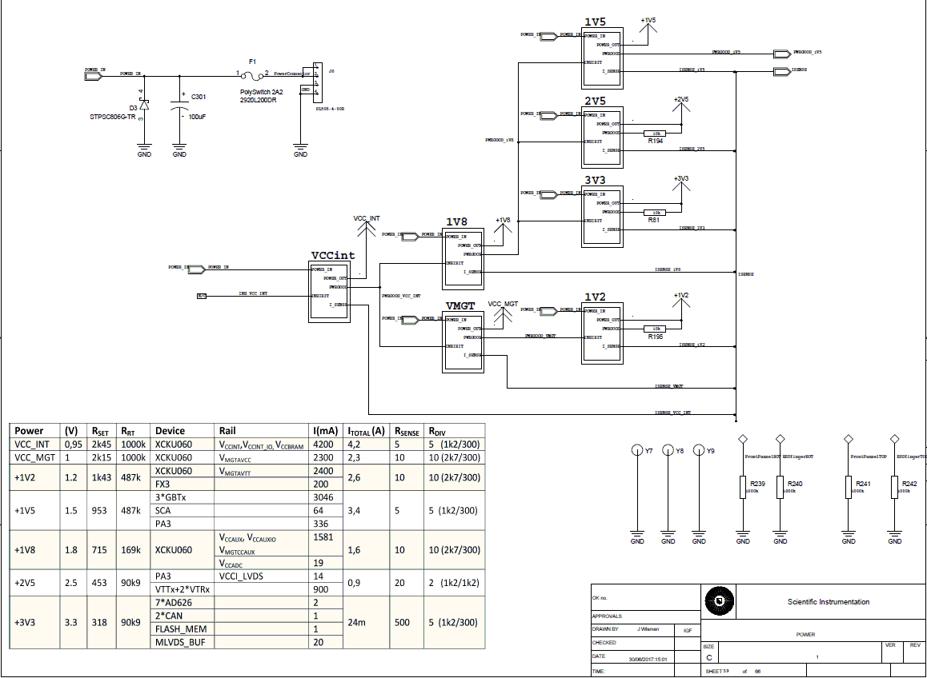
Power-on sequence

Slide 10
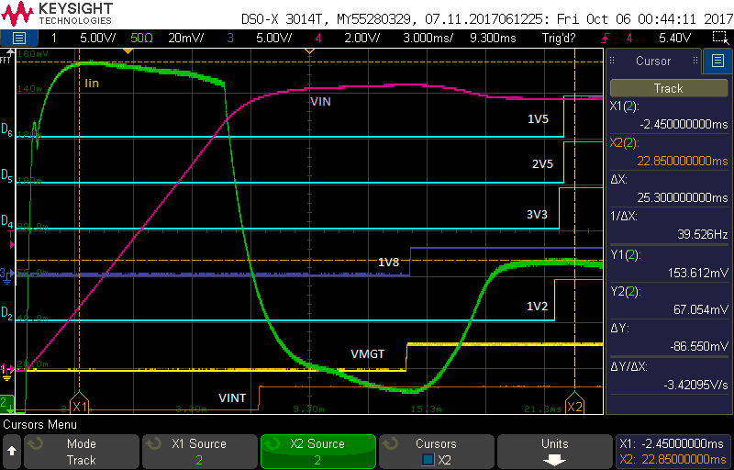

Slide 11
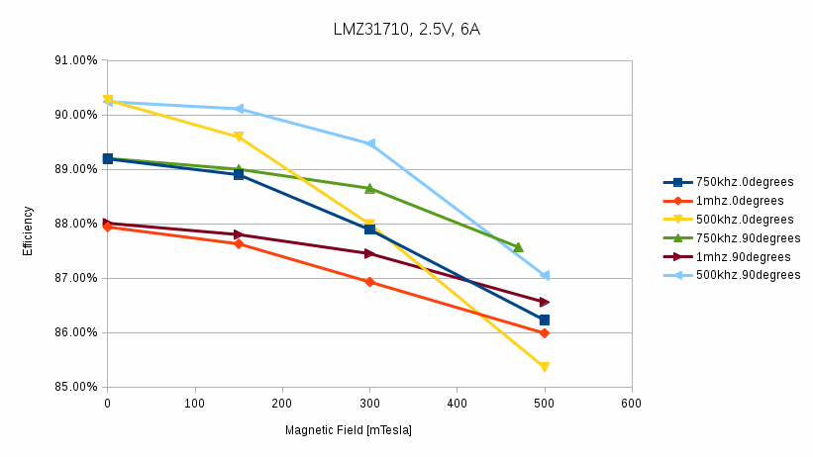
DCDC converter magnetic fied test
LMZ31710 tested under different magnetic field strenght, orientation and load conditions. Main conclusions:
LMZ31710 fully operational with B up to 0,5T at 0°and 90°
Efficiency slightly (4%) reduces with increase in B (even less with B at 90°)
Efficiency at higher switching frequencies less affected by presence of B
Ripple increases with B field (less with B at 90°)
No hysteresis effect: after applying 0,5T, efficiency comes back to start value

Slide 12
Jitter introduced by scrubbing
RUv1 showed increased jitter on its MMCM/PLL outputs when scrubbing is active. (giving DCLK jitter resulting in errors in the Alpide=>RU HSDATA communication)
Tests show same behaviour with Xilinx development boards having an ultrascale device (the jitter increase was not present with the kintex7 devices )
Next sheet shows an increase of the period to period jitter when scrubbing is active. The Jitter increase is non-gaussian (as RMS is hardly affected, mainly the pk-pk jitter).
Subsequent sheet shows that the deviant periods come every 3,25 sec for 0,75 sec
Jitter Issue mitigated by avoiding use of MMCM/PLL for generation of DCLK (fallback solution: employ PA3 PLL)
Board | Device | Jitter (idle) | Jitter (scrubbing)
RUv1 | US | 300 | 900
RUv0 | Kintex7 | 312 | 392
KCU040 | US | 168 | 1120
KCU105 | US | 150 | 850

Slide 13
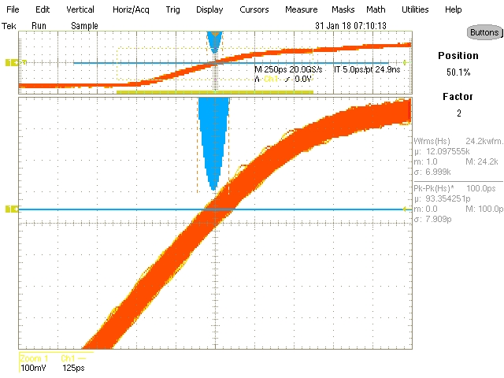
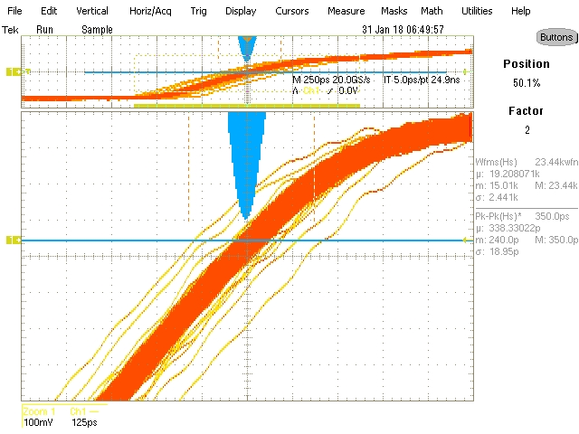
Scrubbing-Jitter Issues measured
RMS jitter (14 ps) hardly affected
Peak to peak jitter 100ps => 400ps (less than other)
Period deviations occurs once every few k-waveforms
Scrub | Tavg | Tmin | Tmax | Tp-p | σ | #cnt
OFF | 24,95 | 24,892 | 25,004 | 112ps | 13,6 | 300k
ON |  | 24,773 | 25,160 | 387ps | 13,7

Slide 14
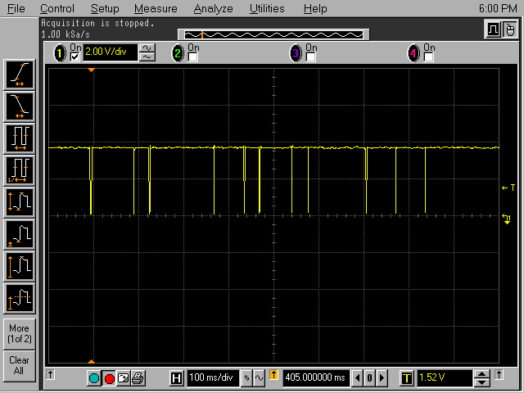
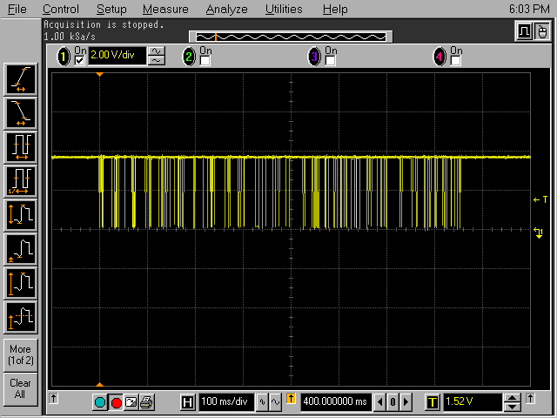
Managed to trigger on deviant periods
In continuous blind scrubbing mode:
Trigger counters indicated scrubcycle every 60/16=3,75 sec
Deviant period triggers occur every 0,75 sec of the 3,75 sec

Slide 15
RUv1 characterization
Utrecht University: Marcel Rossewij, Jody Wisman
NIKHEF: Jan-David Schipper, Paul Kuijer

Slide 16
Measurement results
Power supply (LMZ31710 DCDC regulator)
DC-Accuracy and voltage drop
Noise (time & frequency domain)
Currents during Power-on and after configuration
Sense Amplifier offset error
Clock generation/cleaner/distribution performance

Slide 18
Power up configuration
0,5

Slide 19
Voltage variation among different RUv1
rail | Xilinx US |  |  | DCDC set |  | RUv1_0 SN: |  |  |  |  |  | AVG | STD | AVG-Vo | ‰ | max | max-MAX | min | min-MIN | max-min
 | MIN | typ | MAX | Rset | Vo | 3 | 4 | 5 | 6 | 7 | 8 | 3-8 | mV | mV |  | 3-8 | mV | 3-8 | mV | mV
VINT | 0,922 | 0,95 | 0,979 | 2400 | 0,958 | 0,961 | 0,963 | 0,963 | 0,965 | 0,961 | 0,961 | 0,962 | 1,6 | 4,8 | 5 | 0,965 | 14 | 0,961 | 39 | 4
VMGT | 0,98 | 1 | 1,03 | 2100 | 1,009 | 1,013 | 1,015 | 1,013 | 1,015 | 1,013 | 1,014 | 1,014 | 1,0 | 5,3 | 5 | 1,015 | 15 | 1,013 | 33 | 2
1V2 | 1,18 | 1,2 | 1,23 | 1400 | 1,213 | 1,217 | 1,218 | 1,218 | 1,219 | 1,22 | 1,213 | 1,218 | 2,4 | 4,6 | 4 | 1,22 | 10 | 1,213 | 33 | 7
1V8 | 1,752 | 1,8 | 1,854 | 715 | 1,800 | 1,81 | 1,81 | 1,81 | 1,806 | 1,811 | 1,814 | 1,810 | 2,6 | 10,2 | 6 | 1,814 | 40 | 1,806 | 54 | 8
3V3 | 3,2 | 3,3 | 3,4 | 316 | 3,315 | 3,335 | 3,336 | 3,325 | 3,318 | 3,328 | 3,324 | 3,328 | 6,9 | 12,5 | 4 | 3,336 | 64 | 3,318 | 118 | 18
2V5 | 2,375 | 2,5 | 2,625 | 453 | 2,494 | 2,497 | 2,503 | 2,51 | 2,504 | 2,505 | 2,5 | 2,503 | 4,4 | 9,1 | 4 | 2,51 | 115 | 2,497 | 122 | 13
1V5 | 1,35 | 1,5 | 1,65 | 931 | 1,522 | 1,528 | 1,528 | 1,527 | 1,527 | 1,529 | 1,525 | 1,527 | 1,4 | 5,7 | 4 | 1,529 | 121 | 1,525 | 175 | 4
Measurement device: Keithley 2100
The averaged measured voltages differ up to 6 ‰ from expected
All voltages well in MIN/MAX limits. 1V2 closest (10mV) to limits
(The VMGT/1V2/VAUX MIN values are corrected for the voltage drop)

Slide 20
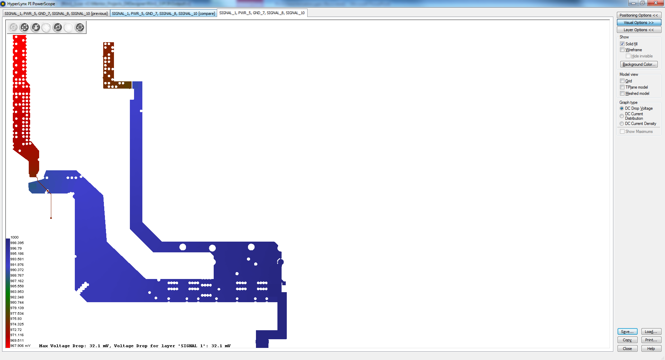
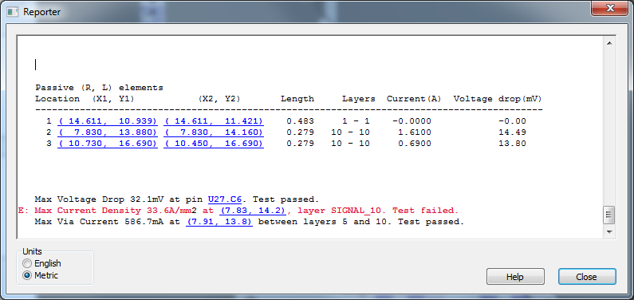
Hyperlynx DC drop analysis VMGT

Slide 21
RUv1_0 (SN3) Voltage (drop over L) measurements
 | min | typ | max | Rset | Vo | location |  | US empty | diff (mV) | Measured (mv) |  | US loaded | diff (mV) | Measured (mV) | diff Loading
VINT | 0,922 | 0,95 | 0,979 | 2400 | 0,958 | Y10 |  | 0,95985 |  |  |  | 0,95893 |  |  | -0,9
VMGT | 0,97 | 1 | 1,03 | 2100 | 1,009 | Y11 |  | 1,01211 |  |  |  | 1,011 |  |  | -1,1
MGTAVCCL | 0,97 | 1 | 1,03 |  |  | L15 | 1,01162 | 1,01125 | -0,4 | 0,6 | 1,00997 | 1,00953 | -0,4 | 0,26 | -1,7
MGTAVCCR | 0,97 | 1 | 1,03 |  |  | L37 | 1,01137 | 1,01089 | -0,5 | 0,6 | 1,00438 | 0,99948 | -4,9 | 4,7 | -11,4
 | 0,97 | 1 | 1,03 |  |  | L34 | 1,01143 | 1,01089 | -0,5 | 0,4 | 1,00437 | 0,99925 | -5,1 | 4,9 | -11,6
1V2 | 1,17 | 1,2 | 1,23 | 1400 | 1,213 | Y12 |  | 1,2151 |  |  |  | 1,2138 |  |  | -1,3
MGTAVTTL | 1,17 | 1,2 | 1,23 |  |  | L16 | 1,2151 | 1,215 | -0,1 | 0,2 | 1,2133 | 1,2132 | -0,1 | 0,1 | -1,8
MGTAVTTR | 1,17 | 1,2 | 1,23 |  |  | L38 | 1,215 | 1,215 | 0,0 | 0,16 | 1,2092 | 1,2061 | -3,1 | 2,9 | -8,9
 | 1,17 | 1,2 | 1,23 |  |  | L36 | 1,215 | 1,215 | 0,0 | 0,15 | 1,209 | 1,206 | -3,0 | 2,9 | -9,0
1V5 | 1,35 | 1,5 | 1,65 | 931 | 1,522 | Y16 |  | 1,5258 |  |  |  | 1,5256 |  |  | -0,2
1V8 | 1,746 | 1,8 | 1,854 | 715 | 1,800 | Y13 |  | 1,8071 |  |  |  | 1,8061 |  |  | -1,0
VCCAUX | 1,746 | 1,8 | 1,854 |  |  | L18 | 1,805 | 1,802 | -3,0 | 3 | 1,8009 | 1,7964 | -4,5 | 4,7 | -5,6
MGTAUXL | 1,75 | 1,8 | 1,85 |  |  | L35 | 1,806 | 1,806 | 0,0 | 0,1 | 1,8025 | 1,8025 | 0,0 | 0,15 | -3,5
MGTAUXR | 1,75 | 1,8 | 1,85 |  |  | L17 | 1,8053 | 1,8053 | 0,0 | 0,13 | 1,8014 | 1,8014 | 0,0 | 0,2 | -3,9
2V5 | 2,375 | 2,5 | 2,625 | 453 | 2,494 | Y15 |  | 2,4929 |  |  |  | 2,4926 |  |  | -0,3
3V3 |  | 3,3 |  | 316 | 3,315 | Y14 |  | 3,3319 |  |  |  | 3,3312 |  |  | -0,7
VMGT/1V2/VAUX: Measured LDROP (firmware active) up to 12/9/6 mV
Hyperlynx analysis give: LDROP 16/15/12 mV (more MGTs active)

Slide 22
DCDC converter output noise measurements
RU_DCDC
US configured
Scope
Keysight
DSO-x 3014
High-res
Vout (J1x)
Diff amp.
Lecroy
DA1855A
100MHz
GND (Jx)
Spectrum analyser
R&S FSL06
x corresponds to DCDC regulator 0...6

Slide 23
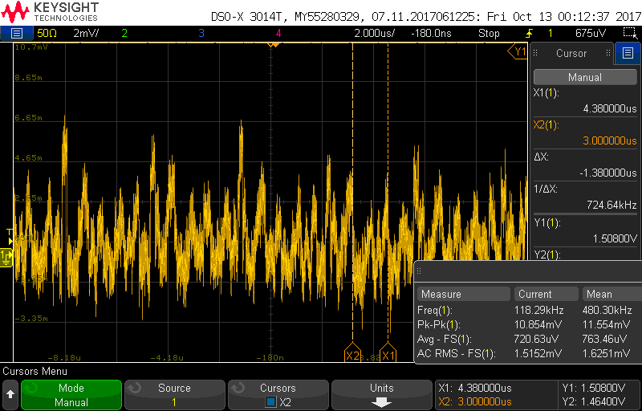
Scope measurement 2V5
Vavg=2,4467V, AC_RMS=1,63mV, fRIPPLE=724kHz

Slide 24
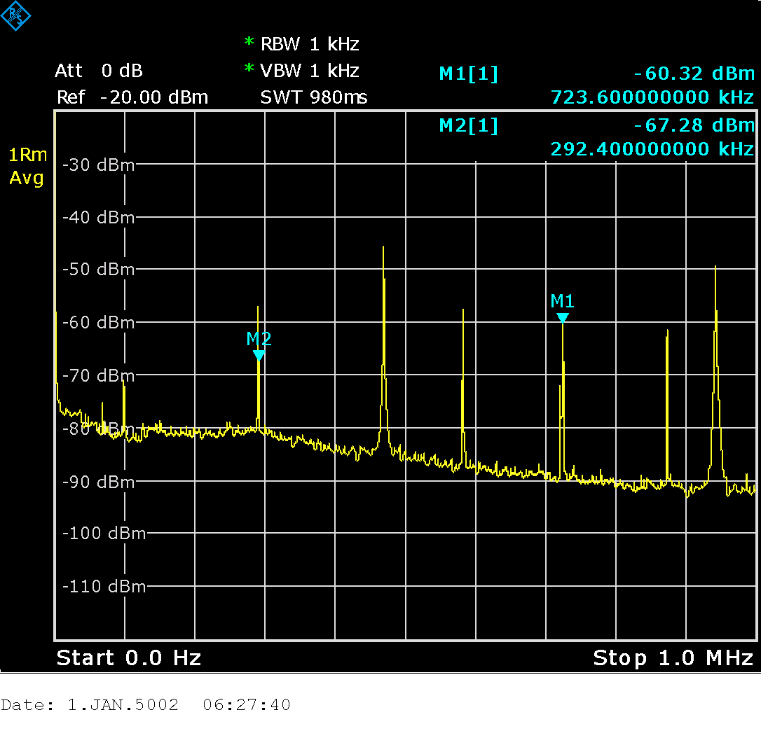
Spectrum analyser measurement 2V5 (fFUNDAMENTEL=293 kHz)

Slide 25
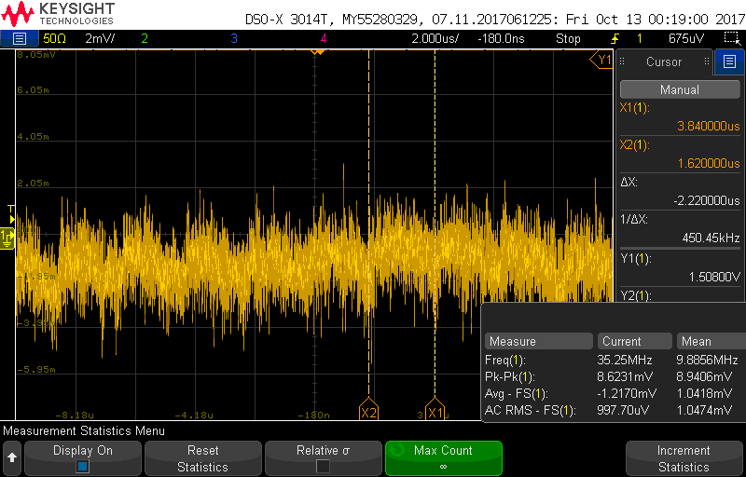
Scope measurement 1V8
AC_RMS=1,05mV, fRIPPLE=450kHz

Slide 26
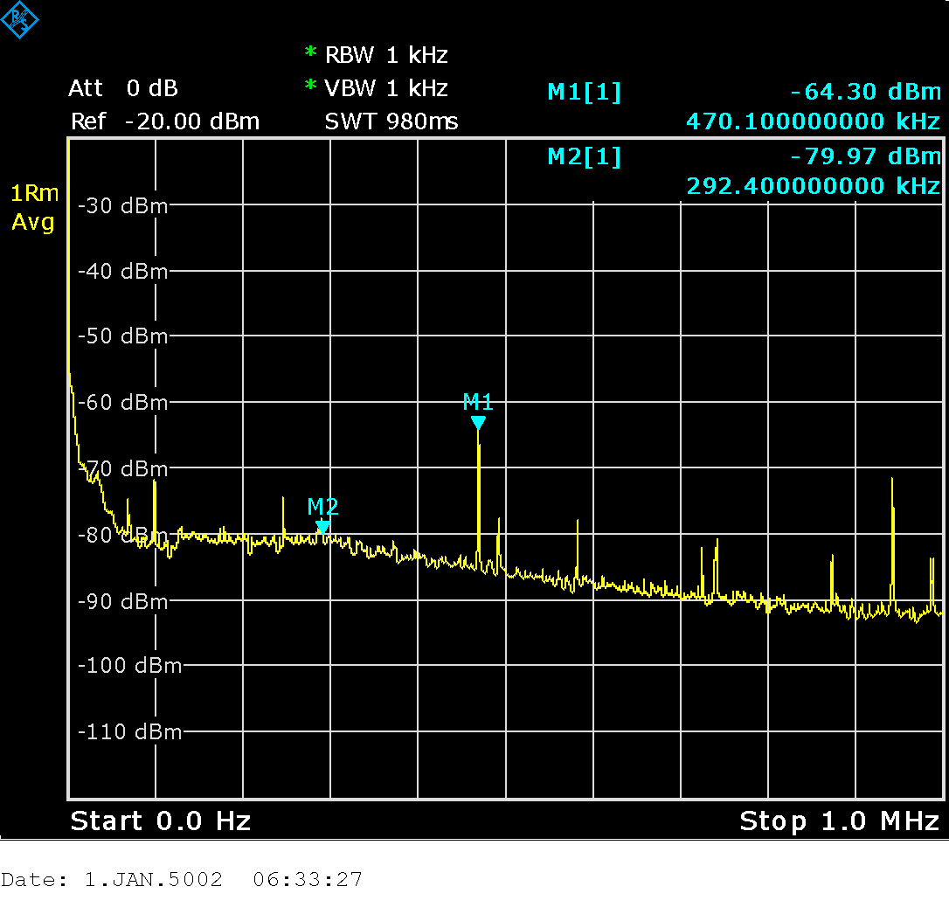
Spectrum analyser measurement 1V8 (fDOMINANT=470 KhZ)

Slide 27
Power Rail noise Measurement summary
X | Rail | Scope VAVG | Scope AC-RMS | Scope pk-pk | Scope fRIPPLE (kHz) | SA-freq Dominant (kHz) | SA-dBm Dominant | US requirement
0 | VCCINT | 0,948 | 0,97 | 7,7 | 245 | 246 | -58
1 | VMGT | 1,00 | 1,19 | 9,5 | 245 | 246 | -58 | <10mVpp
2 | 1V2 | 1,199 | 1,07 | 8,6 | 290 | 292 | -63 | <10mVpp
6 | 1V5 | 1,51 | 1,34 | 12,5 | 245 | 246 290 | -60 -57
3 | 1V8 | 1,78 | 1,05 | 8,9 | 450 | 470 | -64 | <10mVpp
5 | 2V5 | 2,46 | 1,63 | 11,5 | 790 | 470 723 | -46 -60
4 | 3V3 | 3,29 | 0,84 | 7,5 | 290 | 292 | -71
Actual noise/ripple likely lower due to probe pick-up
Noise below (<10mV) the US requirements

Slide 28
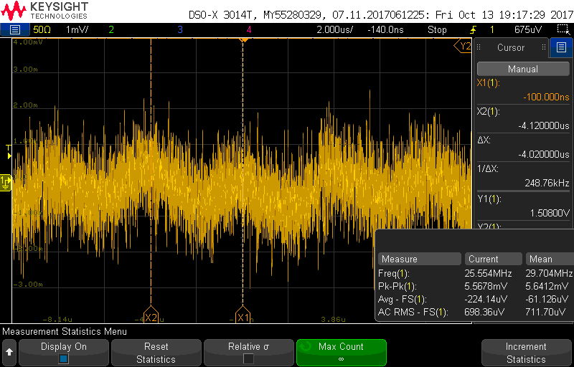
Scope measurement MGT_AVCC_R
Vavg=0,98V, AC_RMS=0,71mV, fRIPPLE=249 kHz

Slide 29
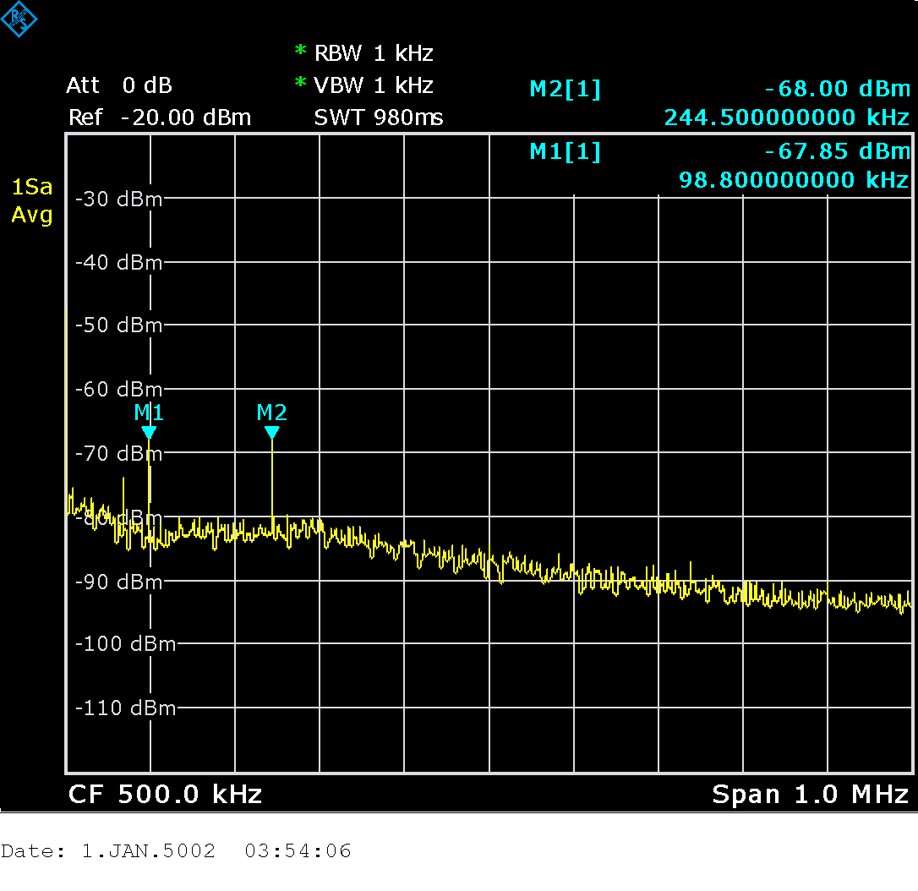
Spectrum analyser measurement MGT_AVCC_R (f=245kHz, 99 kHz)

Slide 30
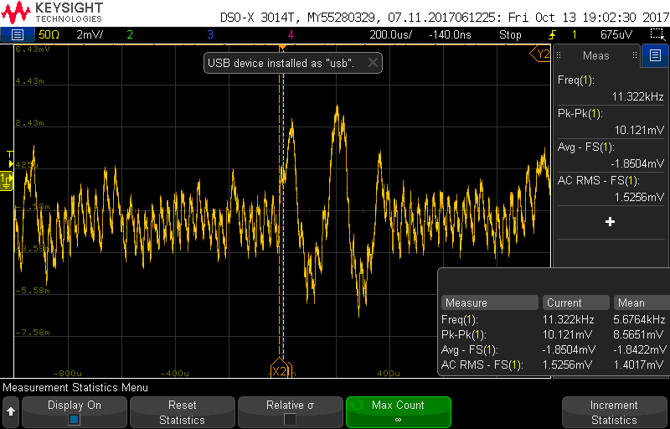
Scope measurement VMGT_AUX_R
AC_RMS=1,4mV, fRIPPLE=33kHz

Slide 31
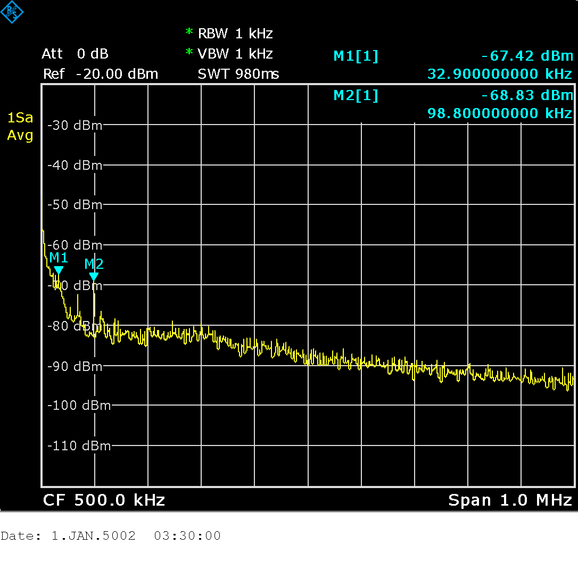
Spectrum analyser measurement VMGT_AUX_R

Slide 32
Noise on US sensitive rail. Measurement summary
Rail | Scope VAVG | Scope AC-RMS | Scope pk-pk | Scope fRIPPLE (kHz) | SA-freq Dominant (kHz) | SA-dBm Dominant
MGTAVCC_L | 1,00 | 0,69 | 5,8 | X | 99 | -68
MGTAVCC_R | 0,98 | 0,71 | 5,6 | 248 | 99 245 | -68 -68
MGTAVTT_L | 1,18 | 0,67 | 5,34 | X | 99 | -68
MGTAVTT_R | 1,18 | 0,73 | 5,7 | X | 99 | -68
MGTVCCAUX_L | 1,76 | 1,4 | 8 | 33 | 33 | -66
MGTVCCAUX_R | 1,76 | 1,4 | 8 | 33 | 33 | -67
Actual noise/ripple likely lower due to probe pick-up
UG576 table 5-9: noise <10mVpp
All noise/ripple within limits

Slide 33
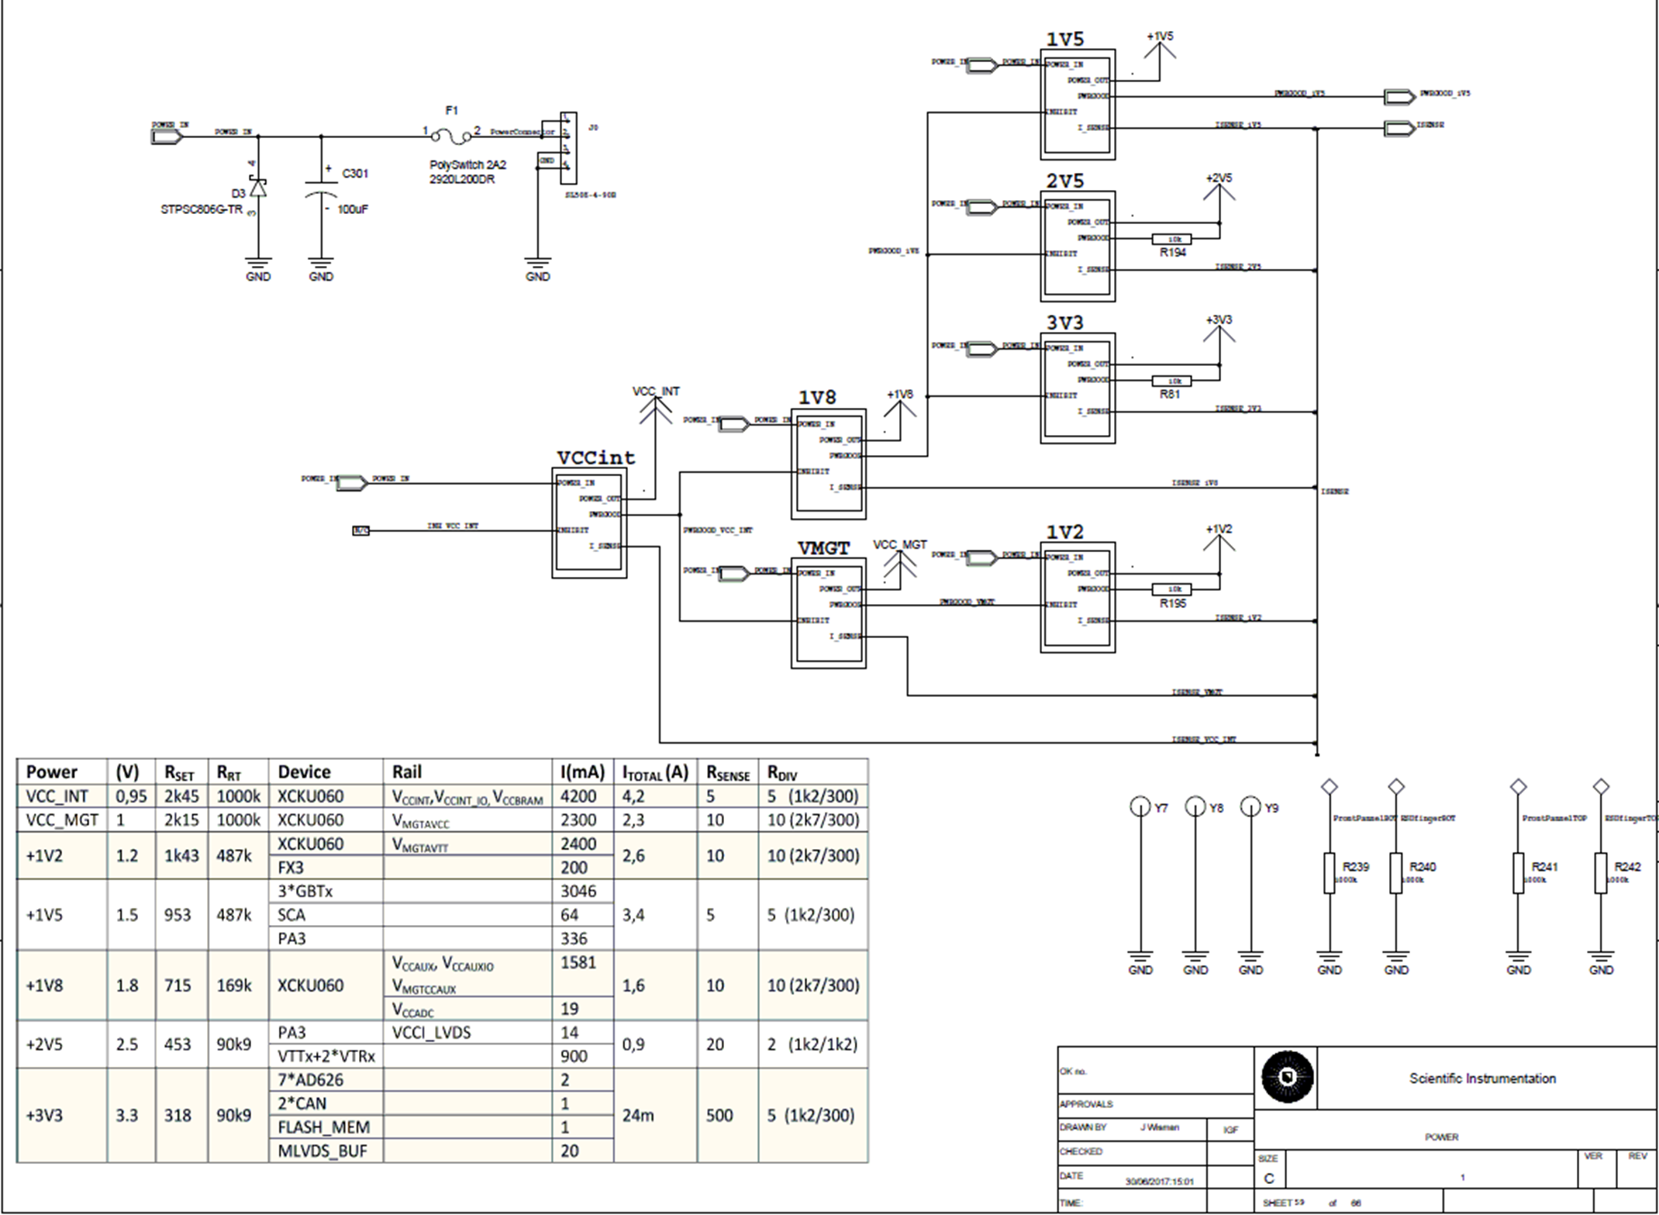
Power-on sequence

Slide 35
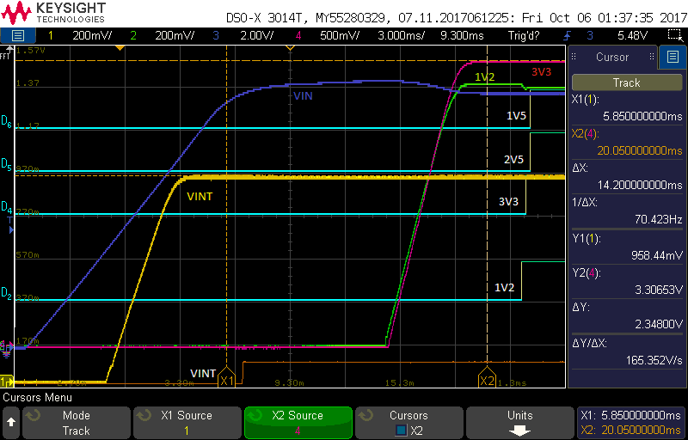

Slide 36
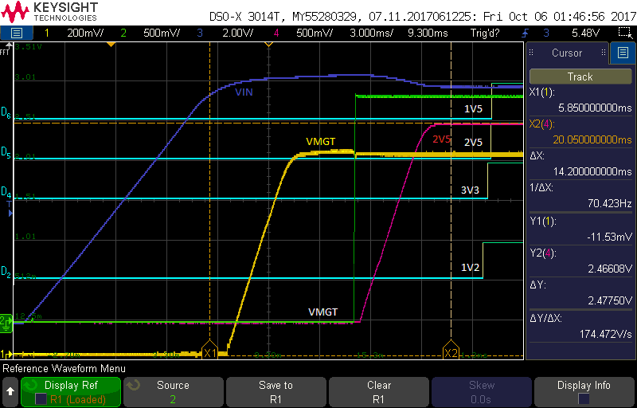

Slide 37
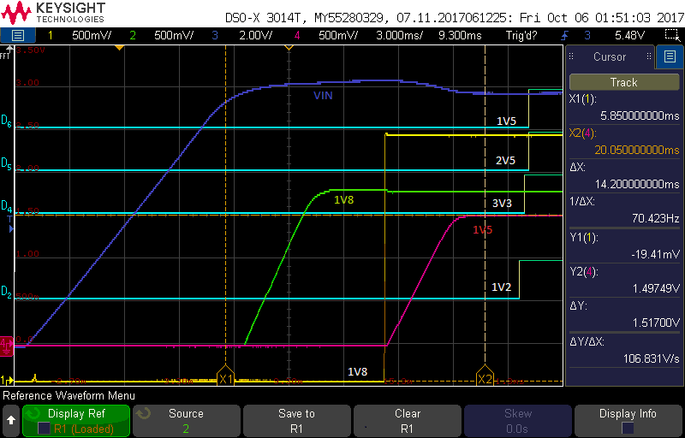

Slide 38
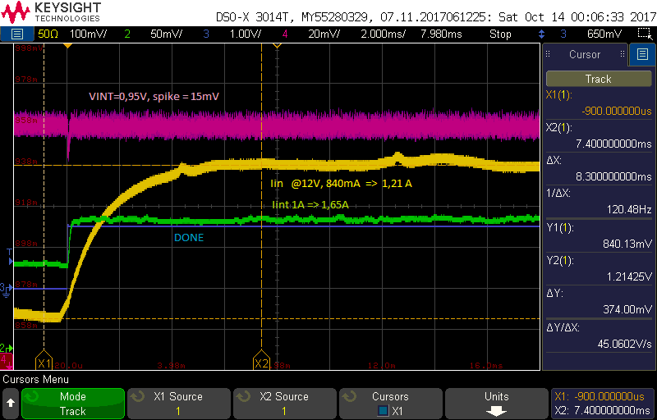
Voltages & currents after Xilinx US configuration: Vin and VINT

Slide 39
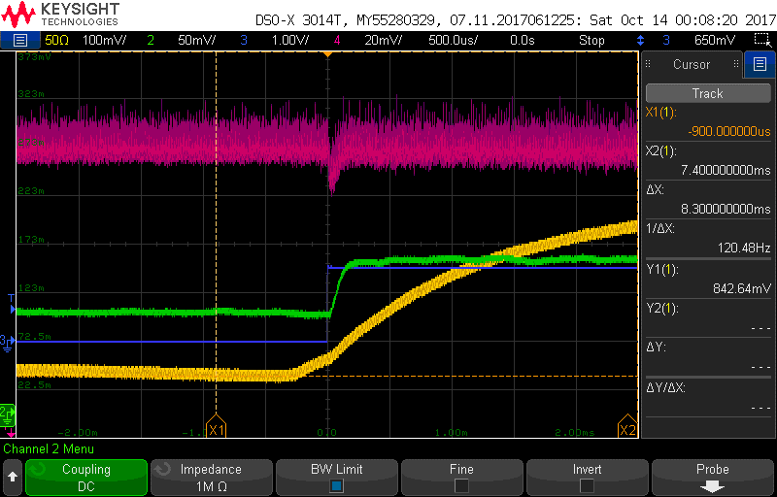
Zoomed: IINT_step=0,65A in 100us, Spike VINT=20mV

Slide 40
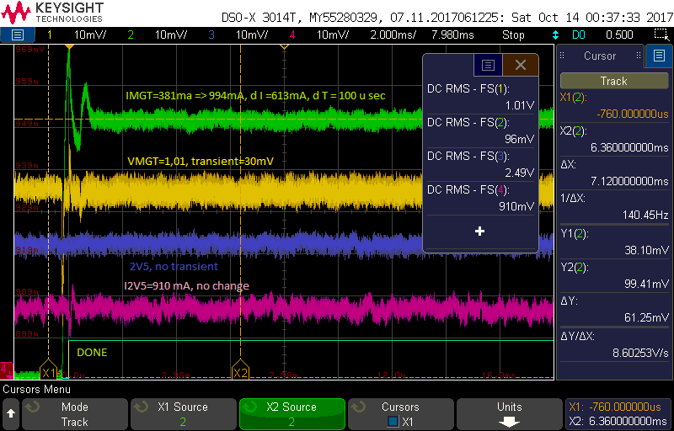
2V5 & VMGT: IMGT_step=613mA in 100us, Spike VINT=30mV

Slide 41
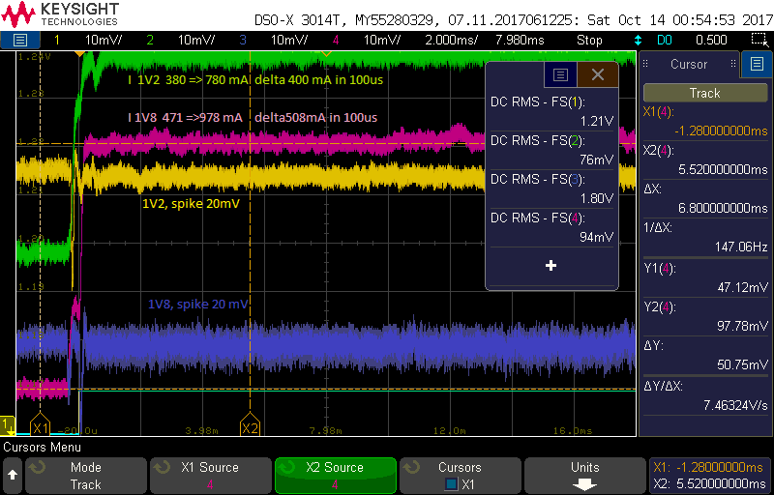
1V2 & 1V8

Slide 42
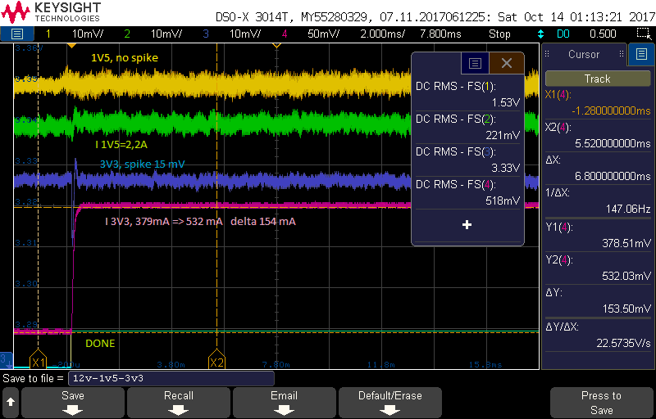
1V5 & 3V3

Slide 43
Summary Xilinx US power on
US | Empty mA | Loaded mA | Estimated Max | I step mA | V spike mV
VINT | 1000 | 1650 | 4200 | 650 | 20
VMGT | 381 | 994 | 2300 | 613 | 30
1V2 | 380 | 800 | 2600 | 420 | 20
1V5 | 2210 | 2210 | 3400 | 0 | 0
1V8 | 471 | 978 | 1600 | 507 | 20
2V5 | 910 | 910 | 900 | 0 | 0
3V3 | 379 | 532 | 500 | 153 | 15
Vspike increase with Istep
Vspike in acceptable range
Actual currents much lower than Estimated max crrents

Slide 44
Replacement current sense amplifier due to offest error
Next sheet shows an analysis of the input offset of the AD626 current sense amplifier used with RUv1_0. Due to the single supply operation, the offset is relative large resulting is errors up to 50%.
Subsequent sheets gives an overview of the radiation tested alternatives. It was decided to move to the partly pin-compatible AD8418.

Slide 45
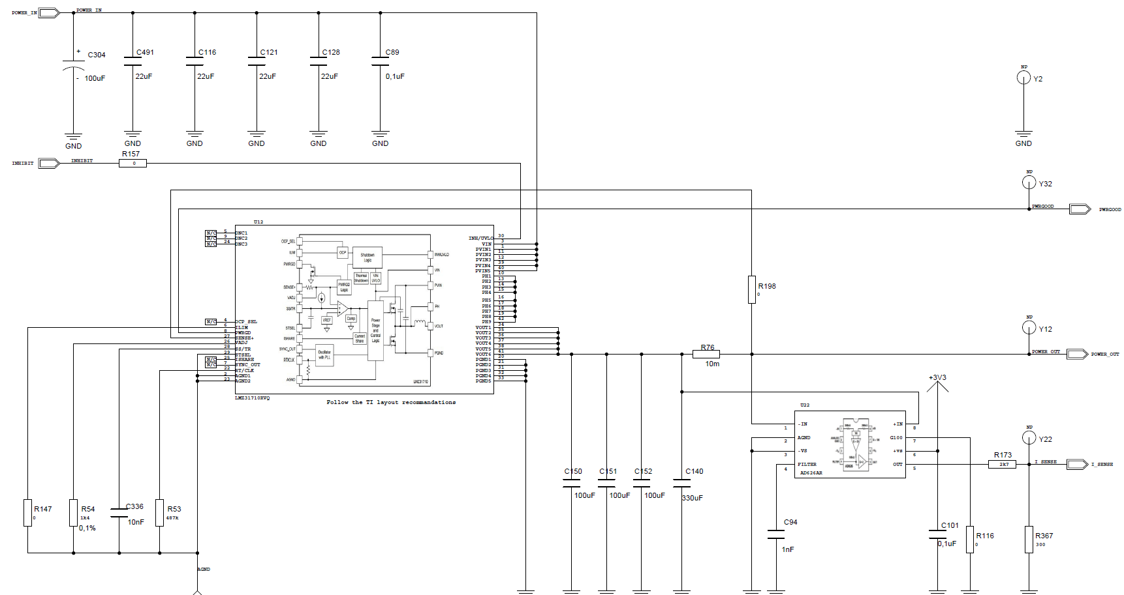

Slide 46
Current sense amplifier offset
Measurements (and datasheet) indicate AD626 current sense amplifier has input offset of +2,4mV when operated in single supply mode.
Datasheets: Input offset increases 10 times in single supply mode
Therefore AD626 indicate too high currents (yielding in ƞDCDC=101%)
Actual/proper currents indicates ƞDCDC=81%
Typical sense resistors drop = 5...10mV =>Structural error up to 50%
What accuracy is required? => Gianluca: 5% is desired: Solutions:
Correction in calculation
Increase Sense resistor => power increase (100mW)
Change Amplifier.
 | V | I (AD626) | P=V*I(AD626) | Vsense | Rsense | I | P | Vsense | Voffset
Vin with 12V FAN | 12 | 1,21 | 14,52 | mV | mΩ | A | W | mv | mV
Vin without FAN | 12 | 1,07 | 12,84 | keithly |  |  |  | AD626 | AD626
VINT | 0,958 | 1,85 | 1,77 | 7,1 | 5 | 1,42 | 1,36 | 9,25 | 2,15
VMGT | 1,01 | 1,015 | 1,03 | 7,65 | 10 | 0,77 | 0,77 | 10,15 | 2,50
1V2 | 1,21 | 0,81 | 0,98 | 5,48 | 10 | 0,55 | 0,66 | 8,10 | 2,62
1V5 | 1,52 | 2,12 | 3,22 | 8,22 | 5 | 1,64 | 2,50 | 10,60 | 2,38
1V8 | 1,806 | 1,06 | 1,91 | 8,3 | 10 | 0,83 | 1,50 | 10,60 | 2,30
2V5 | 2,49 | 0,913 | 2,27 | 15,9 | 20 | 0,80 | 1,98 | 18,26 | 2,36
3V3 | 3,33 | 0,539 | 1,79 | 24,5 | 50 | 0,49 | 1,63 | 26,95 | 2,45
Total DCDC |  |  | 12,98 |  |  |  | 10,41 |  | 2,39
ƞ |  |  | 1,01 |  |  |  | 0,81 |  | 0,14

Slide 47
Current sense amplifier alternatives
TID tested current sense amplifiers:
MAX4199 => Too little gain
INAxxxx => cannot operate on 3,3V
So only MAX4372 & AD8418 remain as alternative for AD626AR
AD8418 nearly pincompatible allowing replacement without change PCB
Power collumn involves all 7 sense amps. including dissipation in sense resistors
Test with AD8418 on 1V2 rail (Rsense=5mΩ) :
Vsense=5,5mV,
VO_AD8418=0,1085V =>error=0,5%
 | Vsupply | Iquies. (μA) |  | CM | Gain | Voff (mV) |  |  | Vo_min | Drive | Package |  | TID | Power | Error
 |  | typ | Max |  |  | Typ | Max | Trange |  |  |  |  | krad | mW | 25°C | -40...85
MAX4372 | 2,7...28 | 30 | 60 | 0..28V | 20,50, 100 | 300 | ±800 | ±1100 | 0,065 | 1,5Ω | Sot23 | Tullio | 30 | 180 | 1,5% | 5%
MAX4199 | 2,7...7,5 | 42 |  | 0..VCC-1,1 | 10 | ±15 | ±400 | ±600 | 0,1 | 5kΩ | SO8 | Leo | 30
AD8418 | 2,7...5 | 1300 @3V3 | 2600 | -2..+70V | 20 | ±200 |  | ±400 | 0,015 | 2Ω | SOIC MSOP |  |  | 411 213 | 0,5% 1% | 0,9% 2%
AD626AR | 2,4...10 | 230 | 290 | -2.. 6*(V-1) | 10..100 | 1900 | 2500 | 2900 | 0,030 |  | SOIC |  |  | 120 | 17% | 26%
INA146 | 4,5...36 | 570 | 700 | ..40V |  | 3000 | 10000 |  |  |  |  | RadWg | >24
INA111 | ±6.. ±18 |  |  |  |  |  |  |  |  |  |  |  | >40
INA141 | ±2,25.. 18 |  |  |  |  |  |  |  |  |  |  |  | <13
INA2128 | ±2,25.. 18 |  |  |  |  |  |  |  |  |  |  |  | <2,5

Slide 48
Clock generation/cleaner/distribition measurements
Frequency (160.316 MHz) and phase noise of the IQD IQXO-661 oscillator (218 fs) and CDCLVD1212 clock buffer (183 fs) are well within spec.
Also the SI5316 jitter cleaner shows the expected behaviour depending and on its loopback filter settings.

Slide 49
X1 & X2: 2,5V LVDS crystal clock oscillator
IQD IQXO-661 LFSPXO076300Bulk
Specified freqency: 160,31588 MHz ±50ppm
160.307.864… 160.323.896
Measured frequency: =>Ok (within spec)
X2: FAN off: 160,31526 MHz (R&S PNA, -3,9 ppm)
X1: FAN off: 160,31530 MHz (R&S PNA, -3,6 ppm)
X1: FAN off: 160,31570 MHz (Fluke PM6669, -1,1 ppm)
X1: Fan on: 160,31610 MHz (Fluke PM6669 +1,4ppm)
X1: Fan on: 160,316111 MHz (R&S FSL06, +1,4ppm)
Output voltage: 247mV min, 330mV typ, 454mV max
Measured (TDS6604 & P7360) X1: 350 mV => OK
Measured (TDS6604 & P7360) X2: 410 mV => OK
Specified phase jitter (12kHz to 20 MHz): 1 ps rms max
Measured phase jitter (12kHz to 20 MHz): 0,218 ps => OK

Slide 50
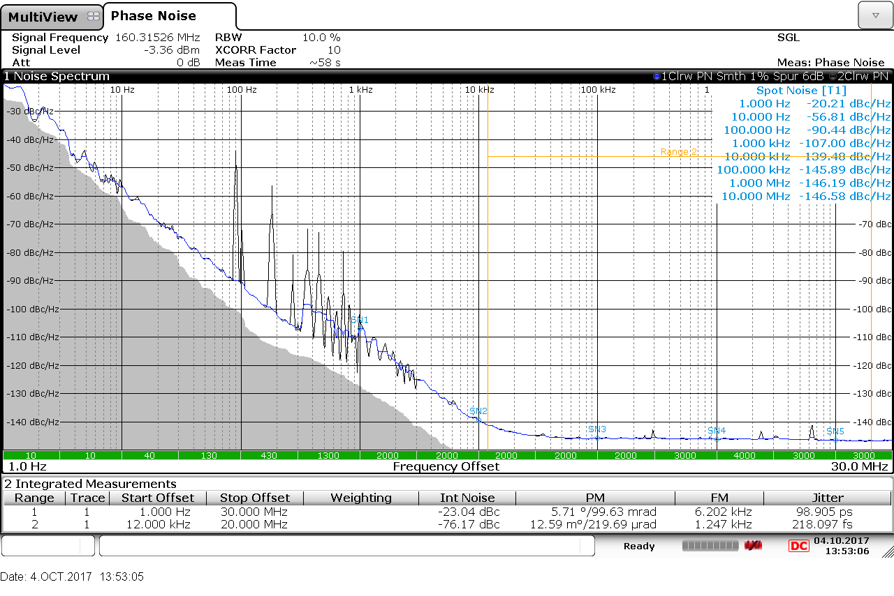
X2 crystal clock oscillator phase noise analyser output

Slide 51
U17: CDCLVD1212 2,5V LVDS 2:12 buffer
Output voltage: 250mV min, 450mV max
Measured (TDS6604 & P7380) J19/J20: 330 mV => OK
Specified additional phase jitter (10kHz to 20 MHz) for 100MHz clock: 171 fs rms nominal
Measured Buffer + X1: 284,7 fs
Additional phase jitter = √(284,7²-218²)=183 fs
(close to nominal value, slightly above possibly due to 2,5V PS rail ripply/noise.)

Slide 52
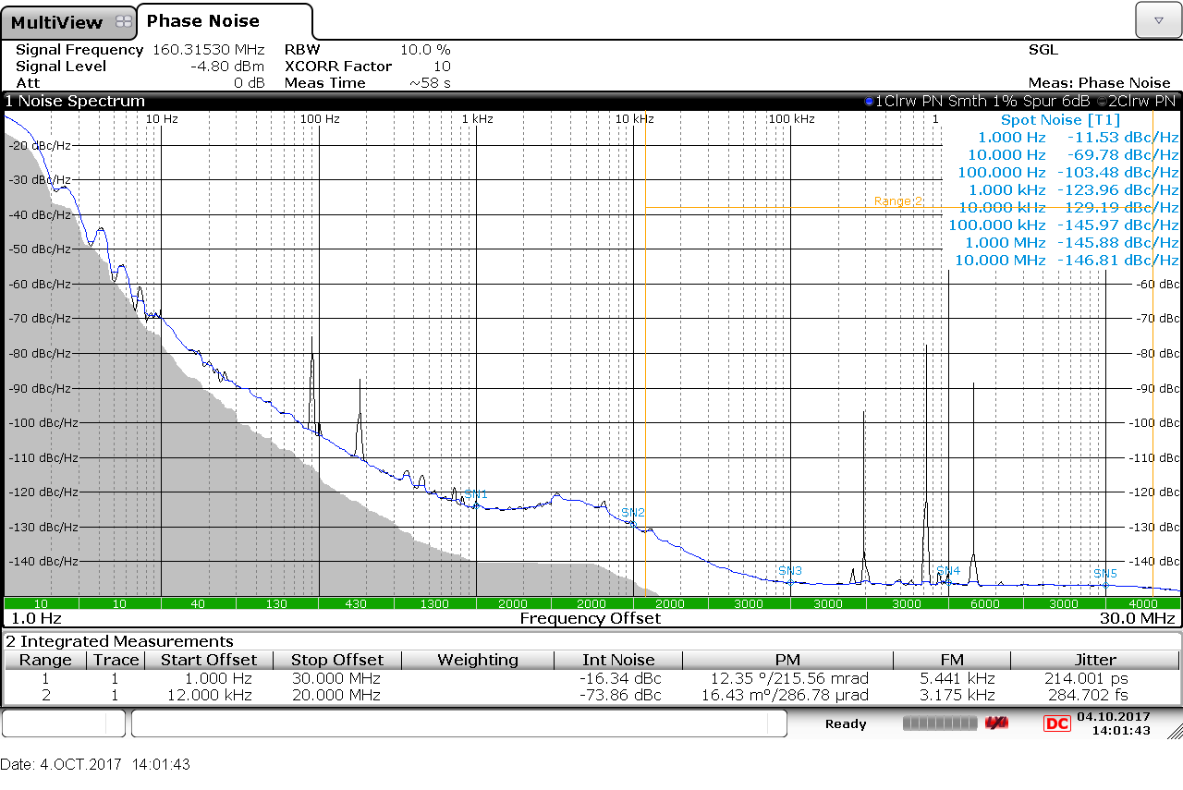
X1 + CDCLVD1212 phase noise analyser output

Slide 53
Spectrum analyser measurement 2V5 rail (fDOMINANT=293kHz & 724kHz)

Slide 54
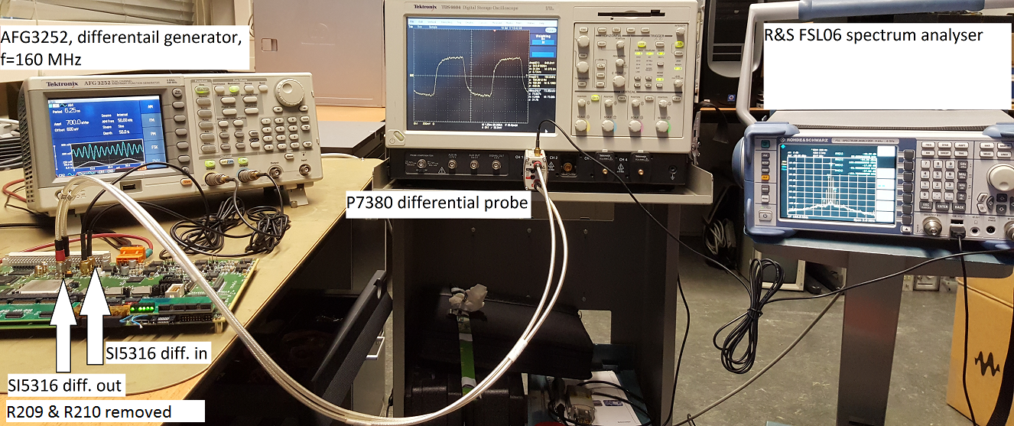
U17: SI5316 jitter cleaner output levels
AFG3252 acts as differential output generator to SI5316 in (J14/J15)
SI5316 out (J16/J17, R209&210 removed) to P7380 diff probe.
SFOUT[1:0] | Specified | Min | Typ | Max | Measured
HM | LVDS | 500 | 700 | 900 | 644
ML | Low swing LVDS | 350 | 425 | 500 | 425
HL | CML | 350 | 425 | 500 | 425
MH | LVPECL | 1100 |  | 1900 | 1440

Slide 55
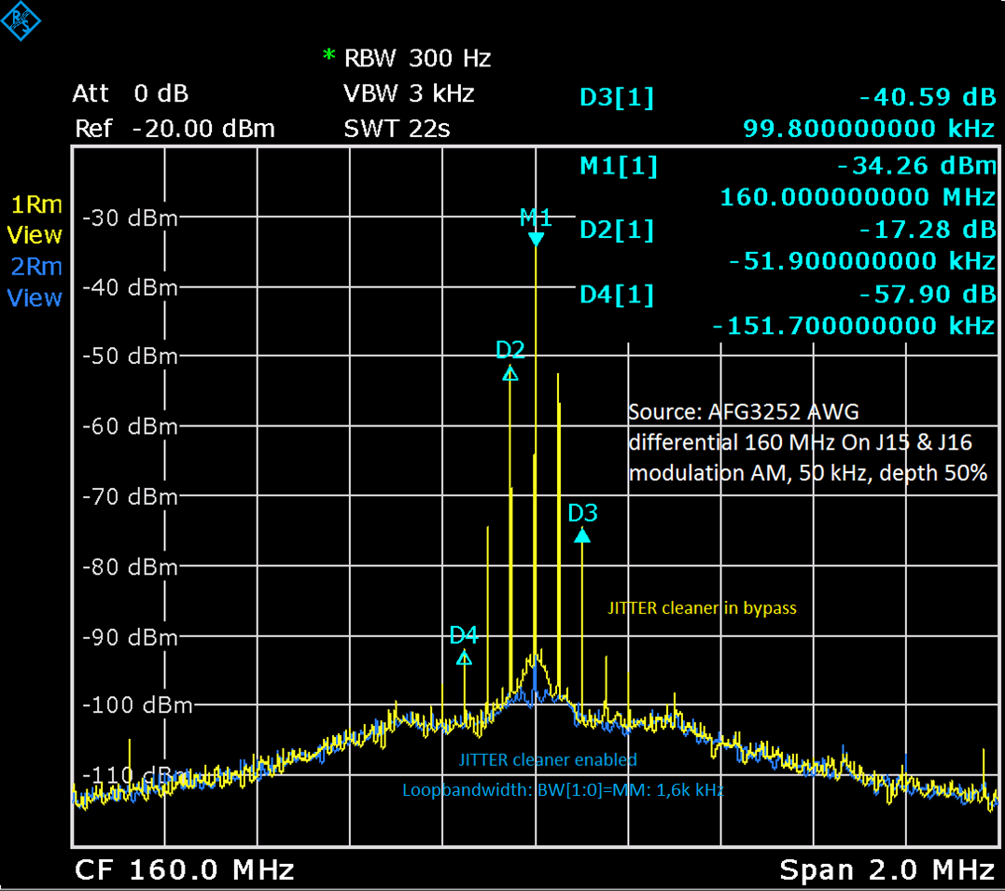
SI5316 out: Input: AFG3252 generator AM modulated with 50 kHz sinus

Slide 56
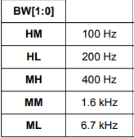
SI5316 PLL loopfilter bandwidth at 6,7 kHz
AFG3252: 160MHz, off=0,6V, amp=1V, MOD=AM sinus, Depth=50%
SI5316: Bandwidth[1:0]=ML=7KHz
kHz | Cleaner disabled |  | Cleaner enabled |  | 20logJitter Out/In
1 | -58,3 | -58,3 | -59,9 | -60 | -1,7
2 | -62,1 | -61,8 | -63,7 | -64,1 | -2,0
5 | -60 | -60 | -63,4 | -63,3 | -3,3
10 | -62,5 | -62 | -69,9 | -69,4 | -7,4
20 | -61,4 | -61,6 | -77,3 | -76,7 | -15,5
40 | -60,8 | -60,5 | -88 | -88 | -27,4
50 | -60,2 | -60,4 | -91,7 | -92,4 | -31,8

Slide 57
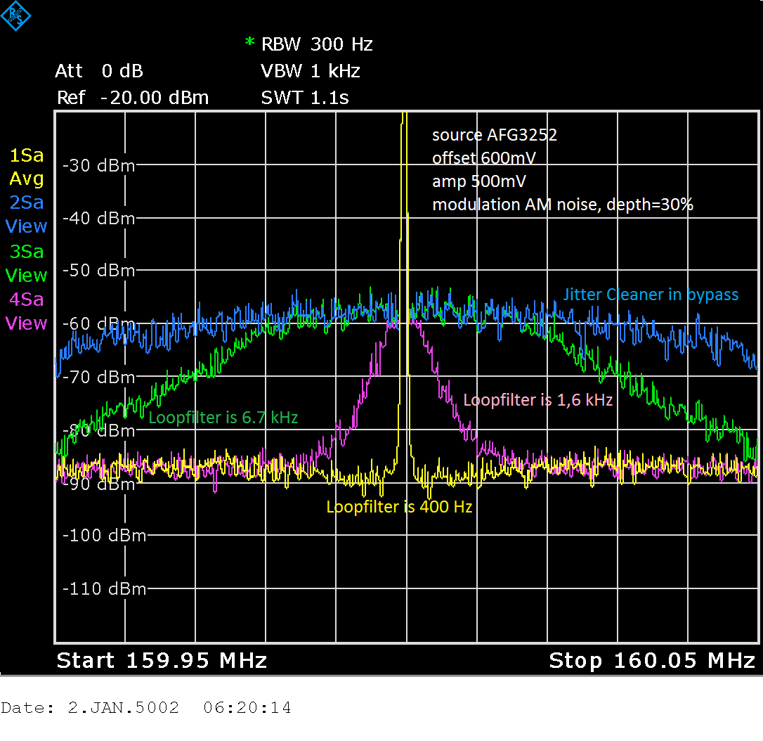
SI5316 with different loopfilters. Source AM noise modulated

