Slide 1
RUv1 Overview
RUv1 pre-production board
Architecture & details RUv1
RUv1 PCB stackup
RUv1.0 & RUv1.1 differences
Marcel Rossewij

Slide 2
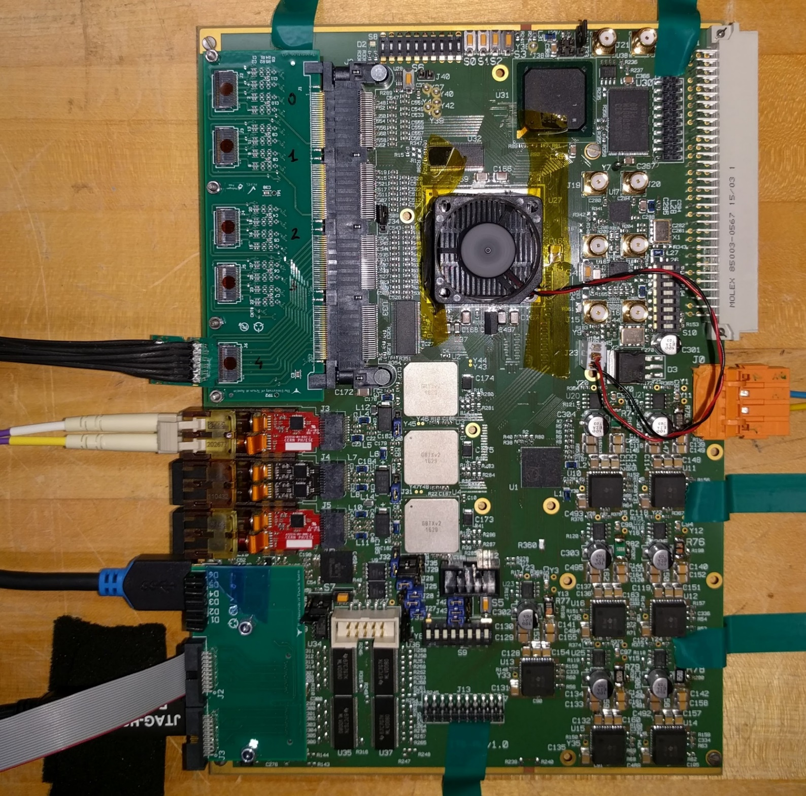
RUv1 production history
6U VME size
8* RUv1.0 boards produced
2 * August 2017
6 * September 2017
13* RUv1.1 boards
6 * November 2017
7 * March 2018
Power
PA3
Ultra Scale
GBTx
GBT
Fibers
Transition Board
Power Mezz
To
Sensors
USB
To
Power
Board

Slide 3
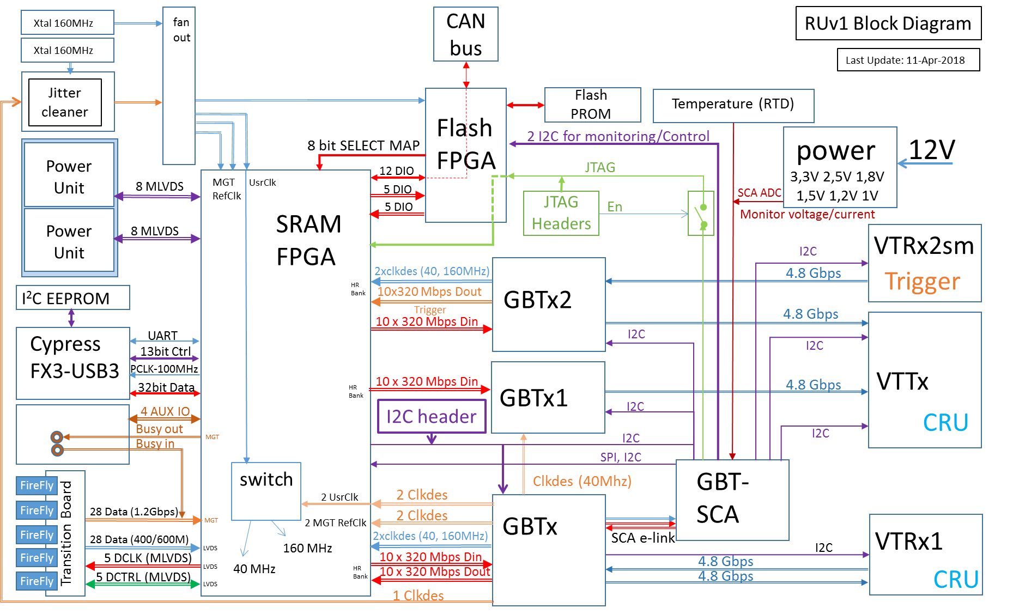
Block schematic

Slide 4
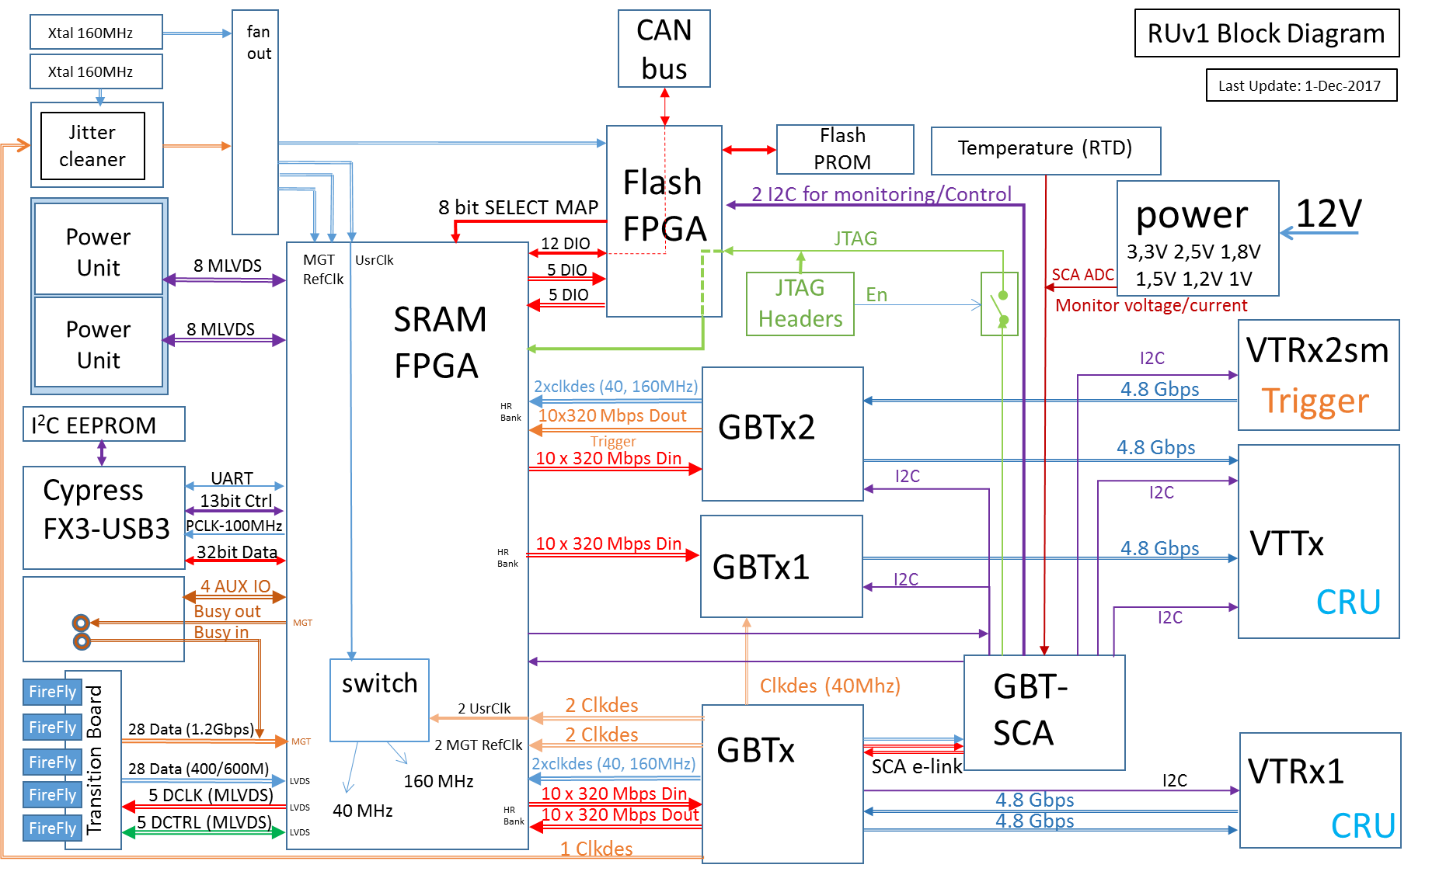
Trigger

Slide 5
Data-path
IB: 9 * 1.2 Gbps
MB/OB: 16/28 * 400 Mbps

Slide 6
Power boards control

Slide 7
Slow Control
Measurement of
7 * Regulator Voltage
7 * Regulator current
2 * RTD

Slide 8
PA3 configuration (JTAG)

Slide 9

US-Flash memory initialization
2 paths forseen:
SCA->I2C
US

Slide 10
Flash GBTx

Slide 11
Configure GBTx

Slide 12
BUSY

Slide 13
Table Top USB operation

Slide 14
RUv1 PCB technology
10 layer
4 signal layers
4 GND layers
2 PWR (35μ)layers
Reverse/core-build stackup
Halogenfree material: Panasonic (R1566)
No blind/burries via’s. Only through hole
OL pad 450μ
IL pad 500μ
Finish ENIG
# | Name |  |  |  | Diff. pairs
 |  |  | width | clearance | width | spacing
1 | Top signal | 18 (35) | 110 | 110 | 110 | 150
 | Core | 150
2 | GND plane | 18 | 150 | 100
 | Prepreg | 200
3 | Signal | 18 | 100 | 100 | 100 | 120
 | Core | 200
4 | GND plane | 18 | 150 | 100
 | Prepreg | 100
5 | Power plane | 35 | 150 | 100
 | Core | 100
6 | power plane | 35 | 150 | 100
 | Prepreg | 100
7 | GND plane | 18 | 150 | 100
 | Core | 200
8 | Signal | 18 | 100 | 100 | 100 | 120
 | Prepreg | 200
9 | GND plane | 18 | 150 | 100
 | Core | 150
10 | Bottom sig. | 18 (35) | 110 | 110 | 110 | 150

Slide 15
Main changes/fixes RUv1.0 => RUv1.1
Issue | Comment |  |  |  | Status RUv1.1
Current sense offset | Change amplifier (AD626 => AD8418) |  |  |  | Fixed
Re-group e-link clk | Use other GBTx clock-out signal |  |  |  | Done
Match CDCLK to DOUT | GBTx DOUT mismatch 22mm/150ps |  |  |  | Fixed
Mirror GBTxI2C conn. | Fixed Mirror error |  |  |  | Fixed
U28 pin 5-6 swapped | For INIT LED (only informative with scrubbing ) |  |  |  | Fixed
Case C497/680u | 1201 => 7343 |  |  |  | Fixed
Flash mem lines absent | RUv1.0 CE2 & R/B2 wired to header J14 pin 17&19 |  |  |  | Fixed
FAN connector J23 pinout |  | 1 | 2 | 3 | RUv1.1 FAN connector Reversed
 | RUv0 | - | 5V | GND
 | RUv1.0 | 12V | 5V | GND
 | FAN | GND | 5V/12V | Tacho out

Slide 16
Minor changes/fixes RUv1.0 => RUv1.1
Issue | Comment | Status RUv1.1
Use higher headers | Change component | Fixed
Input voltage to SCA | Route | Done
CAN/JTAG connector | Distance too small => Move J8 & J7 1mm up | Done
Mis-allignment Transitionboard mountingholes | Marcel: 0,3mm (measered + datasheet) Piero: 0,3mm Jo: 0,56 mm (measured on RU in workshop) | Moved 0,4mm to edge
PA3 reset on clkbuf | Yes | Done
FAN-clip Clearance | Move capacitors C169 | Done
U37 MLVDS DE error | Malfunction Power Unit 2 Interface on J1 | Fixed

