Slide 1
Xtal 160MHz
fanout
CANbus
RUv1 Block Diagram
Xtal 160MHz
Last Update: 1-Dec-2017
Jitter
cleaner
Flash
PROM
Temperature (RTD)
Flash FPGA
8 bit SELECT MAP
2 I2C for monitoring/Control
power
12V
Power Unit
12 DIO
JTAG
3,3V 2,5V 1,8V
1,5V 1,2V 1V
8 MLVDS
MGT RefClk
UsrClk
5 DIO
SCA ADC
5 DIO
JTAG
Headers
En
SRAM
FPGA
Monitor voltage/current
Power Unit
8 MLVDS
VTRx2sm
I2C
2xclkdes (40, 160MHz)
4.8 Gbps
Trigger
I²C EEPROM
HR
Bank
10x320 Mbps Dout
GBTx2
Trigger
4.8 Gbps
10 x 320 Mbps Din
Cypress FX3-USB3
UART
I2C
I2C
13bit Ctrl
PCLK-100MHz
10 x 320 Mbps Din
VTTx
32bit Data
HR
Bank
GBTx1
4.8 Gbps
4 AUX IO
I2C
CRU
Busy out
I2C
I2C
MGT
Busy in
switch
I2C
GBT-SCA
FireFly
2 Clkdes
Clkdes (40Mhz)
I2C
2 UsrClk
FireFly
28 Data (1.2Gbps)
2 MGT RefClk
2 Clkdes
GBTx0
Transition Board
MGT
2xclkdes (40, 160MHz)
SCA e-link
VTRx1
FireFly
28 Data (400/600M)
160 MHz
I2C
LVDS
10 x 320 Mbps Din
FireFly
5 DCLK (MLVDS)
40 MHz
4.8 Gbps
LVDS
HR
Bank
10 x 320 Mbps Dout
4.8 Gbps
CRU
FireFly
5 DCTRL (MLVDS)
LVDS
1 Clkdes

Slide 2
MFT connections:
For the two smallest disks, MFT needs to read sensors at 1.2 Gb/s, at most there are 11 ALPIDEs connected to a single RU, split into 3 ladders, therefore 3 clk/ctrl/data cable assemblies are required.
On the larger disks, switching to 600 Mb/s readout is possible. There are at most 21 ALPIDE connected to a single RU split into 5 ladders, so 5 clk/ctrl/data cable assemblies are required.
A
B
C
D
E
used
Connector
unused
1.2 Gb/s
400 or 600 Mb/s
Unconnected
ITS IL
ITS ML/OL
MFT ID
MFT OD
Would require specific “low level” firmware for the MFT

Slide 3
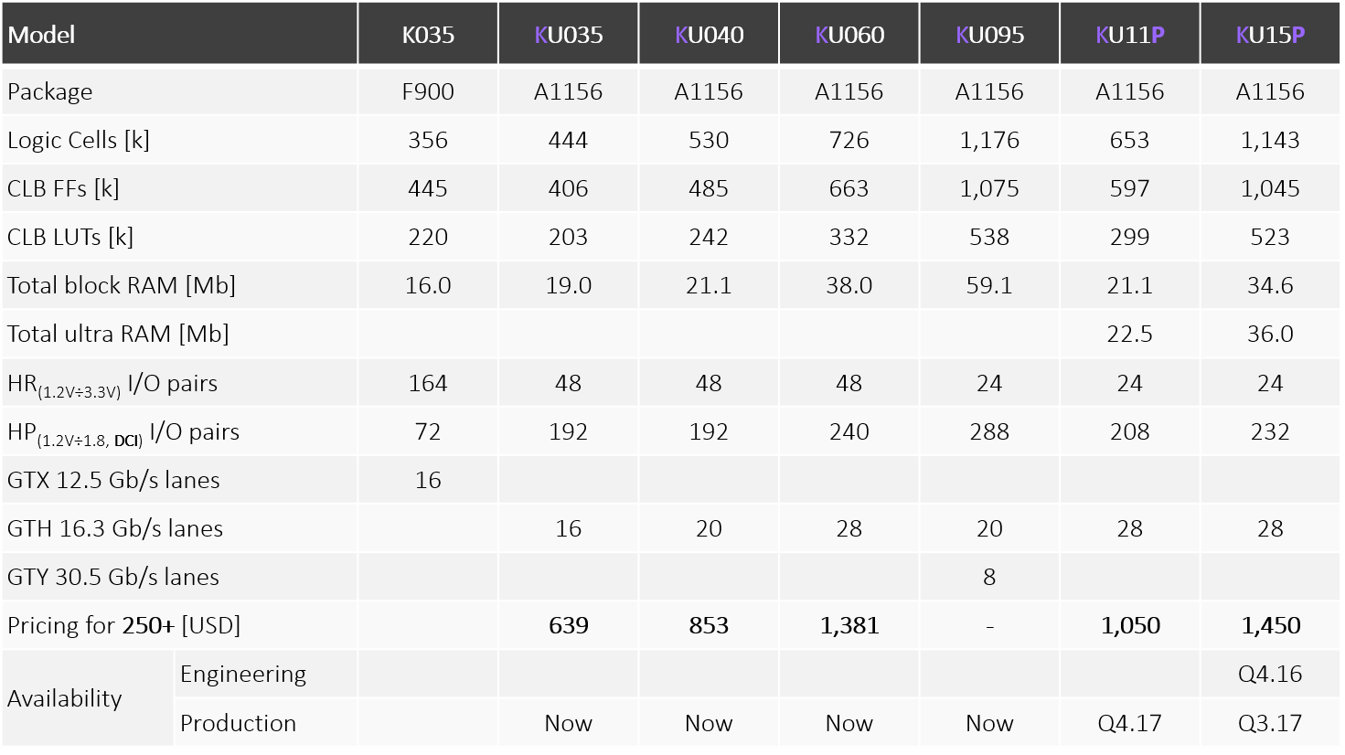
Possible SRAM FPGA choices:
UltraScale & UltraScale+ pin-to-pin compatible devices in A1156 package (35 × 35 mm²).
Only need to check maximum voltage range for some HR banks between US/US+.
We will likely need 250 (ITS) + 100 (MFT) FPGAs (including spares).
Current

Slide 4
General Specifications 1
High Speed I/Os
400/600 Mbps readout of sensors via LVDS has not yet been tested. Matthias has created the firmware necessary to test it, but actual hardware test has not yet been done.
Need to check the compatibility for SLVS and MLVS in the various banks and number of inputs needed with these voltages
Need to check the number of links for both ITS and MFT
GBT
GBTx 1 and 3 get their clocks from downlink (CRU & CTP respectively). GBTx 2 gets is clock from GBTx 1 via clkdes line
Bring 3 clkdes into SRAM FPGA: 160MHz, 40 MHz (Serdes clock), 320MHz (?, elink speed)
JTAG is provided via SCA to both SRAM and Flash FPGA in JTAG chain with jumpers to isolate each part. Add local headers for both SRAM and Flash FPGA
Flash FPGA can communicate with CRU via I2C
Busy
Busy in and out channels via MGT need to be provided to investigate busy handling schemes

Slide 5
General Specifications 2
Radiation Hardness
Choice of Flash FPGA still open. ProAsic3 is preferred choice, but it is rumored it has reprogrammability issues similar to IGLOO2.
Flash FPGA uses SelectMap interface to program SRAM FPGA at power-up. It also uses SelectMap interface for scrubbing. For both purposes, the images are stored in the FlashProm attached to the Flash FPGA (different images?).
Two I2C buses through the GBT-SCA are used for control and monitoring communication with the CRU
During shutdowns when GBT isn’t available, a CANbus interface is used for control & monitoring of PowerUnit. CANbus lines can also be forwarded (via Firmware) from FlashFPGA to SRAM-FPGA to run CANbus core there instead.
SRAM-FPGA is responsible for interaction with PU (control, monitoring, latchup-response). Needs to communicate PU status (including latchup) to FlashFPGA for monitoring via GBT (or CANbus)
For reprogramming the FlashPROM a special firmware could be loaded to SRAM-FPGA to provide data path from GBT through communication bus to FlashFPGA (and in turn to PROM).
Mechanics
Single-sided component mounting

Slide 6
SRAM FPGA IO resources needed
For each GBT
DP 10 at 320 Mb/s e-links (160 MHz).
DP 1 at 160 MHz clock e-link.
DP 1 at 40 MHz clock e-link.
DP 12 IO pairs for each GBTx.
In total (5 GBT links through 3 GBTx chip), data communication only.
DP 60 toward the GBTx.
Flash FPGA connection
SE 32 select MAP.
SE 32 data/control.
SE 64 total.
FX3 chipset
SE 1 UART.
SE 1 Clock.
SE 14 bit control.
SE 32 Bit data.
SE 48 total.
Power Unit
SE 2 × 3 line (HS I2C ) for (2 power unit).
SE 2 × 16 line (8 analog + 8 digital LU/SEU monitor).

