Slide 1
Firmware Overview
J. Schambach

Slide 2
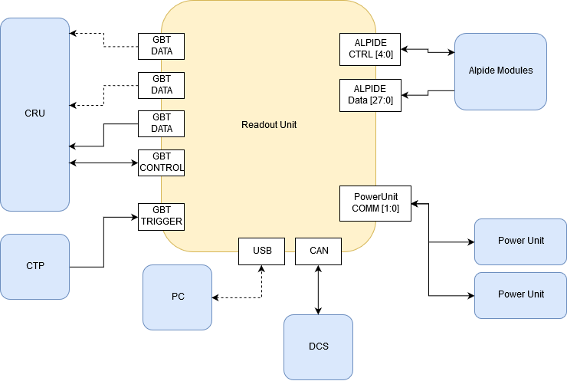
Readout Unit Connectivity

Slide 3
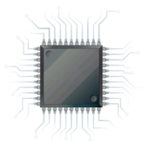
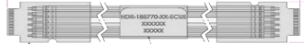
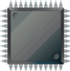

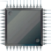
Readout Unit Firmware Purpose
From/To ITS
Readout Unit
SCA
From/To CRU
Copper Links
GBT Links
Programmable Logic
3.2 Gb/s
GBTx
Control
FLASH
Memory
3.2 Gb/s
Optical transceiver
VTRx
Data @ 3.2 Gb/s
FLASH
Memory
Data: 9 x 960 Mb/s
or 16/28 x 320 Mb/s
FLASH
FPGA
3.2 Gb/s
GBTx
Optical transceiver
VTTx
Data @ 3.2 Gb/s
Control (80 Mb/s)
Data @ 3.2 Gb/s
SRAM
FPGA
Clock (40MHz)
3.2 Gb/s
3.2 Gb/s
GBTx
Optical transceiver
VTRx
Trigger
Main Tasks of the Readout Unit:
Receive triggers (heartbeat & physics) from CTP & decode
Receive “control” information from CRU
Deliver triggers to stave sensors
Control, configure and monitor stave sensors
Receive data from stave; decode & compress
Deliver monitoring information to CRU (forwarded to DCS)
Deliver CRU framed data packets to CRU
Determine and handle busy information
Monitor and control Power Board
Handle radiation upsets in programmable logic (& sensors)
Power Board
Power Unit (PU)

Slide 4
Flash FPGA

Slide 5
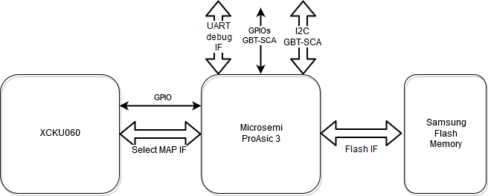
Flash FPGA: Configuration and Scrubbing
Details in
“System scrubbing & re-programming” talk

Slide 6
ProAsic3 Firmware
Components w/ TMR

Slide 7
SRAM FPGA

Slide 8
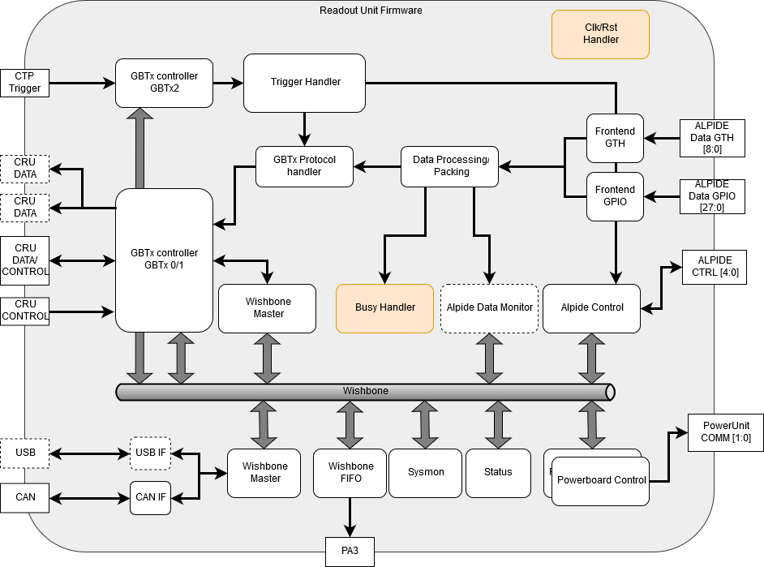
Readout Firmware Overview

Slide 9
Firmware modules - Status
Control Interface (Wishbone bus)
  Implemented and tested (lab, test beams)
  Sending and receiving control words over USB and GBT
Power Board Interface
  Implemented and tested for all 4 I2C busses
  Controls sensor power, read status, currents, and voltages
Alpide Control
  Implemented and tested for all 5 FireFly connectors
  Handles configuration and triggers to sensors
Data Readout and Packaging
  2 Flavors: Inner Barrel (MGT transceivers), Outer Barrel (GPIO fabric logic)
  Implemented and tested for MGT (lab, test beams)
  Outer Barrel path under development (only receiving logic different)
  Receives data from sensors, deserialization, idle removal
  Add CRU protocol and Trigger info
  Send data packets over GBT
  Some features still missing (OB sensor data packaging, sparsification)
GBTx Communication
  Implemented and tested (lab, test beams)
  Use only single GBT link for now for trigger, control, and data
  Full access to Wishbone via CRU protocol
Trigger Handler
  Proof of principle implemented and tested
  Needs additional work (pipelining, additional triggers, …)
Radiation Monitor
  Implemented and tested
  SEU observation
System Monitor
  Implemented and tested
  Read voltages, temperatures
USB interface to wishbone
  Implemented and tested
  Used for tabletop tests, lab setups
FIFO interface to PA3
  Implemented and tested
  Used for fast firmware update of flash
  Can be used from GBT (via CRU control protocol)
Datapath Monitor
  Implemented to monitor protocol, gbtx
Error/Busy Handling
  Still missing

Slide 10
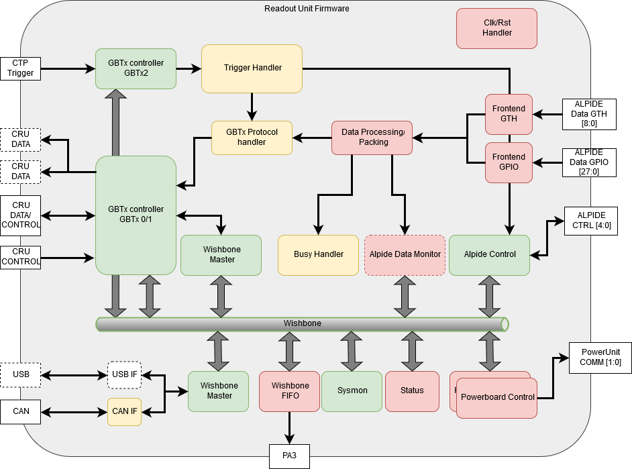
Radiation Protection: Triple Modular Redundancy
TMR Status
TMR completed
To be TMR’ed
No TMR planned

Slide 11
Alpide Data Path Details

Slide 12
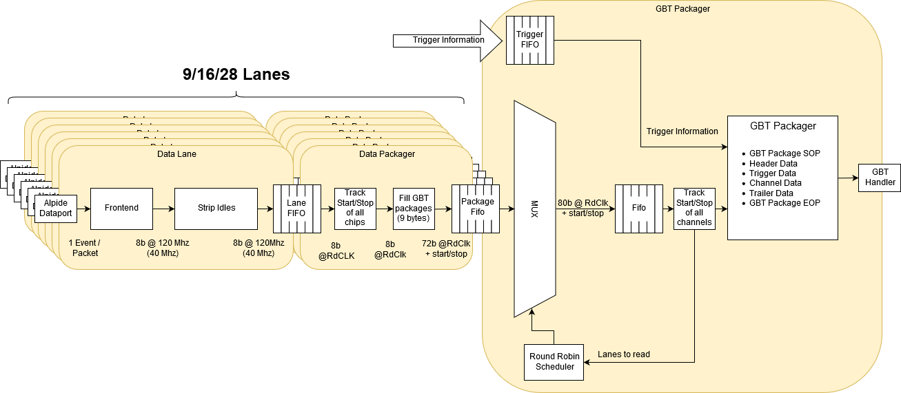
Data Flow

Slide 13
Inner Barrel Data Format
Legend:
C<n>W<m>: Cable <n>, Word <m>
Cx_Id: FIFO identifier (1-9, 5bit)
SOP: CRU Start-of-Packet
EOP: CRU End-of-Packet
BC: Bunch Crossing ID (12bit)
Data out of the Alpide Readout firmware module in the inner barrel mode arrives with a rate of 8 bits every 120MHz clock period. Nine 8-bit data words from one cable are combined with an ID for the FIFO they originate from into an 80 bit GBT word as shown here. A round-robin MUX collects data from each of the nine cables. Finally, the data is framed with the appropriate CRU protocol words, and trigger and status information is added to complete a CRU data packet.
Header

Slide 14
Outer Barrel Data Format
Legend:
C<n>W<m>: Cable <n>, Word <m>
Cx_Id: FIFO identifier (1-28, 5bit)
SOP: CRU Start-of-Packet
EOP: CRU End-of-Packet
BC: Bunch Crossing ID (12bit)
Header
For the outer barrel mode, the same principle on the previous slide applies, but with modified rates and number of fragments combined into a GBT word.

Slide 15
Continuous Readout
HB = Heart Beat Trigger
HBF = Heart Beat Frame
Strobe<x> = Trigger strobe to sensor with trigger time = BC+Orbit at time<x>
BCID<x> = BC ID (part of SDH) (with BC+Orbit) at time<x> after HB
Data = Sensor Pixel addresses
SOP = “Start Of Packet” (CRU protocol)
EOP = “End Of Packet” (CRU protocol)
“Continuous” readout in ITS is accomplished by using “long” (10’s of µ-seconds) strobe lengths (firmware triggered) with short (10’s of nano-seconds) inter-strobe periods to initiate readout. ITS RU firmware therefore divides a “Heartbeat Frame” into several “Strobe” frames with fixed strobe lengths, synchronized to the received heartbeat triggers.
Heart Beat Triggers come every 89.4 µs, so trigger strobes (“frames”) in this example would be approximately 89.4 / 4 = 22.3 µs long and each Heart Beat Frame (HBF) would thus contain 4 packets from the RU. This parameter is programmable and could be adjusted, e.g. to 89.4/8 to have 8 “sub-frames” in each HBF
Data will appear from the sensor some tens of ns after the end of the strobe signal, and some 40MHz clock cycles later on the GBT links. Data contained in each packet corresponds to all physical signals (“events”) between times tx and tx+1. The packets might also contain the busy status for individual sensors of an RU, which could then be used to determine the need for throttling at the CTP.
Although data packets are shown here contiguous, it is possible that “DATA” GBT words are interspersed with “IDLE” or “SWT” (for DCS data) during data transmission to the CRU. Since there is the possibility of SEUs in the RUs’ FPGAs, there will be a “timeout provision” in the CRU protocol to determine if a packet is corrupted/incomplete/missing.

Slide 16
CRU Data
RU 1
RU 2
8 Readout Units
(up to 3 fibers each)
RU 8
HB1
Time
FID
0
FID
0
…
…
FID
0
FID
1
FID
1
FID
1
Need to be combined into 1 Heart Beat Frame (HBF) in FLP
FID
2
FID
2
FID
2
FID
3
FID
3
FID
3
HB2
FID
0
FID
0
FID
0
DMA to FLP memory

Slide 17
Data Hierarchy
IB
MB
OB
9
16
28
…
…
…
Cable 1
Cable 9
Cable 1
Cable 16
Cable 1
Cable 28
8
192
RU
RU
RU
....
RU
......
8
8
....
....
24 (12 FLP?)
CRU/FLP
.......
CRU/FLP
EPN

Slide 18
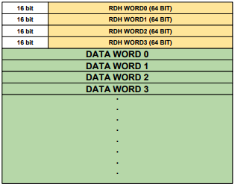
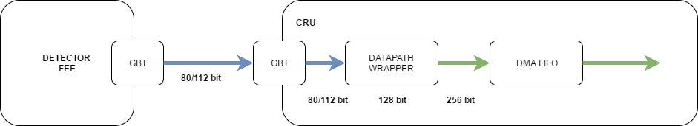
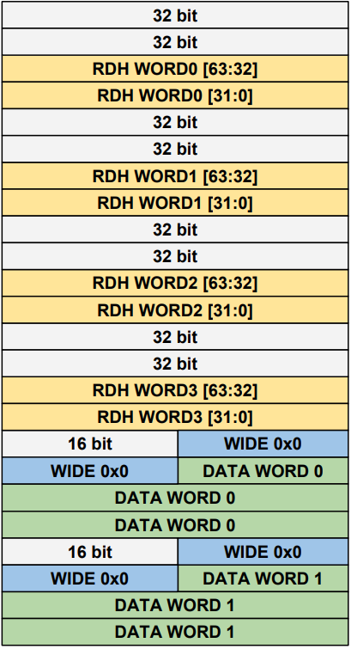
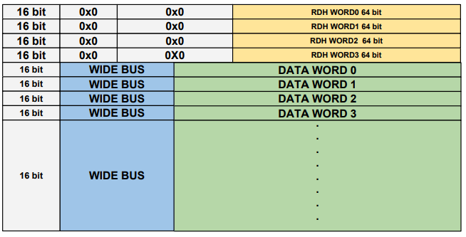
Data Format: GBT to CRU to FLP
GBT RDH
FLP memory
79…………………….……………….……….…………0
0x00
0x04
0x08
0x0C
0x10
CRU memory
127……………………………………………………………………...…63………..……………………………………………………………...…0

Slide 19
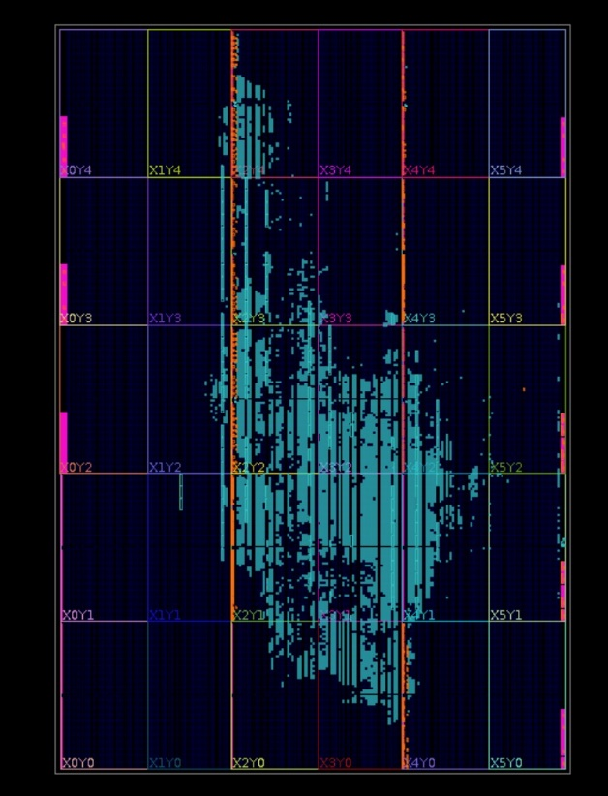
Utilization Report
CLB Logic
Site Type | Used | Available | Util %
CLB | 6038 | 41460 | 14.56
CLBL | 3062
CLBM | 2976
LUT as Logic | 23100 | 331680 | 6.96
using O5 output only | 466
using O6 output only | 19961
using O5 and O6 | 2673
LUT as Memory | 0 | 146880 | 0.00
LUT Flip Flop Pairs | 6970 | 331680 | 2.10
fully used LUT-FF pairs | 855
LUT-FF pairs with one unused LUT output | 5736
LUT-FF pairs with one unissued Flip Flop | 5160
Unique Control Sets | 931
CLB Registers | 26374 | 663360 | 3.98
CARRY8 | 757 | 41460 | 1.83
F7 Muxes | 702 | 165840 | 0.42
F8 Muxes | 287 | 82920 | 0.35
F9 Muxes | 0 | 41460 | 0.00
BLOCKRAM
Site Type | Used | Available | Util %
Block RAM Tile | 146 | 1080 | 13.52
RAM36/FIFO | 134 | 1080 | 12.41
RAMB36E2 only | 134
RAM18 | 24 | 2160 | 1.11
RAMB18E2 only | 24

Slide 20
Control Interfaces

Slide 21
Detector Control System (DCS) Paths
Readout Unit
FLASH
FPGA
PROASIC3
FLASH
PROM
SUPPLY SENSE
TEMP SENSE
CANBUS
SRAM
FPGA
XILINX
ULTRASCALE
POWER
UNIT
I2C
I2C
SCA
POWER
UNIT
I2C
I2C
DETECTOR
SENSORS
DCTRL
GBTx0
VTRX
CRU /
O2 FLP
GBTx1
VTTX
USB3
FX3
GBTx2
VTRX
LTU/
CTP

Slide 22
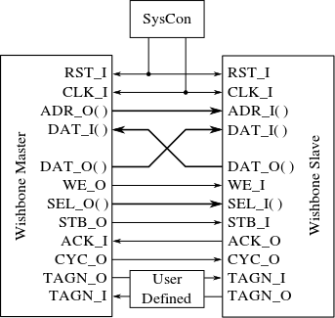
Control Interface
FPGA
Control
Interface
Wishbone Slave 1
16 bit Data
15 bit Address
1 bit R/W
FiFo
Wishbone Master
32 bit
Wishbone Slave 2
Wishbone Bus
FiFo
.
.
Wishbone Bus Structure
32 bit
Wishbone Slave n
Optional

Slide 23
Controls Protocol
Based originally on 32bit USB words sent over FX3
DCS -> FPGA
  Write Request:
  Read Request:
FPGA -> DCS
  Write Response:
    None (no acknowledgement, but errors are kept in a wishbone slave register – associated with the wishbone master - for possible later interrogation)
  Read Response:
  Errors are kept in a wishbone slave register – associated with the wishbone master - for possible later interrogation
31 24 16 0
W/R=1 | Module Addr[6:0] | Reg Addr[7:0] | Data[15:0]
31 24 16 0
W/R=0 | Module Addr[6:0] | Reg Addr[7:0] | Don’t Care[15:0]
31 24 16 0
Error | Module Addr[6:0] | Reg Addr[7:0] | Data Response[15:0]

Slide 24
GBT Controls Transactions
GBT – SWT: Single Word Transaction
79
75
0
DV
SWT
Transaction Parameters
0
No problem on downstream path:
Only kind of communication
Upstream path: SWT interspersed between data packets

Slide 25
GBT Control Protocol
Use CRU protocol “Single Word Transactions” (SWT) as a means for both downlink and uplink of control information
Every USB transaction described in previous slides maps exactly to one SWT GBT word
For radiation testing purposes, we implemented SWT words containing duplicated USB packets
Downstream and Upstream GBT words have the same format:
  Downstream GBT words contain request packets to the wishbone bus
  Upstream GBT words contain response packets from the wishbone bus
A Python module for interacting with the CRU “SWT handler” using the above protocol was developed based on the O² Python module “libReadoutCard”
The User Interface of this “SWT” module are the following functions:
  clrFifos(): Clear the SWT FIFOs in the firmware
  write(mod, addr, data): Write “data” to module “mod” at register address “addr”
  read(mod, addr): Read register “addr” in module “mod”
DV 76 64 32 0
0 | SWT (0x3) | Don’t Care (12b) | Duplicated USB Word (32 bit) | USB Control Word (32 bit)
80 bit GBT word + Data Valid (DV)

Slide 26
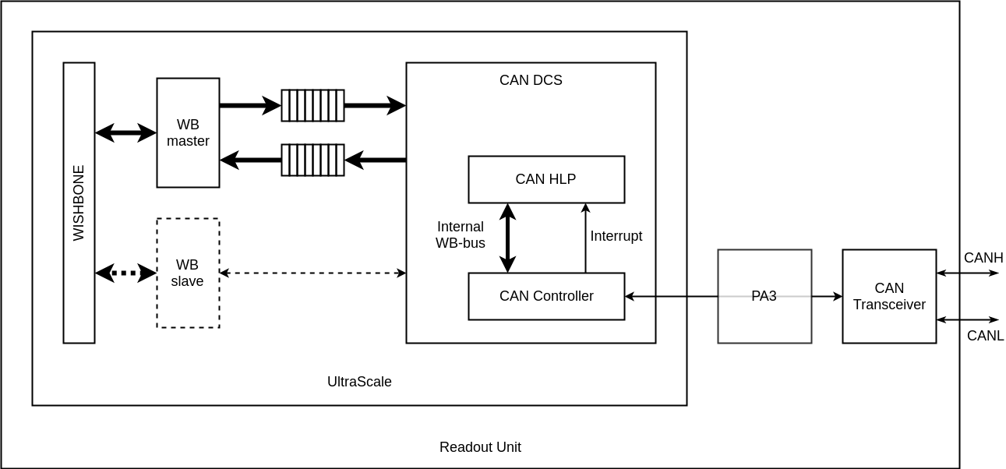
CANbus Controls Transactions
CANbus Opencores controller for raw packets
High-Level-Protocol on top of controller to define a node based communication interface and to define simple READ and WRITE transactions & responses with appropriate payload
Interface to wishbone bus same as GBT:
  Input & Output FIFOs
  Wishbone Master for transactions on bus
WB slave interface in controller to configure protocol parameters like baud-rate and filters
Electrical pass-through
Emulate a “network topology”: Divide 11-bit CAN ID field into a “Node ID” and a “Command” field:
MsgID[10:4] = N[6:0] = NodeID
MsgID[3:0] = C[3:0] = Command
ID[10] | ID[9] | ID[8] | ID[7] | ID[6] | ID[5] | ID[4] | ID[3] | ID[2] | ID[1] | ID[0]
N[6] | N[5] | N[4] | N[3] | N[2] | N[1] | N[0] | C[3] | C[2] | C[1] | C[0]
Allows for up to 128 nodes per CAN network

Slide 27
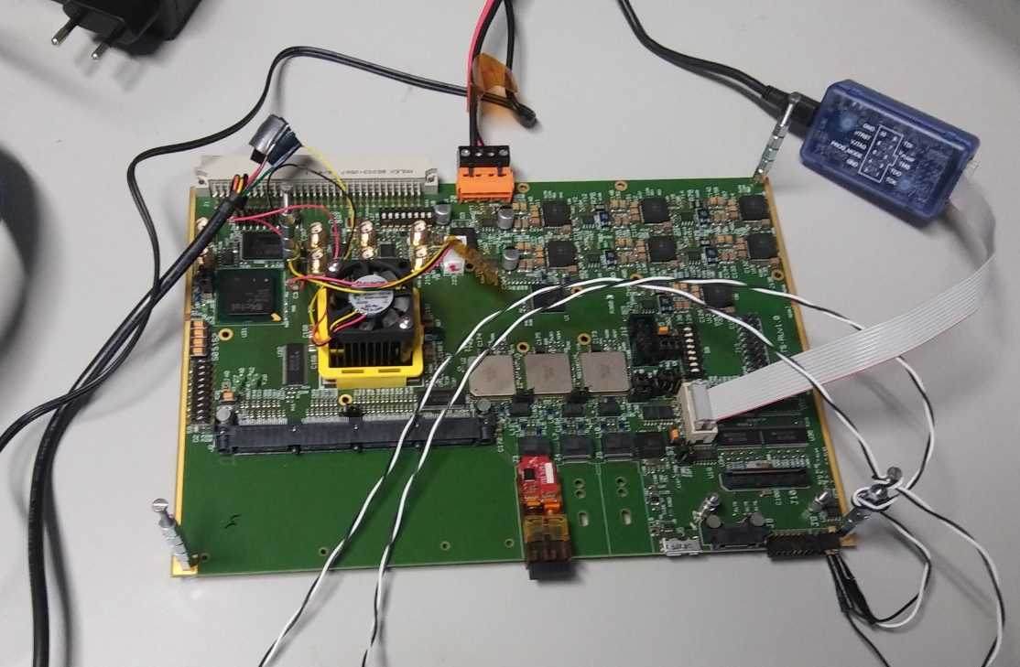
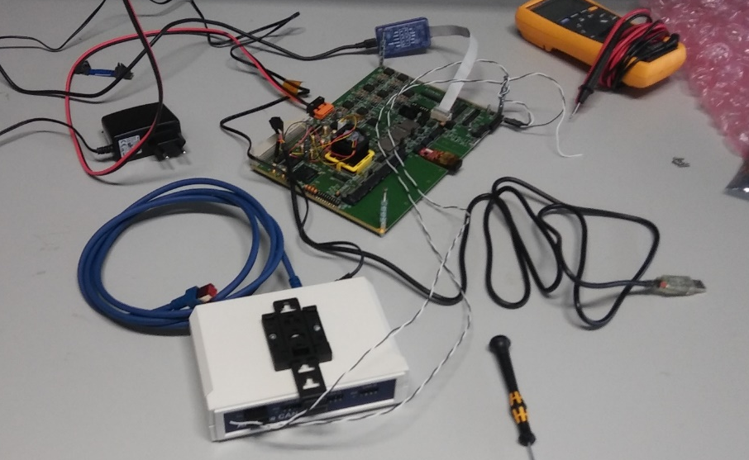
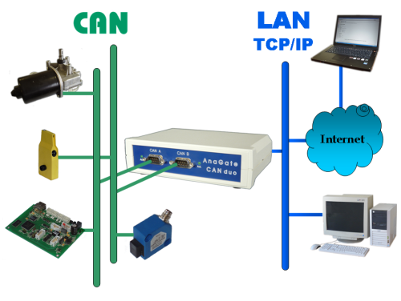
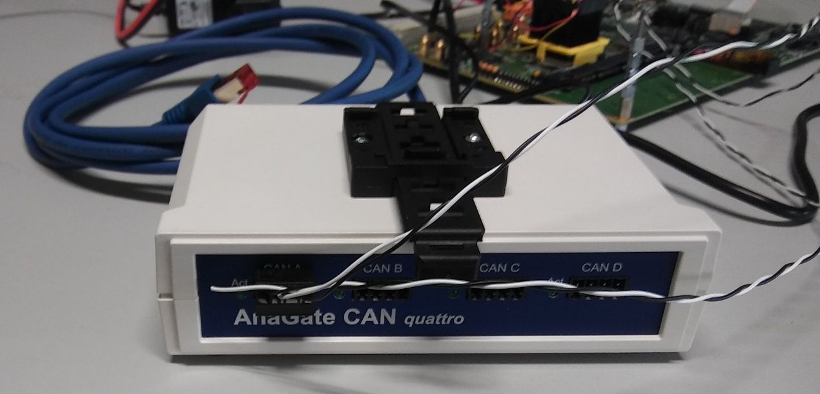
CANbus Test Setup
Anagate “CAN Quattro” CAN controller
Opencores “Project CAN” protocol controller
Wishbone interface to PA3 firmware for configuration
Configured for 1Mbps baud rate
“CAN Monitor” from Anagate to generate and receive standard and extended ID CAN packets with up to 8 bytes payload

Slide 28
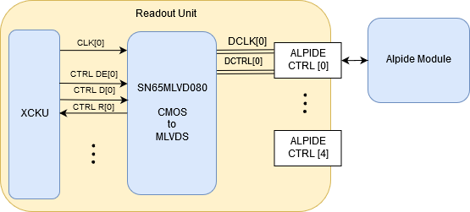
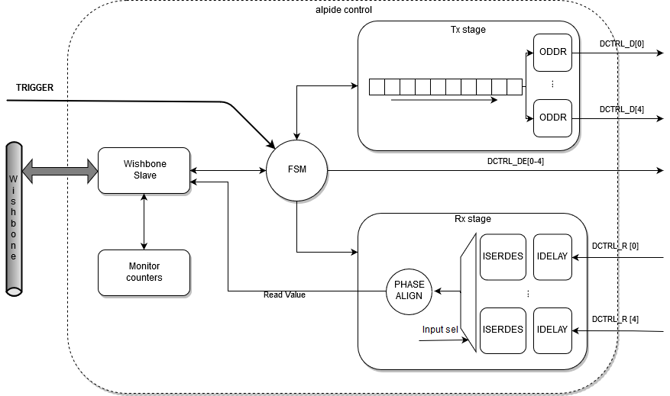
Alpide Control Implementation
Physical Implementation
Firmware Logic

Slide 29
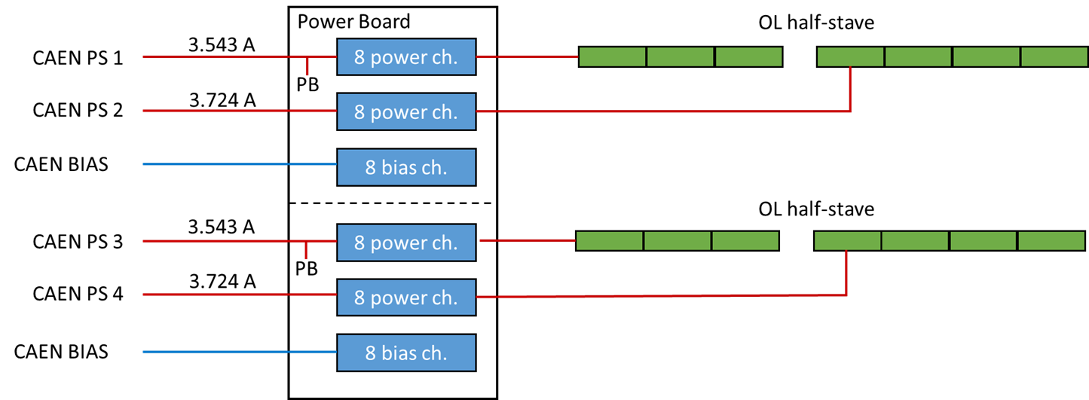
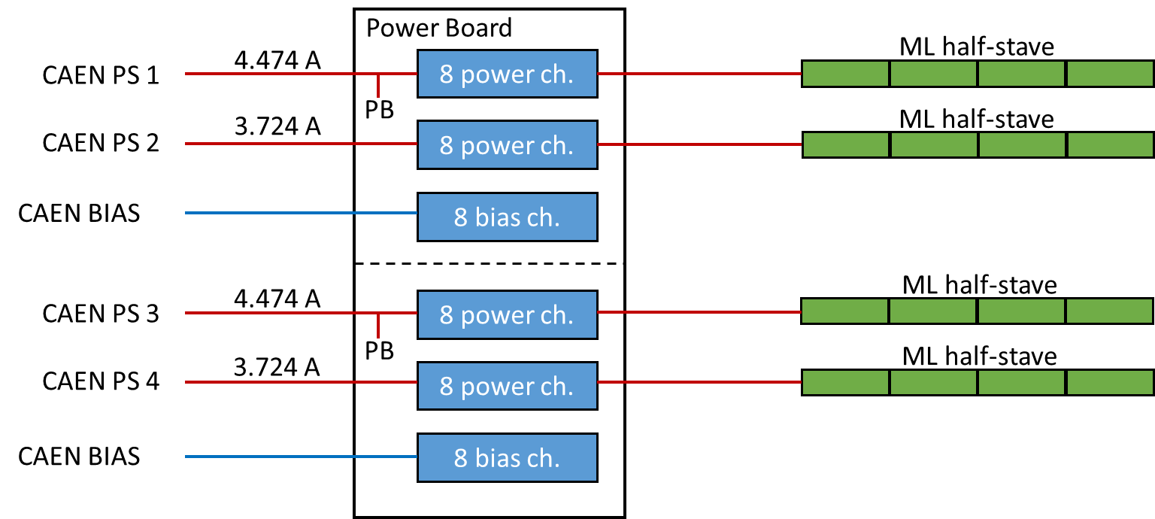
Power Board – Interface to Readout Unit
Two 8-channel Power Units are combined into one board stack called a “Power Board”.
Each Power Unit provides power for up to 8 modules (16 per Power Board)
In layers 5 & 6 each Power Board provides power for one full stave (one power unit per half-stave)
In all other layers, each Power Unit provides power for one stave, so there are 2 staves per Power Board
Each Power Unit is interfaced to a Readout Unit via 2 (differential) I2C buses, with multiple devices per bus
Each Power Board consisting of 2 Power Units therefore has a total of four I2C buses
In layers 5 & 6, each Power Board interfaces to one Readout Unit (a total of four I2C buses per Readout Unit)
In all other layers, each Power Unit interfaces to one Readout Unit (a total of two I2C buses per Readout Unit)
Control via two I2C wishbone slaves (one per Power Unit) allows setting and monitoring voltages, currents, temperature thresholds and power status
Outer Layer Configuration
Middle Layer Configuration

Slide 30
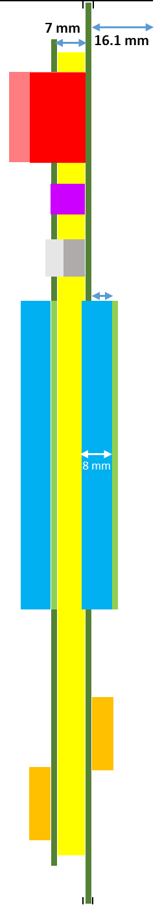
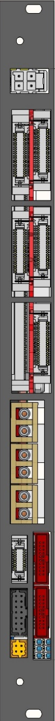
Power Board – Readout Unit Pairing
Outer Layers
Middle Layers
Inner Layers
I2C
I2C
I2C
I2C
I2C
I2C
I2C
I2C
I2C
I2C
I2C
I2C

Slide 31
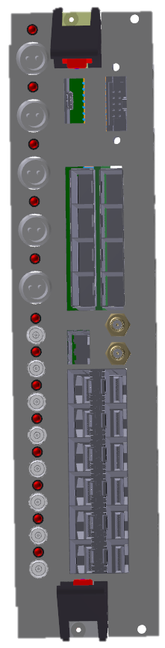
Trigger Interface – Optical Splitting
The CTP directly drives a set of Local Trigger Units (LTUs), each responsible for delivering the trigger to a specific detector.
ITS will have its own LTU
ITS LTU will drive 12 (or 6) Single Mode, 1030nm SFP+ Modules.
Mini-frame
Low radiation area
Readout Unit
Sensor
ITS
optical
copper
Passive optical splitting 1:16 (1:32 also possible)
optical
16×
Up to 28×
Each optical line is split into 16/32 lines by a passive optical splitter, which can withstand the foreseen TID level (10 kRad) and does not suffer from SEU.
As each LTU has 12 optical drivers, a 1:16 splitting ratio (at least) will be ok
12×

Slide 32
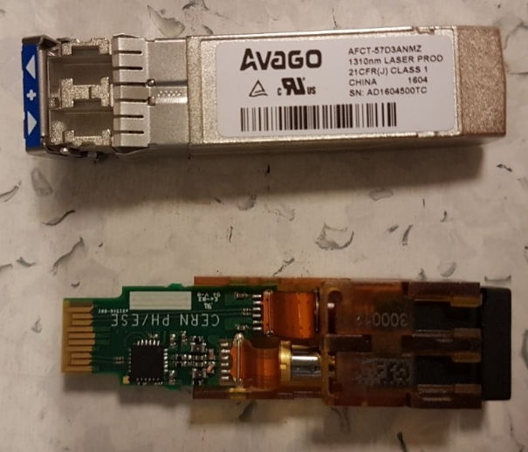
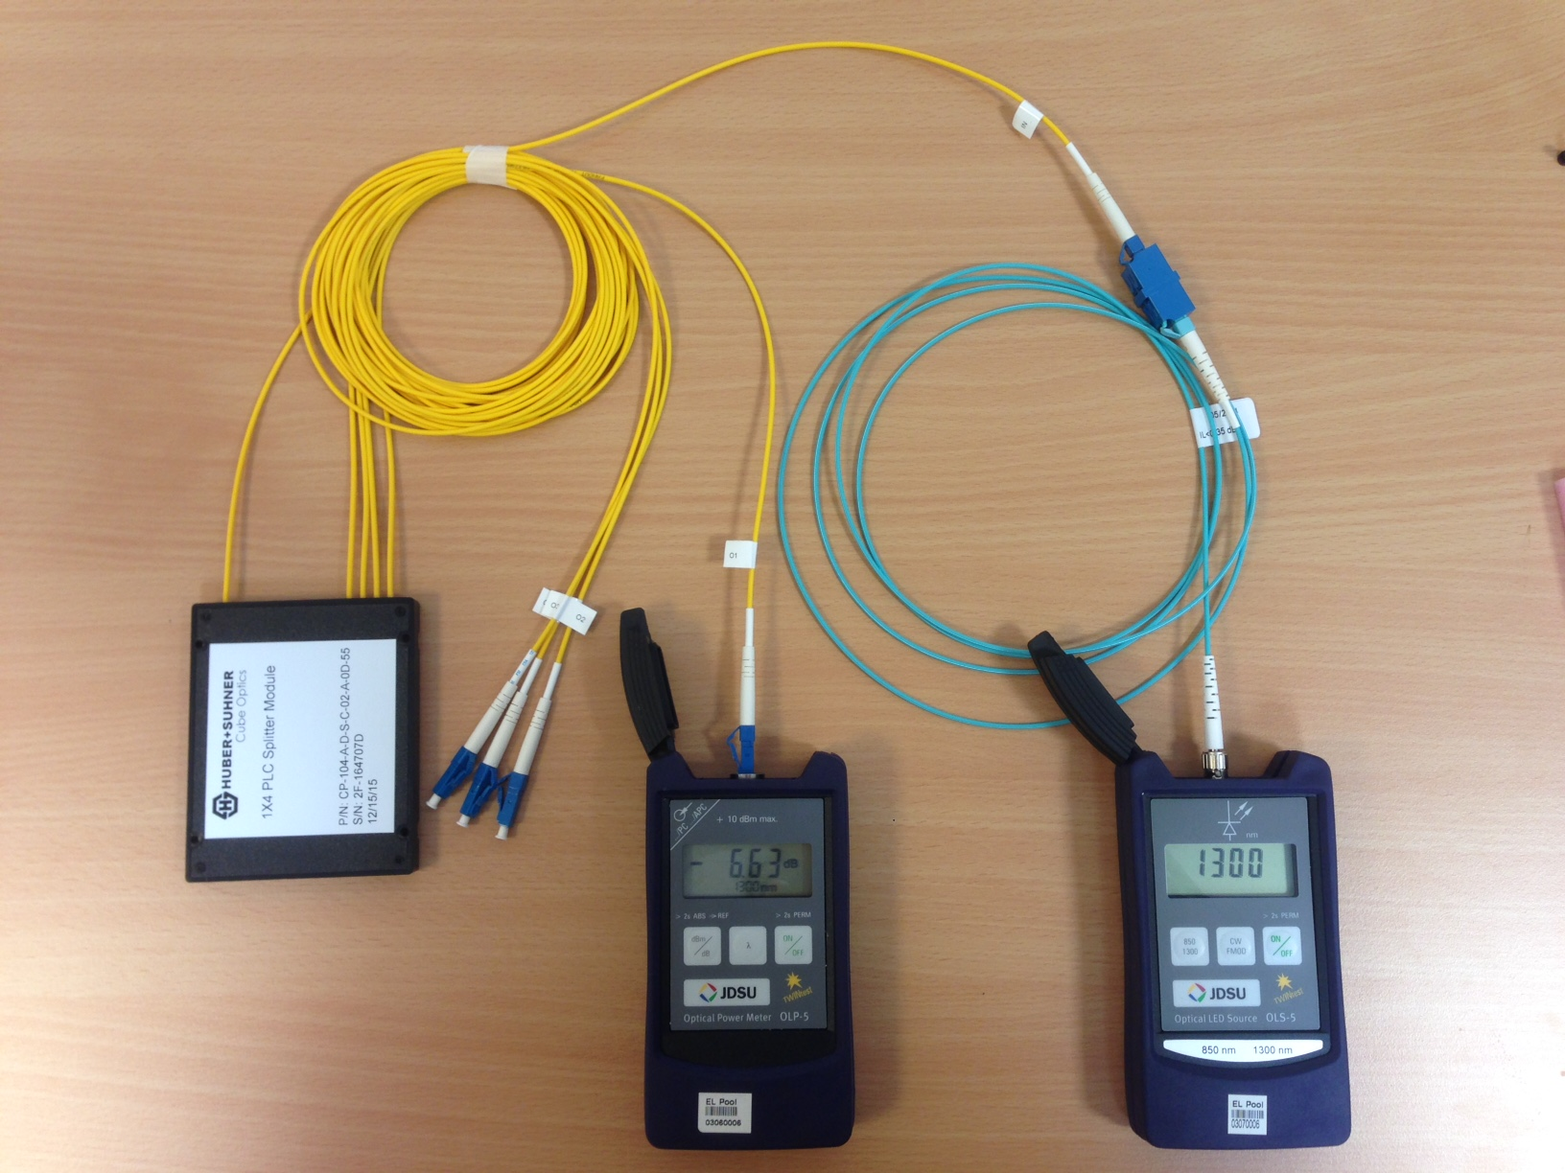
Optical Fiber Power Loss Tests
Splitter | Power loss Ideal splitter [dB]¹ | Power loss Measured [dB] | Margin [dB]²
1:2 splitter | 3 | 3.686 | 16.689
1:4 splitter | 6 | 6.838 | 13.539
1:8 splitter | 9 | 10.535 | 9.841
1:16 splitter | 12 | 14.333 | 6.044
1:32 splitter | 15 | 16.359 | 4.983
¹ The numbers for ideal power loss is taken from
http://www.thefoa.org/tech/ref/testing/test/couplers.html
² Margin is given based on:
- the Avago AFCT-57D3ANMZ transmitter (optical power output +5 dBm)
- the VTRx sensitivity (-15.376 dBm)
³ Fiber optics association: http://www.thefoa.org/tech/lossbudg.htm
As a general rule, the link loss margin should be greater than approximately 3 dB to allow for link degradation over time³.
The dynamic range for the chosen Transmitter & Receiver is about 20 dB
  The LTU has been verified to support the powerful Avago AFCT-57D3ANMZ transmitter.
The power tests shows that all topologies have a margin > 3 dB
  This is in line with the specifications given by the manufacturer of the splitter

Slide 33
Data Streaming

Slide 34
Schematic Setup for Data Streaming Tests
Remote Control
Power Supply
RUv1
UART/USB-2
Power
DC/DCs
ADC
SCA
GPIO or I2C
PA3
PC
Kintex
Ultrascale
Select
Map
CRU
GBTx
CLK
GBT
10
10
Flash
PROM
Power
9 DATA
Power
Board
DCTRL
I2C
DCLK
Inner Barrel Module
Power

Slide 35
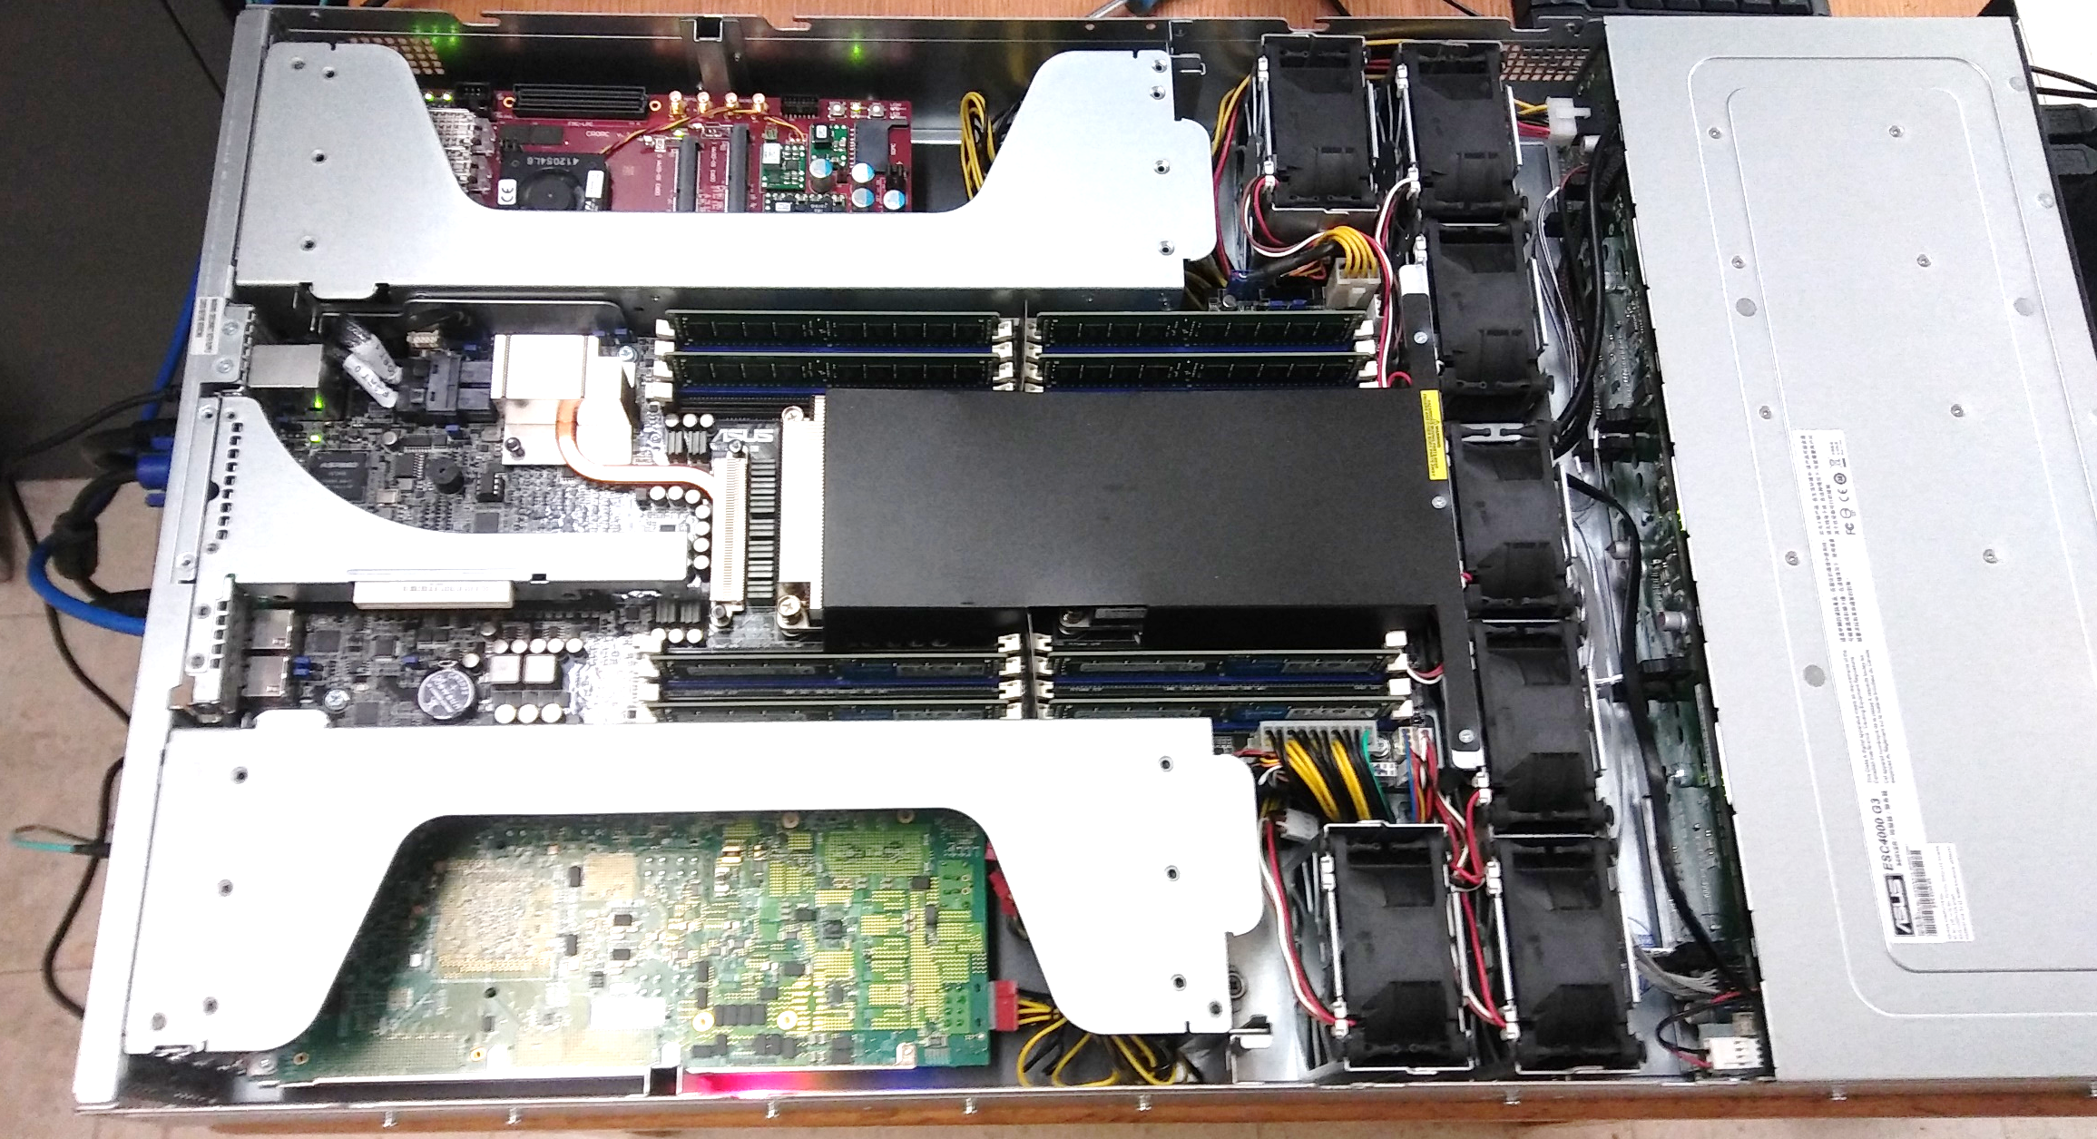
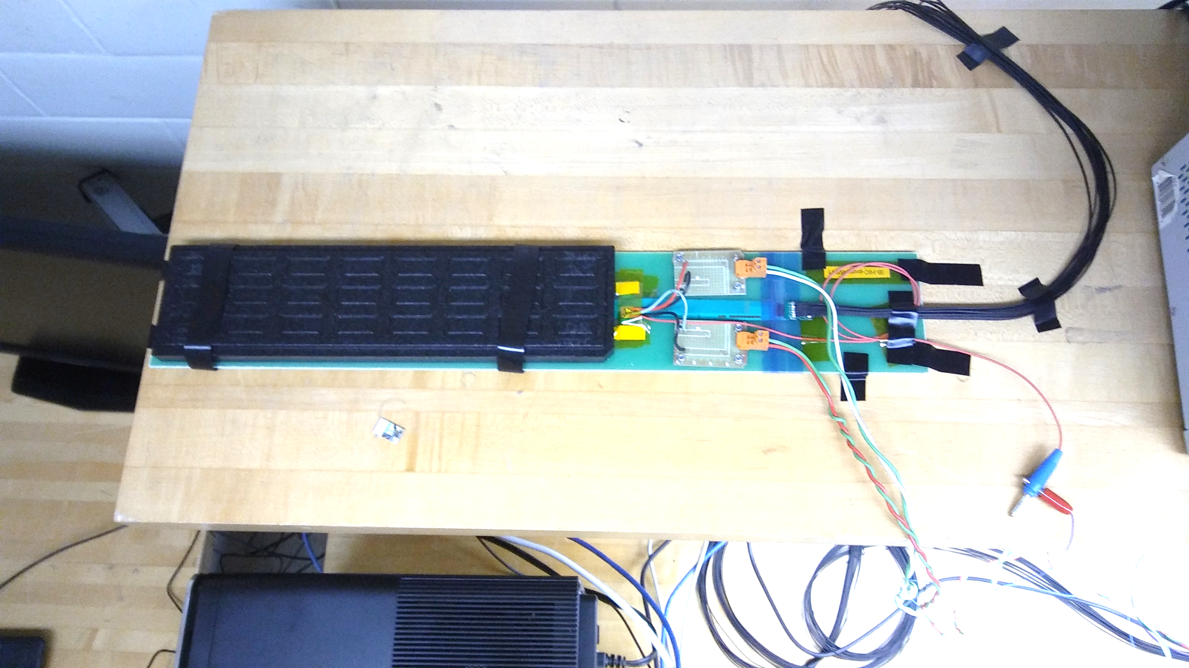
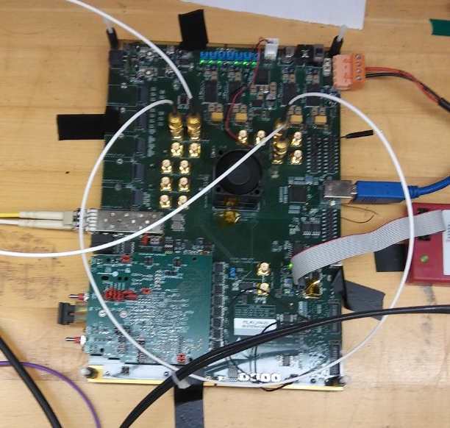
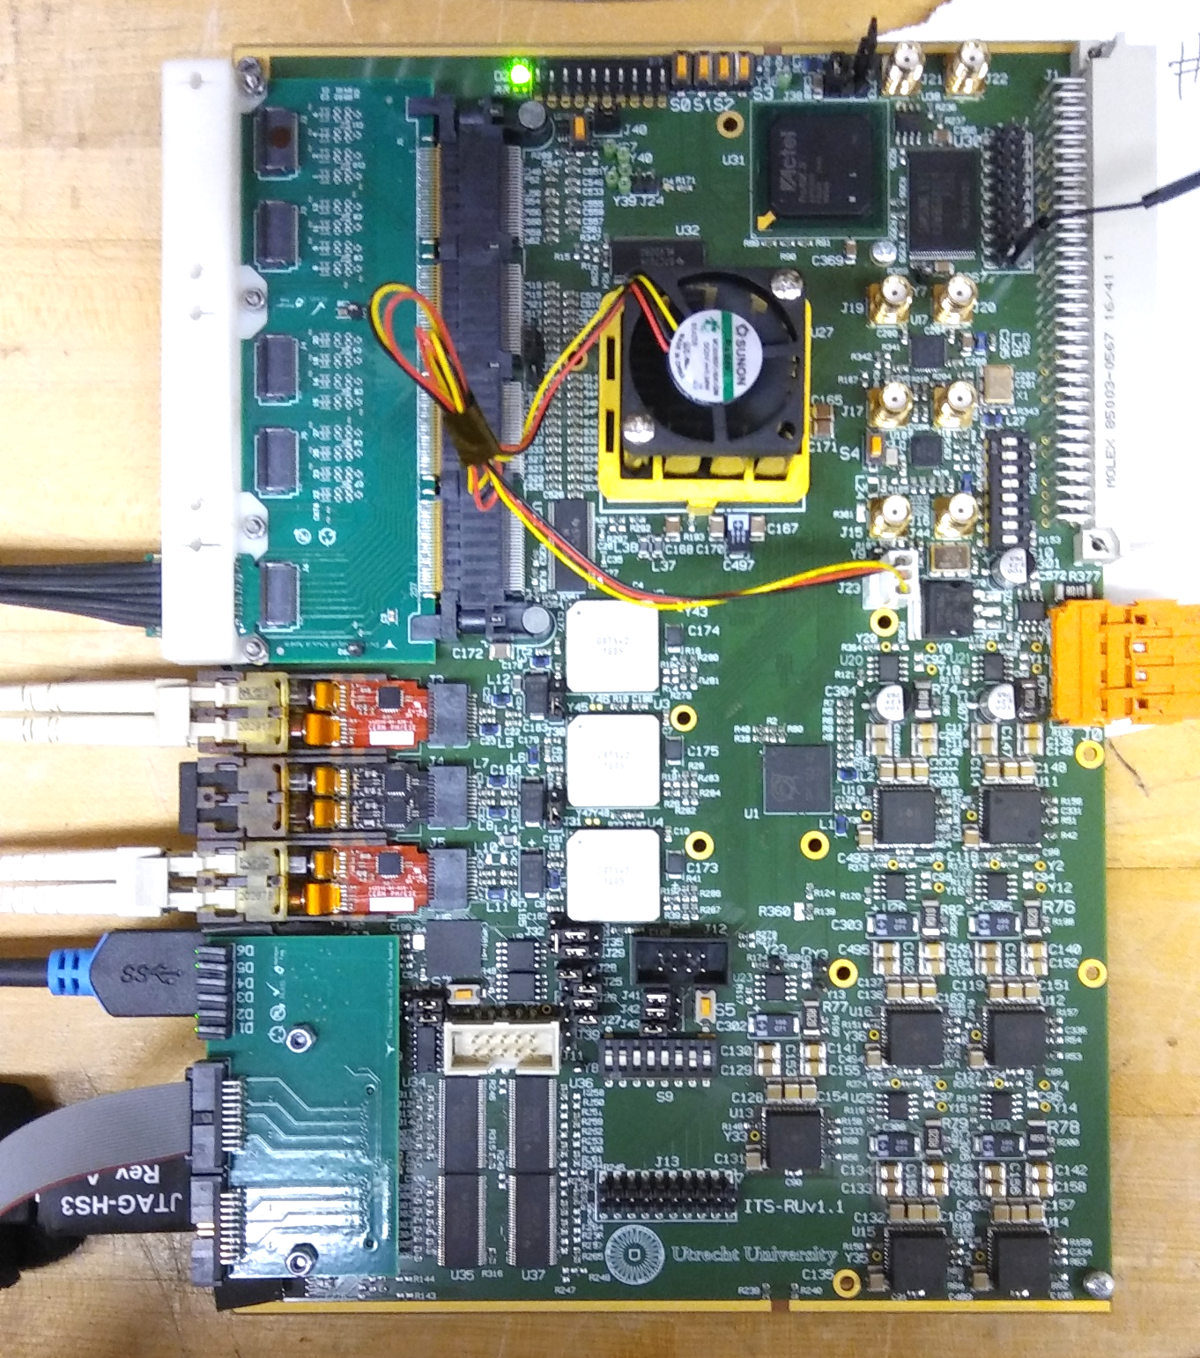
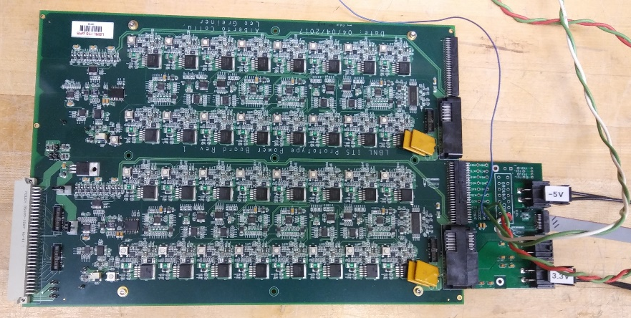
Data Streaming Test Setup
CRU
FLP
Altera Arria-X DevKit
Inner Barrel Module
“CRU” Emulator
Power Board Prototype
RUv1

Slide 36
CRU Interface Tests
Three different Interfaces from CRU to Readout Unit tested: SCA, SWT, Data
SCA interface provided by both C++ and Python library via register write/read.
Tested with Python interface library to read voltages, currents and temperatures from RU SCA
SWT interface provided by both C++ and Python library via registers that access SWT FIFOs in CRU firmware
Tested with Python interface library to read and write registers from various wishbone slaves
Data Path Configuration interface via C++ library to interface with configuration registers
Setup Data Streaming into one of 3 modes:
  Packet Mode
  Raw Link streaming (continuous mode)
  Packet Emulator (for testing)
Trigger Interface Path with configurable source:
  CTP Emulator (firmware from CTP group)
  TTC PON (from LTU)
Data output via DMA over PCIe to memory of FLP in 8kByte packets
Option to record memory pages to a disk file for later analysis

Slide 37
CRU simplified logical data flow
Trigger Emulation inside CRU Firmware

Slide 38
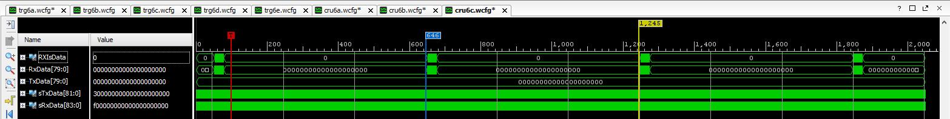
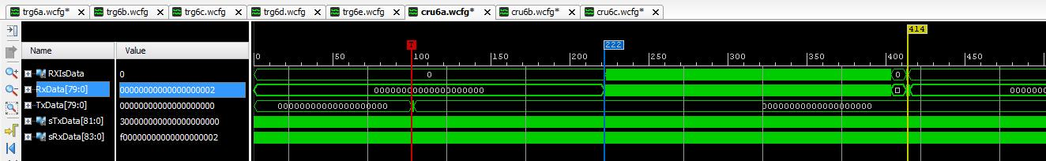
Data Arrival in CRU - Continuous and Triggered
Continuous Readout
Triggered Readout

Slide 39
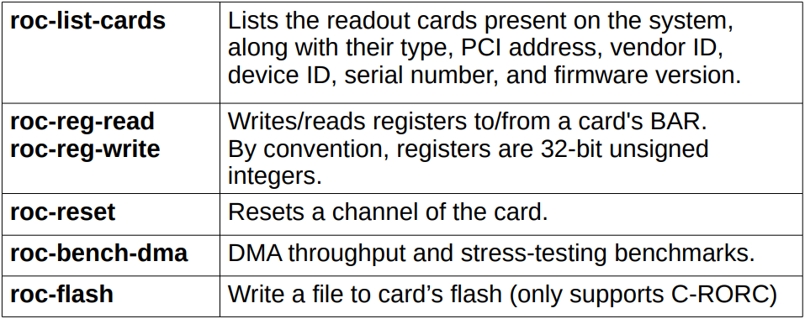
CRU: “Readout Card” (ROC) Interface library

Slide 40
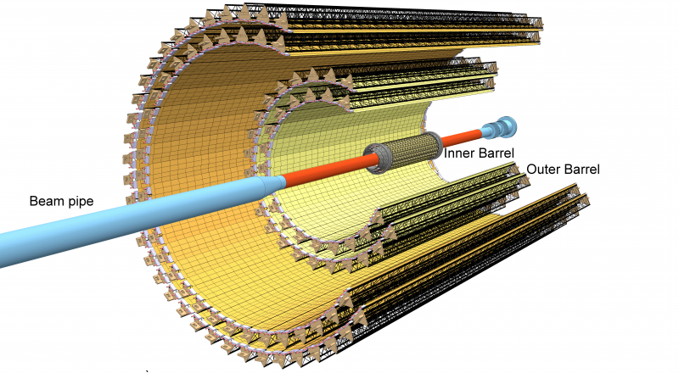
ITS Readout – Data Rate Specifications
ALICE baseline requirements:
50 kHz Pb-Pb
200 kHz p-p
ITS design specification:
100 kHz Pb-Pb
400 kHz p-p

Slide 41
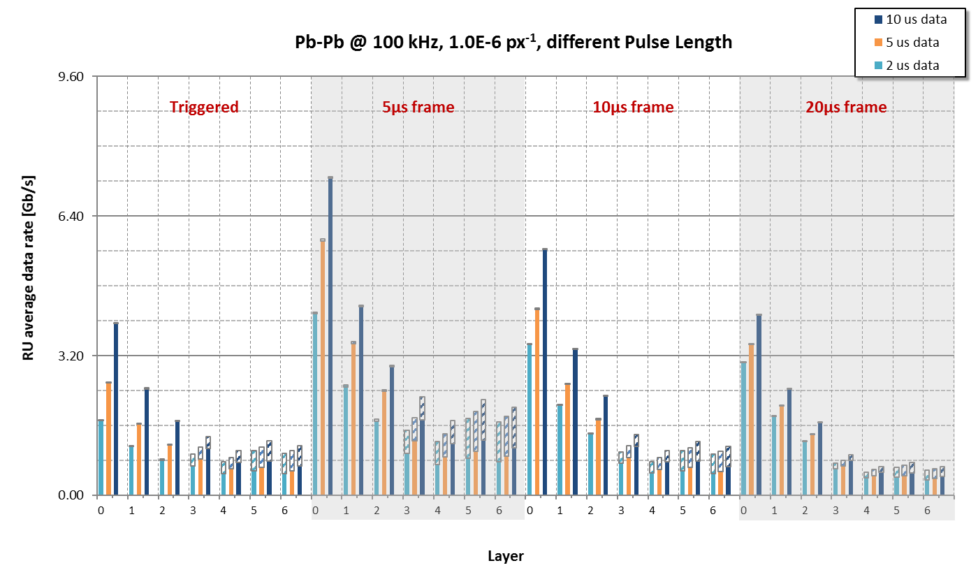
Data rate – PbPb @ 100kHz per Readout Unit

Slide 42
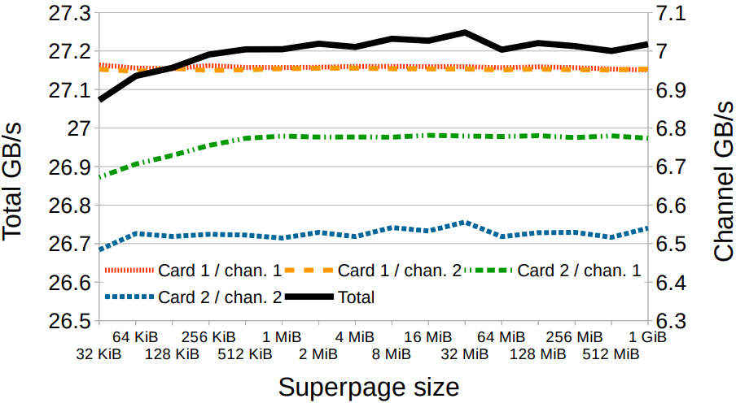
ROC bench tool performance
FLP 2 CRUs 4 PCIe endpoints
Total throughput

Slide 43
Backup Slides - Firmware

Slide 44
Firmware Development Environment
E-group: All communication between firmware developers is organized through membership in a CERN e-group (alice-its-wp10-firmware@cern.ch). The e-group is also used for access control to the version control system (gitlab) and the issue tracking system (JIRA)
Online Documentation: Documentation of hardware, Firmware, and software is posted at the WP10 Twiki page in the “ALICE Web” Twiki: https://twiki.cern.ch/twiki/bin/view/ALICE/ITS-WP10
Hardware Programming languages: We decided to allow 3 different firmware languages: VHDL, Verilog and System Verilog. Currently, the prototype development is on the Xilinx 7-series, and the Vivado toolset supports all 3 languages.
Tool Sets: The current design of the Readout Unit (RU) foresees the main programmable logic to be a Xilinx SRAM based Kintex UltraScale(+). Prototyping was started with a Xilinx Kintex-7. These devices are supported by the Xilinx Vivado Toolset. We are currently using Vivado version 2017.4. The RU design also includes a flash-based device to support scrubbing. This device is foreseen to be the ProAsic-3 from Microsemi which is supported by the Microsemi Libero SoC Design Suite. To develop detector specific logic on the CRU requires the use of the Altera Quartus toolset. We are considering evaluating this toolset in the future. For FX3 (USB) firmware design, we are using the Cypress EZ-USB Suite & GPIF-II Designer.
Simulations: Currently two toolsets are used for firmware test benches: Mentor Modelsim and Cadence Incisive (NCSim). The Cadence tools is only used by CERN collaborators at the moment.
Coding Style: For firmware coding in VHDL, a coding style document was developed: https://twiki.cern.ch/twiki/bin/view/ALICE/FwDevFlowMethods
Scripting: Most firmware toolsets support scripting in Tcl. Tcl is the scripting languate integrated in the Vivado tool environment. The firmware projects developed in WP10 are required to include a Tcl script to create the project and compile it to ensure common project configuration amongst developers. An optional “Makefile” can be used to call targeted Tcl scripts for various tasks (project creation, compilation, simulation, etc…)

Slide 45
Software
Hardware Platform: The main supported platform is currently a PC running the CERN CentOS 7 (CC7) operating system with Vivado 2016.4 and Modelsim SE 10.4a installed. Similar features can be achieved by using the Windows mingw platform with the Msys shell, but full compatibility with the Linux development is not guarantied by WP10
Software Environment: To ensure compatibility for software co-development it is recommended to install the Linux Developer Toolset in CC7 (https://linux.web.cern.ch/linux/devtoolset/), which provides more up-to-date compilers and libraries. Python is used for scripting to interact with the WP10 prototype hardware (currently via USB). We use the Continuum Analytics Anaconda platform (Python 3.6 version) to provide the python tools (https://www.continuum.io/anaconda-overview). This platform is also available for Windows.
Version Control: CERN gitlab is used for version control of the firmware and software development within WP10. The gitlab group for WP10 is located at: https://gitlab.cern.ch/alice-its-wp10-firmware/. Membership in this gitlab group is via the e-group. Various projects are hosted in this gitlab group, the main prototype development is currently in the project “itswp10”.
Issue Tracking: CERN JIRA is used for issue tracking. The WP10 issues are tracked underneath the ALICE project JIRA at: https://alice.its.cern.ch/jira/projects/IT.
File exchange: Files that are too big or not version controlled are exchanged via a shared CERNbox. Currently, this is by invitation only, since the CERNbox account used is a private account.

Slide 46
Backup Slides – Control Interfaces

Slide 47
Opencores CAN Protocol Controller
https://opencores.org/project,can
Written in Verilog
Supports basic CAN and extended CAN
  11-bit ID and 29-bit ID
  ID mask and filtering
Up to 1Mbps operation
Transmit/receive/error interrupts
Wishbone interface (8-bit address and data)
Register map compatible with Philips SJA1000 CAN Controller IC
  https://www.nxp.com/docs/en/data-sheet/SJA1000.pdf
Size: 12k gates (930 flip-flops)

Slide 48
CANbus protocol proposal
Emulate a “network topology”: Divide 11 bit CAN ID field into a “Node ID” and a “Command” field:
MsgID[10:4] = N[6:0] = NodeID
MsgID[3:0] = C[3:0] = Command
ID[10] | ID[9] | ID[8] | ID[7] | ID[6] | ID[5] | ID[4] | ID[3] | ID[2] | ID[1] | ID[0]
N[6] | N[5] | N[4] | N[3] | N[2] | N[1] | N[0] | C[3] | C[2] | C[1] | C[0]
Allows for up to 128 nodes per CAN network
Command Codes
Command Code | Meaning
1 | DATA
2 | “WRITE” command
3 | Write Response (optional)
4 | “READ” command
5 | Read Response
7 | ”STATUS” or “ALERT”
Write Request:
Read Request:
Write (2) | Write Command
Bytes 0 - 1: | “Address” of this “WRITE”.
Bytes 2 – 3: | “Data”
Read (4) | Length= 2
Bytes 0-1: | “Address” of this “READ”.
Write Response:
Read Response:
Write Response (3) | Length = 3
Bytes 0-1: | “Address” (copied from the received message).
Byte 2: | Status resulting from this write or sub-command. A value=0 indicates successful completion. Non-zero values indicate (various) errors (to be determined)
Read Response (5) | Length 2 to 4 bytes
Byte 0-1: | “Address” of this “READ” (copied from the received message).
Bytes 2-3: | 2 additional bytes representing data value resulting from “reading” the requested address. Lack of these bytes (i.e. a short message) indicates an invalid read address/request.

Slide 49
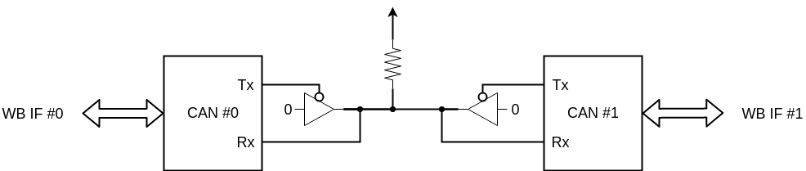
OpenCores CAN Protocol Controller Simulations
Tested using a simple Bitvis UVVM style testbench
Two instances of the CAN controller connected
Two separate WB interfaces to write to each controller
40 MHz clock

Slide 50
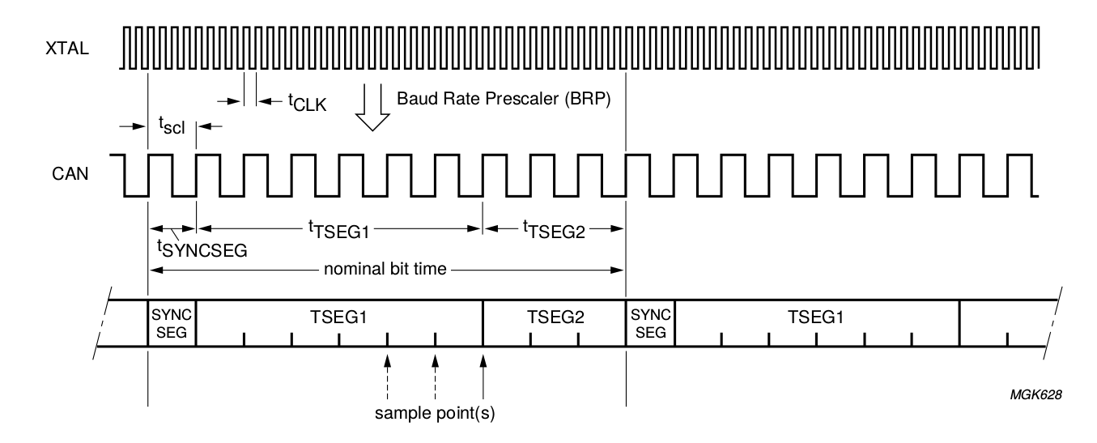
OpenCores CAN Protocol Controller Simulations
Bit Timing Register (BTR0) configured for 4x baud clock prescale
t_{SEG1} set to 7 baud clocks, t_{SEG2} set to 3 baud clocks, in BTR1
t_{SYNCSEG} is always 1 baud clock
Gives us a bit rate of 40 MHz / (4 * (1+7+3)) = 1Mbps

Slide 51
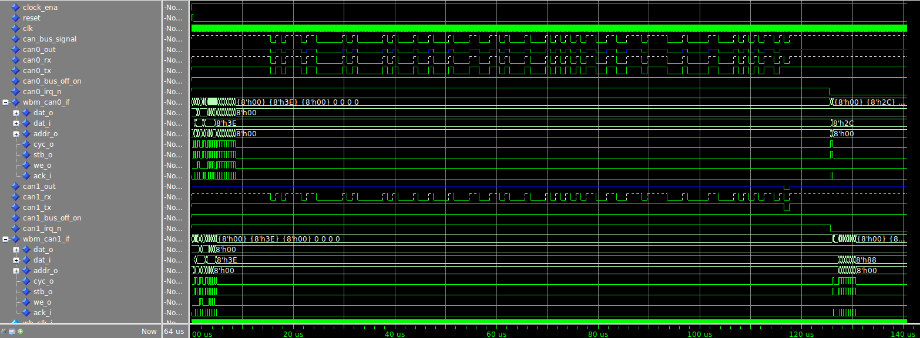
OpenCores CAN Protocol Controller Simulations
Simulation waveforms, showing initial WB transactions on both controllers, CAN transmission, and CAN IRQ lines going low after message

Slide 52
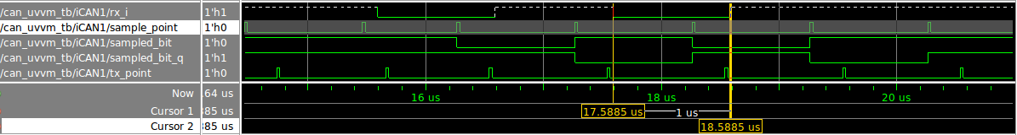
OpenCores CAN Protocol Controller Simulations
sample_point marks the point where bits on rx_i are being sampled
The simulated bit period is 1 us, as it was configured for
The sampling point is located at 7/10ths of a microsecond into each bit, corresponding to what t_{SEG1} and t_{SEG2} were configured for

Slide 53
OpenCores CAN Protocol Controller Simulations
Testbench log
Set up TX buffer on CAN0 with message for CAN1 (ID 0xBB)
# UVVM: ID_LOG_HDR 4940.0 ns TB seq. Start a transaction from CAN0 to CAN1
# UVVM: -------------------------------------------------------------------------------------------------------------------------------------------------------------------------
# UVVM: ID_BFM 5115.0 ns TB seq. wb_write(A:x"0A", x"BB") completed. Set TXID1 to xBB
# UVVM: ID_BFM 5465.0 ns TB seq. wb_write(A:x"0B", x"08") completed. Set TXID2 to x08, 8 bytes data
# UVVM: ID_BFM 5815.0 ns TB seq. wb_write(A:x"0C", x"11") completed. Set data1 to x11
# UVVM: ID_BFM 6165.0 ns TB seq. wb_write(A:x"0D", x"22") completed. Set data2 to x22
# UVVM: ID_BFM 6515.0 ns TB seq. wb_write(A:x"0E", x"33") completed. Set data3 to x33
# UVVM: ID_BFM 6865.0 ns TB seq. wb_write(A:x"0F", x"44") completed. Set data4 to x44
# UVVM: ID_BFM 7215.0 ns TB seq. wb_write(A:x"10", x"55") completed. Set data5 to x55
# UVVM: ID_BFM 7565.0 ns TB seq. wb_write(A:x"11", x"66") completed. Set data6 to x66
# UVVM: ID_BFM 7915.0 ns TB seq. wb_write(A:x"12", x"77") completed. Set data7 to x77
# UVVM: ID_BFM 8265.0 ns TB seq. wb_write(A:x"13", x"88") completed. Set data8 to x88
# UVVM: ID_BFM 8615.0 ns TB seq. wb_write(A:x"01", x"01") completed. Request transmission on CAN0
# UVVM:
# UVVM:
# UVVM: ID_LOG_HDR 8615.0 ns TB seq. Wait for CAN1 to receive message
# UVVM: -------------------------------------------------------------------------------------------------------------------------------------------------------------------------
# UVVM:
# UVVM:
# UVVM: ID_LOG_HDR 125613.5 ns TB seq. Got interrupt from CAN1.
# UVVM: -------------------------------------------------------------------------------------------------------------------------------------------------------------------------
# UVVM: ID_BFM 125790.0 ns TB seq. wb_check(A:x"00", x"XX")=> OK, received data = x"3E". Check that CAN0 transmit interrupt was set
# UVVM: ID_BFM 126140.0 ns TB seq. wb_check(A:x"02", x"XX")=> OK, received data = x"2C". Check that CAN0 transmit complete status bit is set
# UVVM: ID_BFM 126315.0 ns TB seq. wb_check(A:x"00", x"XX")=> OK, received data = x"3E". Check that CAN1 receive interrupt was set
# UVVM:
# UVVM:
# UVVM: ID_LOG_HDR 127315.0 ns TB seq. Verify message received by CAN1
# UVVM: -------------------------------------------------------------------------------------------------------------------------------------------------------------------------
# UVVM: ID_BFM 127490.0 ns TB seq. wb_check(A:x"14", x"BB")=> OK, received data = x"BB". Verify received RXID1
# UVVM: ID_BFM 127840.0 ns TB seq. wb_check(A:x"15", x"08")=> OK, received data = x"8". Verify received RXID2, 8 bytes data
# UVVM: ID_BFM 128190.0 ns TB seq. wb_check(A:x"16", x"11")=> OK, received data = x"11". Verify received data byte 1
# UVVM: ID_BFM 128540.0 ns TB seq. wb_check(A:x"17", x"22")=> OK, received data = x"22". Verify received data byte 2
# UVVM: ID_BFM 128890.0 ns TB seq. wb_check(A:x"18", x"33")=> OK, received data = x"33". Verify received data byte 3
# UVVM: ID_BFM 129240.0 ns TB seq. wb_check(A:x"19", x"44")=> OK, received data = x"44". Verify received data byte 4
# UVVM: ID_BFM 129590.0 ns TB seq. wb_check(A:x"1A", x"55")=> OK, received data = x"55". Verify received data byte 5
# UVVM: ID_BFM 129940.0 ns TB seq. wb_check(A:x"1B", x"66")=> OK, received data = x"66". Verify received data byte 6
# UVVM: ID_BFM 130290.0 ns TB seq. wb_check(A:x"1C", x"77")=> OK, received data = x"77". Verify received data byte 7
# UVVM: ID_BFM 130640.0 ns TB seq. wb_check(A:x"1D", x"88")=> OK, received data = x"88". Verify received data byte 8
Wait for CAN1 to receive message
Verify message contents

Slide 54
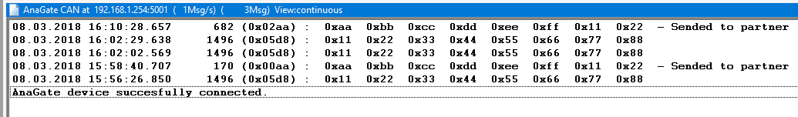
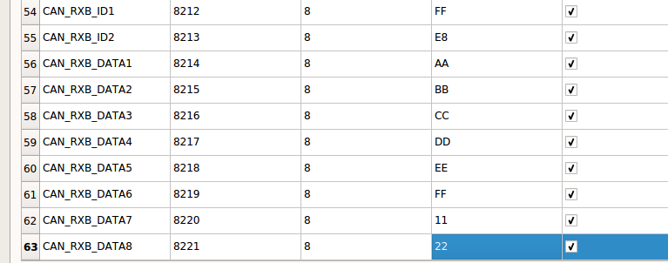
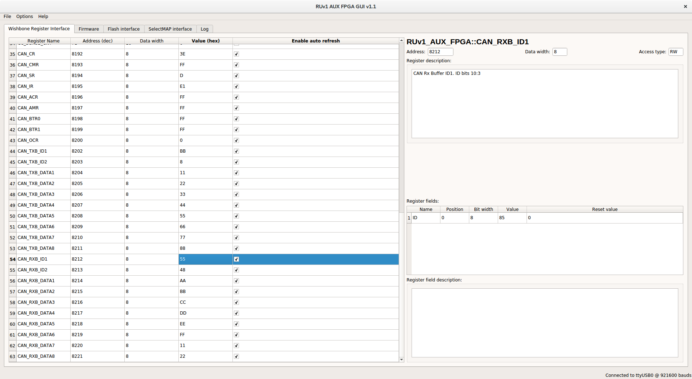
CAN bus testing on RUv1
AnaGate CAN adapter used for testing (same as DCS group is using).
Successfully sent/received CAN messages to/from CAN controller in PA3
AnaGate CAN Monitor program
Readout Unit PA3 GUI software (RX buffer registers)
Readout Unit PA3 GUI software (TX buffer registers)

Slide 55
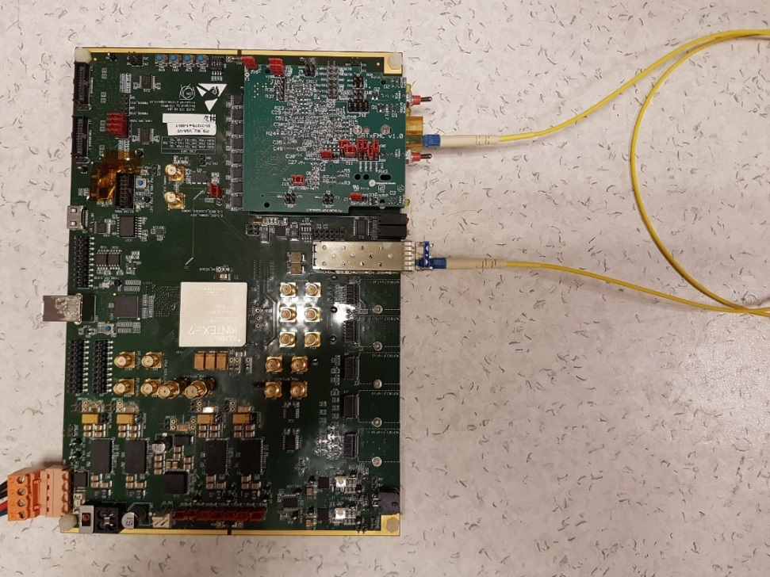
Trigger Interface – Splitter Loopback Test
Loopback test including:
  Actual SFP transmitter & receiver
  1:32 splitter
  Result: 24 hrs w/o errors¹
¹ Test conducted by Jo Schambach

Slide 56
Backup Slides – Data Streaming

Slide 57
PCIe40_v1

Slide 58
CRU v2: PCIe40_v2 from LHCb

Slide 59
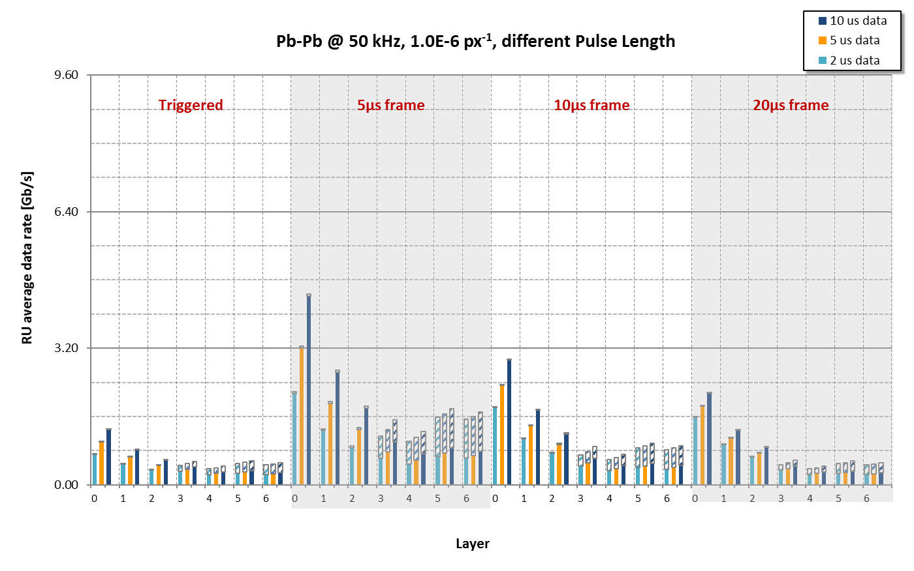
Data rate – PbPb @ 50kHz per Readout Unit

