Slide 1
Space Frame and Cold Plate
Corrado Gargiulo –CERN EP-DT
ALICE ITS Upgrade
Stave Production Readiness Review
CERN, 27 April 2017

Slide 2
ITS Stave: Space Frame and Cold Plate
Description
  Layout
  Coverage
  Hermeticity
  Mechanical gap
  Alignment tolerance

Slide 3
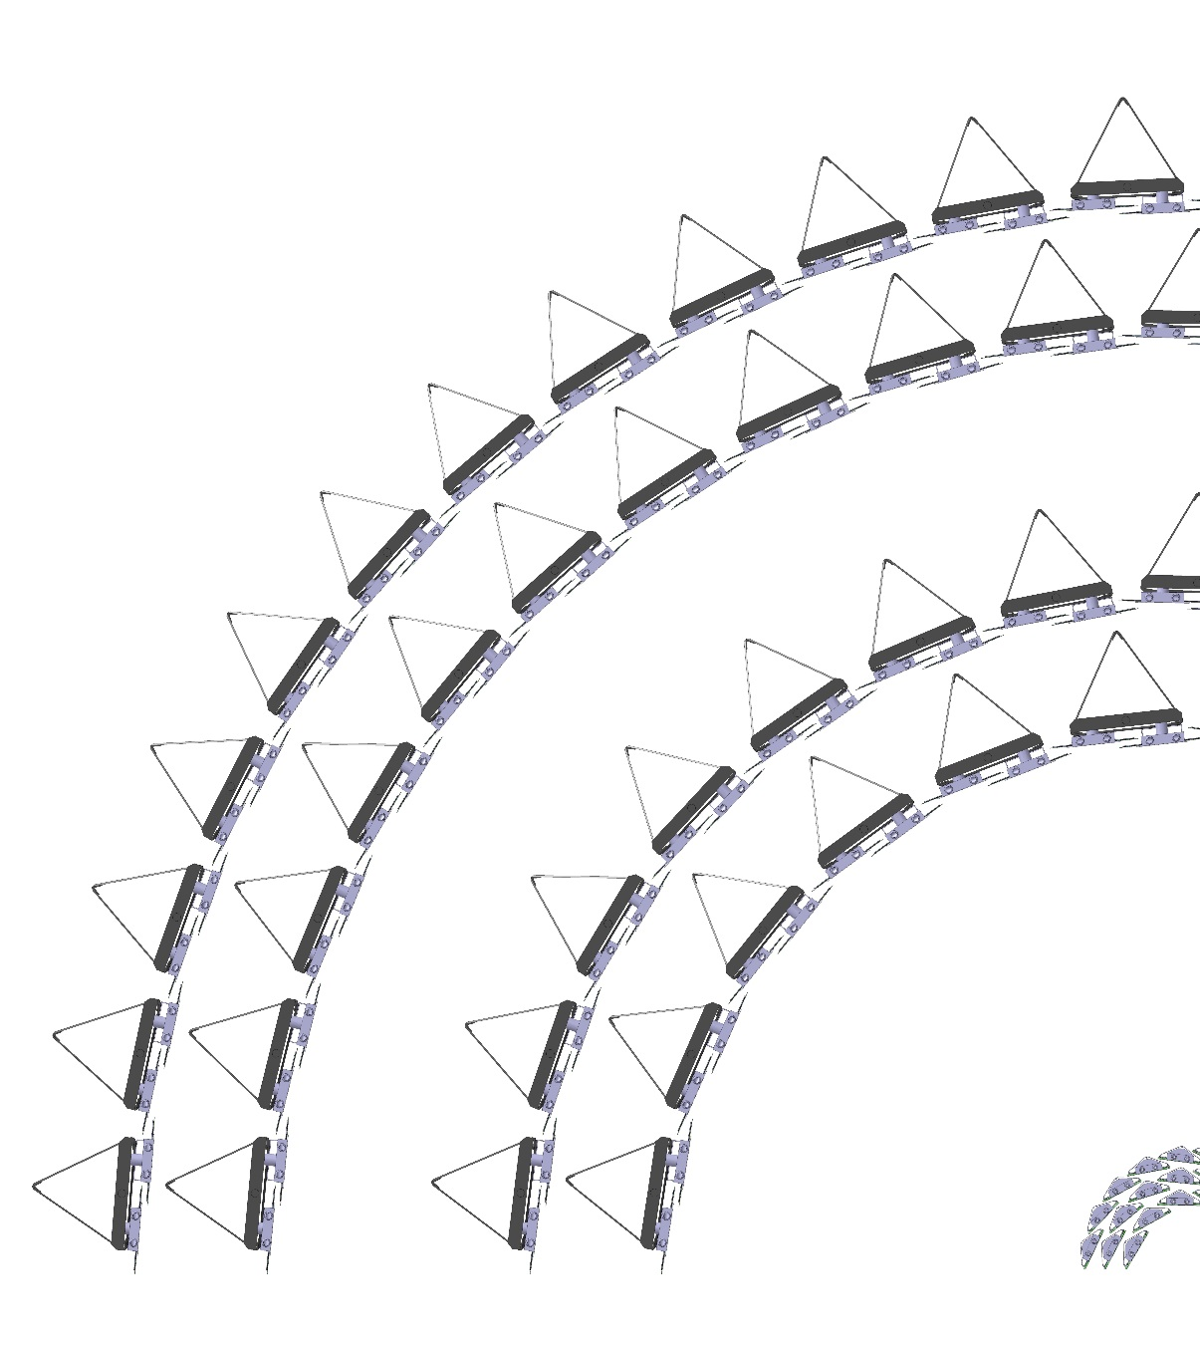
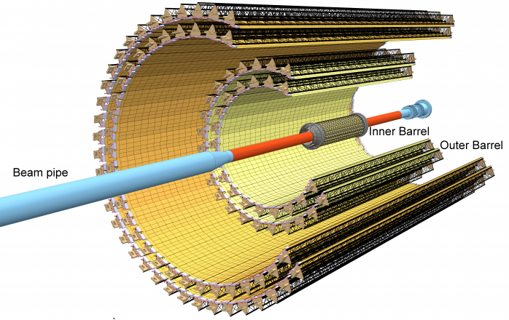
Layout: layers
Outer layers
(OL)
Outer Barrel
(OB)
Middle layers
(ML)
➔ The ITS is constituted by :
- 7 layers; 3 (IL), 2 (ML), 2(OL)
- 192 Staves; 48 (IL), 54 (ML), 90 (OL)
Inner layers
(IL)
Inner Barrel
(IB)
Layer #
6
5
4
3
2
1
0
N. of Stave
48
42
30
24
20
16
12

Slide 4
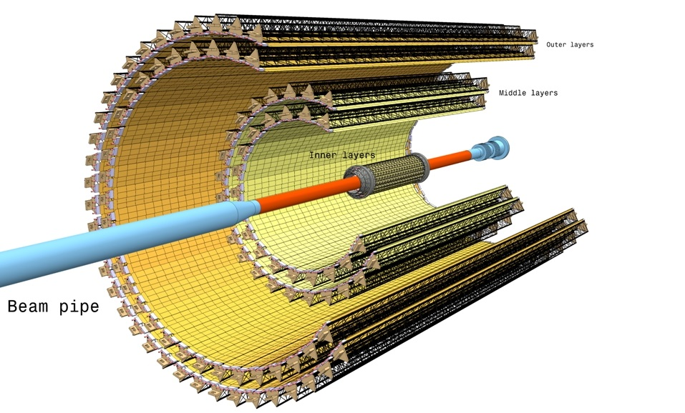
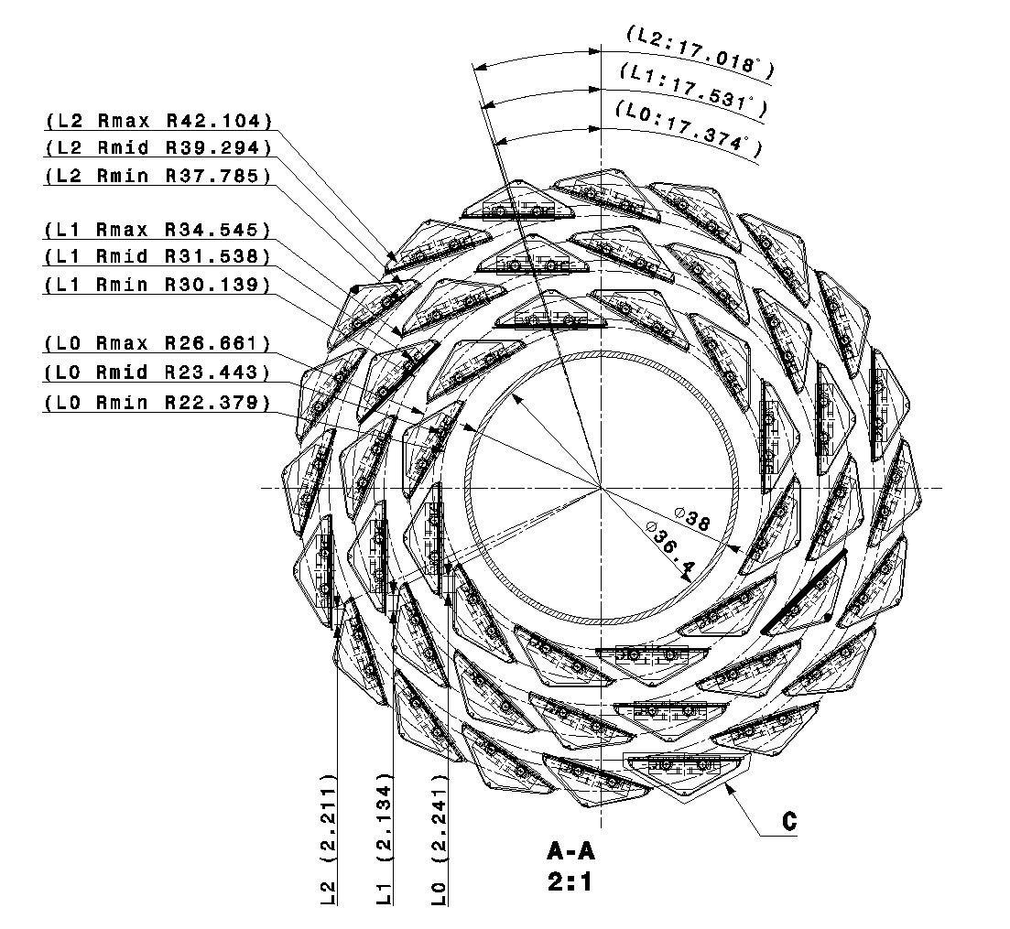
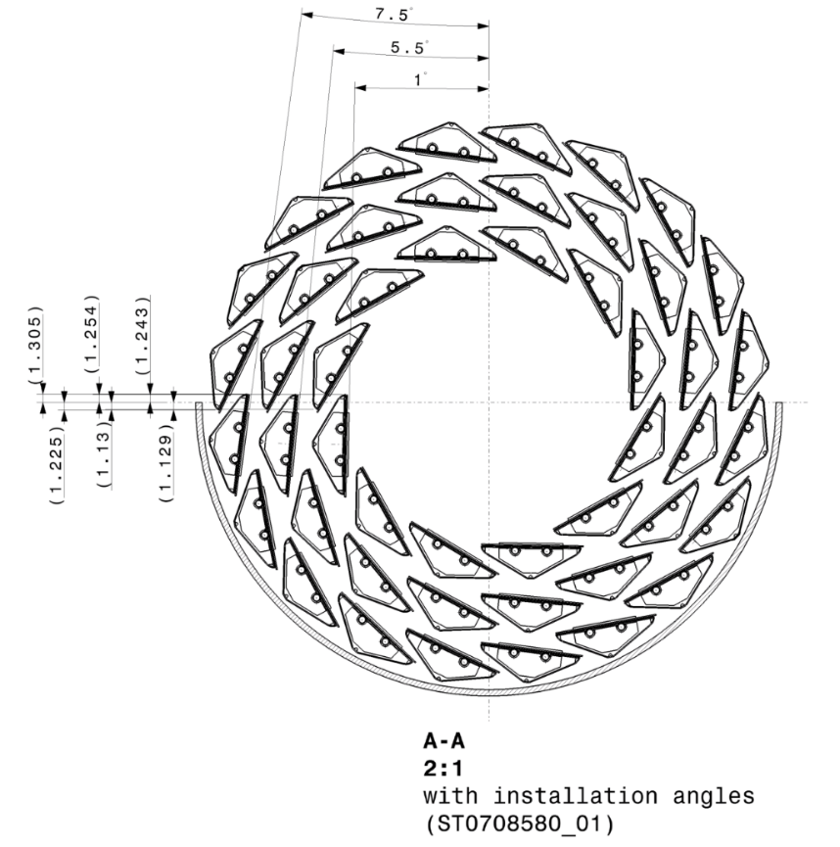
Layout: radial Layers 0, 1, 2
Outer layers
…from 22mm to 42mm radius
Middle layers
Inner layers
Beam pipe
α
chip
Rmid
Rmax
Rmin

Slide 5
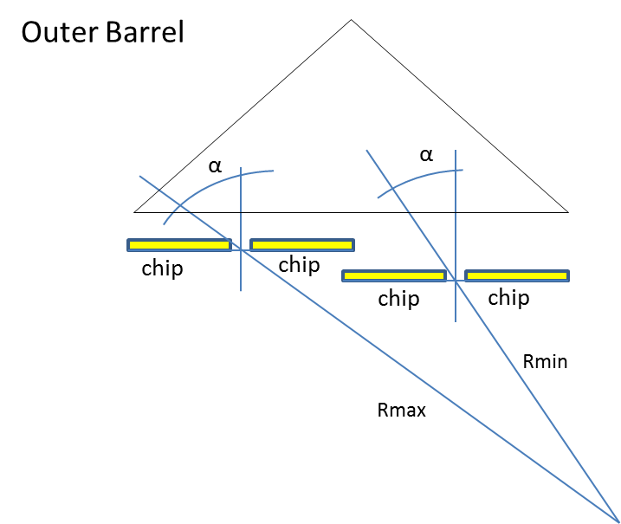
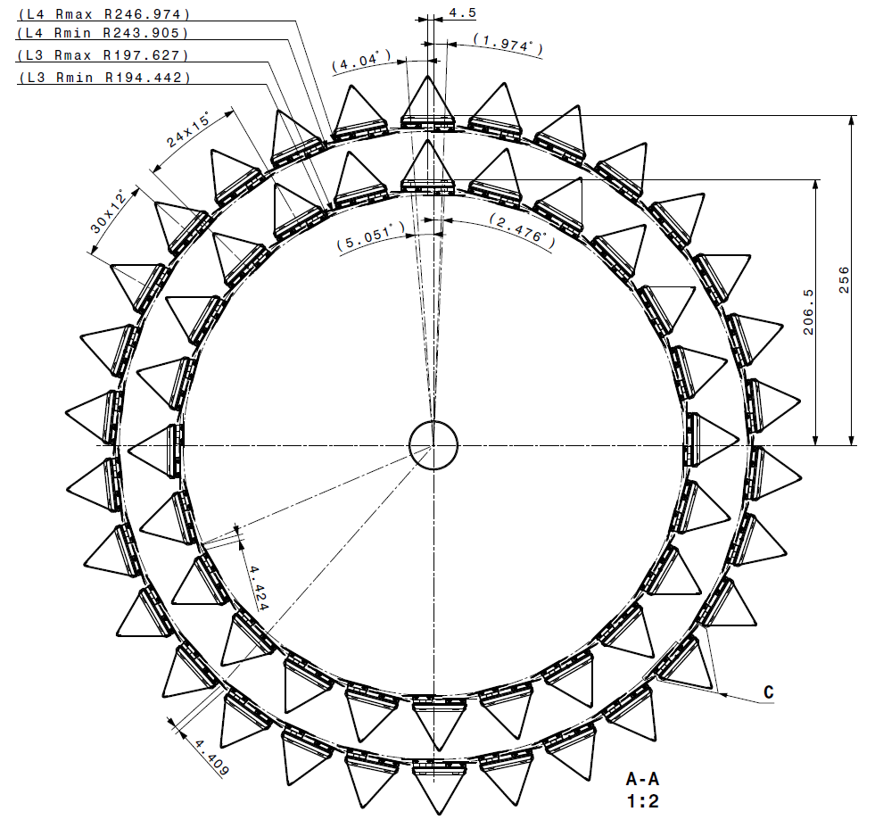
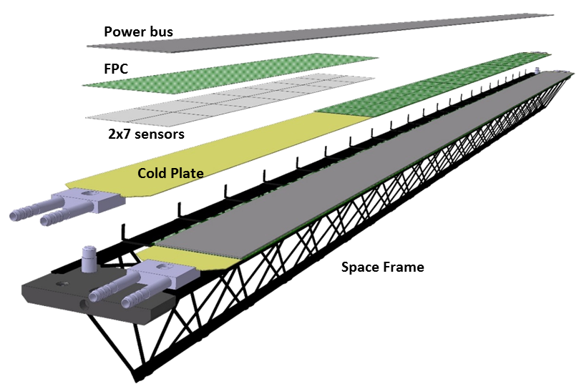
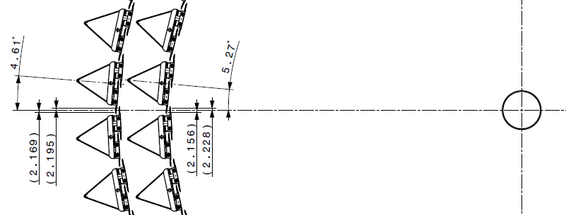
Layout: radial, layers 3-4
Outer layers
…from 194mm to 247mm radius
Middle layers
Inner layers
Beam pipe
n.4

Slide 6
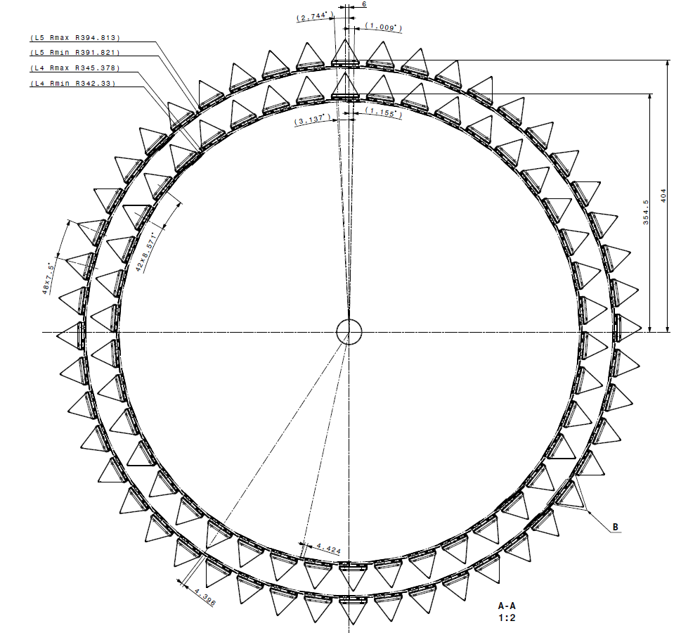
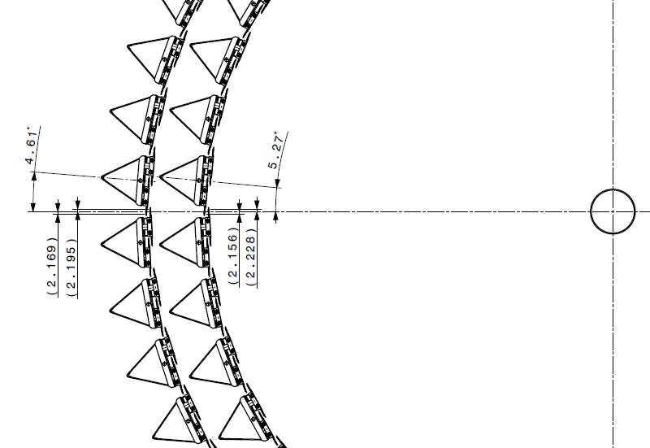
Layout: radial, layers 5-6
Outer layers
Middle layers
Inner layers
Beam pipe
…from 342mm to 395mm radius
n.7

Slide 7
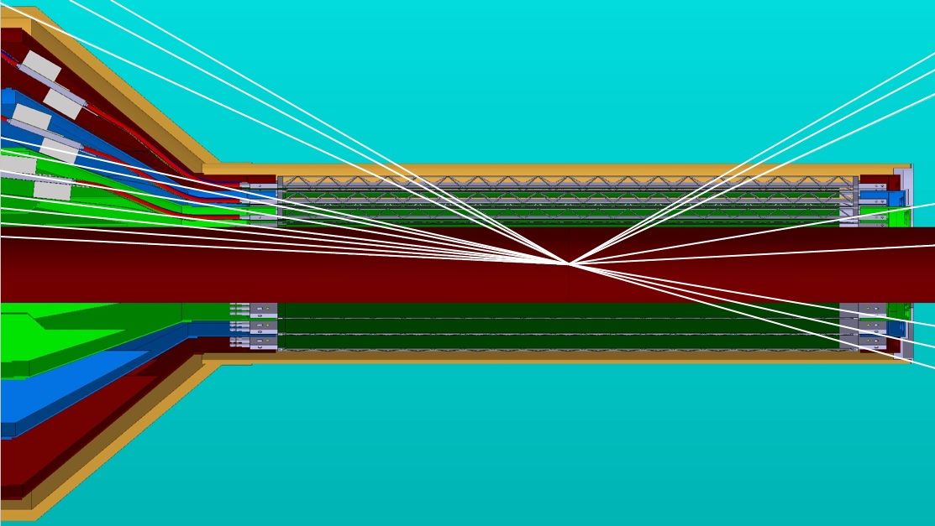
Layout: Coverage azimuth
η= - 1.5 (~24.8°) ITS L3, L5
η= - 1.3 (~30.1°) ITS L6
η= - 1.4 (~28.0°) ITS L4
η= - 1.3 (~30.1°) ITS L6
η= - 1.4 (~28.0°) ITS L4
η= - 1.5 (~24.8°) ITS L3, L5
(12,65°) V0A+ ext
(11,45°) PMD
(9,4°) ITS L0
(6,96°) V0A+
η= -2.5 (~9.4°) MFT
(5,7°) FOCAL EFCA 2014
(4,22°) FOCAL MB 2015
η= - 3.6 (~3.1°) MFT
(2,83°) T0A+
η= - 2.5 (~9.4°) ITS L0
η= - 2.2 (~12.6°) ITS L1
η= - 2.0 (~15.6°) ITS L2

Slide 8
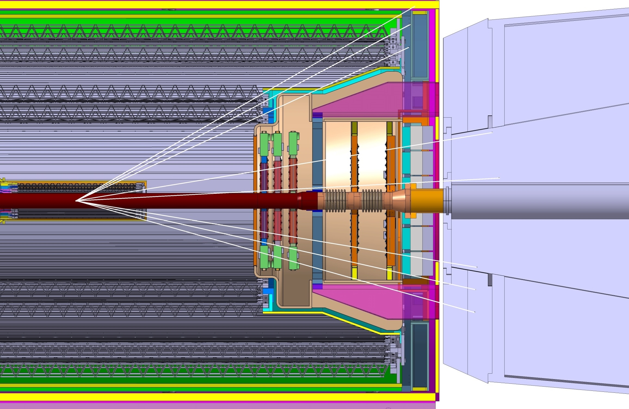
Layout: Coverage azimuth C-side
Cage
MFT Barrel
ITS OB Barrel
η= - 1.3 (~30.1°) ITS L6
(measure in mm)
IP
-135.5
-421.5
-737.5
η= - 1.4 (~28.0°) ITS L4
η= - 1.5 (~24.8°) ITS L3, L5
ITS_L0, L1, L2
ITS_L3, L4
ITS_L5, L6
Hadronic Absorber
76
η= -2.5 (~9.4°) MFT
η= - 3.6 (~3.1°) MFT
FIT
η= - 2.5 (~9.4°) ITS L0
MFT
η= - 2.2 (~12.6°) ITS L1
10
.
10
ITS
η= - 2.0 (~15.6°) ITS L2
15
45
15
MFT_0
IP
1
2
3
4
FIT
(CRYSTAL FRONT FACE)
ABSORBER
-460
-493
-529.5
-684
-768
-799
-900

Slide 9
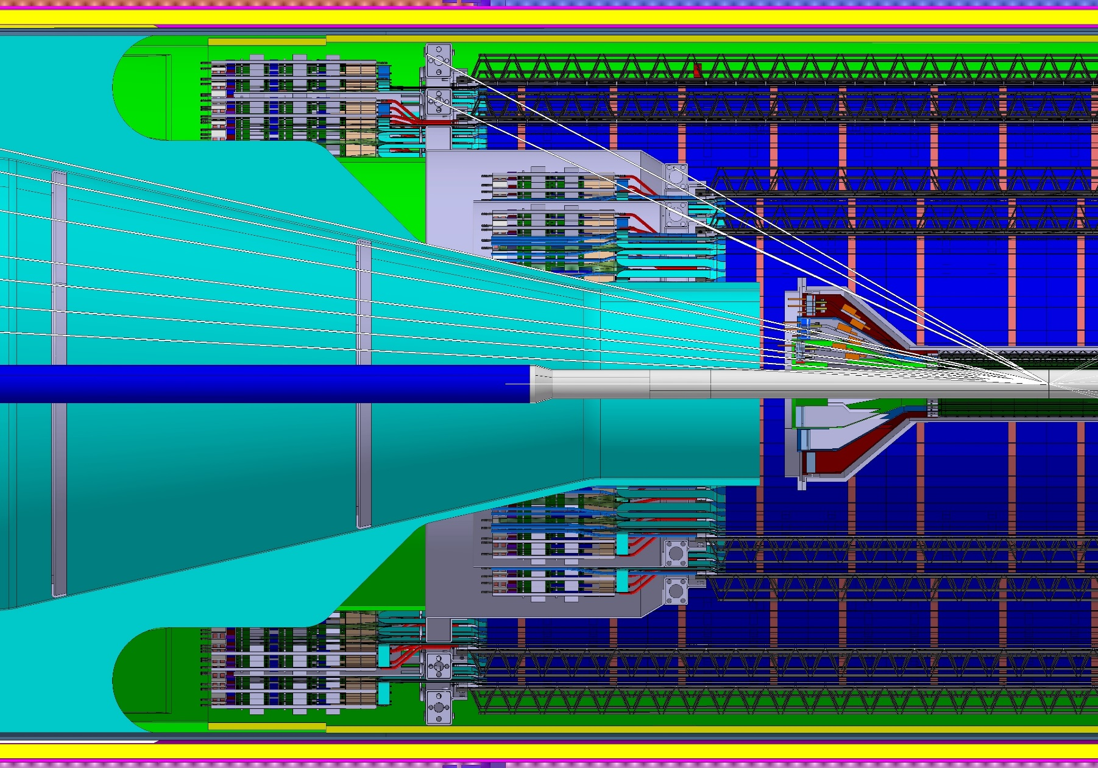

Layout: Coverage azimuth C-side
(measure in mm)
η= - 1.3 (~30.1°) ITS L6
IP NOMINAL
η= - 1.4 (~28.0°) ITS L4
-135.5
-421.5
-737.5
η= - 1.5 (~24.8°) ITS L3, L5
ITS_L0, L1, L2
ITS_L3, L4
ITS_L5, L6
(12,65°) V0A+ ext
(11,45°) PMD
(9,4°) ITS L0
(6,96°) V0A+
(5,7°) FOCAL EFCA 2014
(4,22°) FOCAL MB 2015
(2,83°) T0A+

Slide 10

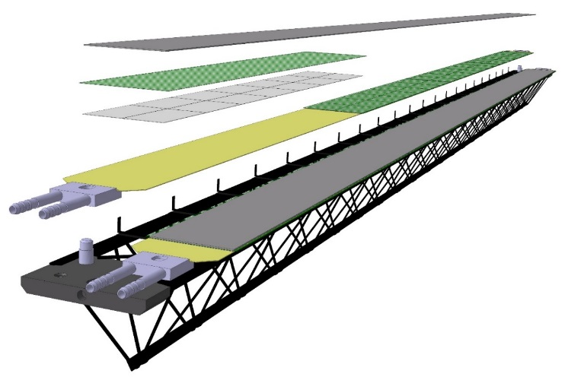
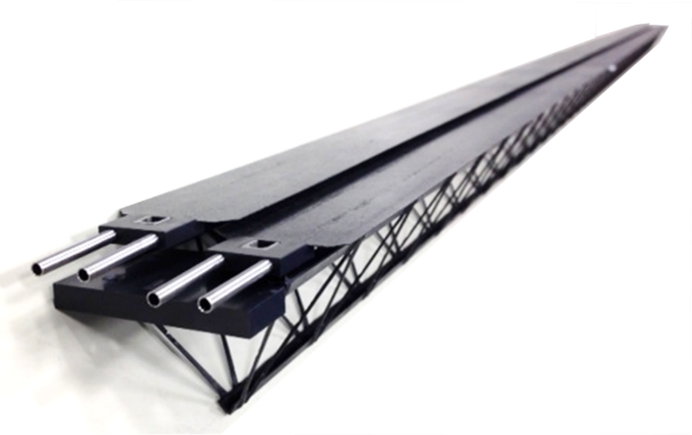
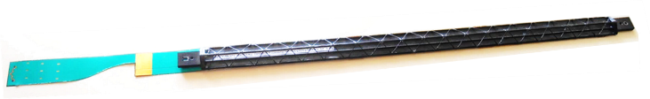
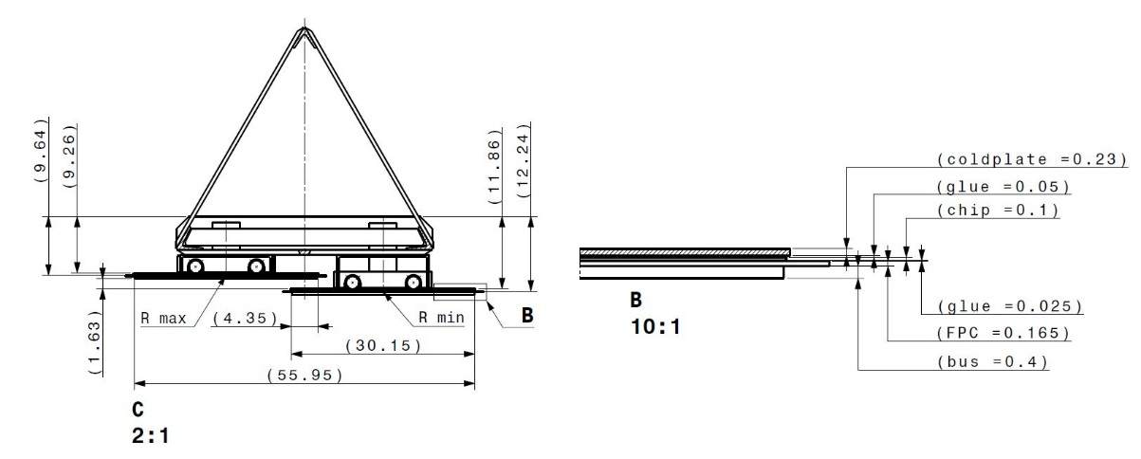
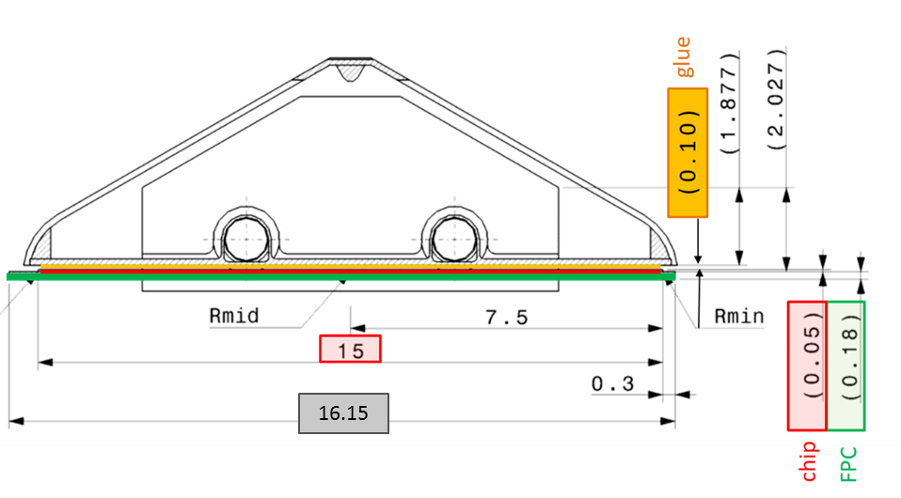
Layout: Main Components
Inner Stave
Outer Stave
Prototype
Power bus
Flexible PCB
FPC
Prototype
Connector
2x7 sensors
9 sensors
Cold Plate
Cold Plate
Space Frame
~ 290mm length,
~ 1.7gram weight
Connector
Space Frame
Fitting
Radius (mm) 23, 31, 39
Nr. Staves: 12, 16, 20
Nr. Chips/ layer: 108, 144, 180
Radius (mm)196, 245.4, 343.8, 393.3
Nr. Staves: 24,30,42,48
Nr. Chips/ module:2x7
Length in z (mm): 271.2 mm
Nr. chips/ Stave: 9
Material thickness:~0,3% X₀
Length in z (mm): 844.2 (ML), 1477.5 mm (OL)
Nr. module/ Stave: 4 (ML), 7(OL)
Material thickness:~1% X0
Coolant Single-phase H₂O leak-less
Pixel operational temperature < 30°C
Pixel max temperature non-uniformity < 5°C
Chip Power dissipation< 100mW/cm²
Coolant Single-phase H₂O leak-less
Pixel operational temperature < 30°C
Pixel max temperature non-uniformity < 5°C
Chip Power dissipation< 100mW/cm²

Slide 11
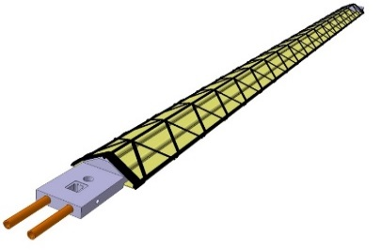
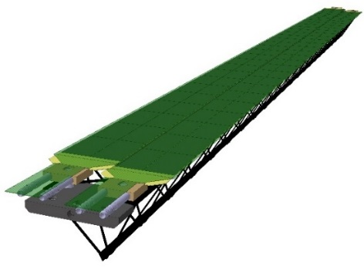
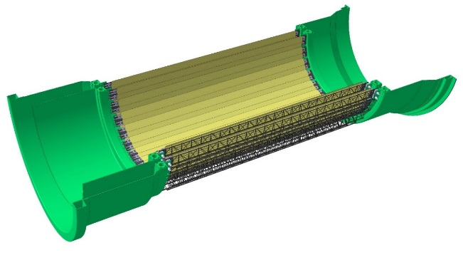
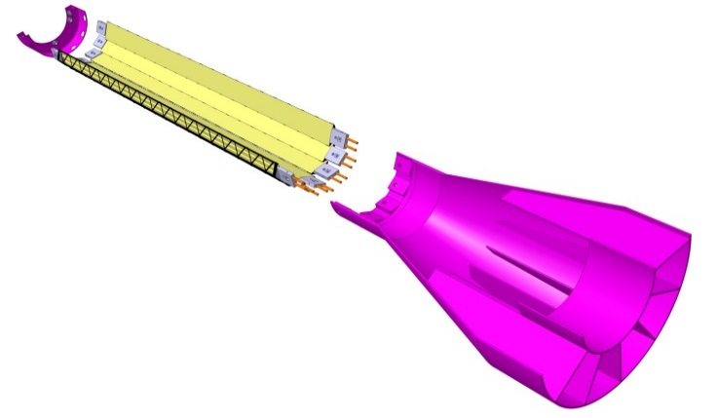
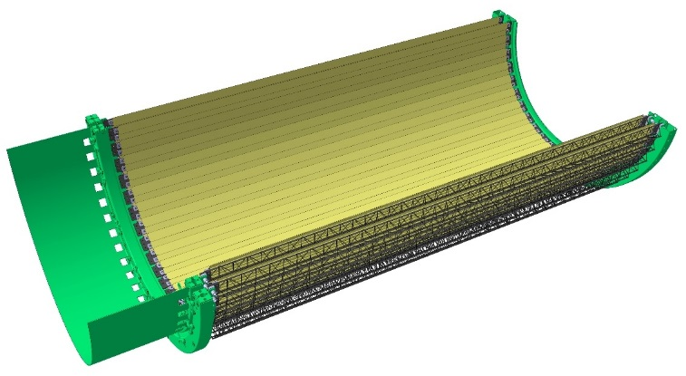
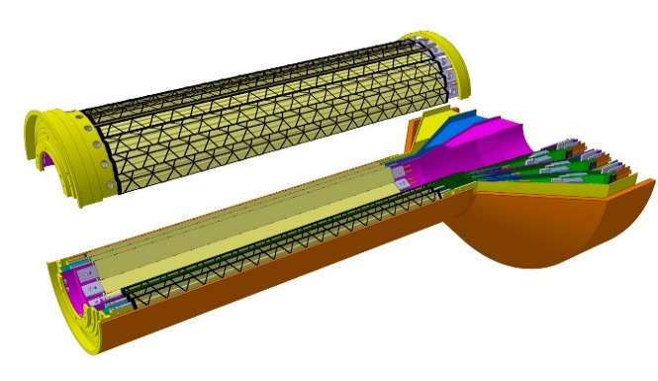
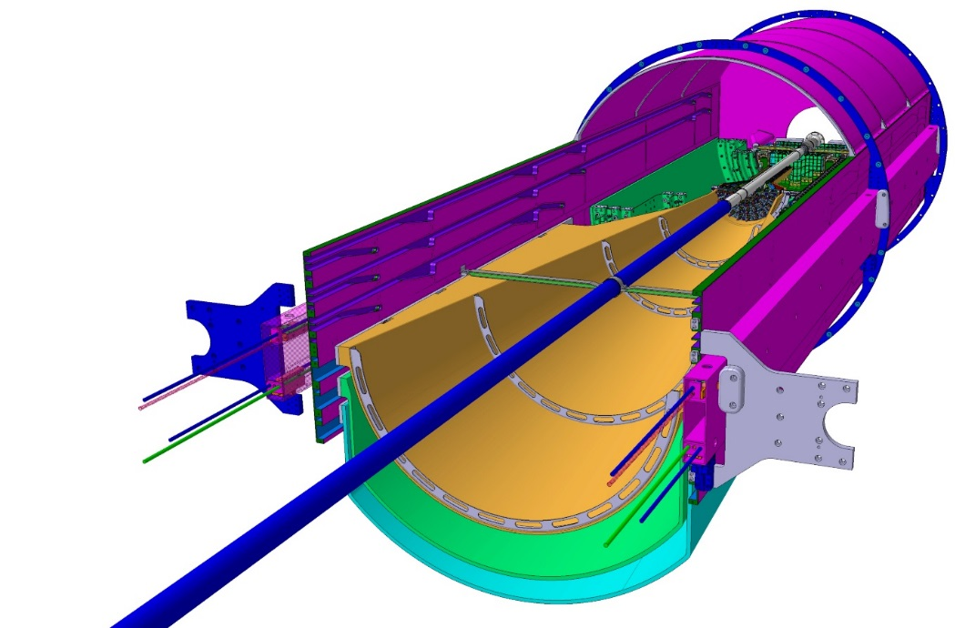
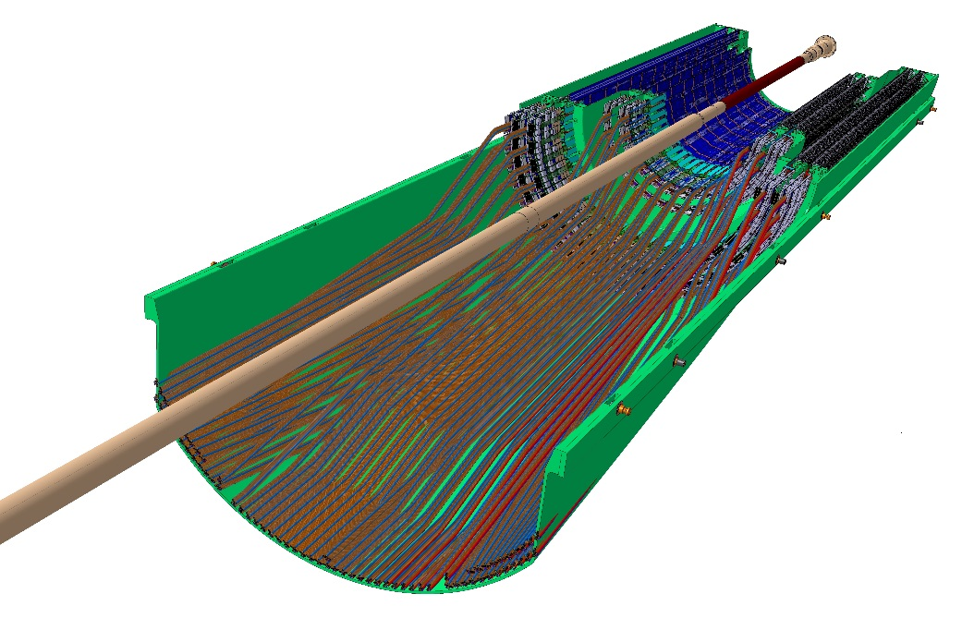
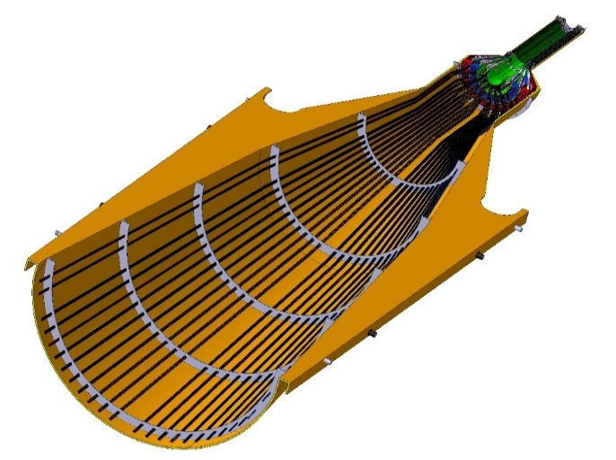
Detector Layout: ITS Detector
2 Middle Layers
End wheel
Inner Barrel
Outer Barrel
Stave
Half Layer
End wheel
Stave
Half Detector
Half Detector
Inner Detector Barrel
3 Inner Layers
Outer Detector Barrel
2 Outer Layers
Service Barrels and Cage
Half Barrel
OB
Service Half Barrel
Cage
Half Barrel
ITS Detector
ITS IB
IB
Service Half Barrel
ITS OB
MFT

Slide 12
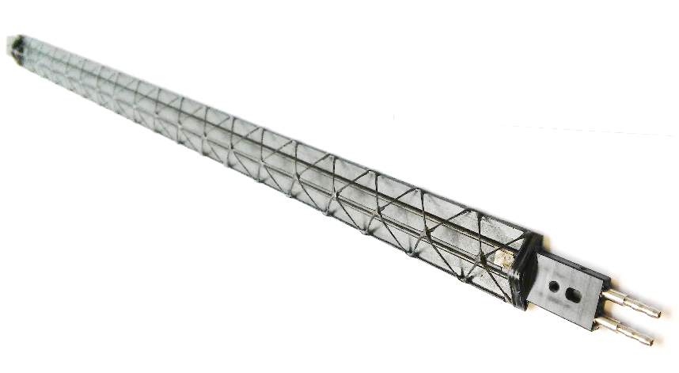
ITS Stave: Space Frame and Cold Plate
Design
Fabrication process
Mechanical characterization
Series Production
Acceptance Test & QA
Production organization and workflow

Slide 13
ITS Stave: Space Frame and Cold Plate
Design
  geometry
  drawings
Fabrication process
Mechanical characterization
Series Production
Acceptance TEST & QA
Production organization and workflow

Slide 14
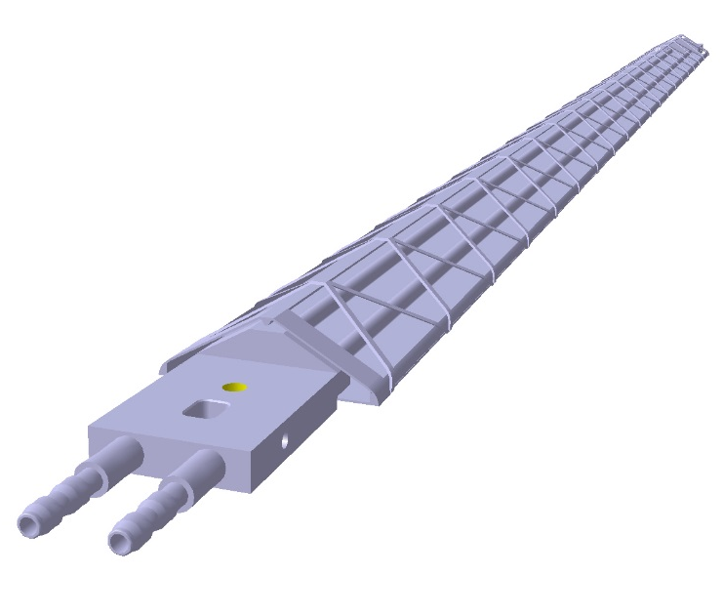
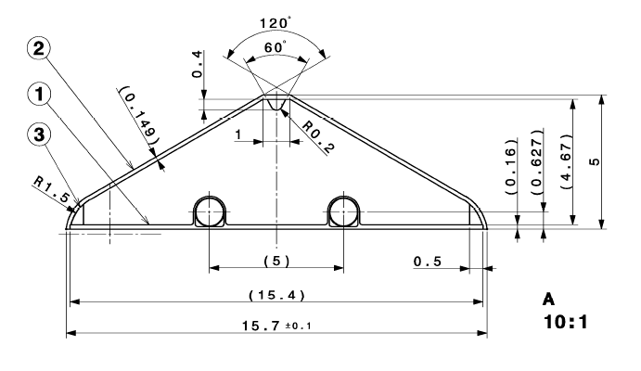
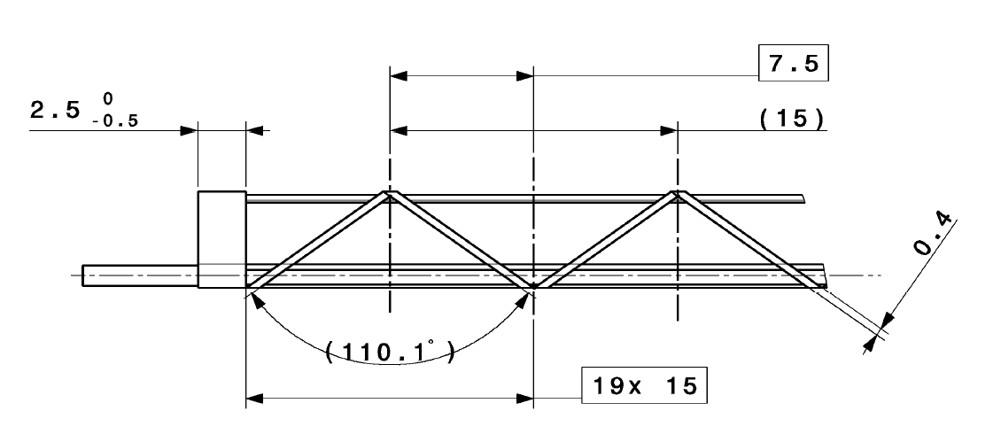
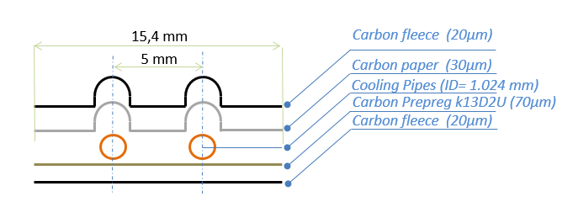
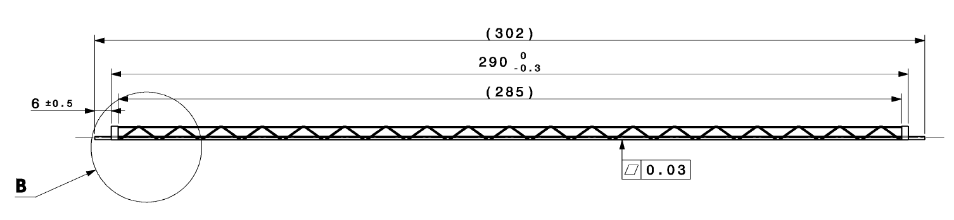
Geometry IB
1
Cold Plate
Impregnated thread M60j 3K
Impregnated thread M55jB 6K
2
3
1

Slide 15
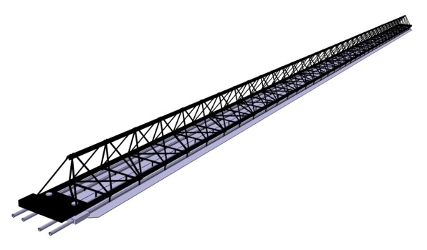
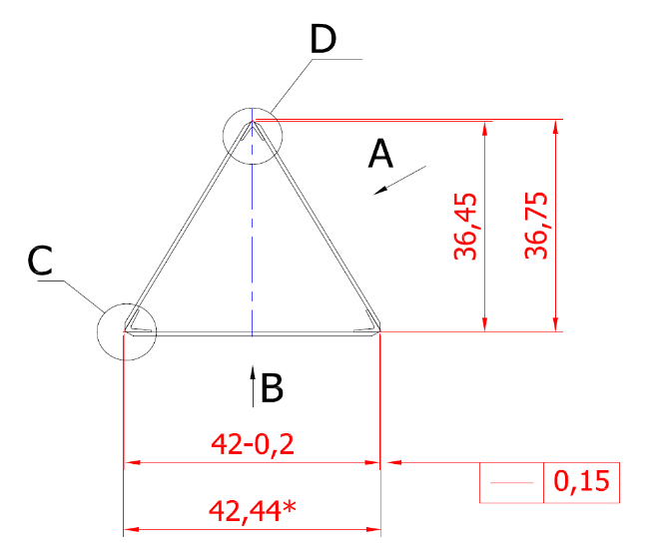
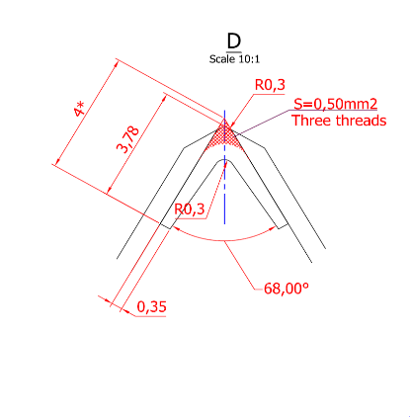
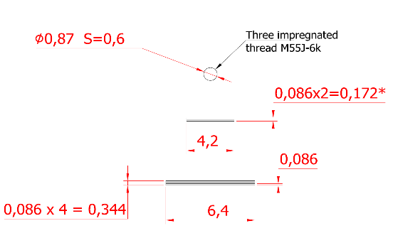
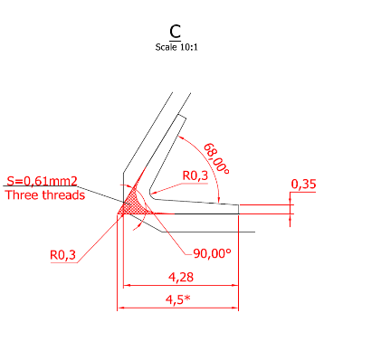
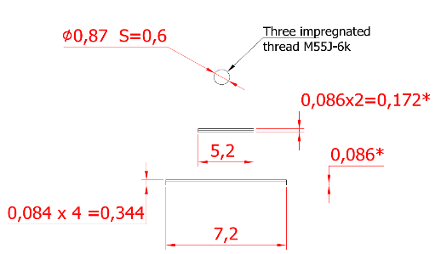
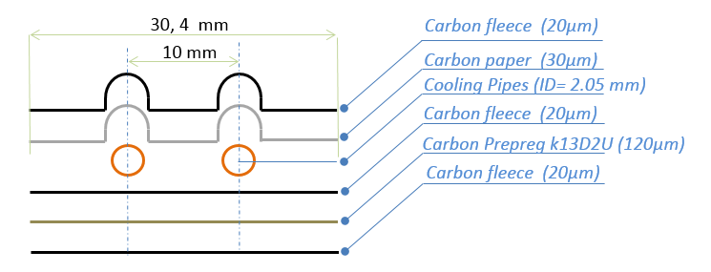
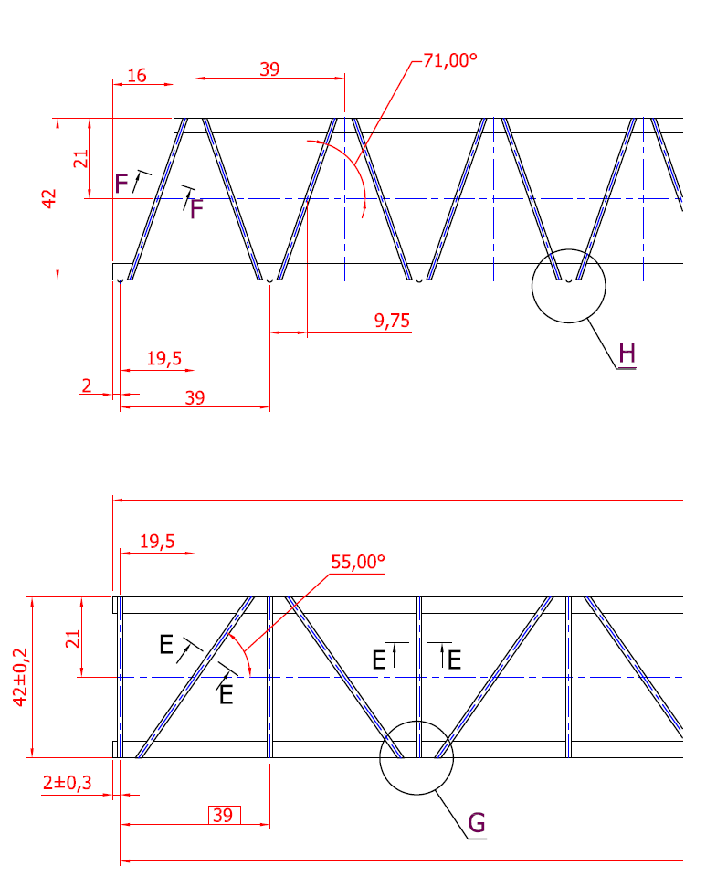
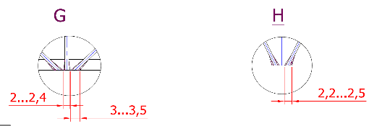
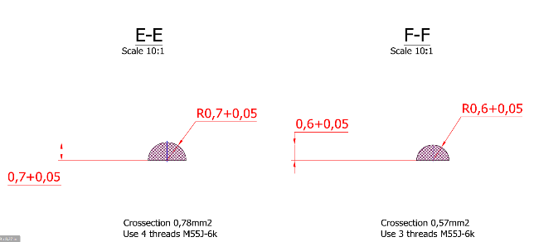
Geometry OB
Component | Layer | Length[mm]
Space Frame | ML | 928
 | OL | 1554
Cold Plate | ML | 922
 | OL | 1548

Slide 16

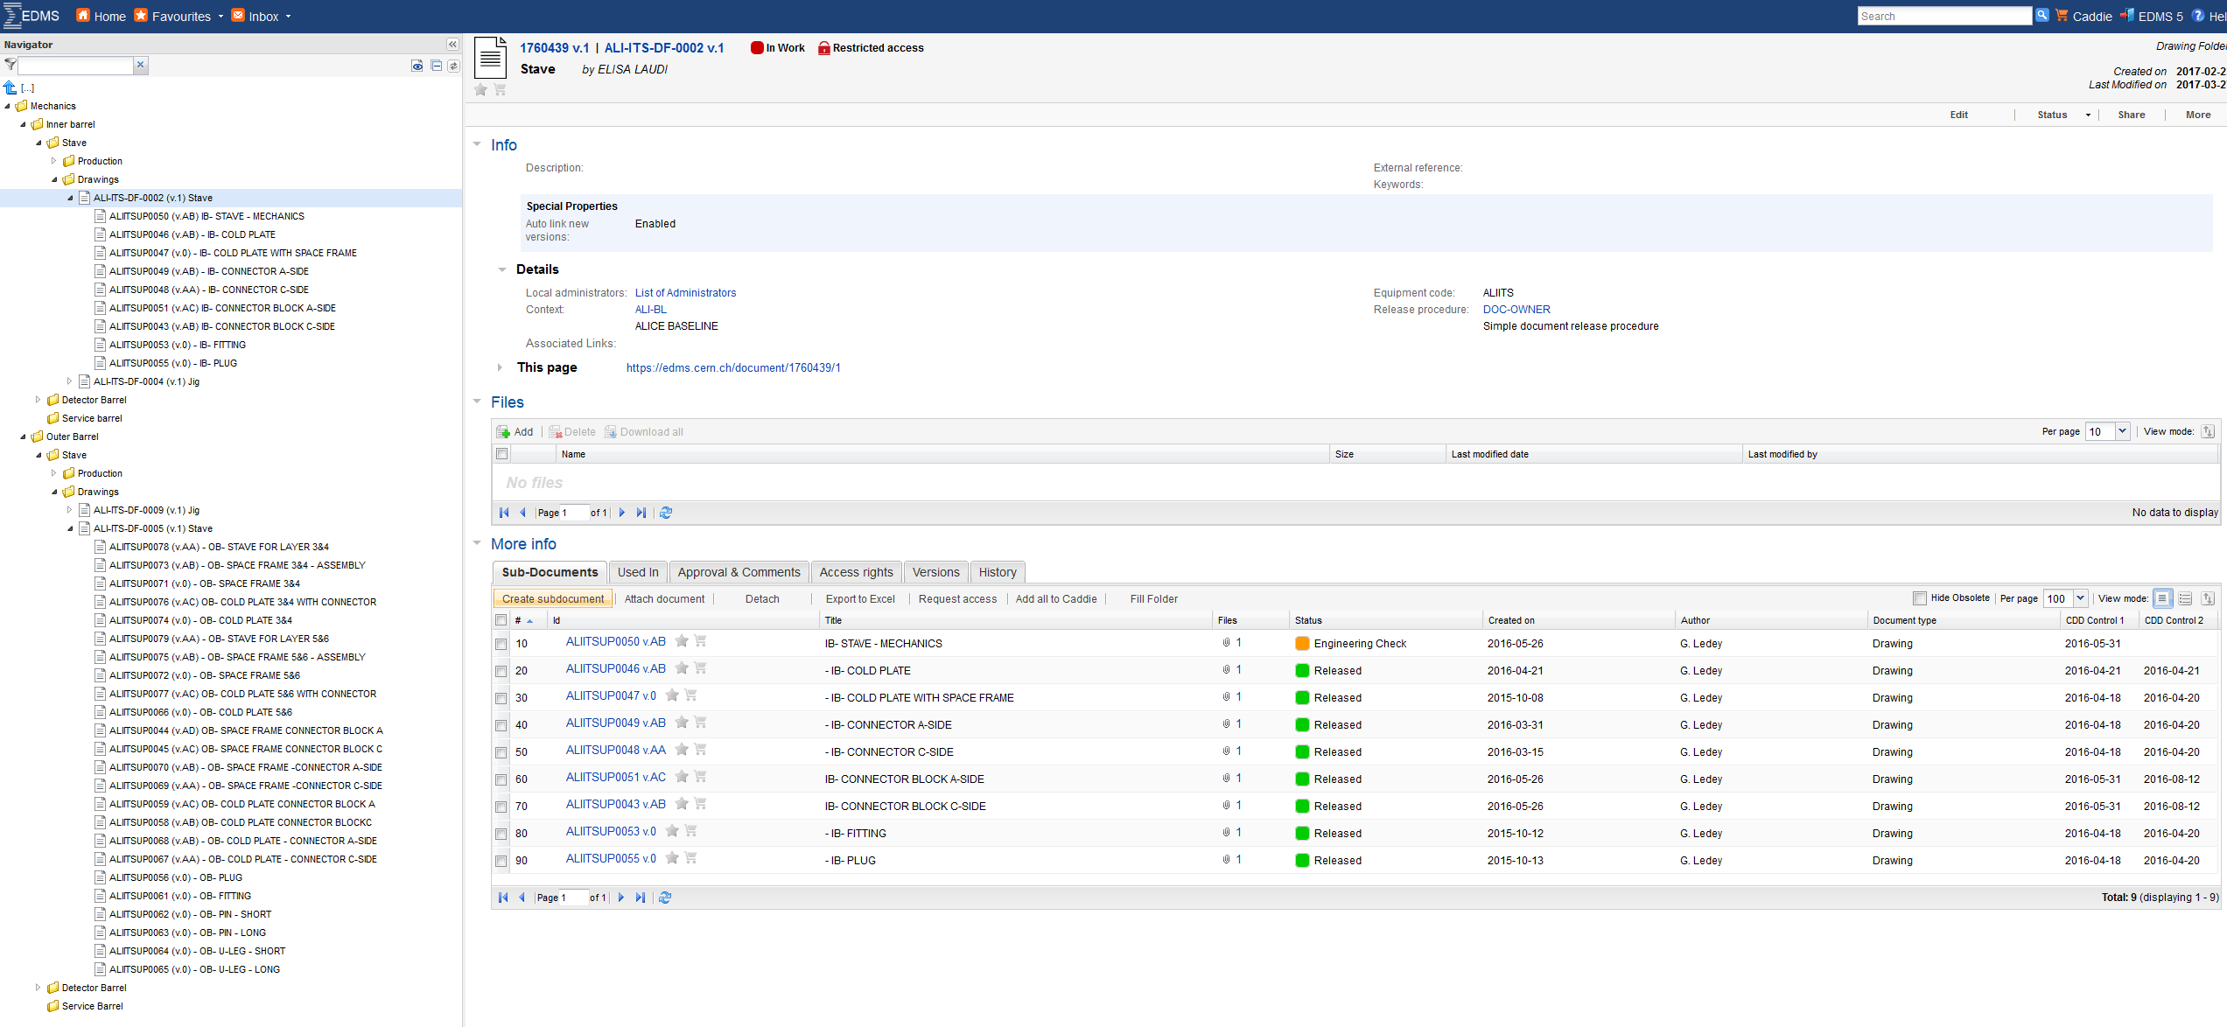
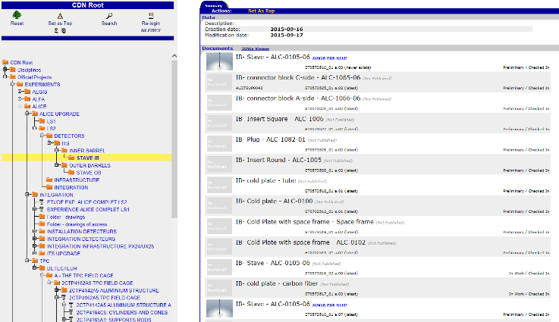
Drawings IB
2D drawings stored
in EDMS and CDD-CERN
3D models stored
in EDMS-CERN
IB drawing name | 2D | 3D
IB-Stave mechanics | ALIITSUP0050 | ST0573516
IB-fitting | ALIITSUP0053 | ST0701532
IB-Cold Plate with Space Frame | ALIITSUP0047 | ST0702514
IB-Connector A-side | ALIITSUP0049 | ST0702249
IB-Connector block A-side | ALIITSUP0051 | ST0573521
IB-insert square | ALIITSUP0052 | ST0573522
IB-Connector C-side | ALIITSUP0048 | ST0702496
IB-Connector block C-side | ALIITSUP0043 | ST0573525
IB-insert round | ALIITSUP0054 | ST0573528
IB-plug | ALIITSUP0055 | ST0573526
https://edms.cern.ch/project/CERN-0000175457
https://edms.cern.ch/nav/SMTP142:229377

Slide 17
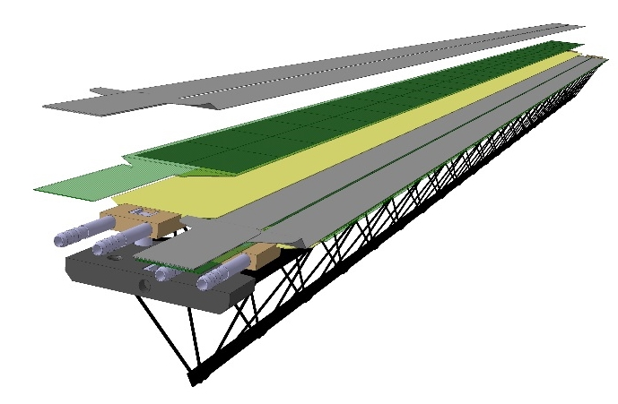
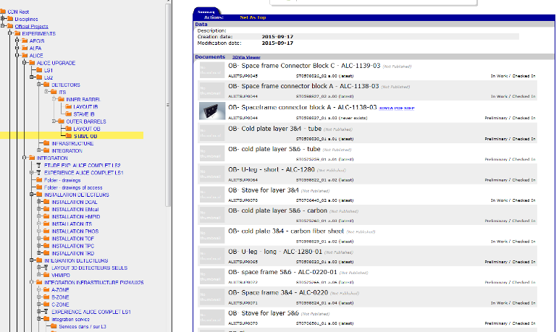
Drawings OB
2D drawings stored
in EDMS-CERN
3D models stored
in EDMS-CERN
OB drawing name | 2D | 3D
OB-Stave for layer 3&4 | ALIITSUP0078 | ST0706449
OB-Stave for layer 5&6 | ALIITSUP0079 | ST0706501
OB-fitting | ALIITSUP0061 | ST0701664
OB-Cold Plate 3&4 with connector | ALIITSUP0076 | ST0702926
OB-Cold Plate 5&6 with connector | ALIITSUP0077 | ST0705437
OB-Space Frame 3&4-Assembly | ALIITSUP0073 | ST0703019
OB-Space Frame 5&6-Assembly | ALIITSUP0075 | ST0705401
OB-insert square | ALIITSUP0060 | ST0598833
OB-insert round | ALIITSUP0057 | ST0598835
OB-plug | ALIITSUP0056 | ST0598834
https://edms.cern.ch/project/CERN-0000175453
https://edms.cern.ch/nav/SMTP142:229378

Slide 18
ITS Stave: Space Frame and Cold Plate
Design
Fabrication process
  Layout
  Materials
  Stave production
Mechanical characterization
Series Production
Acceptance TEST & QA
Production organization and workflow

Slide 19
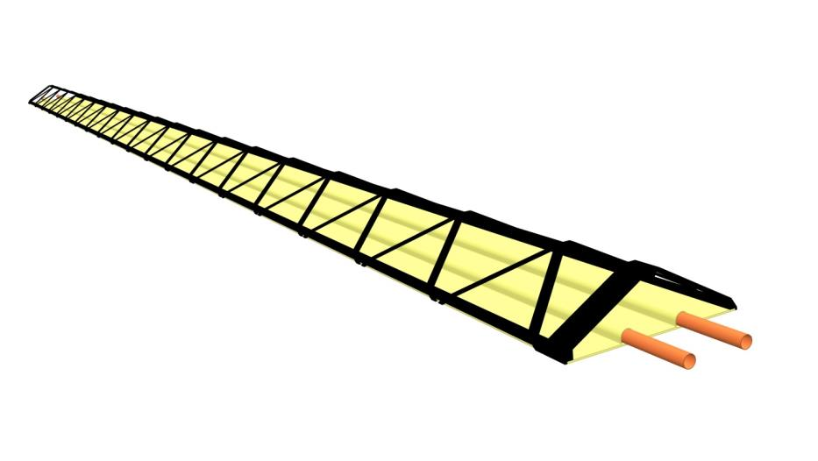
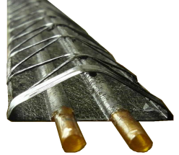


Layout IB
Space Frame
Cold Plate
inlet
outlet
Coolant Single-phase H₂O leak-less
Pixel operational temperature < 30°C
Pixel max temperature non-uniformity < 5°C
Chip Power dissipation< 100mW/cm²
~ 290mm length, ~ 1.7gram weight

Slide 20








Layout OB
Cold Plate
Space Frame
Cold Plates
Coolant Single-phase H₂O leak-less
Pixel operational temperature < 30°C
Pixel max temperature non-uniformity < 5°C
Chip Power dissipation< 100mW/cm²
Space Frame
Cross section 0.78 mm²
n. 4 Impregnated
threads M55J-6K
Cross section 0.61 mm²
n. 3 Impregnated
threads M55J-6K
Prototype
n. 3 Impregnated
thread M55J-6K
n. 3 Impregnated
thread M55J-6K
~1500mm length,
~ 80gram weight
Carbon Prepreg
M55JB-6k
Carbon Prepreg
M55JB-6k

Slide 21

Material quantities IB
Layer 0,1,2:
  12+16+20pc =48 pc; spare 120%; total 106
Item | Spec. | Qt. final production
Polyimide tubes | ID=1.024mm,th=0.025mm L=340mm | 212 pc
Carbon prepreg | k13D2U 80g/m2 ( 80µm) | 0.65 m²
Carbon fiber roving | M55J-6K | 106 m
Carbon fiber roving | M60J 3k | 376m
Carbon fleece | 190289-X | 1.5 m²
Carbon paper | FGS_003 Amec-thermasol | 0.46 m²
Resin | ED-20 GOST 10587-84 | 0.2 kg
Peek Connectors | PEEK CA 30 | 212 pc
Fittings | 316L | 212pc

Slide 22

Material quantities OB
Layer 5,6:
42+48 pc = 90pc; 20%spare, total 108
Layer 3,4:
24+30 pc = 54pc; spare 20%; total 65
 | Item | Spec. | Qt. final prod.
Space Frame | Carbon fiber roving | M55J-6K | 2520 m
 | Carbon prepreg | m55J 90micron | 5.8 m2
 | Resin | ED-20 GOST 10587-84 | 2.0 kg
 | Peek Connectors | PEEK CA 30 | 130 pc
Cold Plate | Polyimide tubes | ID=2.05 mm, th=0.032mm L=900 mm | 260 pc
 | Carbon fleece | 190289-X 8gr/cm2 | 8.0 m2
 | Carbon prepreg | k13D2U 120g/m2 ( 120mkm) | 16 m2
 | Carbon paper | FGS_003 Amecthermasol | 4 m2
 | Resin | ED-20 GOST 10587-84 | 2.6 kg
 | Peek Connectors | PEEK CA 30 | 260 pc
 | Fittings | 316L | 260pc
 | Item | Spec. | Qt. final prod.
Space Frame | Carbon fiber roving | M55J-6K | 5427 m
 | Carbon prepreg | M55J | 14.6 m2
 | Resin | ED-20 GOST 10587-84 | 3.5 kg
 | Peek Connectors | PEEK CA 30 | 216 pc
Cold Plate | Polyimide tubes | ID=2.05 mm, th=0.032mm L=1500 mm | 432pc
 | Carbon fleece | 190289-X 8gr/cm2 | 22.6 m2
 | Carbon prepreg | k13D2U 120g/m2 ( 120mkm) | 30.6 m2
 | Carbon paper | FGS_003 Amecthermasol | 11.2 m2
 | Resin | ED-20 GOST 10587-84 | 4.3 kg
 | Peek Connectors | PEEK CA 30 | 432 pc
 | Fittings | 316L | 432 pc

Slide 23





Fabrication process IB
Manual lay-up on mould: Cfleece/K13D2U 90°/Cfleece
Cure at 24°C for 24h
pipe/Cpaper/Cfleece
Cure at 125°C for 3h
Remove pipes mandrels @ 80°C
Cold Plate Finishing
Locate the Cold Plate in the winding moulds
Place the three vertex M55J longitudinal threads
Wind with M60J
Cure at 24°C for 24h
Remove inside mandrel
Cut wound thread at moulds interfaces
Space Frame Finishing
Connectors gluing
Fitting gluing
Cold Plate Coating
QA test
Store

Slide 24




Fabrication process OB
Space Frame
Prepare carbon thread, prepreg and resin
Cover external moulds with vaseline/teflon tape 10 micron
Place impregnated thread beams in the groves of the 3 external moulds
Press and cover with teflon
Prepare the 3 internal 1/3 wedge mandrels with veseline/teflon
Place prepreg strips and thread on the edge of the moulds, apply resin on both sides
Screw the two side external moulds to form a V
Insert the 1/3 internal wedge-mandrel
Install the enflatable internal mandrel
Install the other two 1/3 internal wedge mandrel
Install the bottom external mould
Thighten the bolts
Rum up temp at 60°C and apply 3-4 bar pressure in the enflatable mandrel
Cure at 130°C for 3 hours
Rump down the temperature
Open the mould at 100°C
Cool to room temperature
Finishing, cleaning and coating
QA test
Store, ship
Cold Plate
Prepare carbon paper, prepreg, fleece, pipes and resin
Cover mould with vaseline/teflon tape 10 micron
Place plyies of fleece prepreg and fleece inside the bottom mould
Close the mould with the top part
Cure at 130°C 3h
Prepare polyimide tubes with internal steel wire mandrel
Cover the mould (plate side) vaseline/teflon film
Cover the mould (pipe side) with Penta 111 and teflon
Place the cured laminate from step 5 in the mould
Place fleece on bottom mould/ put resin
Place carbon paper on bottom mould/put resin
Place tubes with mandrels in the mould
Couple top and bottom mould, screw together
Rise temperature and t 60°C torque screw to nominal value
Cure 24h at RT
Finishing clening and coating
QA test
Store, Ship

Slide 25












Interfaces
IB
OB
Mechanical connection
  The Stave is positioned on the end wheels reference planes by connectors at both extremities that engage a ruby sphere fixed in the reference plane. The Stave position is then frozen by a bolt.
Hydraulic connection
  SSteel fitting 316L connected to PUR plastic tube, tightness provided by mechanical interference
Mechanical connection
Hydraulic connection
Inserts removed
120 connectors produced
and measured. Diameter
tolerances better than 10 micron

Slide 26








Interfaces
IB
OB
Grounding connection
  Grounding points for the carbon structures.
  3 Grounding points at each extremities of the Space Frame OB and IB/OB Cold Plates by embedding a nickel foil 0.0075mm to which a grounding wire is soldered.
DSS Temperature sensor connection
  Thermocouple position on Space Frame
Grounding connection
DSS Temperature sensor connection
Nickel foil 0.0075mm
PT100

Slide 27

Schedule: IB Space Frame & Cold Plate
1 lot = 10 Space Frame&Cold Plate
Total production= 12 lots=120 Space Frames & Cold Plates
15 working days to produce 1 lot
180 working day to complete production (8months)

Slide 28
Schedule: OB Space Frame
OUTER LAYERS
1 lot = 7 Space Frame
Total production=16 lots=112 Space Frame
11 working days to produce 1 lot
MIDDLE LAYERS
1 lot = 8 Space Frame
Total production= 8 lots=64 Space Frame
12 working days to produce 1 lot
272 working days to complete production (13months)

Slide 29

Schedule: OB Cold Plate
OUTER LAYERS
1 lot = 7 Cold Plates
Total production= 32 lots=224 Cold Plates
10 working days to produce 1 lot
MIDDLE LAYERS
1 lot = 8 Cold Plates
Total production= 16 lots=128 Cold Plates
11 working days to produce 1 lot
356 working days to complete production (16months)

Slide 30
ITS Stave: Space Frame and Cold Plate
Design
Fabrication process
Mechanical characterization
Series Production
Acceptance TEST & QA
Production organization and workflow

Slide 31








Characterization test: Bending test
-component level-
  Objective: Determine flexural stiffness
  Test article: IB Space Frame
  Test procedure: 3 points bending test
  Objective: Determine flexural stiffness
  Test article: OB Space Frame+ CPs
  Test procedure: 3 points bending test
IB
OB
Flexural stiffness EI~0.3Nm2 Flexural stiffness EI~1.41Nm2
Flexural stiffness EI~670Nm2 Flexural stiffness EI~900Nm2
Sag 0.41 mm @ F=60g
Sag 0.20 mm @ F=30g
Sag 0.163mm
@F=2N concentrated load
Sag 0.17mm @F=0.2N concentrated load

Slide 32


Characterization test: Torsional test
-component level-
  Objective: Determine torsional stiffness
  Test article: IB Space Frame
  Test procedure: Space Frame fixed at one side, torque at the opposite side
  Objective: Determine torsional stiffness
  Test article: OB Space Frame+ Cold Plates
  Test procedure: Space Frame fixed at one side, torque at the opposite side
IB
OB
Displacement measurement Tesatronic TT20 unit with 0.2 μm accuracy
Torsional stiffness GIp~0.33Nm²
Torsional stiffness GIp~11 (Middle),11.5 (Outer)Nm²
Inner layer
Middle layer
Outer layer
G [g] | F [N] | M [Nm] | A-B [um] | tg ϕ [rad] | ϕ | Glp [Nm^2]
5 | 0.05 | 0.005 | 180 | 0.004 | 0.004 | 0.38
10 | 0.09 | 0.009 | 470 | 0.010 | 0.010 | 0.29
15 | 0.14 | 0.014 | 572 | 0.012 | 0.012 | 0.36
20 | 0.19 | 0.019 | 758 | 0.016 | 0.016 | 0.36
25 | 0.24 | 0.024 | 1254 | 0.026 | 0.026 | 0.27
G [g] | F [N] | M [Nm] | A-B [um] | tg ϕ [rad] | ϕ | Glp [Nm^2]
0 | 0 | 0 | 0 | 0.000 | 0.000 | 0.00
40 | 0.39 | 0.041 | 152 | 0.003 | 0.003 | 11.71
60 | 0.59 | 0.062 | 232 | 0.005 | 0.005 | 11.5
80 | 0.78 | 0.082 | 304 | 0.006 | 0.006 | 11.71
120 | 1.18 | 0.124 | 470 | 0.01 | 0.01 | 11.36
180 | 1.77 | 0.185 | 704 | 0.015 | 0.015 | 11.37
G [g] | F [N] | M [Nm] | A-B [um] | tg ϕ [rad] | ϕ | Glp [Nm^2]
0 | 0 | 0 | 0 | 0.000 | 0.000 | 0.00
40 | 0.39 | 0.041 | 280 | 0.006 | 0.006 | 10.78
60 | 0.59 | 0.062 | 420 | 0.009 | 0.009 | 10.78
80 | 0.78 | 0.082 | 540 | 0.011 | 0.011 | 11.71
120 | 1.18 | 0.124 | 840 | 0.018 | 0.018 | 11.78
180 | 1.77 | 0.185 | 1240 | 0.026 | 0.026 | 10.95

Slide 33








Characterization test: Vibrational test
-component level-
  Objective: Determine natural frequencies
  Test article: IB Space Frame
  Test procedure: sine sweep 0-500 Hz
  Objective: Determine natural frequencies
  Test article: OB Space Frame+ CPs
  Test procedure: sine sweep 0-500 Hz
IB
OB
Space Frame– 1st 167 Hz; 2nd 471 Hz
SF+ CPs– 1st 88.6 Hz; 2nd 126.6 Hz
Space Frame – 167 Hz
Space Frame+HIC dummy – 159 Hz
1° natural frequency
88.6 Hz SPF and CP
52.7Hz with HIC/BUS dummy
2° natural frequency
126.6 Hz SPF and CP
70.1Hz with HIC/BUS dummy
Space Frame – 461 Hz
Space Frame+HIC dummy – 474 Hz

Slide 34




Characterization test: Burst pressure
-component level-
  Objective: Determine the maximum inside pressure
  that a Stave can withstand before burst
  Test article: IB Cold Plate
  Test procedure: increase water pressure up to burst
  Objective: Determine the maximum inside pressure
  that a Stave can withstand before burst
  Test article: OB Cold Plates
  Test procedure: increase water pressure up to burst
IB
OB
Delamination @ 22 bar
Pipe Burst @ 26bar
Polyimide Pipe Burst @ ~50Bar
Tests repeated before and after irradiation
Dose:1.7∙10¹³ MeV equivalent neutrons
Polyimide Pipe Burst @ ~ 25Bar
Burst @ 51Bar
Delamination @ 22 Bar
Burst @ 26Bar

Slide 35




Characterization test: Vacuum
-component level-
  Objective: Verify Stave and plastic tube stability
  under vacuum to validate leak less mode
  Test article: IB Space Frame
  Test procedure: pressure drop test, pull vacuum inside Stave, repeat pressure drop test
  Objective: Verify Stave and plastic tube stability
  under vacuum to validate leak less mode
  Test article: OB Space Frame & Cold Plates +PUR tubes
  Test procedure: press drop test, vacuum, press drop test
IB
OB
No pipes buckling under vacuum
Tests repeated before and after irradiation
Dose:1.7∙10¹³ MeV equivalent neutrons
No pipes buckling under vacuum

Slide 36



Characterization test: Pressure/ Vacuum Cycles
-component level-
  Objective: Verify cooling pipes and connection stability under pressure and vacuum cycling.
  Test article: IB Space Frame+PUR tubes+ hydraulic connectrors
  Test procedure: 9600 pressure/ vacuum cycles with increasing pressure up to 5 bara
TEST | 01 | 02 | 03 | 04 | 05 | 06 | 07 | 08
Pressure (bara) | 1.5 | 2 | 2.5 | 3 | 3.5 | 4 | 4.5 | 5
Vacuum (bara) | 0.02 | 0.02 | 0.02 | 0.02 | 0.02 | 0.02 | 0.02 | 0.02
N. of cycles | 1200 | 1200 | 1200 | 1200 | 1200 | 1200 | 1200 | 1200
Time of cycle (sec) | 2 | 1 | 1 | 0.5 | 0.5 | 1 | 1 | 1
  The cooling system safety valves will be set at ~2 bara means we have a safety factor of 2.5 minimum.
Detailed test description on EDMS: 1741538

Slide 37





Characterization test: Slip Off/ pull out
-component level-
  Test article: OB Space Frame&Cold Plates +PUR tubes
  Objective: Determine the maximum pressure/force required to slip off/pull out a plastic flexible tube from the SS fitting
  Test article: IB Space Frame+PUR tubes
  Test procedure: apply increasing pressure/pulling force to the PUR tube inserted in the fitting
IB
OB
fitting
Slip Off pressure @ 42bar ;
Pull out Force@ 4 kg
Tests repeated before and after irradiation
Dose:1.7∙10¹³ MeV equivalent neutrons
Slip Off pressure @40 Bar (PUR);
Pull out Force@ 13.5kg (PUR)

Slide 38


Characterization test: Pressure drop
-component level-
  Test article: OB Cold Plate+PUR tubes to PP1+ fittings
  Objective: verify that pressure drop along the Stave line is below 0.5 bar.
IB
OB
  Test article: IB Cold Plate+PUR tubes to PP1+ fittings
  Test procedure: Pressure drop is measured at different flow rates at the two ends of the test prototype corresponding to the patch panel position.
Interaction Point
IB End Wheel
Service barrel
Patch Panel
The pressure drop measured is 0.39 bar
at a nominal flow rate of 3 L/h
The pressure drop measured is 0.2 bar
at a nominal flow rate of 6 L/h

Slide 39





Characterization test: long term water effect
-component level-
  Test article: OB Cold Plate
  Objective: evaluate effect of circulating water in the tubes during a period of time representative of operational life
  Test article: IB polyimide pies and Space Frame
  Test procedure::uninterrupted water circulation from the present ITS cooling system in ALICE CAVERN
IB
OB
after 300 days
after 594 days
after 800 days
after 1400 days
…
No degradation effect observed after
pipes
Staves
since May 2013
since October 2016

Slide 40






Characterization test: Thermo-elastic test
-component level-
  Objective: Determine the thermo-elastic expansion
  Test article: IB Space Frame 25mm sample
  Test procedure: temperature increase and sample length change measured by LVDT
  Objective: Determine the thermo-elastic expansion
  Test article: OB Space Frame & Cold Plate
  Test procedure: temperature increase and sample length change measured by microscope.
IB
OB
CTE< 5µm/m/°C
CTE< 4-6µm/m/°C
DIL 402
Atmosphere | Helium at 150 ml/min
Calibration standard | Graphite
temperature program | RT to 150ºC at 1ºC/min
Sample length | approx. 25 mm
Δl resolution:
0.125 nm / 1.25 nm

Slide 41


Characterization test: Coating thickness uniformity
-component level-
  Objective: Determine the Parylene thickness uniformity
  Test article: IB Cold Plate
  Test procedure: Scanning Electron Microscope
30 mm
IB
OB
BUS
33 mm
30.4 mm
FPC
chip
FPC (175µm)
16.15 mm
Cold Plate
Coating Parylene (10µm)
TBC
?
0.3 mm
15 mm
Pixel Chip (50µm)
0.85 mm
Volume resistivity
Parylene-N 1.4 10 ¹⁷ Ohm cm
measured on 25µm thick coating
ECCOBOND-45 > 10 ¹³
Glue (90µm)
Coating Parylene (10-µm)
Parylene coating thickness uniformity 10 -13 μm

Slide 42


Characterization test: electrical isolation test
-component level-
  Objective: Determine the electrical isolation provided by Parylene coating.
  Test article: IB Cold Plate
  Test procedure: measure electrical Resistance on CP with and without Parylene
  Test article: OB Cold Plate
IB
OB
Al Plate chip size
Chip 0
Chip 2
Glue (50um)
Al Plate HIC size
Glue (80um)
Parylene coating (10um)
Parylene coating (10um)
Cold Plate
Cold Plate
Parylene coating increase R by one order of magnitude
R from GΩ to 10 G
Parylene coating increase R by two-three order of magnitude
R from MΩ to GΩ
non-coated Stave
parylene-coated Stave
non-coated Stave
parylene-coated Stave
ALC-0312-01-060
ALC-0312-01-019

Slide 43





Characterization test: Parylene test
-component level-
HIC rework impact on Parylene
  Objective: Verify if the Parylene coating is affected by a reworking process of a HIC.
  Test article: OB Cold Plate Parylene coated sample
  Test procedure:: measure R; apply Eccobond 45 at dummy HIC (Al plate) interface, let it set for 20min, remove the Eccobond45 with isopropyl alcohol; measure R
Peel test
  Objective: find out the force needed to peel off a chip from the surface of a Parylene Cold Plate.
  Test article: OB Cold Plate Parylene coated sample
  Test procedure: peel test of Cold Plate and a blank chip glued with ECCOBOND 45. Force applied to a strip glued to the chip, that replicates the flex cable.
OB
OB
No electrical resistance change
Peel force= 800 gr
The 2 sets of Aluminium strips glued with Eccobond 45
Surface of the CP after removing
the Eccobond with isopropyl alcohol.
Peel force
Eccobond after 20 min
between CP and strips.

Slide 44





Characterization test: Thermal test
-system level-
  Objective: Determine Stave thermal map in operative condition
  Test article: IB Stave (Space Frame +HIC)
  Test procedure: operate Stave (PW ON, DTU config, nom PW)
  at different flow rates (0.5 l/min nominal)
  from
T_{in}=18.25 °C
Inlet
Outlet
periphery
Tin=18.25 °C
center
Configuration:
Analog: 1.8 V 108 mA
Digital: 1.8 V 860 mA
matrix
Powering:
Analog: 1.8 V 108 mA
Digital: 1.8 V 455 mA
Surface Temperature at Power On, DTU Config, nom power .
Surface temperature at nominal flow rate.
ΔT between the longitudinal surface temperature and the fluid inlet temperature, at different flow rate.

Slide 45



Characterization test: Thermal test
-system level-
  Objective: Determine Stave thermal map at different trigger rates (100kHz and 400 kHz)
  Test article: IB Stave (Space Frame +HIC)
  Test procedure: operate Stave at different trigger rates and map Stave temperature
Point 1
Point 3
Point 4
100 kHz trigger 1024 pixels occupancy
400 kHz Trigger 128 pixels occupancy

Slide 46










Characterization test: vibration
-system level-
        Objective: Verify Stave natural frequencies and transport
        Test article: IB Stave (Space Frame +HIC)
        Test procedure: sine sweep, random, sine sweep
No frequency shift has been observed between sine sweep before and after random
Visual inspection after every test: no wire bonding damage was observed.
1st 168 Hz, 2nd 466 Hz
3rd 580 Hz

Slide 47


Characterization test: Thermo-elastic
-system level-
  Objective: Determine Stave thermo-elastic expansion
  Test article: IB Stave (Space Frame +HIC)
  Test procedure: increase IB Stave temperature in a controlled oven, optical measure of extreme chips markers
  Measure by 3D machine:
    Machine ZEISS O-INSPECT
    Probe CFC 3 mm
    Measure uncertanty: ±1.9 µm+L/250 (L in mm)
  Ambient temperature: 20°C ± 1°C
  Temperatures: 20°C, 32°C, 40°C, 50°C
~1.5µm/°C
Chip
marker

Slide 48
ITS Stave: Space Frame and Cold Plate
Design
Fabrication process
Mechanical characterization
Series Production
Acceptance TEST & QA
Production organization and workflow

Slide 49










Series production status: IB
Positioning
Cooling
Stiffness
0.3 m, 1.7gr
Light-stiff mechanical Space Frame
Light-high thermal conductive
Cold Plate
Stave Precise positioning
end pieces
The number of Space Frame produced to date for the ITS Inner Barrel are 162 out of 106; (40*)
Total number of structures needed IB Layer 0,1,2: 12+16+20pc = 48pc; spare 120%; total 106 SF
* with connectors and fittings
Cold Plate
Space Frame
Manual Layup
Water leak-less cooling
Pipe Burst pressure @ 51bar
Filament winding
Amec FGS_003
Pyre M.L.
K13D 2U
M60J
Embedded polyimide pipes
fleece

Slide 50









Series production status: OB
Positioning
Stiffness
Cooling
1.5 m, 40 g
1.5m, 21g
Connection between
Space Frame and Cold Plate
Stave Precise positioning
End Pieces
Light-stiff mechanical Space Frame
Light-high thermal conductive
Cold Plate
The number of Space Frame and Cold Plate produced to date for the Middle Layers are 78 SF out of 65 (9*), 98 CP out of 130 (10*)
The number of Space Frame and Cold Plate produced to date for the Outer Layers are 120 SF out of 108 (12*), 180 CP out of 216 (65*)
* with connectors and fittings
Total number of structures needed
OB ML, Layer 3,4: 24+30 pc = 54pc; spare 20%; total 65 SF (130 CP)
OB OL, Layer 5,6: 42+48 pc = 90pc; 20%spare; total 108 SF (216 CP)
Polyimide pipes
Carbon peek machined part
M55j thread
Filament deposition
Carbon paper (FGA)
Carbon fleece
Manual layup
M55j prepreg

Slide 51

Logistic: ALICE composite lab
Clean room CERN-Meyrin Bldg 167
90m2 clean environment, 22±2°C, 50% humidity
3 FTE Composite production
2 FTE assembly and QA

Slide 52
ITS Stave: Space Frame and Cold Plate
Design
Fabrication process
Mechanical characterization
Series Production
Acceptance TEST & QA
Production organization and workflow

Slide 53



Shop Traveler (QA)
Production QA
document used for traceability of the hardware; manufacturing, assembly and tests performed.
It tracks all activities carried out at the component, starting from raw material and internal manufacturing of parts including the corresponding inspection activities:
⇒ Procurement of raw material (e.g. CFRP, Adhesives, etc.).
⇒ Manufacturing of components, manufacturing details (e.g. inserts, fittings, brackets, tubes etc.)
⇒ Gluing of components
⇒ Testing.

Slide 54
Acceptance tests (QA): IB
IB metrology and weight
  Weight and planarity are measured
IB water circulation
  Pressure drop at different flow rates is measured to verify that no obstruction is present in the cooling channel due to manufacturing process
IB bending test
  Space Frame stiffness is verified by 3 point bending test
IB pressure test
  System could need to run slight overpressure
  (0.1bar to 0.5bar) to completely drain the air from the piping at the start up.
  System safe at minimum 1 Bar relative.
  System test at 2 bar relative for safety margin

Slide 55






Acceptance test (QA): OB
Space Frame metrology and weight
CP thickness, weight, width uniformity
Space Frame bending test
  Space Frame stiffness is verified by 3 point bending test
CP water circulation test
  Pressure drop at different flow rates is measured to verify that no obstruction is present in the cooling channel due to manufacturing process.
CP pressure test procedure
  System could need to run slight overpressure (100 to 500 mbar) to completely drain the air from the piping at the start up. System safe at minimum 1 bar relative. System test at 3 bar relative for safety margin.
Cold Plate 1.0m ,14gr
Cold Plate 1.5m, 20gr

Slide 56
ITS Stave: Space Frame and Cold Plate
Design
Fabrication process
Mechanical characterization
Series Production
Acceptance TEST & QA
Production organization and workflow

Slide 57





Storage and shipment
storage
Storage
Clean room CERN-Meyrin Bldg 167
clean environment, 22±2°C, 50% humidity
Shipment
-Destination IB: CERN; OB: Daresbury, Frascati, LBNL, NIKHEF, Turin
-Shipping Box Box equipped with shock logger
-Incoming inspection: Ribs and u-leg visual inspection at reception
Experience with more then 20 shipments either by car, train and flight
Shipment

Slide 58
Schedule: connectors gluing, coating and QA
IB
  1 Day
    n. 1 IB Space Frame assembly
      -IB Connectors gluing
      -IB Fitting gluing
  1 Week
    n.4 IB Space Frame with coating and QA
OB
  1 Day
    n.1 OB Space frame & 2 Cold Plate assembly
      -OB Cold Plate Connectors gluing
      -OB Space Frame Connectors and U-leg gluing
  1 Week
    n.4 OB Space Frame+8 Cold Plate with coating and QA
Layer 0,1,2
12+16+20 pc = 48pc; spare 20%; total 106
Layer 3,4
24+30 pc = 54pc; spare 20%; total 65
Layer 5.6
42+48 pc = 90pc; spare 20%; total 108
 |  |  | 2017 |  |  |  |  |  |  |  |  |  |  |  | 2018
 | J |  |  | F | M | A | M | J | J | A | S | O | N | D | J | F | M | A | M | J | J | A
IB | SPF+CP | Produced |  |  |  | 40 | 1 6 | 16 | 16 | 16 | 16
 |  | Needed |  |  |  |  |  | 10 | 10 | 10 | 10 | 10 | 10 | 10 | 10 | 10 | 10 | 10 | 10
OB | CP | Produced |  |  |  | 75 | 32 | 32 | 32 | 32 | 32 | 32 | 32 | 32 | 32
 |  | Needed |  |  |  |  |  |  |  | 86* |  |  | 86* |  |  | 86* |  |  | 86*
 | SPF | Produced |  |  |  |  | 16 | 16 | 16 | 16 | 16 | 16 | 16 | 16 | 16 | 16 | 16
 |  | Needed |  |  |  |  |  |  |  | 43* |  |  | 43* |  |  | 43* |  |  | 43*
* 43=16(Middle Layer)+ 27(Outer Layer)

