Slide 1
DAQ shifter
Main tasks: execute runs, monitor the status of the Inner Barrel
Run Control panel and monitoring panel available on DCS machine
DCS machine: aliitsdcs2.cern.ch
Username for DCS machine: itsshift (ask password to the shift leader)
QC shifter
Main tasks: execute QC, monitor the status of the Outer Barrel
QC executed on FLP machine: flpits6.cern.ch
Monitoring panel available on DCS machine
DCS machine: aliitsdcs4.cern.ch
Username for DCS machine: itsshif2 (ask password to the shift leader)

Slide 2
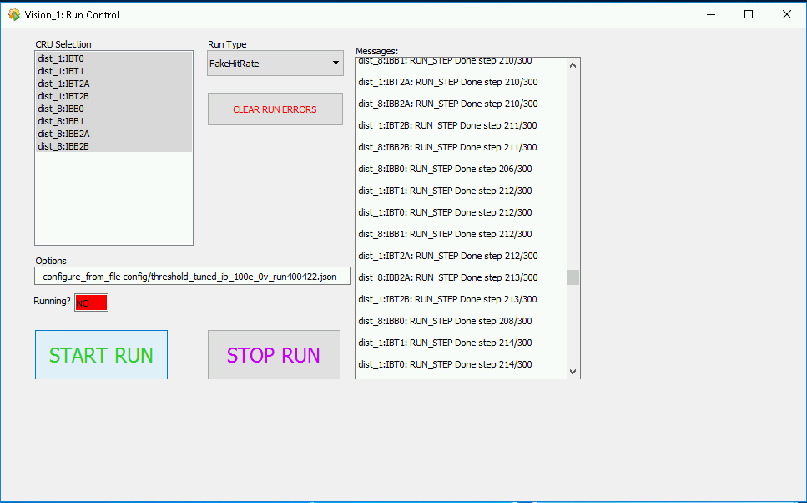
DAQ shifter​
Main tasks: execute runs, monitor the status of the Inner Barrel​
DCS machine: aliitsdcs2.cern.ch
Username for DCS machine: itsshift (ask password to the shift leader)​
Output of Inner Barrel is collected through 8 CRUs. Mounted on 4 FLPs. Before start a run one must be sure that all the 8 CRUs are selected.
If not yet gray (as in figure) click on each line with left button of the mouse in order to select them.

Slide 3
DAQ shifter​
Main tasks: execute runs, monitor the status of the Inner Barrel​
DCS machine: aliitsdcs2.cern.ch
Username for DCS machine: itsshift (ask password to the shift leader)​
The run type can be selected through this drop down menu.
Three kind of runs are normally executed:
ThresholdScan
FakeHitRate
ReadoutTest
Rarely shift leader can ask to execute:
RUConfigDump
To select a run, click on it.

Slide 4
DAQ shifter​
Main tasks: execute runs, monitor the status of the Inner Barrel​
DCS machine: aliitsdcs2.cern.ch
Username for DCS machine: itsshift (ask password to the shift leader)​
When executing ThresholdScan or FakeHitRate a configuration file needs to be selected. The field called "Option" can be used to choose a configuration file.
In the case of ReadoutTest config file is not needed, the value to be used is:
--skip
In the case of ThresholdScan and FakeHitRate, the full line, containing the path of the configuration file is reported in the manual, chapter "Shift schedule and and tasks".
Be sure that you are using the correct Options for each run.

Slide 5
DAQ shifter​
Main tasks: execute runs, monitor the status of the Inner Barrel​
DCS machine: aliitsdcs2.cern.ch
Username for DCS machine: itsshift (ask password to the shift leader)​
At this point the run can be executed. CLICK button "START RUN" to launch it.

Slide 6
DAQ shifter​
Main tasks: execute runs, monitor the status of the Inner Barrel
DCS machine: aliitsdcs2.cern.ch ​
Username for DCS machine: itsshift (ask password to the shift leader)​
When a run is launched, a lot of messages are reported in the right part of the panel. These messages carry a lot of information about execution of the run.
Four main sections can be identified:
Initialization of the run, including run number definition
Chips configuration
Run steps execution
End of the run
ThresholdScan and FakeHitRate have a fixed number of steps and stop automatically. ReadoutTest must be stopped manually according to schedule.
At the end of the run clear messages about quality of the run are reported.

Slide 7
DAQ shifter​
Main tasks: execute runs, monitor the status of the Inner Barrel​
DCS machine: aliitsdcs2.cern.ch
Username for DCS machine: itsshift (ask password to the shift leader)​
Led "Running?" tells you if the run is in execution:
Red "No" = No running
Green "Yes" = Running ongoing
Actually from the messages it become clear which is the status of ongoing run.
Button "START RUN" become unclickable when the run is ongoing.
It could happen that the led "Running?" remains green "Yes" also when the run is actually finished.
If you are sure that the run is actually finished, you can click "CLEAR RUN ERROR" button to make the "START RUN" button clickable again.

Slide 8
DAQ shifter​
Main tasks: execute runs, monitor the status of the Inner Barrel​
DCS machine: aliitsdcs2.cern.ch
Username for DCS machine: itsshift (ask password to the shift leader)​
If you need to stop a run (this is usually the case of ReadoutTest) you have to click on "STOP RUN" button
Do NOT click "STOP RUN" if the run is already finished.

Slide 9
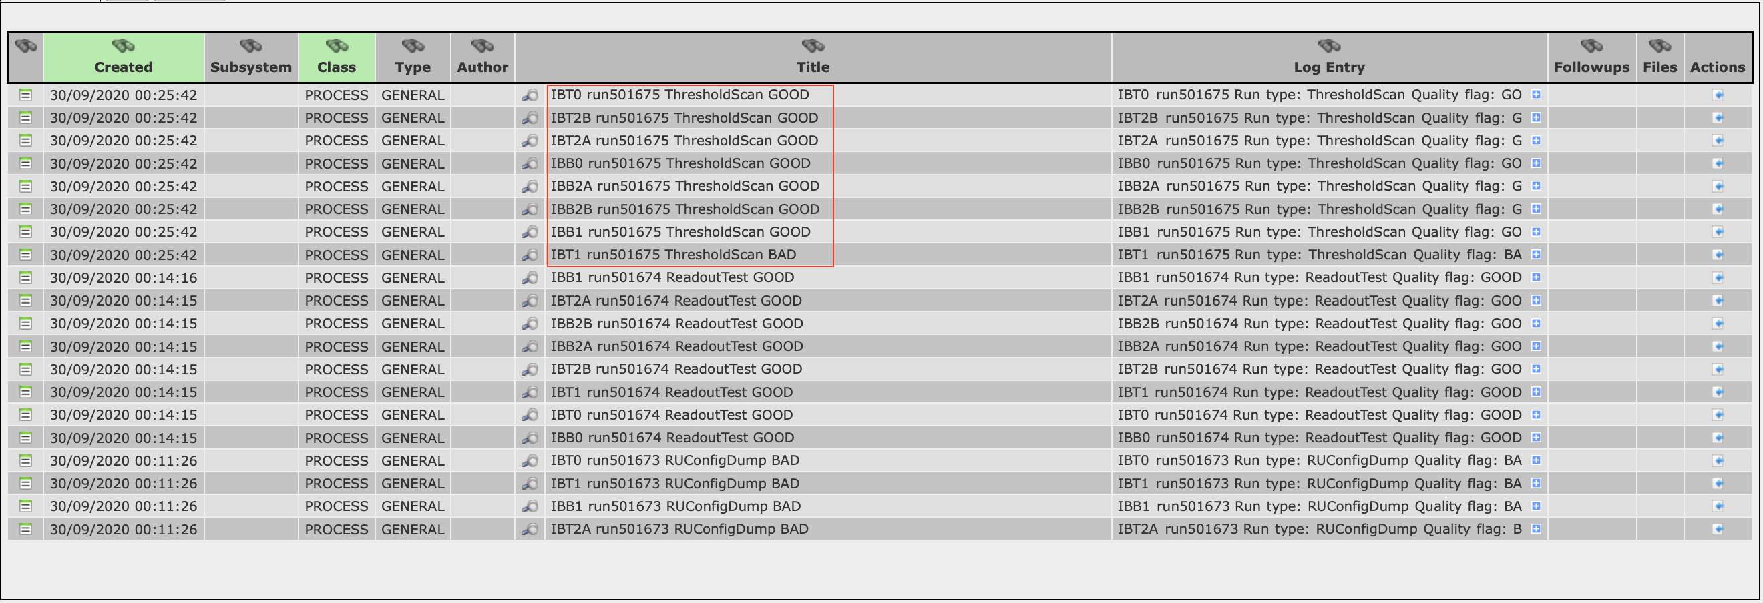
DAQ shifter​
Main tasks: execute runs, monitor the status of the Inner Barrel​
DCS machine: aliitsdcs2.cern.ch
Username for DCS machine: itsshift (ask password to the shift leader)​
At the end of each run, 8 entries are created automatically in the logbook. These correspond to the 8 CRUs included in the data taking, called:
Layer0 : ibt0, ibb0
Layer1 : ibt1, ibb1
Layer2 : ibt2a, ibt2b, ibb2a, ibb2b
Shifters must verify that all the 8 entries are create and that the associated run number is the correct one.
As described in the manual: ​
if some of these entries are not created, they need to create by hand​, following a model provided on the shifter manual
If the run number is wrong, shift leader must be contacted and notified

Slide 10
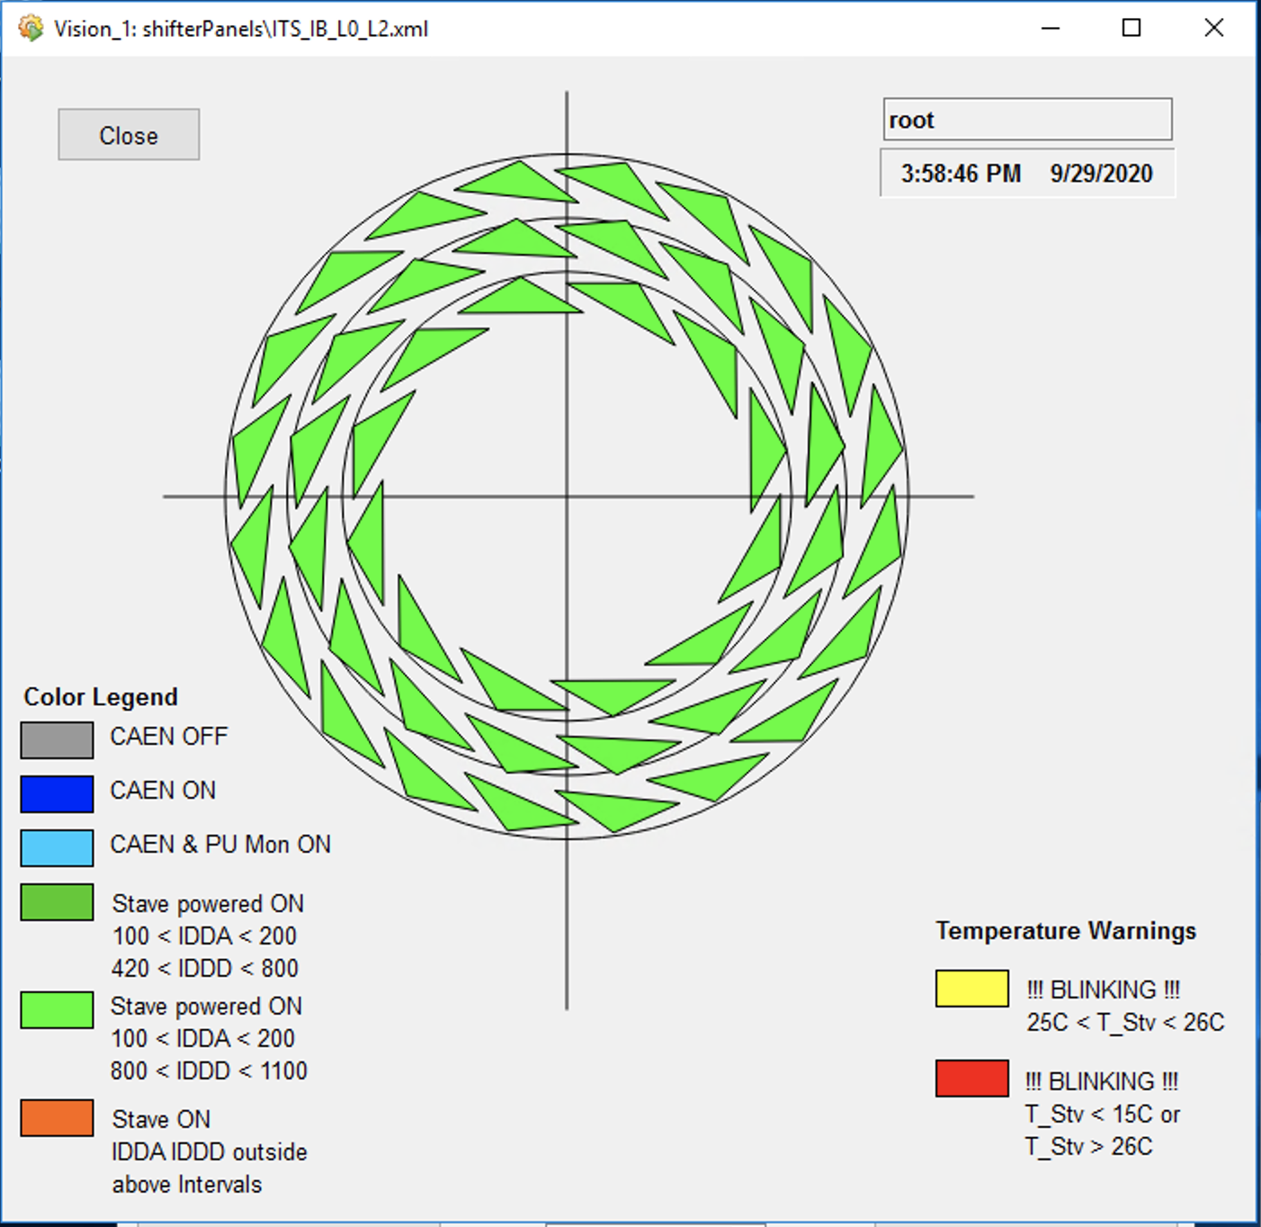
DAQ shifter​
Main tasks: execute runs, monitor the status of the Inner Barrel​
DCS machine: aliitsdcs2.cern.ch
Username for DCS machine: itsshift (ask password to the shift leader)​
This is the panel used to monitor the status of the stave of the Inner Barrel. It is a transverse section of the detector geometry, where each triangle represents a stave. Layers are called from innermost to the outermost: Layer 0, Layer 1 and Layer 2. Staves are numbered and the name convention is e.g.: L0_10, for stave 10 in Layer 0.
Triangles can change color depending on two parameters:
Analog and Digital current value
Stave temperature value
Legend is reported directly in the panel.
Normal color, when chips are configured (during the run) is light green (as in the picture).
How to proceed in case of failure of one stave is described in the manual.

Slide 11
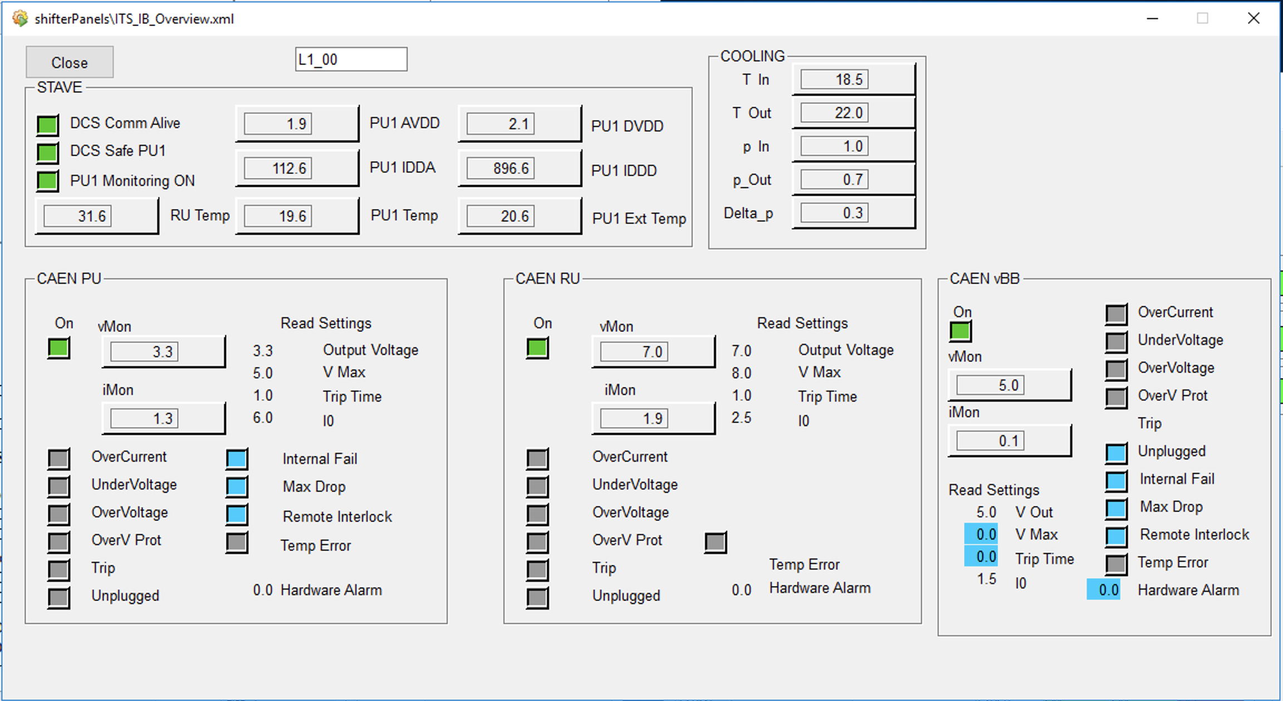
DAQ shifter​
Main tasks: execute runs, monitor the status of the Inner Barrel​
DCS machine: aliitsdcs2.cern.ch
Username for DCS machine: itsshift (ask password to the shift leader)​
Clicking on one triangle a new panel pops up, including information about the status of the selected stave: HIC analog and digital voltage/current, RU/PU1/PU2 temperatures, cooling plant parameters, CAEN channels parameters.

Slide 12
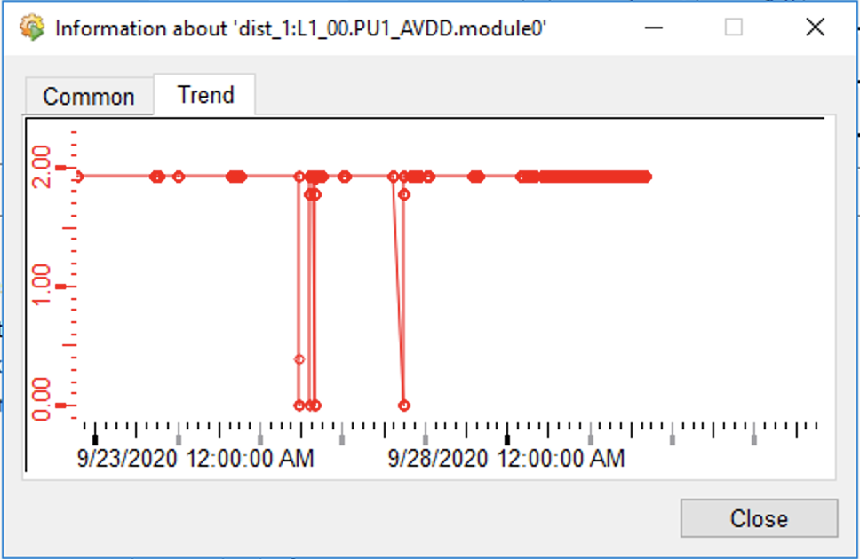
DAQ shifter​
Main tasks: execute runs, monitor the status of the Inner Barrel​
DCS machine: aliitsdcs2.cern.ch
Username for DCS machine: itsshift (ask password to the shift leader)​
​
Clicking on the right side of each value window a new panel can be open. Selecting "Trend" panel a trending plot of the selected parameter can be seen. This is used in case of failure to debug and understand the reason of the failure of one specific stave.

Slide 13
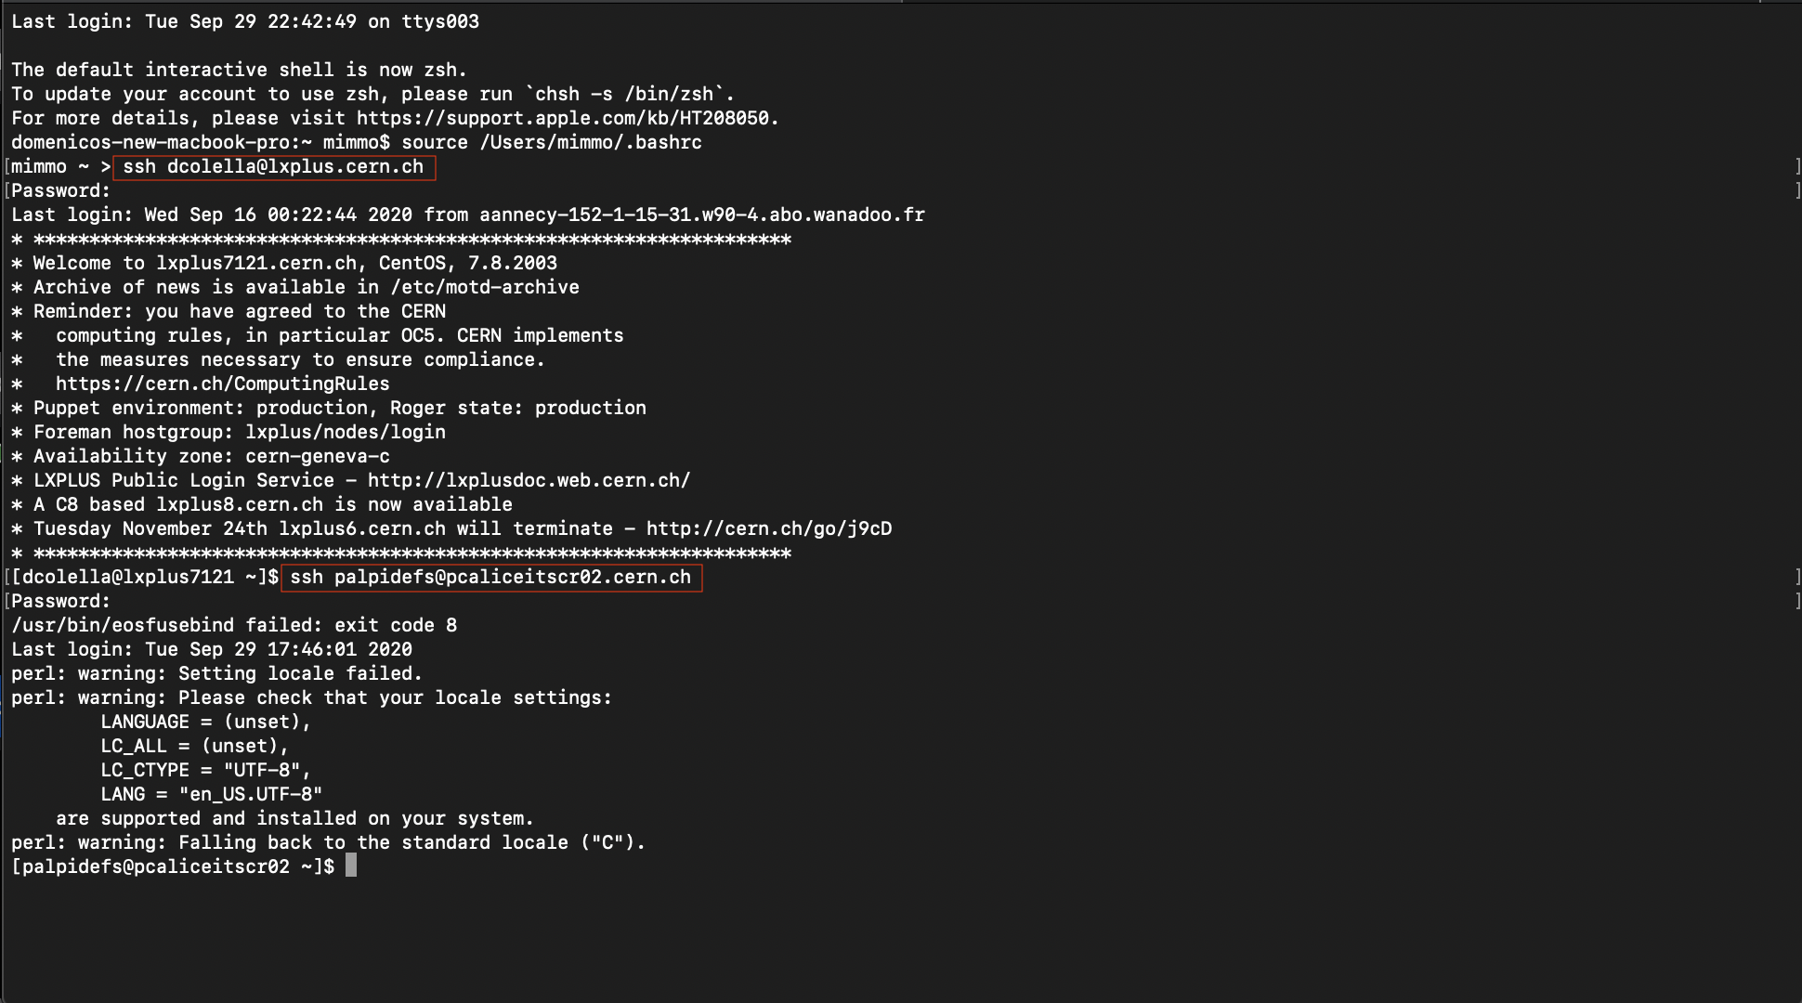
QC shifter
Main tasks: execute QC, monitor the status of the Outer Barrel
DCS machine: aliitsdcs4.cern.ch
Username for DCS machine: itsshif2 (ask shift leader for password)
QC executed on FLP machine: flpits6.cern.ch
Local laptop terminal
How to connect to QC machine from your laptop is described in the manual.
Here sample screenshots of a terminal with sequence of commands are reported.

Slide 14
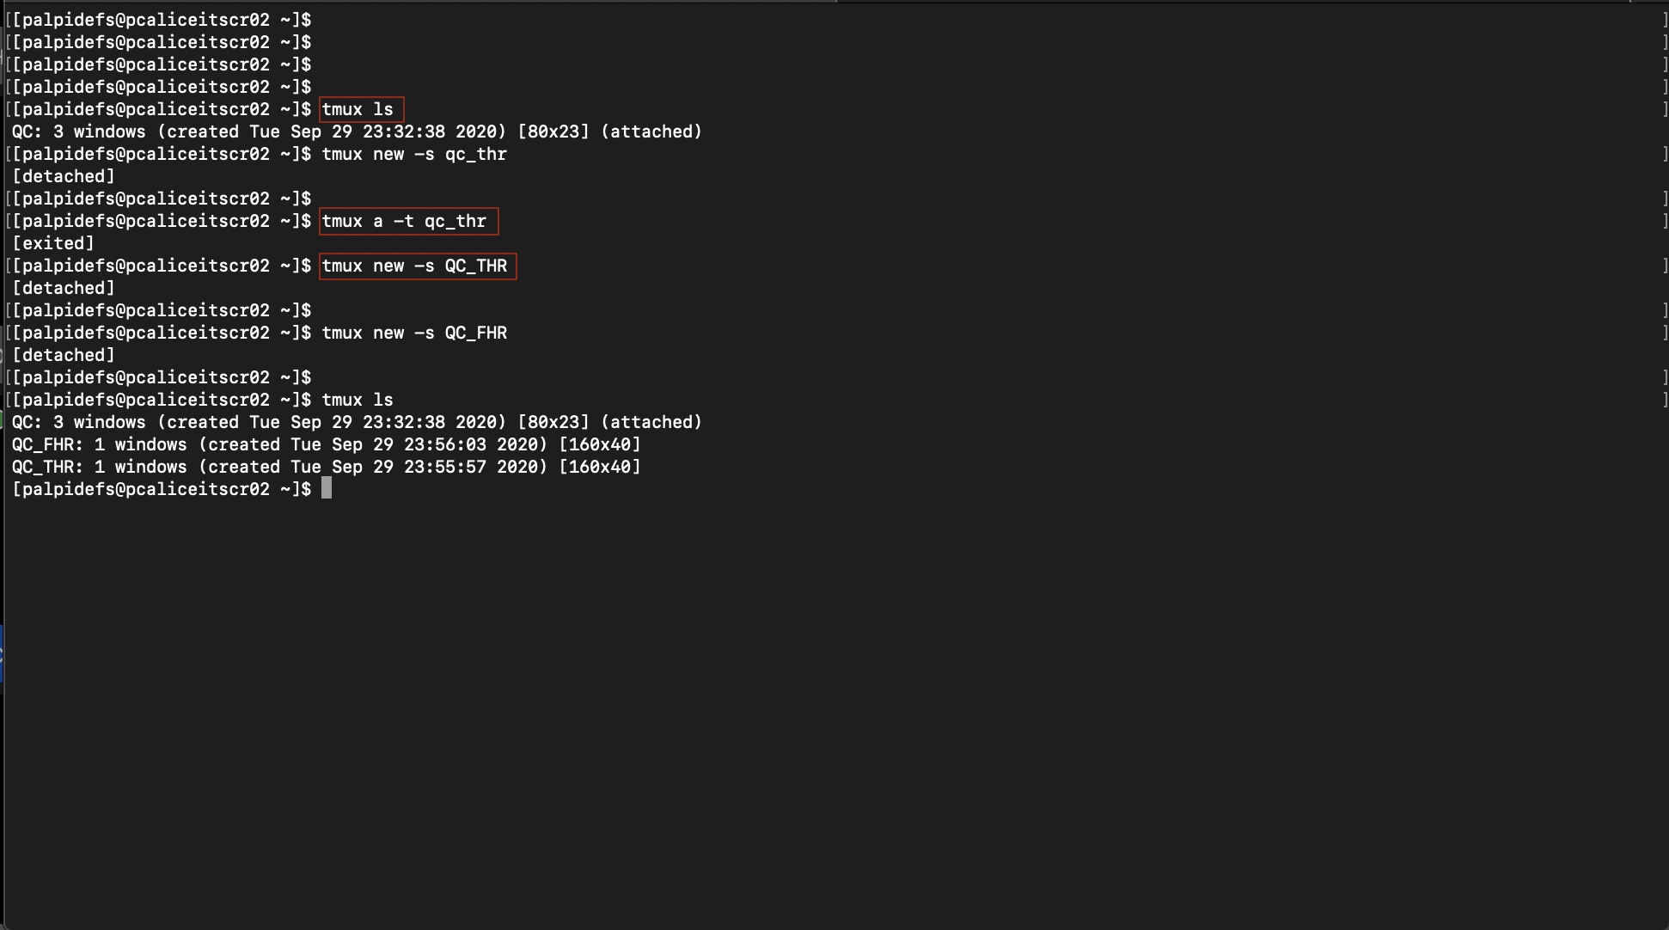
QC shifter
Main tasks: execute QC, monitor the status of the Outer Barrel
DCS machine: aliitsdcs4.cern.ch
Username for DCS machine: itsshif2 (ask shift leader for password)
QC executed on FLP machine: flpits6.cern.ch
Control room PC terminal
How to connect to QC machine from your laptop is described in the manual.
Here sample screenshots of a terminal with sequence of commands are reported.

Slide 15
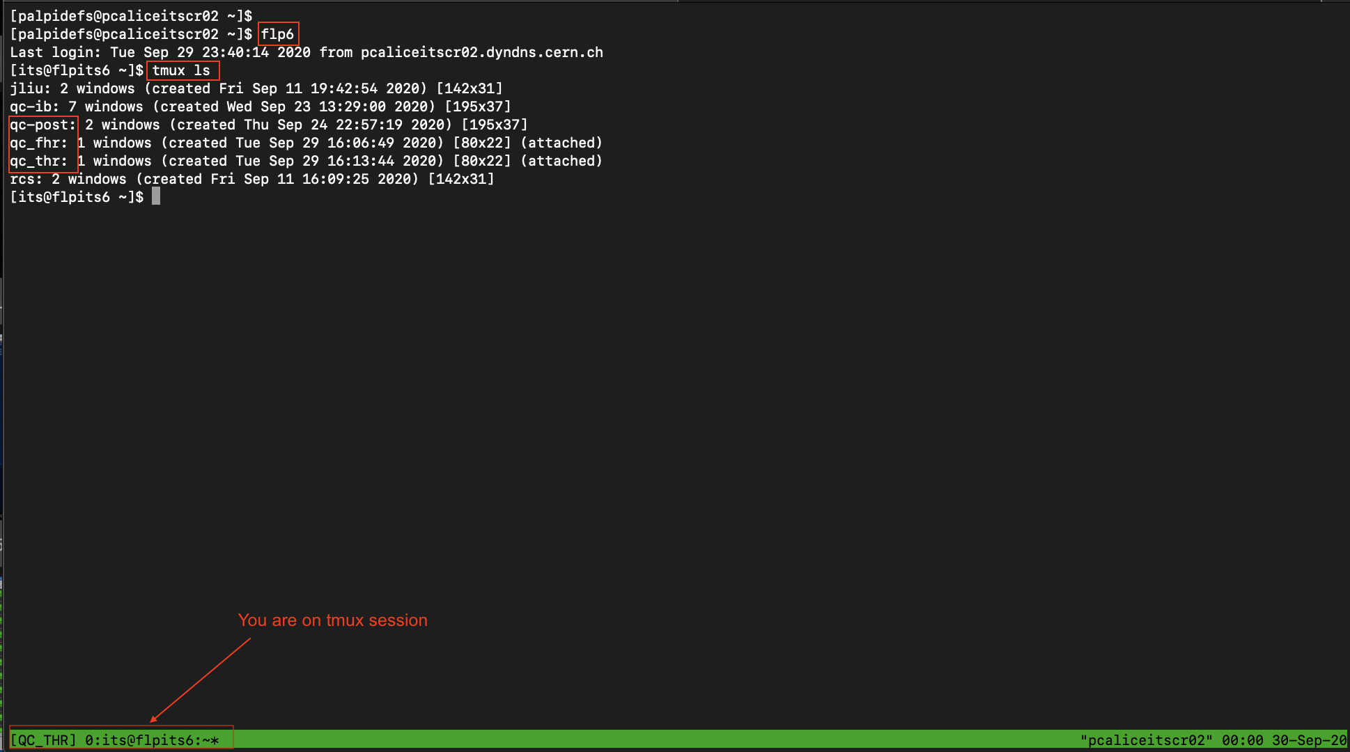
QC shifter
Main tasks: execute QC, monitor the status of the Outer Barrel
DCS machine: aliitsdcs4.cern.ch
Username for DCS machine: itsshif2 (ask shift leader for password)
QC executed on FLP machine: flpits6.cern.ch
tmux session and flpits6
How to connect to QC machine from your laptop is described in the manual.
Here sample screenshots of a terminal with sequence of commands are reported.

Slide 16
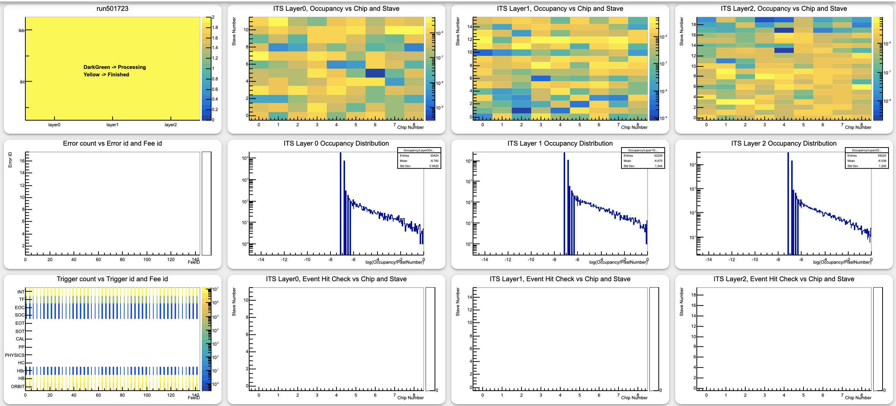
QC shifter
Main tasks: execute QC, monitor the status of the Outer Barrel
DCS machine: aliitsdcs4.cern.ch
Username for DCS machine: itsshif2 (ask shift leader for password)
QC executed on FLP machine: flpits6.cern.ch
Results of the analysis of the QC_FHR are shown In the following web interface: https://qcg-test.cern.ch/?page=layoutShow&layoutId=5f3fc798af8b6db8a8889389&layoutName=ITS_FHR_IB_Online
QC running progression
FakeHitRate map
Total number of hits in a chip/events/number of pixels in the chip
Error table
Occupancy distribution
x-axis --> log of occupancy(#hits/#events)
y-axis --> Number of pixels
Internal Checking map An entry is added for each chip if a number of pixel > 100 fired in the same event
Trigger check
Layer 0
Layer 1
Layer 2

Slide 17
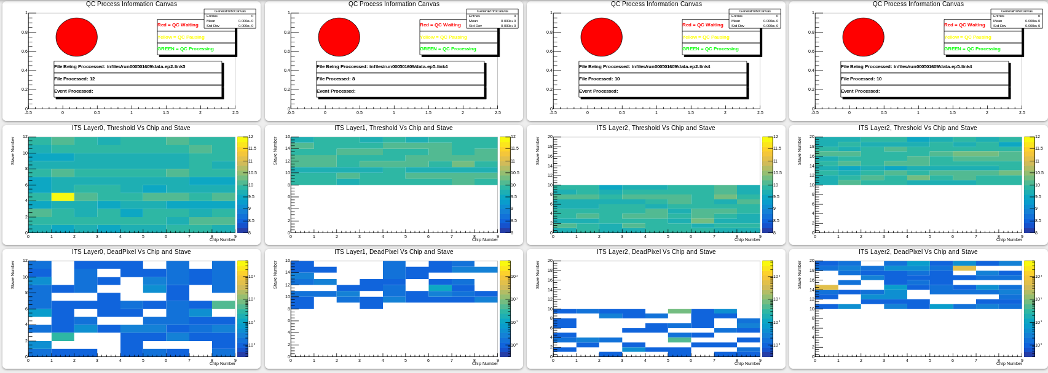
QC shifter
Main tasks: execute QC, monitor the status of the Outer Barrel
DCS machine: aliitsdcs4.cern.ch
Username for DCS machine: itsshif2 (ask shift leader for password)
QC executed on FLP machine: flpits6.cern.ch
Results of the analysis of the QC_FHR are shown In the following web interface: https://qcg-test.cern.ch/?page=layoutShow&layoutId=5e3c6ae923836bd5a7b01cb9&layoutName=ITS_THR_IB
QC running progression
Threshold map
Dead pixels map
Layer 0
Layer 1
Layer 2 TOP
Layer 2 BOTTOM
Staves L1_00-L1_07 empty in this example because of a problem on ibt1

Slide 18
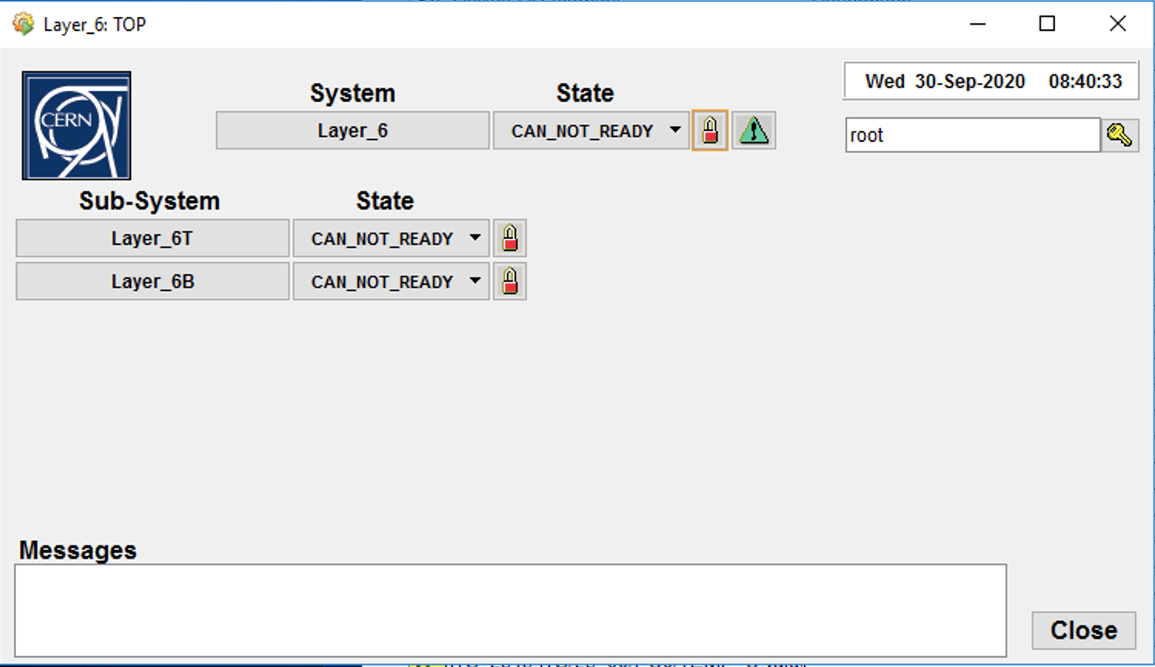
QC shifter
Main tasks: execute QC, monitor the status of the Outer Barrel
DCS machine: aliitsdcs4.cern.ch
Username for DCS machine: itsshif2 (ask shift leader for password)
QC executed on FLP machine: flpits6.cern.ch
Monitoring of the OB staves (at the moment, 1/10/2020) is done using the FSM panel and is presently limited to the status of L6 staves. The shifter must verify that the "top node" of the FSM is always in status "STANDBY". (In the attached example the top node is in status "CAN_NOT_READY)
A lock mechanism regulates the right to apply commands to the components of the FSM. If the lock is RED you cannot send command and change the status of a component. Shifter is not supposed to do so.
FSM top node

Slide 19
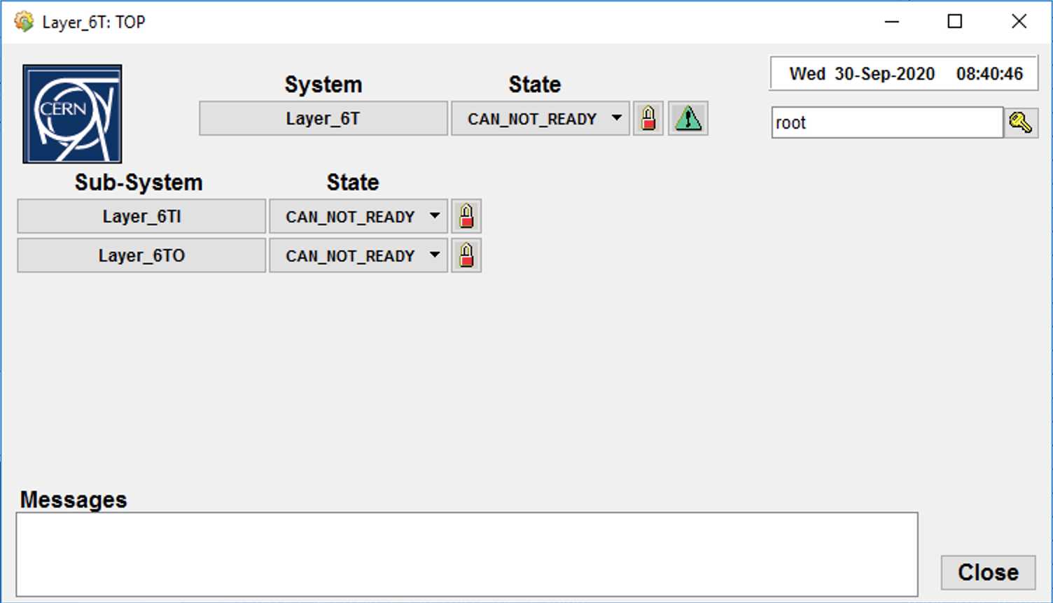
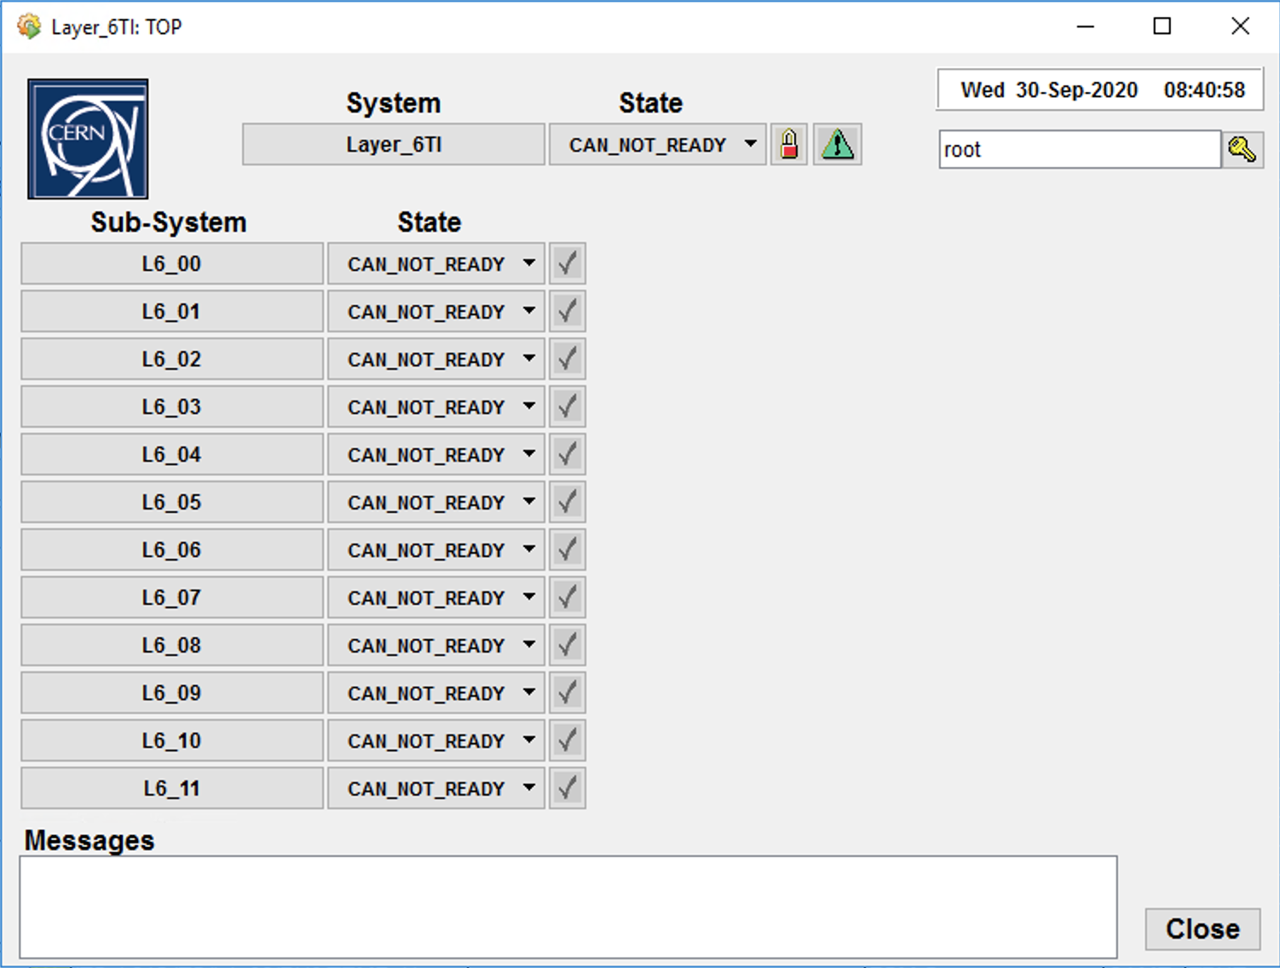
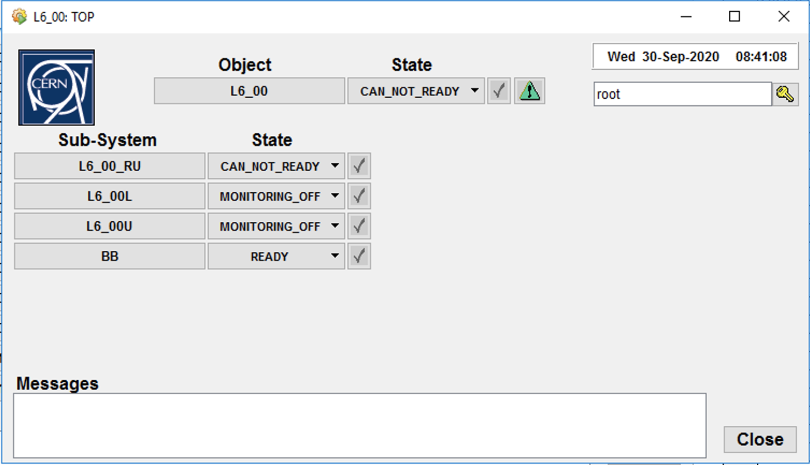
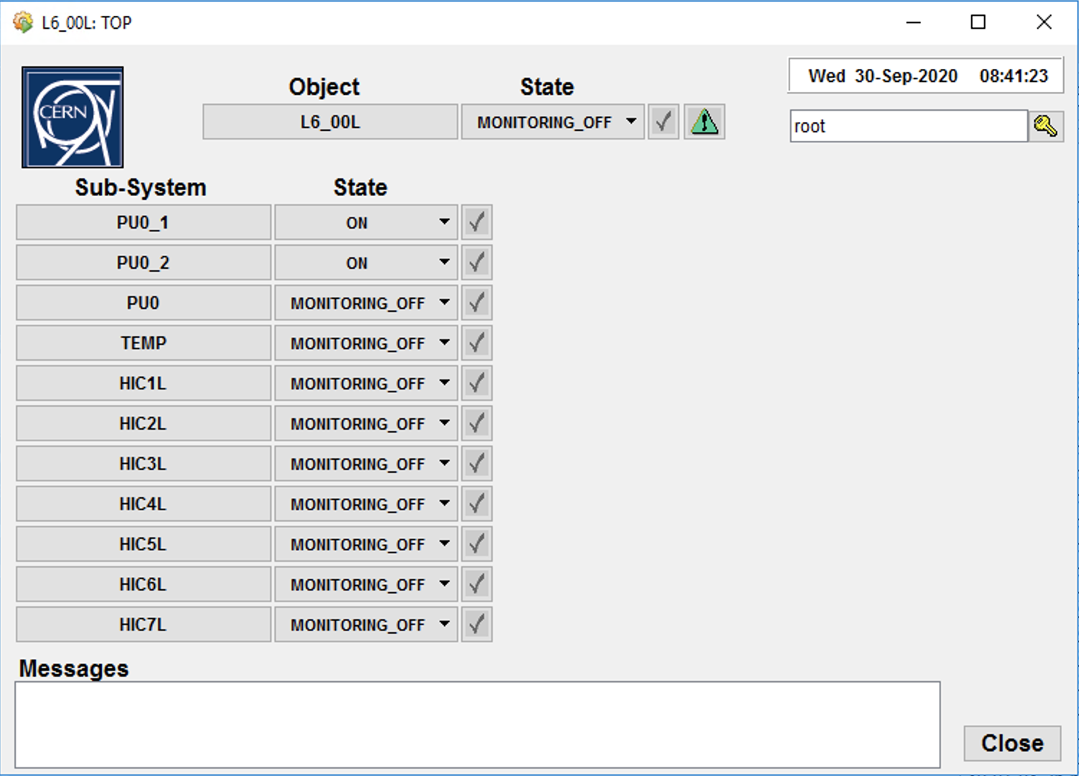
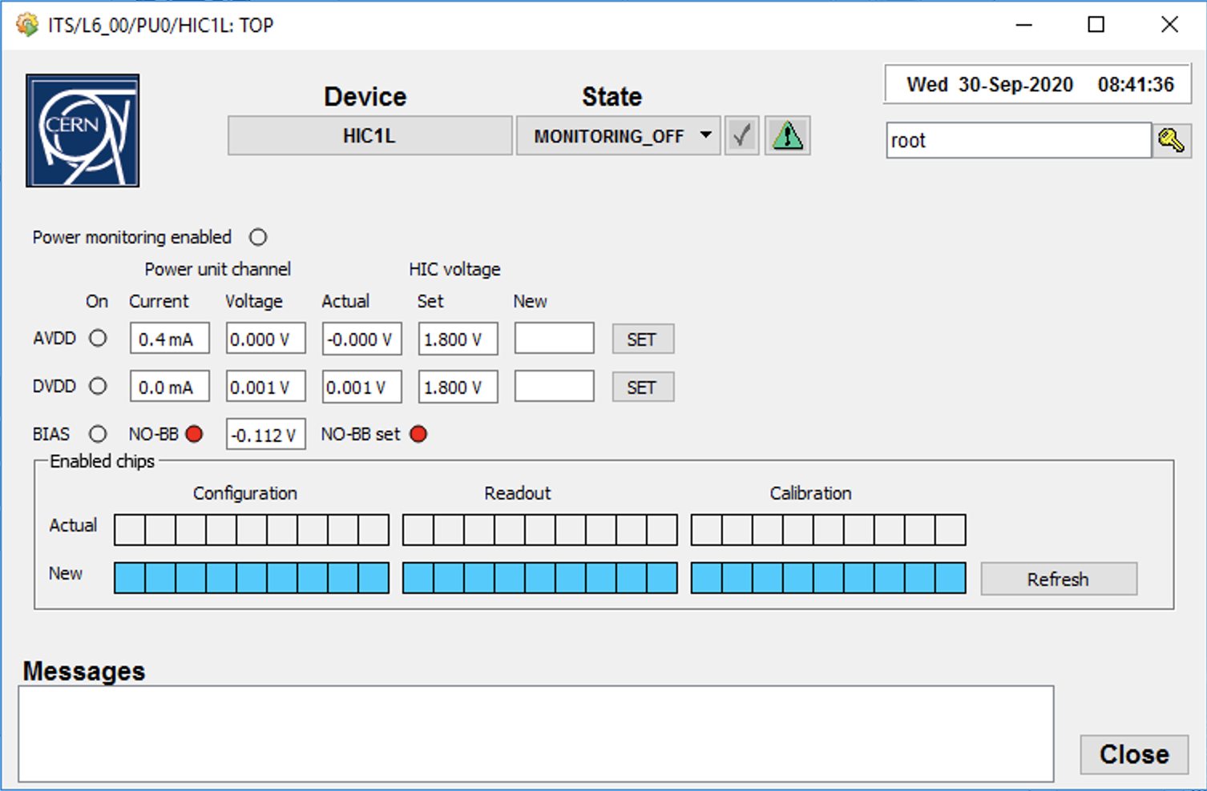
QC shifter
Main tasks: execute QC, monitor the status of the Outer Barrel
DCS machine: aliitsdcs4.cern.ch
Username for DCS machine: itsshif2 (ask shift leader for password)
QC executed on FLP machine: flpits6.cern.ch
The FSM tree can be expanded to read HIC parameter panel, useful in case of failure of a stave.

Slide 20
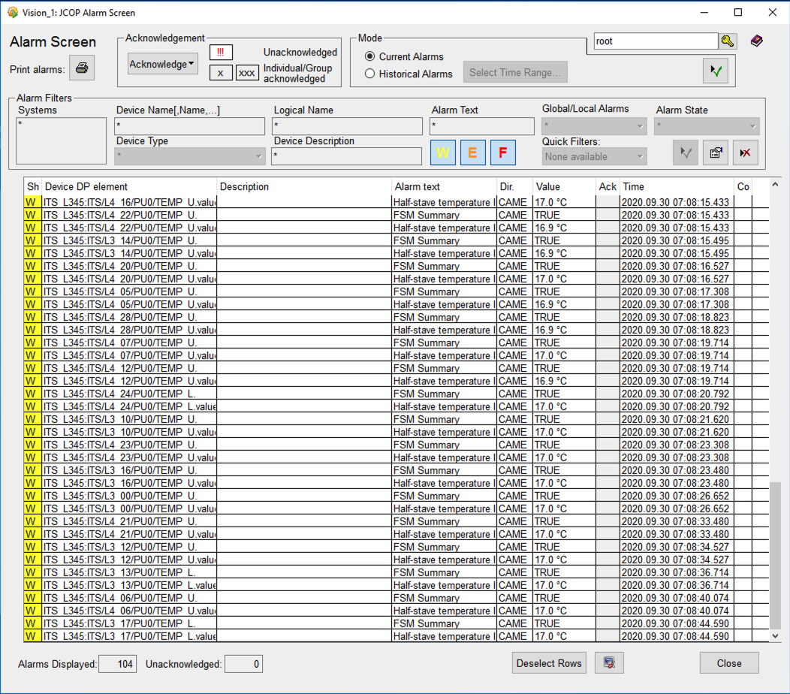
QC shifter
Main tasks: execute QC, monitor the status of the Outer Barrel
DCS machine: aliitsdcs4.cern.ch
Username for DCS machine: itsshif2 (ask shift leader for password)
QC executed on FLP machine: flpits6.cern.ch
A second panel is available in the DCS machine aliitsdcs4, for detector status monitoring: the alarm panel.
Each line in this table corresponds to a warning or an alarm. They can be CAME (source is still active) or WENT (source is not active).
Last column provide information about the appearance time of the warning/alarm.
Presence of new warning/alarm must be notified to the SL. Notice that, an alarm could change from CAME and WENT rapidly; in this case it could be a false alarm. It still must be notified to shift leader.

Slide 21
Mattermost "Commissioning Shifts" channel header
Link to the Manual for experts
Autojoin link to the always open Vidyo virtual room for shifters and experts
Links to the QC web interface
Link to the Manual for shifters
Link to the Logbook
Always keep the Mattermost chat OPEN

