Slide 1
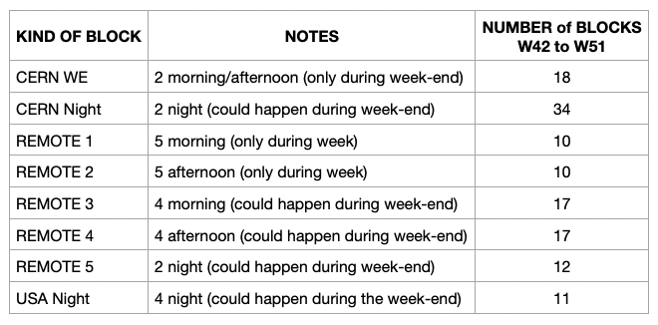
ITS Commissioning Shifts (updated 10/12/2020)
US Team takes CERN evening shifts (11PM – 7AM): “USA Night”(5PM-1AM/EST)
4 nights per shift block
A total of 11 blocks
https://mattermost.web.cern.ch/aliitscomm/channels/commissioning-shifts

Slide 2
Email from Domenico Colella (10/07/2020):
…..
Attached you can find a schema that help understanding definitions of different kind of blocks,
for a period of two consecutive weeks ("ShiftBlocks_Schema.png"). Obviously there can be elasticity in the assignment of remote night shift blocks; the schema alternating one REMOTE 5 block and one USA Night block can be rearranged depending on the needs.
Finally, training is done in two steps:
1) studying the documentation specifically created for this: [1] and [2]
2) attending one shift and following, for few hours, the activities done by actual shifters connecting to
the following Vidyo room [3]
Unless specifically requested, the training session will not be structured. You will simply connect, follow
what the shifters does and feel free to make as many questions as you like. Please, let me know before the moment you want to connect so that I can anticipate this to shifters and being present myself to help with explanations.
[1] https://espace.cern.ch/alice-its-commissioning/_layouts/15/WopiFrame.aspx?sourcedoc=/alice-its-commissioning/Shared%20Documents/ITS-shift-instructions.docx&action=default
[2] https://espace.cern.ch/alice-its-commissioning/_layouts/15/WopiFrame.aspx?sourcedoc=/alice-its-commissioning/Shared%20Documents/Shifter_panels.pptx&action=default
[3] https://vidyoportal.cern.ch/join/jVKVQhUhjy

Slide 3
ITS Commissioning Remote Shift (from Doc #1)
"You need to use the remote desktop program within windows (startmenu->Remote desktop connection)
!! BUT please don't try to connect when it's not your shift !! You will kick the current shifter from the machine”
(only one connection is allowed)

Slide 4
Remote Login to CERN Gateway
Instructions about remote activities are reported in the manual [1], chapter "Shift in Remote Connection".
In the two cases of the ssh connection for QC activities or remote desktop connection for DAQ and monitoring activities, you have to pass through a gateway.
In the case of ssh connection, the gateway is lxplus.
In the case of remote desktop, the gateway is the machine cernts.cern.ch.
In both cases you have to use your NICE account to connect inside the CERN network.
Once you manage to be inside CERN network, you can use again a remote desktop connection to access the DCS machines.
Again, all the steps are specified in the mentioned chapter.
Let me know if you need further explanations.
mxliu@~>ssh miliu@lxplus.cern.ch
Warning: Permanently added the ECDSA host key for IP address '188.185.89.29' to the list of known hosts.
Password:
* ********************************************************************
* Welcome to lxplus712.cern.ch, CentOS, 7.8.2003
* Archive of news is available in /etc/motd-archive
* Reminder: you have agreed to the CERN
* computing rules, in particular OC5. CERN implements
* the measures necessary to ensure compliance.
* https://cern.ch/ComputingRules
* Puppet environment: production, Roger state: production
* Foreman hostgroup: lxplus/nodes/login
* Availability zone: cern-geneva-b
* LXPLUS Public Login Service - http://lxplusdoc.web.cern.ch/
* A C8 based lxplus8.cern.ch is now available
* Tuesday November 24th lxplus6.cern.ch will terminate - http://cern.ch/go/j9cD
* ********************************************************************
[miliu@lxplus712 ~]$

Slide 5
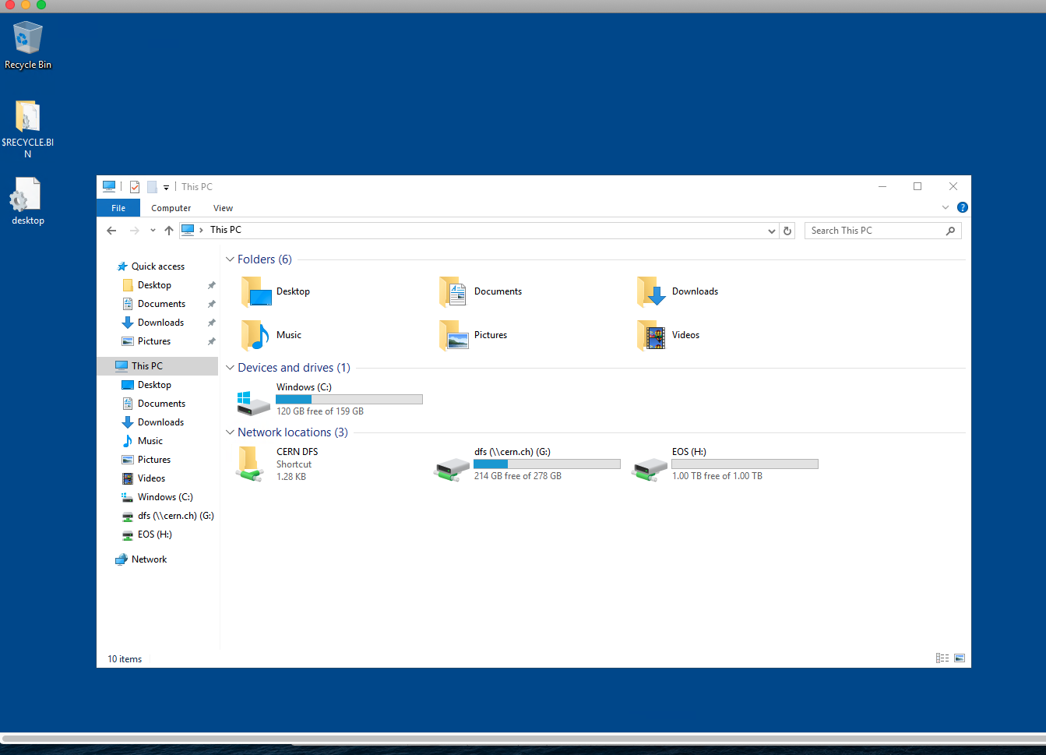
Screenshot of my Remote Desktop: CERNTS
"You need to use the remote desktop program within windows (startmenu->Remote desktop connection)
!! BUT please don't try to connect when it's not your shift !! You will kick the current shifter from the machine”
(only one connection is allowed)

Slide 6
Vidyo Display (from #3 link)

