Slide 1
CERN Visit
Ming Liu, Walt Sondheim
09/16-20, 2019

Slide 2
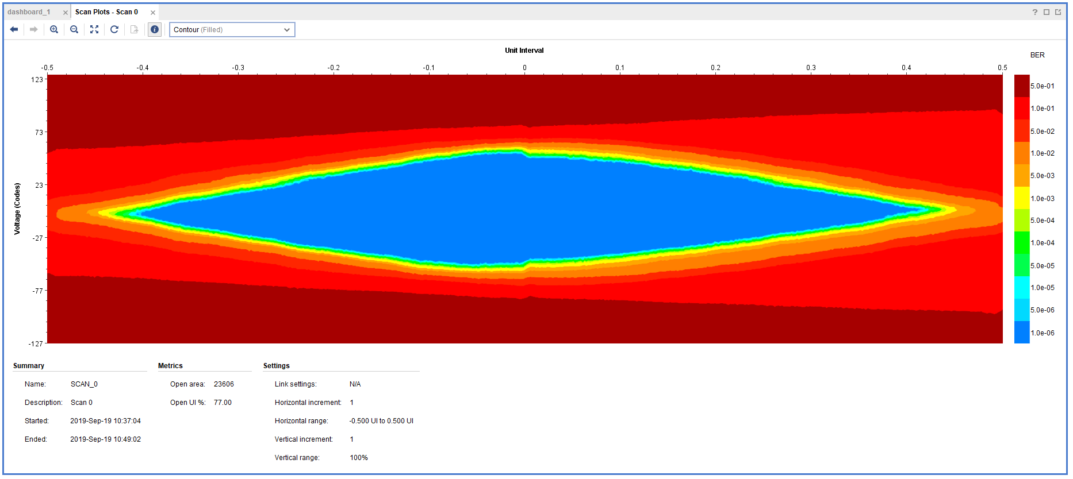
11.4m SamTec Readout Cable Test
Double looped readout cables:
Effective length = 2 x 11.4 m = 22.8m
Data rate: 1.2Gbps
One overnight run, ~10hrs
Error rate < 1.4 x10⁻¹⁴

Slide 3
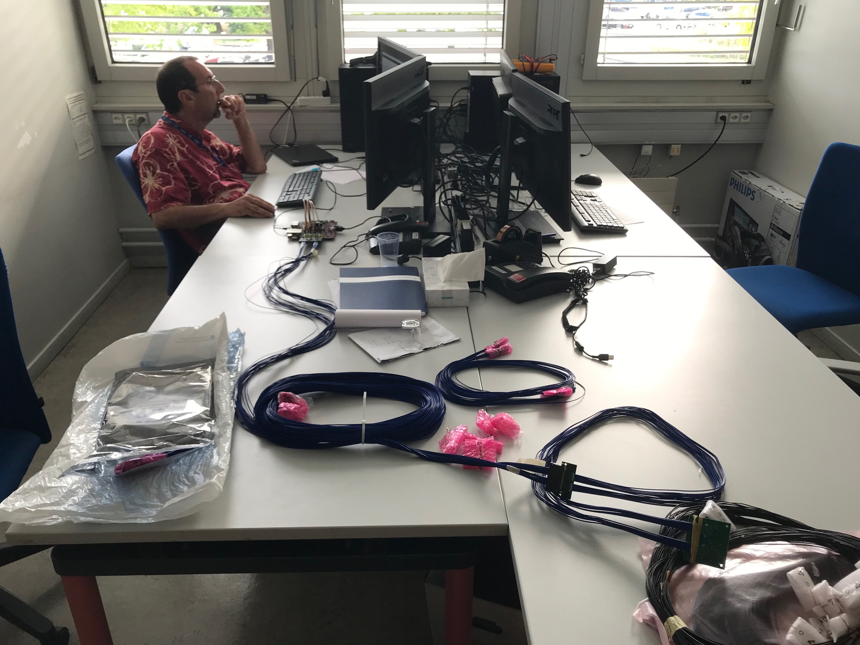
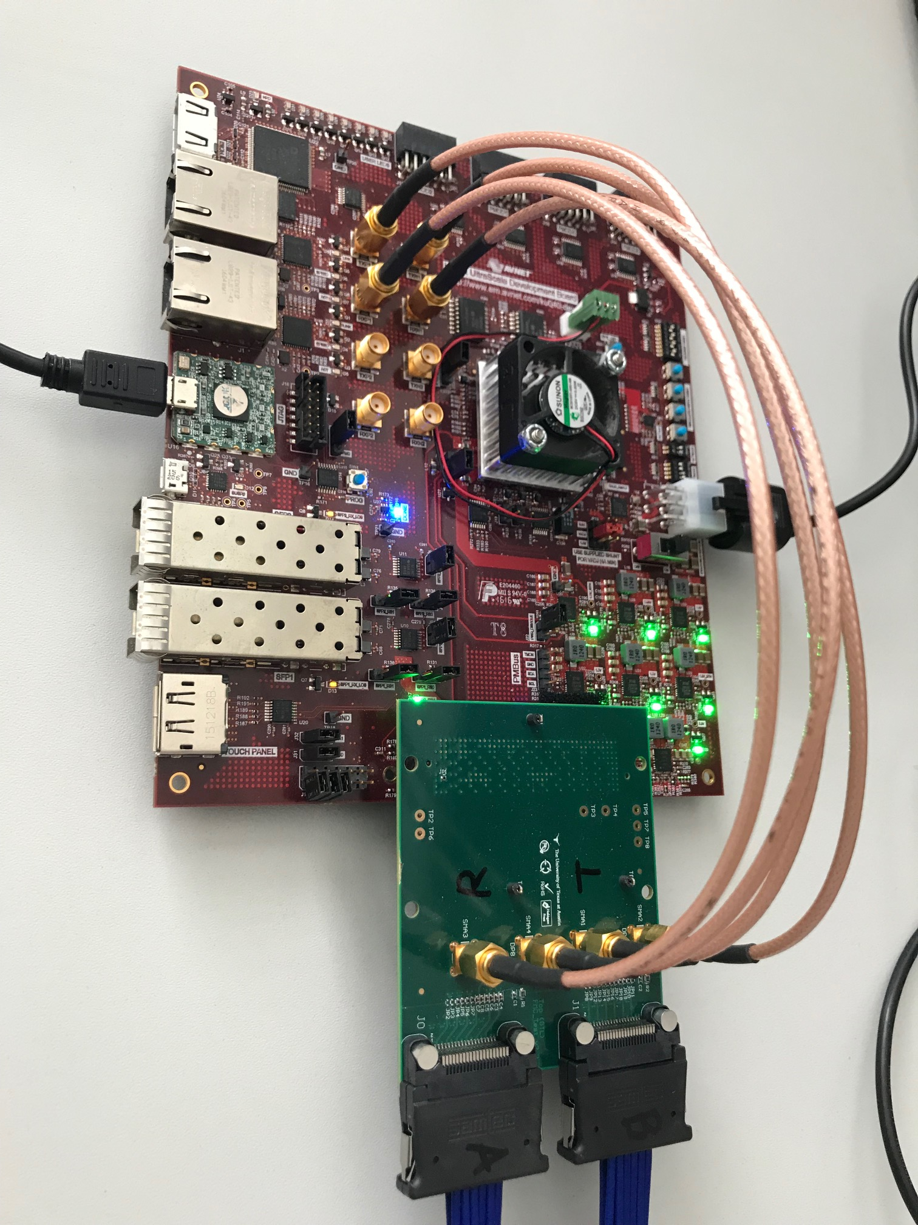
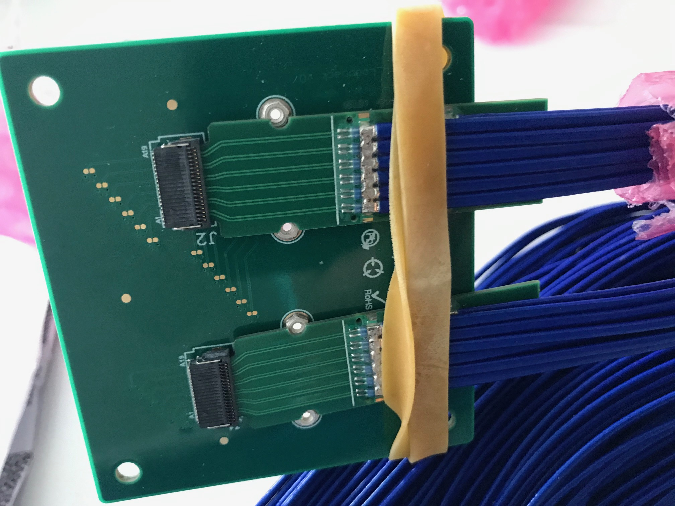

Slide 4
Stave Production
From this week
Bi-weekly meeting on Thursday 5PM/CERN (9AM/LANL)
~10 staves/month
Limited by Wirebonding , 2~3 staves/week
Production last 7~11 months

Slide 5
Carbon Structures
Visited WorkShape
Very productive, well prepared

Slide 6
ITS Commisioning

