Slide 2
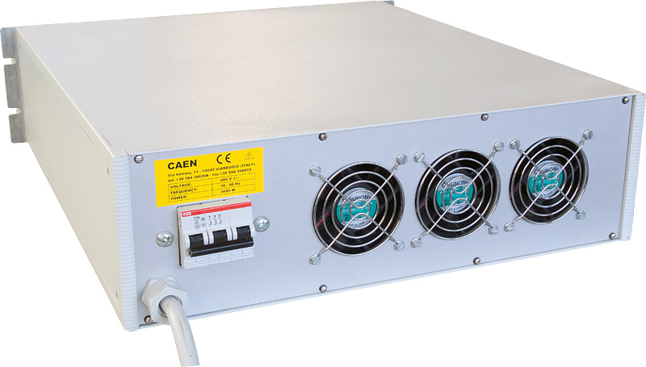
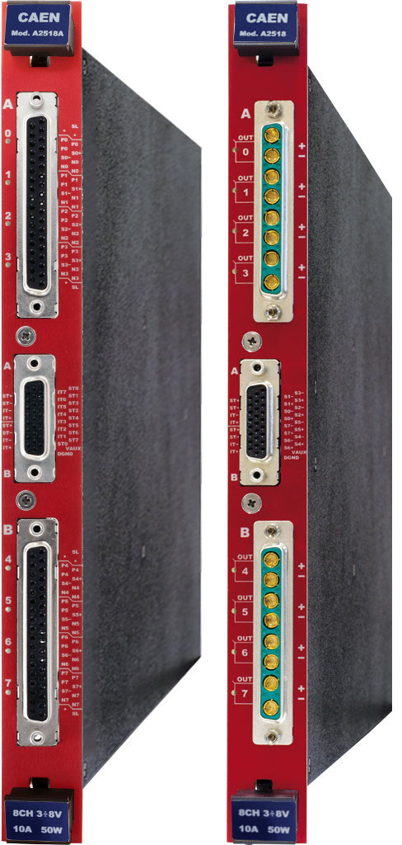
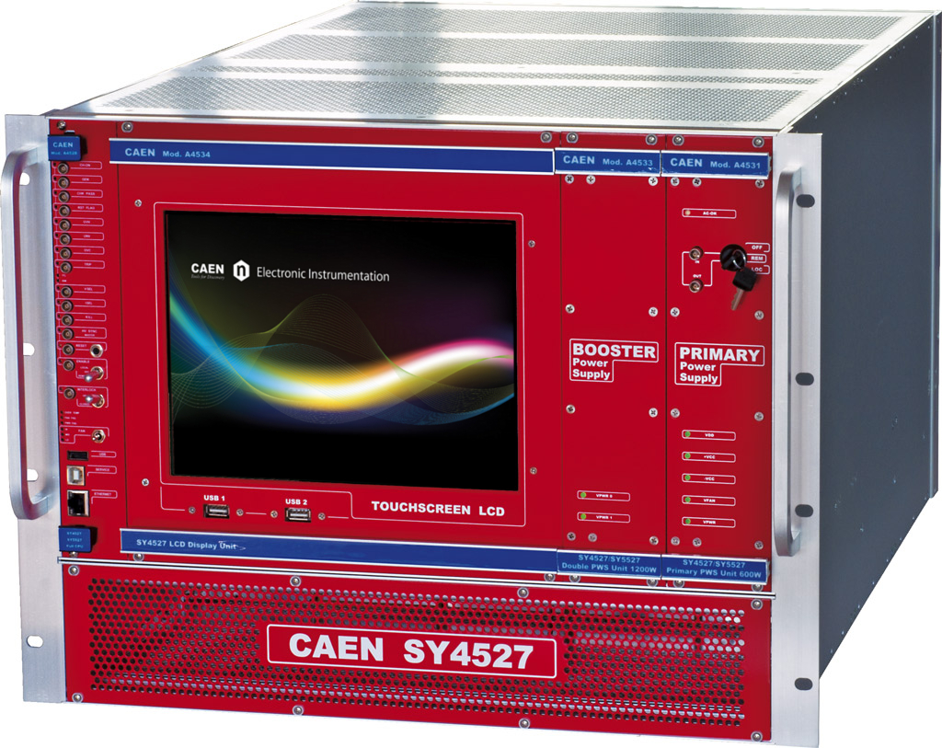
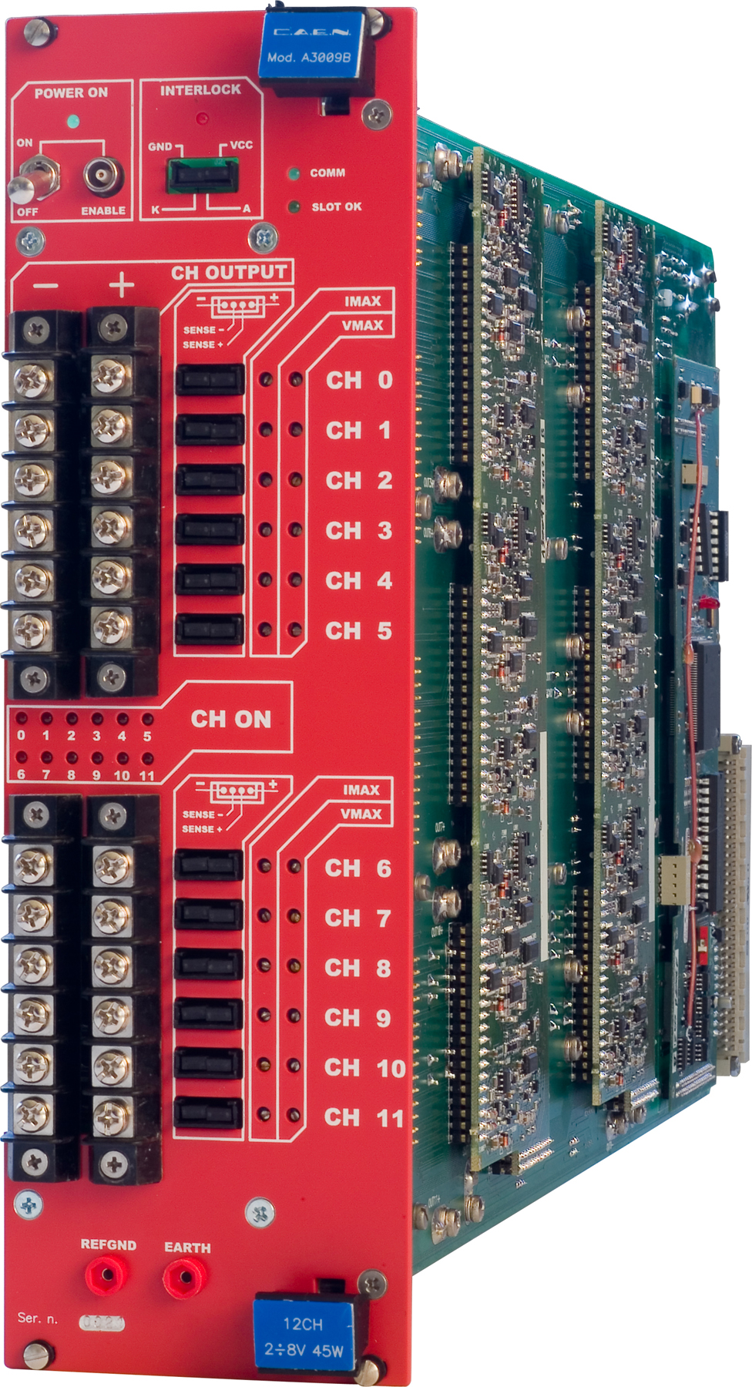
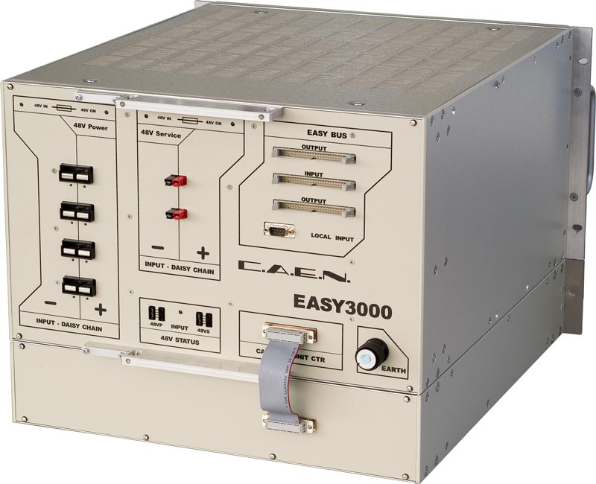
A3009B
Eur 7750
8V/9A/45W 12-ch floating
3.3V output
that powers 1.8V digital and analog rails
A3486
Eur 13000
220/400Vac->48Vdc
2ch/2kW / 1ch/4kW
A1676A
Eur 1470
Branch controller
Up to 6 crates
A2518
Eur 2050
8V/10A 8-ch individual floating
EASY3000
Eur 2850
Crate for hostile area
SY4527
Eur 5900
Basic 600W model

Slide 3
IB staves: 48 staves
Need 24 power boards & 48 readout units
1 power board (2 units) powers 2 IB staves.
1 readout unit read 1 IB stave
48 channels from CAEN that provides 3.3V for power boards
(How much for readout boards?)
19” wide X 7U VME crate has 21 slots.
4 slots per 2-staves (2-slot for power boards, 2-slot for 2 readout units).
1 crate for 10 staves.
5 crates needed.
3.3V channels
1.5A per CAEN 3.3V channel into power boards.
48 channels total.
-5V channel:
1 channel per crate (5 crates total).
1A per channel spec.

