Slide 1
sPHENIX HF Trigger Study, 04/2018
Single track large DAC trigger for B-hadron in p+Au and p+p
  Enable B-hadron flow and R_pA in p+Au
MVTX + INTT + others (electron Trigger)
RU + “Trigger board/FELIX-like”
Pythia simulation:
  200GeV p+p
  BB -> muons, |eta|<1
B
DCA_XY

Slide 2
PYTHIA simulations
pT > 0.3GeV, muons
DCA_XY > 500 um
  Eff = 52.5%
DCA_XY > 1,000 um
  Eff = 33.9%
sPHENIX DAQ 15kHz
  MB ~ 1kHz
FH sampled by MB:
  1kHz/10MHz = 1x10^-4
Even with 10% HF Trigger Eff, we gain:
  0.1/10^-4 = 1000!
  Enable B-hadron physics at low pT

Slide 3
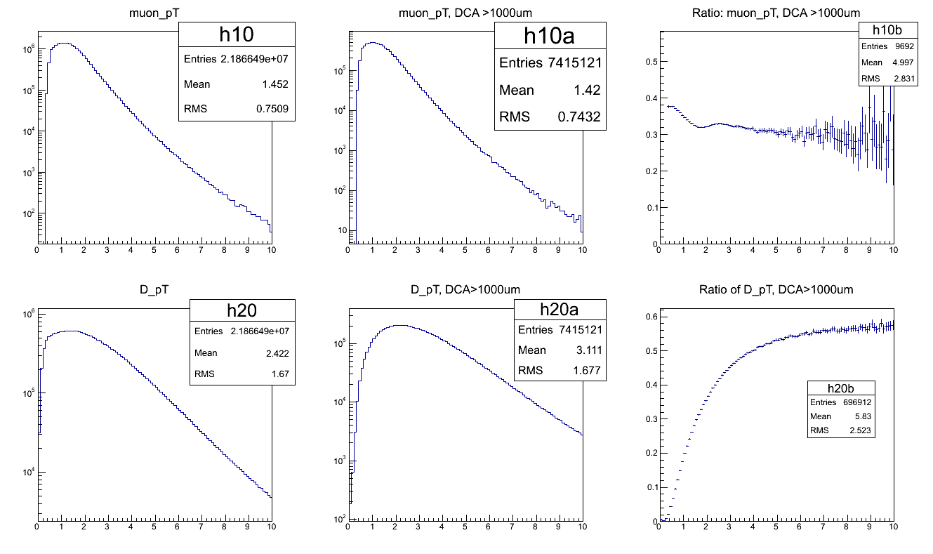
Trigger Effiencey for B->mu+X, DCA > 1000 um

Slide 4
Muons from pp200
Muon pT: 0.5 – 10GeV

Slide 5
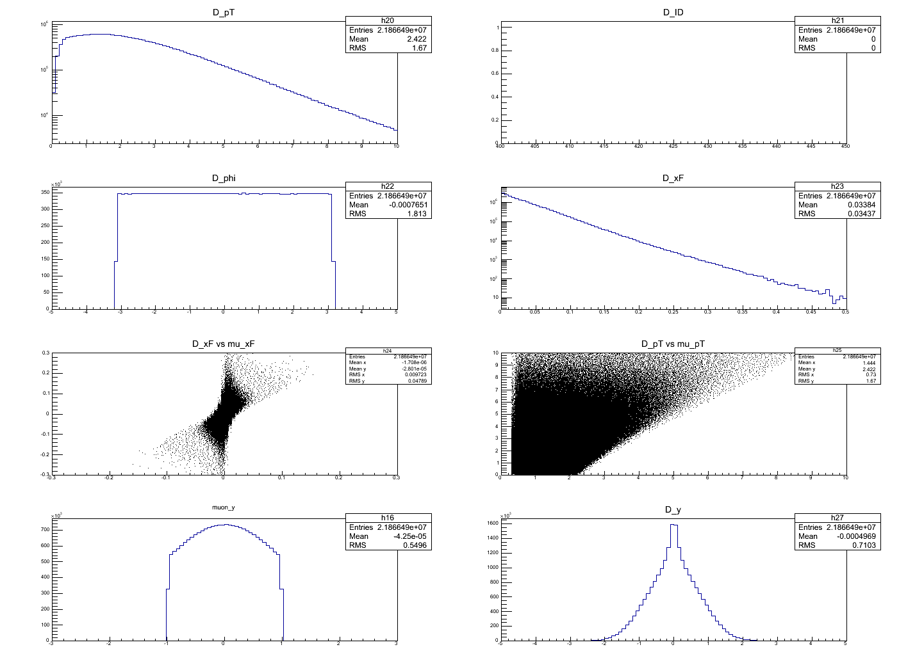
B hadrons (->mu)
pT(B): 0 -10GeV

