Slide 1
A new DOE SBIR-I Project to Develop an Open Heavy Flavor Trigger for sPHENIX: 2/2019 – 12/2019

Slide 2
Goal of this SBIR-I Project
BNL NSLS-II beamline system
sPHENIX HF trigger development ($25K awarded to LANL): 2/19/2019 – 12/18/2019
  LANL provides physics inputs:
  open HF and BG simulations with sPHENIX detectors (MVTX + INTT) to produce raw hit distributions
  Sun Rise Technology will 1) use the sPHENIX MVTX/INTT hit distributions to train NN package developed by Sunrise Technology, and 2) implement the trigger algorithm on a FPGA evaluation board
  Evaluate and improve the trigger algorithm
Develop sPHENIX HF trigger system through SBIR-II (2020 - 2022)
Build hardware for sPHENIX
Develop firmware
Installation in IR in 2022, ready for Day-1 physics in 2023

Slide 3
sPHENIX HF Trigger Study
INTT
Single track large DAC trigger for B-hadron in p+Au and p+p
  Enable B-hadron flow and R_pA in p+Au
MVTX + INTT + others (electron Trigger)
RU + “Trigger board/FELIX-like”
Pythia simulation for sPHENIX:
  200GeV p+p
  BB -> muons, |eta|<1
MVTX
B
DCA_XY

Slide 4
Muons from pp200
An example:
sPHENIX tracking acceptance,
B->muon + X
Muon pT: 0.3 – 10GeV
Approach:
- Fast tracking (FPGA based) in 2-D, DCA
Multiple tracklets, in hadronic channel
New FELIX-based readout for MVTX+INTT in CR

Slide 5
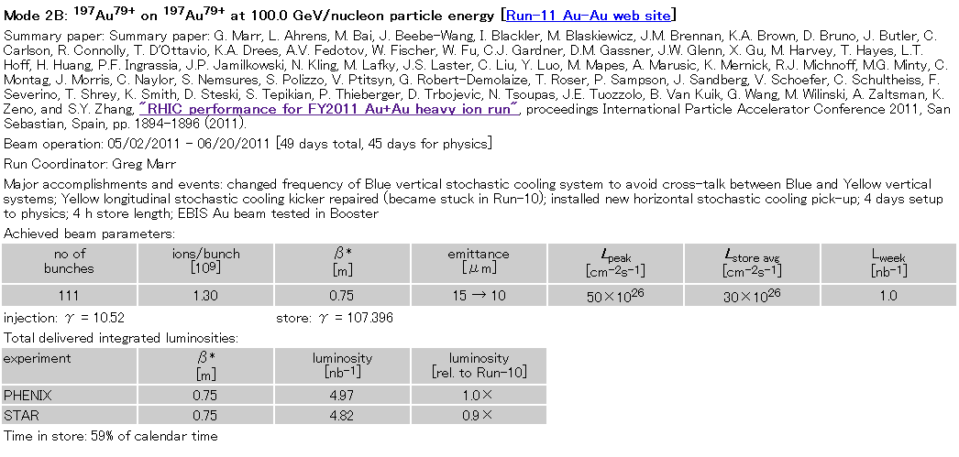
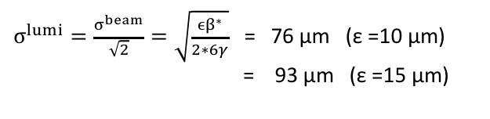
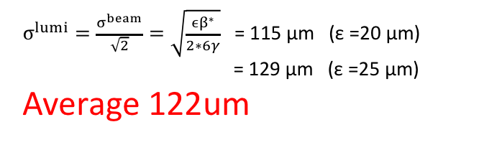
Expected beam spot size in sPHENIX
obtained parameters from CAD’s web page:
http://www.rhichome.bnl.gov/RHIC/Runs/
definition of emittance
ε = (βγ) * (6σ^2)/β*
(βγ) : relativistic factors
σ : RMS beam size
β* : amplitude function
ε :95% normalized emittance
RUN11 AuAu 200GeV
RUN12 pp 200GeV
β* = 0.75 m (PHENIX)
β* = 0.85 m (PHENIX)
$σ^{lumi}=\frac{σ^{beam}}{\sqrt{2}}=\sqrt{\frac{ϵβ^{∗}}{2∗6γ}}$= 76 μm (ε =10 μm)
= 93 μm (ε =15 μm)
$σ^{lumi}=\frac{σ^{beam}}{\sqrt{2}}=\sqrt{\frac{ϵβ^{∗}}{2∗6γ}}$= 115 μm (ε =20 μm)
= 129 μm (ε =25 μm)
Average 122um
ASANO 2012/07/17

Slide 6
PYTHIA simulations
pT > 0.3GeV, muons
DCA_XY > 500 um
  Eff = 52.5%
DCA_XY > 1,000 um
  Eff = 33.9%
sPHENIX DAQ 15kHz
  MB ~ 1kHz
HF sampled by MB:
  1kHz/10MHz = 1x10^-4
Even with 10% HF Trigger Eff, we gain:
  0.1/10^-4 = 1000!
  Enable B-hadron physics at low pT

Slide 7
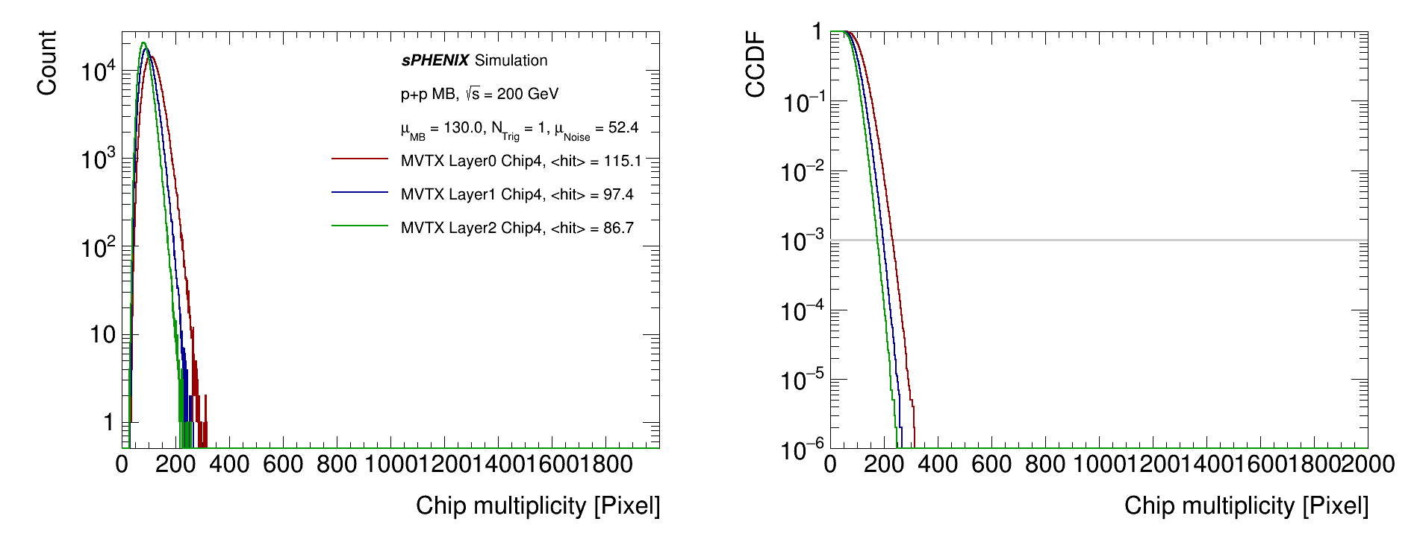
p+p multiplicity, per-strobe, chip-4
Jin’s simulations
p+p collision related data is completely dominated by pile-ups
Central limit theorem: High number of pile up → low non-Gauss high tails
Continuous-mode is quite safe @ 10-us strobe window
13 MHz p+p collision, 10-us integration, 1 trigger, 10⁻⁴ noise per strobe
10-us readout

Slide 8
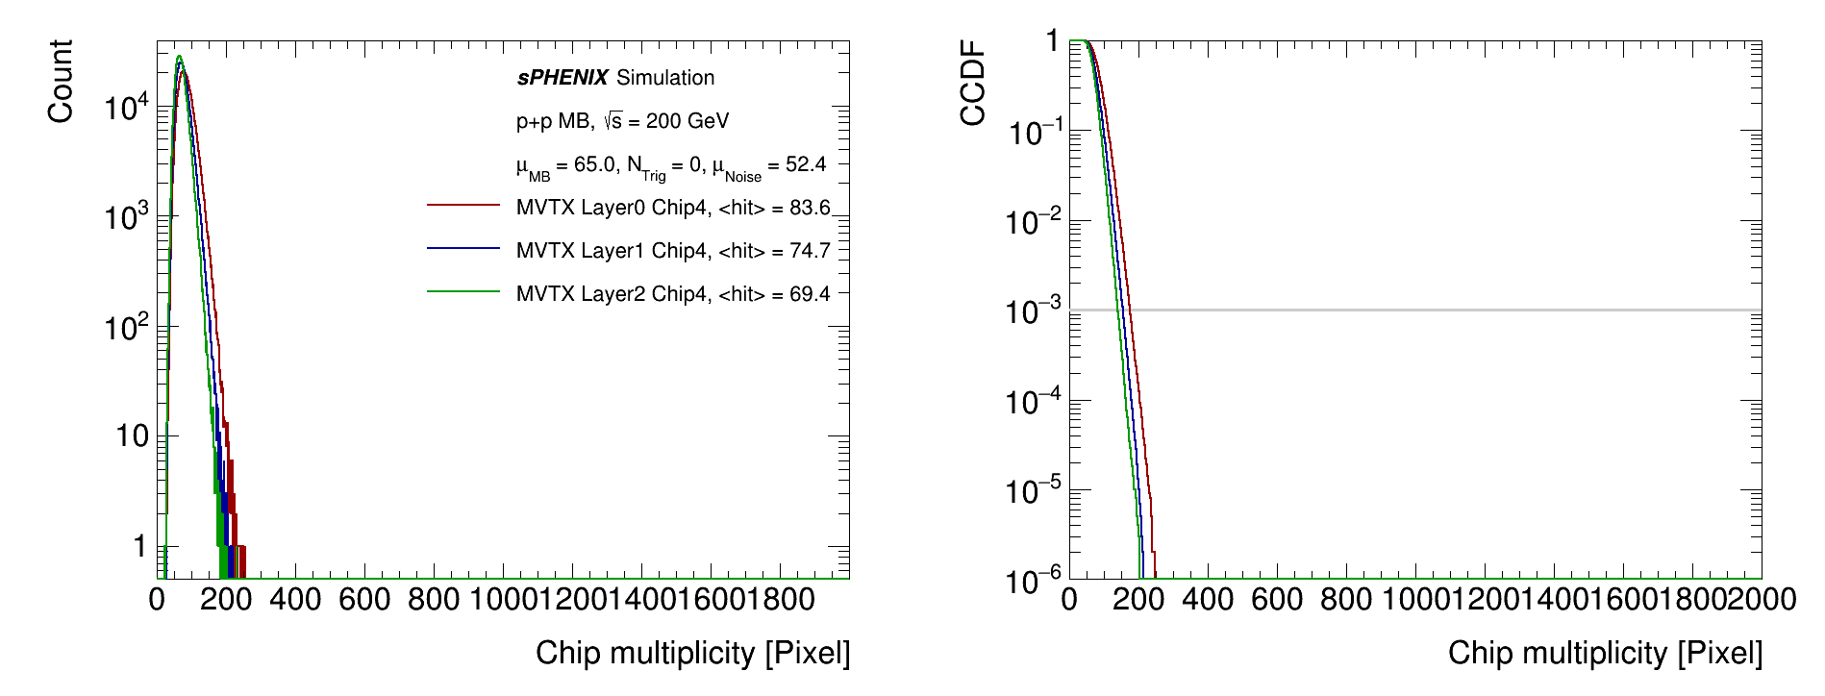
p+p multiplicity, per-strobe, chip-4
Jin’s simulations
Continuous-mode is plausible at 5-us strobe window too
  Probability [readout-time per-strobe > 5us] < 0.1%
13 MHz p+p collision, 5-us integration, 1 trigger, 10⁻⁴ noise per strobe
5-us readout

