Slide 1
Discussions with Kai on GBTx1
09/23/2021
Unstable GBTx1 link between RU and FELIX
New sPHENIX HF Trigger Project

Slide 2
sPHENIX MVTX Readout Issues:
https://docs.google.com/presentation/d/1-wsSyadLgK7Rr79Ug95bbQdtVszYqZrZrypN47DR2uM/edit?usp=sharing
and test summary of GBTx1:
https://docs.google.com/document/d/1u5jwNs0xC0vP3ZMBLH3iHSFRPngN7YCCb3L7jL-Z1C4/edit?usp=sharing
Unstable GBTx1 link between RU and FELIX
Currently working with a wide tolerance of “GLink loss window”
~ 200ms
In the GBT implementation reset_rx_cdr_stable_out is used to check alignment. This signal seems to be not stable for GBTx1 and the signal is deasserted for few ms which causes a reset in the alignment check process...

Slide 3
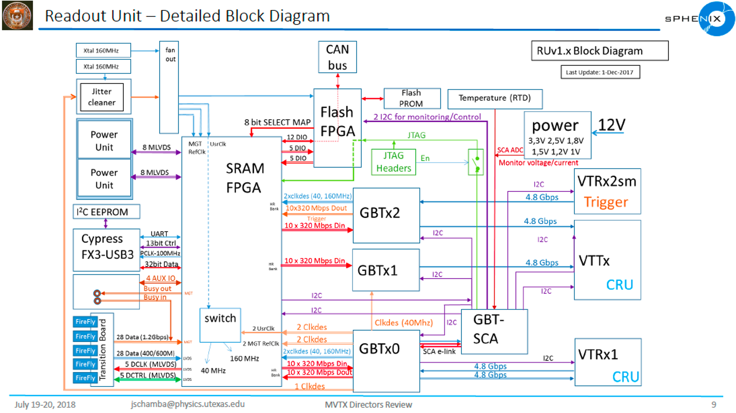
MVTX: VTRx/VTTx
all multimod
Trigger_In
From FELIX
(6/11/2020)
Data_Out x2
To FELIX
Data + GBT-SCA
+ SWT
(6/11/2020

Slide 4
Permanent Solutions?
update FELIX FW?
Similar configurations of multiple GBTs w/ derived CLK were tested/used at ATLAS, no problem seen
But one needs to be careful about GBT configuration
Suggestions from Kai Chen [9/21/2021]
Check the GBTx1 configuration, contact CERN GBT group for help if needed;
Check the GBTx1 output signal on scope, stability against the CLK
Did ALICE/ITS see similar issues with CRU?
Ignore the misalignment: (this could be dangerous,basically what we are doing now)
- do NOT check GBT alignment with “reset_rx_cdr_stable_out”

Slide 5
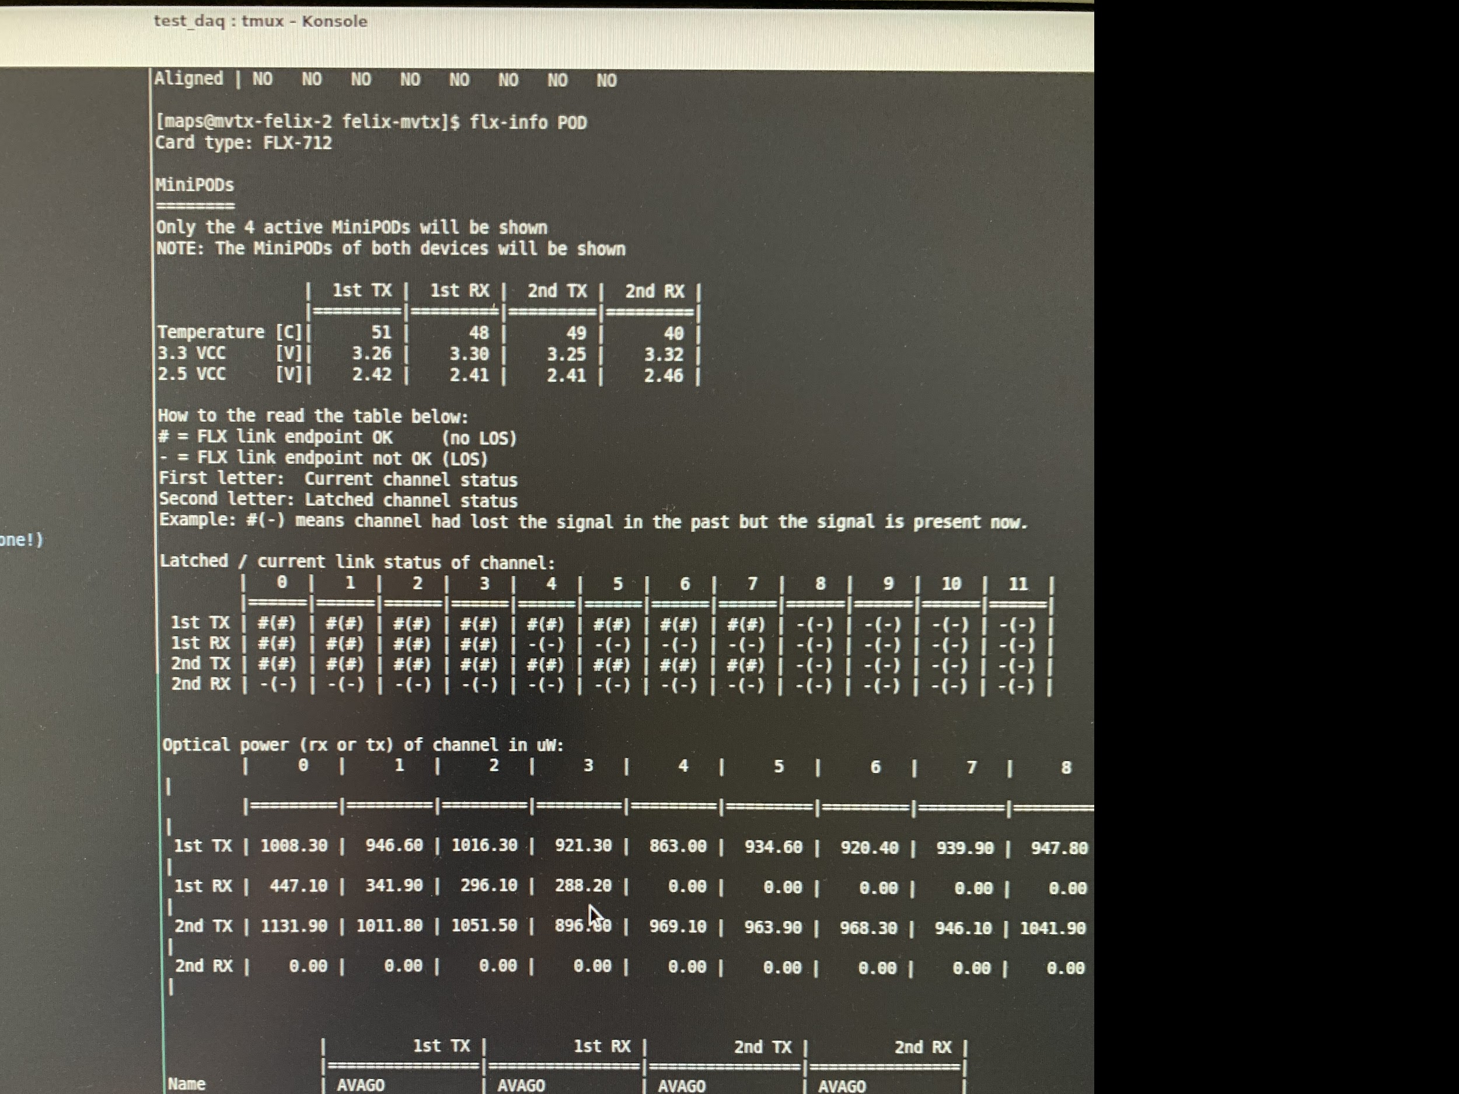
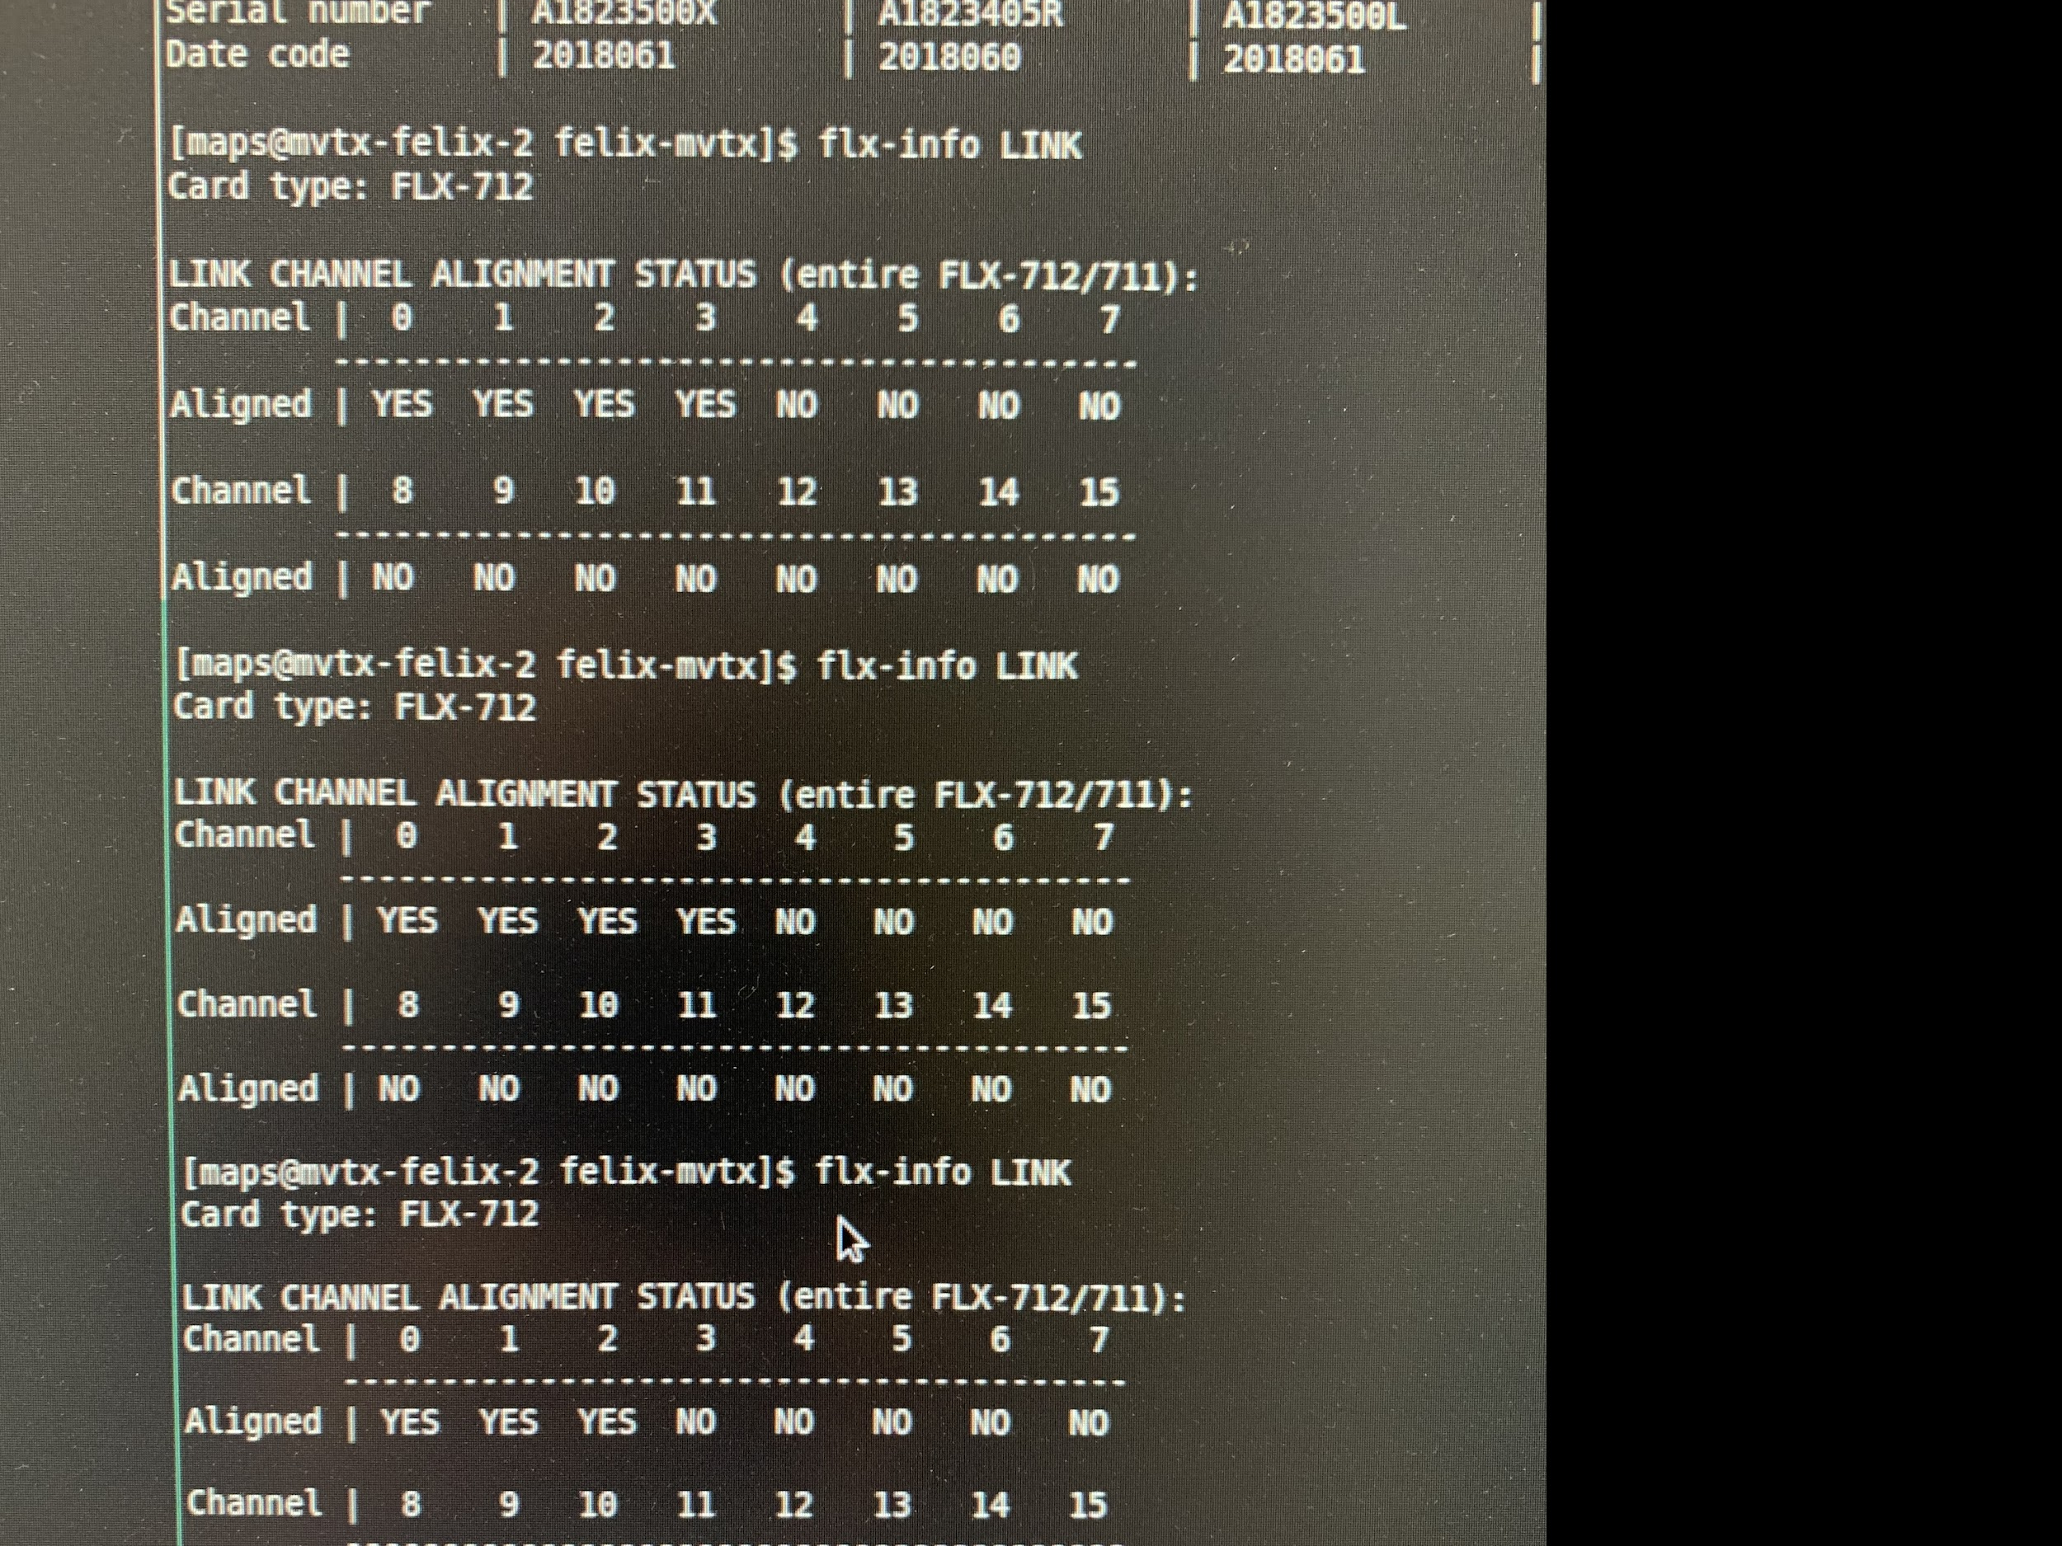
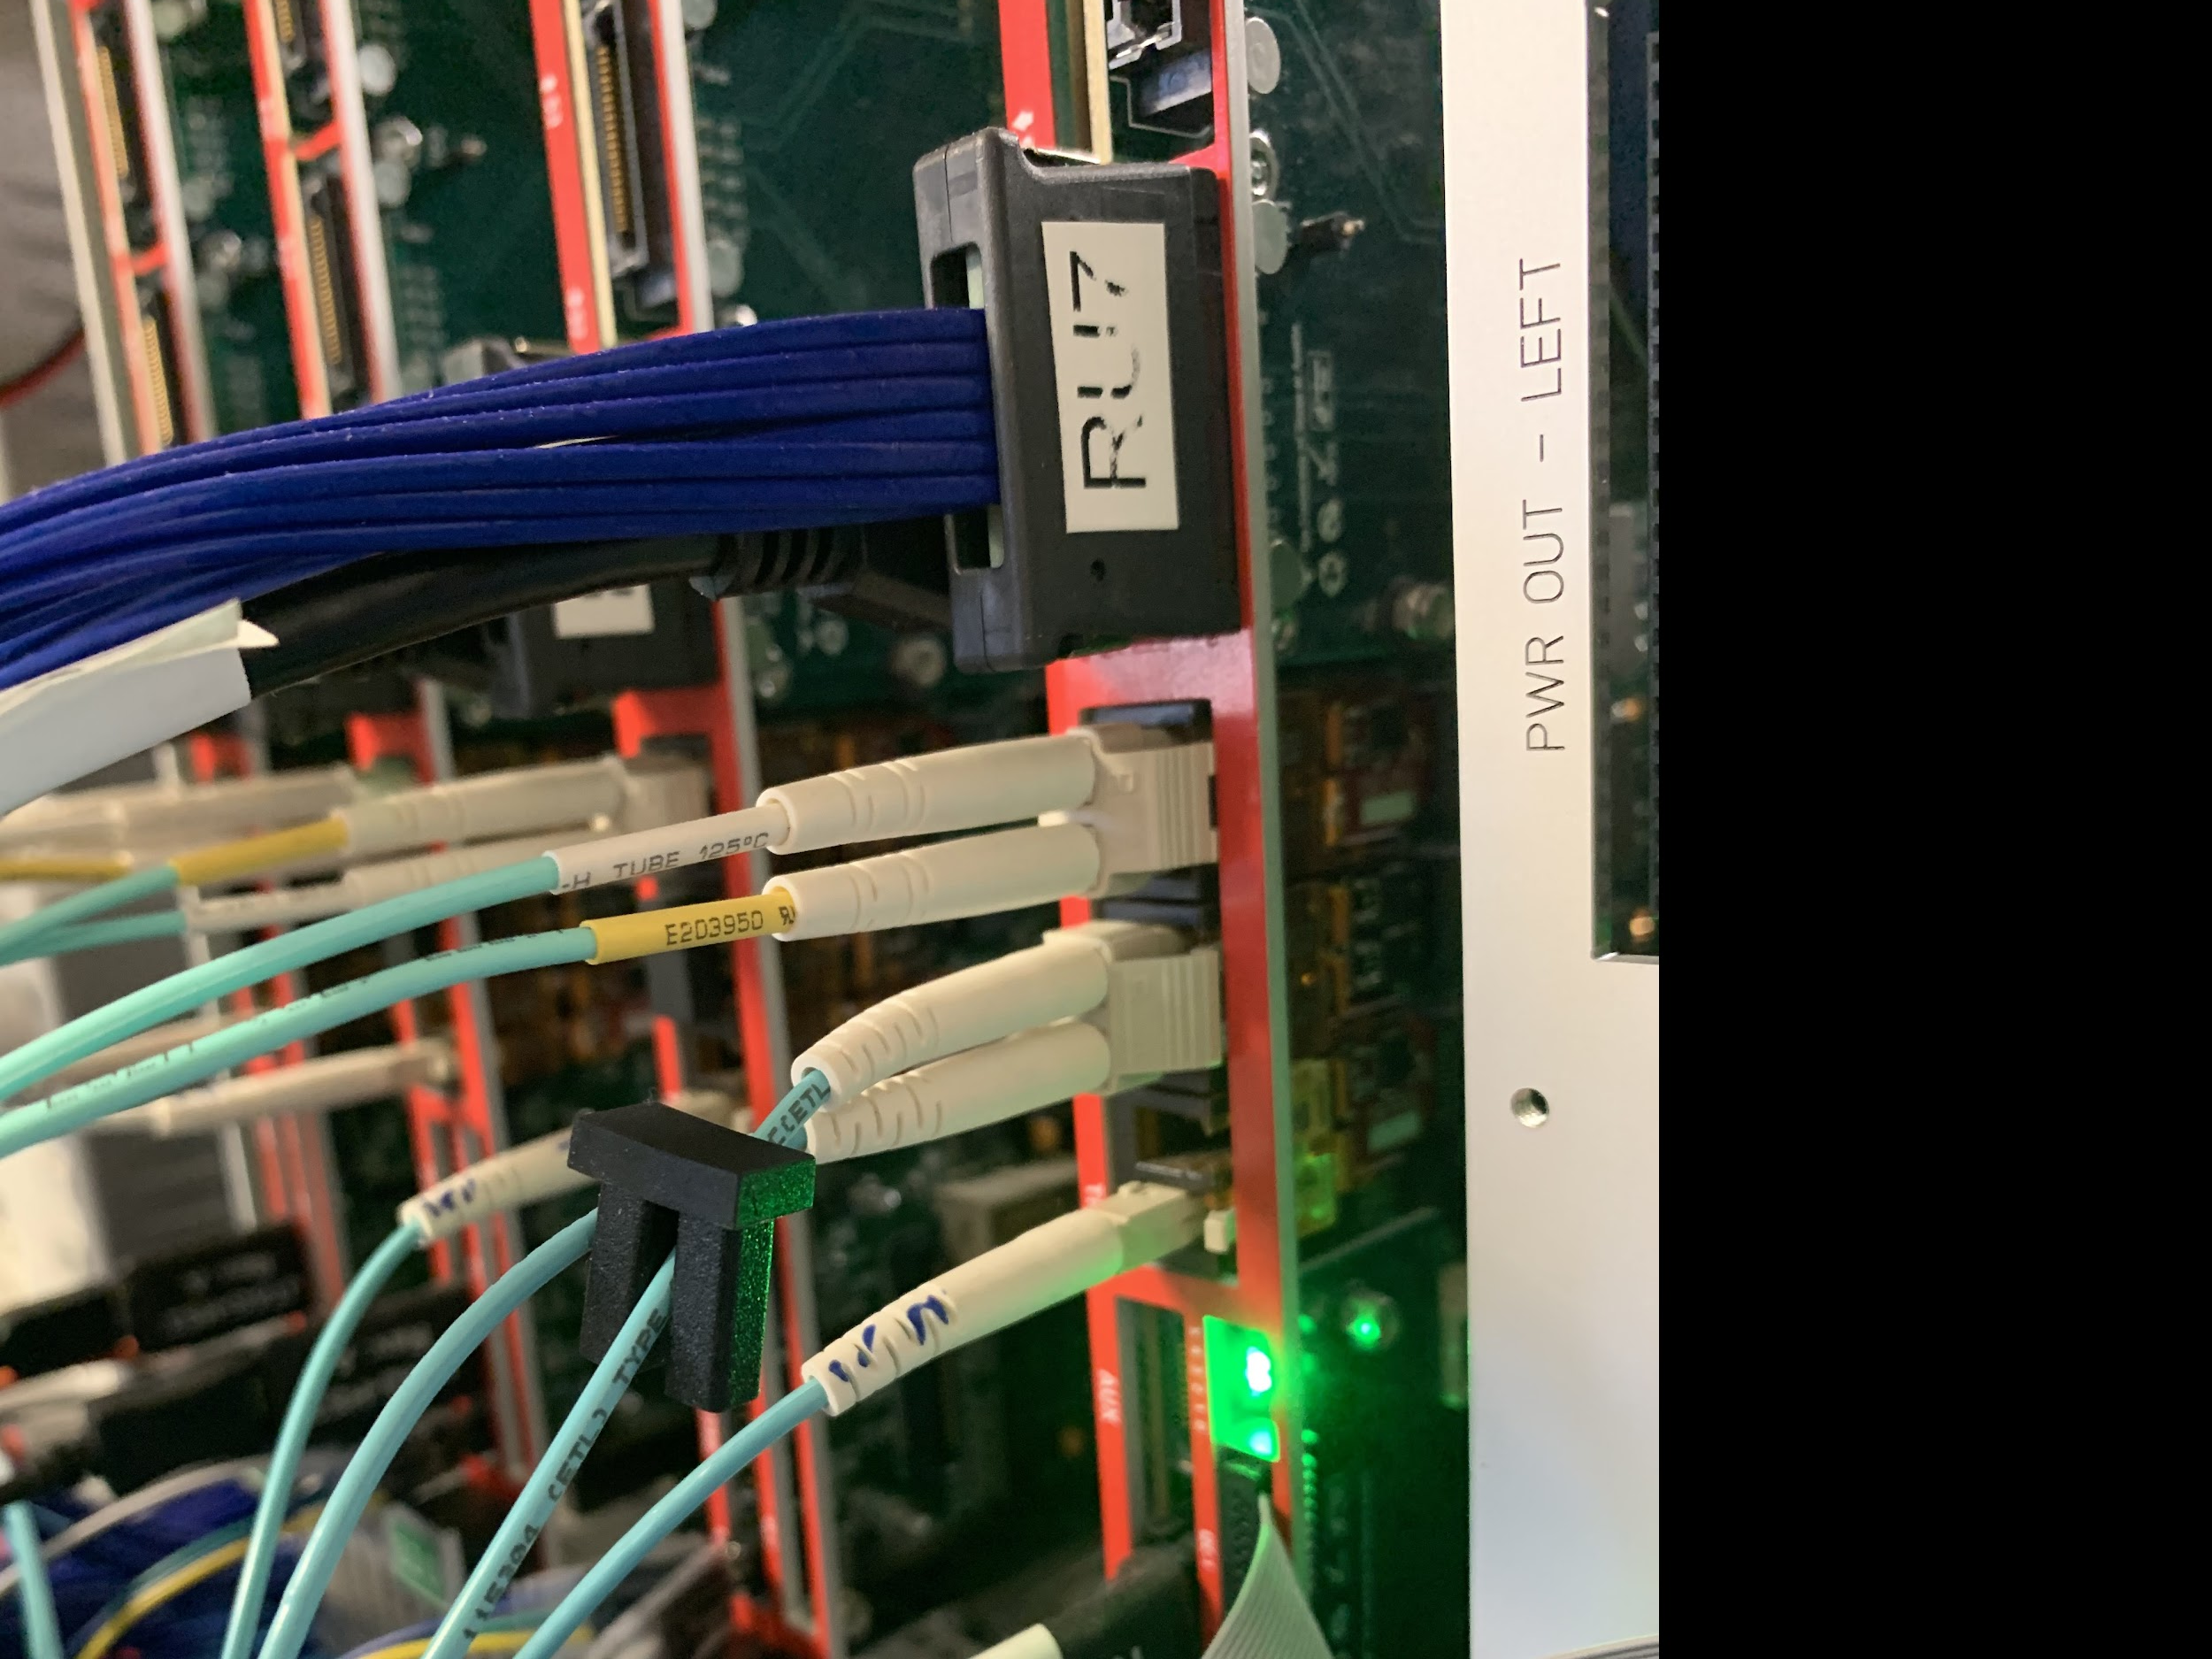
3-GBT Readout Test , 03/19/2021
RU FW:
FELIX FW:
Summarized on the MatterMost

Slide 6
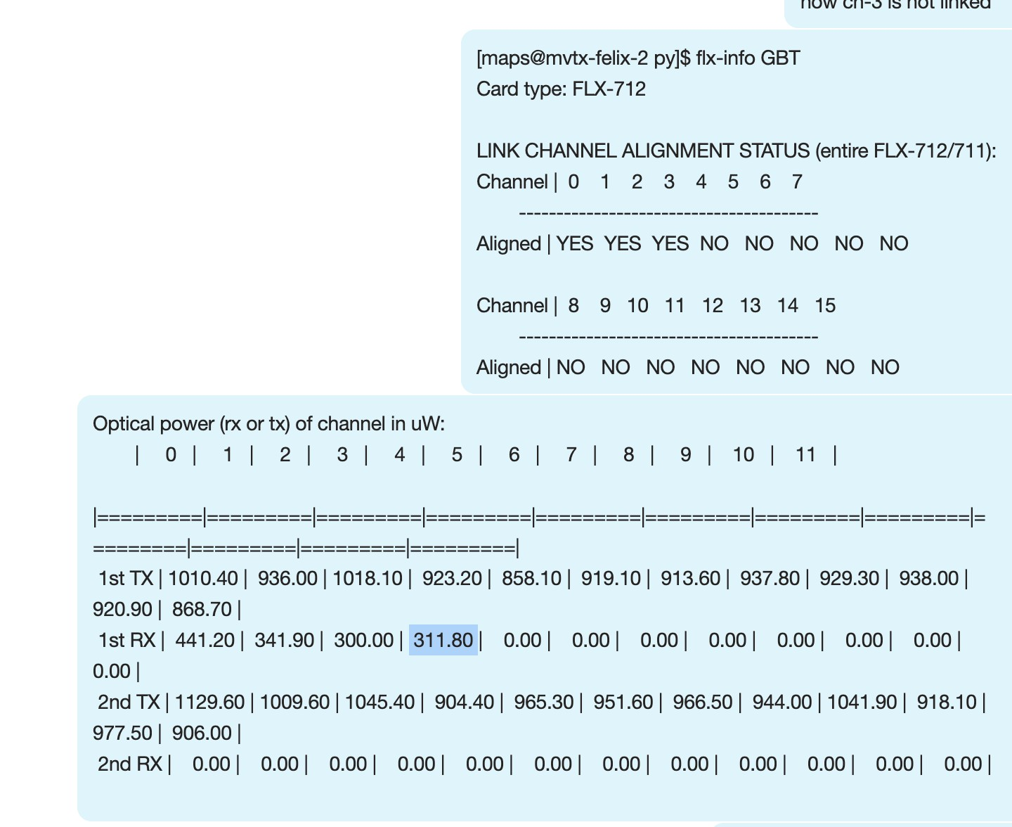
Test with RU-1, 03/21/2021
Same issue of locking VTTx1, but this time, the optical power seems okey (311 uW)
In the current MVTX testbench setup, the FELIX card provides 40.079MHz global CLK generated locally
Different CLK domain?

Slide 7
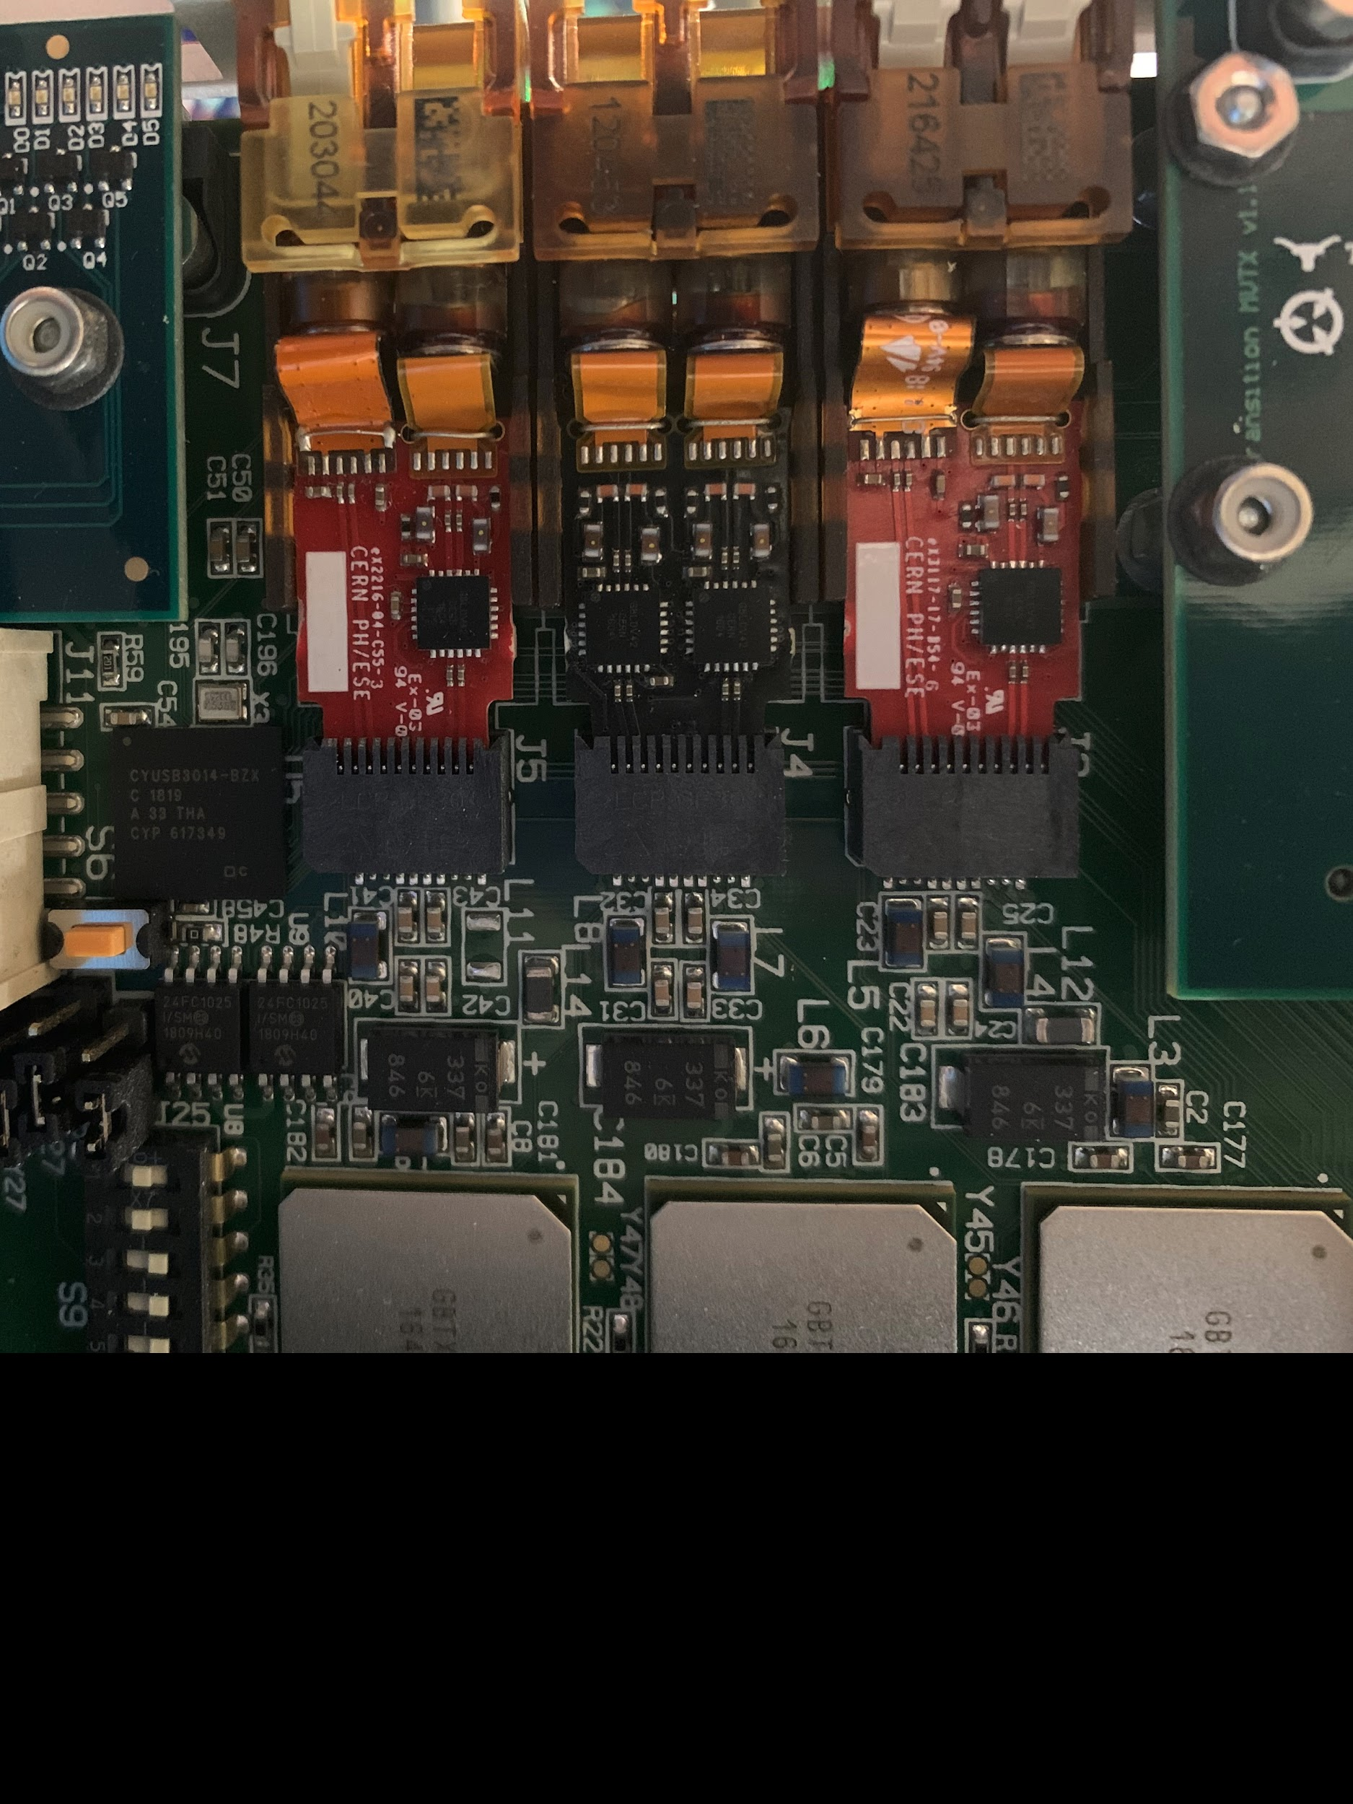
RU GBT-VTTx/VTRx lines
VTRx → GBTx0
  TX
  RX
VTTx →
  GBTx1 (Top)
  GBTx2 (Bottom)
VTRx (TTC) → GBTx2
  XX
  RX (TTC)

Slide 8
New sPHENIX HF Trigger R&D

Slide 9
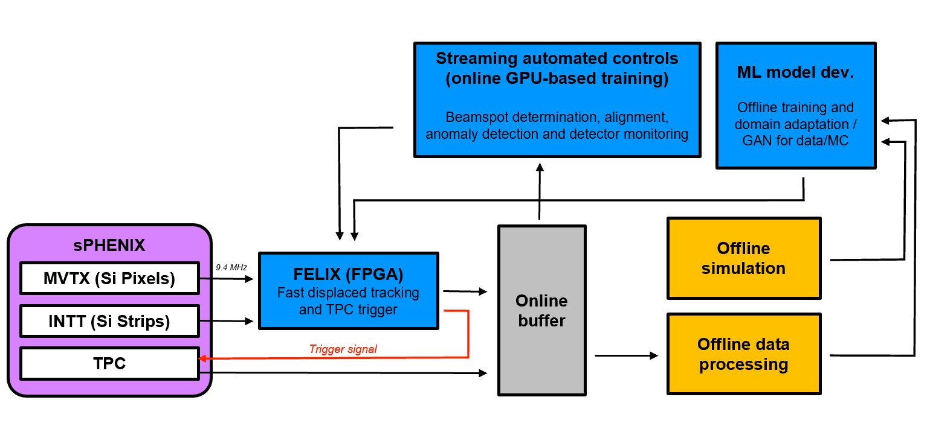
SMART Trigger R&D: sPHNEIX as a Test Bench

Slide 10
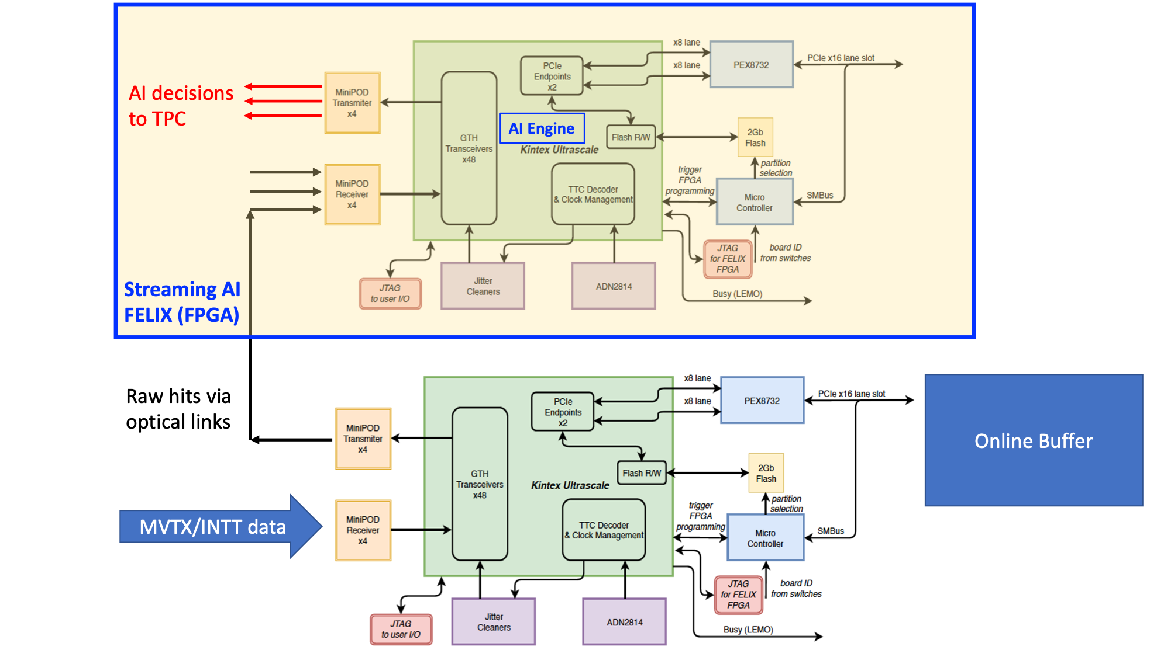
Two FELIX
Boards, v2.0
FELIX v1.5/v2.0
Or
gFEX like?
- gFEX’ w/ 2 FPGAs
“GCM”…
- Newer FELIX version, more powerful FPGA chips
48 inputs
(MVTX:3xN)
(INTT: 4xN’)
(N, N’)
[8b/10b]
(N,N’)
Do simple data re-arrangement on FELIX
and send them to TRIG/FELIX with 8b/10b,
reduced the fibers from 24 to N (MVTX)
MVTX/RU
MVTX: 8 (staves) x 3 (GBT) = 24

Slide 11
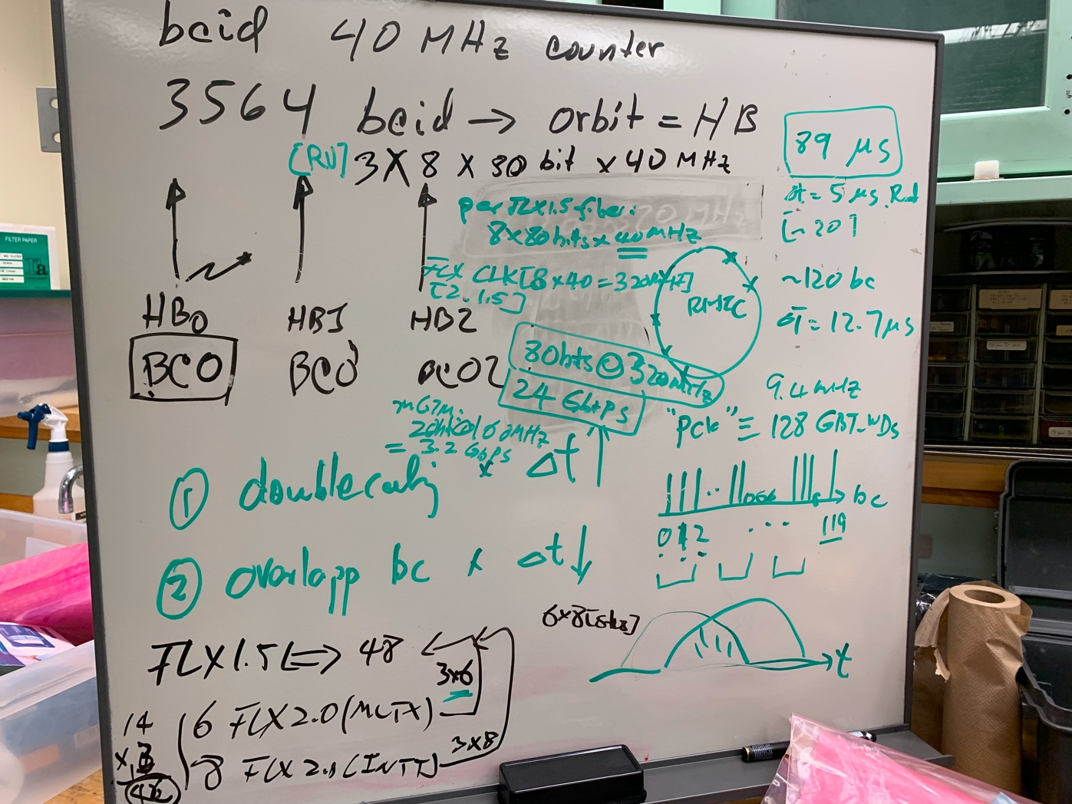
Data Throughput Estimation: MVTX and INTT
One FELIX(v2.0) raw data throughput from 8 MVTX staves:
One MVTX FELIX connected to 8 RUs (Staves) via 3 (GBTx) optical-links per RU:
8 (staves) x 3 (GBT links) x 80bits(GBT payload) x 40 MHz
= 8 x 3 x 3.2 Gbps ~ 75Gbps
(4.8Gbps optical link speed)
Total MVTX data:
6 (FLX) x [8 x 3 x 3.2 Gbps] = 6 x 75Gbps ~ 450 Gbps
Total INTT data:?? ~Small fraction of MVTX
Can fit within 2 FELIX cards:
9.6Gbps x 0.8 per fiber x 48 fiber per FLX ~ 368 Gbps
0.5x(MVTX + INTT) = 220Gbps + XXX_INTT < 350Gbps
One FELIX v1.5 available @LANL (spares at BNL?)
48 IO ports:
MVTX: 6 FELIX v2.0 (47 ports, one used for GTM communication, only 24 used)
INTT: 8 FELIX v2.0 (47 ports, # used?)

Slide 12
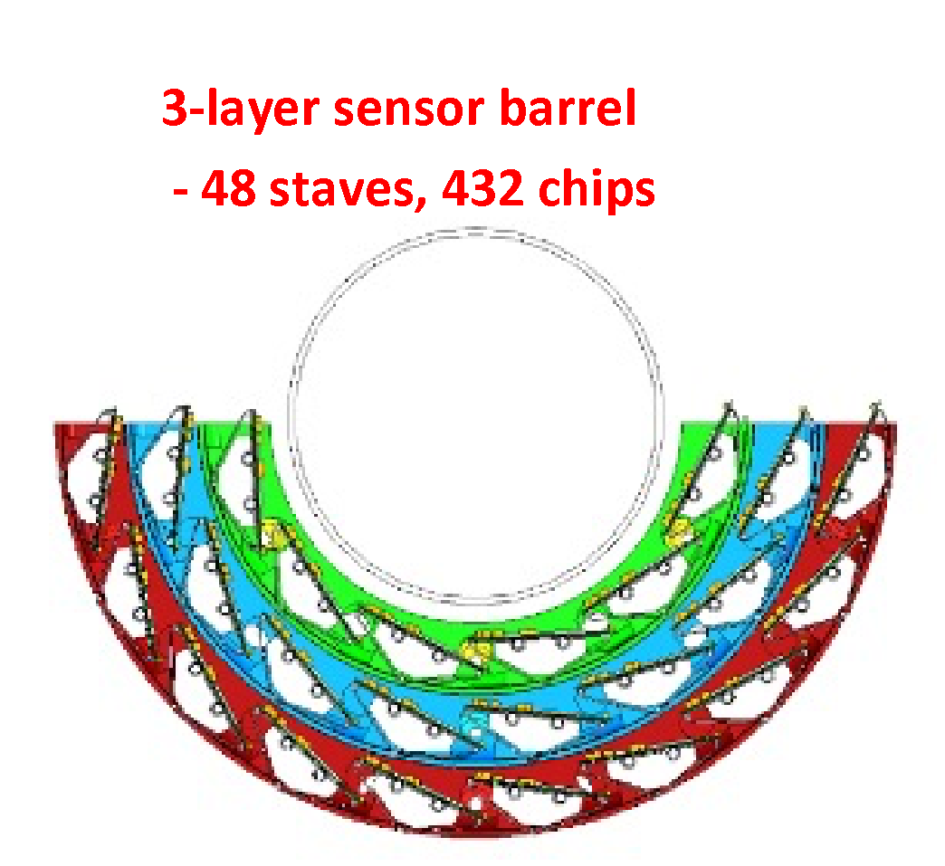
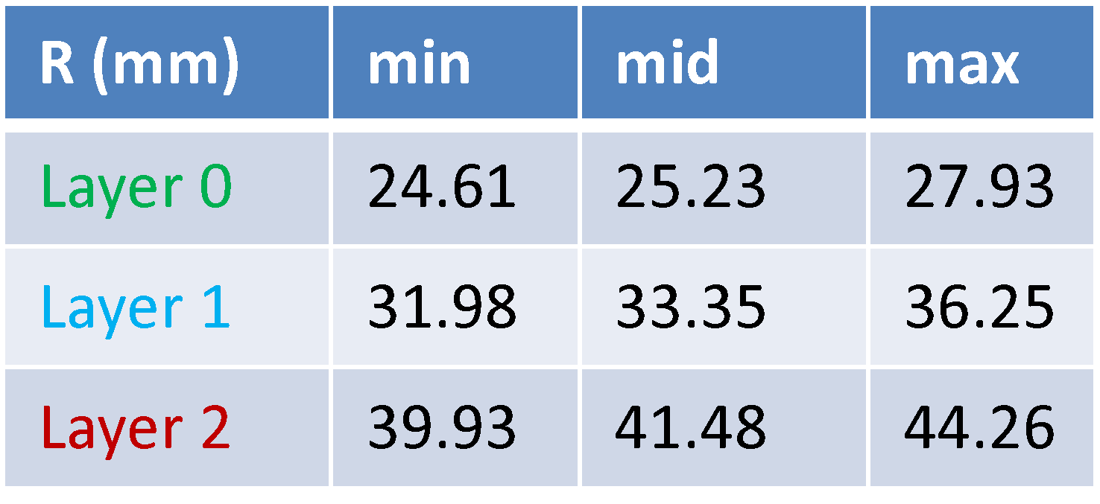
MVTX: 3 layers
L0 = 12 staves
L1 = 16 staves
L2 = 20 staves

Slide 13
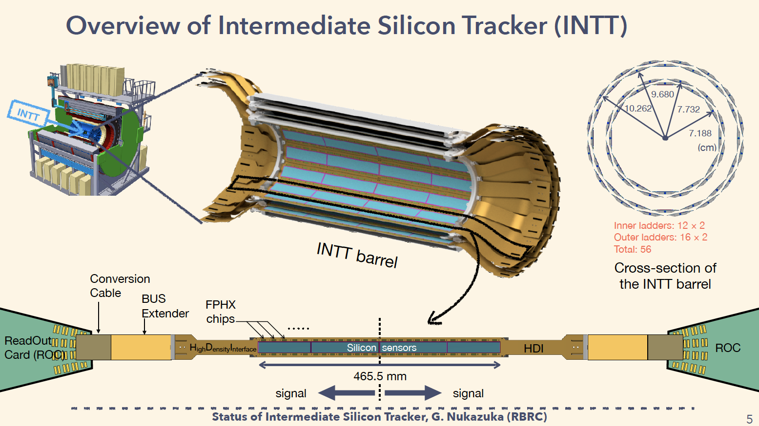
INTT: 2 layers
Total silicon strips:
L1 = 159,744
L2 = 212,992
Readout:
8 FELIX cards
details TBD

Slide 14
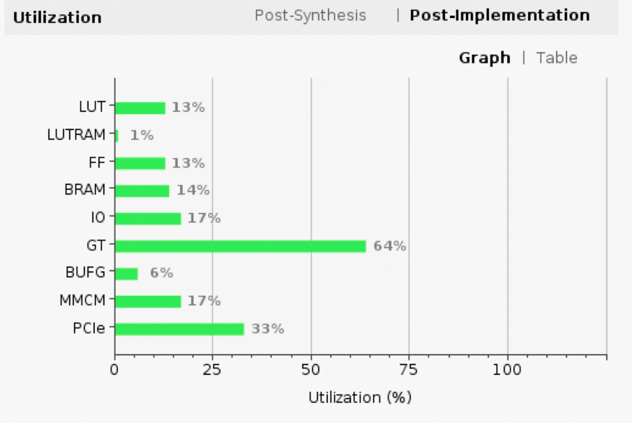
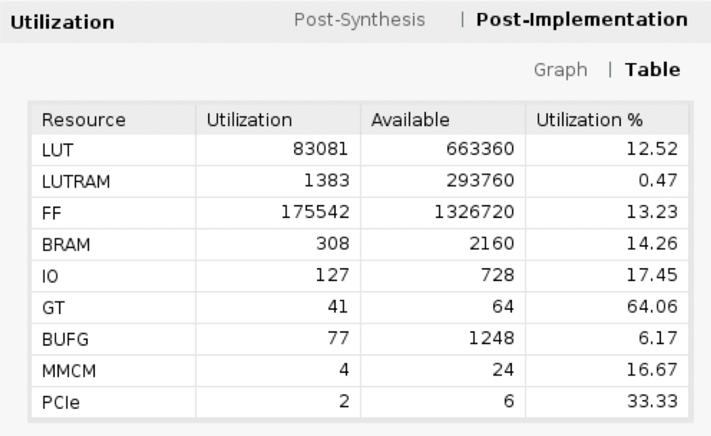
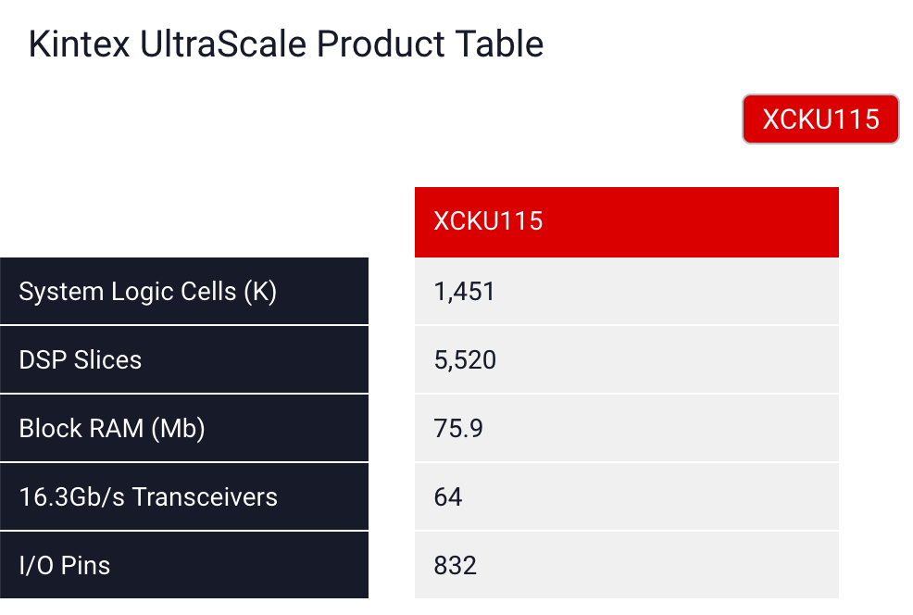
FELIX Resource Utilization in MVTX Readout
DSP: 5,520
NOT used yet;
Data re-arrangement

Slide 15
Collaboration with CCNU: K. Chen et al
Develop software and firmware for the FELIX/new Trigger FPGA
  MVTX readout
  FELIX Trigger
  Can be tested first at LANL/ORNL test bench
  One student available
Setup a test bench at CCNU for sPHENIX trigger development
  {1 RU + (stave/HIC)} or an equivalent FPGA board to send “MVTX” mockup raw data
  1 FELIX “MVTX backend”
    or an equivalent FPGA board to send “MVTX” mockup data to the trigger board
  1 FELIX “Trigger” board
    Or an equivalent FPGA board to receive “MVTX” mockup data

