Slide 1
Intelligent experiments through real-time AI: Fast Data Processing and Autonomous Detector Control for sPHENIX and future EIC detectors
A collaborative proposal to DOE to develop “smart triggers” for sPHENIX and EIC
LANL(NP), MIT(NP, HEP), Fermilab(HEP), NJIT(CS)
Team of NP, HEP and Computer Science
Fermilab “HLS4ML” collaboration
Goals:
Develop smart physics triggers (HF and other rare events) with streaming readout in p+p and p+A collisions in sPHENIX and also at the future EIC experiments in e+P and e+A collisions at RHIC
New collaborators:
ORNL
CCNU, Kai Chen et al, one student available
BNL sPHENIX DAQ/Trigger
initial discussion with INTT/RIKEN group, more follow up

Slide 2
SMART Trigger R&D: sPHNEIX as a Test Bench

Slide 3
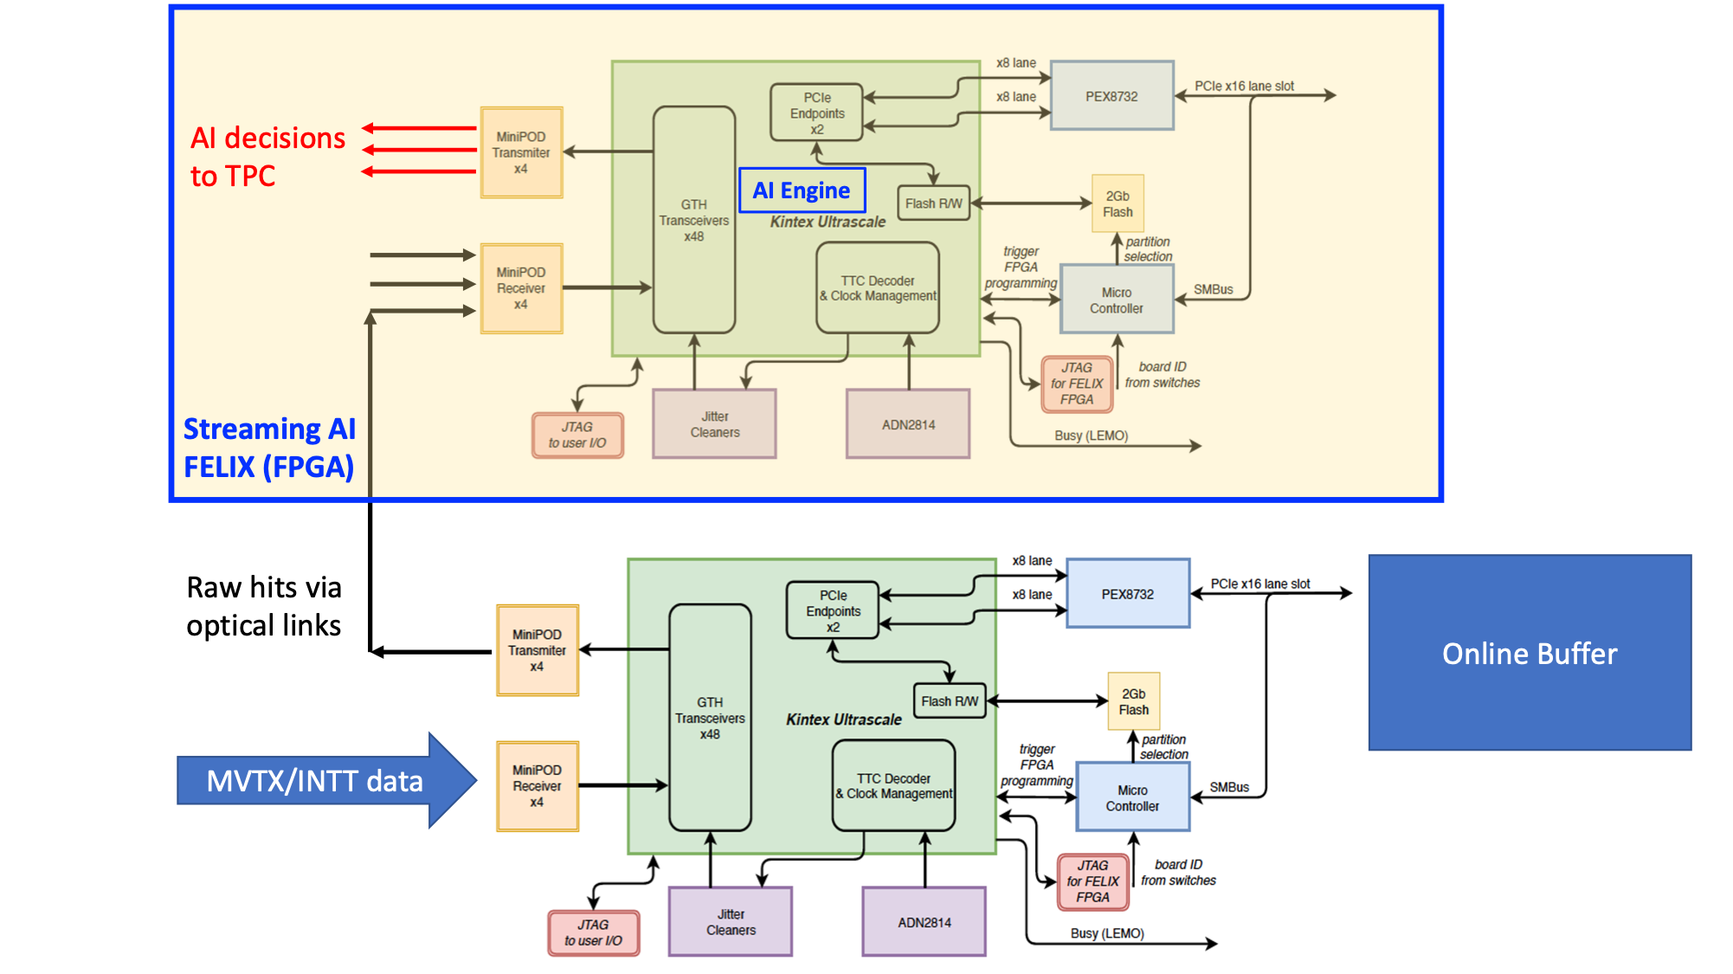
Two FELIX
Boards, v2.0
FELIX v1.5/v2.0
Or
gFEX like?
- gFEX’ w/ 2 FPGAs
“GCM”…
- Newer FELIX version, more powerful FPGA chips
48 inputs
(MVTX:3xN)
(INTT: 4xN’)
(N, N’)
[8b/10b]
(N,N’)
Do simple data re-arrangement on FELIX
and send them to TRIG/FELIX with 8b/10b,
reduced the fibers from 24 to N (MVTX)
MVTX/RU
MVTX: 8 (staves) x 3 (GBT) = 24

Slide 4
Data Throughput Estimation: MVTX and INTT
One FELIX(v2.0) raw data throughput from 8 MVTX staves:
One MVTX FELIX connected to 8 RUs (Staves) via 3 (GBTx) optical-links per RU:
8 (staves) x 3 (GBT links) x 80bits(GBT payload) x 40 MHz
= 8 x 3 x 3.2 Gbps ~ 75Gbps
(4.8Gbps optical link speed)
Total MVTX data:
6 (FLX) x [8 x 3 x 3.2 Gbps] = 6 x 75Gbps ~ 450 Gbps
Total INTT data:?? ~Small fraction of MVTX
Can fit within 2 FELIX cards:
9.6Gbps x 0.8 per fiber x 48 fiber per FLX ~ 368 Gbps
0.5x(MVTX + INTT) = 220Gbps + XXX_INTT < 350Gbps
One FELIX v1.5 available @LANL (spares at BNL?)
48 IO ports:
MVTX: 6 FELIX v2.0 (47 ports, one used for GTM communication, only 24 used)
INTT: 8 FELIX v2.0 (47 ports, # used?)

Slide 5
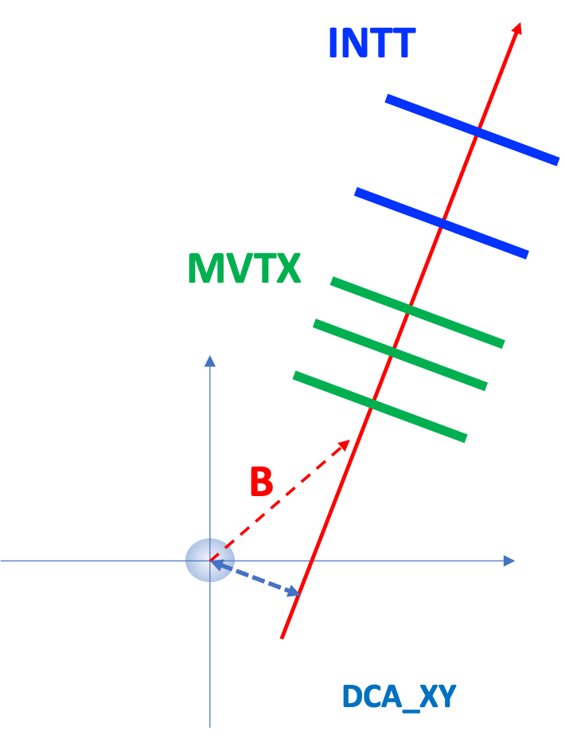
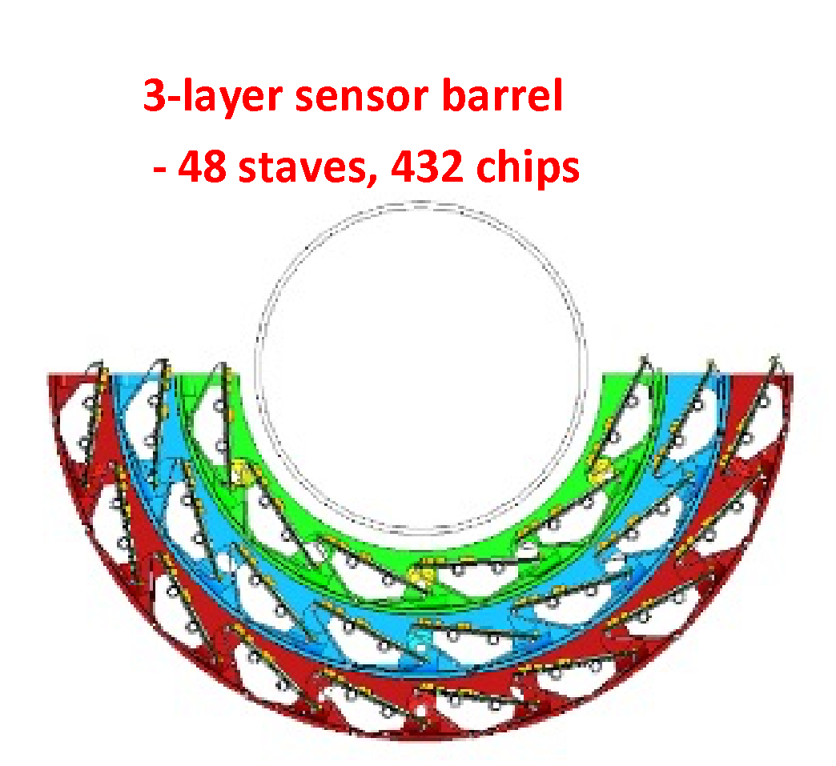
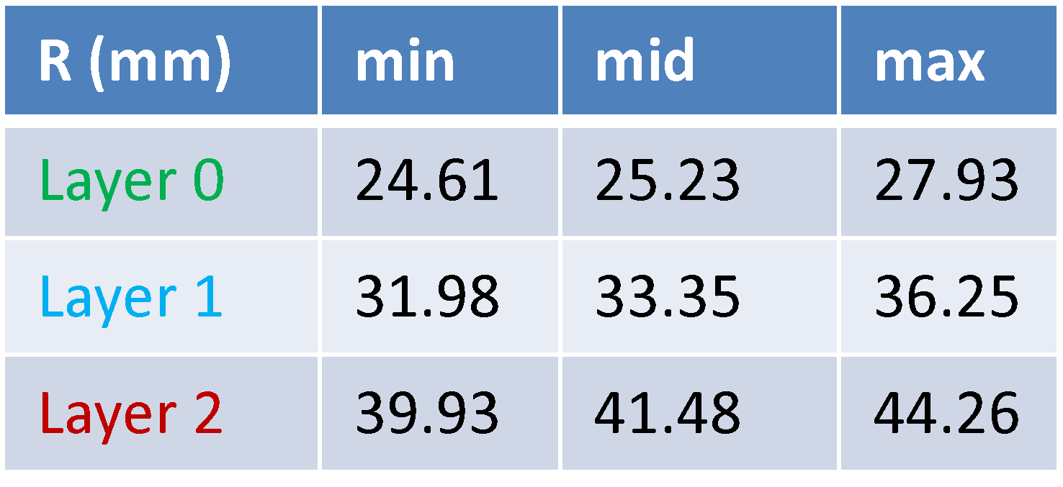
MVTX: 3 layers
L0 = 12 staves
L1 = 16 staves
L2 = 20 staves

Slide 6
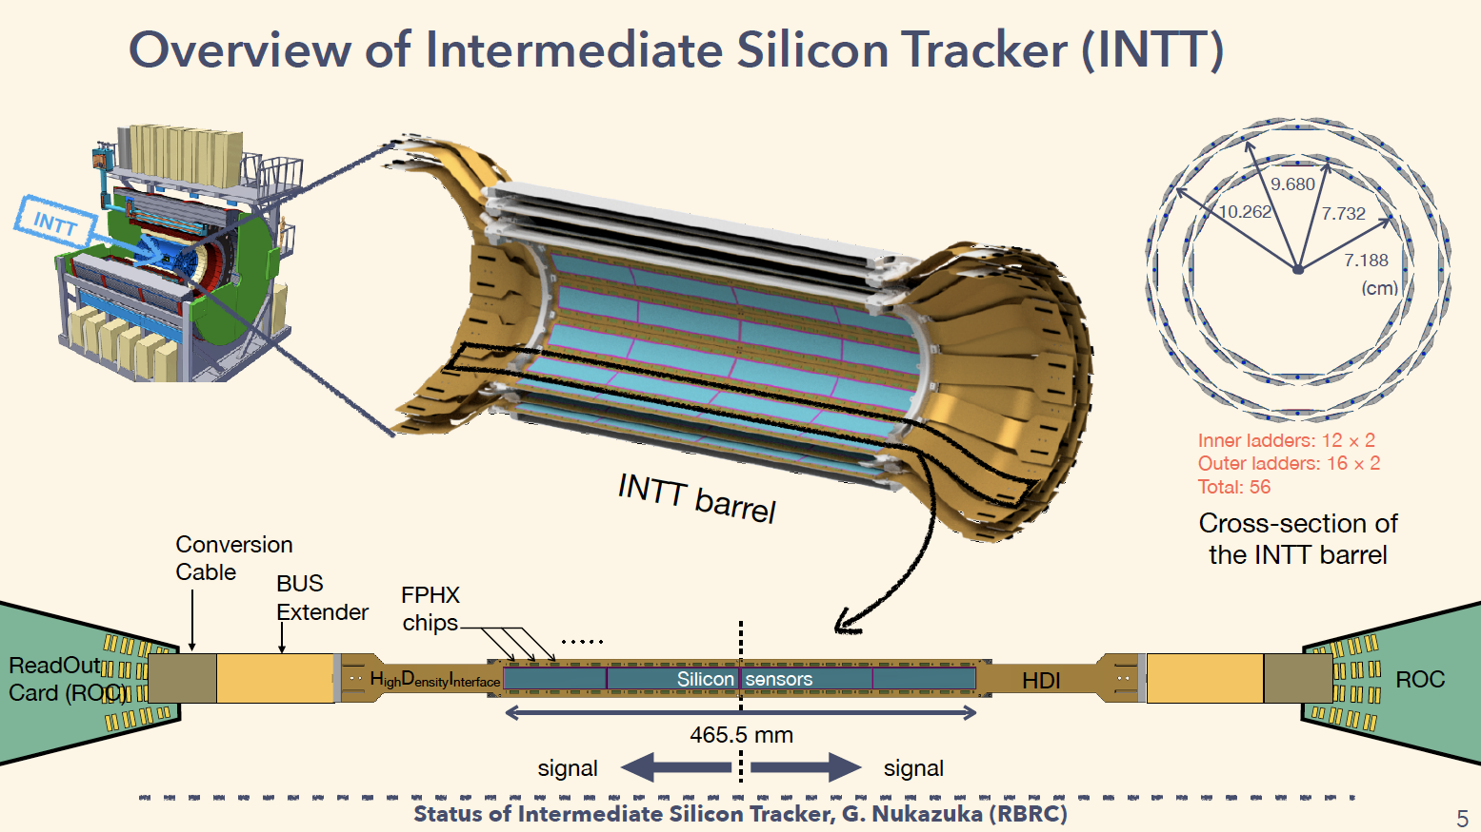
INTT: 2 layers
Total silicon strips:
L1 = 159,744
L2 = 212,992
Readout:
8 FELIX cards
details TBD

Slide 7
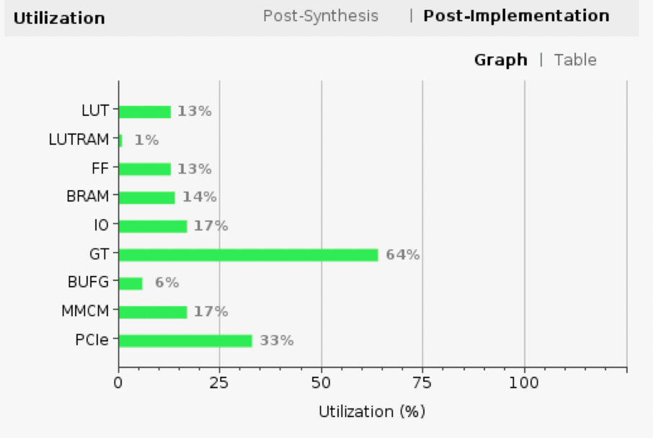
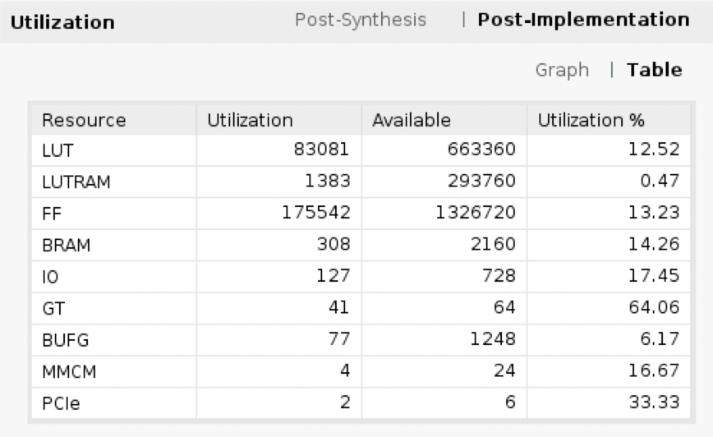
FELIX Resource Utilization in MVTX Readout
DSP: 5,520
NOT used yet;
Data re-arrangement

Slide 8
Collaboration with CCNU: K. Chen et al
Develop software and firmware for the FELIX, one student available
MVTX readout
FELIX Trigger
Can be tested first at LANL test bench
Setup a test bench at CCNU for sPHENIX trigger development
{1 RU + (stave/HIC)} or an equivalent FPGA board to send “MVTX” mockup raw data
1 FELIX “MVTX backend”
or an equivalent FPGA board to send “MVTX” mockup data to the trigger board
1 FELIX “Trigger” board
Or an equivalent FPGA board to receive “MVTX” mockup data

Slide 9
More about FELIX

Slide 10
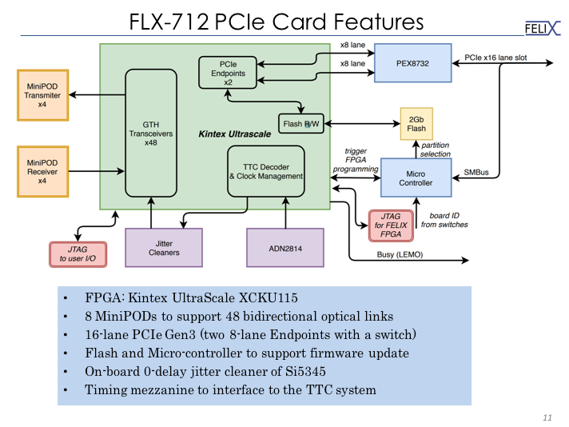

Slide 11
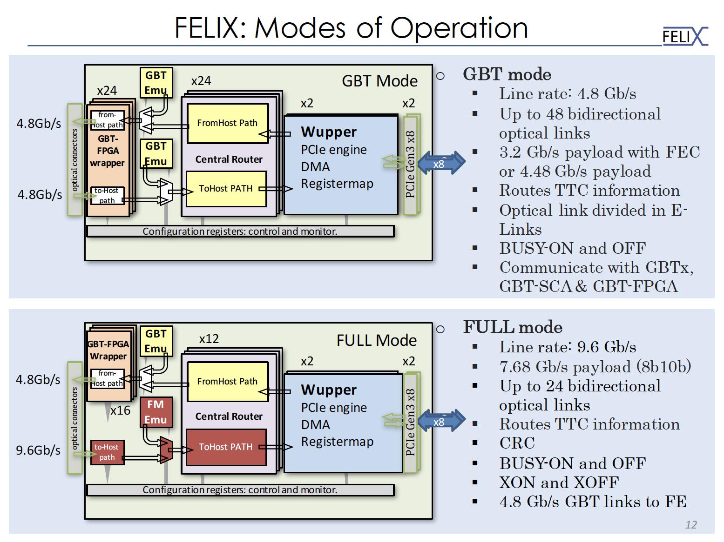
MVTX Readout Mode
MVTX/INTT Trigger Mode?

Slide 13
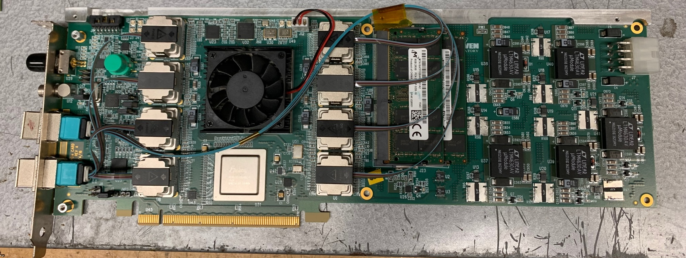
One FELIX v1.5 and Two FELIX2.0 available @LANL
48 IOs
16GB memory
4 DDR
each 64 lanes@2Gbps[~120Gbps]
Kai Chen’s suggestion: (09/21/2021)
Use FELIX v2.0, much better optimization of resource usage and layout
BNL may have a few spare FELIX v1.5 (from test runs)

Slide 14
gFEX

Slide 15
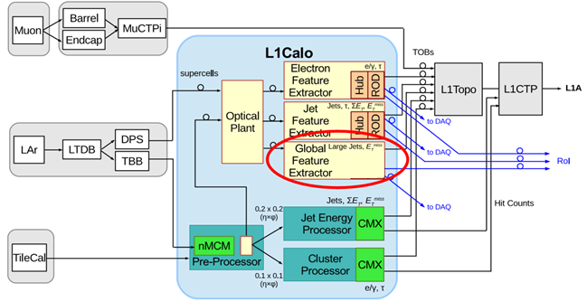
gFEX option?

Slide 16
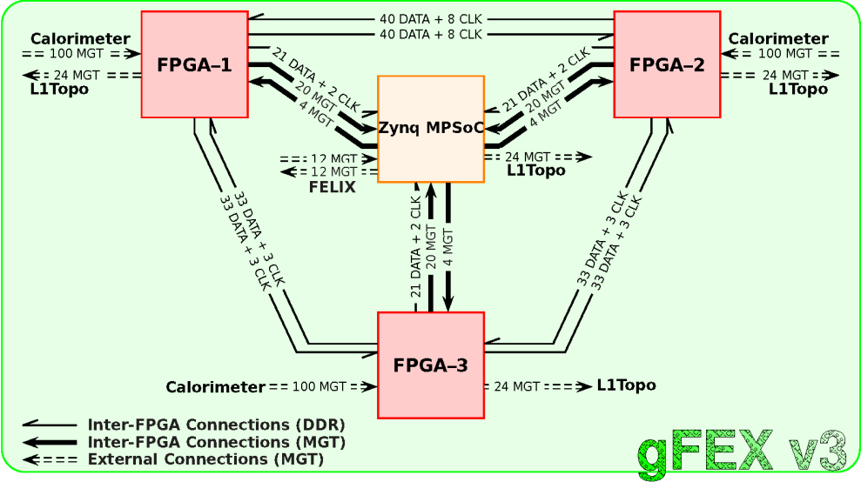

Slide 17
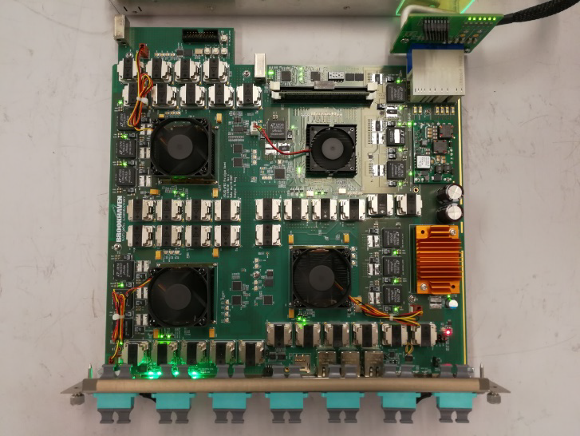

Slide 20
sPHENIX MVTX Readout

Slide 21
sPHENIX MVTX Readout Issues:
https://docs.google.com/presentation/d/1-wsSyadLgK7Rr79Ug95bbQdtVszYqZrZrypN47DR2uM/edit?usp=sharing
and test summary:
https://docs.google.com/document/d/1u5jwNs0xC0vP3ZMBLH3iHSFRPngN7YCCb3L7jL-Z1C4/edit?usp=sharing
Unstable GBTx1 link between RU and FELIX
Currently working with a wide tolerance of “GLink loss window”
~ 200ms
In the GBT implementation reset_rx_cdr_stable_out is used to check alignment. This signal seems to be not stable for GBTx1 and the signal is deasserted for few ms which causes a reset in the alignment check process...

Slide 22
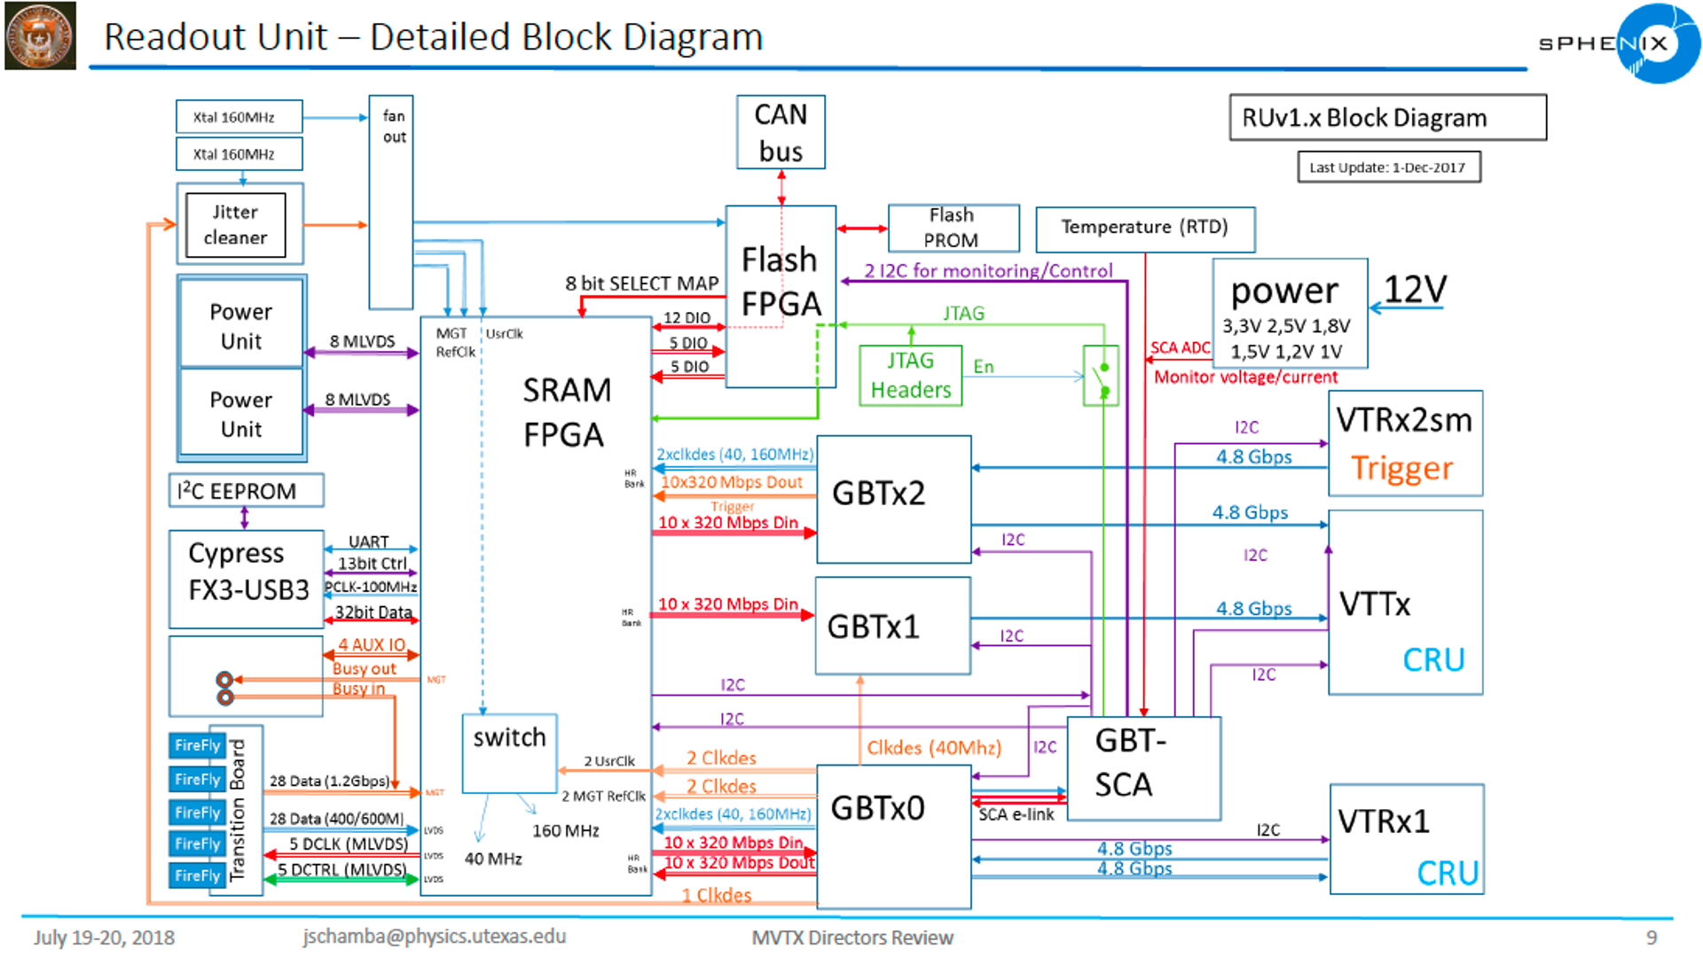
MVTX: VTRx/VTTx
all multimod
Trigger_In
From FELIX
(6/11/2020)
Data_Out x2
To FELIX
Data + GBT-SCA
+ SWT
(6/11/2020

Slide 23
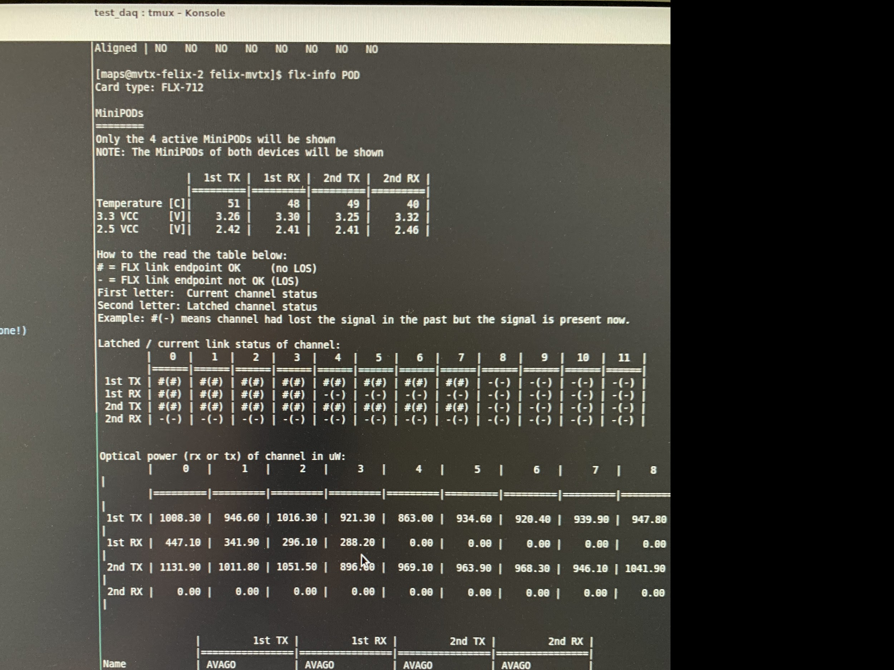
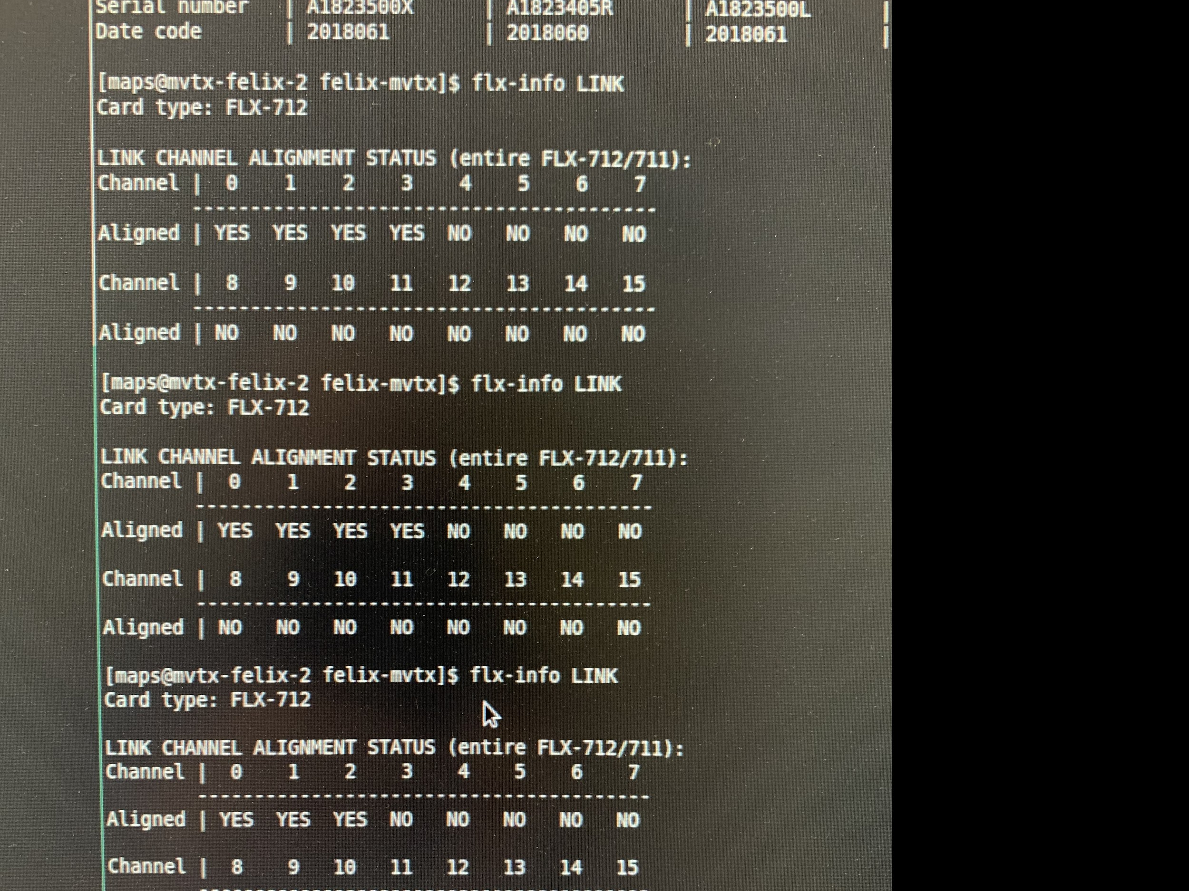
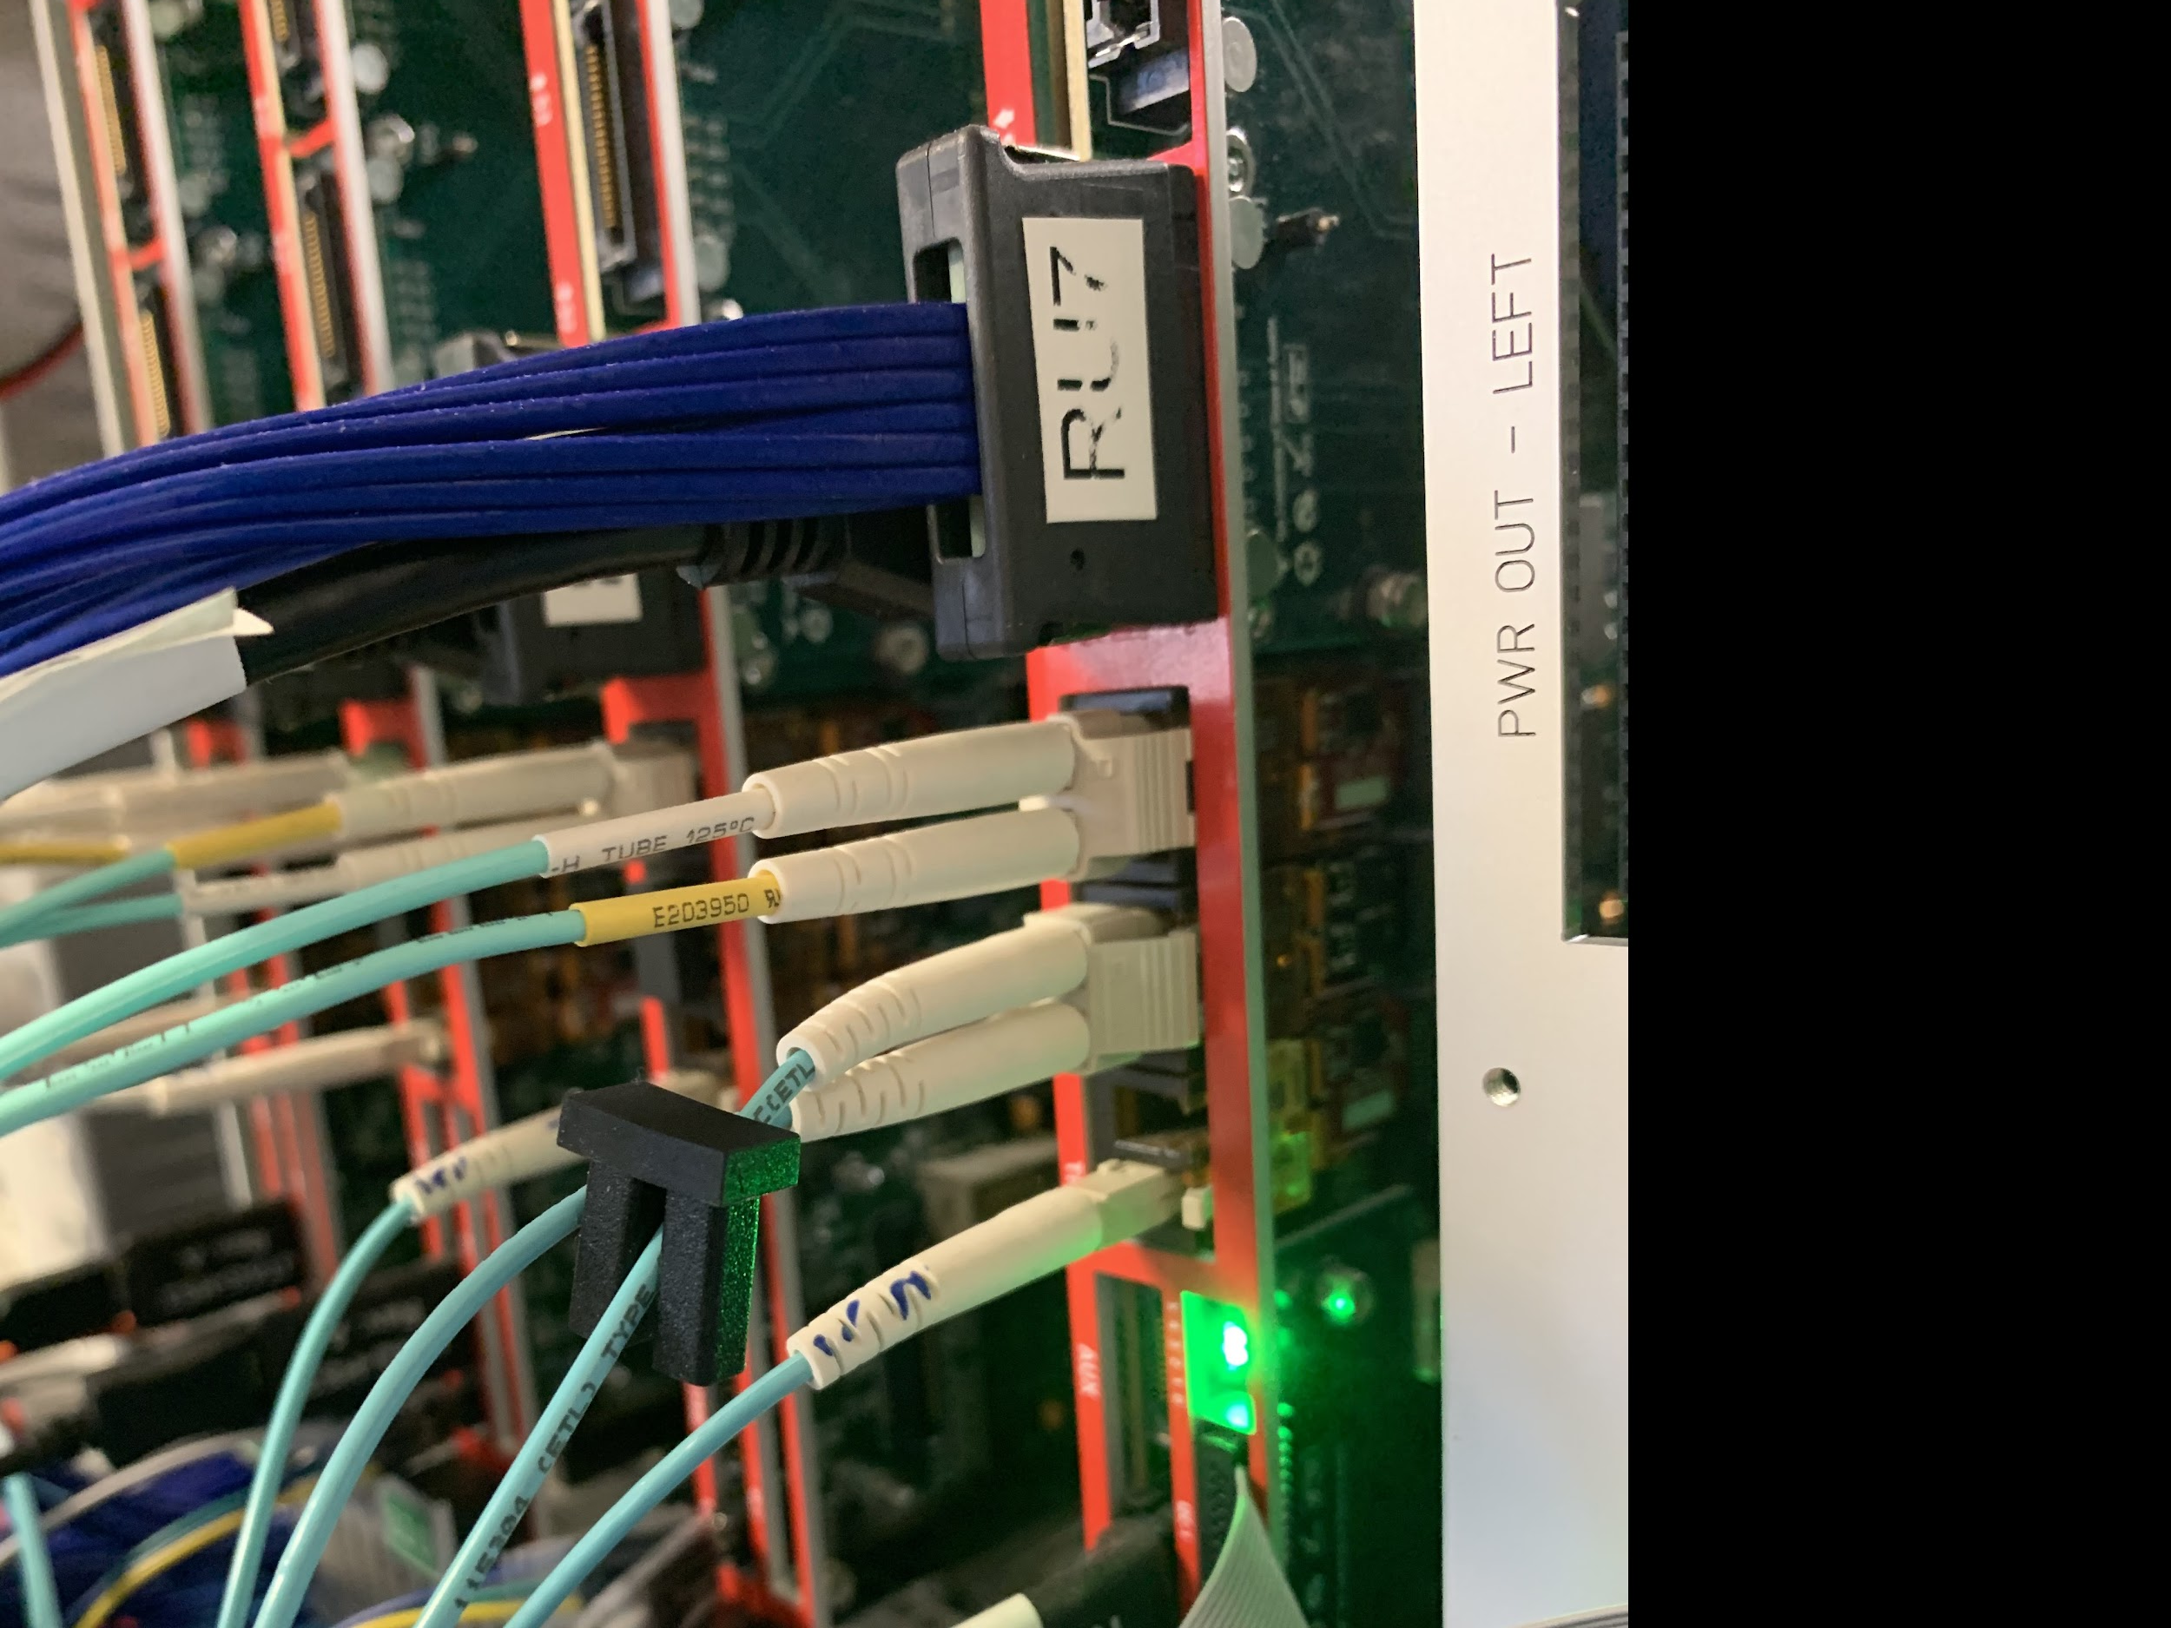
3-GBT Readout Test , 03/19/2021
RU FW:
FELIX FW:
Summarized on the MatterMost

Slide 24
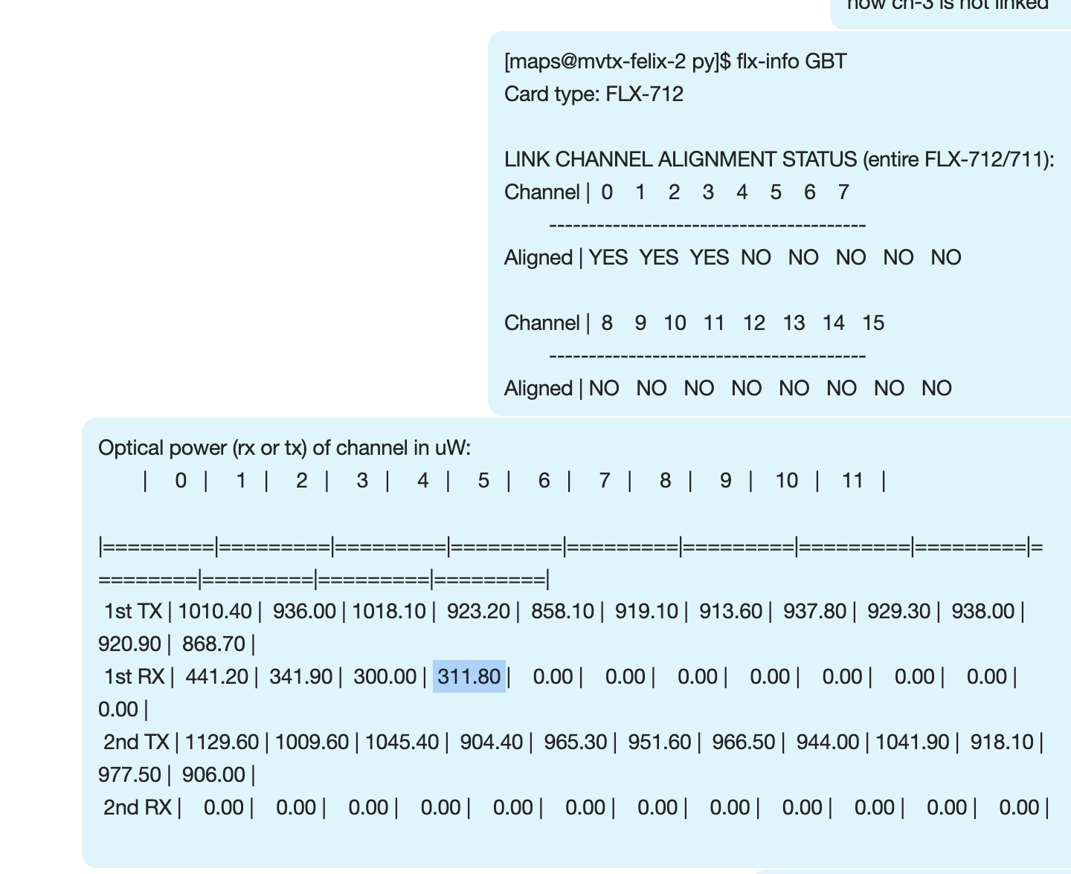
Test with RU-1, 03/21/2021
Same issue of locking VTTx1, but this time, the optical power seems okey (311 uW)
In the current MVTX testbench setup, the FELIX card provides 40.079MHz global CLK generated locally
Different CLK domain?

Slide 25
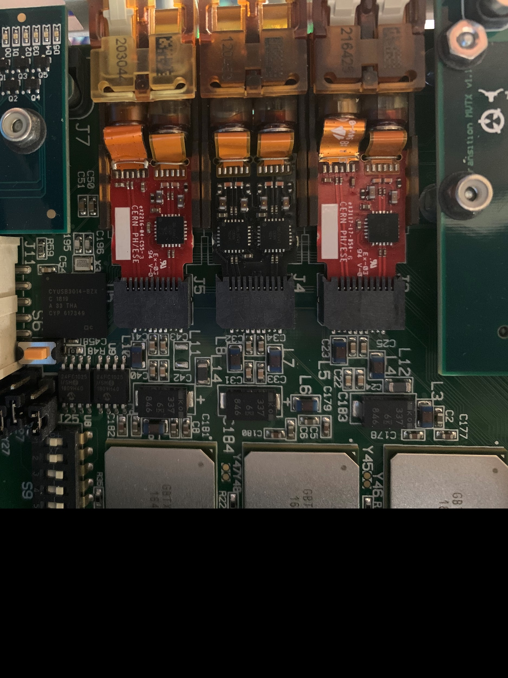
RU GBT-VTTx/VTRx lines
VTRx → GBTx0
TX
RX
VTTx →
GBTx1 (Top)
GBTx2 (Bottom)
VTRx (TTC) → GBTx2
XX
RX (TTC)

Slide 26
Permanent Solutions?
update FELIX FW?
Suggestions from Kai Chen [9/21/2021]
Check the GBTx1 configuration, contact CERN GBT group for help;
Check the GBTx1 output signal on scope
Did ALICE/ITS see similar issues with CRU?
Ignore the misalignment: (this could be dangerous)
do NOT check GBT alignment with “reset_rx_cdr_stable_out”

