Slide 1
Intelligent experiments through real-time AI: Fast Data Processing and Autonomous Detector Control for sPHENIX and future EIC detectors
A collaborative proposal to DOE to develop “smart triggers” for sPHENIX and EIC
LANL(NP), MIT(NP, HEP), Fermilab(HEP), NJIT(CS)
Team of NP, HEP and Computer Science
Goals:
Develop smart physics triggers (HF and other rare events) with streaming readout in p+p and p+A collisions in sPHENIX and also at the future EIC experiments in e+P and e+A collisions at RHIC

Slide 2
SMART Trigger R&D: sPHNEIX as a Test Bench

Slide 3
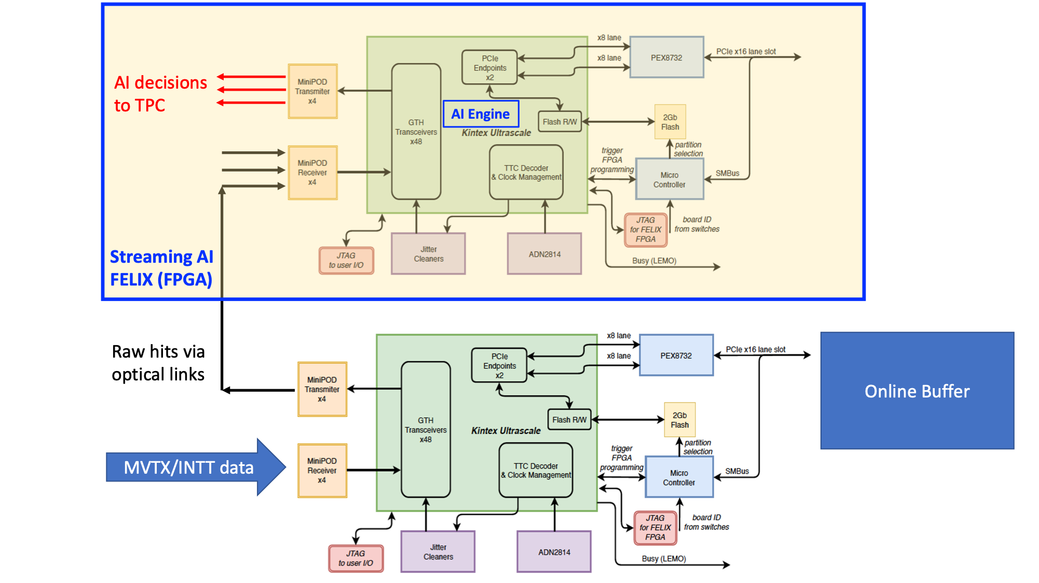
FELIX v1.5/v2.0
Or
gFEX like?

Slide 4
Data Throughput Estimation: MVTX and INTT
One FELIX(v2.0) raw data throughput from 8 MVTX staves:
One MVTX FELIX connected to 8 RUs (Staves) via 3 (GBTx) optical-links per RU:
8 (staves) x 3 (GBT links) x 80bits(GBT payload) x 40 MHz
= 8 x 3 x 3.2 Gbps
Total MVTX data:
6 (FLX) x [8 x 3 x 3.2 Gbps]
Total INTT data:??
One FELIX v1.5 available @LANL
48 IO ports:
MVTX: 6 FELIX v2.0 (47 ports, one used for GTM communication, only 24 used)
INTT: 8 FELIX v2.0 (47 ports, # used?)

Slide 5
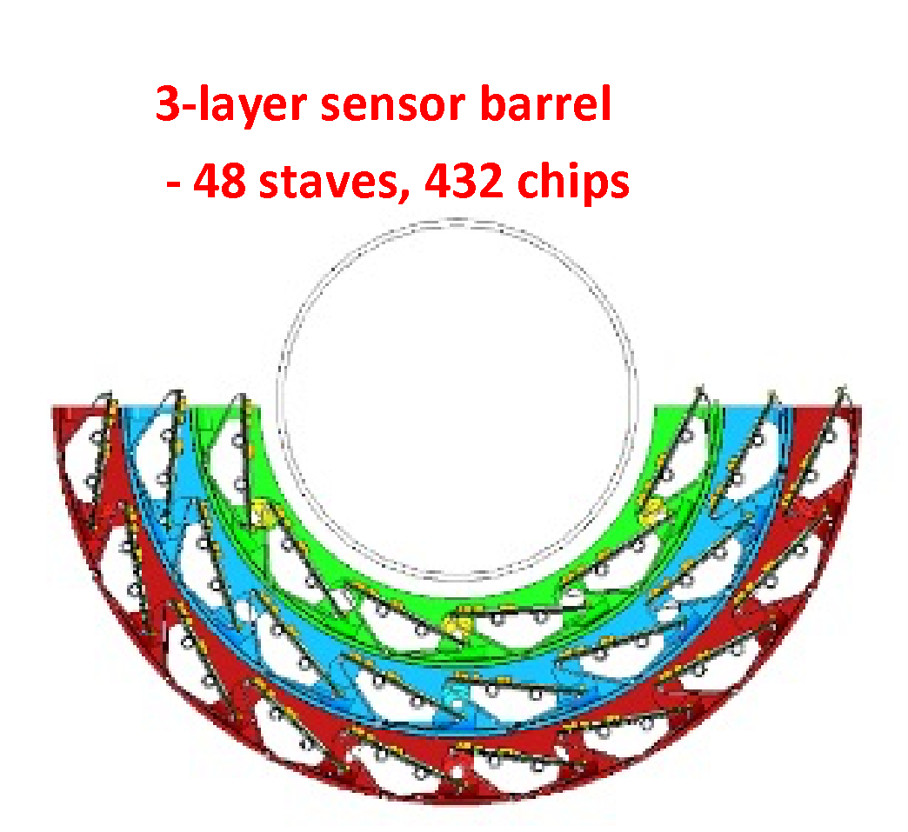
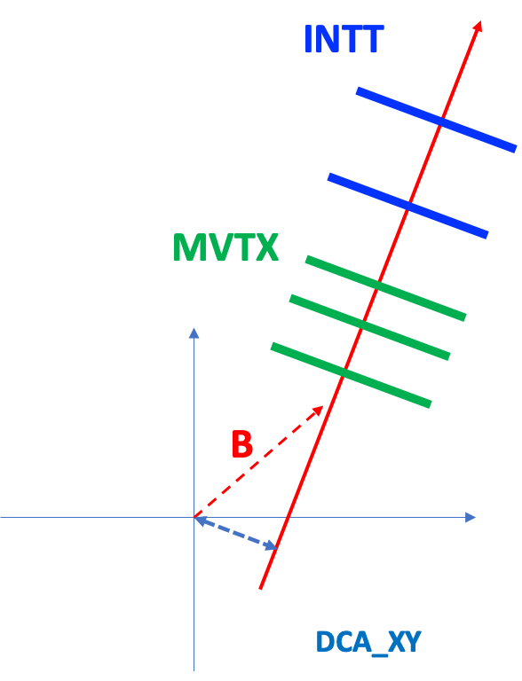
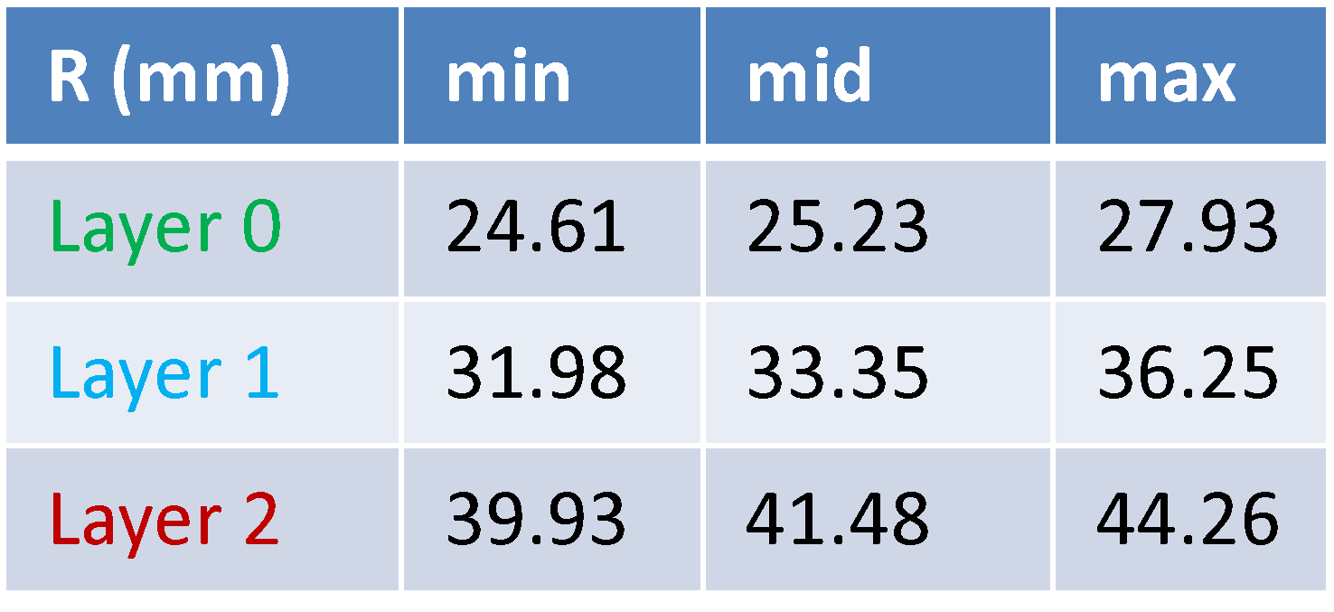
MVTX: 3 layers
L0 = 12 staves
L1 = 16 staves
L2 = 20 staves

Slide 6
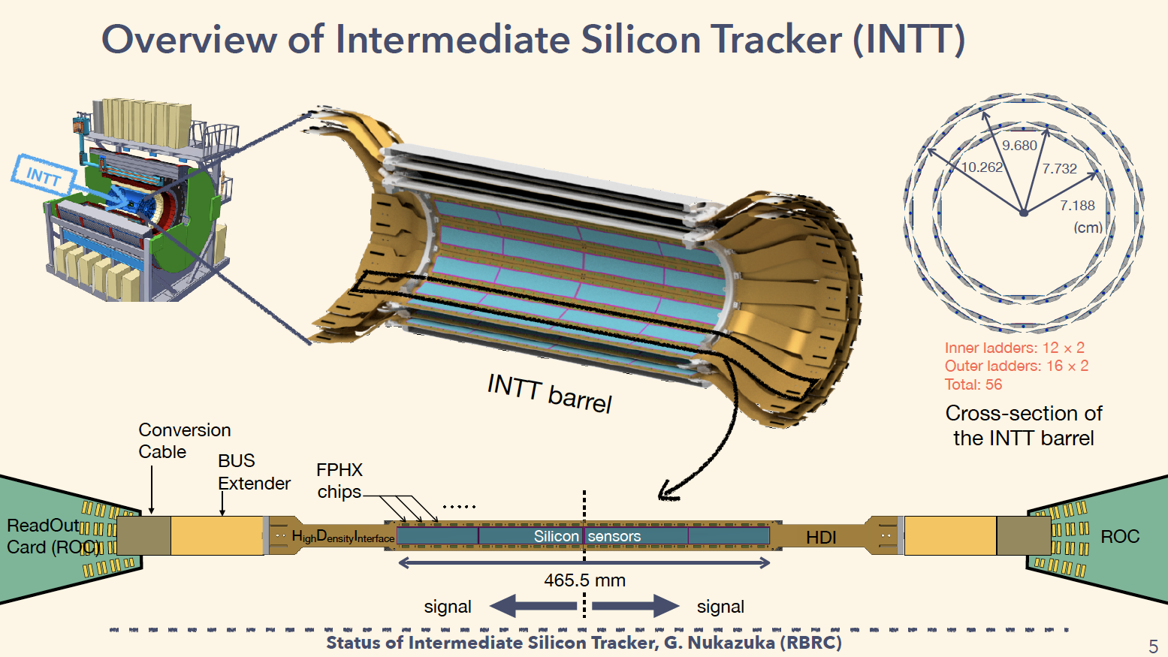
INTT: 2 layers
Total silicon strips:
L1 = 159,744
L2 = 212,992
Readout:
8 FELIX cards
details TBD

Slide 7
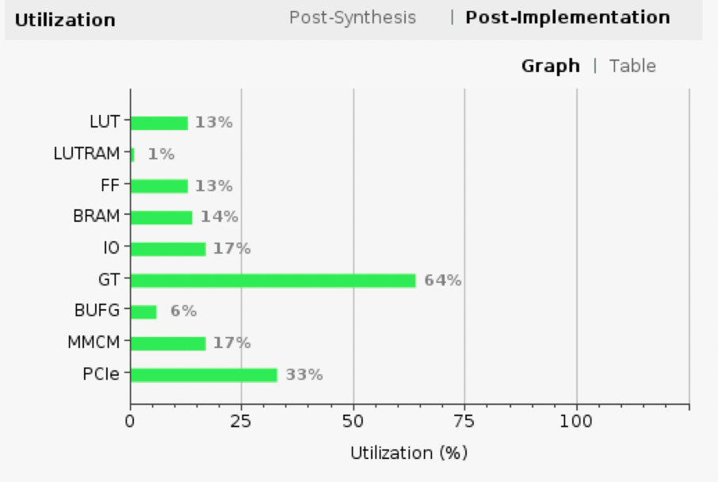
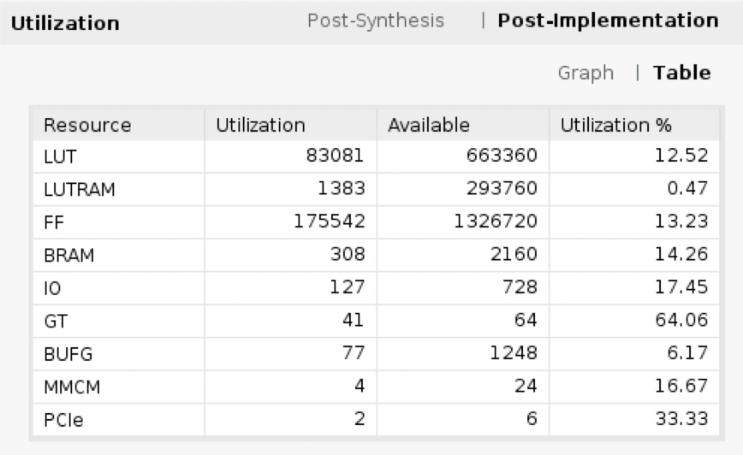
FELIX Resource Utilization in MVTX Readout

Slide 8
sPHENIX MVTX Readout Issues:
https://docs.google.com/presentation/d/1-wsSyadLgK7Rr79Ug95bbQdtVszYqZrZrypN47DR2uM/edit?usp=sharing
and test summary:
https://docs.google.com/document/d/1u5jwNs0xC0vP3ZMBLH3iHSFRPngN7YCCb3L7jL-Z1C4/edit?usp=sharing
Unstable GBTx1 link between RU and FELIX
Currently working with a wide tolerance of “GLink loss window”
~ 200ms
In the GBT implementation reset_rx_cdr_stable_out is used to check alignment. This signal seems to be not stable for GBTx1 and the signal is deasserted for few ms which causes a reset in the alignment check process...

Slide 9
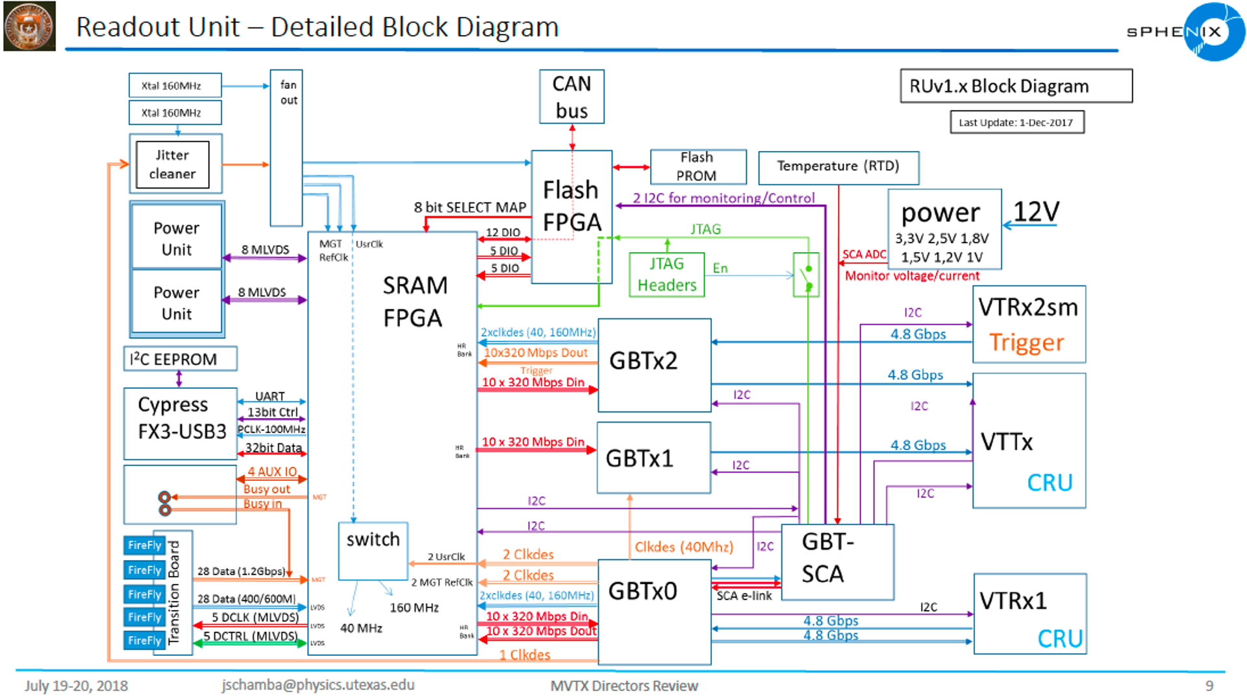
MVTX: VTRx/VTTx
all multimod
Trigger_In
From FELIX
(6/11/2020)
Data_Out x2
To FELIX
Data + GBT-SCA
+ SWT
(6/11/2020

Slide 10
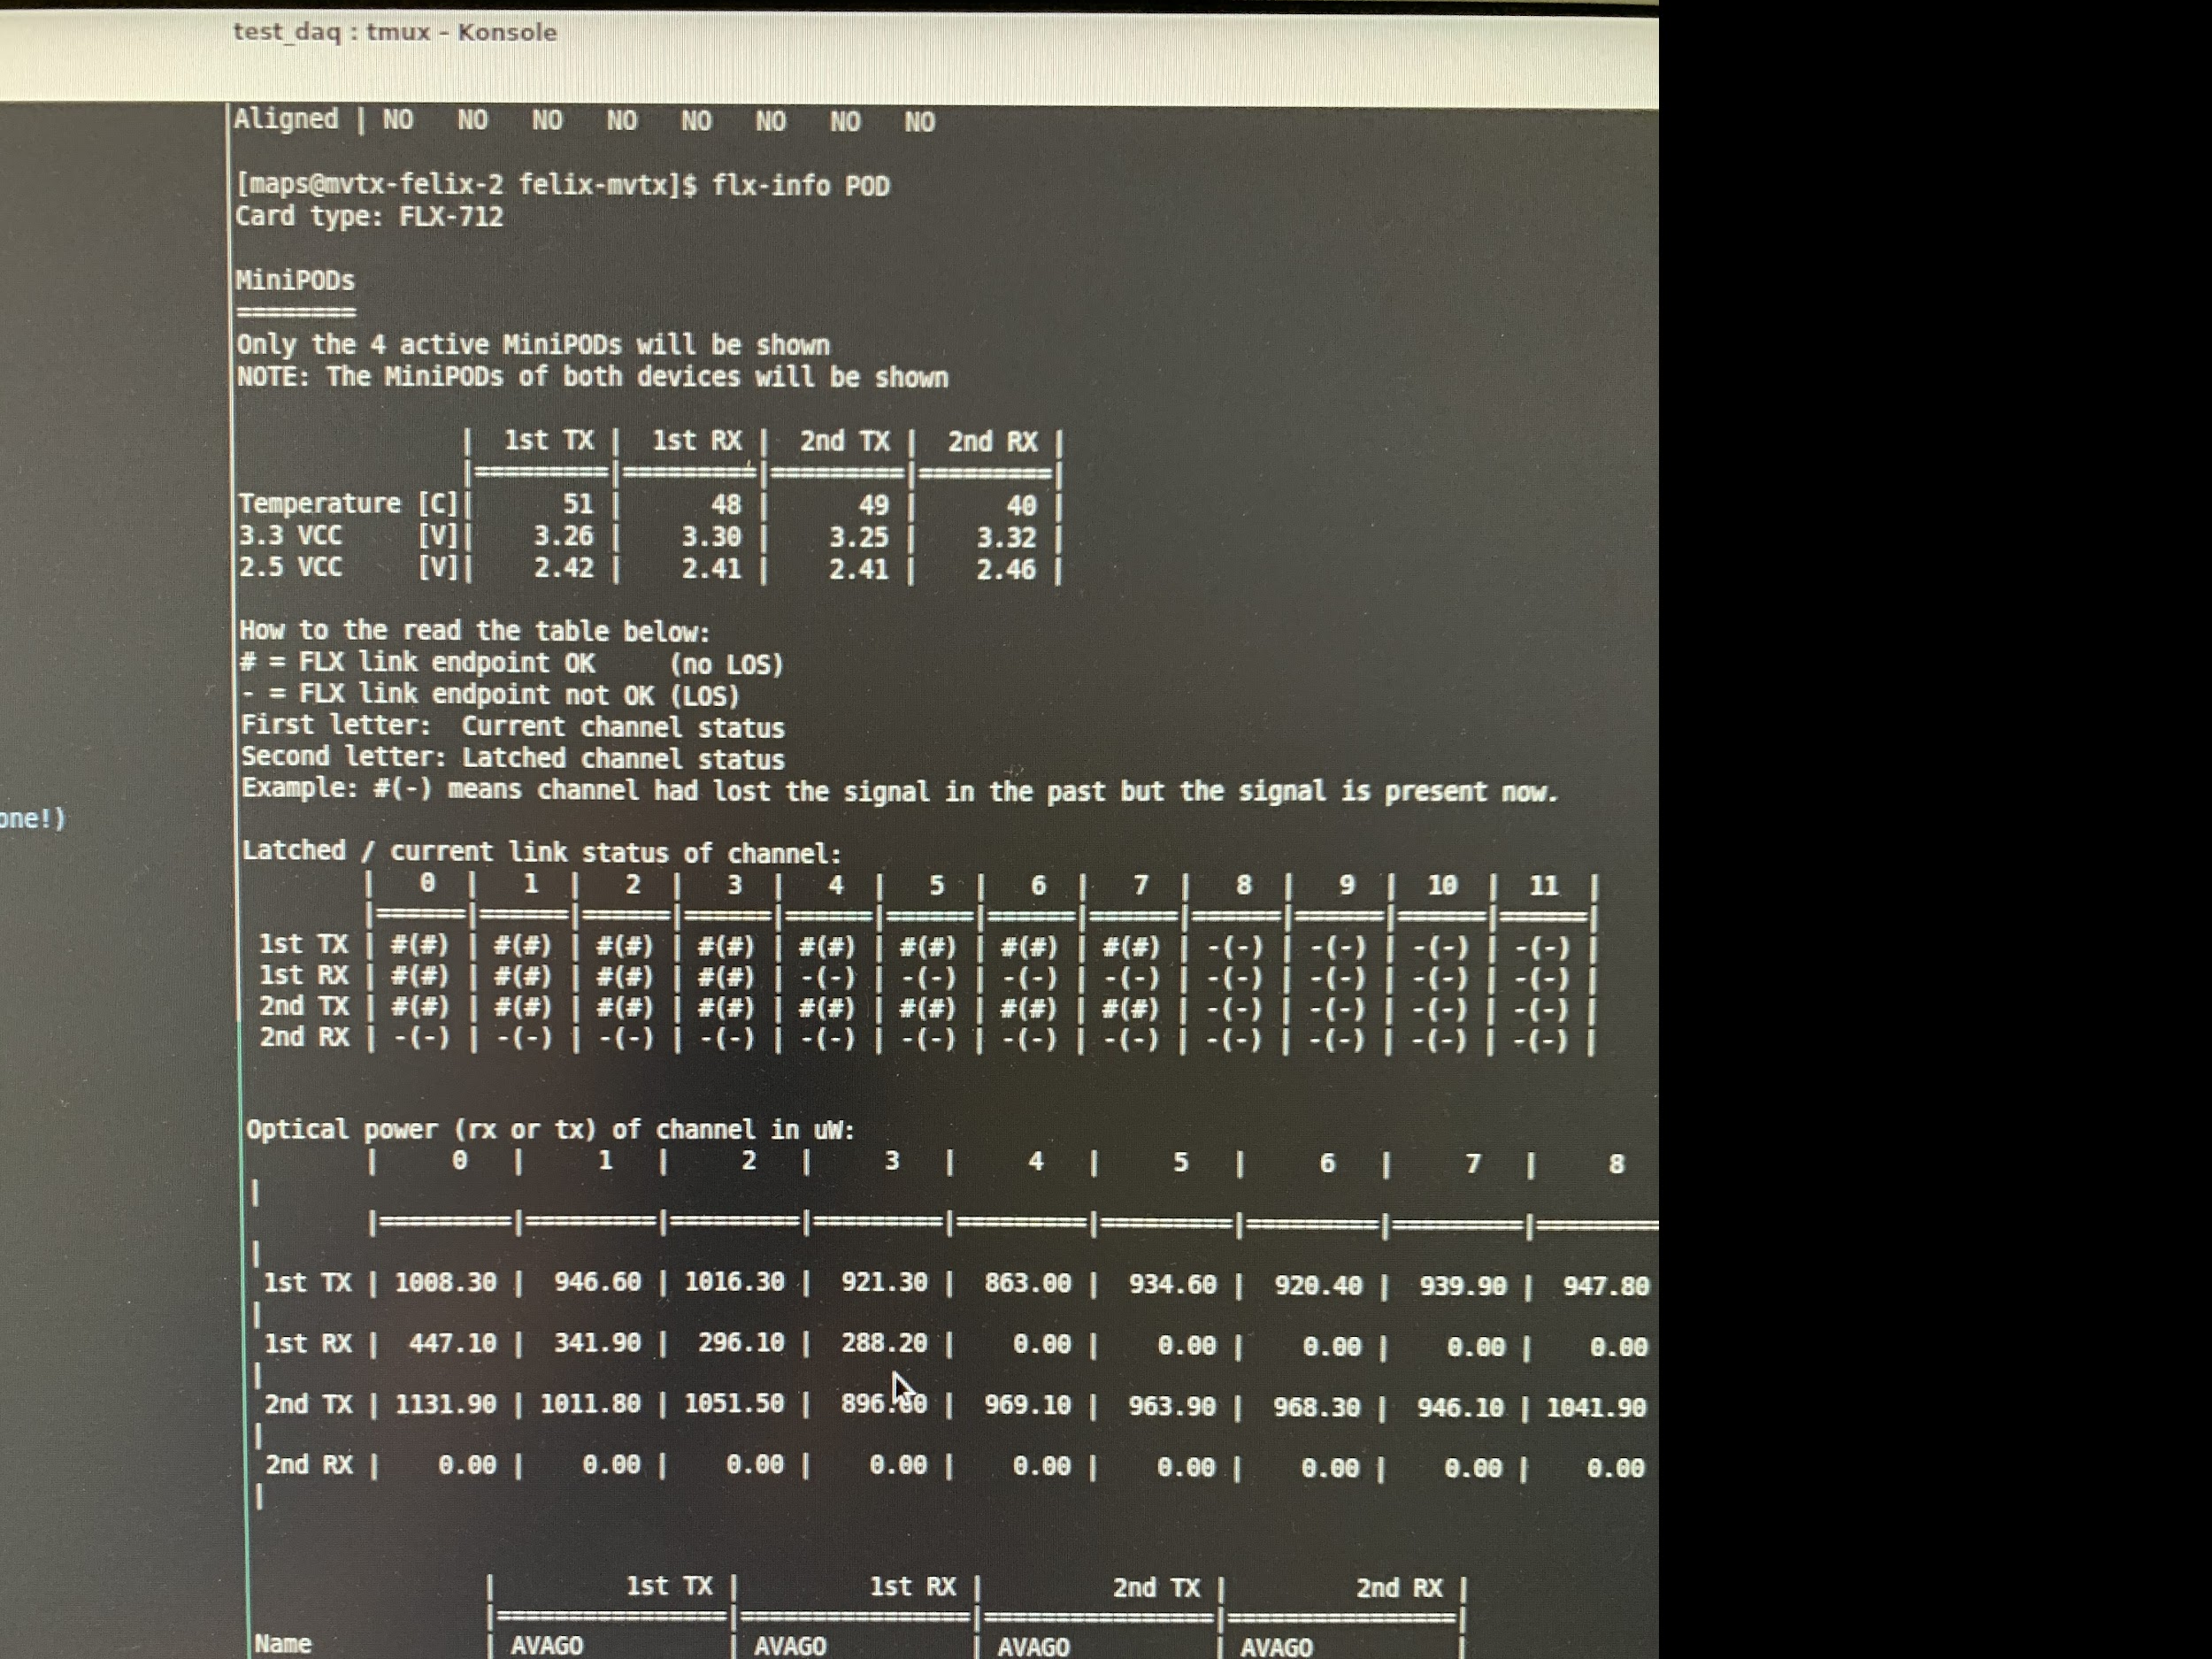
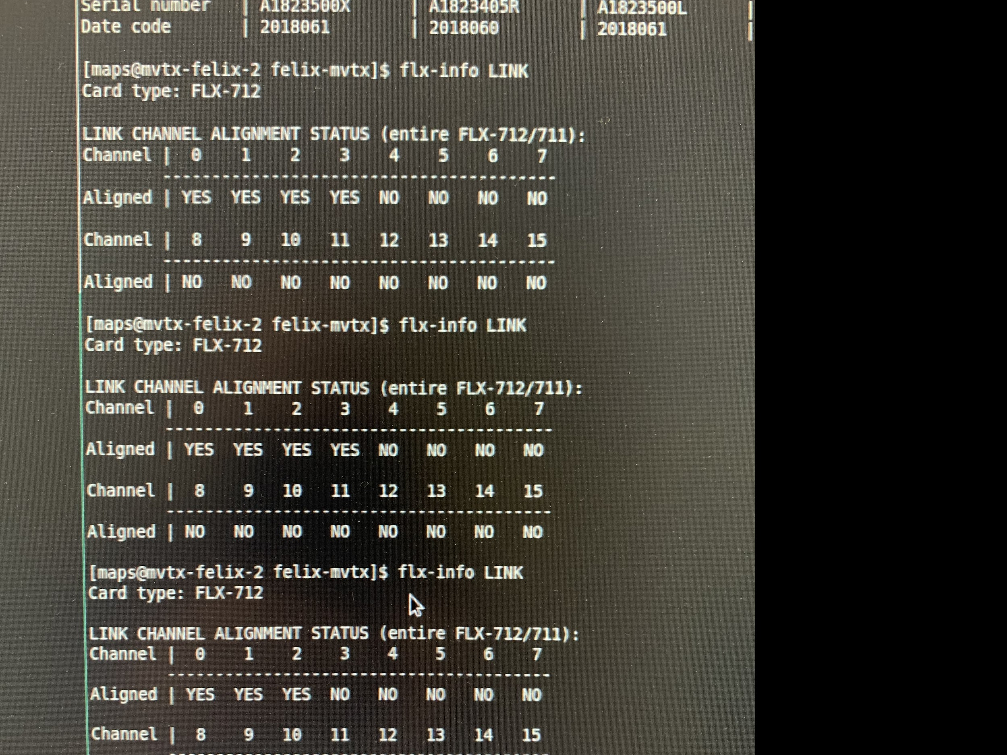
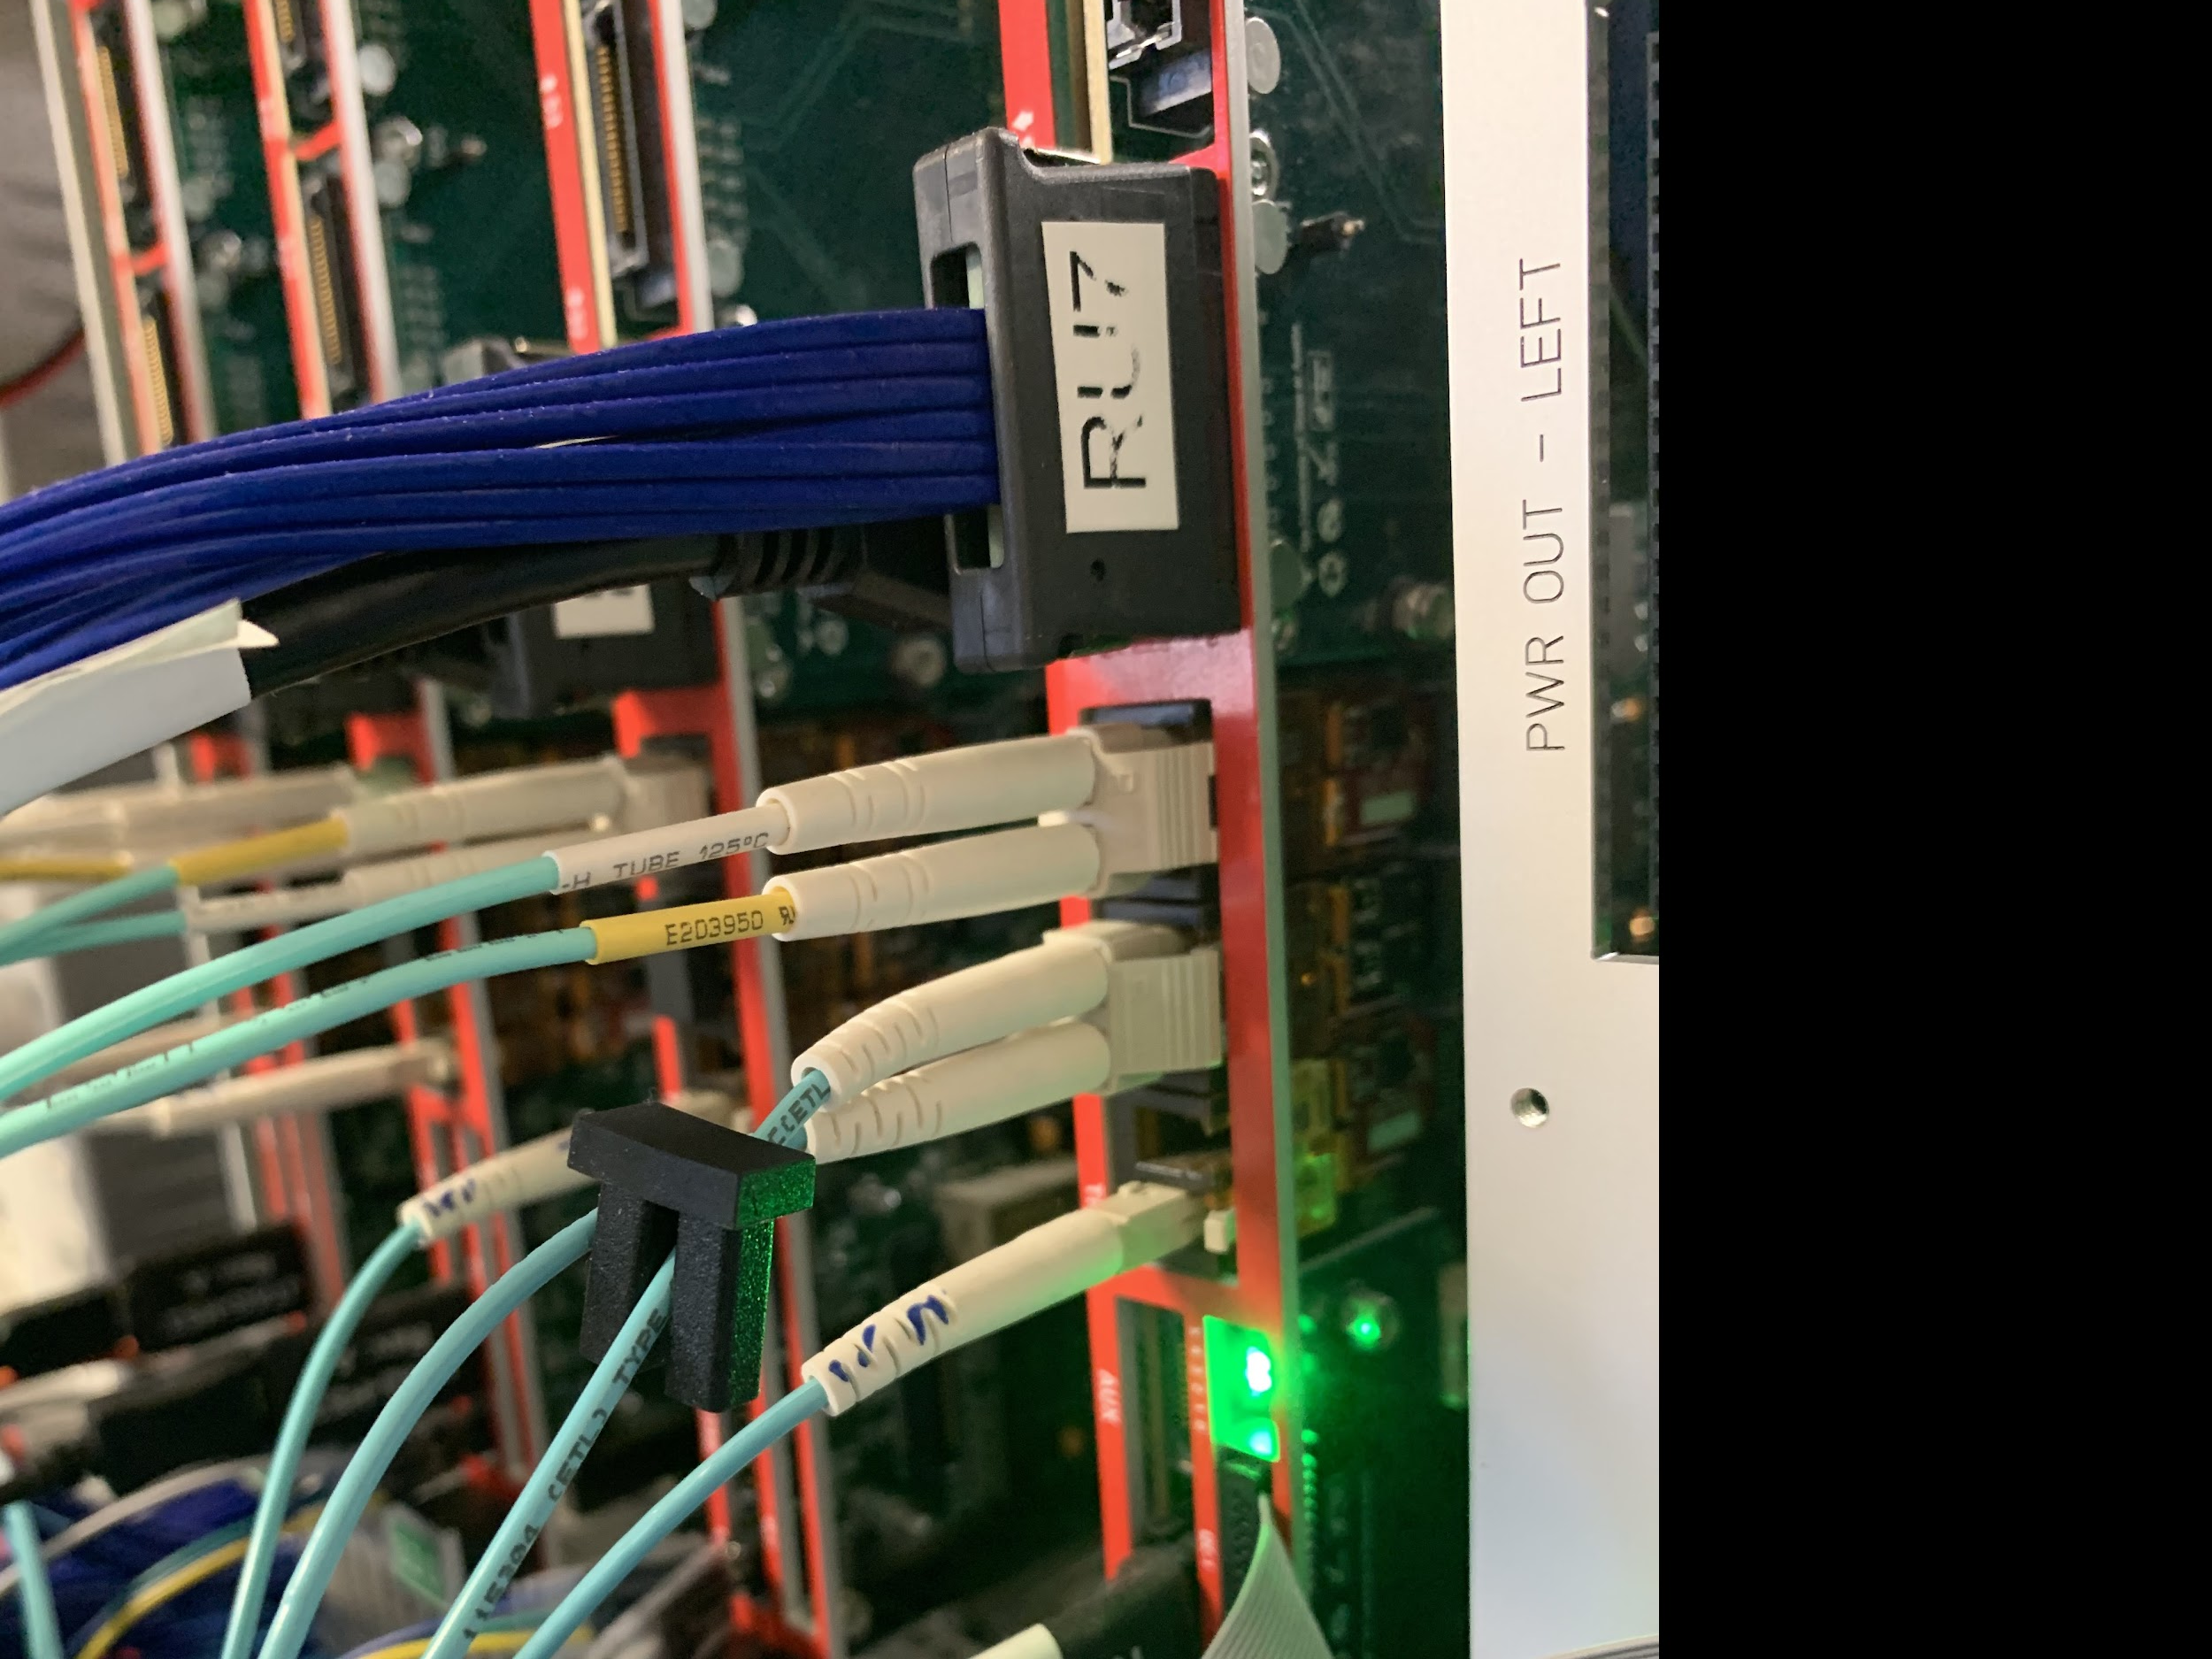
3-GBT Readout Test , 03/19/2021
RU FW:
FELIX FW:
Summarized on the MatterMost

Slide 11
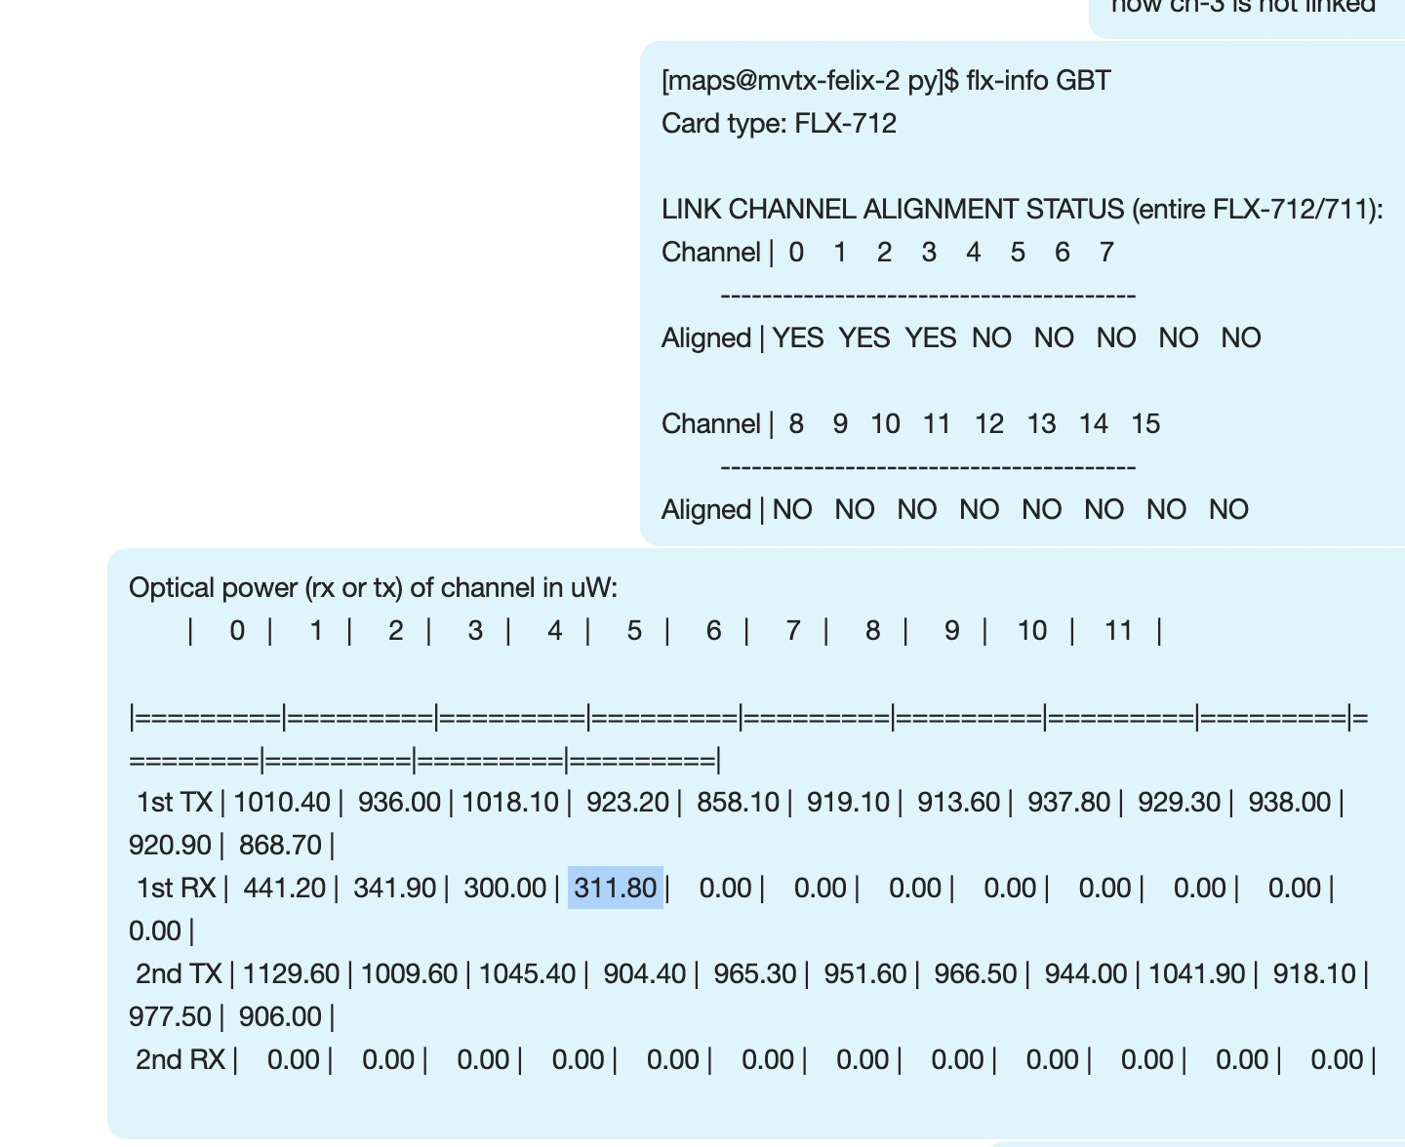
Test with RU-1, 03/21/2021
Same issue of locking VTTx1, but this time, the optical power seems okey (311 uW)
In the current MVTX testbench setup, the FELIX card provides 40.079MHz global CLK generated locally
Different CLK domain?

Slide 12
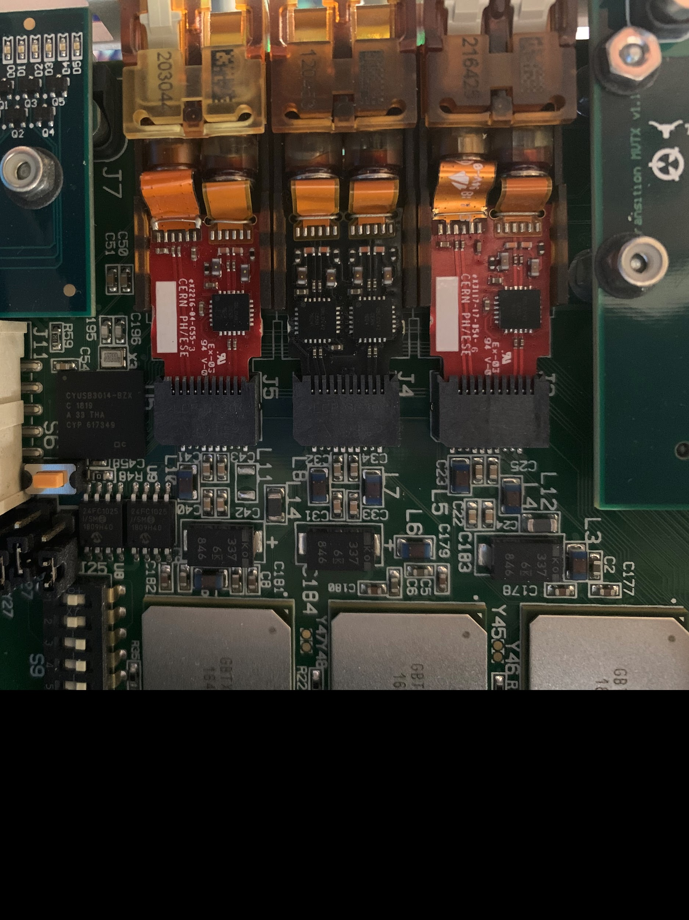
RU GBT-VTTx/VTRx lines
VTRx → GBTx0
TX
RX
VTTx →
GBTx1 (Top)
GBTx2 (Bottom)
VTRx (TTC) → GBTx2
XX
RX (TTC)

Slide 13
Permanent Solutions?
update FELIX FW?

Slide 15
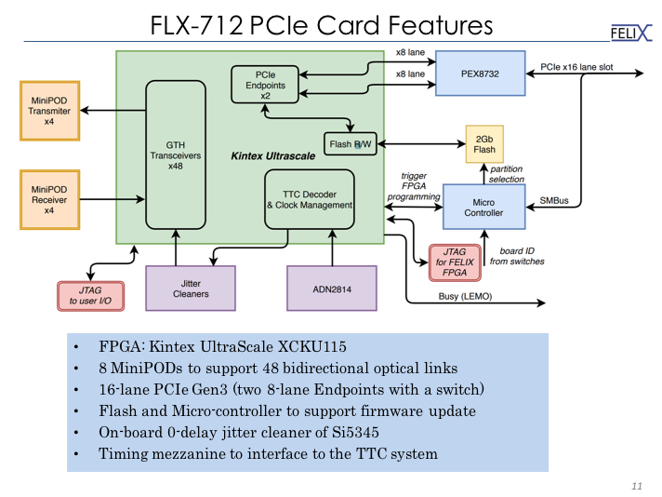

Slide 16
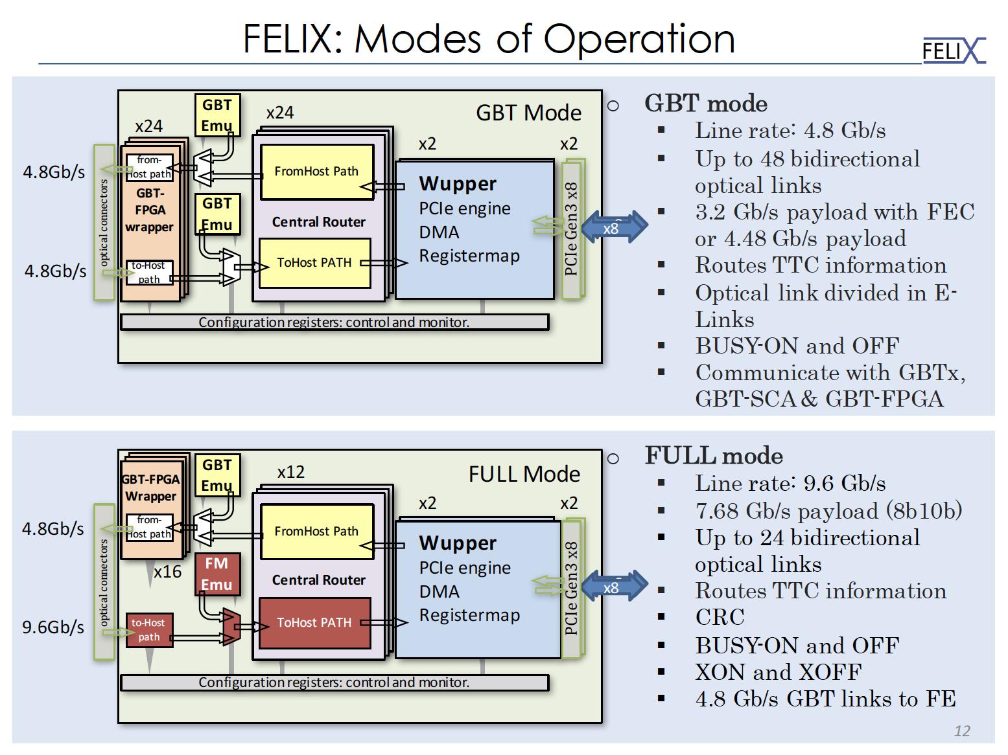
MVTX Readout Mode
MVTX/INTT Trigger Mode?

Slide 18
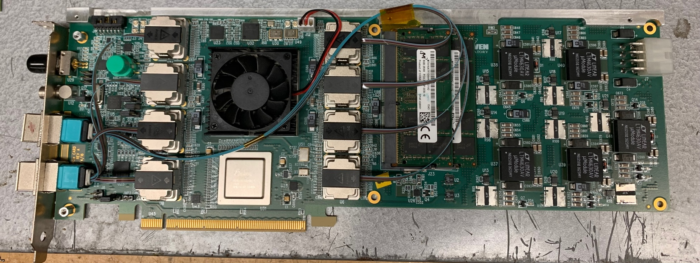
One FELIX v1.5 and Two FELIX2.0 available @LANL
48 IOs
2 x 8GB
16GB memory

Slide 19
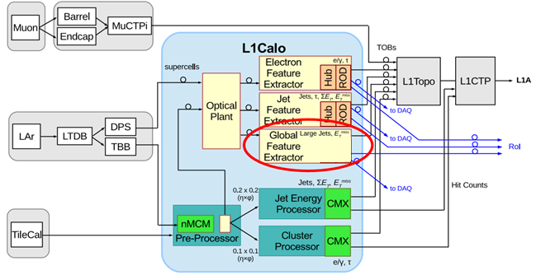
gFEX option?

Slide 20
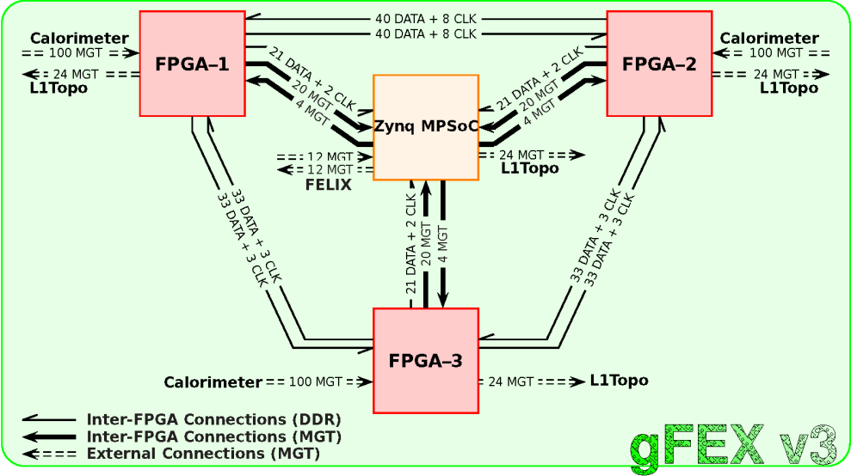

Slide 21
