Slide 1
Magnet Mapping
John Haggerty

Slide 2
The sPHENIX magnetic field
The field in sPHENIX is determined by the properties of the solenoidal coil and the magnetic material enclosing it
We (Wuzheng Meng and Kin Yip in C-AD, Achim Franz in Physics) have done a detailed three dimensional calculation of the field in sPHENIX which account as thoroughly as possible the magnetic properties and geometry of the Outer HCAL and end doors
  Calculated with OPERA (FEA from the people behind Solidworks)
  Coil properties from Ansaldo, Pasquale Fabbricatore, and SLAC
  We have investigated the effects of other small quantities of magnetic materials and have found their effect to be negligible
Early on, we considered not measuring the field but just relying on calculation
  The field was mapped very precisely in BaBar, so the coil properties have been verified
  The flux return of sPHENIX is “simpler” and has more iron (there could be some saturation at corners, but not in bulk)
  We considered ”DIY” (by the Superconducting Magnet Division)
But we decided that mapping before installing the complex TPC, INTT, MVTX, and beam pipe assembly would be prudent

Slide 3
https://ep-dep-dt.web.cern.ch/b-field-mapping-magnet-support
Contract with extremely experienced CERN group to do the mapping
  They have mapped ATLAS, CMS, STAR
  They bring equipment and expertise
Felix Bergsma retired, Burkhardt Schmidt has been our point-of-contact
Russ Feder and Leo DeMino have been doing the mechanical engineering on our side

Slide 4
What to map
We wish to map the volume of the Time Projection Chamber (TPC) from the beam pipe to the outer radius of the TPC, as close as we can get to the EMCAL
  20 mm < r < 900 mm
  -1100 mm < z < 1100 mm
The central field is about 1.4 T at the current it was operated at SLAC
Our tracking system is designed to achieve a momentum resolution of at best 0.1% so we with to achieve a mapping precision of at least 0.1%
We will compare the measured map to the 3D OPERA calculation
  Hopefully in real time!

Slide 5
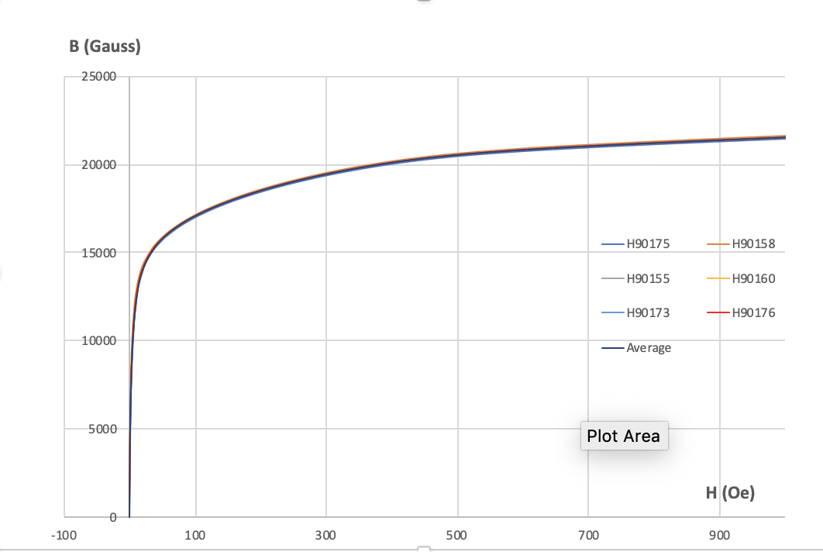
Properties of the steel
Magnetization of 6 samples of barrel steel have been measured by Magnetic Instrumentation
The properties were very similar coupon-to-coupon
Incorporated into OPERA model

Slide 6
It’s not all about B_{z}
The results of the OPERA calculation are here: https://github.com/haggerty/sphenixoperamaps
  The azimuthal component of the field is pretty small in the tracking volume
  The radial component of the field is not that small and has interesting properties
Chris incorporated this 3D field map into our simulation (AFAIK)

Slide 7
Simple picture (Wuzheng Meng)

Slide 8
Br

Slide 9
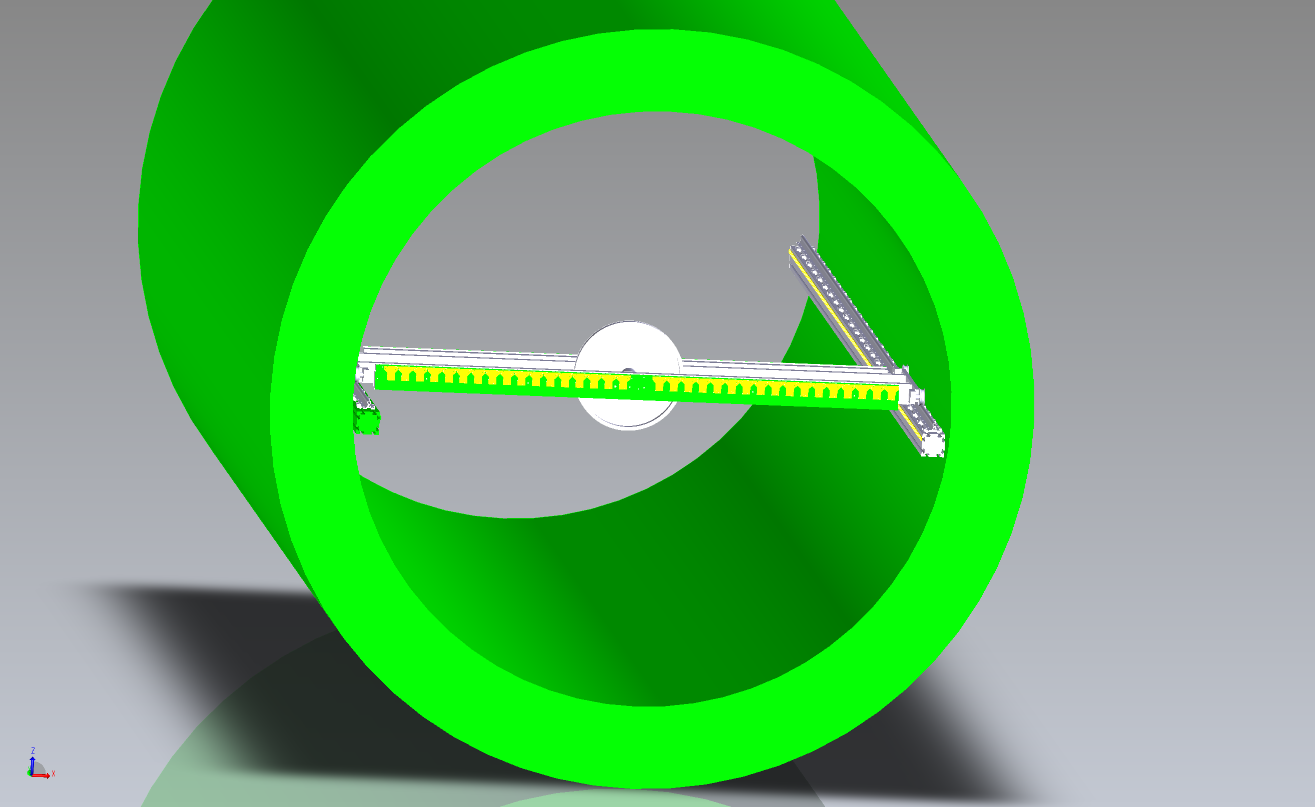
ATLAS mapper

Slide 10
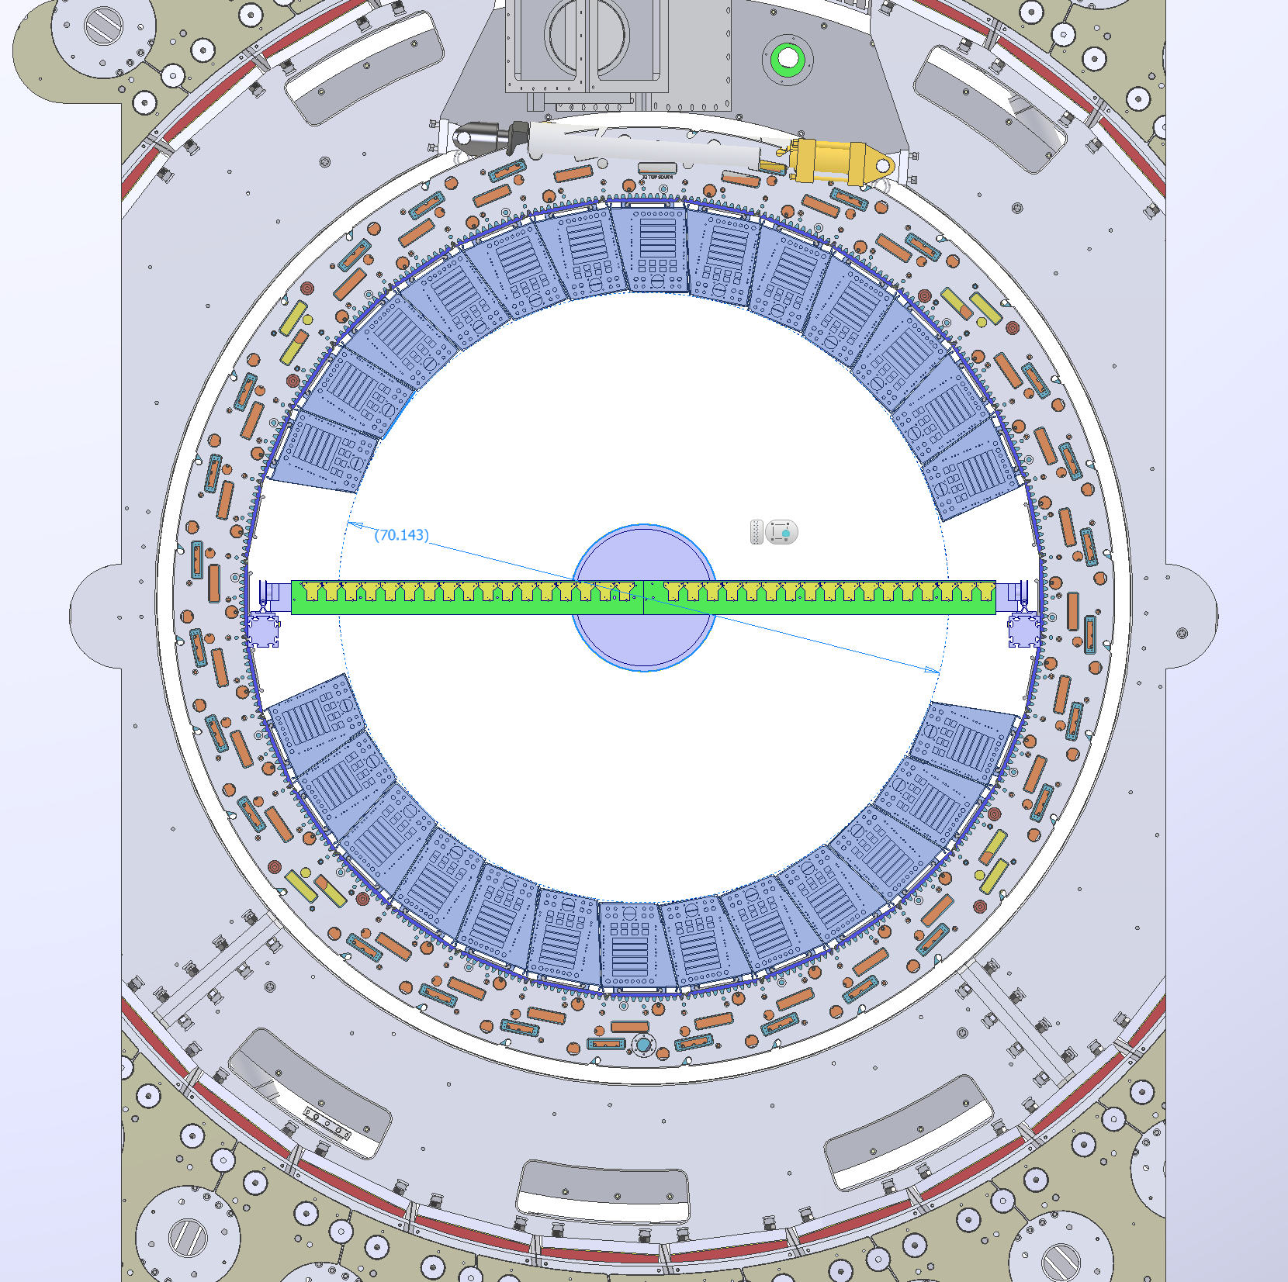
70.1” (1781.6 mm)
Russ Feder

Slide 11
Leo DeMino

Slide 12
When does this happen?
The detector has to be rolled into the IR
  We have no provision to provide power and cryo to the solenoid anywhere except in the IR
The detector has to have the Inner and Outer HCAL and end doors installed
The upper platform has to be on the detector (to support the valve box and other equipment)
The cryo and power supply connections need to be made, the cryostat pumped down, and the coil cooled to 4K
We need the access platform on top to do all that
The target date is “as soon after roll-in as possible”
  Present expectation is August 2022, but in a state of flux (as it were)
The CERN group is also mapping the MPD solenoid at NICA in Dubna but with a different apparatus

Slide 13
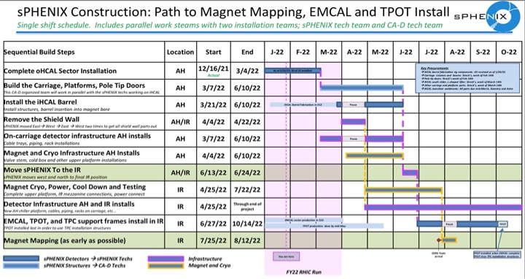
Russ Feder schedule as of 2022-02-04

Slide 14
Mapping details
Mapping granularity
  They typically make a measurement at 5° intervals (72 measurements)
  2 cm grid in z?
The vane settles down in 5-50 sec… up to 110 hours for a complete detailed map
I will probably argue to make a less fine-grained map initially so we can detect any pathologies at the outset
I estimate that the mapping itself will take 1-3 weeks
Access to the IR will be very limited during mapping operations
Survey of the apparatus in place is very important
Field residuals in ATLAS were ~0.5 mT we hope to achieve about the same

Slide 15
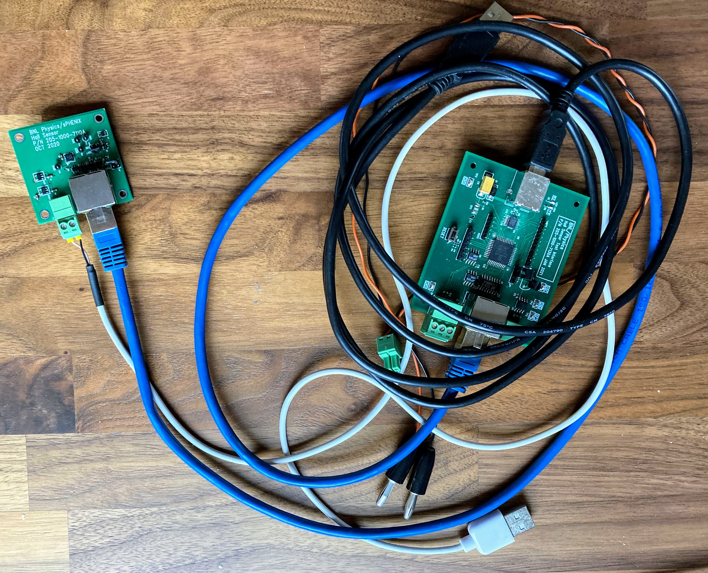
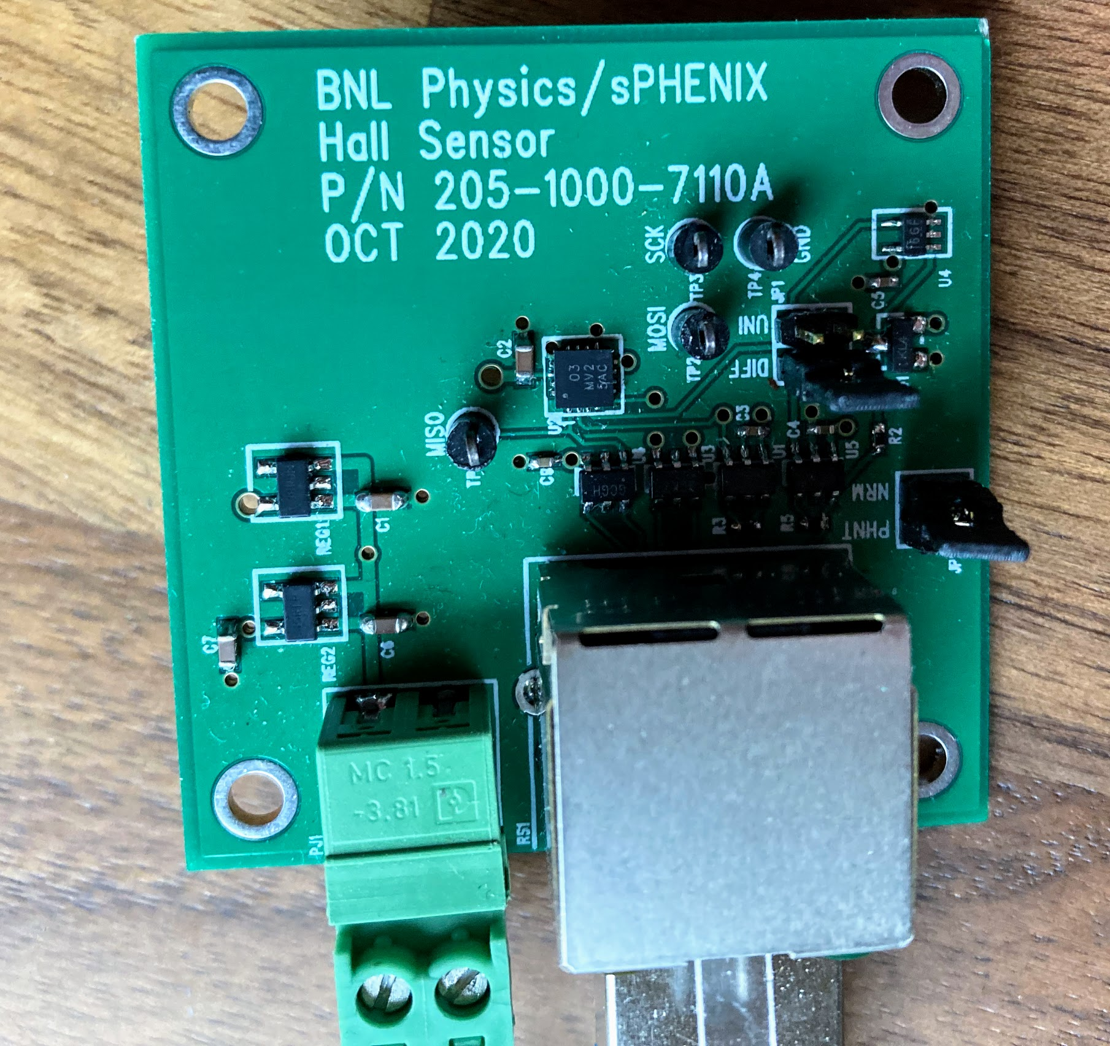
Monitoring
In operation, we’ll monitor the field with Metrolab’s Magvector MV2 3-axis Hall probes https://www.metrolab.com/products/magvector-mv2/
Steve Boose has designed readout electronics that we’re testing
The idea is to have about 6 measurements on either end of the TPC

Slide 16
Summary
We have a plan (almost) in place for a group of experts from CERN to map the magnetic field
  Ed O’Brien has been working on getting the contract with CERN in place
We plan to map the solenoid ”as soon as possible” after roll-in and connecting the magnet

Slide 17
Some mechanical details
From Russ Feder and Leo DeMino

Slide 20
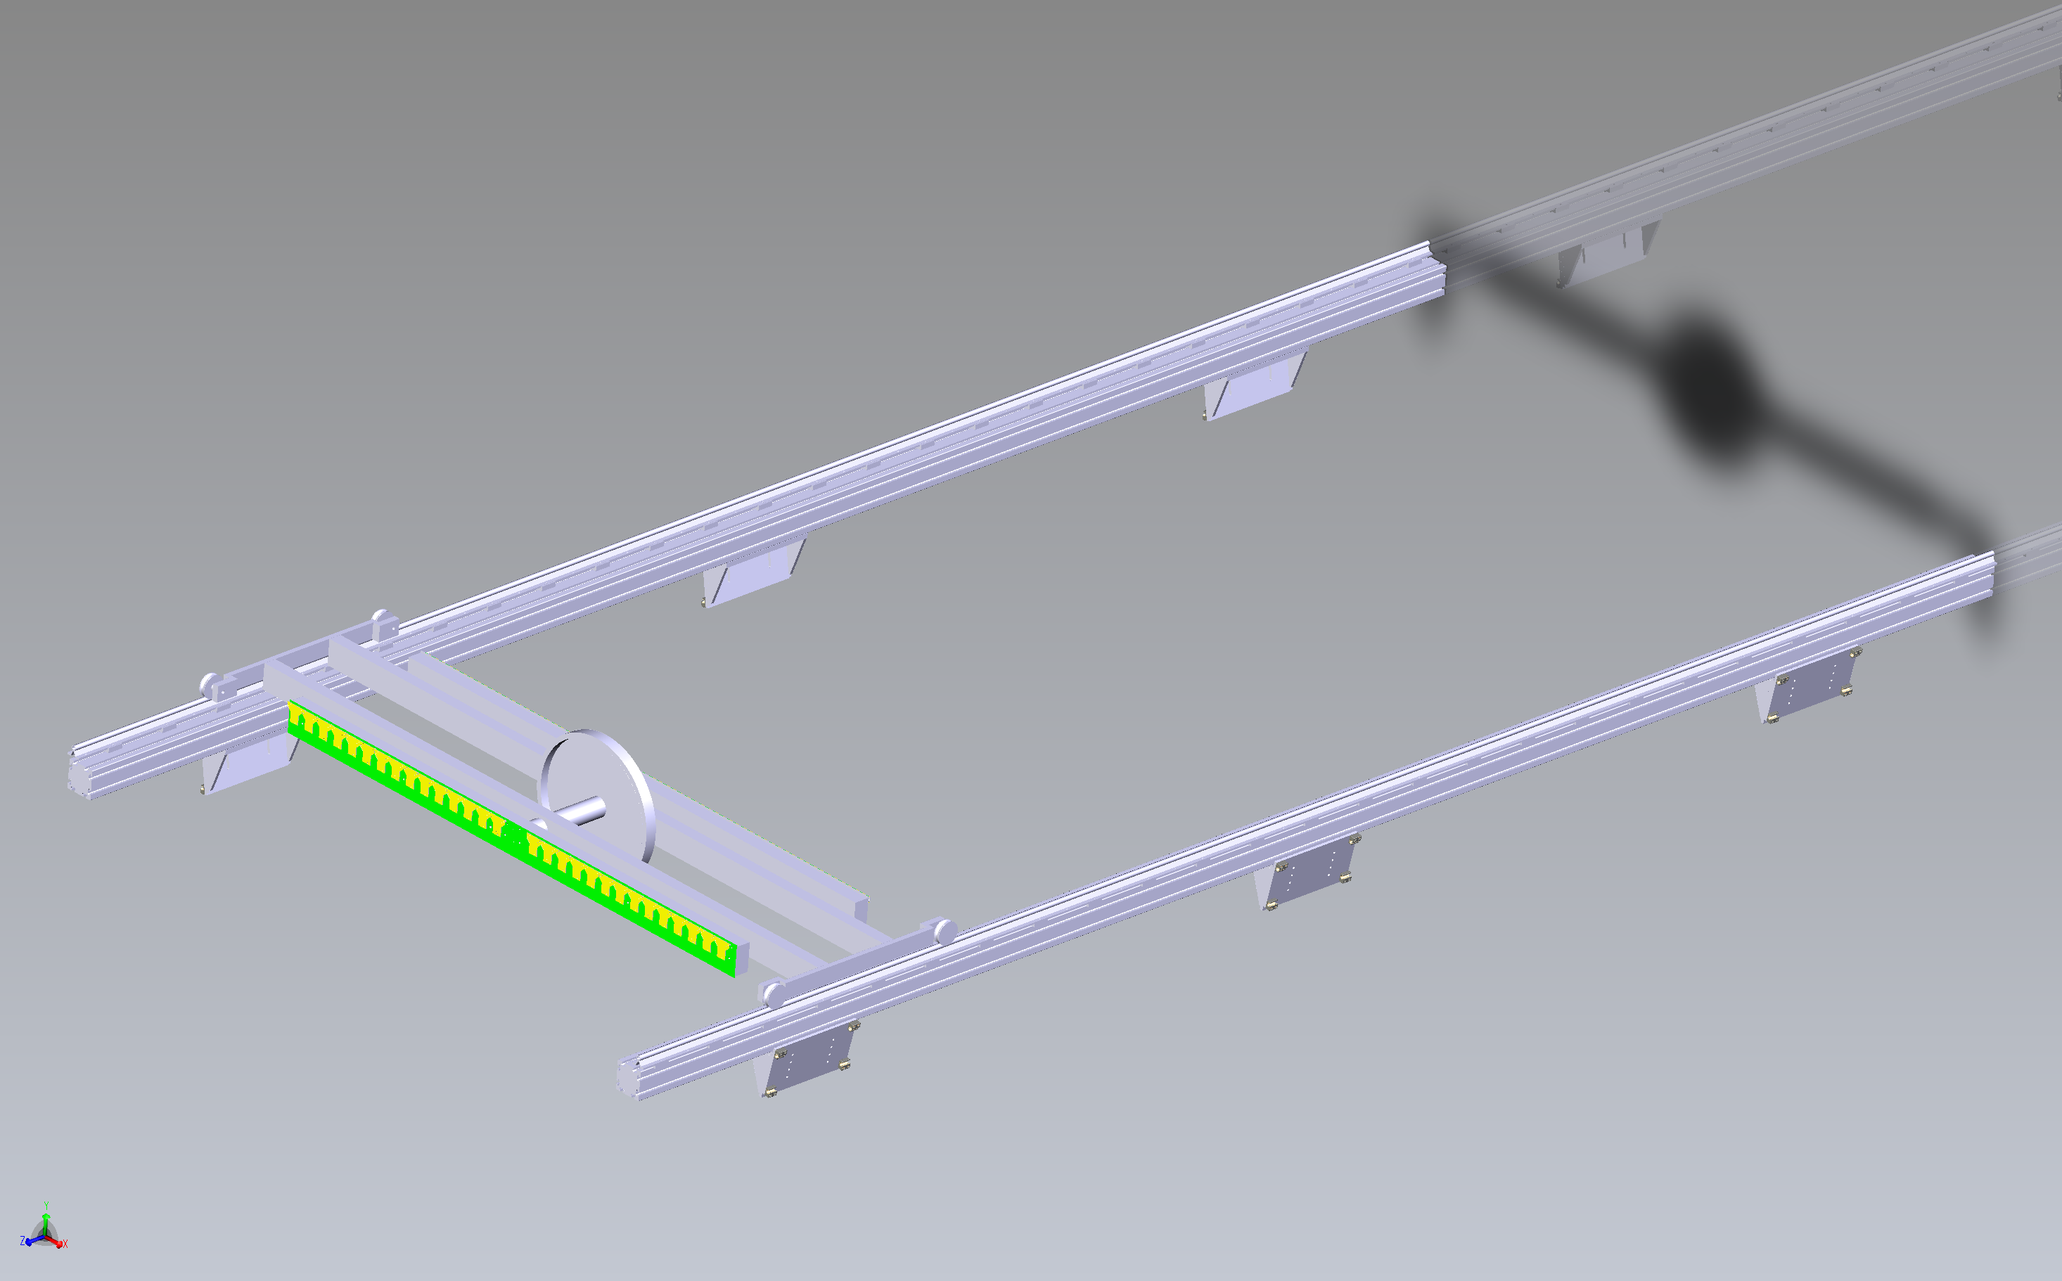
Frame to support mapper

