Slide 1
MVTX Status and Plan
Camelia, Grazyna, Jo and Ming
2/14/2022
MVTX Bi-weekly General Meeting

Slide 2
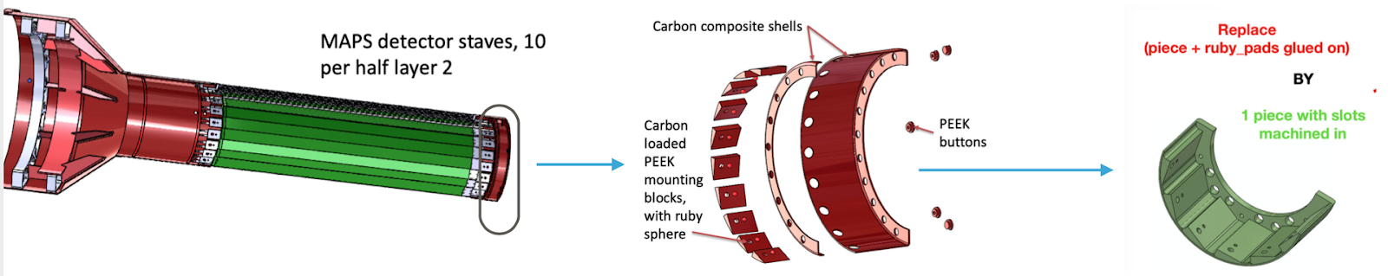
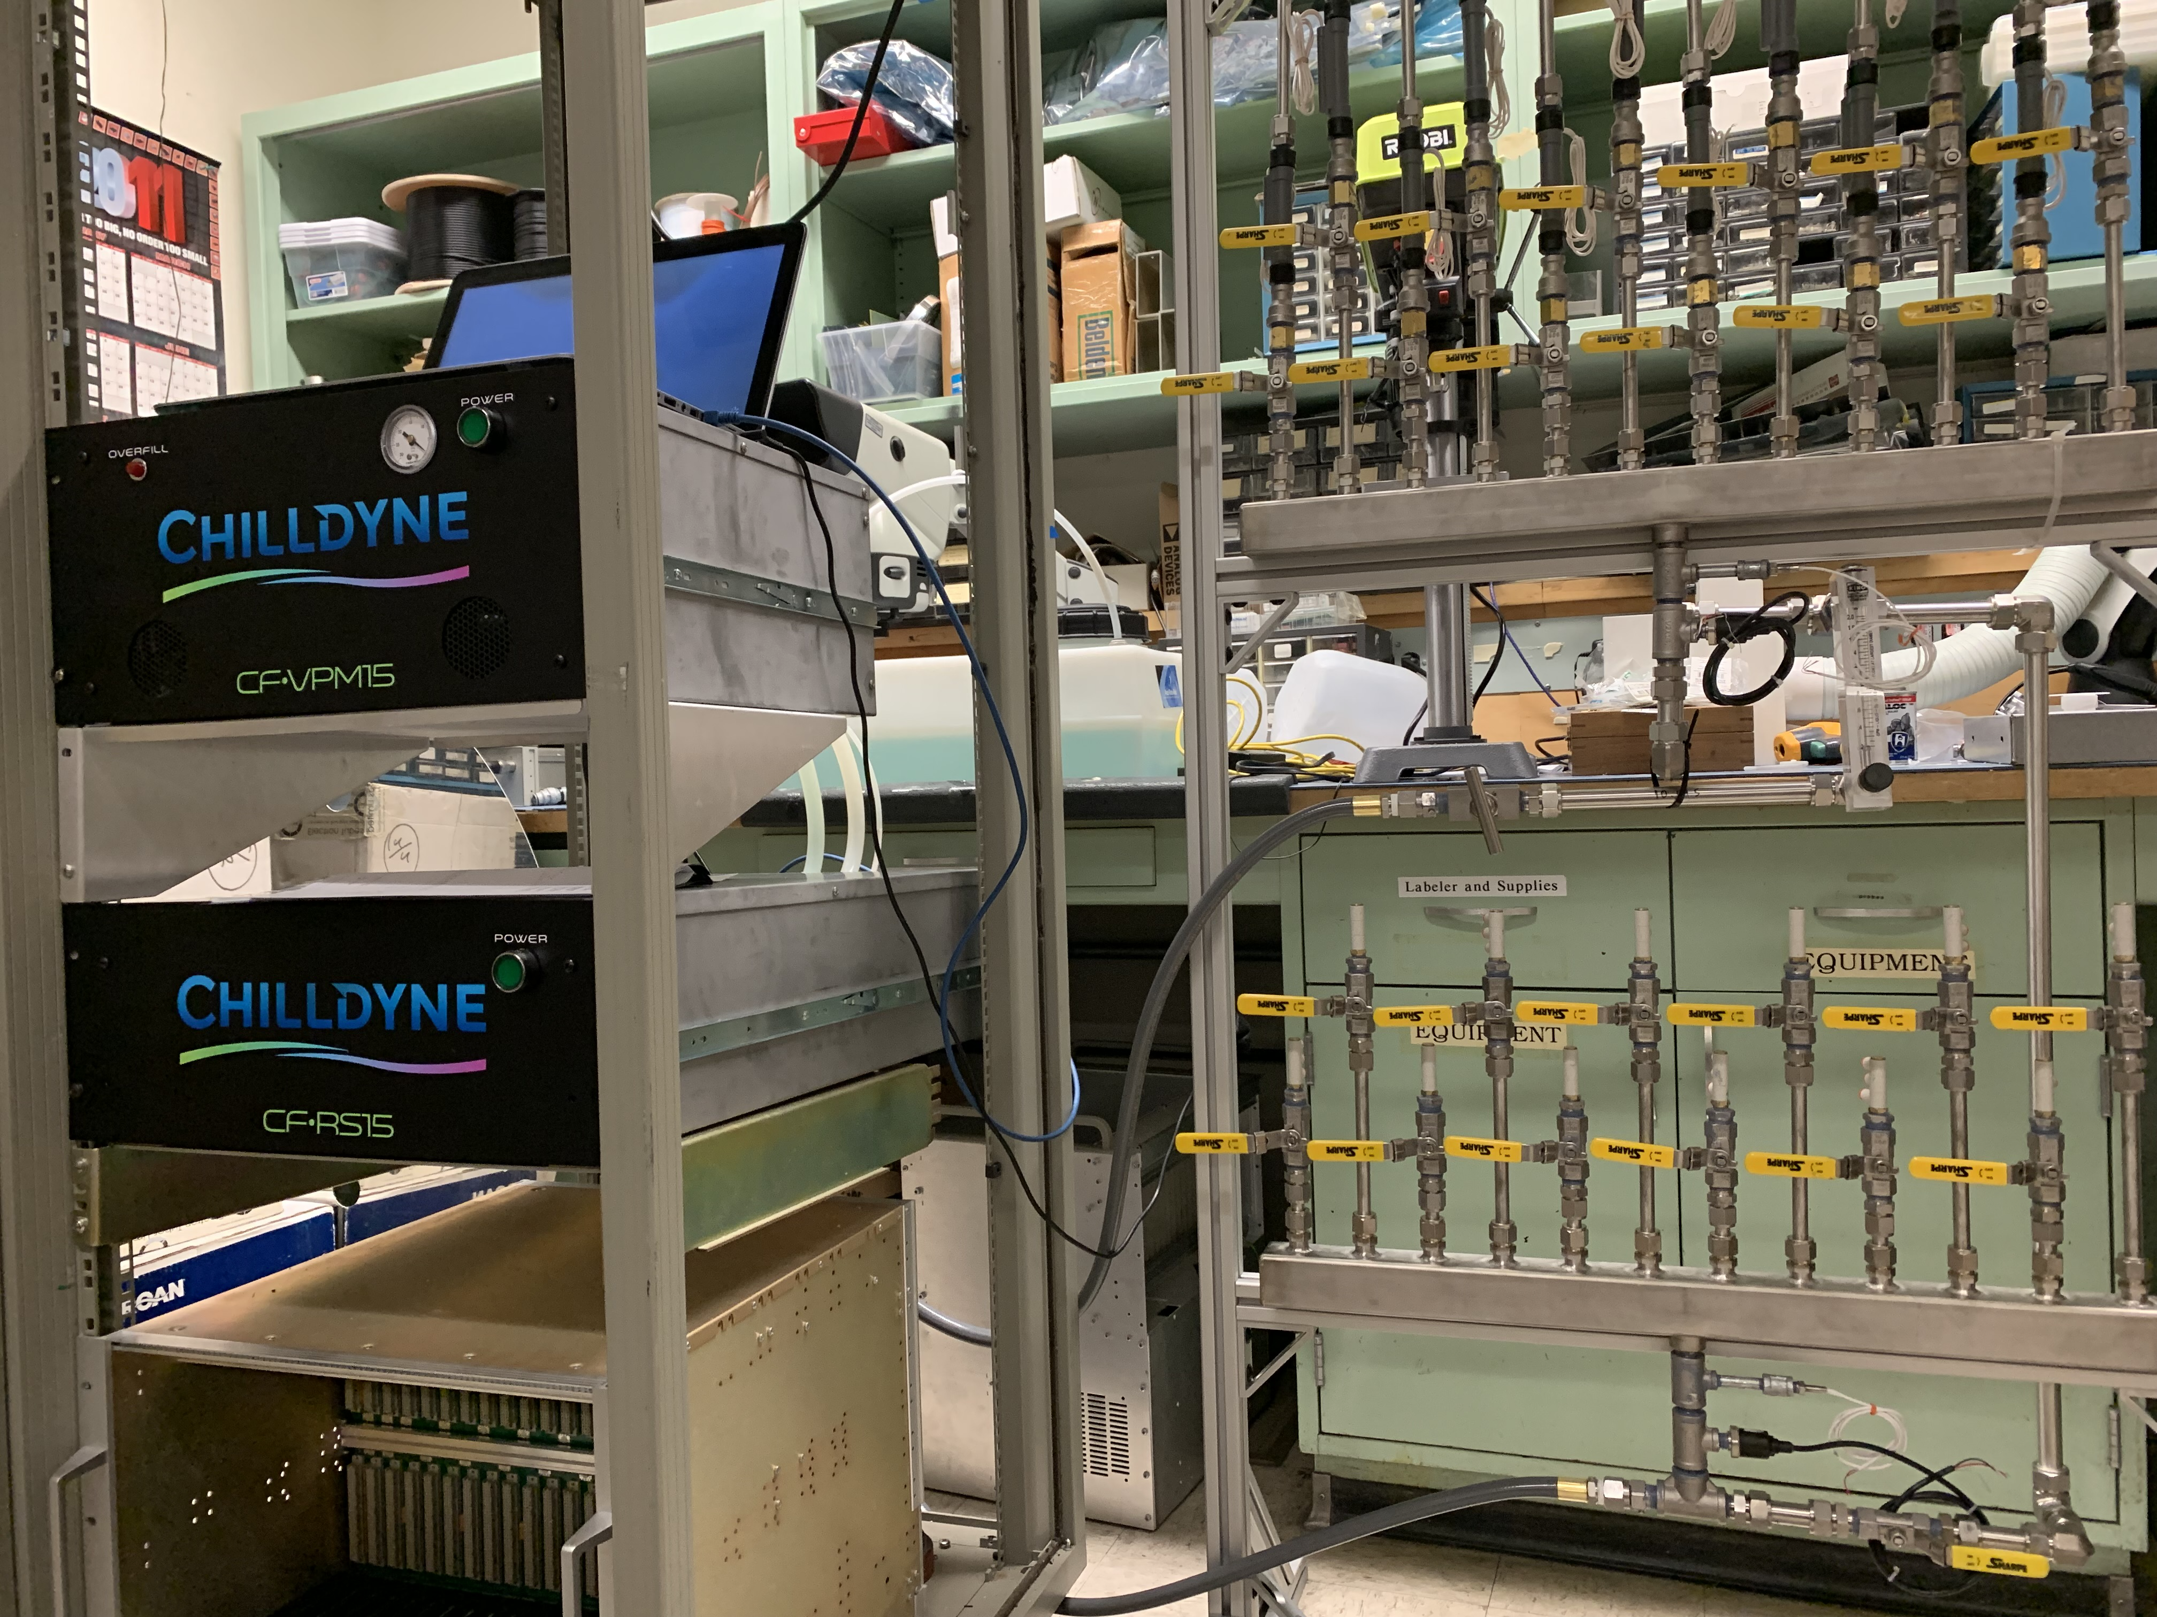
Work in Progress and Concerns
South EW
Half-detector assembly at LBNL: schedule?
  South End-Wheels work
  active discussions last week
Readout and control integration: ~by Feb. 2022
  Preliminary new data format in RCDAQ
  Setup a full chain 8-stave/RU/PU + CAEN + FELIX + mGTM, in progress
Finish cooling system design by ~ mid Feb
  Cooling system discussed with BNL, 2/10
  Electronics cooling system setup at LANL
Detector QC, calibration, alignment etc.
  Online QC software development w/ new data format
Cooling system test @LANL
Chiller + Patch panel
30 cooling plates
One dummy stave

Slide 3
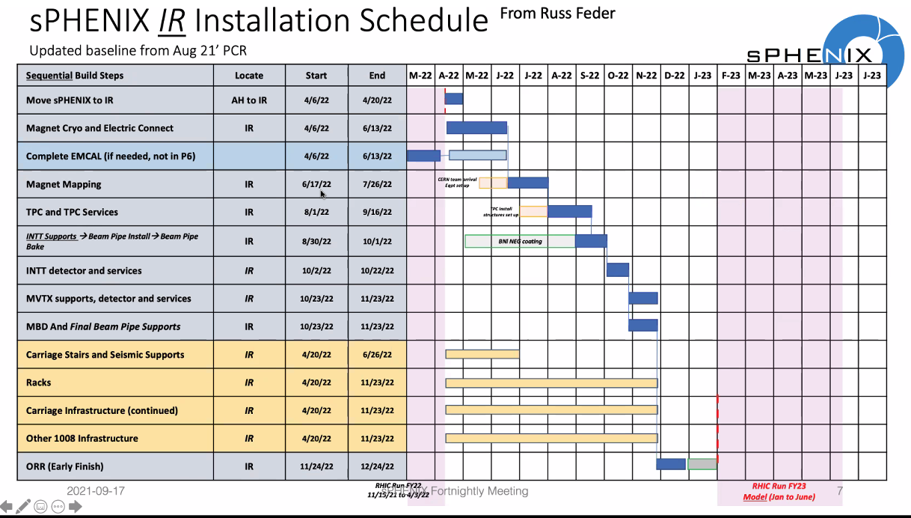
sPHENIX Installation Schedule Update
MVTX: 10/23-11/23, 2022 → delayed by ~ 1month?
Delayed ~ 1 month
Reported at commissioning
meeting 2/7/2022

Slide 4
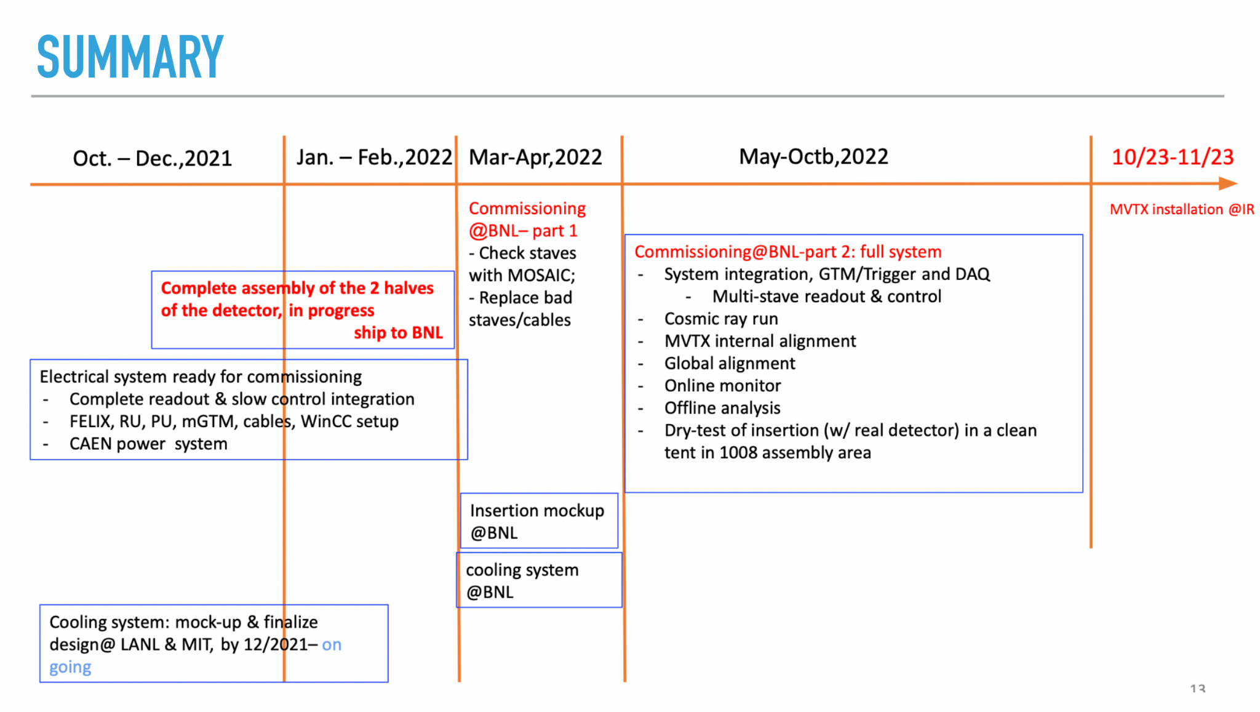
Remaining Key Tasks and Schedules
Schedule presented 1/6/2022
sPHENIX collaboration meeting
(Possible delay ~1 month?)
Plan to set up a BIG clean tent in the sPHENIX assembly area in May:
for the full insertion mockup
Full half-detector commissioning
Today; delay in half-detector assembly … by ~1 month?

Slide 5
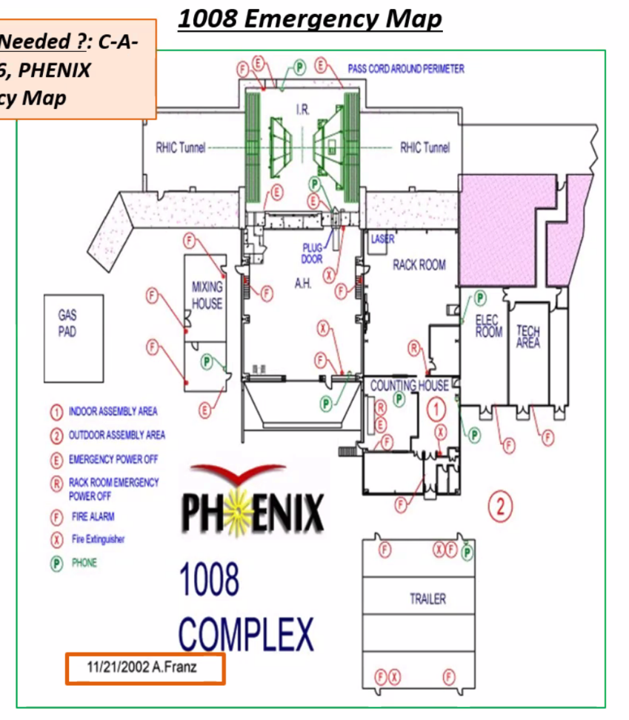
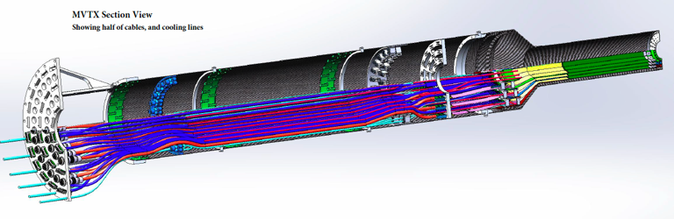
Pre-installation @ 1008: Jan. – OCT., 2022
Clean tent at 1008: Jan – May, 2022
- Half-detector QC @#1
MOSAIC test stand for stave QA
  PU+MOSAIC reside in a VME Crate
  2 test stands
QA two half-detectors
  Single stave QA, one-by-one, 48 total
  48 SamTec readout cables
  48 DVDD cables
  48 AVDD cables
  48 “HV” bias cables
  48 PT100 T-readback
QA time: 4hrs/stave
  Two MOSAIC systems available, ~24 days
#2 plan: May – Oct.
full detector commissioning
plan under discussions
#1
#2
MVTX Detector
MOSAIC
Test Stand

Slide 6
BNL Commissioning Travel Plan Approved
“The ROOP request for your MVTX Team has been approved for onsite access beginning February 14, 2022.
Each must contact the Clinic at OMC@bnl.gov to set up an appointment to validate their vaccines.
This can be virtually. Further details regarding training will follow.”
Jan-Feb:
  Setup clean tent, power and cooling system
  Setup MOSAIC test bench
  Setup 6 FELIX servers
Mar-Apr:
  Half-detector stave QC
  Possible rework of half-detector
May-Sep:
  Full commissioning
BNL travel google docs:
Travel plan: https://docs.google.com/spreadsheets/d/1rPCD_5E5Mi8oLz5d0K1_onjZi4BaeHwL1x390UaNgp8/edit?usp=sharing
BNL travel approval paperwork:
https://docs.google.com/document/d/1seXXCxdGgXm_XD-v2Z6m9TLz6j6dXUMbyUZv1gCNluY/edit?usp=sharing
- 11 people approved!
additional request for 12 submitted
Jim, Joe, Ho-San, Grazyna
Nacer*, Jason, Hugo, Walt,
Eric, Danielle*, Nicolas, Hubert
Need BNL guest appointments

Slide 7
Additional slides

