Slide 1
MVTX Status, 02/15/2022

Slide 2
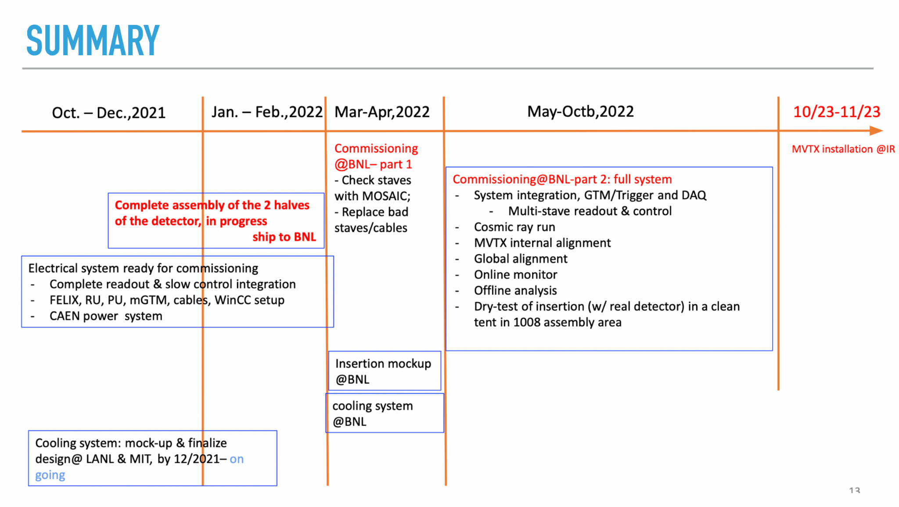
Remaining Key Tasks and Schedules
Schedule presented 1/6/2022
sPHENIX collaboration meeting
(Possible delay ~1 month?)
Plan to set up a BIG clean tent in the sPHENIX assembly area in May:
for the full insertion mockup
Full half-detector commissioning
Today; delay in half-detector assembly … by ~1 month?

