Slide 1
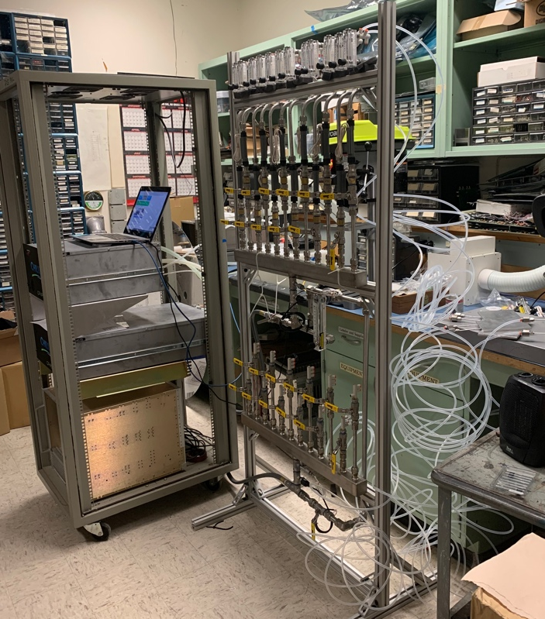
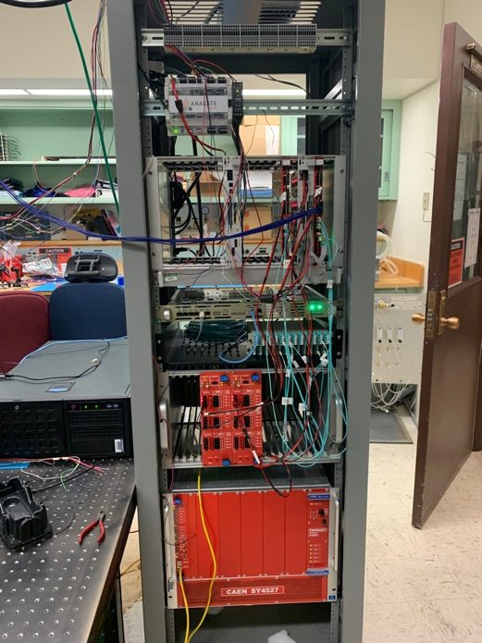
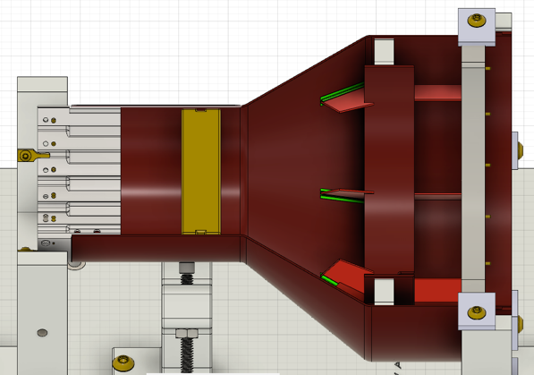
MVTX Status, 02/15/2022
Readout and electrical control system
  Implemented new data format for continuous readout;
  Implemented full 8-DMA readout per FELIX, all 6 AMD FELIX servers in hand;
  Replacing RU VTRx transceivers flex cables in progress at CERN, complete by May 2022
  Most CAEN power system in hand, delays in last a few power module delivery, by March 2022
  Detector safety monitoring and slow control system designed, PLC procurement in progress, some delays in electronics, ETA, Feb. 26 2022
  All inside-detector signal and power cables produced and tested for half-detector assembly, long cables will be delivered in March 2022
Mechanical system
  Carbon Fiber composite structures produced and CMM’ed;
  Assembly jigs fabricated and procedures practiced
  Improving out-of-tolerance Al South End-Wheels for final assembly at LBNL, possible delay to complete 2 half-detectors by ~a few weeks (TBD); still on track for on-time installation
Services
  Cooling system designed and reviewed, system testing at LANL and MIT
  Power system, service cable layout plan developed and reviewed
MVTX detector insertion system prototyped and reviewed
  Final design improvement in progress
Detector commissioning plan developed:
  Phase-I commissioning plan developed to QA half-detectors at BNL after delivery from LBNL, MVTX experts are working at BNL to setup clean tent for the testing
  Phase-II full detector pre-installation commissioning: preliminary plan developed, including full scale detector insertion mockup
  Experts’ BNL on-site work plan approved for travel
Full readout and control integration
-Staves
-RUs
-FELIX/AMD
-mGTM
-CAEN power
MVTX cooling system test:
Chiller
Patch panel
Cooling plates
MVTX commissioning phases #1, #2
South-EW and CFC
CMM surveyed at LBNL
Improving South End-Wheel and CFC structure glue bonding:
- work in progress

Slide 2
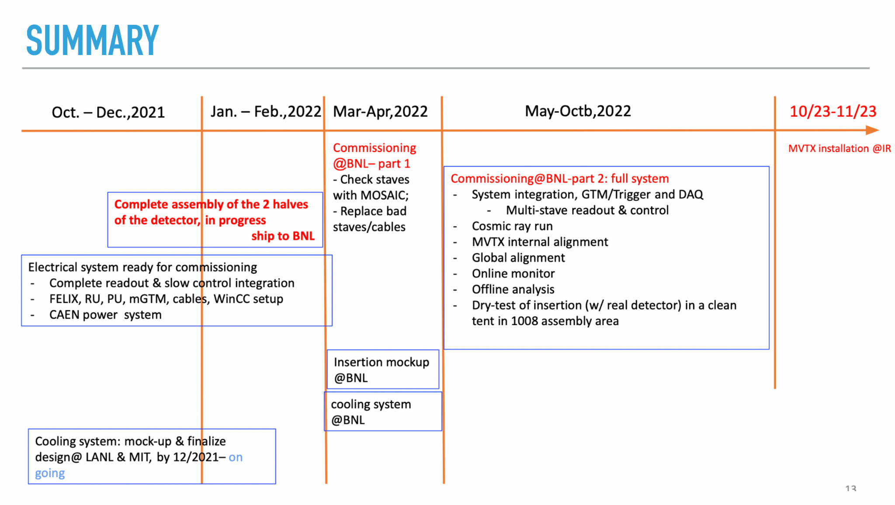
Remaining Key Tasks and Schedules
Schedule presented 1/6/2022
sPHENIX collaboration meeting
(Possible delay ~1 month?)
Plan to set up a BIG clean tent in the sPHENIX assembly area in May:
for the full insertion mockup
Full half-detector commissioning
Today; delay in half-detector assembly … by ~1 month?
Still on track for installation

