Slide 1
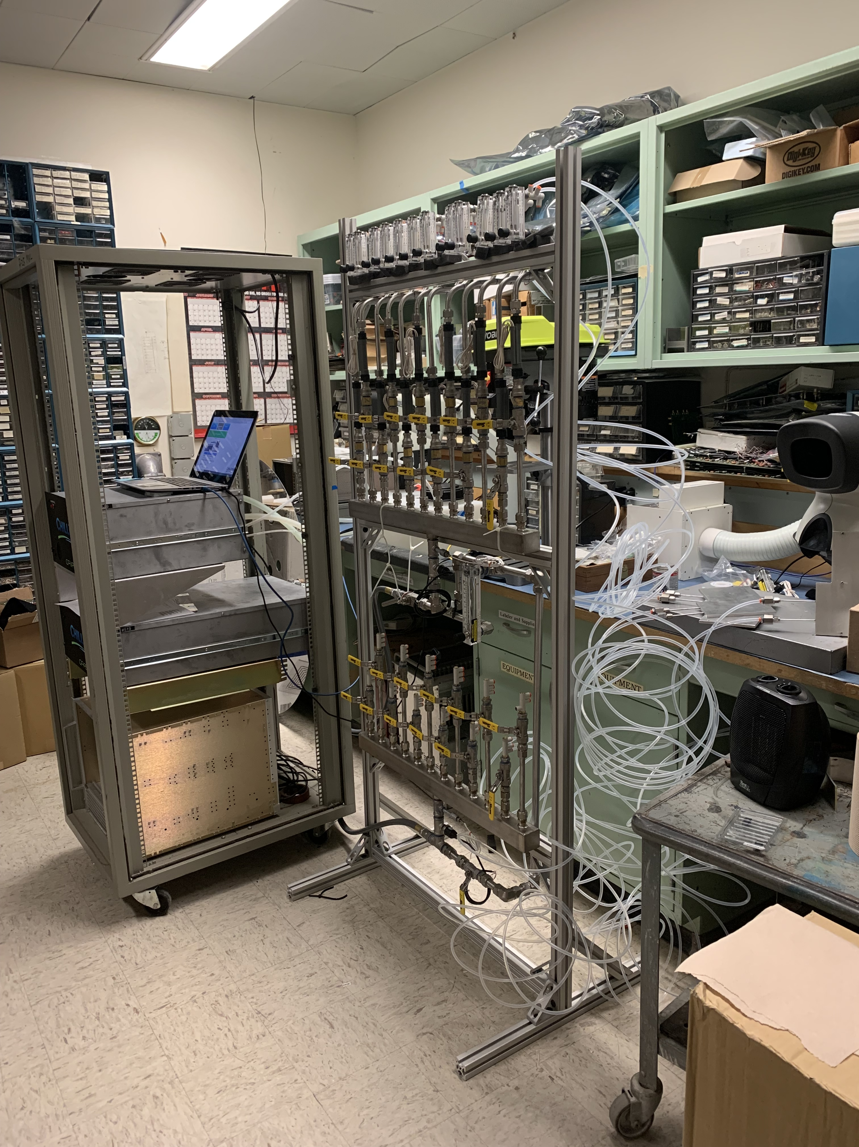
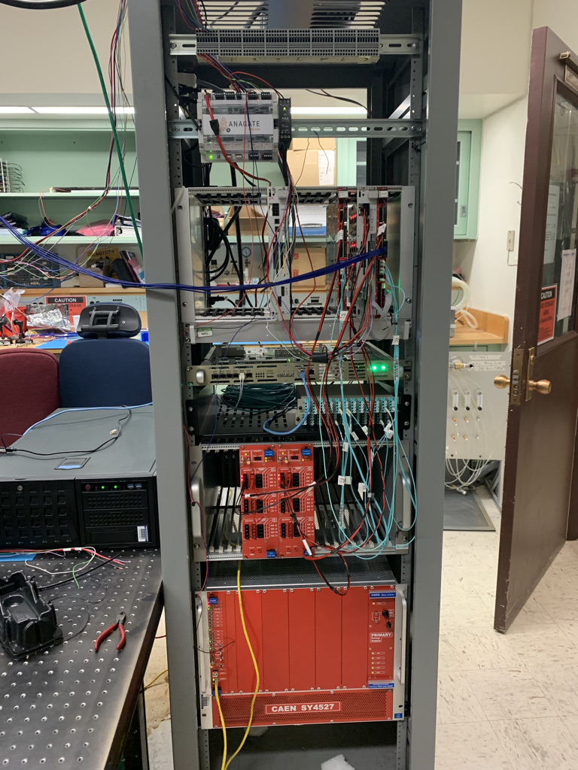
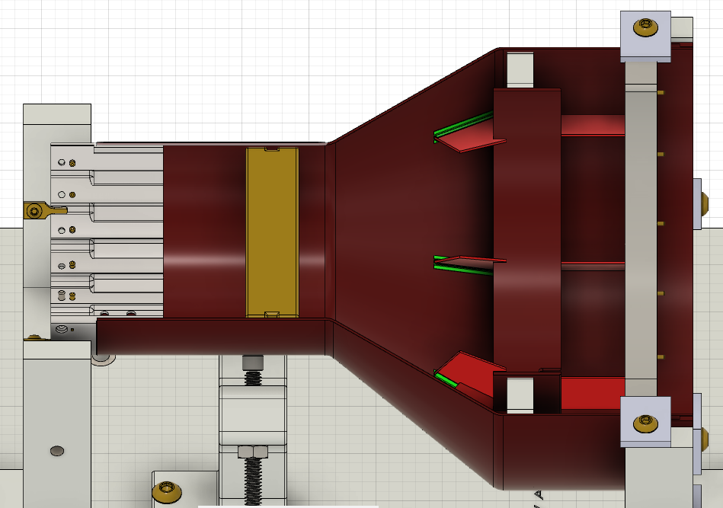
MVTX Status, 02/15/2022
Readout and electrical control system
  Implemented new data format for continuous readout;
  Implemented full 8-DMA readout for FELIX
  Detector safety monitoring and slow control system designed, PLC procurement in progress, some delays in electronics, ETA, Feb. 26 2022
  All inside-detector signal and power cables produced and tested for half-detector assembly, long cables will be delivered in March 2022
Mechanical system
  Carbon Fiber composite structures produced and CMM’ed;
  Assembly jigs fabricated and procedures practiced
  Improving out-of-tolerance Al South End-Wheels for final assembly at LBNL, possible delay to complete 2 half-detectors by ~a few weeks (TBD); still on track for on-time installation
Services
  Cooling system designed and reviewed, system testing at LANL and MIT
  Power system, service cable layout plan developed and reviewed
MVTX detector insertion system prototyped and reviewed
  Final design improvement in progress
Detector commissioning plan developed:
  Phase-I commissioning plan developed to QA half-detectors at BNL after delivery from LBNL, MVTX experts are working at BNL to setup clean tent for the testing
  Phase-II full detector pre-installation commissioning: preliminary plan developed, including full scale detector insertion mockup
Full readout and control integration
-Staves
-RUs
-FELIX/AMD
-mGTM
-CAEN power
MVTX cooling system test:
Chiller
Patch panel
Cooling plates
MVTX commissioning phases #1, #2
South-EW and CFC
CMM surveyed at LBNL
Improving South End-Wheel and CFC structure glue bonding:
- work in progress

Slide 2
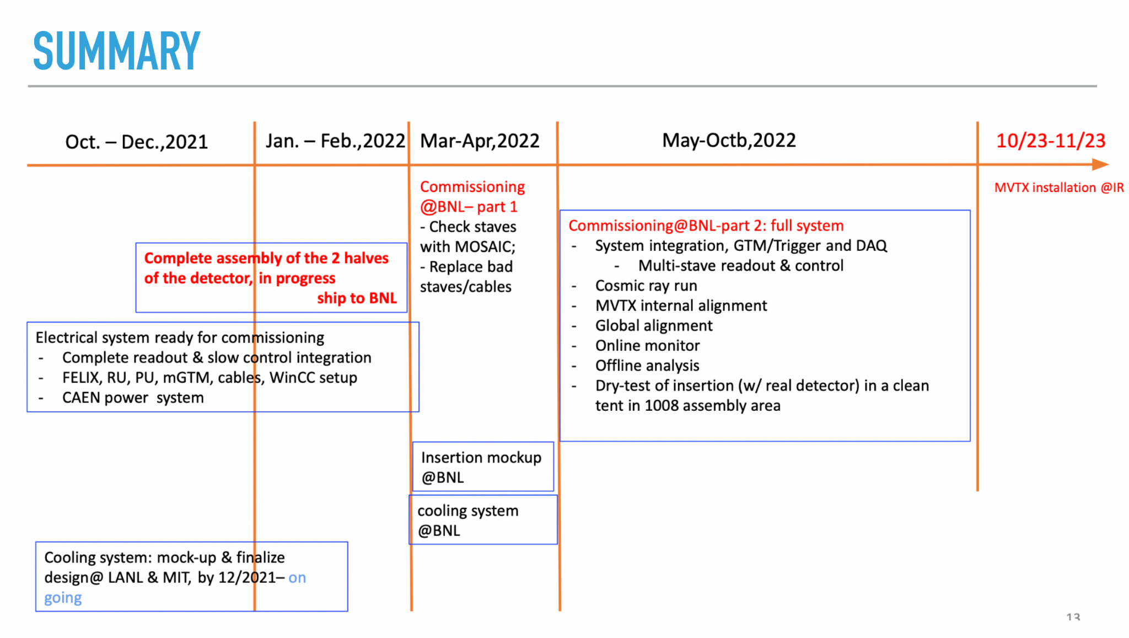
Remaining Key Tasks and Schedules
Schedule presented 1/6/2022
sPHENIX collaboration meeting
(Possible delay ~1 month?)
Plan to set up a BIG clean tent in the sPHENIX assembly area in May:
for the full insertion mockup
Full half-detector commissioning
Today; delay in half-detector assembly … by ~1 month?

Slide 3
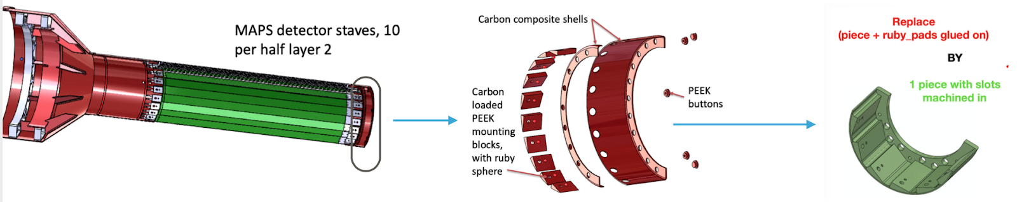
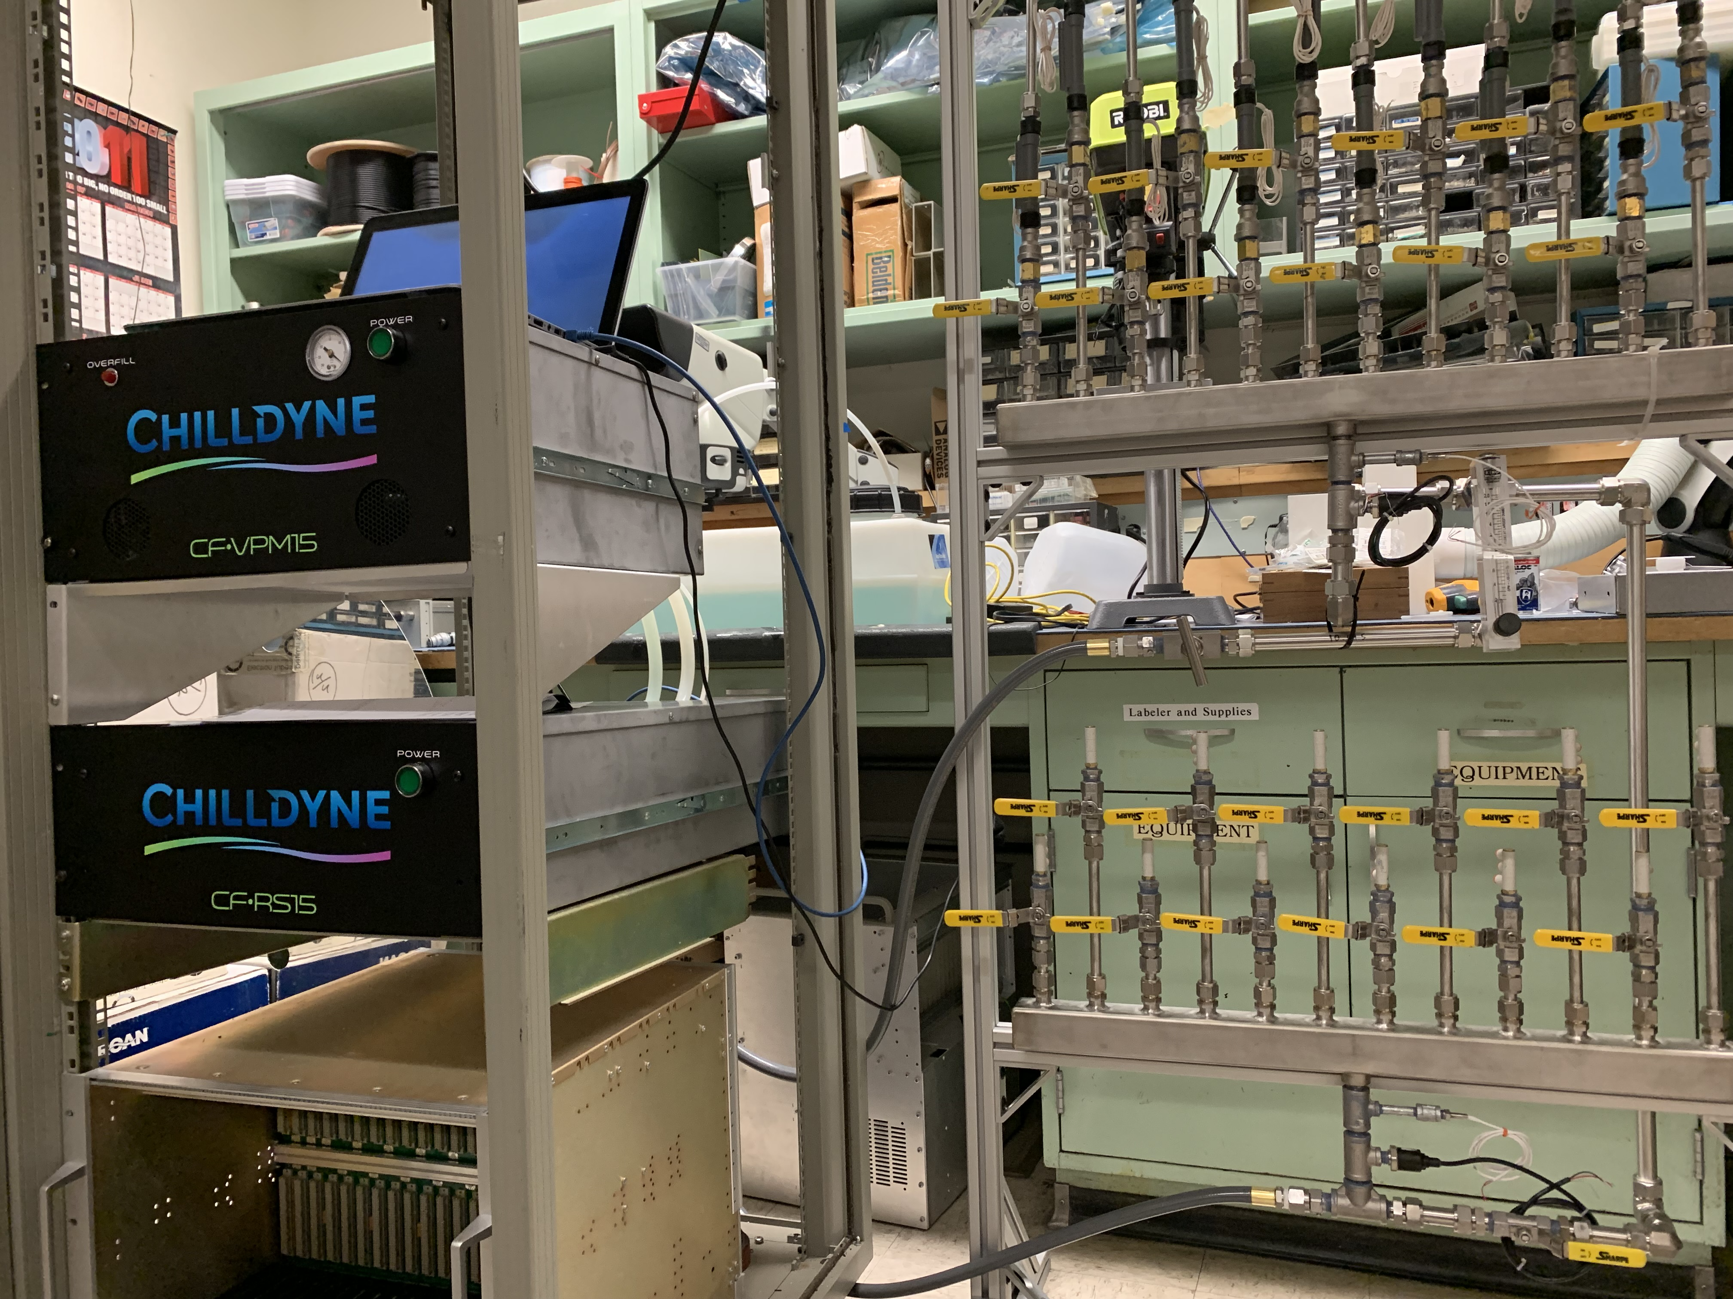
Work in Progress and Concerns
South EW
Half-detector assembly at LBNL: schedule?
  South End-Wheels work
  active discussions last week
Readout and control integration: ~by Feb. 2022
  Preliminary new data format in RCDAQ
  Setup a full chain 8-stave/RU/PU + CAEN + FELIX + mGTM, in progress
Finish cooling system design by ~ mid Feb
  Cooling system discussed with BNL, 2/10
  Electronics cooling system setup at LANL
Detector QC, calibration, alignment etc.
  Online QC software development w/ new data format
Cooling system test @LANL
Chiller + Patch panel
30 cooling plates
One dummy stave

Slide 4
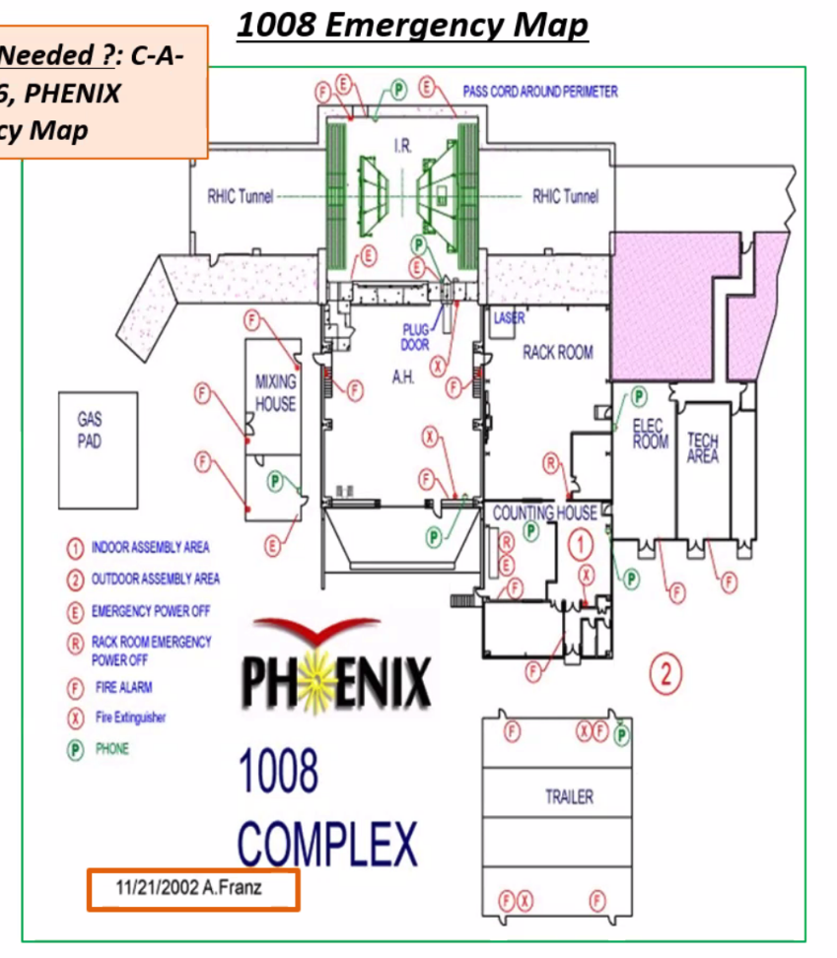
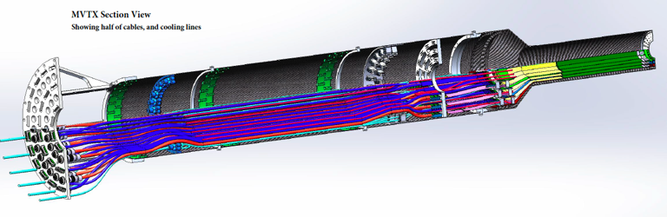
Pre-installation @ 1008: Jan. – OCT., 2022
Clean tent at 1008: Jan – May, 2022
- Half-detector QC @#1
MOSAIC test stand for stave QA
  PU+MOSAIC reside in a VME Crate
  2 test stands
QA two half-detectors
  Single stave QA, one-by-one, 48 total
  48 SamTec readout cables
  48 DVDD cables
  48 AVDD cables
  48 “HV” bias cables
  48 PT100 T-readback
QA time: 4hrs/stave
  Two MOSAIC systems available, ~24 days
#2 plan: May – Oct.
full detector commissioning
plan under discussions
#1
#2
MVTX Detector
MOSAIC
Test Stand

Slide 5
BNL Commissioning Travel Plan Approved
“The ROOP request for your MVTX Team has been approved for onsite access beginning February 14, 2022.
Each must contact the Clinic at OMC@bnl.gov to set up an appointment to validate their vaccines.
This can be virtually. Further details regarding training will follow.”
Jan-Feb:
  Setup clean tent, power and cooling system
  Setup MOSAIC test bench
  Setup 6 FELIX servers
Mar-Apr:
  Half-detector stave QC
  Possible rework of half-detector
May-Sep:
  Full commissioning
BNL travel google docs:
Travel plan: https://docs.google.com/spreadsheets/d/1rPCD_5E5Mi8oLz5d0K1_onjZi4BaeHwL1x390UaNgp8/edit?usp=sharing
BNL travel approval paperwork:
https://docs.google.com/document/d/1seXXCxdGgXm_XD-v2Z6m9TLz6j6dXUMbyUZv1gCNluY/edit?usp=sharing
- 11 people approved!
additional request for 12 submitted
Jim, Joe, Ho-San, Grazyna
Nacer*, Jason, Hugo, Walt,
Eric, Danielle*, Nicolas, Hubert
Need BNL guest appointments

