Slide 1
MVTX Status and Plan
Camelia, Grazyna, Jo and Ming
MVTX bi-weekly generalmeeting
1/31/2022
https://indico.bnl.gov/event/14637/

Slide 2
Remaining Key Tasks and Schedules
Presented 1/6/2022
sPHENIX collaboration meeting
Plan to set up a BIG clean tent in the sPHENIX assembly area in May:
for the full insertion mockup
Full half-detector commissioning
Today

Slide 3
Work in Progress and Concerns
Half-detector assembly at LBNL: schedule?
Assembly jig improvement
EW pins in hand; Last 2 clamps fabricated, MIT->LBNL soon;
Short cables produced, but not tested yet
Short 1.6m SamTec cables shipped to ORNL for testing; Long ones EAT ~ mid Feb. (PP3 -> Rack)
Power cables assembled at LBNL
Readout and control integration: ~by Feb. 2022
Preliminary new data format in RCDAQ (one channel)
Online QC software development in progress
Setup a full chain 8-stave/RU/PU + CAEN + FELIX + mGTM
Received 8 Silver staves, 4PUs from LBNL
Finish cooling system test by ~ mid Feb
Air bubbles
Offline calibration and alignment
Dead/hot pixels, noise/threshold
Geometry and alignment
FY22 Budget – meeting w/ Ed, Jan. 21
MIT, paperwork in progress
LANL, requests 0.1 FTE support for Walt
ORNL, additional travel budget to BNL; M&S done through BNL?
LBNL, may request additional $$ later

Slide 4
BNL Commissioning Travel Plan Approved
“The ROOP request for your MVTX Team has been approved for onsite access beginning February 14, 2022.
Each must contact the Clinic at OMC@bnl.gov to set up an appointment to validate their vaccines.
This can be virtually. Further details regarding training will follow.”
Jan-Feb:
Setup clean tent, power and cooling system
Setup MOSAIC test bench
Setup 6 FELIX servers
Mar-Apr:
Half-detector stave QC
Possible rework of half-detector
May-Sep:
Full commissioning
BNL travel google docs:
Travel plan: https://docs.google.com/spreadsheets/d/1rPCD_5E5Mi8oLz5d0K1_onjZi4BaeHwL1x390UaNgp8/edit?usp=sharing
BNL travel approval paperwork:
https://docs.google.com/document/d/1seXXCxdGgXm_XD-v2Z6m9TLz6j6dXUMbyUZv1gCNluY/edit?usp=sharing
- 11 people approved!
Jim, Joe D., Grazyna next
Anyone else?

Slide 5
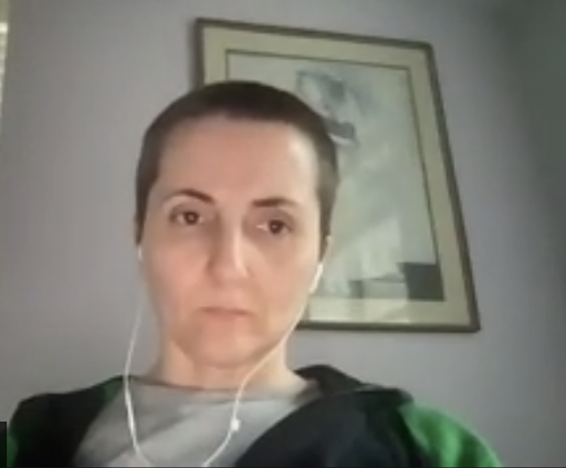
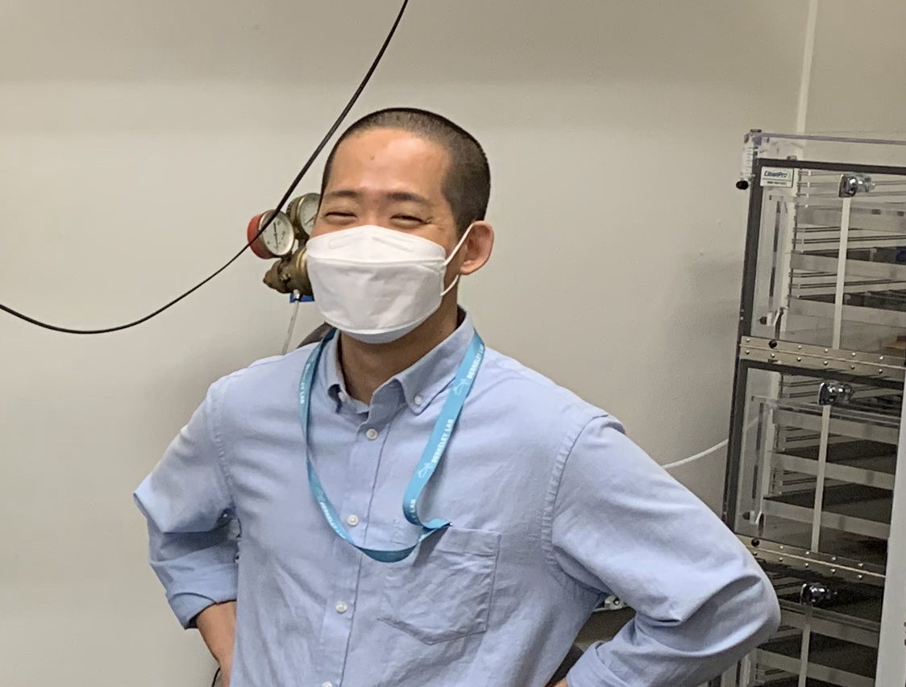
Thank you Camelia and Hanseul!
Jim, Cameron will organize/follow up MIT/Bates efforts
- Camelia will continue helping us from remote for next a few months

