Slide 1
MVTX(INTT) Readout and Event Alignment
Yasser, Jo and Ming
sPHENIX HF TGM
Feb. 2, 2022

Slide 2
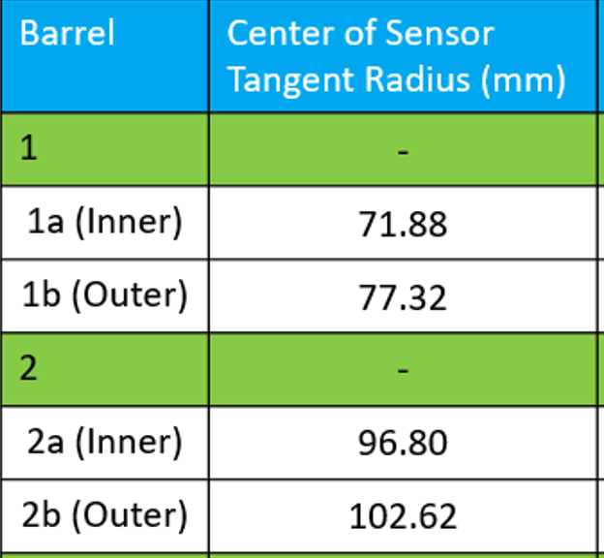
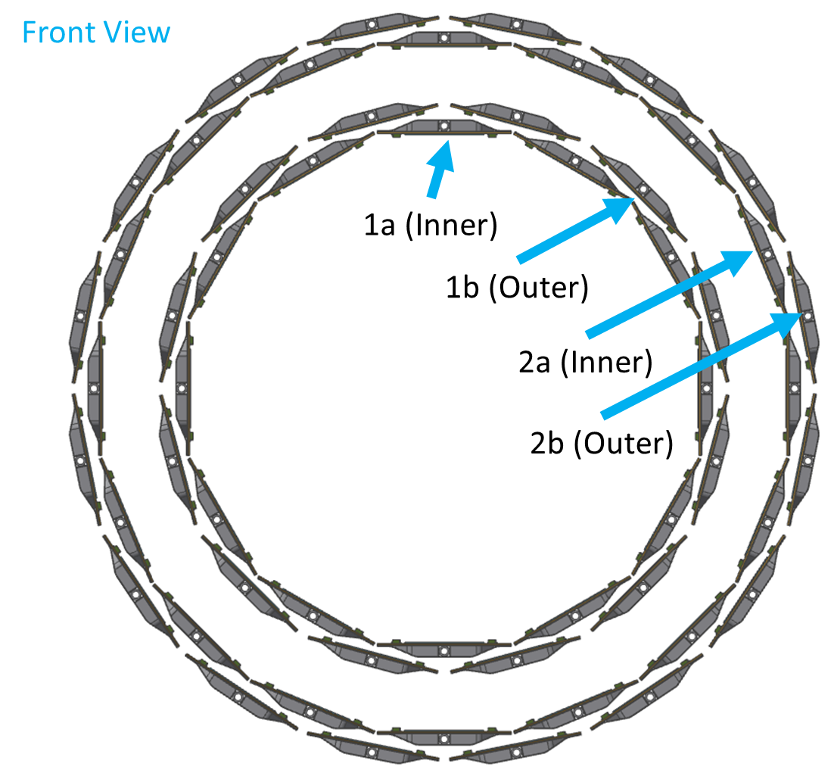
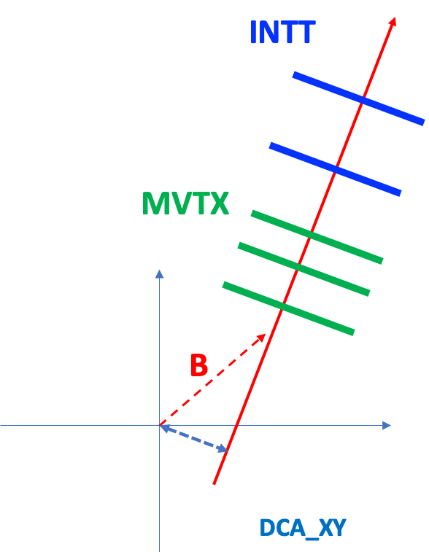
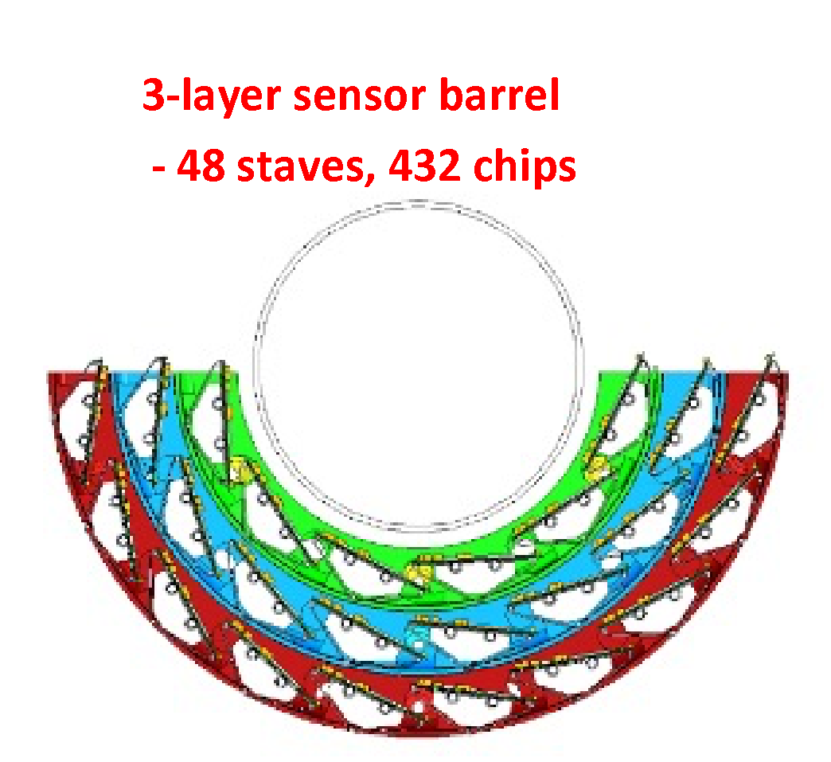
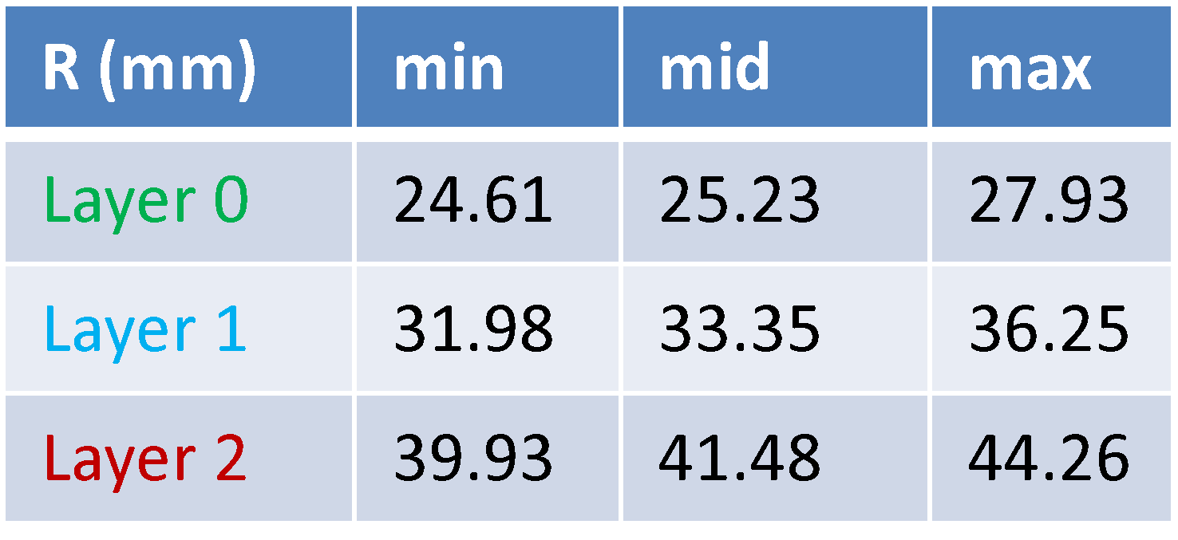
MVTX + INTT: 3 + 2 layers
INTT
Silicon Strips:
78um x 16mm (A)/20mm (B)
R=9.8cm
7.4cm
4.1cm
MVTX
Silicon pixels:
27um x 29um
R=2.5cm

Slide 3
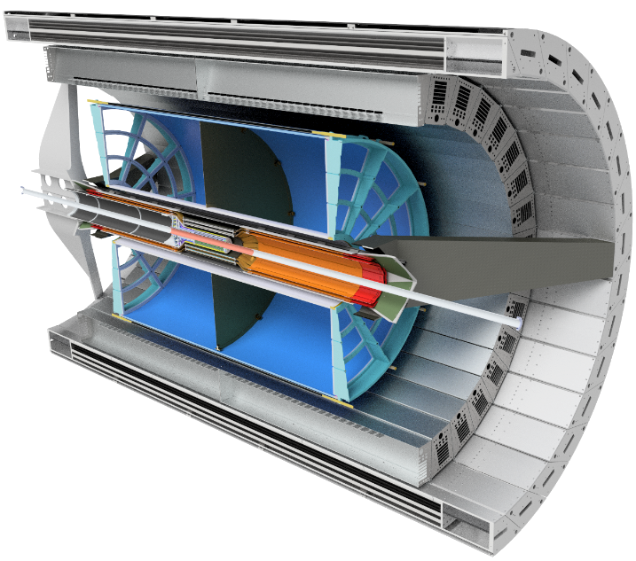
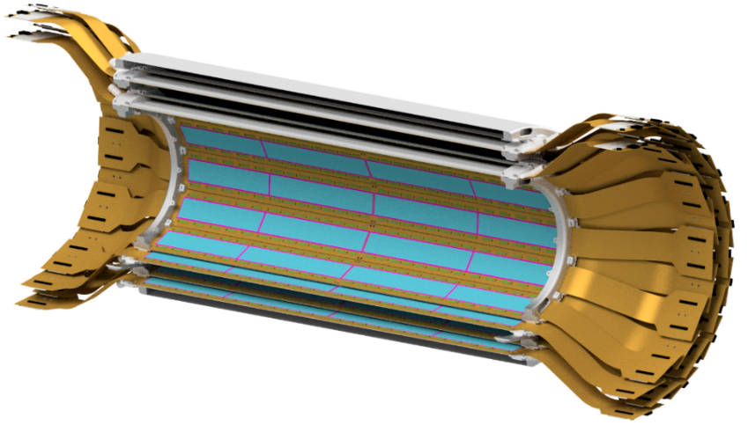
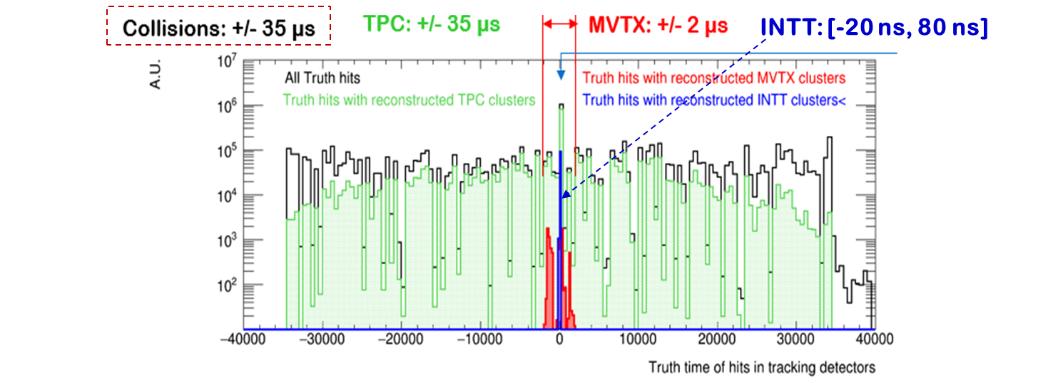
INTT: 1 RF timing resolution
Strip sensor: AC-coupled silicon sensor
FPHX: used successfully in FVTX/PHENIX tracker:
MVTX: ~5uS event timing resolution
iHCAL
EMCAL
MVTX
TPC
INTT: Two Silicon Strip Barrels

Slide 4
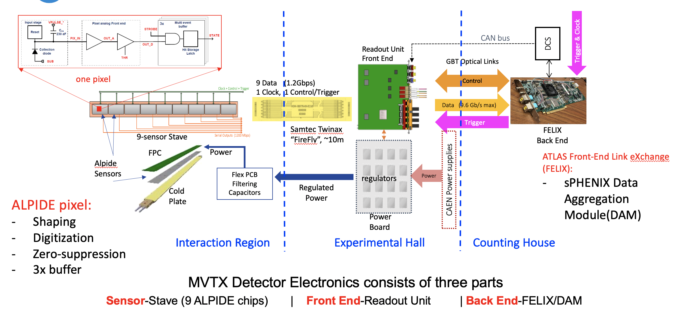
MVTX Readout, Power and Controls
MVTX hits arrival @FELIX
(rising+strobe) uS after collisions
(dep. readout config.)

Slide 5
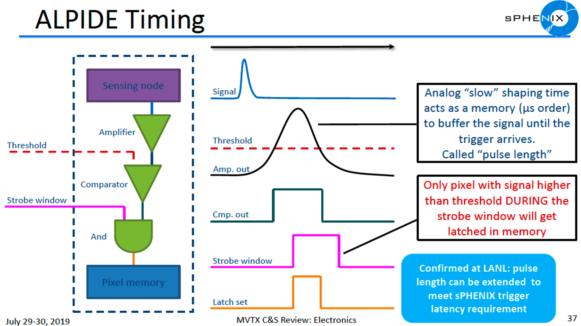
~10ns
Rising 1~2us
Width ~5us
~Readout
starts
~5us

Slide 6
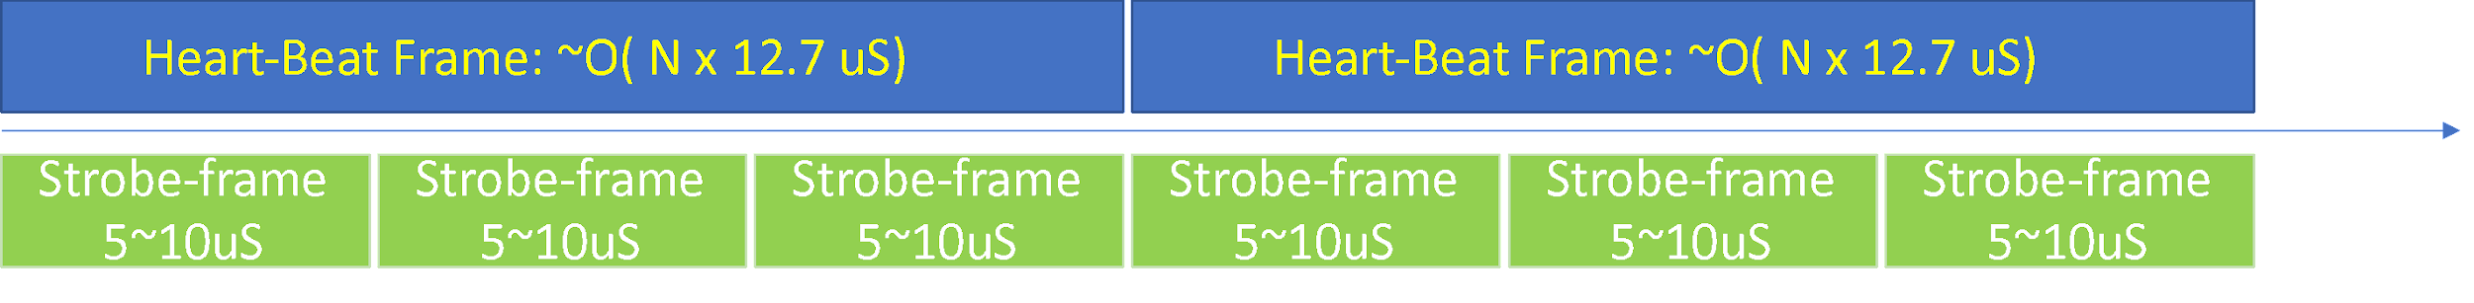
MVTX Readout – Continuous Readout
Time frames: all programmable
Fixed Heart Beat Frame (HBF): 10~100 uS,
  Readout FELIX data to disk
  Could be N x 12.7 uS (one RHIC cycle)
Fixed strobe frame (SF): ~5 uS
  Readout ALPIDE data to RU
  The smallest timestamp
MVTX data package:
~ strobe-frame, could be as short at ~2uS
shorter strobe-> duplicated hits/larger data volume
ALPIDE
RU
FELIX
Disk
time
……. INTT packet (1 RF CLK)

Slide 7
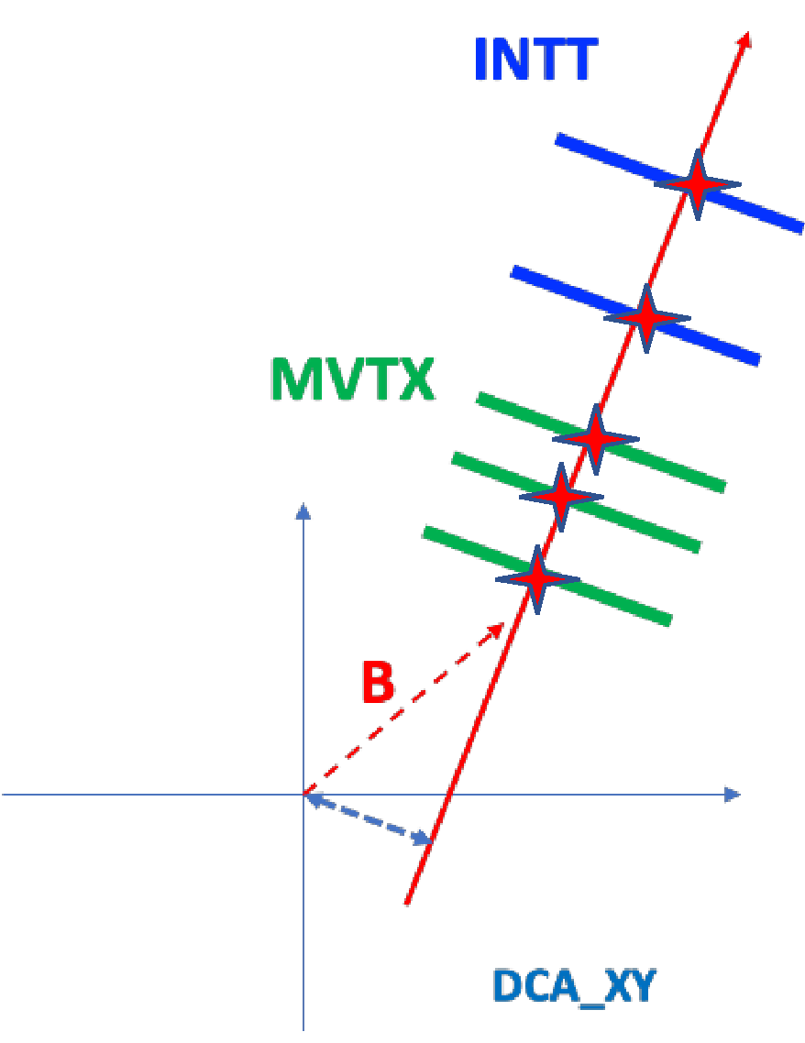
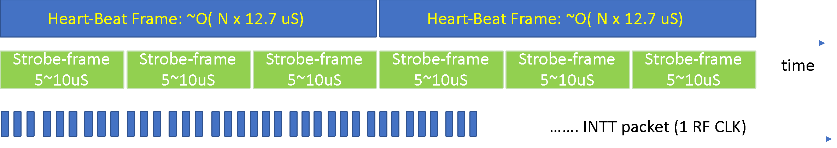
MVTX + INTT Event Alignment
INTT 1-RF packet 🡺 select MVTX hits (tracking fitting)
To form (MVTX_Hits + INTT_Hits) events
sPHENIX global RF timing (RF counters) used to sync MVTX and INTT packets
MVTX: @beginning of strobe signal
INTT: @ a given RF CLK
RHIC cycle: 120 RF budgets: 12.7 uS

Slide 8
Backup

Slide 9
MVTX Hits vs Strobe Length (ITS Sim)

Slide 10
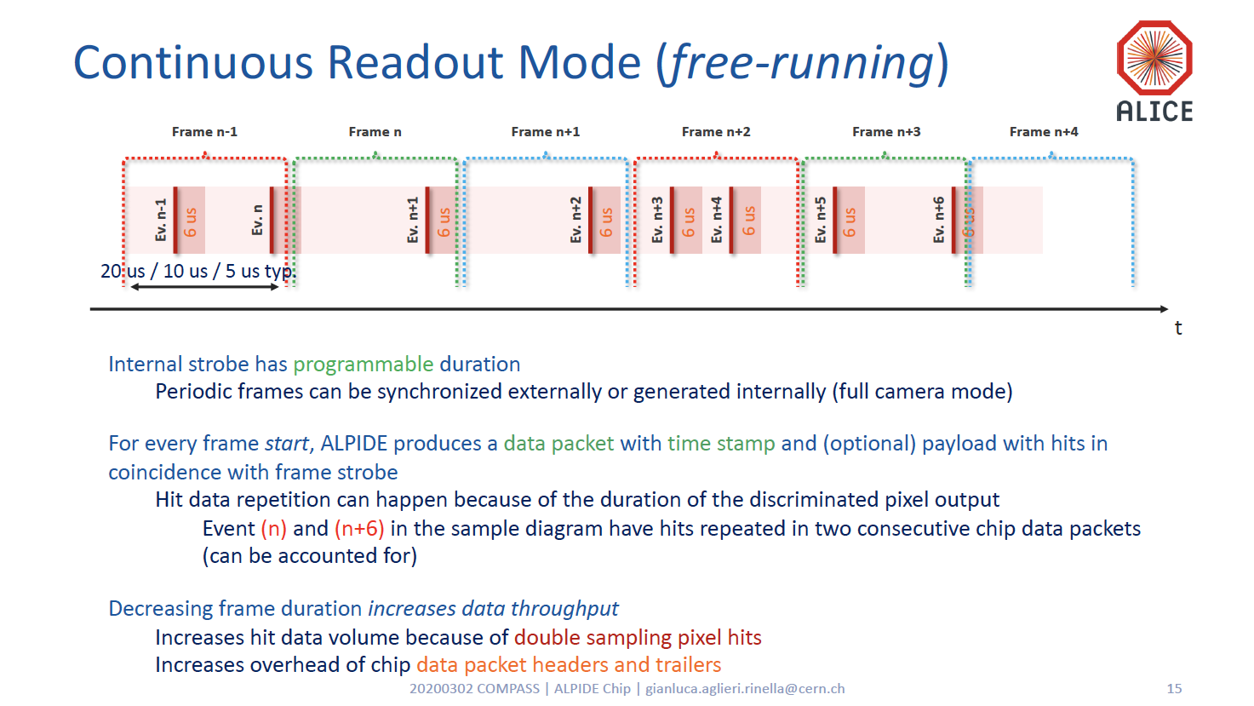
Strobe-Frame

Slide 11
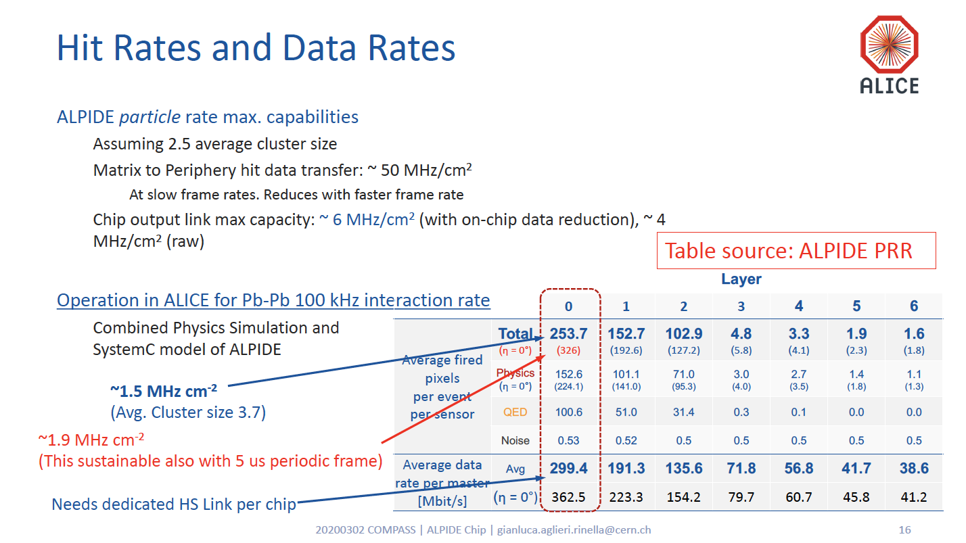

Slide 12
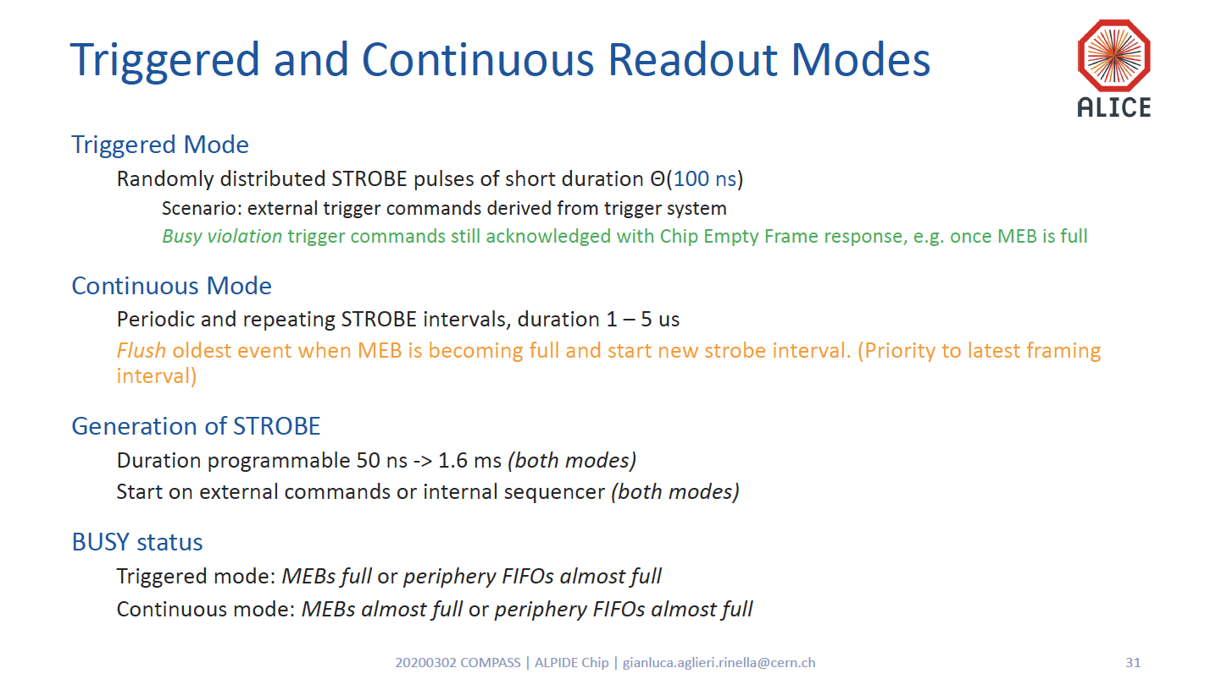

Slide 13
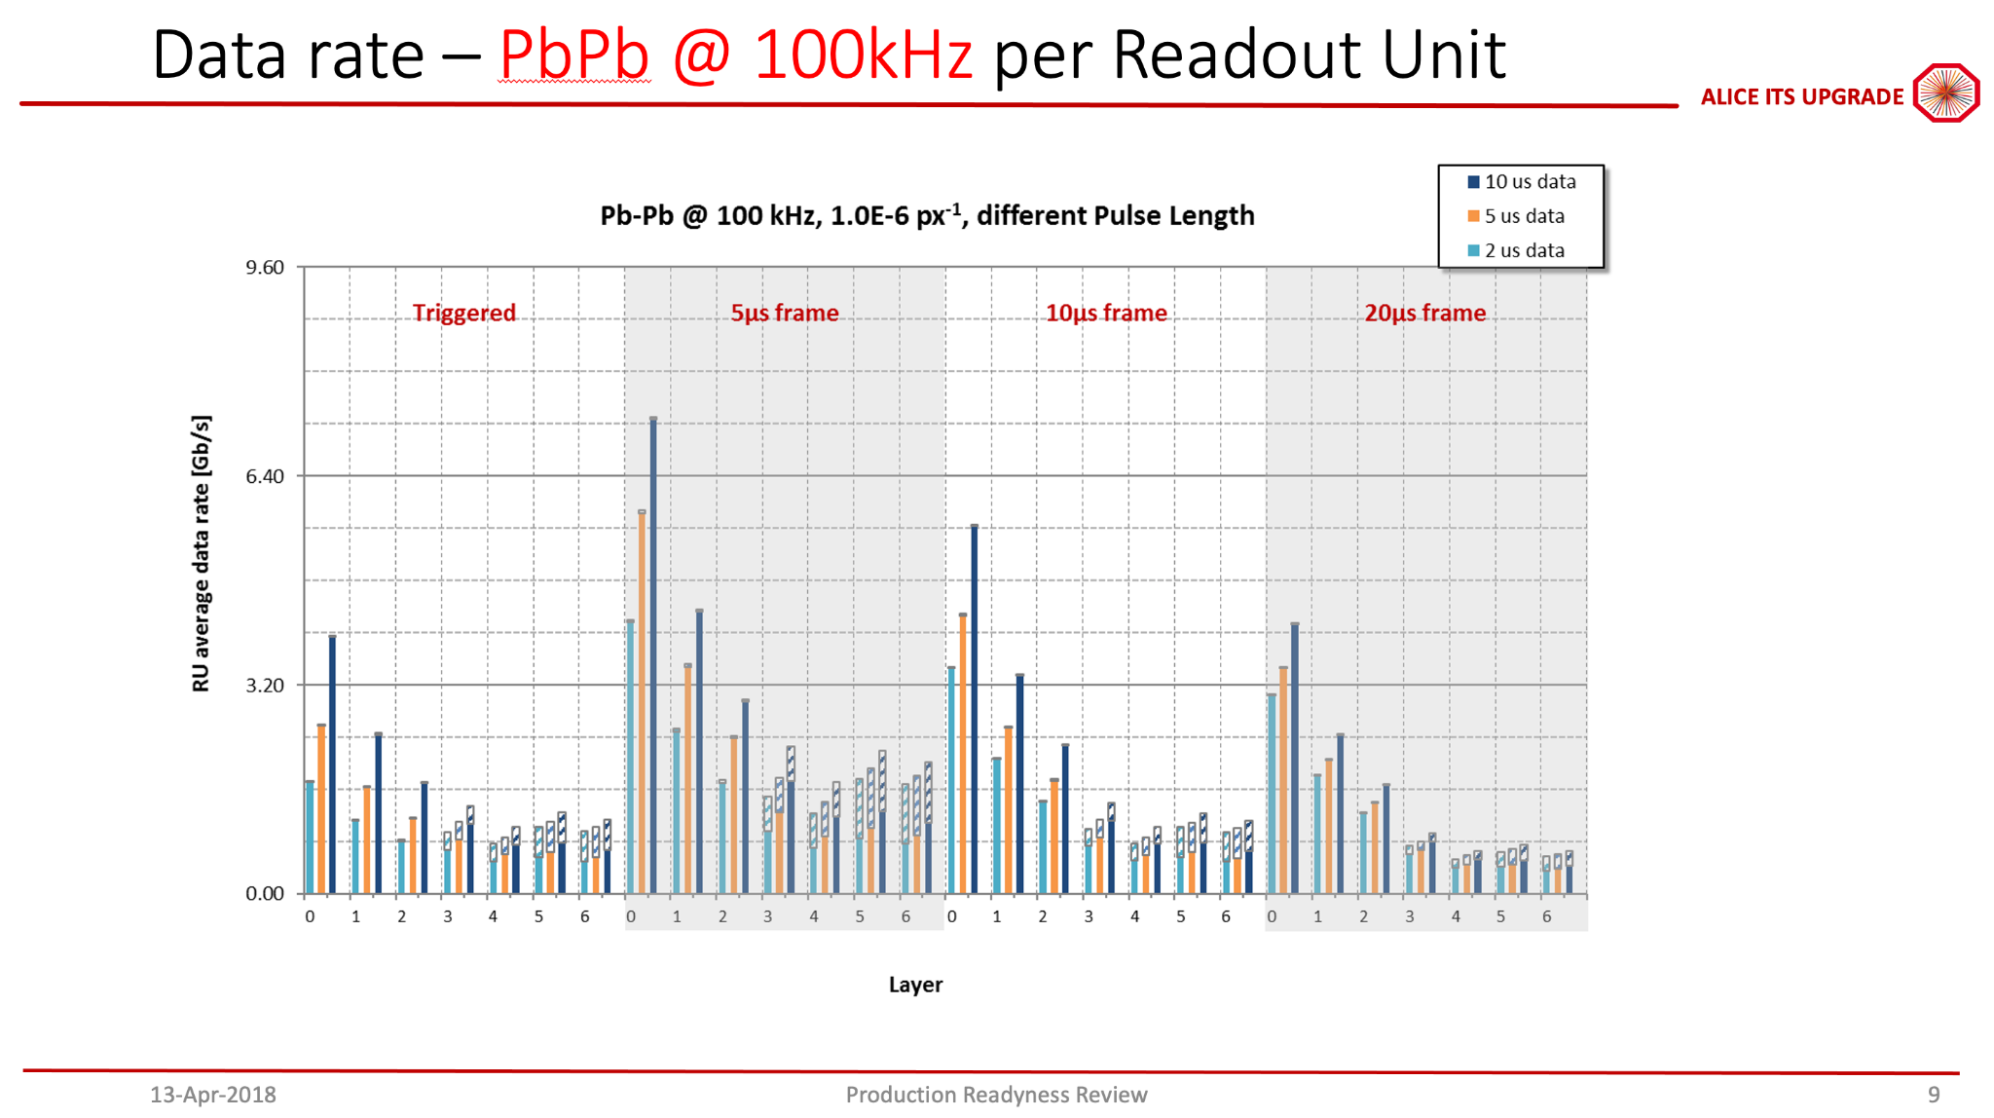

Slide 14
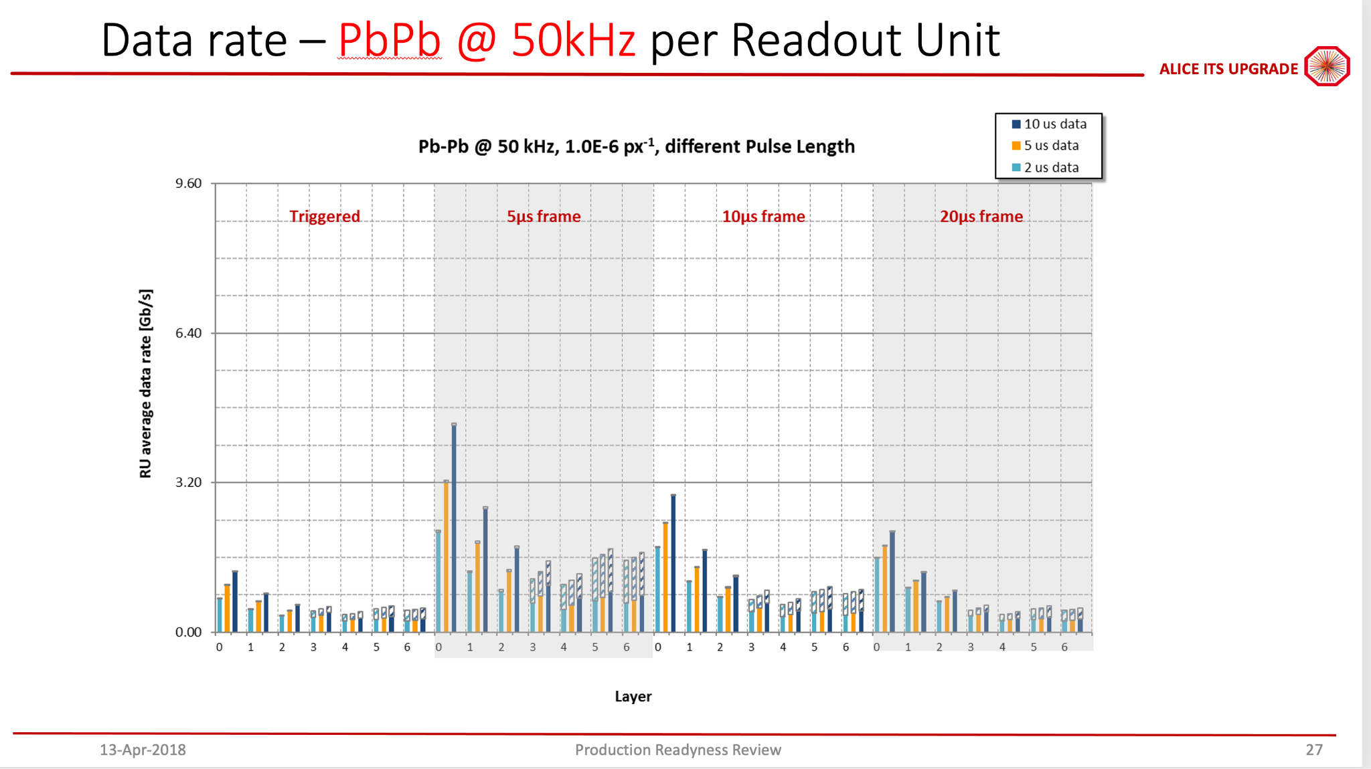

Slide 15
FPHX Chip (Analog Section)
Tracking System: MVTX+INTT+TPC
T-peak ~ 60 ns (programmable)
128 channel
46, 50, 60, 67, 85, 100, 150, or 200 mV/fC
60 ns peak time (rt- pgmbl)
3—bit ADC (th-pgmbl)
Optimized to 1 to 2.5 pf input
115e + 134e/pf
~ 70 to 140 μW/ch (dep. gain)
Program gain and Vref
Disc outputs
3-bit ADC
Vref
+
Shaper
Integrator
_
Comp
Input
Vth0
Comp
At max. input transistor bias of 38uA: 115e + 134e/pF
Silicon strip + readout line capacitance ~ 6pF
Predicted noise ~ 115e + 134e/pF * 6pF ~ 1,000e
Signal ~ 20,000e
Expected S/N ~ 20/1
Vth1
Comp
Programmable Thresholds
Vth7

Slide 16
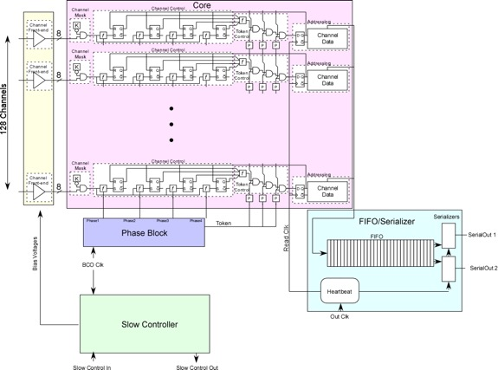
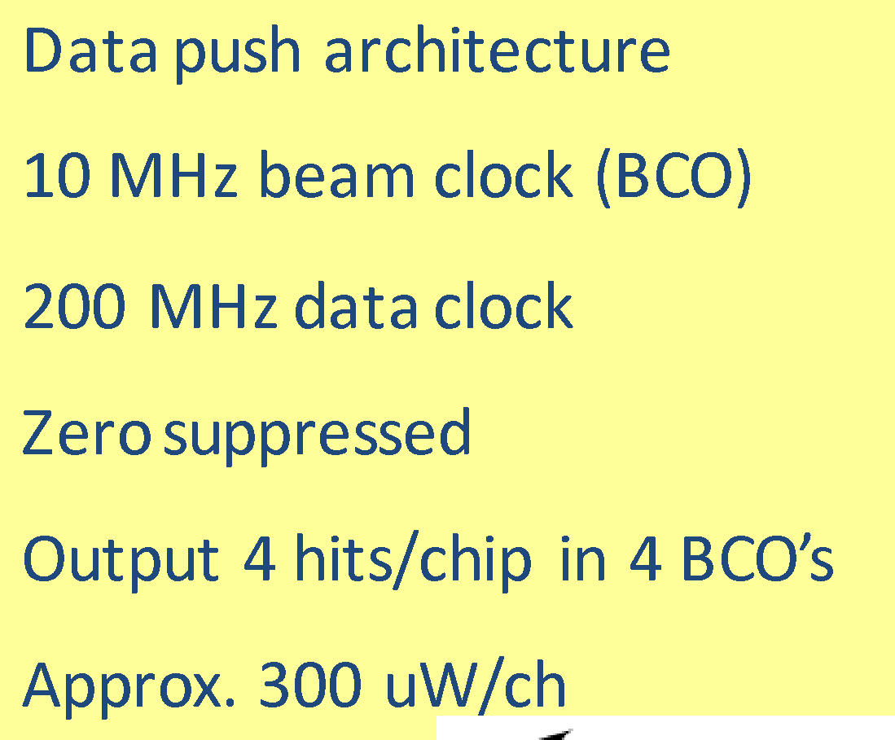

FPHX Chip (Digital Section)
Analog
Tracking System: MVTX+INTT+TPC
Data Processing
Data Output
20 bit Serial data word structure

