Slide 1
MVTX Status and Plan
Camelia, Jim, Grazyna, Jo and Ming
MVTX Project bi-weekly meeting
2/07/2022
https://indico.bnl.gov/event/14752/

Slide 2
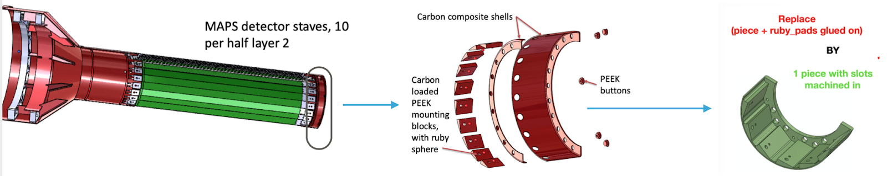
Work in Progress and Concerns
Half-detector assembly at LBNL: schedule?
  Assembly jig improvement
    EW/CFC assembly issues, Al SEW spring back ~100um (<40um required)
  Short cables produced, test in progress
    Short 1.6m SamTec cables test in progress @ORNL, 2~3 weeks?
    Power cables assembled at LBNL
Readout and control integration: ~by Feb. 2022
  Preliminary new data format in RCDAQ (one channel)
    Online QC software development in progress
  Setup a full chain 8-stave/RU/PU + CAEN + FELIX + mGTM
Finish cooling system design by ~ mid Feb
  3 cooling panel discussion with BNL this morning ,
Offline calibration and alignment
  Dead/hot pixels, noise/threshold, alignment
  Discussion with Xin/LBNL last week, to work on MVTX calibration and internal alignment
FY22 Budget – meeting w/ Ed, Jan. 21
  MIT, paperwork in progress
  LANL, requests 0.1 FTE support for Walt
  ORNL, additional travel budget to BNL; M&S done through BNL?
  LBNL, may request additional $$ later
South EW
https://docs.google.com/document/d/1tf7F4kbKHJQK5yRC-_uux4KUMWylDd_OhAgPFdqNXks/edit#
LBNL report: 2/3/2022
https://docs.google.com/presentation/d/19bHrFrtd5A5bDs_U4JckvNtN_kBB315EH8V-WvBNsso/edit?pli=1#slide=id.p1
https://docs.google.com/document/d/1sGXjI7-JWnSVJLXJAE7nzSKvy31i-NvTcDXqpdRdnAU/edit#heading=h.los5dnin6uf8

Slide 3
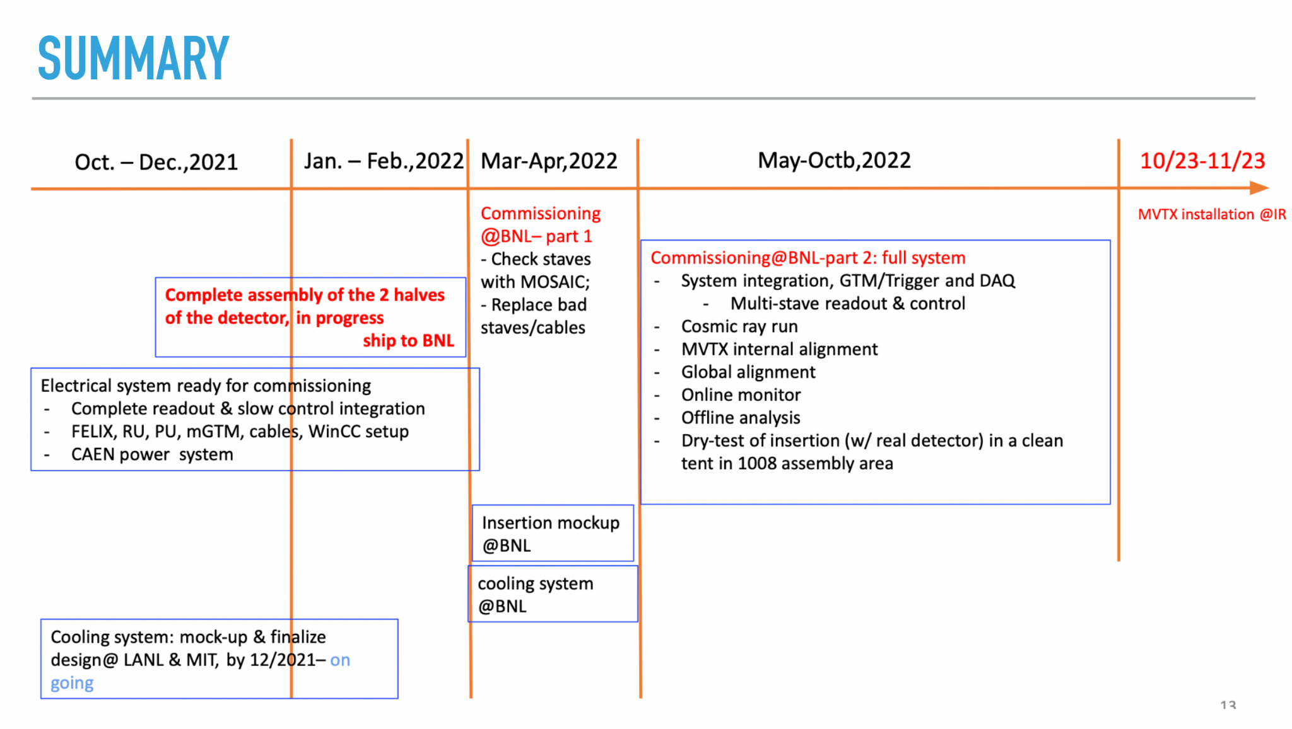
Remaining Key Tasks and Schedules
Presented 1/6/2022
sPHENIX collaboration meeting
Plan to set up a BIG clean tent in the sPHENIX assembly area in May:
for the full insertion mockup
Full half-detector commissioning
Today; some delay in half-detector assembly expected …

Slide 4
BNL Commissioning Travel Plan Approved
“The ROOP request for your MVTX Team has been approved for onsite access beginning February 14, 2022.
Each must contact the Clinic at OMC@bnl.gov to set up an appointment to validate their vaccines.
This can be virtually. Further details regarding training will follow.”
Jan-Feb:
  Setup clean tent, power and cooling system
  Setup MOSAIC test bench
  Setup 6 FELIX servers
Mar-Apr:
  Half-detector stave QC
  Possible rework of half-detector
May-Sep:
  Full commissioning
BNL travel google docs:
Travel plan: https://docs.google.com/spreadsheets/d/1rPCD_5E5Mi8oLz5d0K1_onjZi4BaeHwL1x390UaNgp8/edit?usp=sharing
BNL travel approval paperwork:
https://docs.google.com/document/d/1seXXCxdGgXm_XD-v2Z6m9TLz6j6dXUMbyUZv1gCNluY/edit?usp=sharing
- 11 people approved!
additional request for 12:
Jim, Joe, Ho-San, Grazyna
Nacer, Jason, Hugo, Walt,
Eric, Danielle, Nicolas, Hubert
Anyone else?

Slide 5
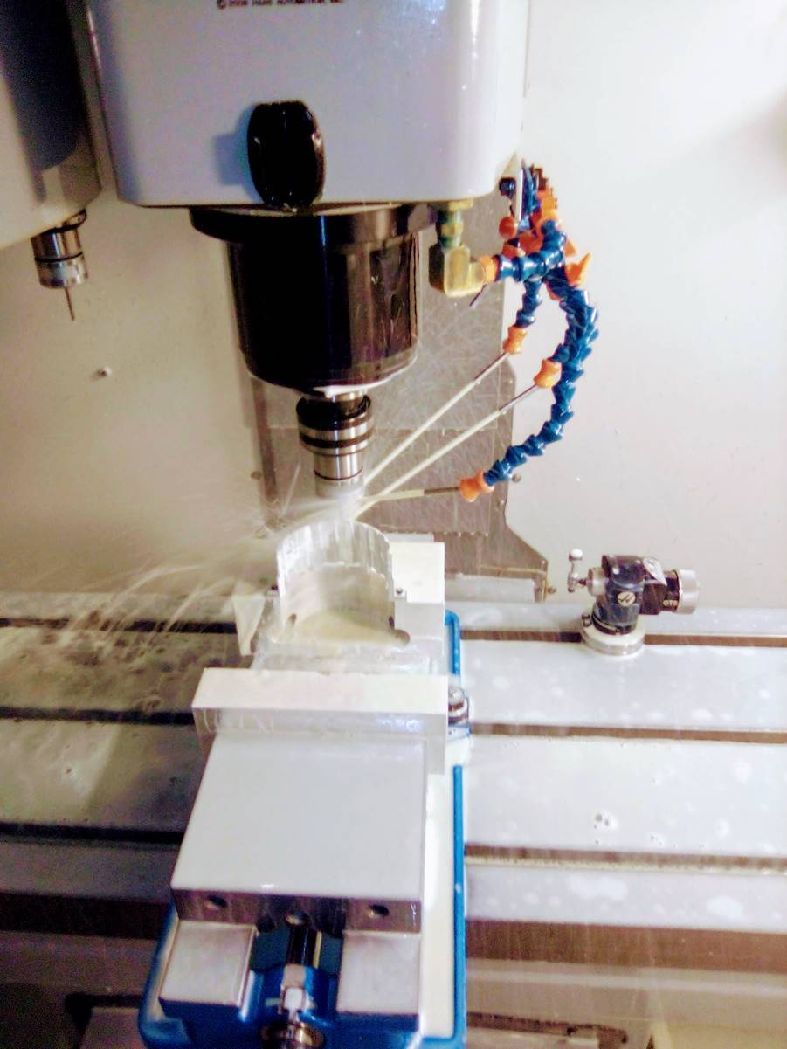
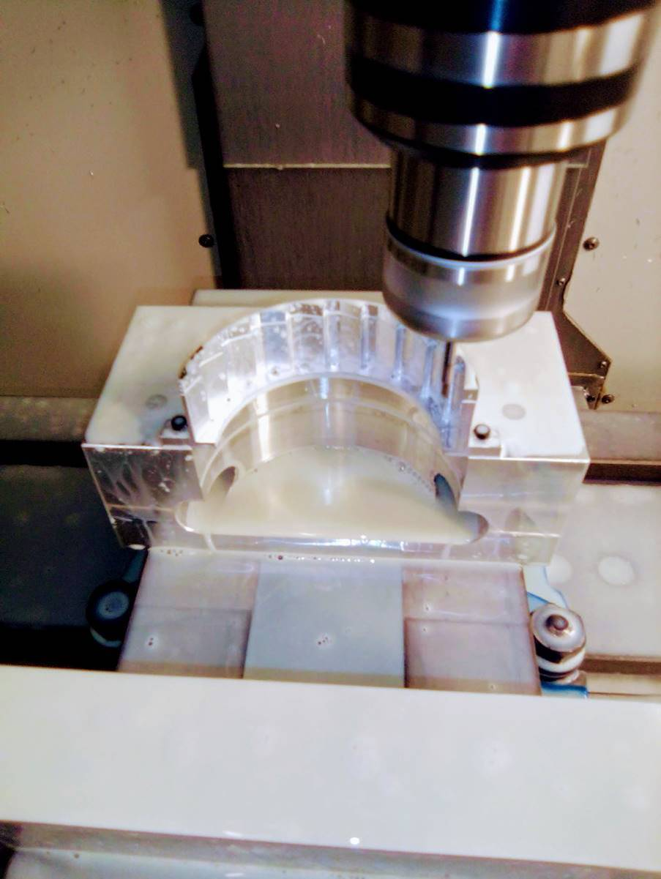
Backup slides – from MIT Machine shop
North EW
South EW

Slide 6
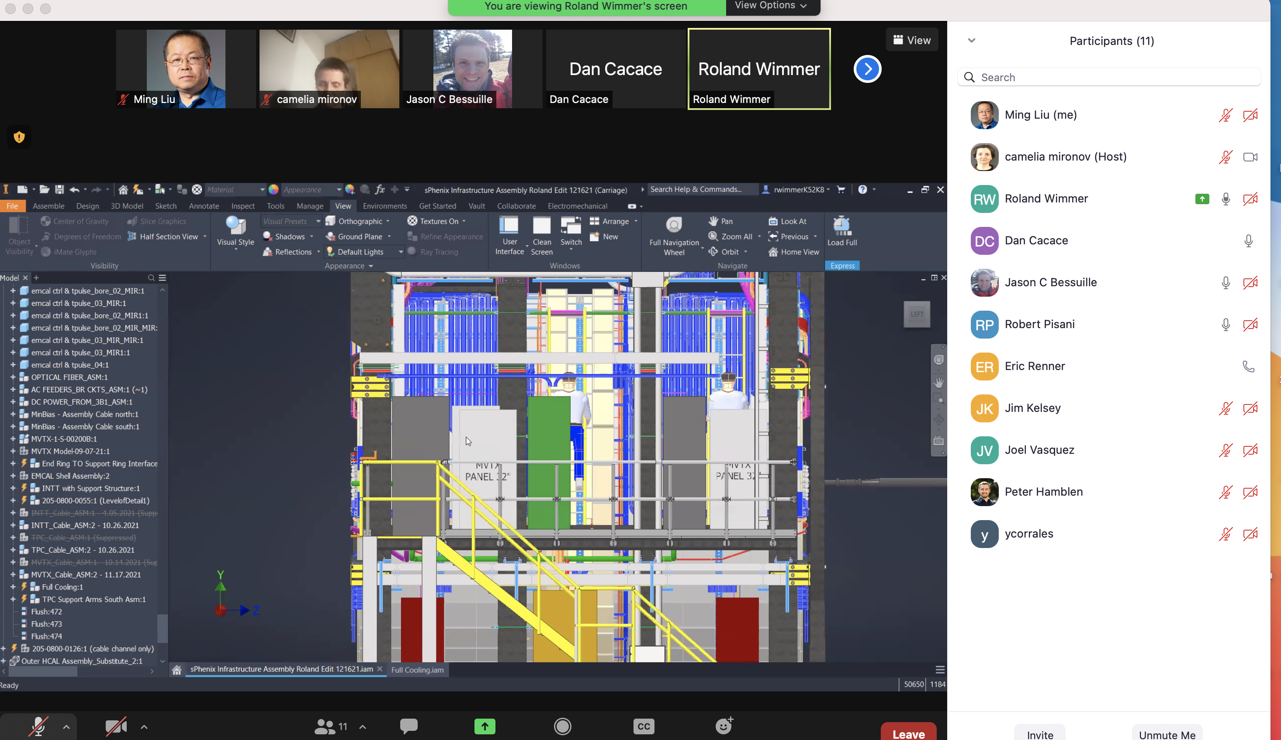
Meeting with BNL – MVTX Cooling Plan, 2/7/2022
Finalize the layout
Design in ~2 weeks
- Detector air cooling

Slide 7
Potential sPHENIX schedule delay:
~ 2 months?
Reported by John H. at commissioning meeting today 2/7/2022
https://indico.bnl.gov/event/14754/
Magnet mapping (by CERN crew) in late August, 2022
It takes 1~3 weeks to finish the mapping
  6 EMCal modules removed/reinstalled

Slide 8
When does this happen?
The detector has to be rolled into the IR
  We have no provision to provide power and cryo to the solenoid anywhere except in the IR
The detector has to have the Inner and Outer HCAL and end doors installed
The upper platform has to be on the detector (to support the valve box and other equipment)
The cryo and power supply connections need to be made, the cryostat pumped down, and the coil cooled to 4K
We need the access platform on top to do all that
The target date is “as soon after roll-in as possible”
  Present expectation is August 2022, but in a state of flux (as it were)
The CERN group is also mapping the MPD solenoid at NICA in Dubna but with a different apparatus

Slide 9
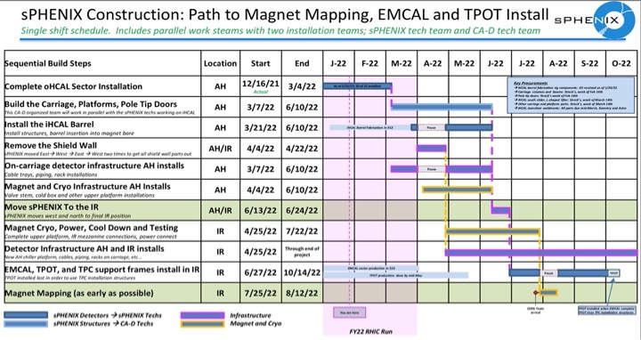
Russ Feder schedule as of 2022-02-04

Slide 10
Mapping details
Mapping granularity
  They typically make a measurement at 5° intervals (72 measurements)
  2 cm grid in z?
The vane settles down in 5-50 sec… up to 110 hours for a complete detailed map
I will probably argue to make a less fine-grained map initially so we can detect any pathologies at the outset
I estimate that the mapping itself will take 1-3 weeks
Access to the IR will be very limited during mapping operations
Survey of the apparatus in place is very important
Field residuals in ATLAS were ~0.5 mT we hope to achieve about the same

