Slide 1
MVTX & INTT Readout Speed
11/09/2021
Fast-ML Bi-Weekly

Slide 2
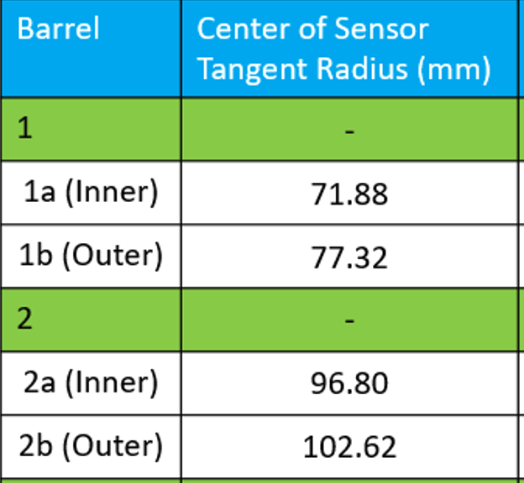
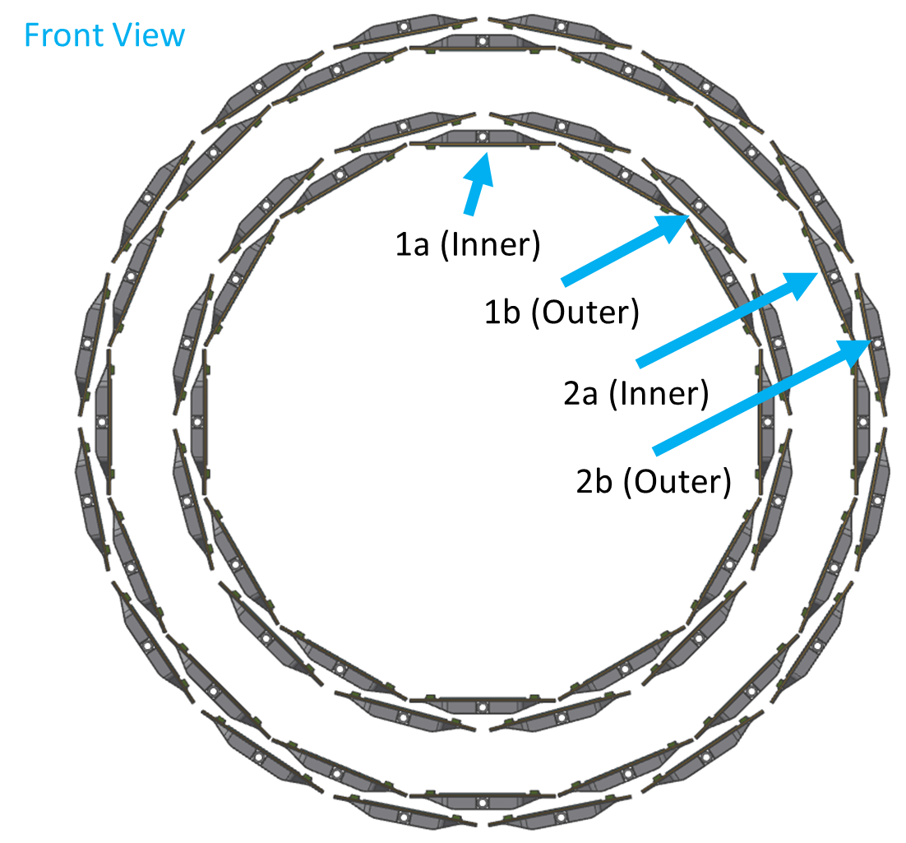
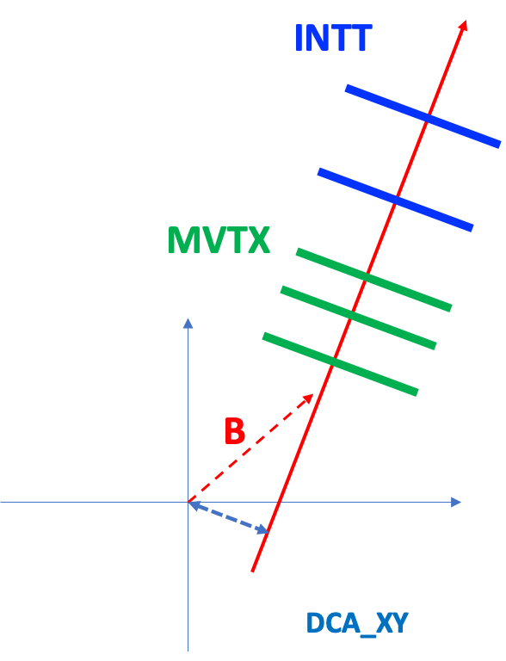
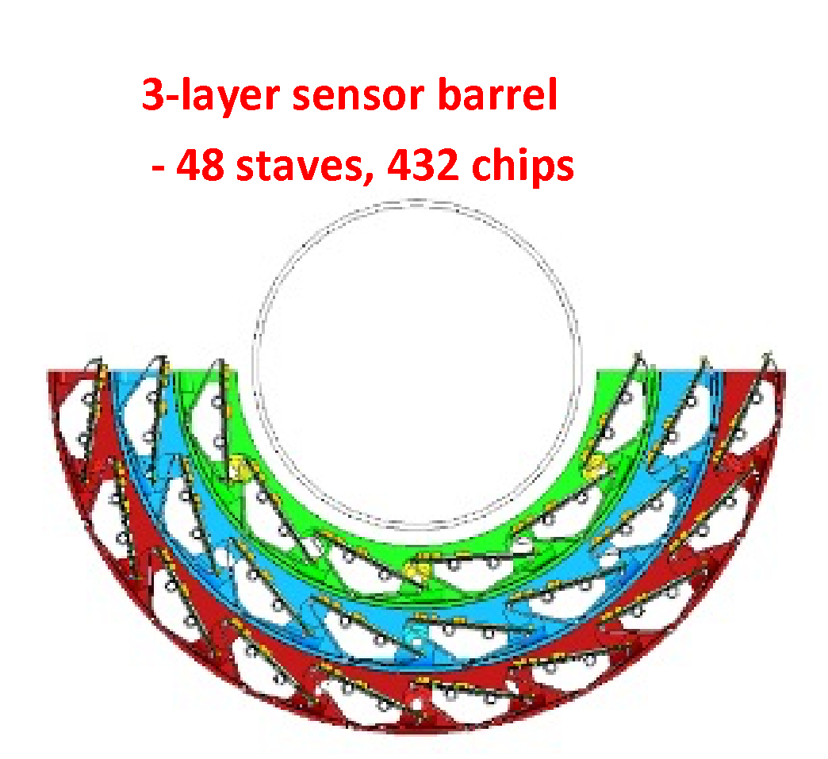
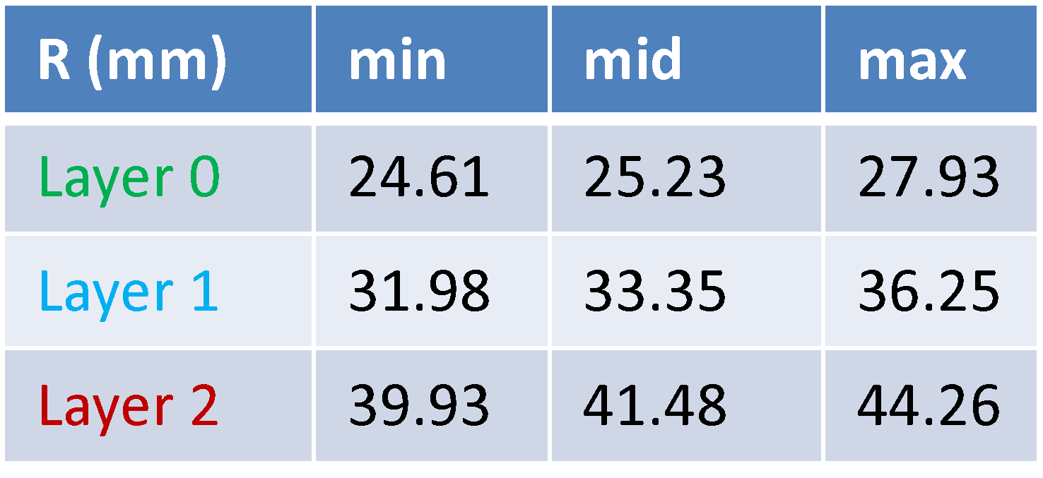
MVTX + INTT: 3 + 2 layers
INTT
Silicon Strips:
78um x 16mm (A)/20mm (B)
R=9.8cm
7.4cm
4.1cm
MVTX
Silicon pixels:
27um x 29um
R=2.5cm

Slide 3
~10ns
Rising 1~2us
Width ~5us
~Readout
starts
~5us

Slide 4
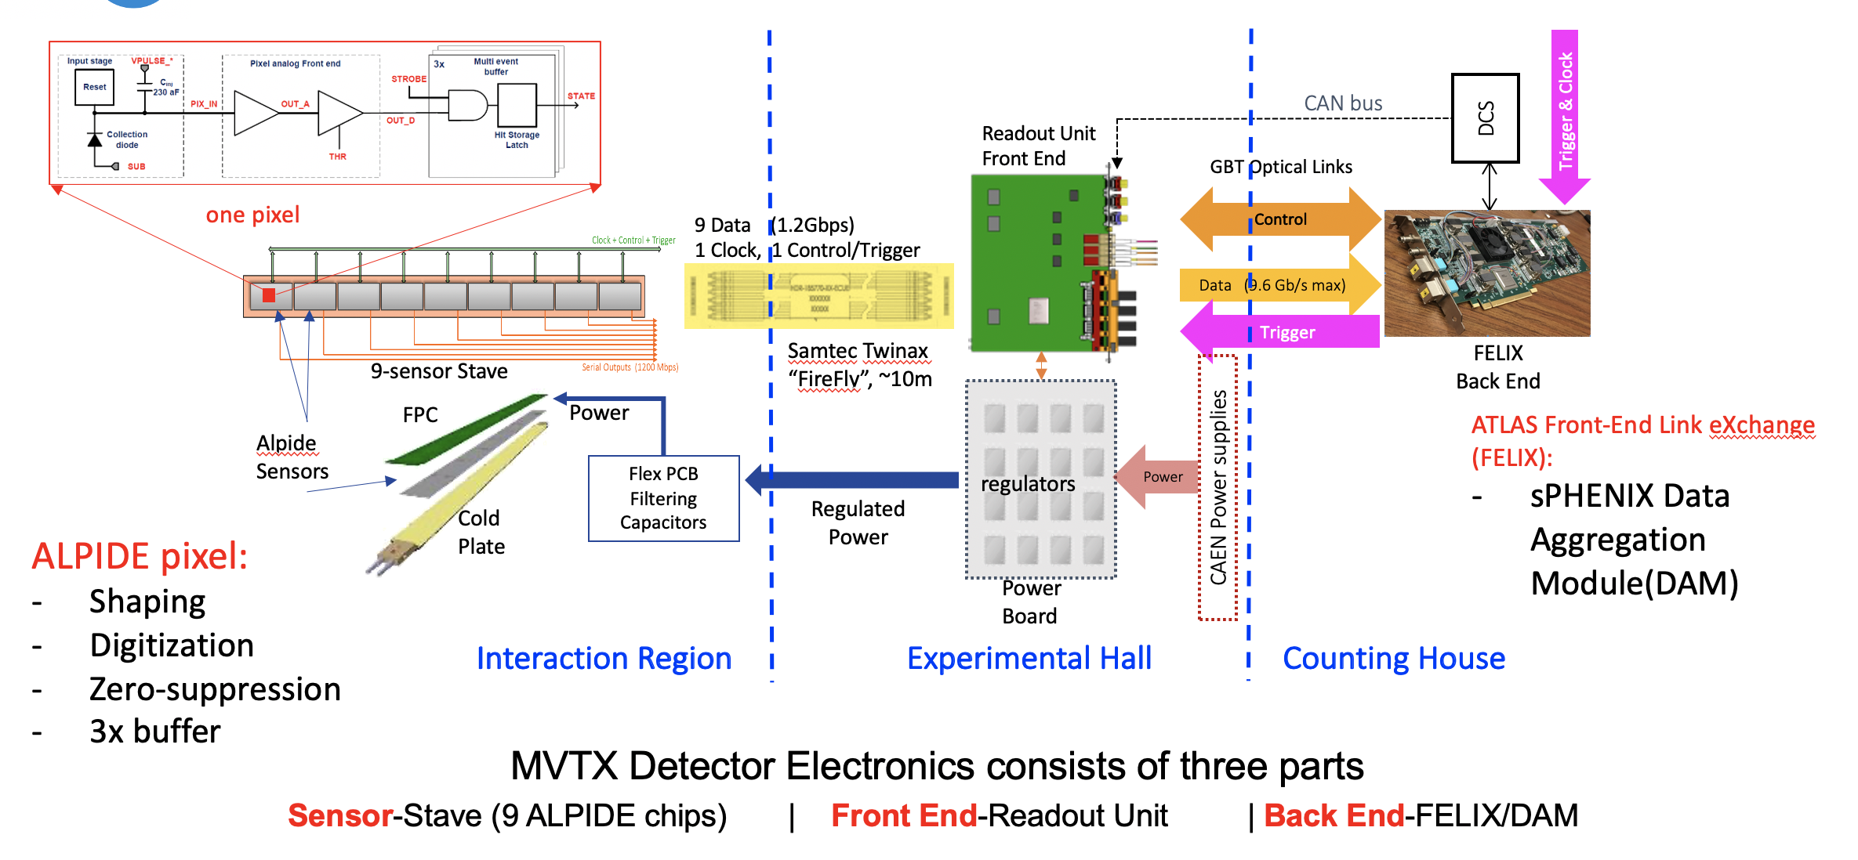
MVTX Readout, Power and Controls
MVTX hits arrival @FELIX
>~2 us after collisions
(dep. Readout config)

Slide 5
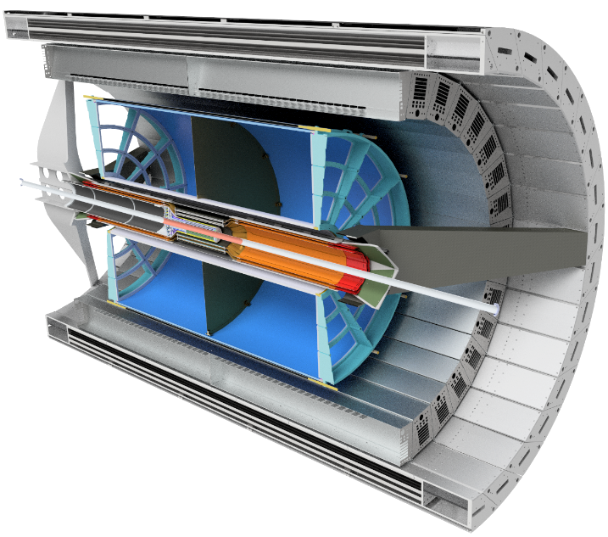
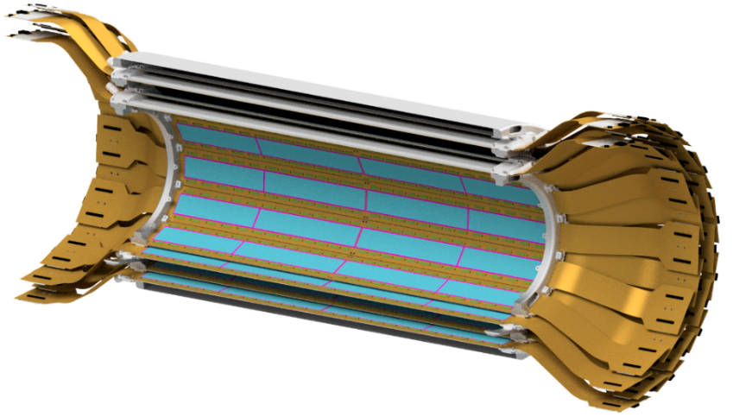
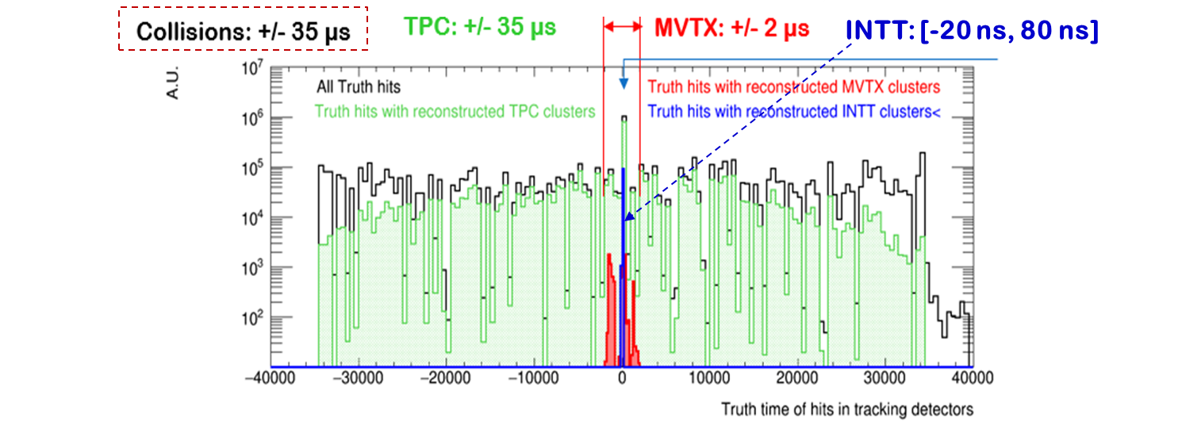
FPHX: used successfully in FVTX/PHENIX tracker
Strip sensor:
AC-coupled silicon sensor, standard HPK silicon sensor design (78 um)
HDI: conservative copy of FVTX/PHENIX
CFC-Stave: NEW design
iHCAL
EMCAL
MVTX
TPC
INTT: Two Silicon Strip Barrels

Slide 6
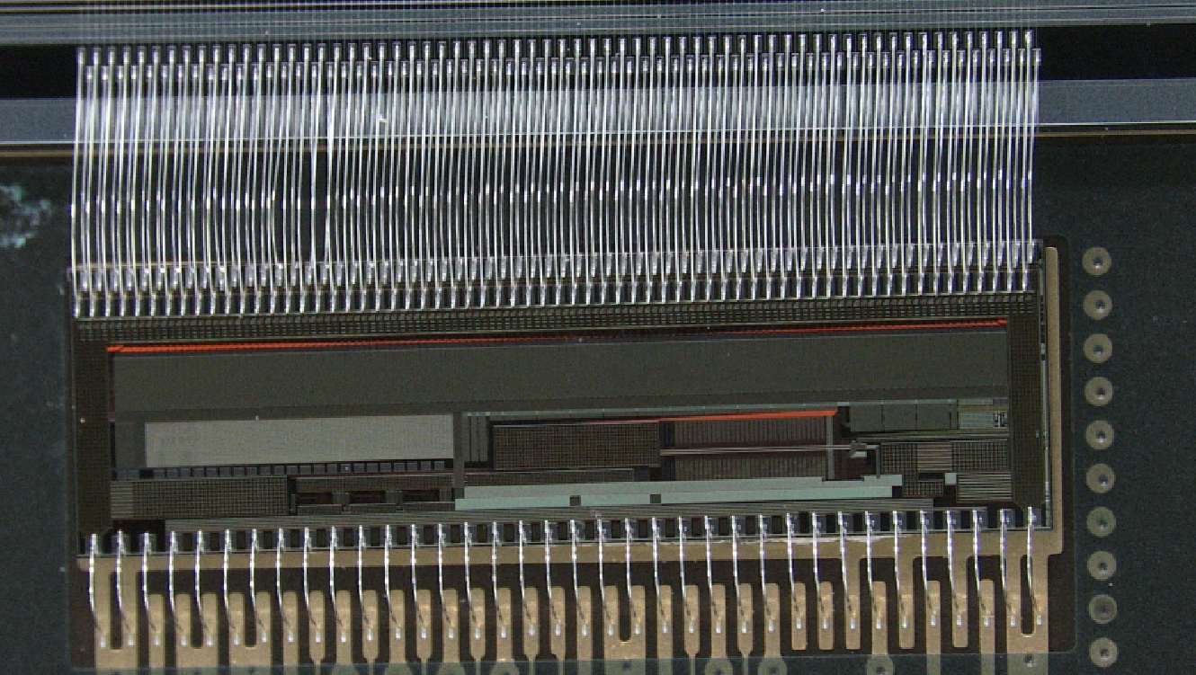
INTT Ladder Electric Components
Tracking System: MVTX+INTT+TPC
INTT Full Ladder
Type-B
Type-A
1. Silicon strip sensors
2. FPHX Chips
3. HDI Readout Cable
Type-B
Type-A
Wirebonding
(silicon-FPHX)
FPHX Chip
Wirebonding
(FPHX-HDI)
HDI

Slide 7
FPHX Chip (Analog Section)
Tracking System: MVTX+INTT+TPC
T-peak ~ 60 ns (programmable)
128 channel
46, 50, 60, 67, 85, 100, 150, or 200 mV/fC
60 ns peak time (rt- pgmbl)
3—bit ADC (th-pgmbl)
Optimized to 1 to 2.5 pf input
115e + 134e/pf
~ 70 to 140 μW/ch (dep. gain)
Program gain and Vref
Disc outputs
3-bit ADC
Vref
+
Shaper
Integrator
_
Comp
Input
Vth0
Comp
At max. input transistor bias of 38uA: 115e + 134e/pF
Silicon strip + readout line capacitance ~ 6pF
Predicted noise ~ 115e + 134e/pF * 6pF ~ 1,000e
Signal ~ 20,000e
Expected S/N ~ 20/1
Vth1
Comp
Programmable Thresholds
Vth7

Slide 8
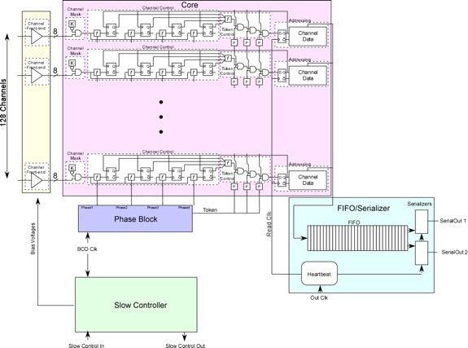
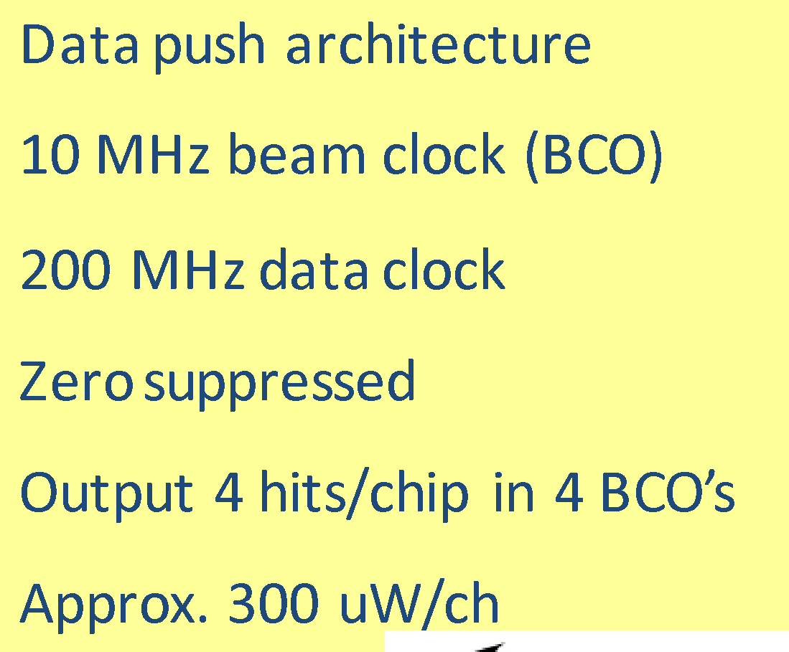
FPHX Chip (Digital Section)
Analog
Tracking System: MVTX+INTT+TPC
Data Processing
Data Output
20 bit Serial data word structure

Slide 9
SMART Trigger R&D: sPHNEIX as a Test Bench
Readout time:
MVTX: >2us (goal ~6us?)
INTT: ~ 0.4us (4 BC)

Slide 10
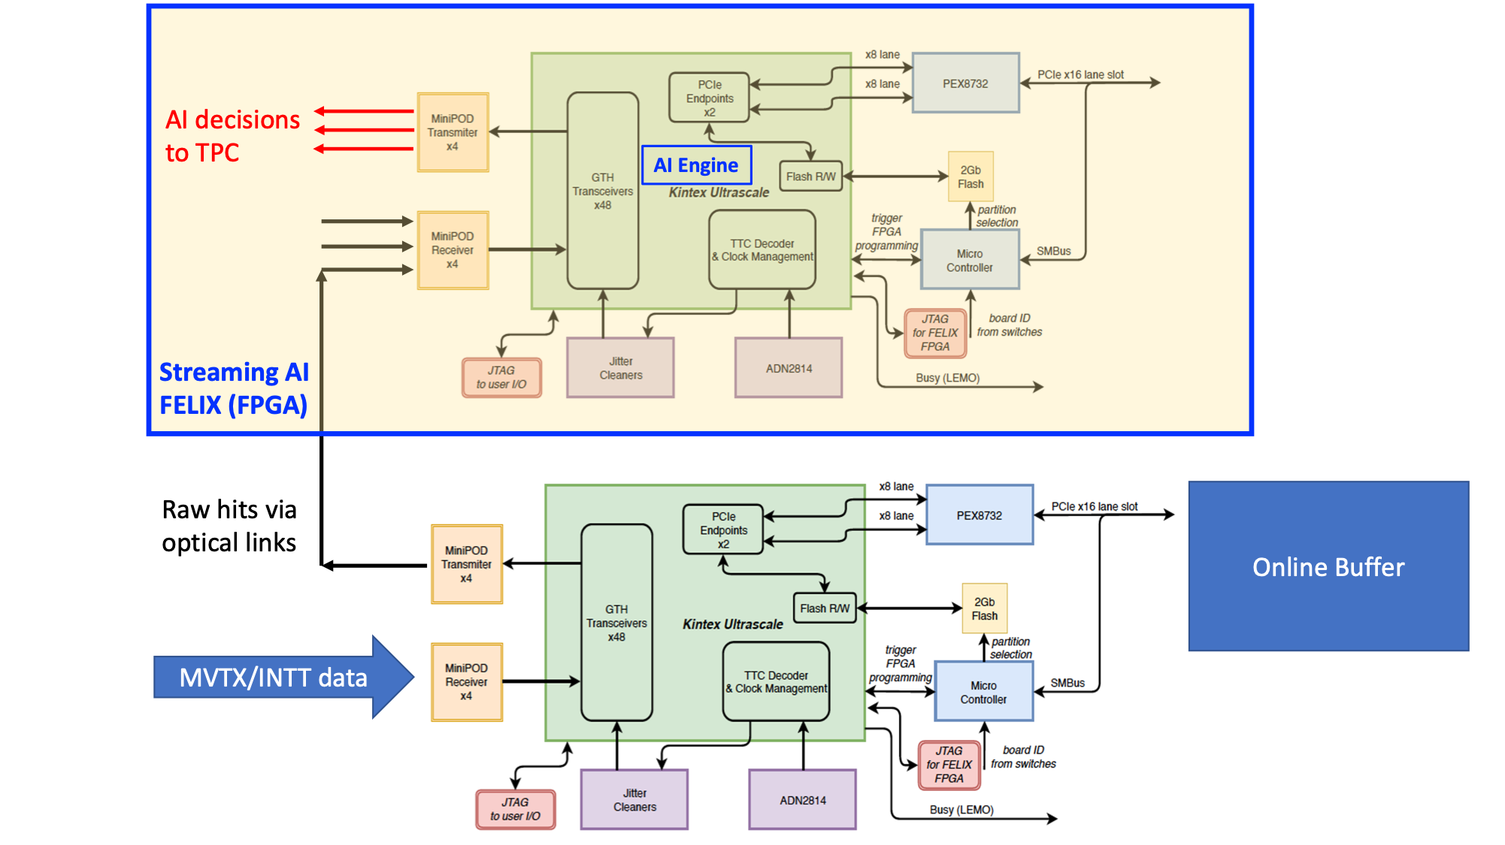
Two FELIX
Boards, v2.0
FELIX v1.5/v2.0
Or
gFEX like?
CMS trigger board (96 IOs)
- gFEX’ w/ 2 FPGAs
“GCM”…
- Newer FELIX version, more powerful FPGA chips
48 inputs
(MVTX:3xN)
(INTT: 4xN’)
(N, N’)
[8b/10b]
(N,N’)
Do simple data re-arrangement on FELIX
and send them to TRIG/FELIX with 8b/10b,
reduced the fibers from 24 to N (MVTX)
-MVTX/RU
-INTT/ROC
MVTX: 8 (staves) x 3 (GBT) = 24
INTT: TBD

Slide 11
Data Throughput Estimation: MVTX and INTT
One FELIX(v2.0) raw data throughput from 8 MVTX staves:
One MVTX FELIX connected to 8 RUs (Staves) via 3 (GBTx) optical-links per RU:
8 (staves) x 3 (GBT links) x 80bits(GBT payload) x 40 MHz
= 8 x 3 x 3.2 Gbps ~ 75Gbps
(4.8Gbps optical link speed)
Total MVTX data:
6 (FLX) x [8 x 3 x 3.2 Gbps] = 6 x 75Gbps ~ 450 Gbps
Total INTT data:?? ~Small fraction of MVTX (<30%?)
Could fit within 2 FELIX cards:
9.6Gbps x 0.8 per fiber x 48 fiber per FLX ~ 368 Gbps
0.5x(MVTX + INTT) = 220Gbps + XXX_INTT < 350Gbps
One FELIX v1.5 and Two FLX v2.0 @LANL
48 IO ports:
MVTX: 6 FELIX v2.0 (47 ports, one used for GTM communication, only 24 used)
INTT: 8 FELIX v2.0 (47 ports, # used?)

Slide 12
Backup slides

Slide 13
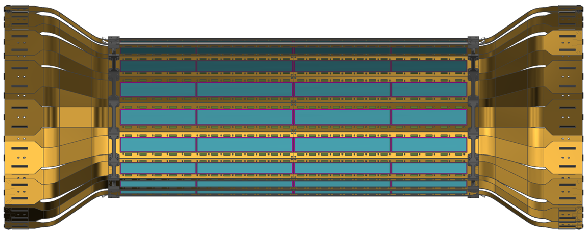
3.01: INTT Two Barrels Specification
Two Barrels

Slide 14
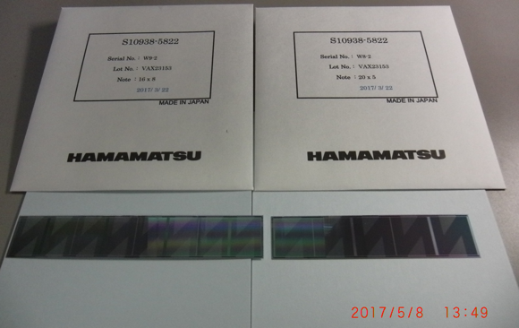
Silicon Strip Sensors (Hamamatsu)
Type-A (8 x 2 cells)
Type-B (5 x 2 cells)
Tracking System: MVTX+INTT+TPC
19.97mm
128mm
100mm
φ-direction
9.984mm
Single cell
A: 16 mm (B:20 mm)
Single cell geometry (active region):
128 strips (better resolution in φ-direction)
Strip width = 78 μm
φ-length = 78 μm x 128 strips x 2 cells =19.97 mm
z-length = A: 16 mmx 8=128 mm
B: 20 mm x5=100 mm
Type-A
Type-B

