Slide 1
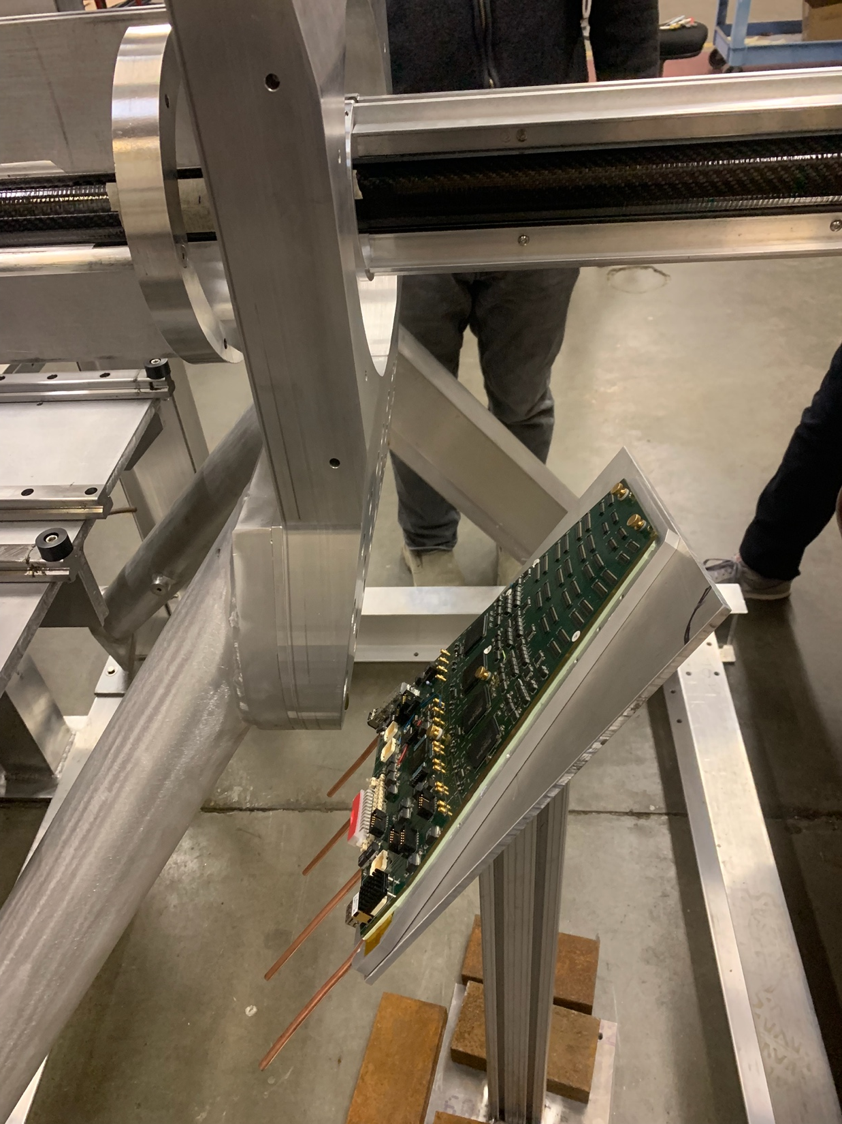
MVTX Supporting Structure – X-Wing
Beam pipe
MVTX X-Wing in the
final position
MVTX + beam-pipe mockup at MIT Bates, 12/14/2021
INTT ROC

Slide 2
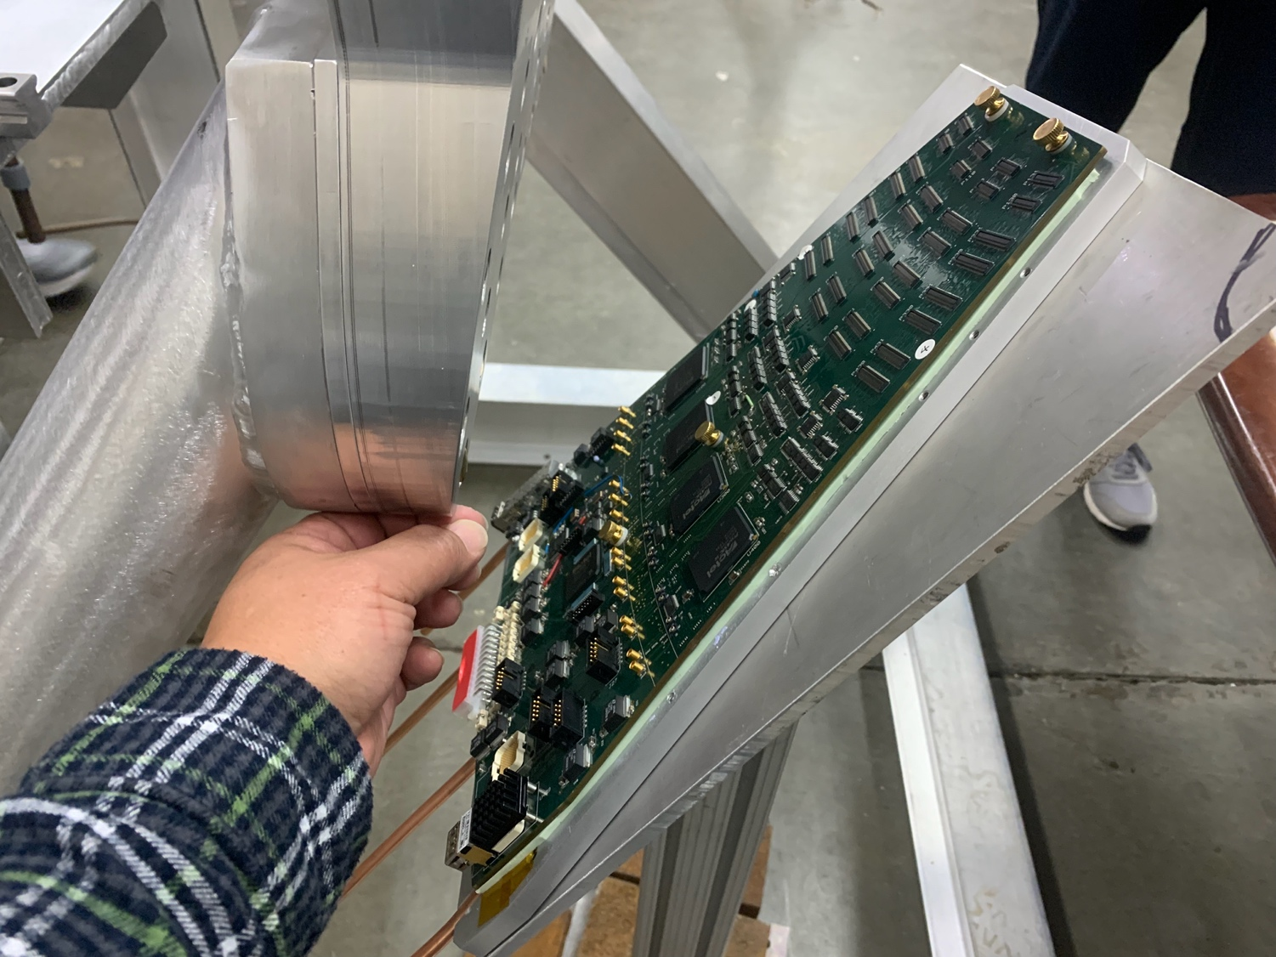
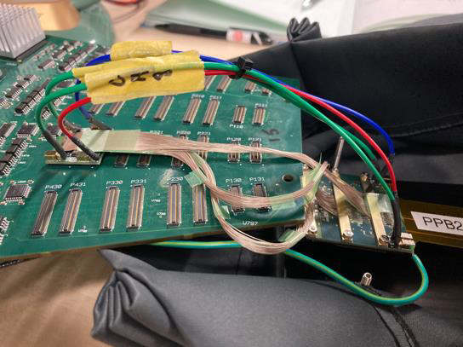
INTT and MVTX Support Structure X-Wing
MVTX X-Wing
support
INTT ROC
@MIT
12/14/2021
Ming’s hand
From INTT presentation @sPHENIX bi-weekly 2/18/2022

