Slide 1
MVTX Status and Plan
Camelia, Grazyna, Jo and Ming
MVTX bi-weekly project meeting
1/24/2022
https://indico.bnl.gov/event/14503/

Slide 2
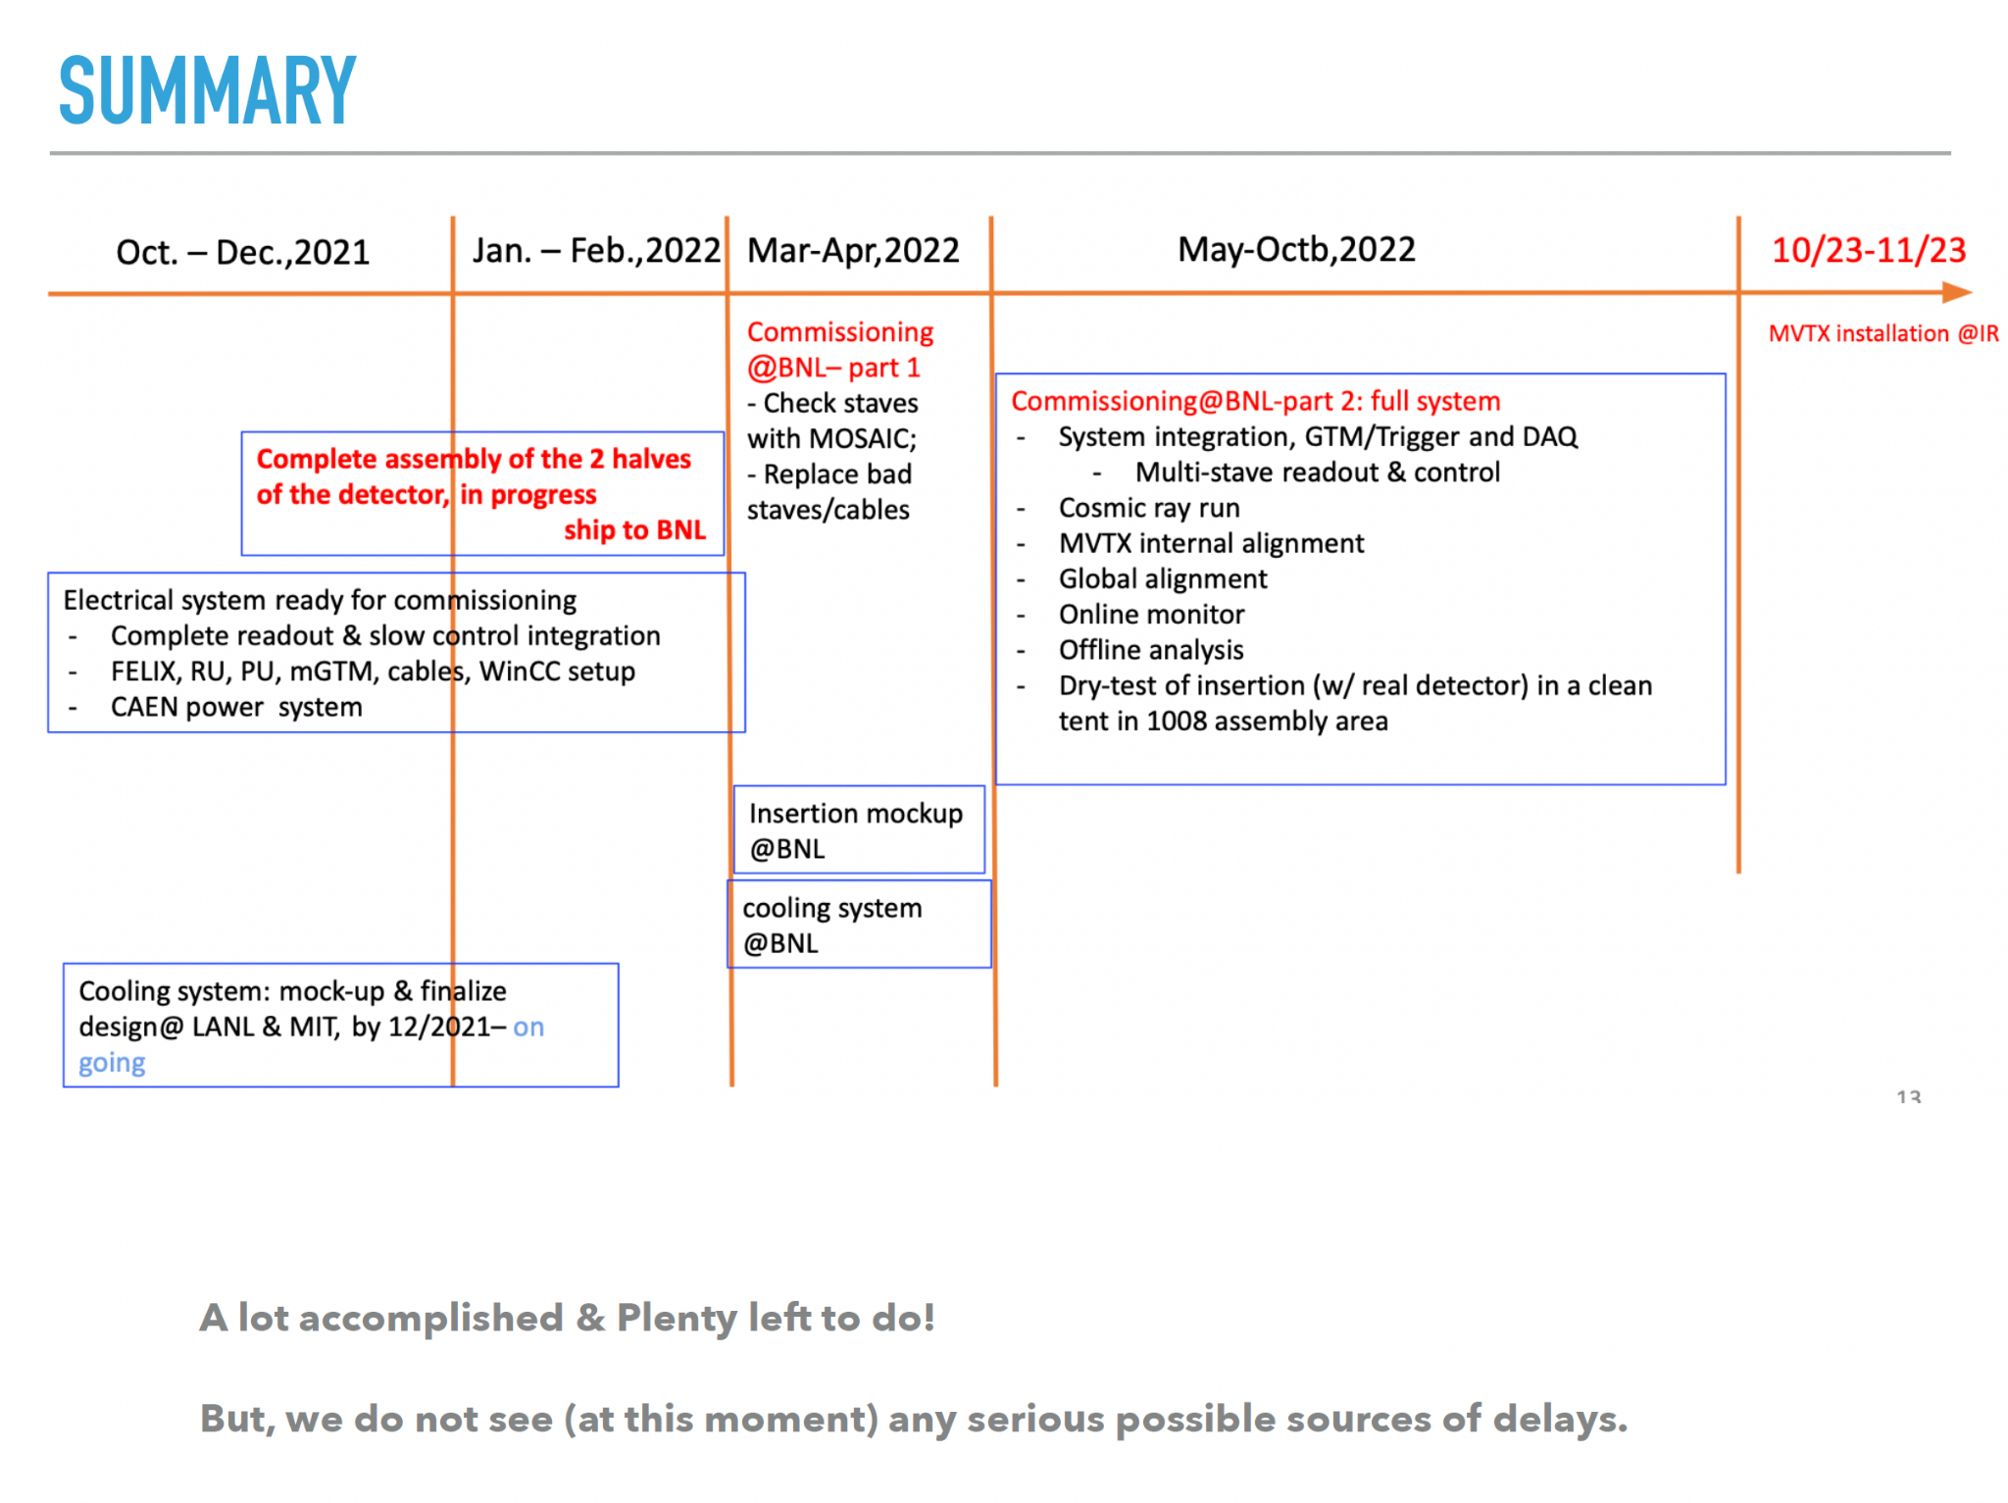
Remaining Key Tasks and Schedules
Presented 1/6/2022
sPHENIX collaboration meeting
Plan to set up a BIG clean tent in the sPHENIX
assembly area in May: (if the 1st tent too small)
for the full insertion mockup
Full half-detector commissioning

Slide 3
Some Concerns and Progress
Half-detector assembly at LBNL: schedule?
  Assembly jig improvement
  Short cables available, not tested yet
    SamTec cables delivered to LANL
    Power cables assembled at LBNL
Readout and control integration: ~by Feb. 2022
  New data format in RCDAQ
    Online QC software
  Full chain of 8-stave/RU/PU + CAEN + FELIX + mGTM
    In progress at LANL
Finish cooling system test by ~ mid Feb
  Air bubbles
Budget – phone meeting w/ Ed last Friday 1/21
  MIT, paperwork in progress
  LANL, requests 0.1 FTE support for Walt
  ORNL, additional travel budget to BNL; M&S done through BNL?
  LBNL, may request additional $$ later

Slide 4
BNL Commissioning Travel Plan submitted
Jan-Feb:
  Setup clean tent, power and cooling system
  Setup MOSAIC test bench
  Setup 6 FELIX servers
Mar-Apr:
  Half-detector stave QC
  Possible rework of half-detector
May-Sep:
  Full commissioning
BNL travel google docs:
Travel plan: https://docs.google.com/spreadsheets/d/1rPCD_5E5Mi8oLz5d0K1_onjZi4BaeHwL1x390UaNgp8/edit?usp=sharing
BNL travel approval paperwork:
https://docs.google.com/document/d/1seXXCxdGgXm_XD-v2Z6m9TLz6j6dXUMbyUZv1gCNluY/edit?usp=sharing

