Slide 1
Intelligent Experiment Through Real-Time AI:
Fast Data Processing and Autonomous Detector Control for sPHENIX and Future EIC Detectors
Ming Liu
Los Alamos National Lab
For the Fast-ML Team
sPHENIX Collaboration Meeting
Jan. 5-7, 2022

Slide 2
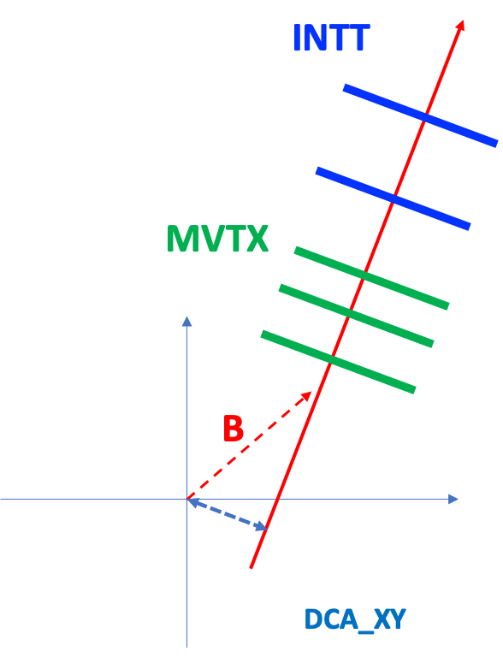
The Problem
– Rare events hard to trigger by conventional methods
sPHENIX challenge p+p@200GeV:
Very high p+p collision rate: ~10MHz
  Charm production rate: ~100kHz
    0.5mb/42mb ~1%
  Beauty production rate: ~ 500Hz
    2 ub/42mb ~ 0.005%
No effective trigger to select low pT HF events
  Triggered MB rate ~1kHz << 10MHz
    Lost most of the HF events at low pT
  High pT jet trigger, pT > 10GeV
  Streaming readout -> huge data volume, DAQ/tape cost
EIC challenge:
high rate e+p and e+A collisions
Our approach:
Develop effective HF (or other rare events) triggers for p+p and e+p
Streaming readout key detectors for high efficiency
AI-based beam/detector monitoring and autonomous feedback & control
ML-trained algorithm for HF tagging
  Rare physics don’t require “slow detectors” for measurements
Beam spot:
~100um

Slide 3



The DOE FOA Call in 2021
Proposals called on 3/16, 2021
  Short deadline, 4/30/2021
  Very intense work
Initial team of NP, HEP and CS
  LANL, MIT, FNAL and NJIT
    ORNL, CCNU and NTU joined later

Slide 4
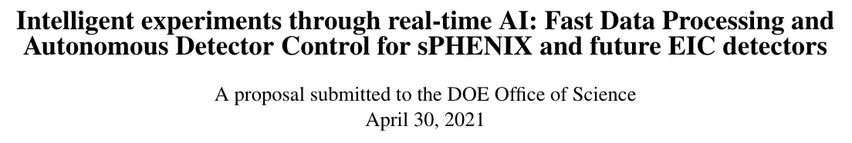
Our Proposal
Embed AI/ML algorithms on fast FPGA-based trigger system
  Low trigger decision latency ~10us
Streaming readout key inner trackers to FPGAs to identify HF events through track topology
  High efficiency in HF tagging with AI/ML
  HLS4ML package developed by HEP
Monitor and update beam-spot and detector alignment in real time
  Update geometry in real time
Send HF-trigger signal to the rest of other detectors
  Initiate readout if not already in the data stream

Slide 5

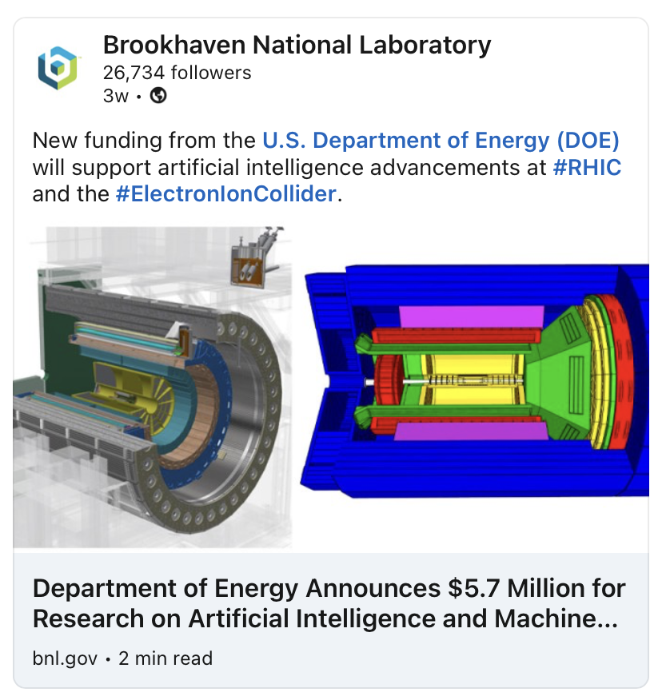
DOE Awards Announced 12/2/2021
$1.5M for our proposal
FY22-23

Slide 6
The Team
LANL (NP)
  Yasser Corrales, Cameron Dean, Zhaozhong Shi, Noah Wuerfel, Kun Liu, Cesar da Silva, Hugo Pereira da Costa, Ming Liu … new PDs
MIT (NP, HEP)
  Gunther Roland, Philip Harris (HLS4ML), Yen-Jie Lee, Or Hen, Cristiano Fanelli et al
FNAL(HEP)
  Nhan Tran(HLS4ML), Engineer, Yu-Dai Tsai (Theorist, ML) et al
NJIT(CS)
  Dantong Yu, students + PDs
ORNL(NP)
  Jo Schambach
CCNU(EE, NP)
  Kai Chen(FELIX), Yaping Wang et al
NTU (CS)
  Fu Song, students + PDs
In collaboration with experts from BNL - Jin Huang, Martin Purschke, John Haggerty et al

Slide 7
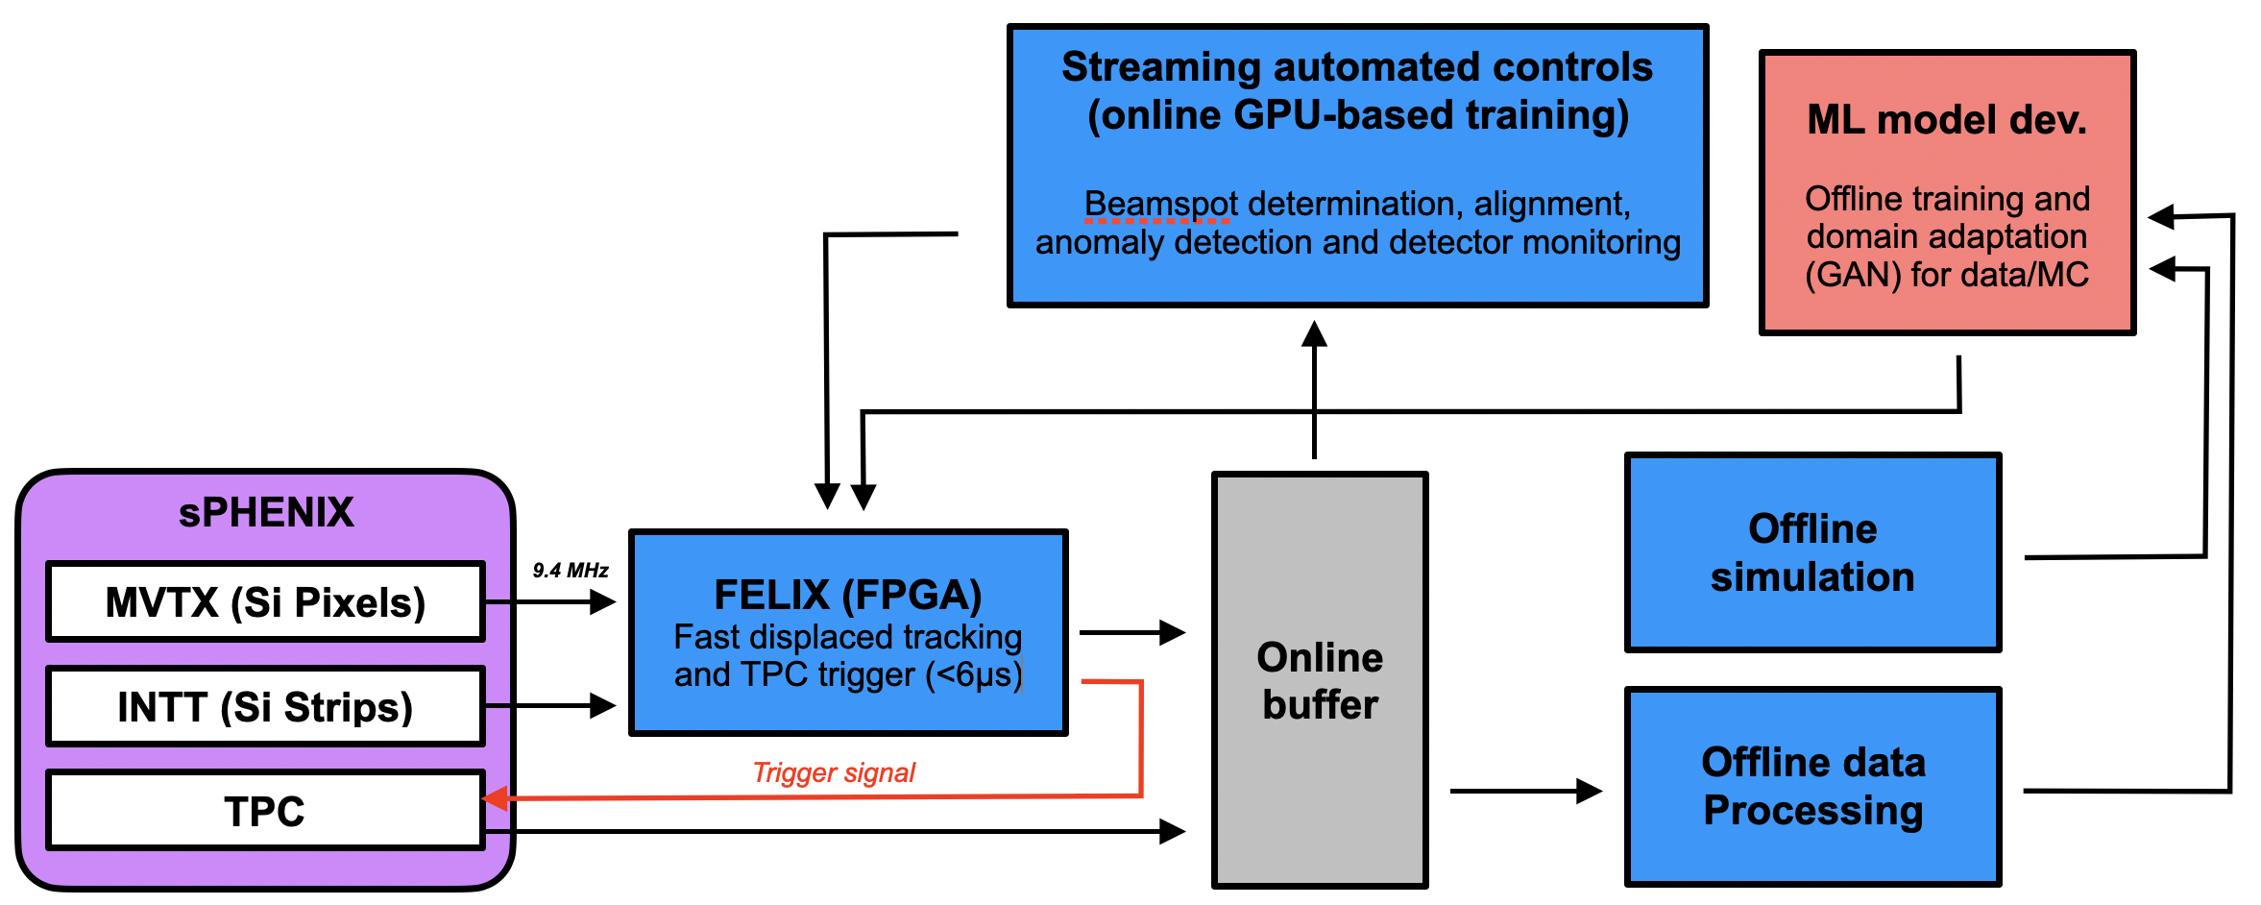
HF AI Trigger: sPHENIX as a Test Ground
Sensor hit readout time:
MVTX: ~3us
INTT: ~0.4us (4 BC)
SRO
sPHENIX DAQ & Trigger integration challenge

Slide 8
Timeline
2021
2022
2023
2024
2030+
Project started
Initial simulations constructed
First data for algorithm training
MVTX & INTT SRO
Fast tracking algorithms in place
GPU feedback machine R&D
Initial FPGA bitstream
Refine interface between system and detectors
Improve algorithms with latest data stream
Pre-commissioning
Deploy device at sPHENIX
pp/pA run
Design updated system for EIC
Take advantage of new technology if required
Deploy device at EIC

Slide 9
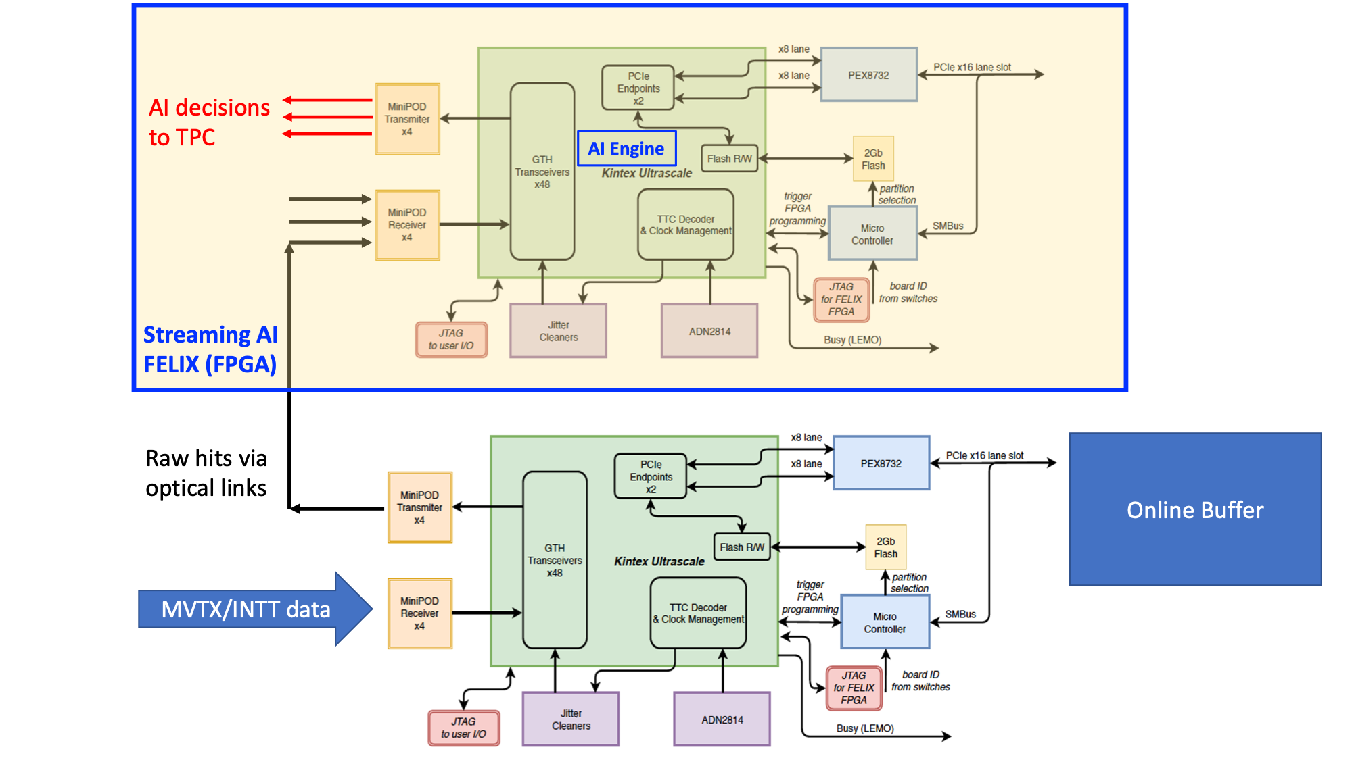
A Prototype Implementation Proposal
Trigger boards, TBD
FELIX
CMS trigger boards
Other options
FELIX/DAM sPHENIX

Slide 10
Physics and Detector Simulations
(Pythia + GEANT) → MVTX/INTT hit maps -> raw data (pixel hits) in JSON
trigger AI-ML training
generate raw real data like electronics bit stream for hardware simulations
Cameron, Zhaozhong, Jin,
Yasser, Noah et al

Slide 11
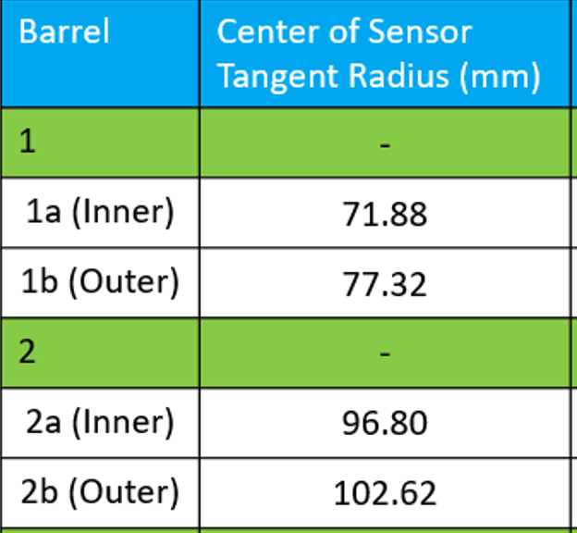
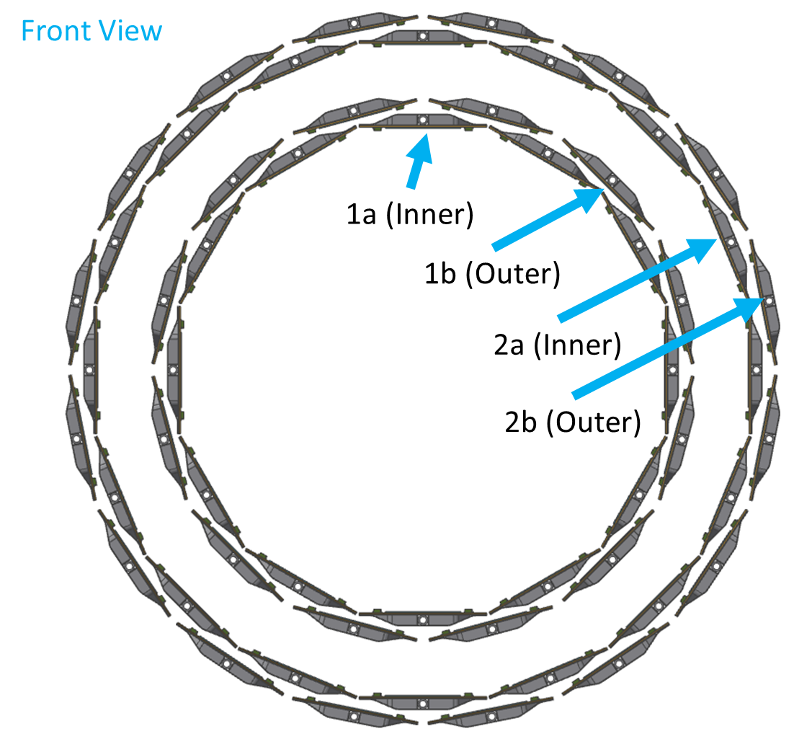
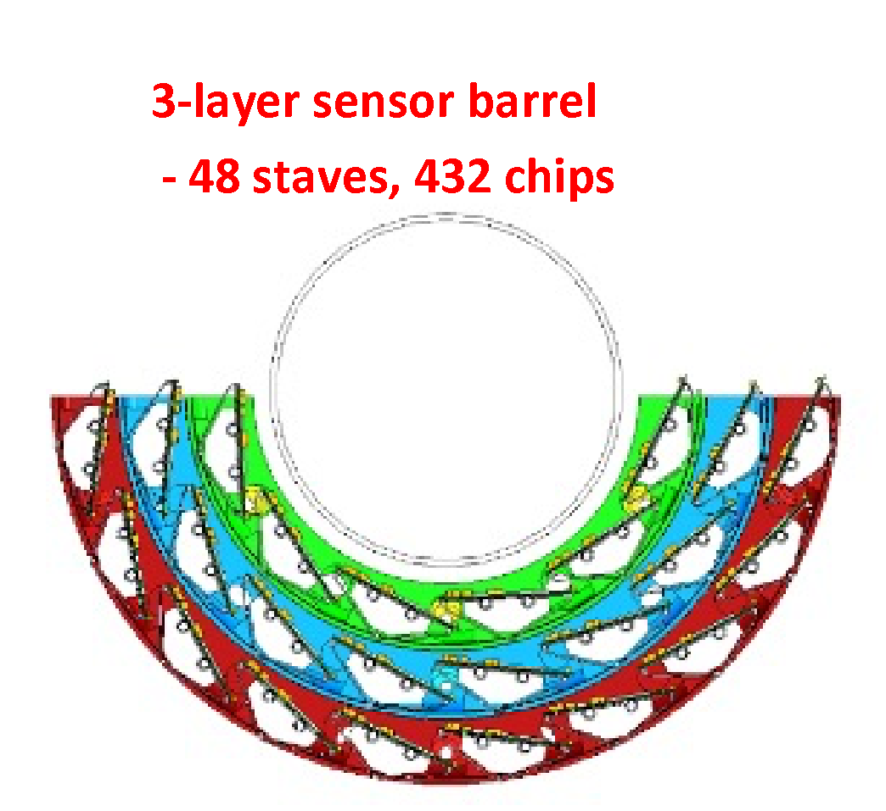
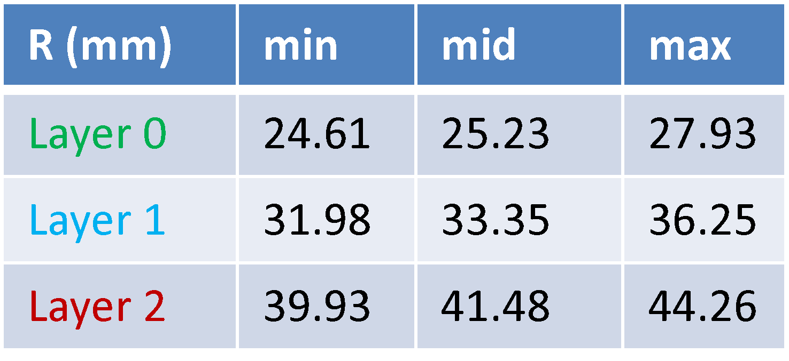
MVTX + INTT: 3 + 2 layers
INTT
Silicon Strips:
78um x 16mm (A)/20mm (B)
R=9.8cm
7.4cm
4.1cm
MVTX
Silicon pixels:
27um x 29um
R=2.5cm

Slide 12
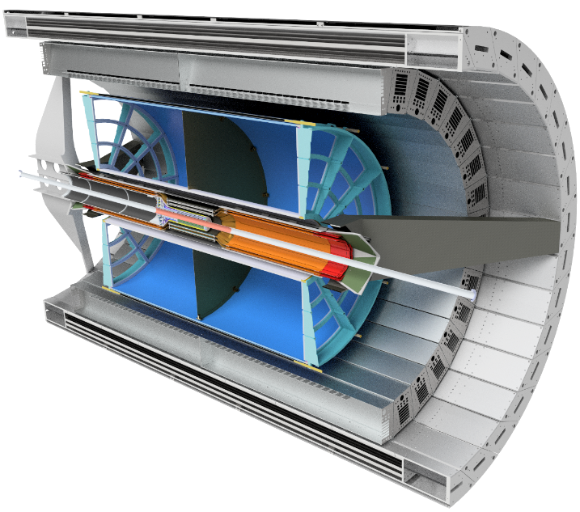
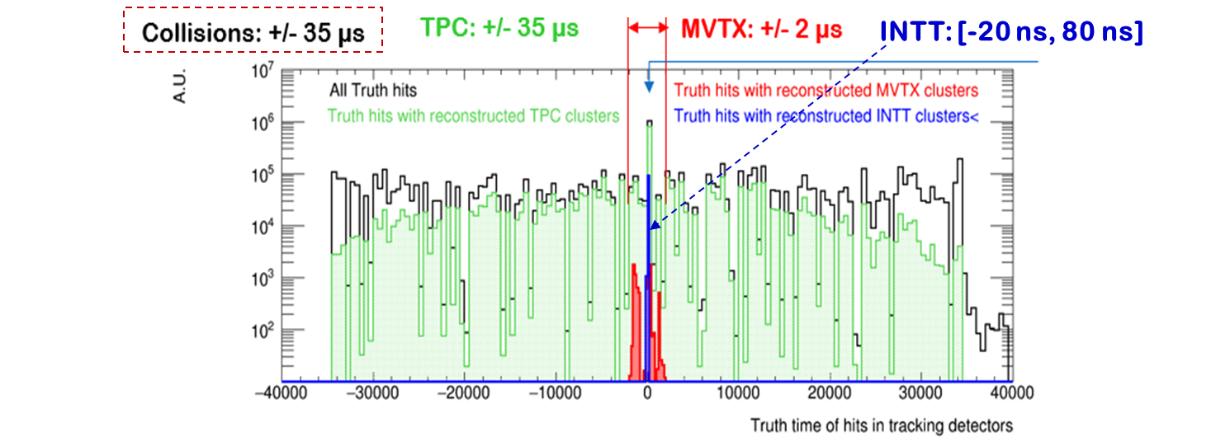
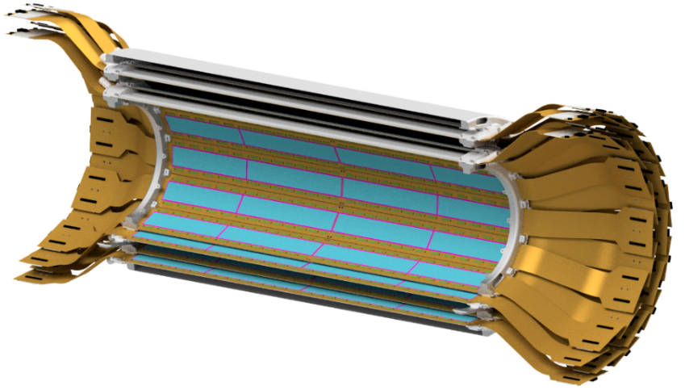
Event Timing: Reject out of time MVTX hits with INTT
iHCAL
EMCAL
MVTX
TPC
INTT: Two Silicon Strip Barrels

Slide 13
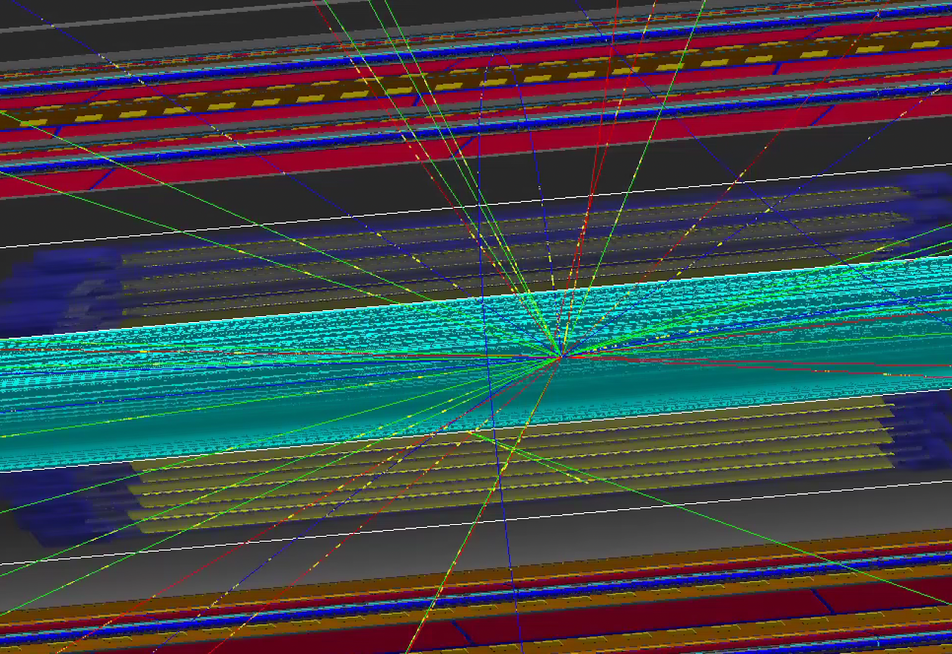

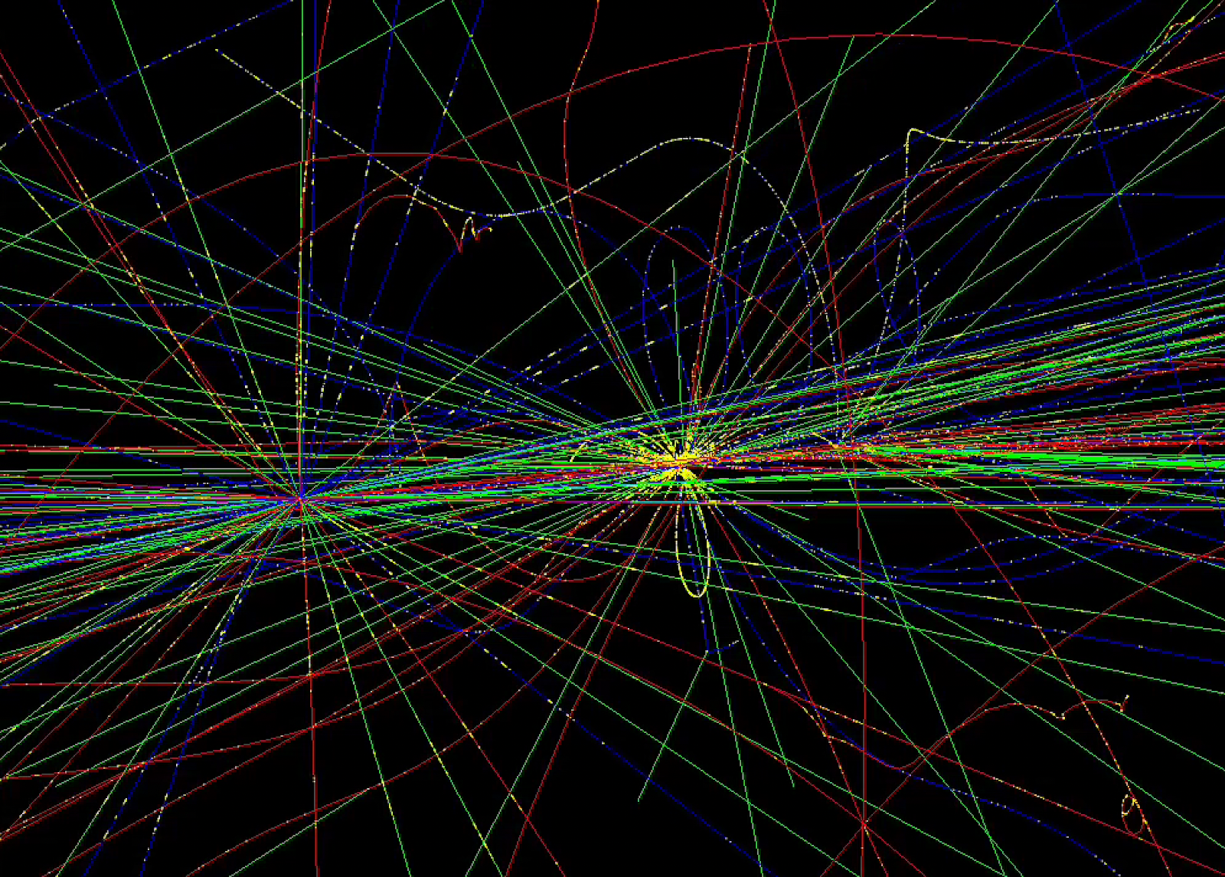
Detector/Physics Simulations (sPHENIX)
From Cameron
Can simulate any number of signal and background events with full digitization
Package developed to extract raw hit information, used for
  algorithm training (JSON output)
  sim data to raw data bit pattern
3 p+p collisions

Slide 14
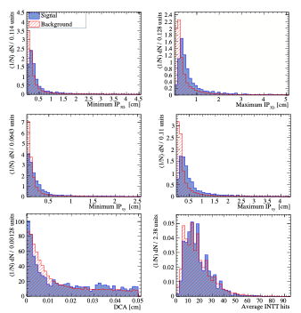








Case study: AI HF selections
Is ML better for selecting HF decays over conventional selections?
Challenge:
  Must run online, in FPGA. Hence variables must be “simple”

Slide 15
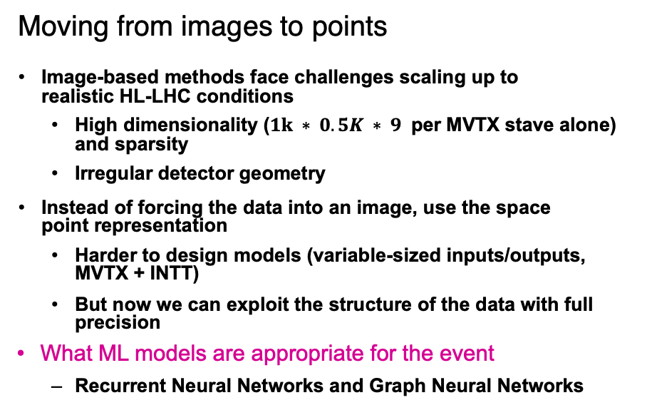
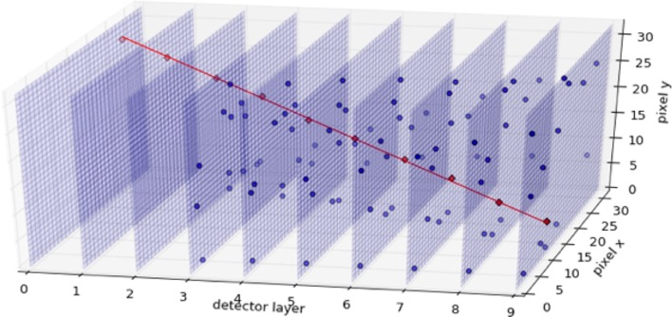
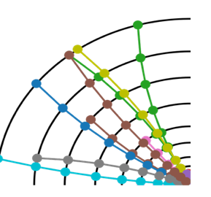
Event Data Descriptions – NJIT/LANL

Slide 16

Trigger Algorithm R&D – NJIT/LANL
Implemented several models to solve the trigger detection problem:
Directly applied GNN model to trigger detection problem (GNN)
Added a global vector to the GNN model to represent some global feature (VPGNN)
DiffPool model (DiffPool)
VpGNN + DiffPool (GNNDiffPool)
ParticleNet , Giorgian
Another model we tried: Set2Graph (Affinity Matrix Prediction)
Inputs:
-hits
-tracklets

Slide 17
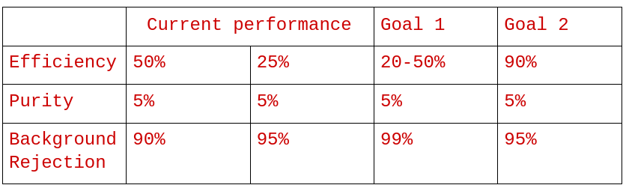
Initial Study from NJIT: Efficiency and Purity
Proper mix of simulated data: 100(BG) + 1 HF(charm) events

Slide 18
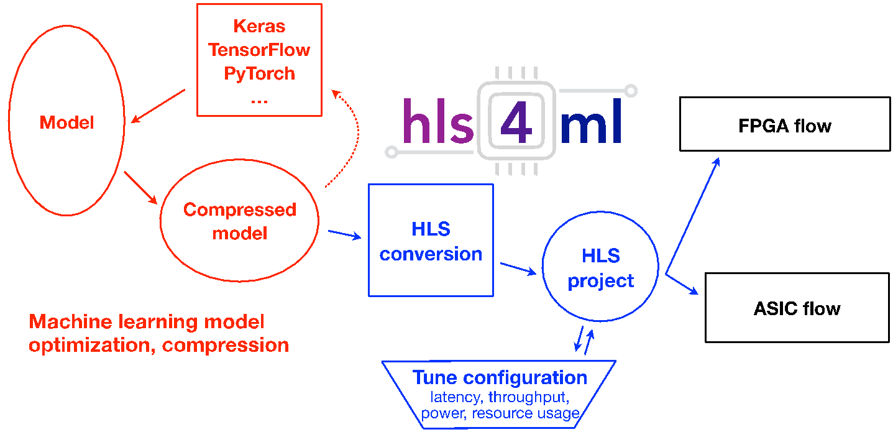
Translating Models to FPGA Firmware, FNAL/MIT
Algorithms must have low latency and resource usage
hls4ml translates NN algorithms into high level synthesis
Also generates IP cores for easy implementation
Red – typical ML algorithm development stages, Python/C++
Blue – HLS conversion to FPGA IP
Black – typical implementation onto chips

Slide 19
AI-Trigger SW/FW Pipeline - Status
  Fetch events from event buffer (Work in Progress, sim to raw data)
  Data Pre-processing Clustering (Work in Progress on FPGA implements)
  Tracking + Outlier hits Removal (Done in FPGA)
  Triggering (Done in FPGA, need performance tuning)
  Triggers on TPC (Interface and integration with sPhenix Detector, last step)

Slide 20
Hardware and Computing
Hardware implementation
data stream processing
Test AI algorithms on FPGA

Slide 21
A Toy Model – Hardware Implementation (sPHENIX)
Beam vtx(x,y) alignment,
calibration etc.
GPU/CPU
KC 705
(MVTX)
sPHENIX
Simulation
(Online Buffer)
VC 709 (FPGA/AI)
e-Link/PCIe
g-Link
KC 705
(INTT)
Fast HF
trigger output
Streaming readout sim data:
8b/10b MVTX/INTT data (KC705) to FPGA/AI Engine (VC709)

Slide 22
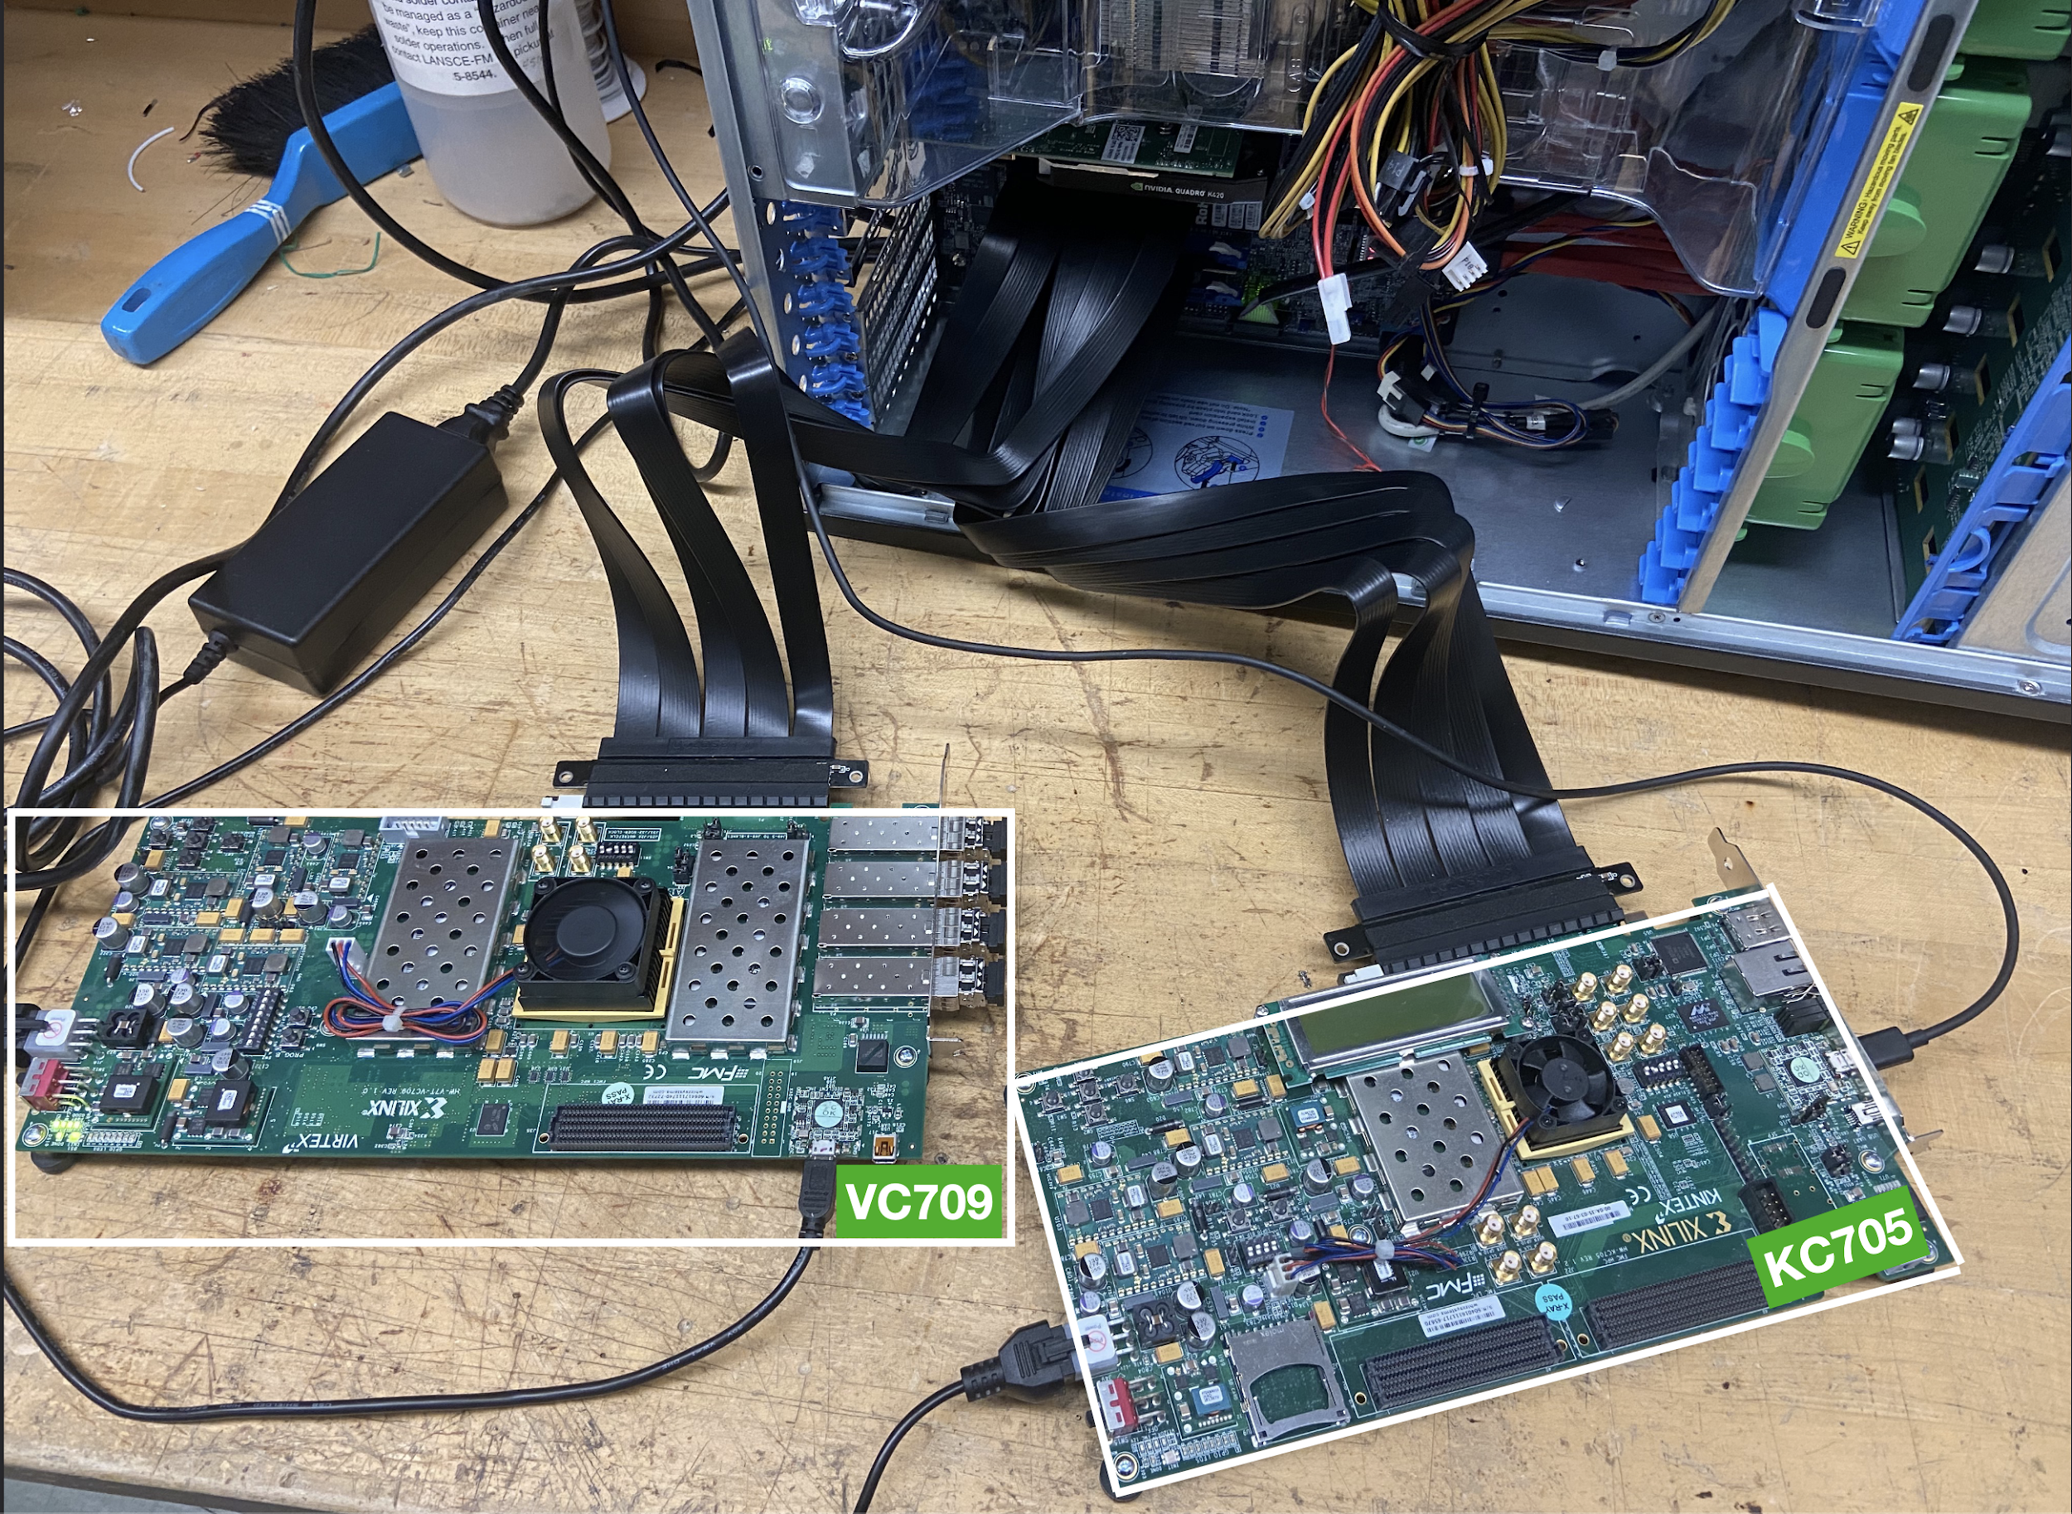
Realizing in Firmware
FELIX card shares same FPGA as Xilinx VC709, ideal testing ground
KC705 represents our MVTX+INTT Data Aggregation Module
Successfully transmit data from host PC to DMA
  Convert MVTX sim data to real-data-like bit-stream in progress
Next:
  Transmit MVTX/INTT sim data to VC709(AI-Engine) through G-Links
Noah, Yasser
Test bench @LANL

Slide 23
Project Workflow Status
Work not commenced
Simulate signal/background
Extract hit locations
Work started
Train algorithms for tracking, monitoring and selection
Preliminary available
Convert to bit pattern
Convert to HLS
Write firmware
Upload to test bench
Convert to bitstream
Output decision to rest of system

Slide 24
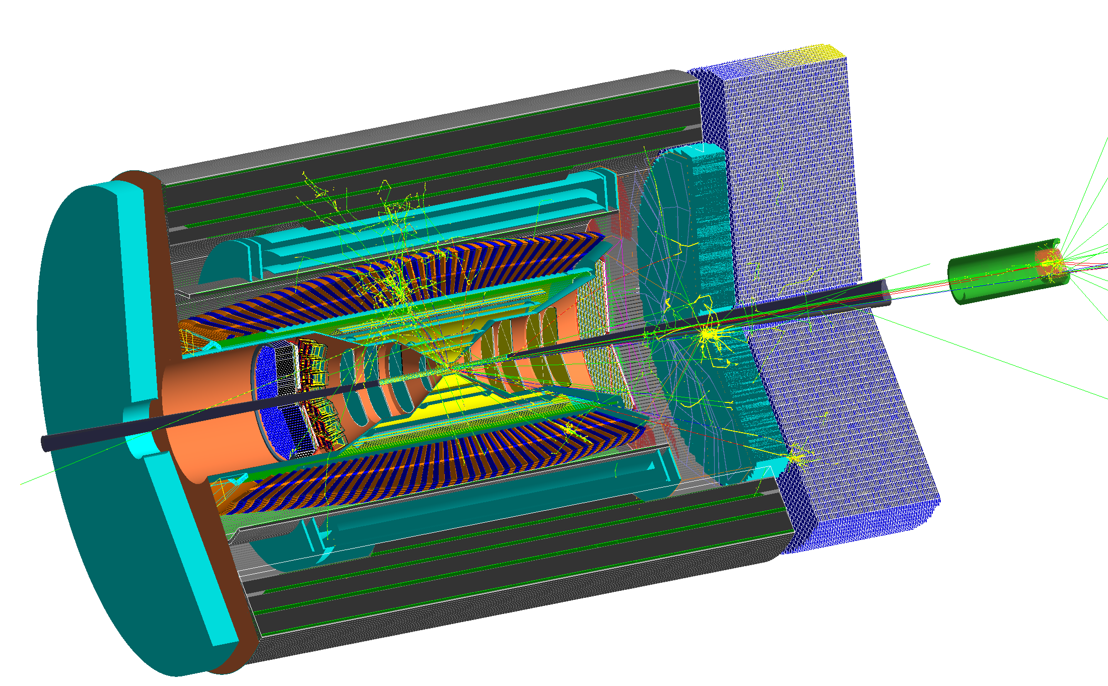
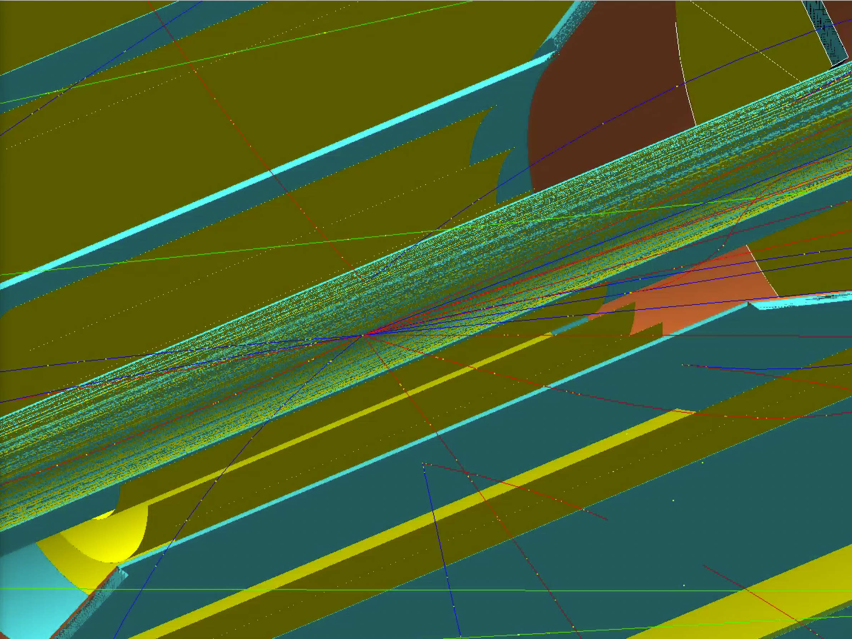
EIC: Simulating events (ECCE)
EIC physics simulations progressed rapidly in 2021
Large volume of data already at hand (>800M events)
No digitization yet but we can use smeared hits to understand potential
Cameron

Slide 25
Summary of Progress
Success stories since proposal approved
Full Geant4 simulations of MVTX and INTT plus Geant4 simulation of EIC detectors
Tracking GNN algorithms are being developed at NJIT
Prototype hardware set up at LANL with host-to-client transfers running
Second lab (FELIX+GPU) being set up at MIT
HLS4ML development at Fermilab, MIT and NJIT
FELIX FW development at ORNL and LANL

Slide 26
Outlook
Next several months:
  Convert simulation output to equivalent bit pattern through G-Link
  Develop initial tracking and selection algorithms
  Convert algorithms to HLS code to run on FPGA
  Pass simulated data to FPGA as if it were real data
Goals:
  Build a full prototype and benchmark performance with simulations by 2023;
  Install device in sPHENIX before 2024 (RHIC pp run)
Project could significantly improve sPHENIX HF capabilities
  Project relies on inner tracker MVTX and INTT SRO
After successful deployment at sPHENIX, focus shifts to future EIC detectors

Slide 27
Backup

Slide 28
from sPHENIX to EIC
sPHENIX takes data from 2023
  Can be used as a proof-of-principle (as well as a real use case)
EIC has lower average multiplicity
  relatively easier to select
  likely to use similar tracker technology to MVTX (ITS-2 vs ITS-3)
Large overlap of team between sPHENIX and EIC/ECCE
  knowledge preservation
  share a simulation framework

Slide 29
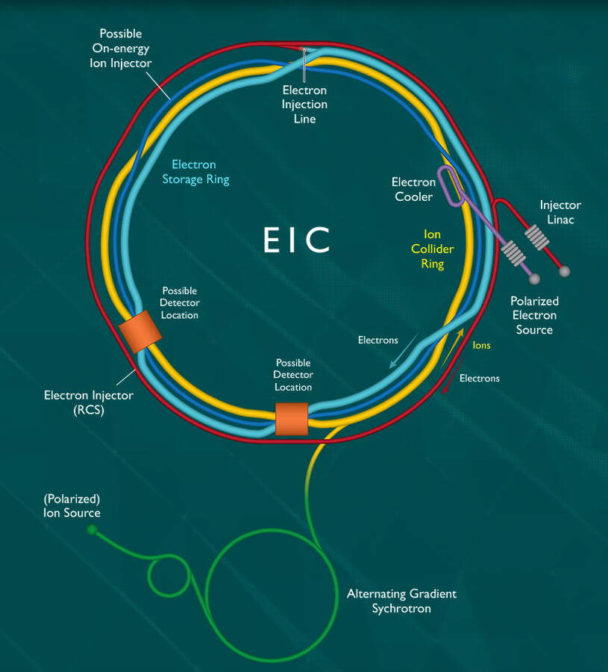
The Electron-Ion Collider
Next generation accelerator
  To be operating at BNL from the early 2030s
  the future of nucleon structure probes and many other studies
Three collaborations have submitted detector proposals:
ATHENA
CORE
ECCE
[https://www.bnl.gov/eic/]

Slide 30
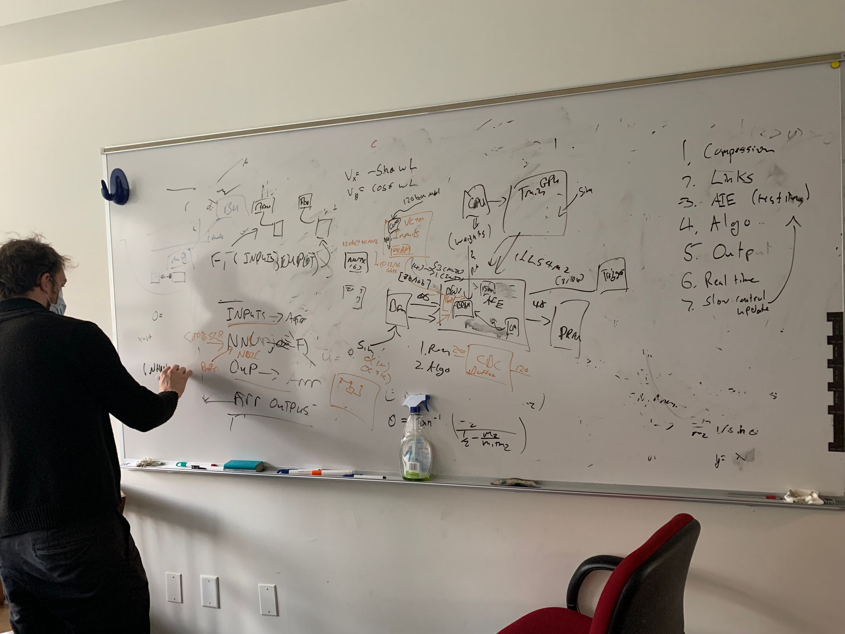
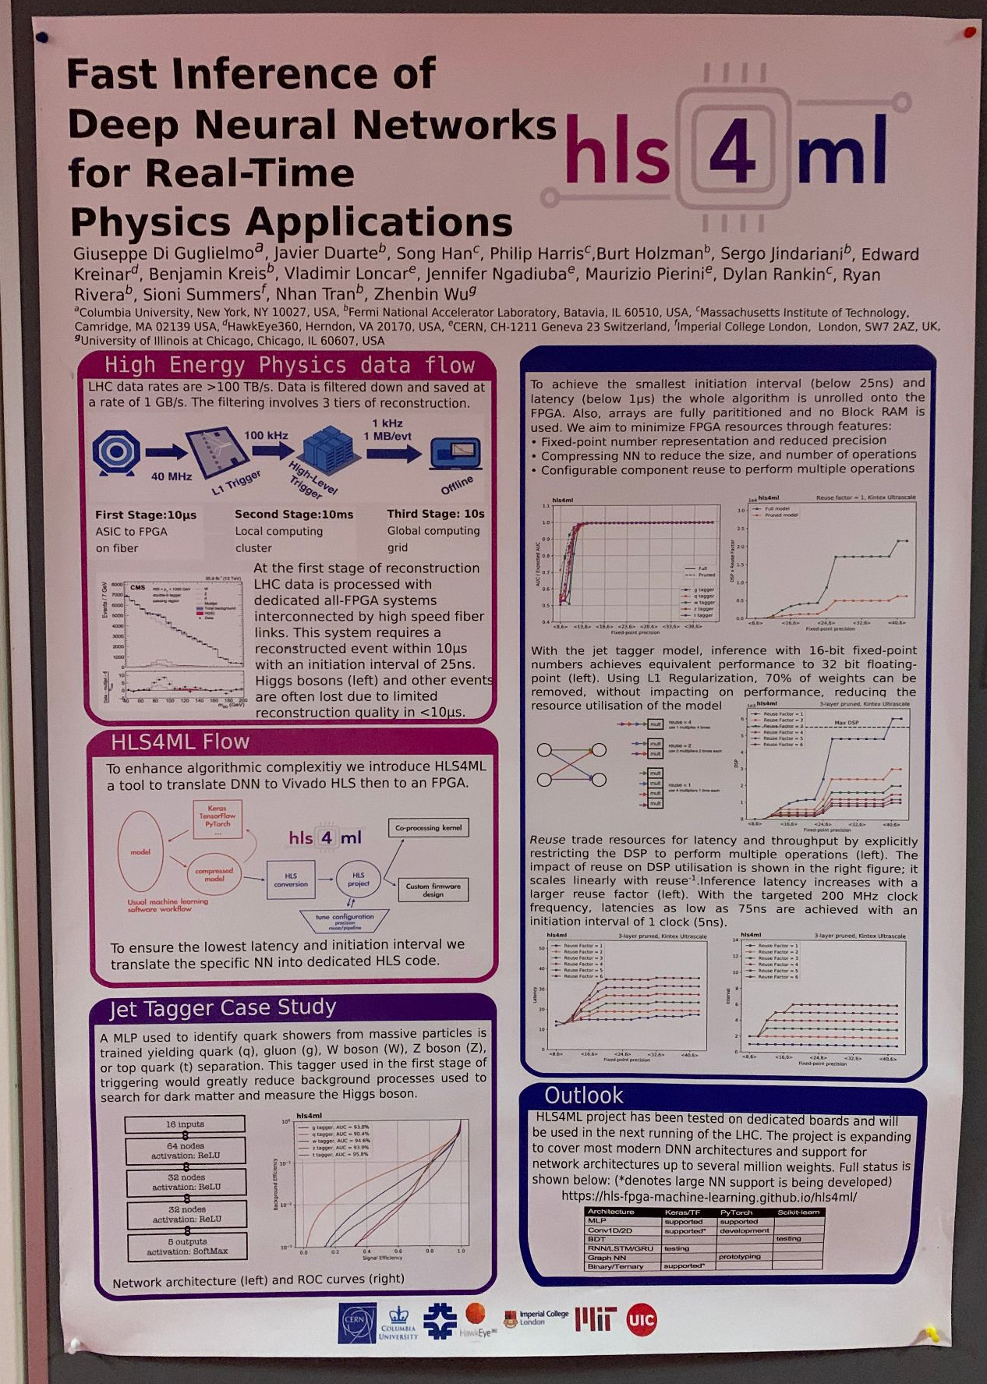
Discussions at MIT, 12/14/2021
Phil, Yasser and Ming @MIT 12/2021

Slide 31
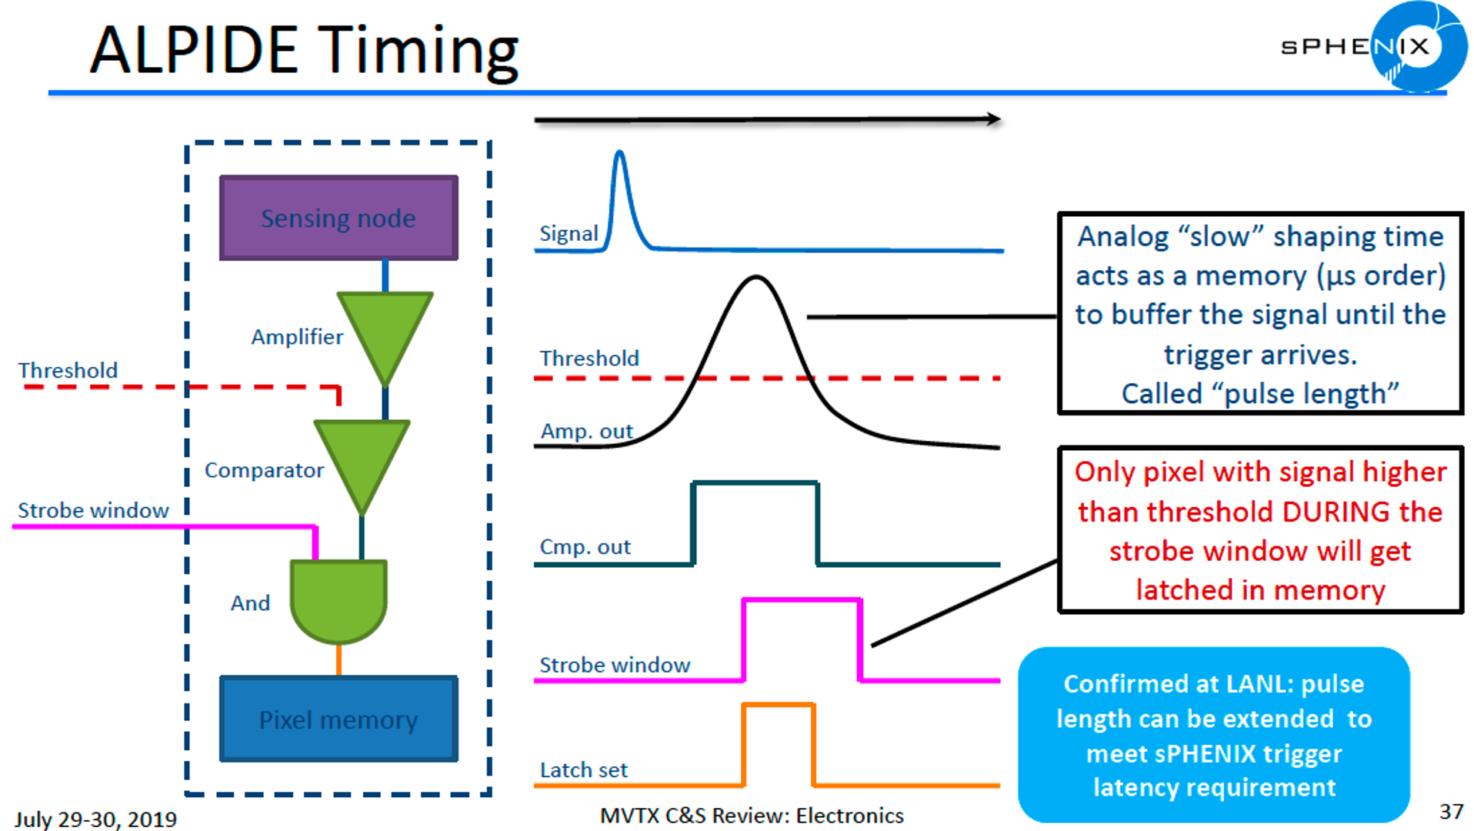
~10ns
Rising 1~2us
Width ~5us
~Readout
starts
~5us

Slide 32
FPHX Chip (Analog Section)
Tracking System: MVTX+INTT+TPC
T-peak ~ 60 ns (programmable)
128 channel
46, 50, 60, 67, 85, 100, 150, or 200 mV/fC
60 ns peak time (rt- pgmbl)
3—bit ADC (th-pgmbl)
Optimized to 1 to 2.5 pf input
115e + 134e/pf
~ 70 to 140 μW/ch (dep. gain)
Program gain and Vref
Disc outputs
3-bit ADC
Vref
+
Shaper
Integrator
_
Comp
Input
Vth0
Comp
At max. input transistor bias of 38uA: 115e + 134e/pF
Silicon strip + readout line capacitance ~ 6pF
Predicted noise ~ 115e + 134e/pF * 6pF ~ 1,000e
Signal ~ 20,000e
Expected S/N ~ 20/1
Vth1
Comp
Programmable Thresholds
Vth7

Slide 33
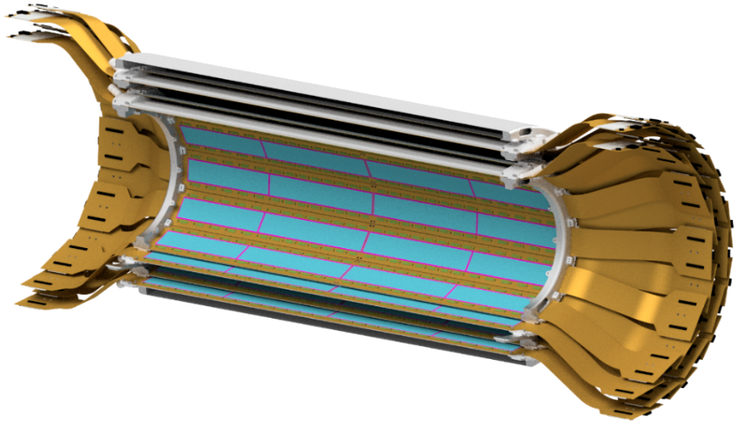
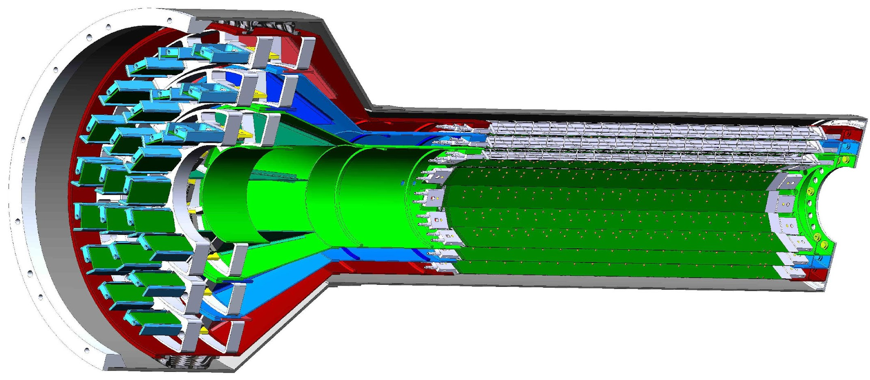
Tracking at sPHENIX
INTT
Tracking consists of 3 sub-detectors:
  Pixel Vertex Detector (MVTX)
  Intermediate Silicon Tracker (INTT)
  Time Projection Chamber (TPC)
MVTX and INTT are both capable of streaming readout
Combined tracking to r = 10.3 cm
2 active double-layers
47 cm active length/ladder
Silicon strip detector
MVTX
3 active layers
9 ASICs/stave
27 cm active length/stave
Pixel detector

Slide 34
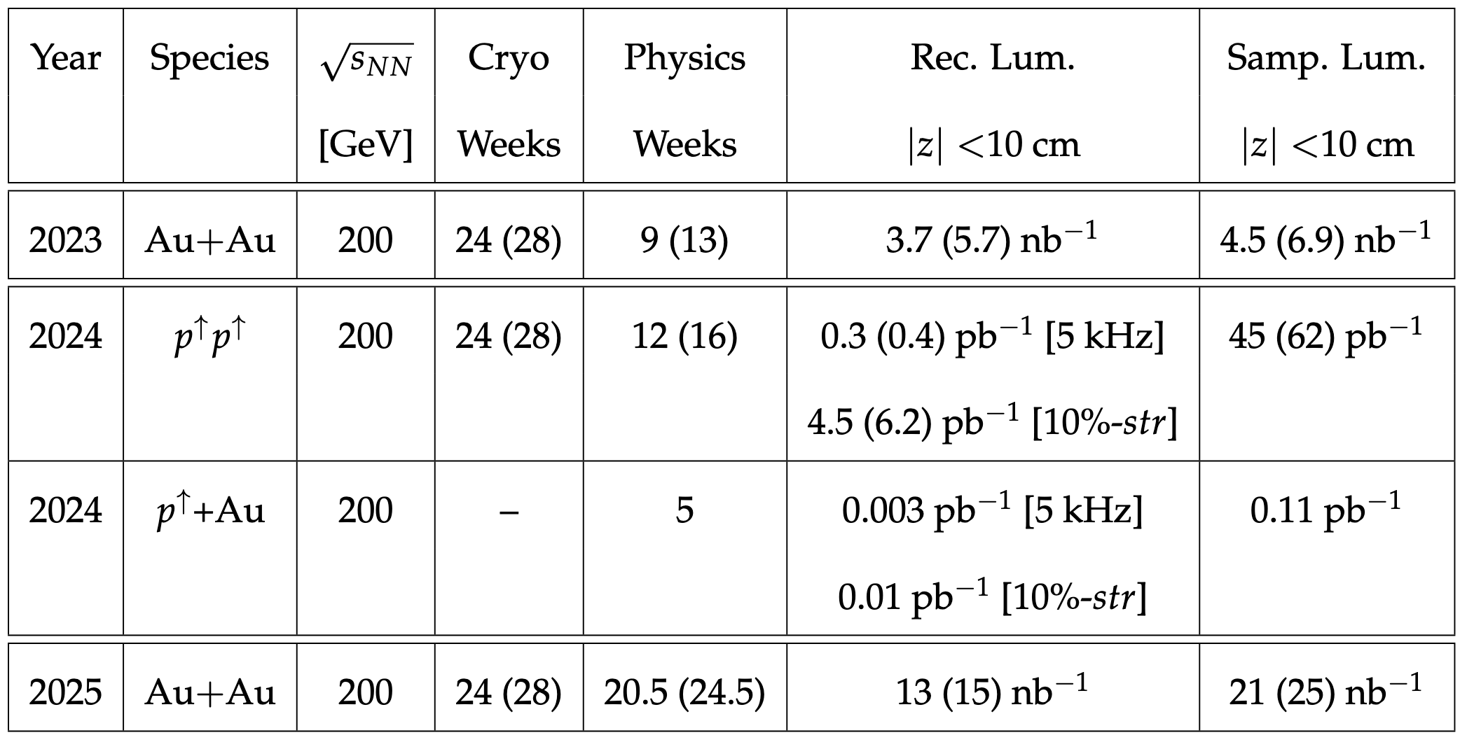
sPHENIX HF constraints
sPHENIX has great tracking and calorimetry
However, limited by calorimetry backend readout rate (15kHz) in triggered mode
RHIC pp rate is ~10 MHz
Plan: Use tracker SRO to
recover some heavy flavor
physics potential
sPHENIX beam-use proposal. 5 kHz refers to final rate with triggered readout, 10%-str refers to 10% streaming readout

Slide 35
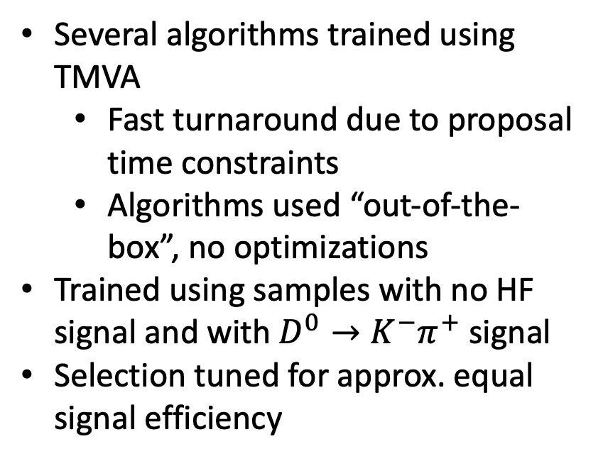
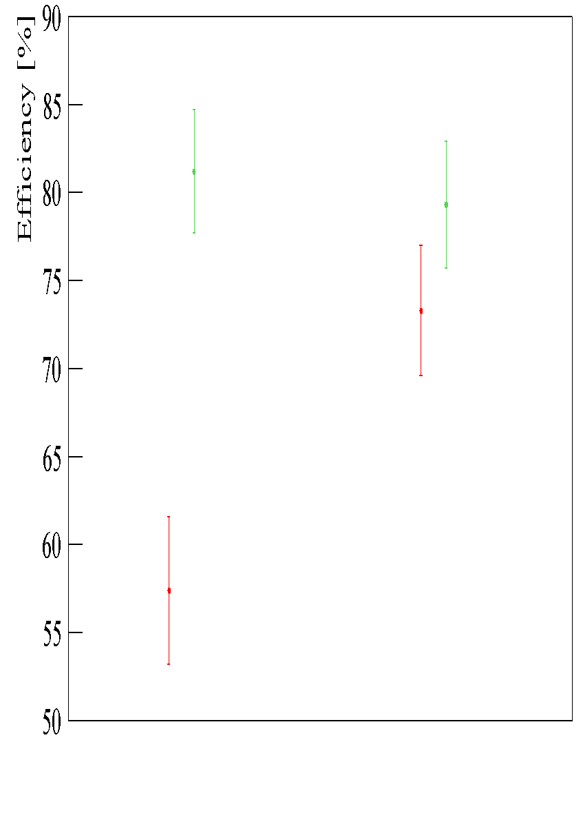
Case study: AI HF selections
Conventional Selection
ML Selection
Green – The signal selection efficiency
Red – The background rejection efficiency

Slide 36
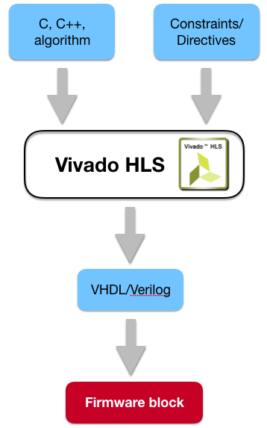

How are FPGAs programmed?
Hardware Description Languages
HDLs are programming languages which describe electronic circuits
High Level Synthesis
Compile from C/C++ to VHDL
Pre-processor directives and constraints used to optimize the design
Drastic decrease in firmware development time!
Today we’ll use Xilinx Vivado HLS [*]
[*] https://www.xilinx.com/support/documentation/sw_manuals/xilinx2020_1/ug902-vivado-high-level-synthesis.pdf

Slide 37
Constructing ML algorithms
Aim to develop algorithms as Graph Neural Networks (GNN)
Advantageous over Convolutional Neural Networks (CNN) by adding edge information
Detector and physics knowledge will improve predictions
Algorithms deployed at several points:
  Fast tracking on FPGA
  Topological separation of HF signals on FPGA
  Beam-spot and anomaly detection on GPU
  Part of feedback system to improve 1 & 2 plus inform detector operators

Slide 38
Constructing ML algorithms
Anomaly detection is important in all experiments
RHIC experiments cannot be accessed during beam to fix issues
Aim to use variational autoencoders
Incoming data can be compared for:
Noisy pixels
Dead strips
Change in beam spot or alignment
Pass info. back to selection system to improve yield
Pass back to control room

Slide 39
What we actually used in Json Data Files?
‘RawHit’ contains two part: [u'MVTXHits', u'Description']
‘MVTXHits’ contains all the hits information.
Each hit contains: [u'Coordinate', u'ID']
‘ID’ contains: [u'Layer', u'PixelZIndex', u'Chip', u'Stave',
u'PixelPhiIndexInLayer', u'HitSequenceInEvent',
u'PixelPhiIndexInHalfLayer',u'PixelHalfLayerIndex', u'Pixel',
u'HalfLayer']

Slide 40
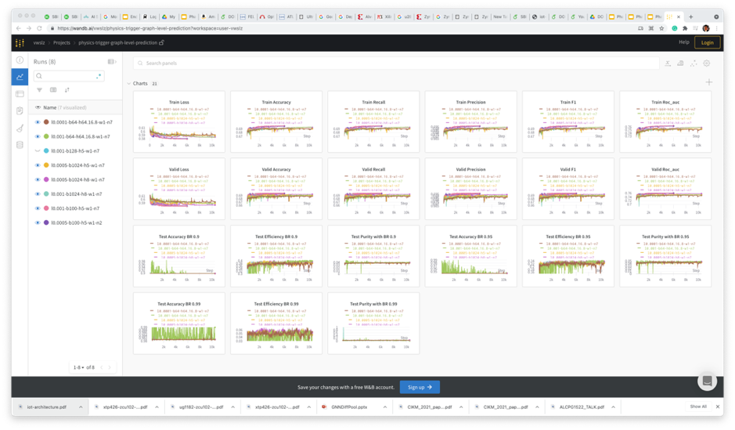
Training Dashboard

