Slide 1
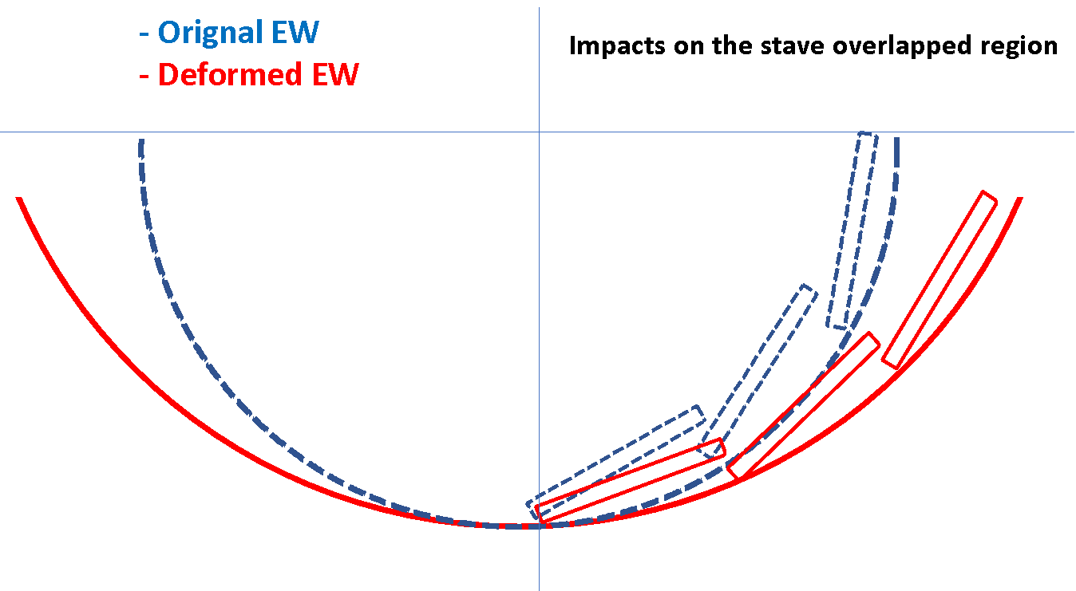
R
dR
the overlapped region is not affected much?
2nd order effects?
check with CAD model ?
L0: dR/R = 0.069/30.970 = 0.22%
L1: dR/R = 0.130/38.990 = 0.33%
L2: dR/R = 0.142/46.740 = 0.30%

Slide 2
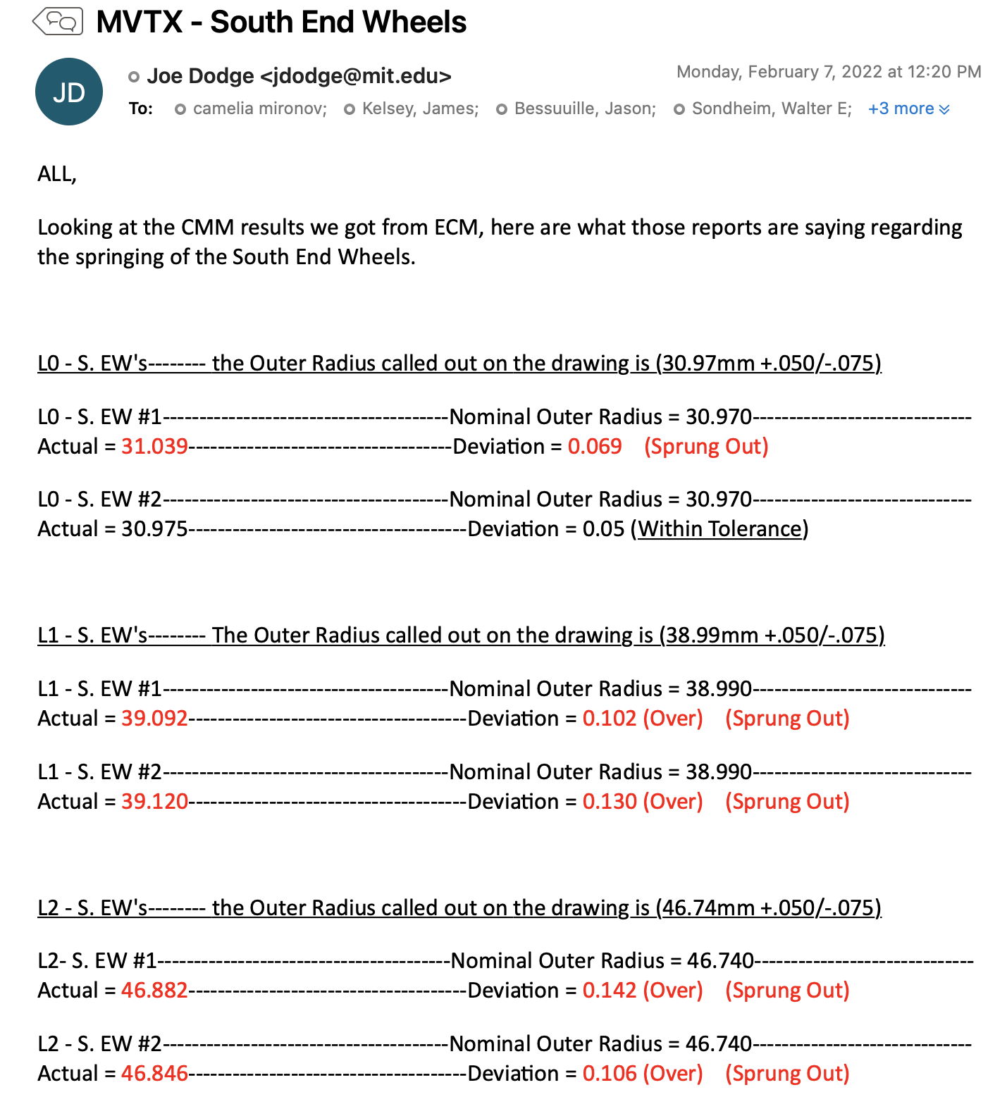
from MIT
L0: dR/R = 0.069/30.970 = 0.22%
L1: dR/R = 0.130/38.990 = 0.33%
L2: dR/R = 0.142/46.740 = 0.30%

Slide 3
Slides from LBNL Updates, Feb. 3, 2022
https://docs.google.com/presentation/d/19bHrFrtd5A5bDs_U4JckvNtN_kBB315EH8V-WvBNsso/edit?pli=1#slide=id.g11018c35548_0_85

