Slide 1
New GEANT4 physics model
without “multiple scattering & energy loss staggling”
14 Feb. 2022
J. Y. Jeong¹, J. H. Kim², Y. K. Kim¹, Y. Kwon²
Hanyang Univ.¹
Yonsei Univ.²

Slide 2
Motivation & brief summary
Frequent questions arise while in alignment effort. “What would be the charged particle trajectories under the magnetic field with mean energy loss but without physical fluctuations. Therefore, We want a simulation without fluctuations and build a reference for alignment.
Specifically we need to turn off ‘multiple scattering’ and ‘energy loss straggling’ in GEANT4.
To utilize the standard simulation tool with minimum modification, we made efforts to utilize the object ‘G4EmParameters’ and turn off interactions. The effort was, however, not successful, and we decided to develop a physics model without interaction, a small deviation to be documented.

Slide 3
MSC calculation in each layer
$$MSC_{Beampipe,Layer_{x}}=\frac{13.6}{momentum}×\sqrt{0.0021}×\left(Radius_{Layer_{x}}−Radius_{Beampipe}\right)$$
$$MSC_{Layer_{x},Layer_{y}}=\frac{13.6}{momentum}×\sqrt{0.0035}×\left(Radius_{Layer_{y}}−Radius_{Layer_{x}}\right)$$
$$Layer_{0}^{′}s MSC=MSC_{Beampipe,Layer_{0}}$$
$$Layer_{1}^{′}s MSC=\sqrt{{\left(MSC_{Beampipe,Layer_{1}}\right)}^{2}+{\left(MSC_{Layer_{0},Layer_{1}}\right)}^{2}}$$
$$Layer_{2}^{′}s MSC=\sqrt{{\left(MSC_{Beampipe,Layer_{2}}\right)}^{2}+{\left(MSC_{Layer_{0},Layer_{2}}\right)}^{2}+{\left(MSC_{Layer_{1},Layer_{2}}\right)}^{2}}$$
Thanks to Dr. Jin Huang

Slide 4
G4EmParameters class set-up
auto g4emparameters = G4EmParameters::Instance();
g4emparameters->SetPixe(false);
std::cout<<"[G4Emparameters::Instance] "<<g4emparameters<<std::endl;
// SetLateralDisplacement
std::cout<<"[G4Emparameters::LateralDisplacement] A "<<g4emparameters->LateralDisplacement()<<std::endl;
g4emparameters->SetLateralDisplacement(false);
std::cout<<"[G4Emparameters::LateralDisplacement] B "<<g4emparameters->LateralDisplacement()<<std::endl;
//SetLossFluctuations
std::cout<<"[G4Emparameters::LossFluctuations] A "<<g4emparameters->LossFluctuation()<<std::endl;
g4emparameters->SetLossFluctuations(false);
std::cout<<"[G4Emparameters::LossFluctuations] B "<<g4emparameters->LossFluctuation()<<std::endl;
g4emparameters->SetMuHadLateralDisplacement(false);
std::cout<<"[G4Emparameters::SetMuHadLateralDisplacement] "<<g4emparameters->MuHadLateralDisplacement()<<std::endl;
g4emparameters->SetLateralDisplacementAlg96(false);
g4emparameters->ActivateAngularGeneratorForIonisation(false);
g4emparameters->SetEnableSamplingTable(false);
g4emparameters->SetMscThetaLimit(0);
g4emparameters->SetGeneralProcessActive(false);
ofstream a("InterationDat.txt");
g4emparameters->StreamInfo(a);
a.close();
//G4RunManager::GetRunManager()->PhysicsHasBeenModified();
=======================================================================
====== Electromagnetic Physics Parameters ========
=======================================================================
LPM effect enabled 1
Spline of EM tables enabled 1
Enable creation and use of sampling tables 0
Apply cuts on all EM processes 0
Use integral approach for tracking 1
Use general process 0
Enable linear polarisation for gamma 0
Enable sampling of quantum entanglement 0
X-section factor for integral approach 0.8
Min kinetic energy for tables 100 eV
Max kinetic energy for tables 100 TeV
Number of bins in tables 84
Number of bins per decade of a table 7
Verbose level 0
Verbose level for worker thread 0
Bremsstrahlung energy threshold above which
primary is added to the list of secondary 100 TeV
Lowest triplet kinetic energy 1 MeV
Enable sampling of gamma linear polarisation 0
5D gamma conversion model type 0
5D gamma conversion model on isolated ion 0

Slide 5
=======================================================================
====== Ionisation Parameters ========
=======================================================================
Step function for e+- (0.2, 1 mm)
Step function for muons/hadrons (0.2, 0.1 mm)
Lowest e+e- kinetic energy 1 keV
Lowest muon/hadron kinetic energy 1 keV
Fluctuations of dE/dx are enabled 0
Use ICRU90 data 0
Use built-in Birks satuaration 1
Build CSDA range enabled 0
Use cut as a final range enabled 0
Enable angular generator interface 0
Factor of cut reduction for sub-cutoff method 1
Max kinetic energy for CSDA tables 1 GeV
Max kinetic energy for NIEL computation 0 eV
Linear loss limit 0.01
Read data from file for e+e- pair production by mu 0
=======================================================================
====== Multiple Scattering Parameters ========
=======================================================================
Type of msc step limit algorithm for e+- 1
Type of msc step limit algorithm for muons/hadrons 0
Msc lateral displacement for e+- enabled 0
Msc lateral displacement for muons and hadrons 0
Urban msc model lateral displacement alg96 0
Msc lateral displacement beyond geometry safety 0
Range factor for msc step limit for e+- 0.04
Range factor for msc step limit for muons/hadrons 0.2
Geometry factor for msc step limitation of e+- 2.5
Safety factor for msc step limit for e+- 0.6
Skin parameter for msc step limitation of e+- 1
Lambda limit for msc step limit for e+- 1 mm
Use Mott correction for e- scattering 0
Factor used for dynamic computation of angular
limit between single and multiple scattering 1
Fixed angular limit between single
and multiple scattering 0 rad
Upper energy limit for e+- multiple scattering 100 MeV
Type of nuclear form-factor 1
Screening factor 1
=======================================================================

Slide 6
MSC in 500 MeV μ⁻
 |  | Beryllium beam pipe |  | radius: | 20.765 | mm
Energy |  | Layer0 | 4.792641 | um
500 | MeV | Layer1 | 27.19121 | um
 |  | Layer2 | 37.40691 | um
Pixel location histograms at Layer 2
G4EmParameters
Class was set to turn off the multiple scattering interaction.
The multiple scattering interaction was not turned off!

Slide 7
We try a different method to turn off the multiple scattering interaction.
We modified source codes of the FTFP_BERT physics module.
And we made a class which indicate whether each interaction is applied.

Slide 8
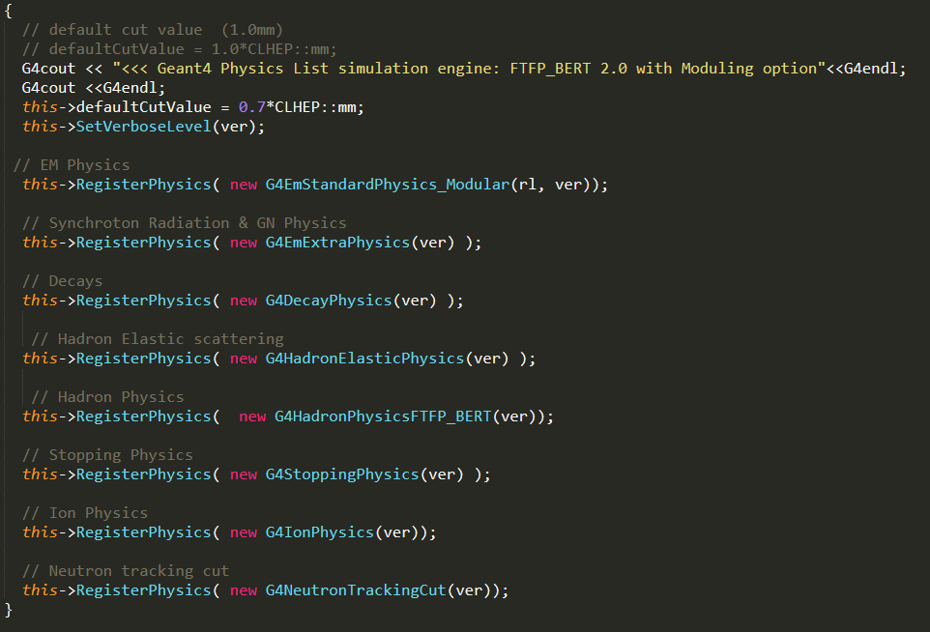
Physicslist_reactionopt.cc

Slide 9
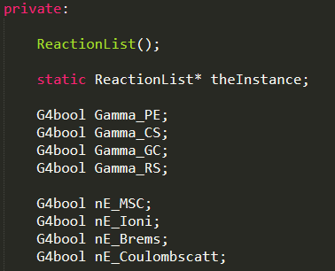
ReactionList.hh
...
Functions to get/set the flag which indicate whether each interaction is turned on/off.

Slide 10
Existing method to apply a physics model
Fun4All_G4_sPHENIX.C
{
...
G4Setup();
...
se->run(1);
}
G4Setup_sPHENIX.C
{
PHG4Reco* g4reco = new PHG4Reco;
...
g4Reco->SetPhysicsList(“FTFP_BERT”);
...
se->registerSubsystem(g4Reco);
}
PHG4Reco.cc
{
if (m_PhysicsList == “FTFP_BERT”
{
myphysicslist = new FTFP_BERT(Verbosity());
}
...
m_Runmanager->SetUserInitialization(myphysicslist);
}
List of physics models
we can choose
FTFP_BERT
FTFP_BERT_HP
FTFP_INCLXX
FTFP_INCLXX_HP
QGSP_BERT
QGSP_BERT_HP
QGSP_BIC
QGSP_BIC_HP
QGSP_INCLXX
QGSP_INCLXX_HP
EIC

Slide 11
New way to apply a physics model which can turn on/off interactions
Fun4All_G4_sPHENIX.C
{
...
ReactionList* fReactionList=ReactionList::Instance();
fReactionList->SetReactionFlag("mu-","MultipleScattering",true);
G4Setup();
...
se->run(1);
}
G4Setup_sPHENIX.C
{
PHG4Reco* g4reco = new PHG4Reco;
...
g4Reco->SetPhysicsList(“Physicslist_reactionopt”);
...
se->registerSubsystem(g4Reco);
}
PHG4Reco.cc
{
if (m_PhysicsList == “reactionopt”
{
ReactionList* fReactionList=ReactionList::Instance();
myphysicslist = new Physicslist_reactionopt(fReactionList, Verbosity());
}
...
m_Runmanager->SetUserInitialization(myphysicslist);
}
List of physics models
we can choose
FTFP_BERT
FTFP_BERT_HP
FTFP_INCLXX
FTFP_INCLXX_HP
QGSP_BERT
QGSP_BERT_HP
QGSP_BIC
QGSP_BIC_HP
QGSP_INCLXX
QGSP_INCLXX_HP
EIC
Physicslist_reactionopt
We tried to modify original source codes as less as possible.

Slide 12
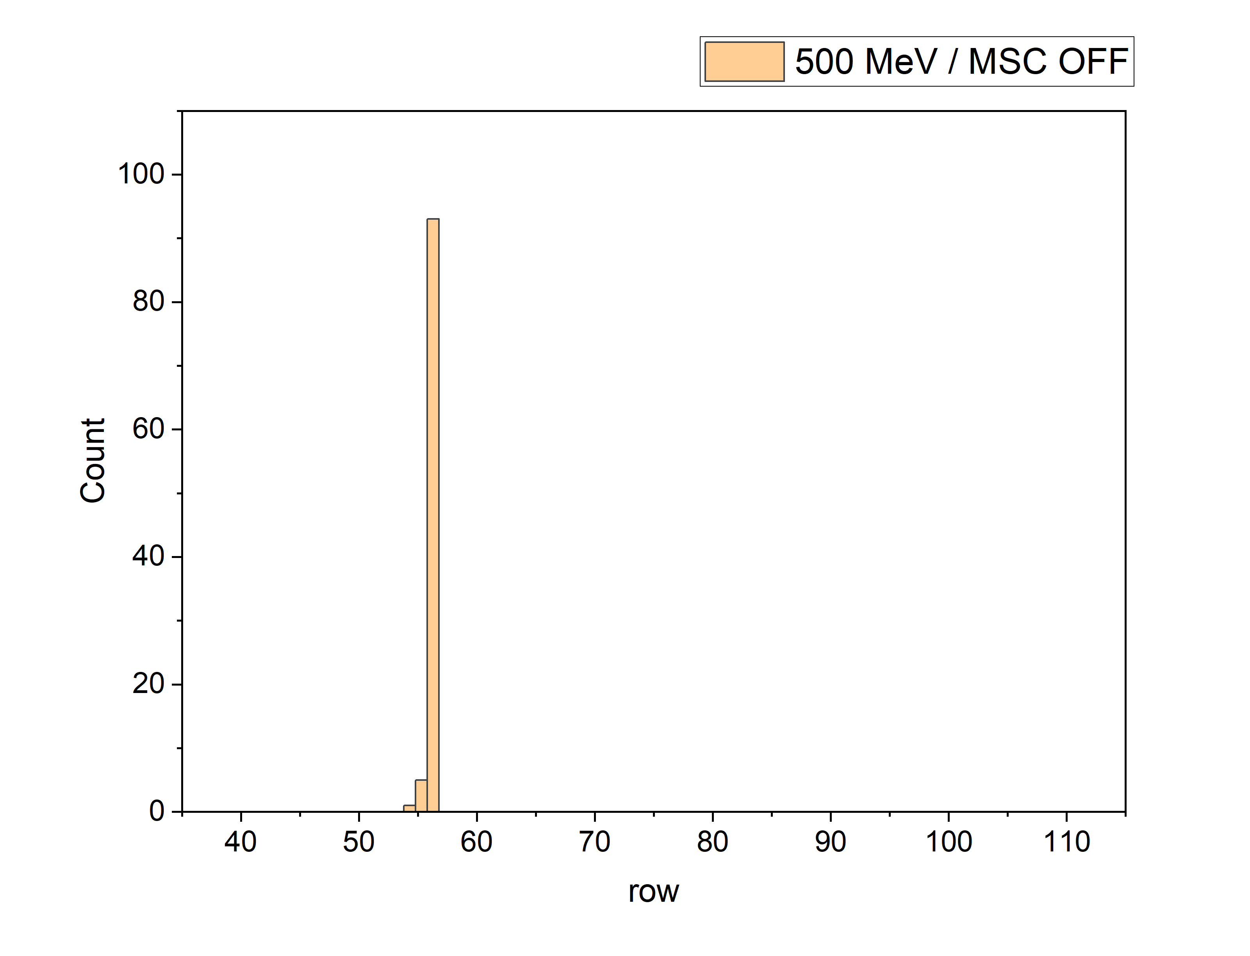
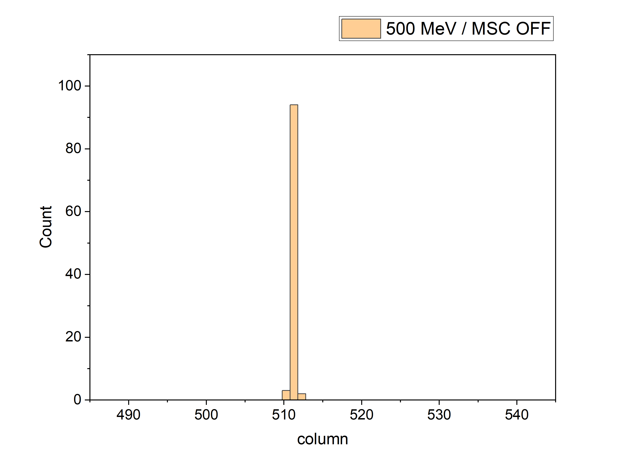
ON
ON
Layer 2 (before)
Layer 2 (after)
The modified physics model seems to turn off the multiple scattering.

Slide 13
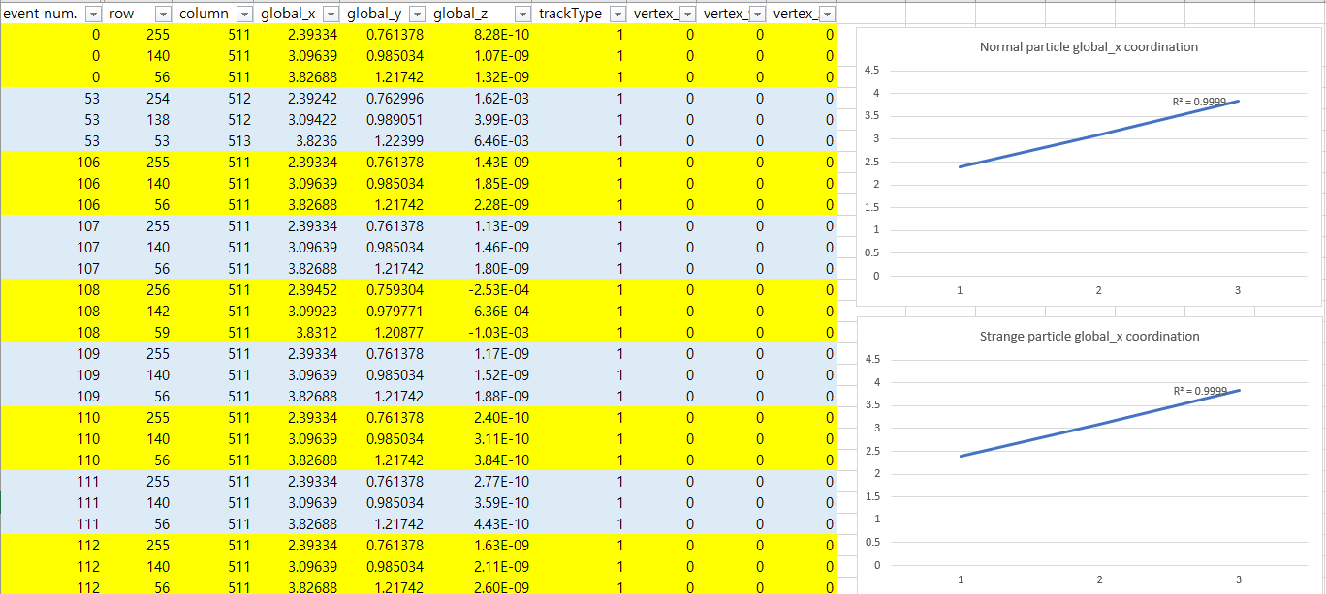
There is still a small spread.
It seems to be linear…
Particles shows the same global x,y coordinate when they hit the No.56 sensor in row.
So, it seems to be not due to energy loss fluctuation or multiple scattering.
For the other particles (no modification in the physics process), deflection by multiple scattering/energy loss fluctuation are as expected.

Slide 14
Conclusion
We don’t know why, but the interactions was not turned off by G4EmParameters class.
On the other hand, the physics model with small modification seems to turn off the multiple scattering and energy loss.
We can also turn off various interactions with this model.
We can build a database which is needed for the alignment effort.
We want to document the model and register the modification to git repository.

