Slide 1
Using ML to Tag HF/Muons in sPHENIX
Expand PHENIX capability
- Explore muon potentials for
open HFs and quarkonia
sPHENIX Detector
Tracking
EMCal
IHCal
OHcal

Slide 2
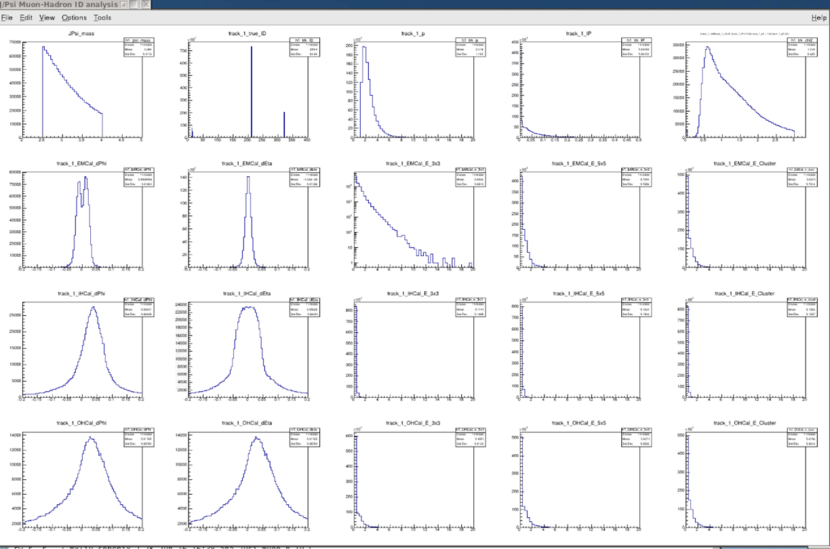
1st test: can we do muon identification with “E” and “p” alone ?
sPHENIX MDC-1 data samples: p+p -> bbar, from Cameron
➔ search for J/Psi -> dimuons
Randomly assign tracks as “muons” and calculate the invariant mass
→ NO clear J/Psi peak
2) Most tracks are pi’s and K’s
Track and energy cluster matching:
- dPhi and dEta
3) EMcal: dphi, deta
1
2
pi
Trks:
p
IP
chi2
e/mu
K
EMCal:
dPhi
dEta
E_3x3
E_5x5
E_cluster
iHCal:
dPhi
E_3x3
E_5x5
E_cluster
OHCal:
dPhi
E_3x3
E_5x5
E_cluster

Slide 3
If we can identify the muons …

Slide 4
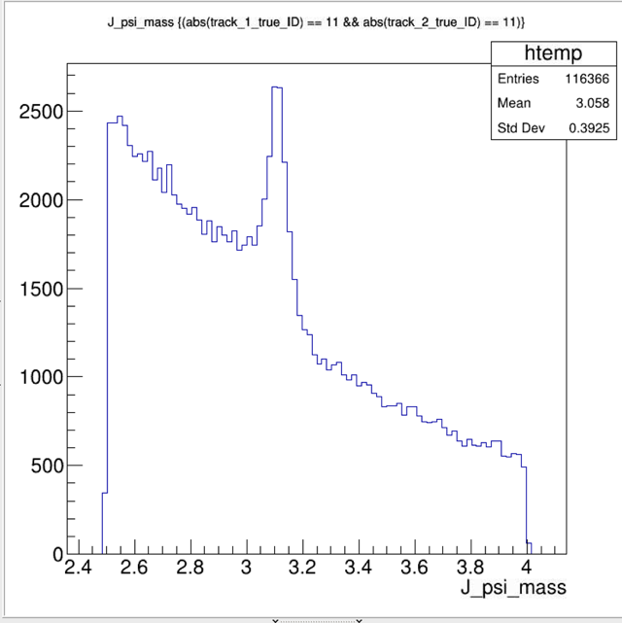
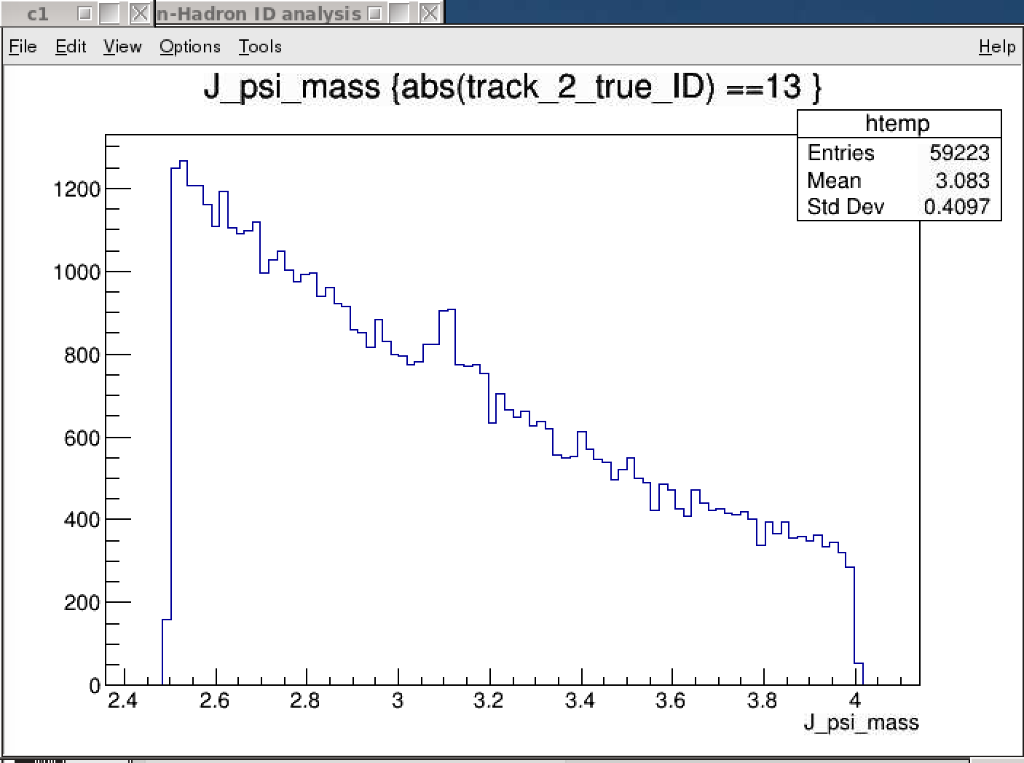
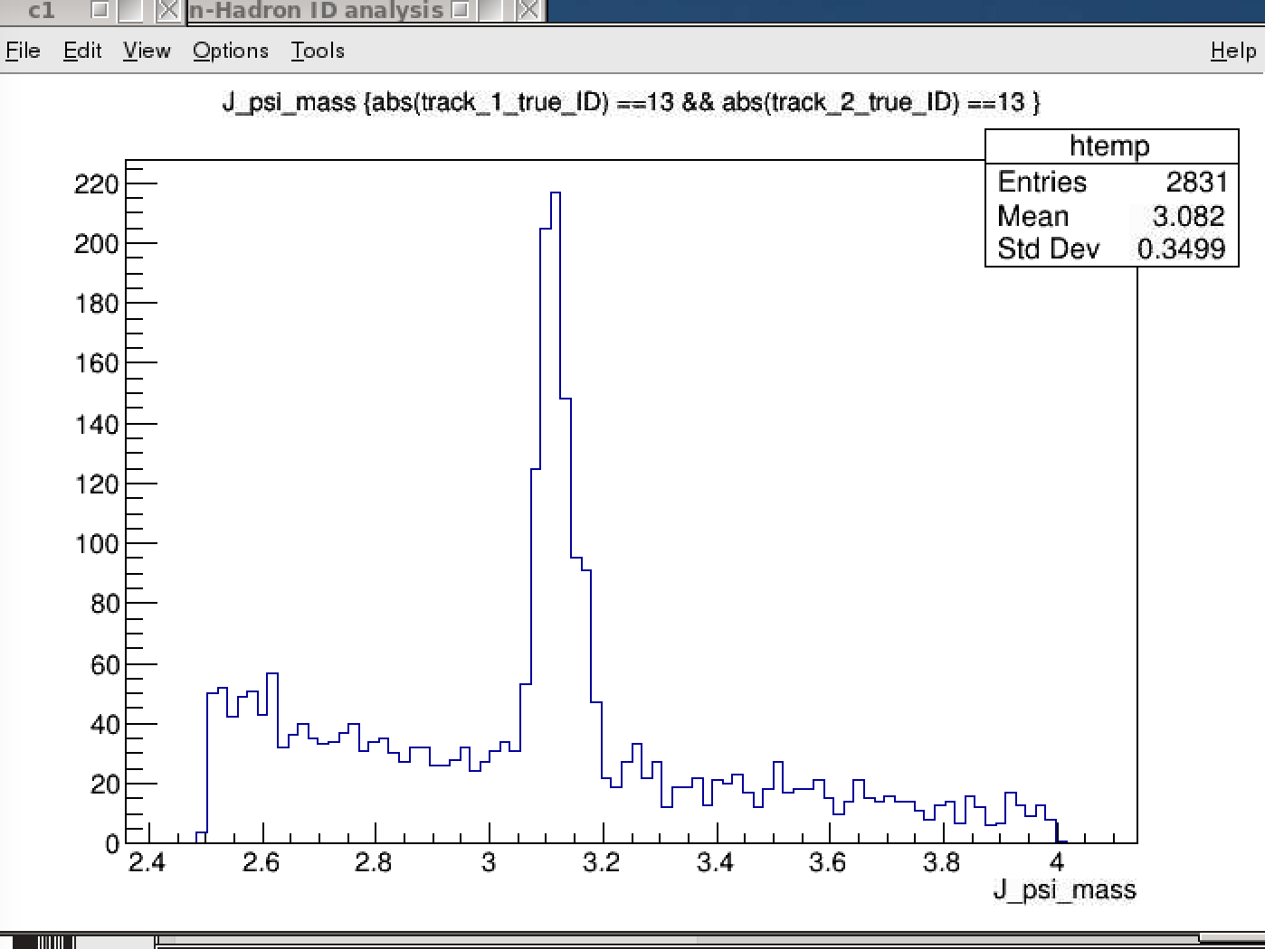
J/Psi Candidates with “di-muons” - later also for di-electrons
B->J/Psi + X
HF samples: pp->b-bbar
(prompt QCD background could be further rejected with DCA cuts)
Two electrons identified
– note the high background
One muon identified
Two muons identified
e+e-

Slide 5
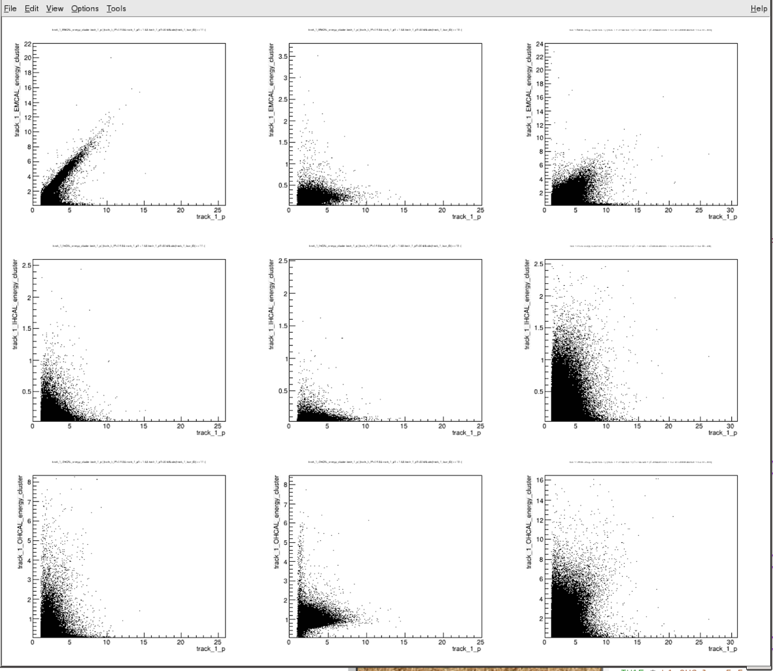
EMCal & Hcal dE vs track p
e^{+/-}
mu^{+/-}
h^{+/-}
EMCal:
E/p matching, okey at high energy for electrons
Broad distribution for muon, MIP-like
Broad distribution,
iHcal:
Broad distributions
EMCal
iHCal
Other than the electrons, it is quite challenge to identify muons and hadrons because of the lack of clear obvious correlations ….
The correlation is quite weak and complicated,
a good example where ML could shine!
oHCal

Slide 6
How well can one identify muons with ML?

Slide 7
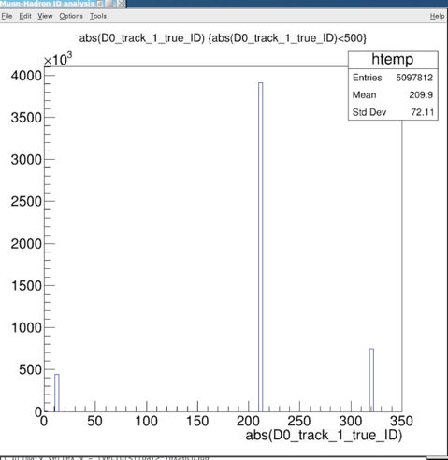
1st Attempt to do Muon Identification with ML in sPHENIX
Tracks’ true ID in the samples
Tracking information, p, DCA, chi2 etc.
Mostly hadrons, ~5% muons
dE and matchings in dPhi, dEta, E/p
EMCal
IHCal
OHcal
The correlation is quite weak and complicated,
a good example where ML could shine!
Training/Testing samples (mostly muons, pi/K)
Cameron’s KFParticle output for J/Psi analysis, from b-bbar events
Track p> 3GeV
EMCal>0, iHCal >=0, oHCal >= 0
Similar results observed for p >2GeV samples
DataRobot package provides 20+ Machine Learning Models for classification
Identify “muons” from the training samples
Selected top performers
Pi+/-
K+/-
e,mu

Slide 8
DataRobot: 20+ ML models available
One can get free trial version …

Slide 9
Muon Identification
3 < p < 20 GeV
has hits in EMCal
Inputs: reconstructed variables:
P, pT, IP, chi2, EMcal, iHCal, oHCal
and also ratios: EMCal/p, iHCal/p and oHCal/p
It seems we can achieve muon identification with:
Purity ~ 70% @ Eff = 40%

Slide 10
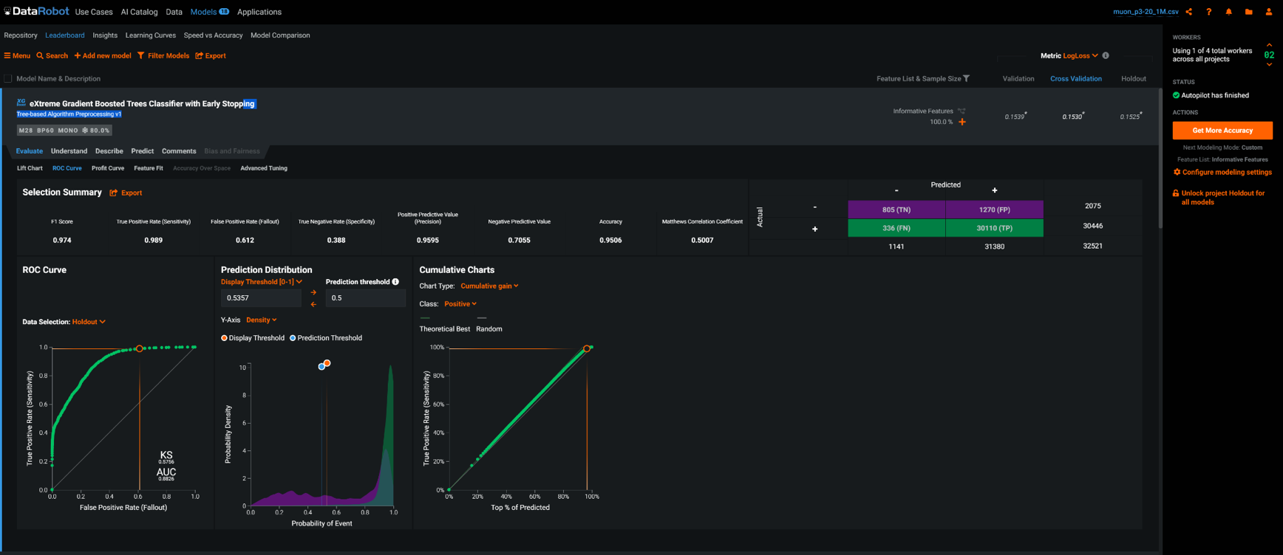
Muons: 3 < p <20 GeV: Extreme Gradient Boosted Tree Classifier with Early Stopping
Purity: 805/2075= 70.6%
Eff. = 530/2287 = 38.8%
FoM = Purity* Eff = 27.4%
Purity: 530/573= 92.5%
Eff. = 530/2287 = 23.2%
FoM = Purity* Eff = 21.5%

Slide 11
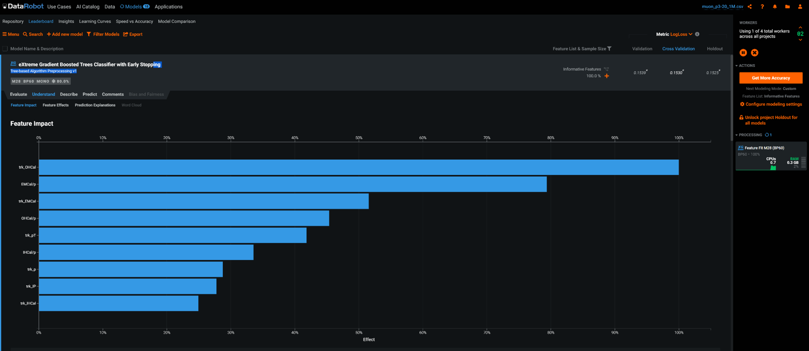
Key features: Extreme Gradient Boosted Trees
dE_oHCal
dE_EMCal/p
Purity: 530/573= 92.5%
Eff. = 530/2287 = 23.2%
FoM = Purity* Eff = 21.5%
< --- Expect trk_IP important to reject prompt hadrons

Slide 12
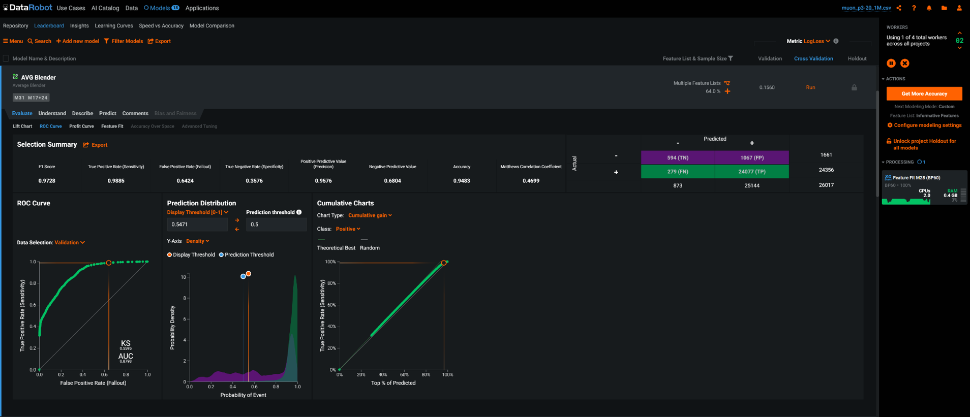
Muons: 3 < p <20 GeV: AVG Blender Model
Purity: 594/873= 68.0%
Eff. = 594/1661 = 35.8%
FoM = Purity* Eff = 24.3%
Purity: 530/573= 92.5%
Eff. = 530/2287 = 23.2%
FoM = Purity* Eff = 21.5%

Slide 13
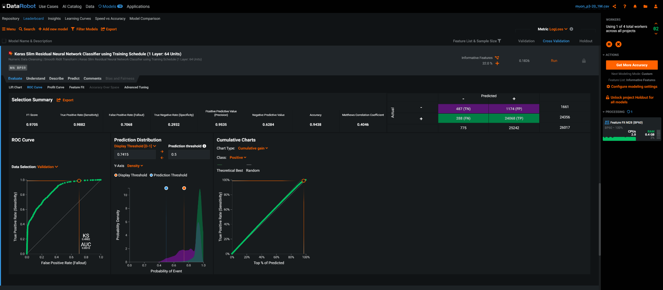
Muons: 3 < p <20 GeV: Keras Slim Residual Neural Network
Purity: 487/775= 62.8%
Eff. = 487/1661 = 29.3%
FoM = Purity* Eff = 18.4%
Purity: 530/573= 92.5%
Eff. = 530/2287 = 23.2%
FoM = Purity* Eff = 21.5%

Slide 14
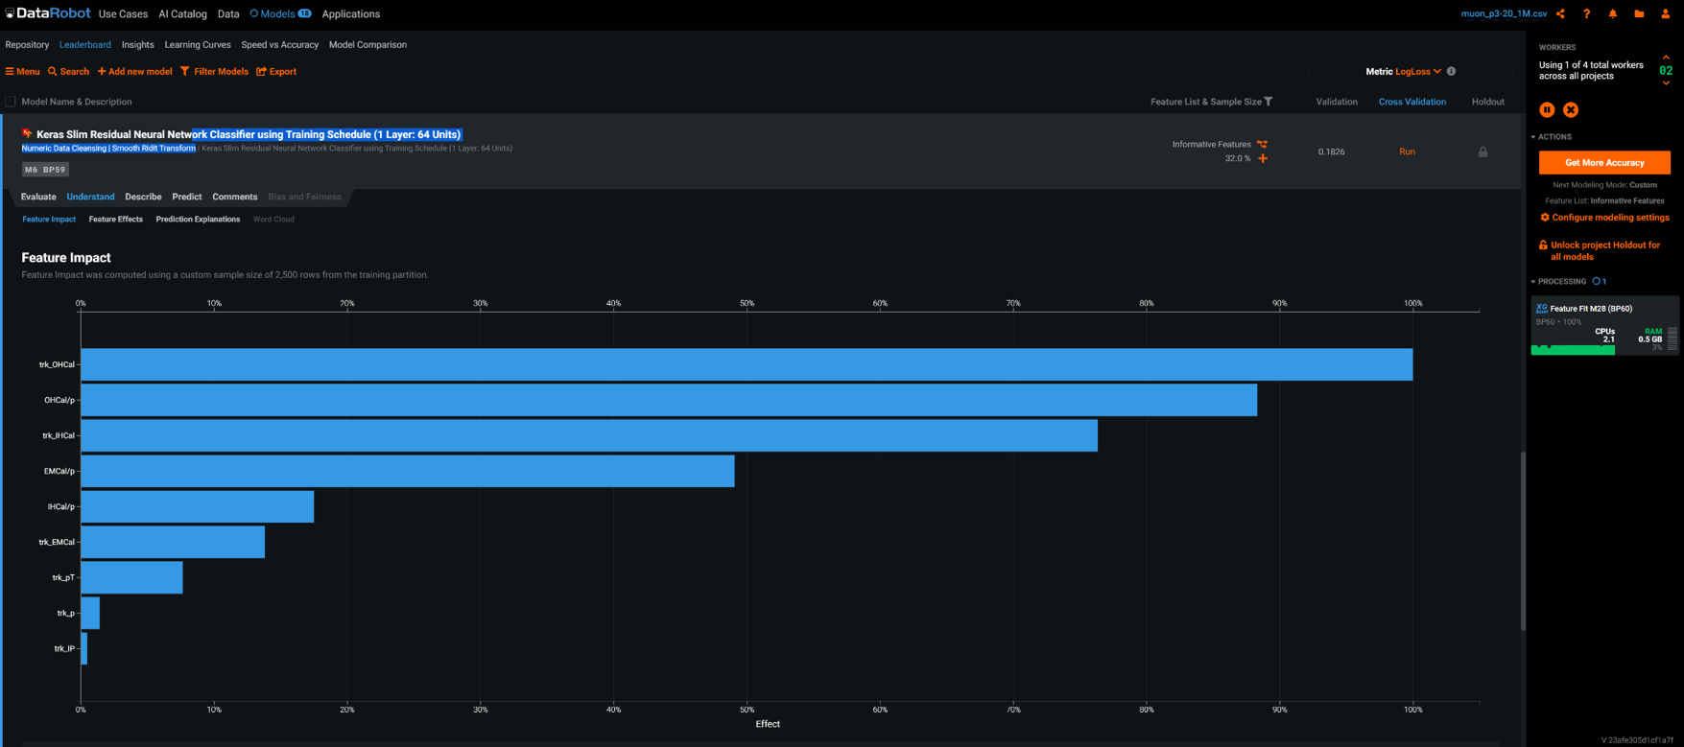
Key features: Keras Slim Residual Neural Network
dE_oHCal
dE_oHCal/p
Purity: 530/573= 92.5%
Eff. = 530/2287 = 23.2%
FoM = Purity* Eff = 21.5%
< --- Expect trk_IP important to reject prompt hadrons

Slide 15
Also looked at the electrons

Slide 16
Electrons: p> 3GeV: from RandomForest
Purity: 932/1047=89.0%
Eff. = 932/2858 = 32.6%
FoM = Purity* Eff = 29.0%

Slide 17
Features’ Impacts: electron ID, from RandomForest Classifier
EMCal/p
EMCal
Trk_IP

Slide 18
What’s next?
LANL PYTorch Training class:
this Tue-Wed. 1 – 3 PM
Muon ID in sPHENIC could have high impact on both open HF and heavy quarkonia programs!
Implement such tools in sPHENIX offline framework
- PyTorch and other tools, ROOT TMVA etc.
Can we trigger on “J/Psi” -> dimuons? (or di-electrons?)
B->J/psi + X in pp and pA collisions
Could sample the whole pp and pA luminosities !!! (currently ~0)
Apply ML to other applications
AI-based HF trigger

Slide 19
ML and HF Trigger for sPHENIX (and EIC)
MVTX+INTT:
Streaming readout through FELIX
FPGA-accelerated AI → identify HF events, “HF trigger” for TPC and other subsystems
Fast HF Triggers to initiate TPC (and EMCal + HCal when available) readout
Full HF program with tracking and EMCal/Hcal for pp and pA
DOE FOA-0002490 Proposal
(LANL, MIT, Fermilab, NJIT)

Slide 20
Backup slides

Slide 21
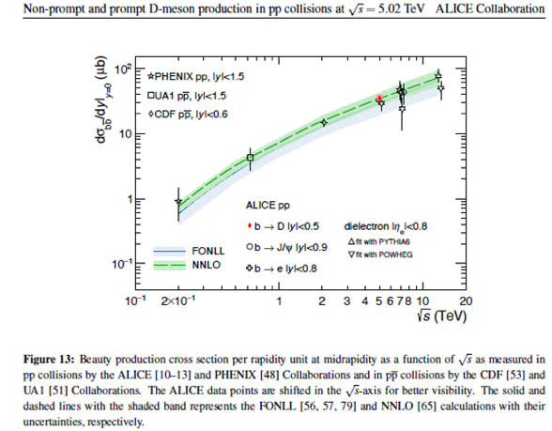
Charm & Beauty hadron production @sPHENIX
Inclusive and exclusive b-hadron measurements:
sPHENIX BUP 2020
B-> mu + X
B->J/Psi + X
J/Psi -> mu+mu-
Upsilon -> mu+ mu-
…
@RHIC 200GeV pp:
ccbar ~ 500ub
bbar ~ 1ub
→ A lot of HF events

Slide 22
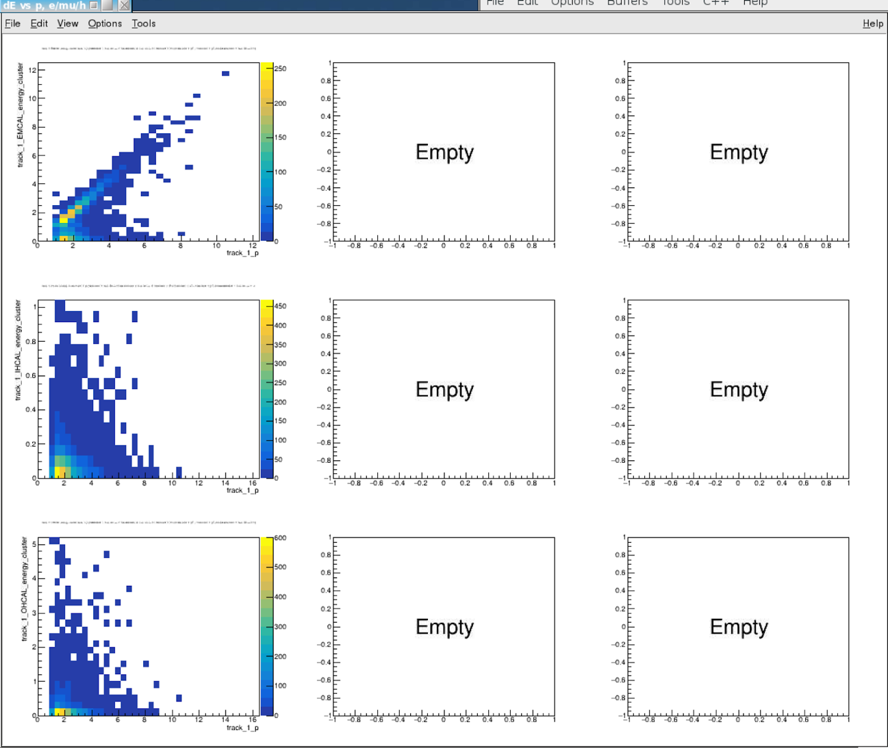
Electrons
EMCal
iHCal
oHCal

Slide 23
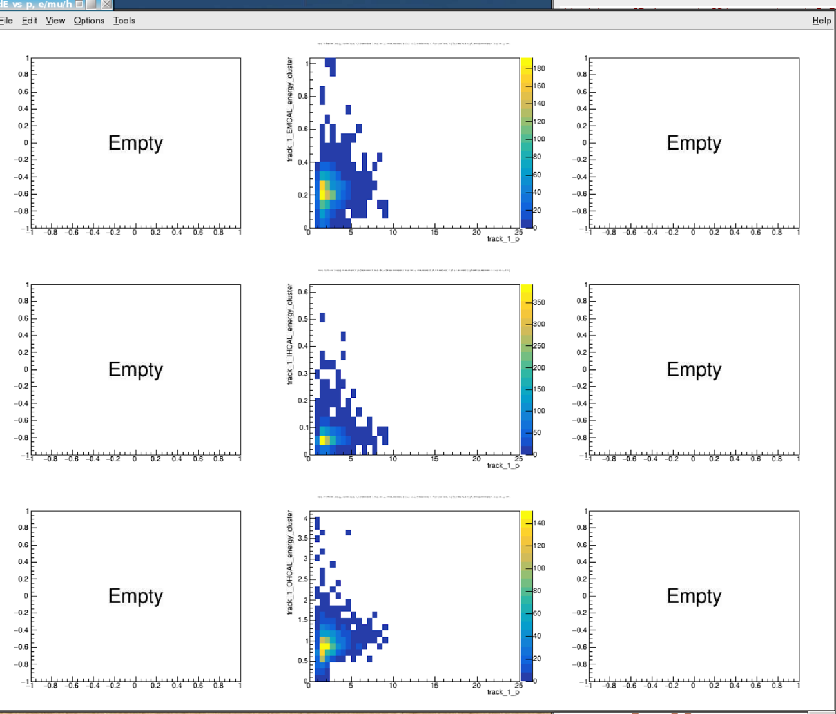
Muons
EMCal
iHCal
oHCal

Slide 24
Hadrons
EMCal
iHCal
oHCal

Slide 25
Update History: e/mu/h Identification
06/14/2021, created after sPHENIX HF meeting
06/16/2021, included tracks w/o EMCal, Hcal hits, set dE = 0
Electron identification
Muon identification
sPHENIX MDC1 analysis note:
https://docs.google.com/document/d/1RfGBSAF3ZumQVzMSGUHD9o0kHrZvVKORq65zpBUhv9o/edit?usp=sharing

Slide 26
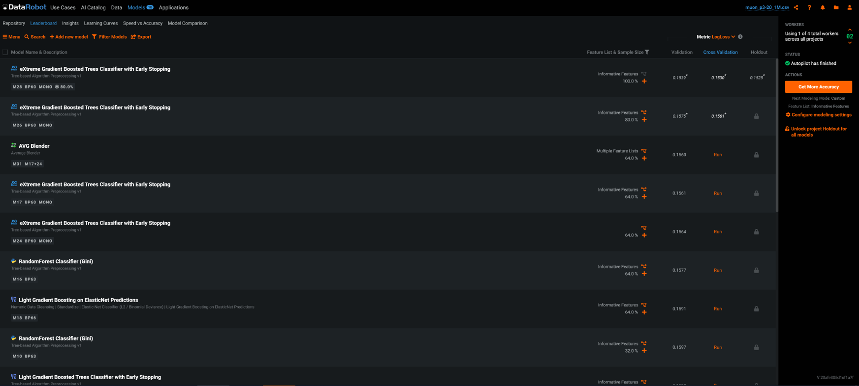
Muons: 3 < p <20 GeV, 20 models
Purity: 530/573= 92.5%
Eff. = 530/2287 = 23.2%
FoM = Purity* Eff = 21.5%

Slide 27
Electroncs: 20+ ML models available

Slide 28
Follow up on ML on e/mu/h identification 06/16/2021
Assigned dE =0 if there is no EMCal, iHCal or oHCal hit information
Track selection: 3 < p < 20 GeV

Slide 29
Electrons: p> 3GeV, from RandomForest
Purity: 932/1047=89.0%
Eff. = 932/2858 = 32.6%
FoM = Purity* Eff = 29.0%

Slide 30
Features’ Impacts: electron ID, from RandomForest Classifier

Slide 31
Electrons: p> 3GeV, from AVG Blender
Purity: 789/901=87.6%
Eff. = 789/2287 = 34.5%
FoM = Purity* Eff = 30.2%

Slide 32
Electrons: p> 3GeV, from Keras Slim NN
Purity: 530/573= 92.5%
Eff. = 530/2287 = 23.2%
FoM = Purity* Eff = 21.5%

